Slide 1
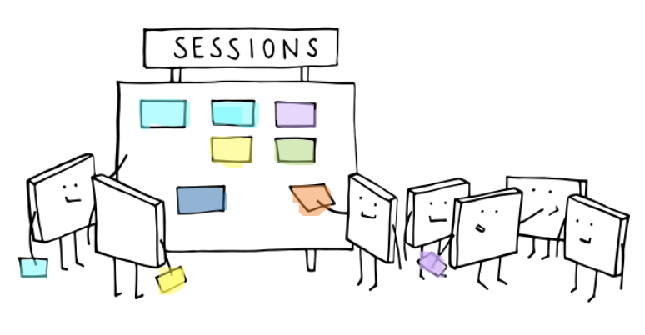
ABC
The colour coded set of cards.
Cath Fenn
Senior Academic Technologist | MB ChB

Slide 2

Learning principle: Acquisition
Learning through acquisition is what learners are doing when they are listening to a lecture or podcast, reading from books or websites,
and watching demos or videos.

Slide 3
Learning principle: Acquisition
Conventional method
Digital technology
Reading books, papers;
l
Attending a lecture
Listening to a podcast
Read a book
Watch a webinar
Hello
Watch a video
Collaborate on a shared doc
Reviewing e-learning modules
Watch a lecture capture
Read a PDF of resources
Interacting with a prebuilt digital construal with expert guidance to illustrate technical principles and meta-principles
(see comment from MB)

Slide 4
Learning principle: Collaboration
Learning through collaboration embraces mainly discussion, practice, and production.
Building on investigations and acquisition it is about taking part in the process of knowledge building itself.

Slide 5
Learning principle: Collaboration
Conventional method
Digital technology
Reading books, papers;
Small group project
Online small group projects in Moodle (available tools include: forums, wikis, chat) or other tools including Office 365, Padlet, Google for discussing /building outputs
Drawing on a whiteboard together
Making a 3D model
Create a flip chart
Using a virtual whiteboard, or a system like Canva, or even a PPT
Create a shared/group ePortfolio on Mahara
Asking for help from staff
Create wiki entries together using an editing workflow
Collaborate on a OneDrive doc
Interacting with a construal as a group – delegating subgroups to exploring specific aspects of a construal

Slide 6
Learning principle: Discussion
Learning through discussion requires the learner to articulate their ideas and questions,
and to challenge and respond to the ideas and questions from the teacher,
and/or from their peers.

Slide 7
Learning principle: Discussion
Conventional method
Reading books, papers;
Digital technology
Tutorials
Online tutorials (MS Teams)
Face-to-face interaction
Online forums
Group discussion
Chat in WhatsApp or telegram
Ad hoc discussion during presentations or activities
Skype meetings
Debate around fundamental principles etc.
Pre-structured Moodle forums
Chat in MS Teams box and/or voice discussion of content of chats with leader
Move from practical interaction with specific construals to identification of general principles behind construal

Slide 8
Learning principle: Inquiry (Investigation)
Learning through inquiry
guides the learner to explore, compare and critique the texts, documents and resources that reflect the concepts and ideas being taught.

Slide 9
Learning principle: Inquiry
Conventional method
Digital technology
in a range of materials and resources;
Using conventional methods to collect
Comparing texts, searching and evaluating information and ideas.
Using text-based study guides
Using online advice and guidance
Search in the library
Search online
Identifying gaps in personal knowledge, by detailing what is currently known, to tailor inquiry
Use online tools to search and evaluate information
Playing with other people's
pre-built construals and adapting
and extending them for personal use
Cross-referencing lecture material against reference texts

Slide 10
Learning principle: Practice
Learning through practice enables the learner to adapt their actions to the task goal, and use the feedback to improve their next action.
Feedback may come from self-reflection, from peers, from the teacher, or from the activity itself, if it shows them how to improve the result of their action in relation to the goal.

Slide 11
Learning principle: Practice
Conventional method
Digital technology
Reading books, papers;
Practising exercises
Using models
Students work on computers in the class, teacher able to walk between PCs and offer help
Exercises with the technology available at home (e.g. smartphone)
Activities in laboratories
Simulations / online role play
Hard to replace the teacher walking around a computer lab, but could use screen sharing.
Acquiring the skills (cf 'coding')
needed to make own digital
construals, and building a construal
from scratch

Slide 12
Learning principle: Production
Conventional method
Digital technology
Reading books, papers;
Producing articulations using:
Producing and storing digital documents (H5P, Moodle wiki or blog, Office 365, Google)
Create a video
Peer teaching
Academic presentations
eportfolios
Write and deliver a presentation
Students work on parts of a system (e.g. developing an application), and then combine their parts.
Making and giving an account of making a digital construal – typically by producing a construal and a reflection on its construction and relation to other artefacts etc

Slide 13
Learning principle: Production
Learning through production is the way the teacher motivates the learner to consolidate what they have learned by articulating their current conceptual understanding and how they used it in practice.

