Slide 1
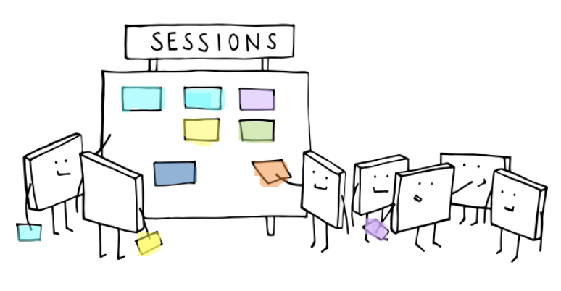
ABC
ABC workshops
An exploration of the moving staff CPD online challenge.
Cath Fenn
Senior Academic Technologist | MB ChB

Slide 2
Aims
Exploring the potential affordances of the ABC workshops to support student-centered rapid curriculum development.
Could we support our education teams with remote workshops through an adapted version of the ABC workshop?

Slide 3

Why bother?
So what?
Is there a pedagogic argument for delivering an area of the curriculum with support of digital technology or fully online?
Which pedagogic approaches and models in your current curriculum could benefit from embracing the affordances of digital technology?
Do you need to change your current pedagogic approaches when adapting to a digital context?
Notes:
Starting as I usually do with the provocative question, followed by some key things to consider before you get started.
Consider your motivations for reimagining your teaching and designing new activities. Also consider what will motivate your students to engage with these activities.

Slide 4
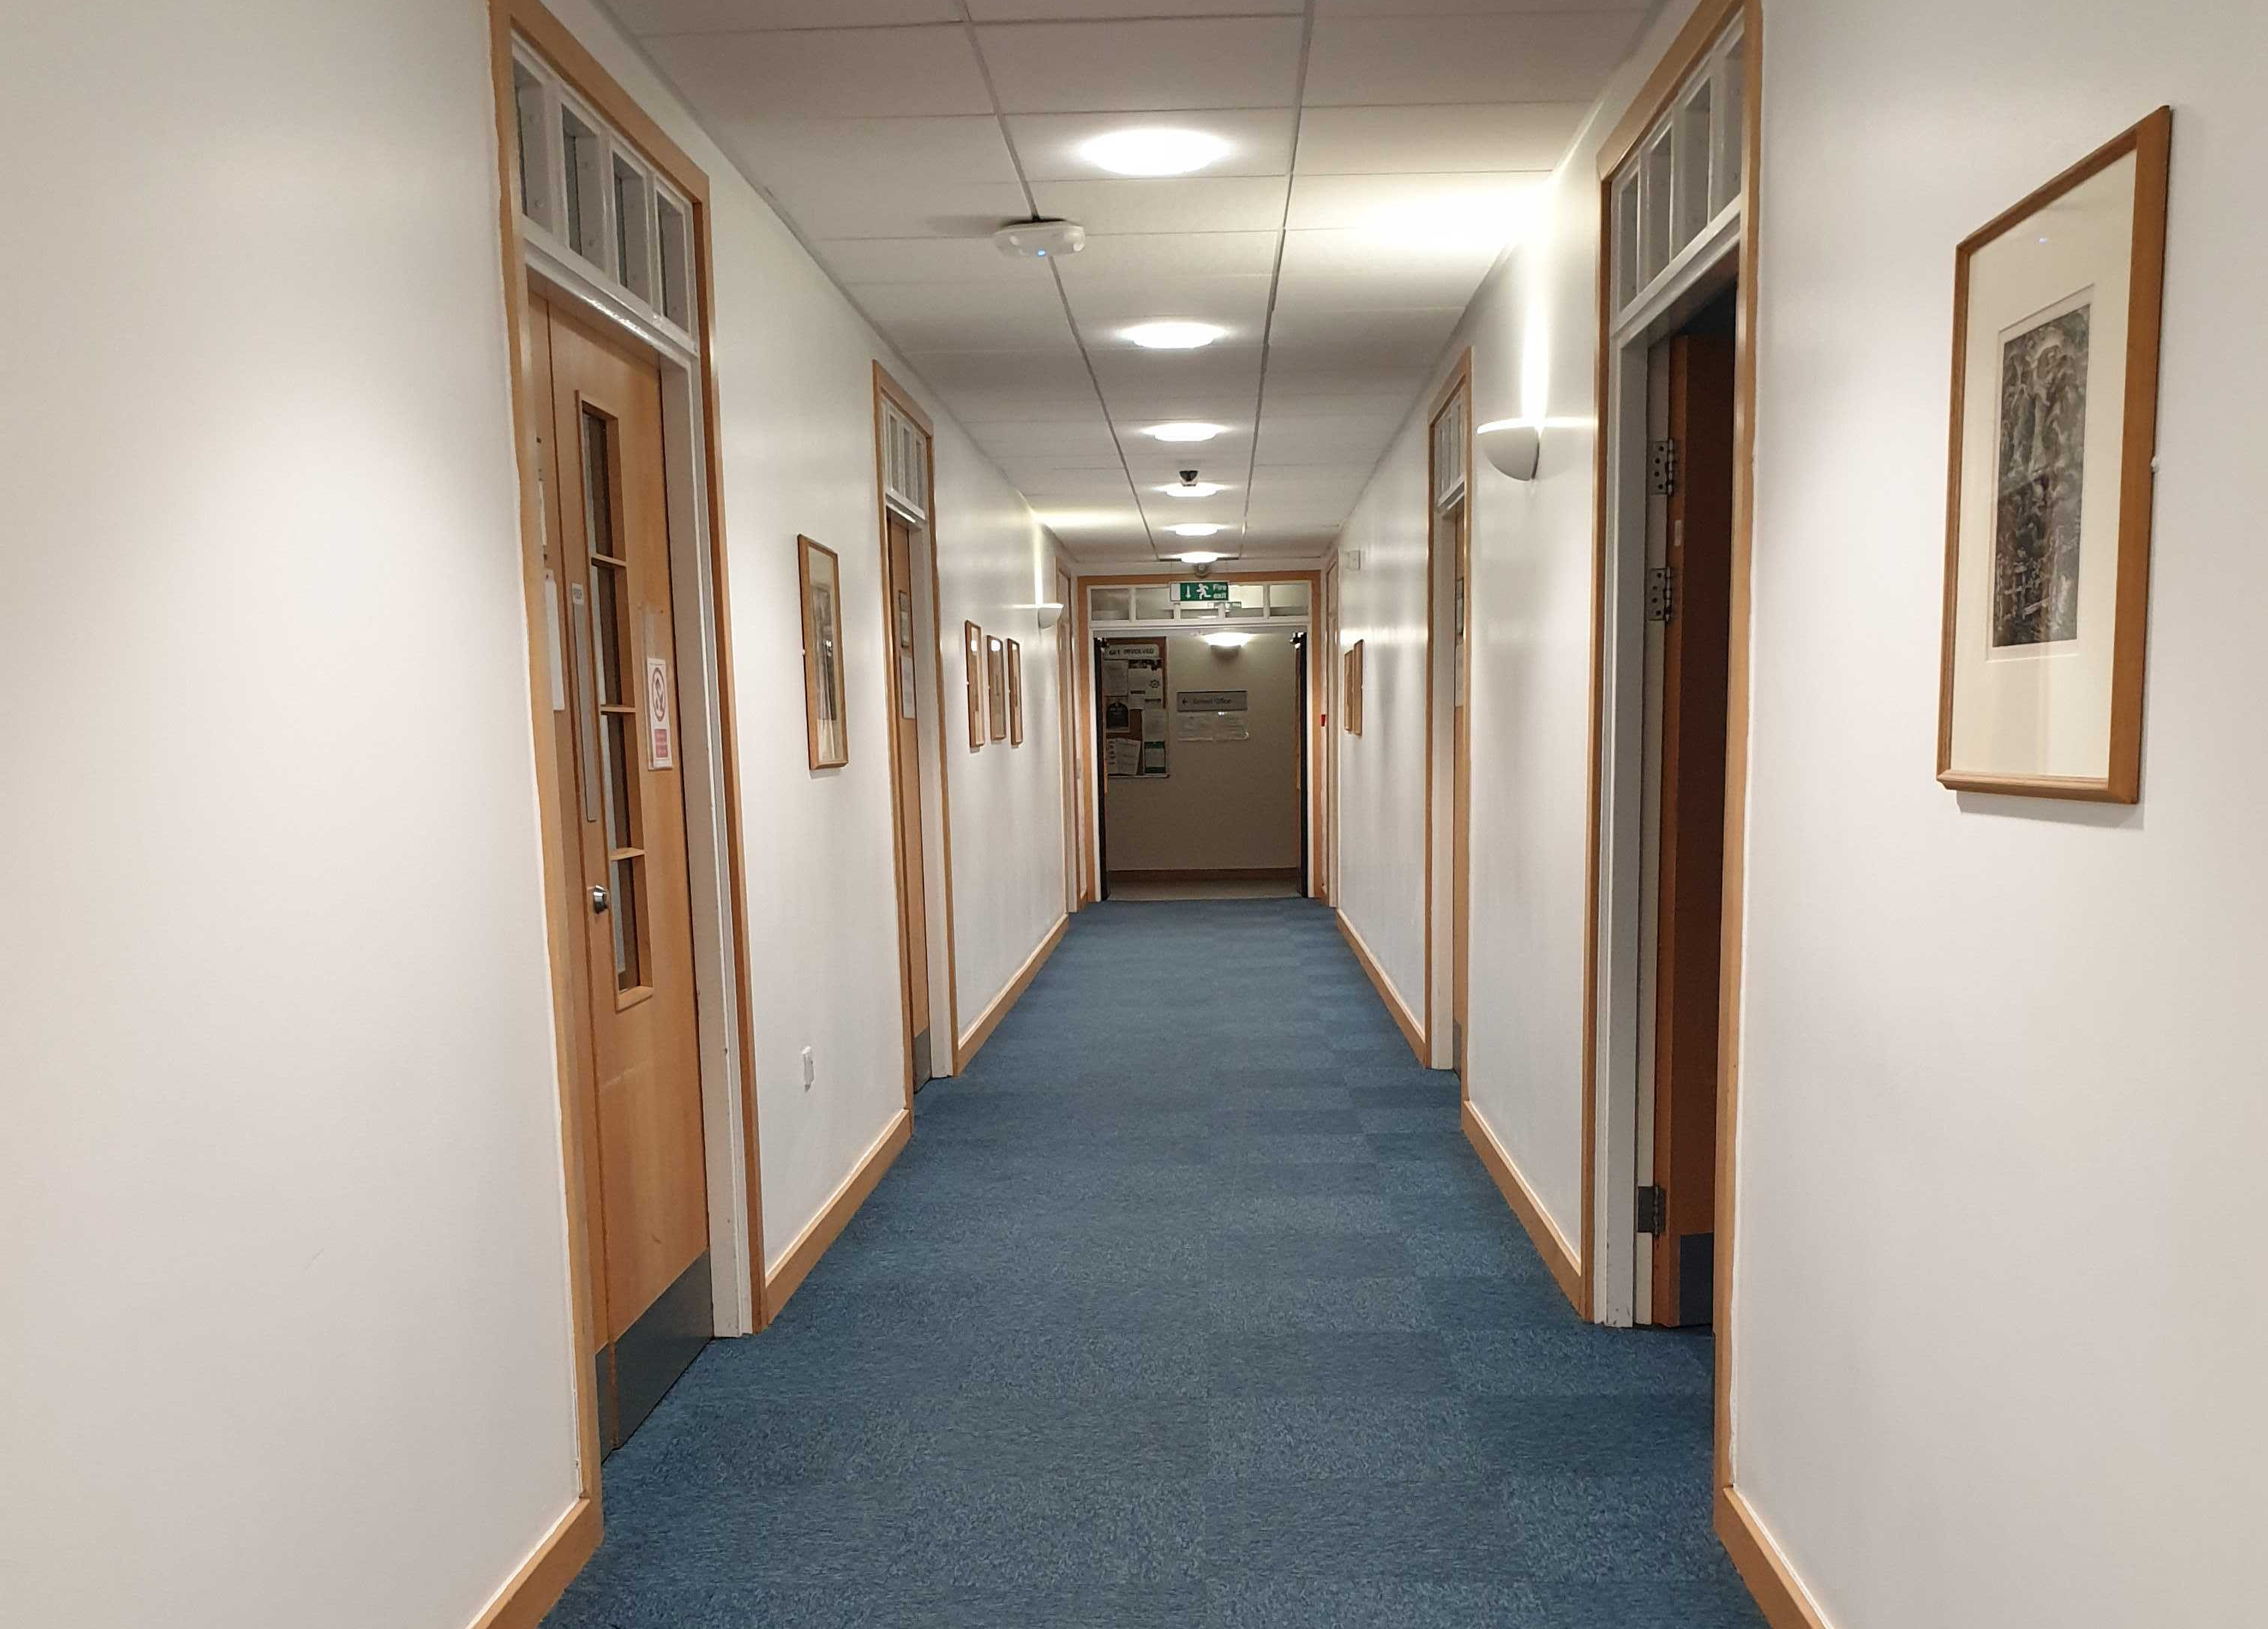
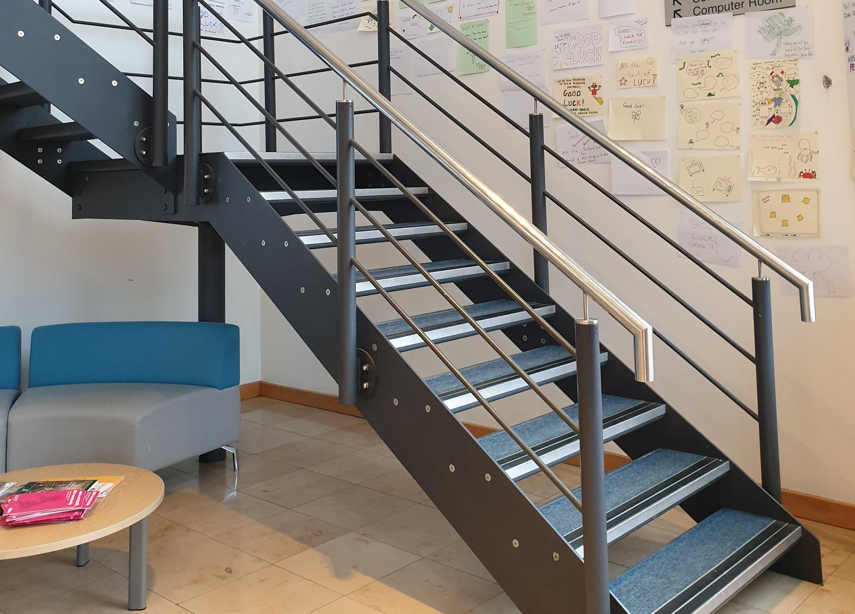

Slide 5
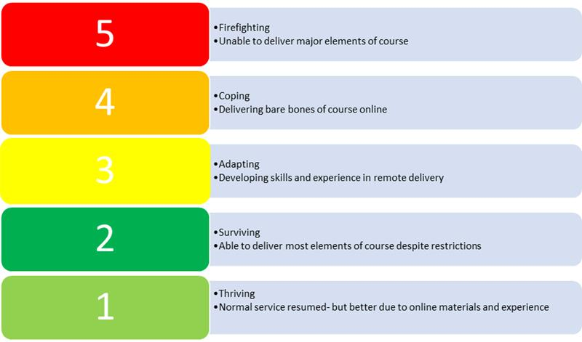
Notes:
Visual created by Kate Owen, Deputy Head of MB ChB.

Slide 6

Why?
Dr. Diana Laurillard, Professor of Learning with Digital Technologies @ University College London, shares why faculty with a research focus should take those same skills and apply them to their teaching.
https://vimeo.com/149159489
Notes:
How does this fit within wider academic practice?

Slide 7
Blooms taxonomy
Create
Evaluate
Analyse
Apply
Understand
Remember
Why is it important in instructional design?
Notes:
Familiar hierarchical model. (c.1956)
Go back to basics. A reminder of basic fundementals.
Seeks to describe the differences between the kinds and levels of learning.
More recent representations look like this pyramid.

Slide 8
Independent learning
Notes:
Skills for independent learning.
Remember: remote learning has a much greater reliance on independent learner. Really useful lifelong skills. Support and nurturing required to develop these skills.
An exciting aspect of adopting or incorporating online learning is that it can offer opportunities for students to engage with content and people more flexibly. It can help you provide choices that support students’ self-regulation and decision-making.
Online learning can encourage independent learning as well as provide support that would not be possible in a traditional classroom-based course.
Consider which aspects of the curriculum you are working with could benefit from the promotion of self-regulation and decision-making skills.
You could find there are aspects of the curriculum that work better with remote and online delivery!

Slide 9
Instructional design
A systematic approach using learning and instructional theory.
3 basic elements.
Develop
Evaluate
Design
Notes:
Where to start.
Suggest this is not a solitary activity, teamwork and collegiality important factors.
Systematic should not equate to dehumanising the experience on either the development or delivery side.
It would be easy to become overwhelmed by the prospect of taking on any level of redesign for a block of teaching. It is more of a challenge if much of this introduces changes to practice and other aspects which pull you out of your comfort zone.
Taking a systematic approach and selecting a learning design model that fits your purpose helps to keep you on track.
LD = the entire process whereby the analysis of gaps knowledge and identification of intended learning outcomes supports the design and development of learning experiences.
There are a range of models discussed in the literature. On a small project chose a model and keep it simple. Examples in further reading on final slide.

Slide 10

Learning types
The 6 learning types https://youtu.be/wnERkQBqSGM
Notes:
So what does the ABC model have that could help us?
ABC is based on the pedagogic theory of Professor Diana Laurillard’s Conversational Framework. The six learning types have proved to be a very effective method to helping teachers describe and discuss the student learning process. Students and non-teaching staff also find the learning types intuitive and easy to use and can produce innovative and creative storyboards with no prior experience of learning design.

Slide 11
Task 1 – learning types
Consider each learning type.
Edit the PowerPoint slides to list activities that you feel fall into each of these learning types.

Slide 12
ABC workshop format
Participants work in groups to create a visual storyboard outlining the principle and sequence of learning activities (both on and offline) required to meet the module’s learning outcomes​
Participants look for opportunities for formative and summative assessment throughout the module​
Notes:
So how does this come together in a workshop format?

Slide 13
Workshop activities in face to face environment
Activity 1 | Module summary – agree a brief description of your chosen module and an overview of envisaged activities. | 15 minutes (groups)
Activity 2 | Groups select the learning types cards and arrange them in sequences on the timeline. | 20 minutes (groups)
Activity 3 | Cards are turned over and learning activities selected from (or added to) the cards. Points of assessment/feedback are then highlighted. The storyboard is agreed as a representation with an action plan. | 20 minutes (groups)
Activity 4 | Each group pitches module to the room. Vote on which modules sound like the best to sign up for. | 20 minutes (groups)

Slide 14
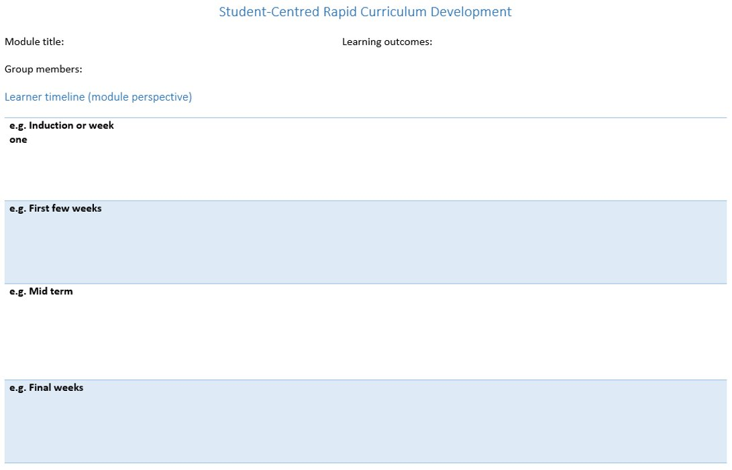
Timeline sheet

Slide 15
Paper based face to face version
Notes:
Tried and tested, here is an example output from the face to face version of the ABC workshop.
Sunil Chudasama (Law School) to share his experience of this session.

Slide 16

Acquisition
Production
Collaboration
Practice
Discussion
Inquiry
(Investigation)
Notes:
Overview of the balance of learning types based on the peer to peer learning board.

Slide 17
Task 2
The block of learning you producing a learning design for is for a pre-induction/induction/transition period.
What will you call it?
What are your key learning outcomes?
Create a summary suitable to “sell” this block of learning to the incoming/returning students.

Slide 18
Task 3
Select the learning types cards that match the activities that will support students to cover the learning outcomes.
Arrange them in sequences on the timeline https://padlet.com/wmsdigitalage/k6j7a4vw44vu
Notes:
Breakout rooms -

Slide 19
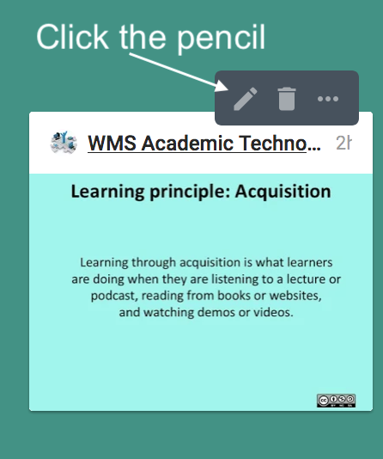
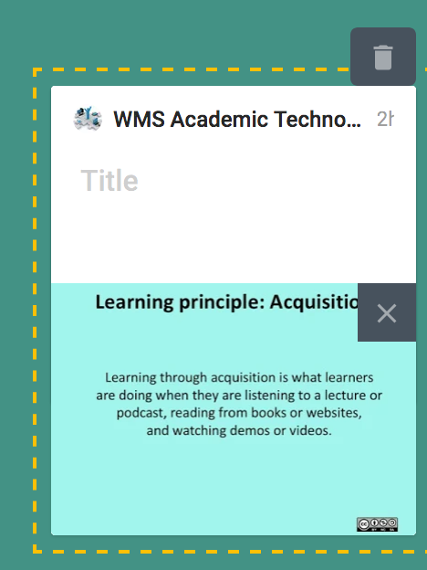

Task 4
Cards are edited and learning activities added to them https://padlet.com/wmsdigitalage/k6j7a4vw44vu
Points of assessment/feedback are then highlighted. Gold star for summative, Silver star for formative.

Slide 20
ABC curriculum design Workshop action plan
The storyboard is agreed as a representation with an action plan.
Objectives
E.g. pre requisites / induction
E.g. Early module
E.g. Mid module
E.g. End of module
Action points / reflections
Notes:
Sketch out your action plan during the workshop.
Consider using tools such as Microsoft Planner or Trello both really useful for collaborative development.

Slide 21
Task 5 - Group discussion
Could we support our education teams with remote workshops through an adapted version of the ABC workshop?

Slide 22
Suggested further reading
ABC Learning Design Toolkit - UCL Digital Education
JISC Guides including:
Developing blended learning content approaches | Curriculum design and support for online learning
The 7Cs of Learning Design - rethinking design practice
7Cs of learning design (pdf)
Paper from Networked Learning Conference 2014
As part of Designing e-learning for Health - FutureLearn MOOC
ASPIRE Framework - University of Nottingham | Using a quality framework tool
ADDIE Model - Analysis, Design, Development, Implementation, and Evaluation. Origin obscure but widely used so plenty available on Google search.
The International Learning Design Cross-Institutional Network (ILD-CIN) is an international special interest group, focusing on the research and practice of Learning Design and allied fields such as Learning Analytics.
How might a series of interactive learning resources be pulled together for an integrated learning experience? Take a look at the team-based learning implementation at Macquarie University.
At Macquarie University they have started implementing Team-Based Learning in the Faculties of Arts and Medicine and Health Sciences. They have developed a set of resources available to everyone, including videos and guides for educators and students.
You can access them through MQ's learning and teaching blog: http://teche.mq.edu.au/2018/04/wtf-is-tbl/
What is independent learning and what are the benefits for students? Author(s): Bill Meyer, Naomi Haywood, Darshan Sachdev and Sally Faraday Publisher: London: Department for Children, Schools and Families Research Report 051, 2008 [Original title: Independent Learning: Literature Review]
Future Teacher 3.0 EU funded project

