Slide 1

Online Revision
Using Moodle and Goodle Docs

Slide 2

Challenge
To take all students through a new external exam in 3 months
Extra Considerarions
The content is over double the amount in a typical GCSE (normally studied over 2 years)
The students have no or little prior knowledge of the subject
There are very limited past/example papers available for staff(first year of running)
Only 1.5hrs contact time per week/15 weeks in the term to cover all topics

Slide 3
Solution
Online, interactive revision materials for students covering all topics delivered via Moodle.

Slide 4
Benefits
Allow class tutors to focus on supporting students in the class where needed
Gives students continuous extended activities that they can be involved in during sessions to increase knowledge
Invites students to self-assess their own areas of weakness and focus on those over areas they are strong in
Accessible 24/7 and in multiple locations
Automatically provides data to the tutor so they can easily see topics which most students are struggling with so that they can tailor upcoming lessons.

Slide 5

How?
First stage, Moodle quizzes. - Took a long time to make, slow to make and not easy to duplicate.
Second stage, Google forms – Provides data in automatic google sheets and can include a variety of media to help support the subject.
Third Stage, embedding into Moodle.

Slide 6
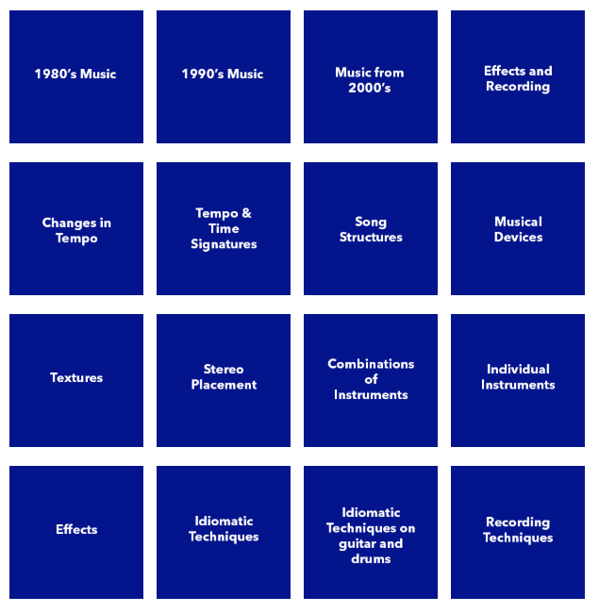








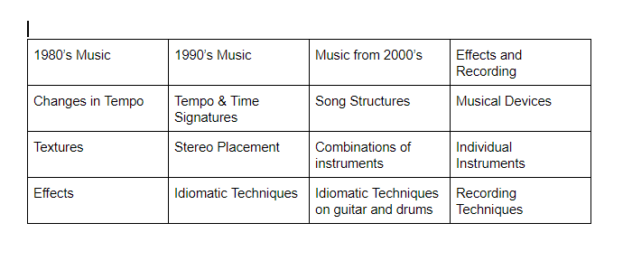


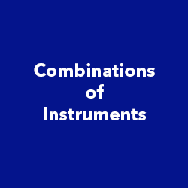




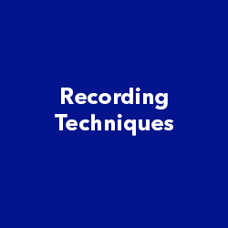
Landing page in Moodle
All topics listed
Buttons created
Organised in ‘gameshow’ style table

Slide 7
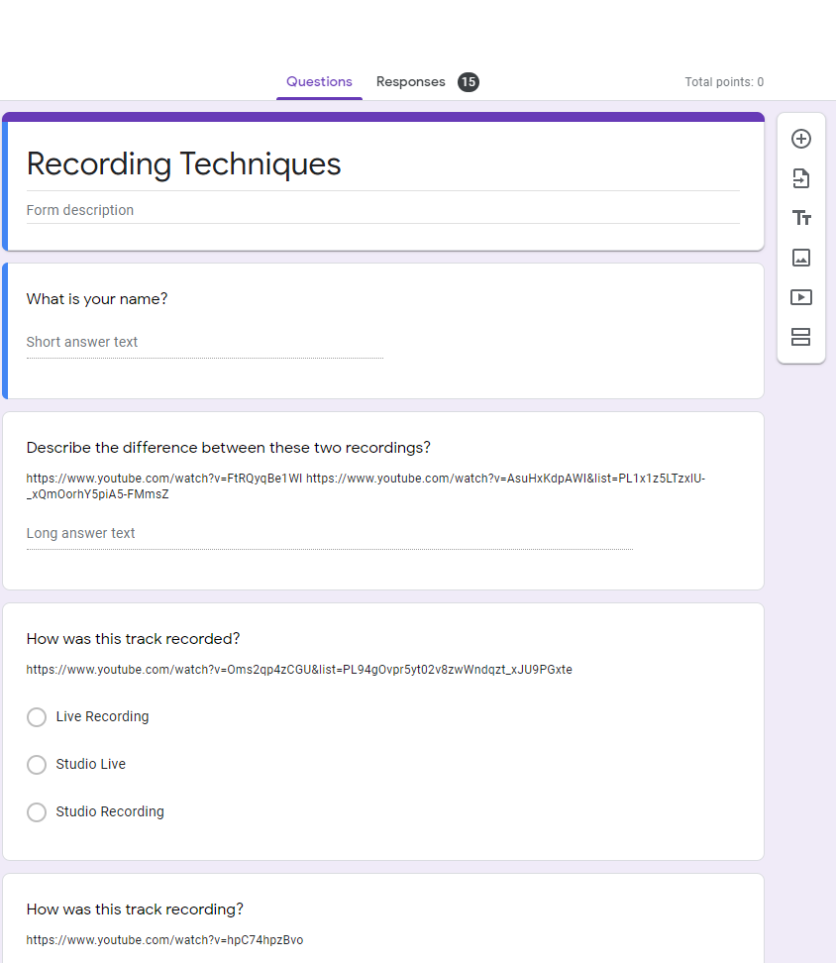
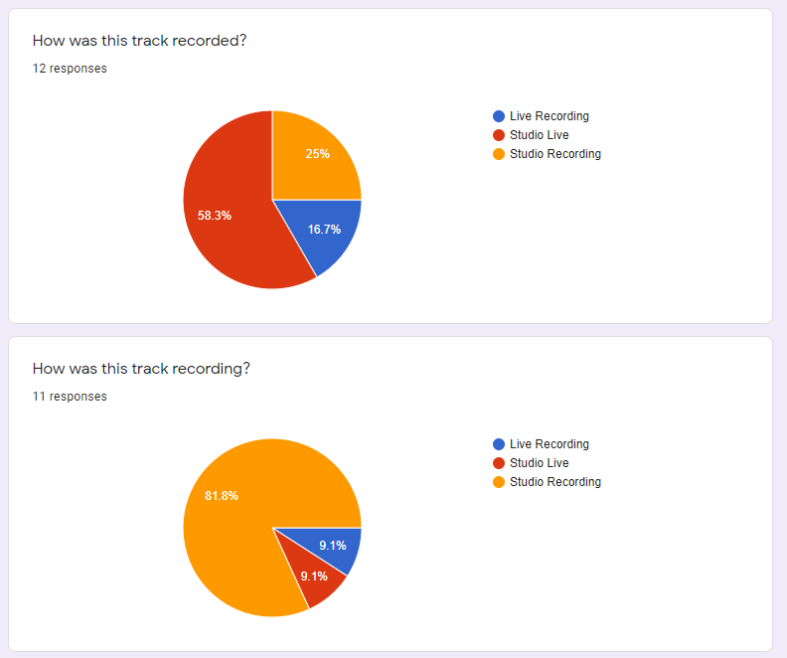
Example Form and responses

Slide 8
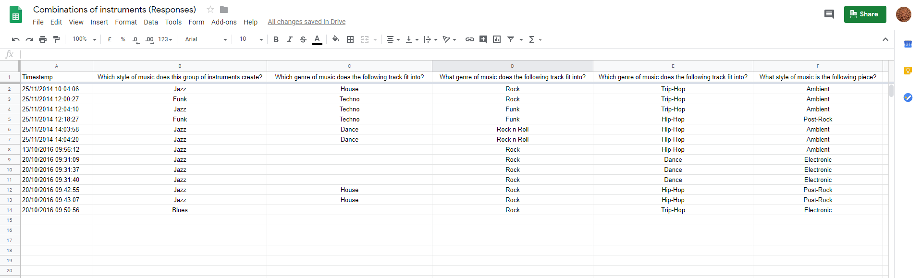
Examples of Google Sheets (Results)

Slide 9
Problems, Limitations and improvements
User (student) fatigue
Youtube links would not always work if content had been removed by Youtube/user.
You need to ask for the users name as the first question if you want the Excel sheet to show who
It doesn’t display the correct and incorrect answers to users
Possibilities to link to extra research for those who need more info
Still required some management

Slide 10

Outcomes
We achieved 15% above national average for pass rate on exams – (colleagues had commented before this that some of the content was A Level or Degree level)
All students (around 18) passed one of the exams which contained this resource
More work before teaching had started, but greater teacher availability in class to support students and manage the classroom
Students became easily familiar with the model
Students became very good at self-assessing and recognising where they needed to improve
More trust from students and a better student-teacher relationship

