Slide 1


Slide 2

Creating asynchronous video content
Kerry Pinny, Senior Academic Technologist
12th May 2020 | TEALfest | @warwicktealfest | #WarwickTEALfest

Slide 3
Today we’ll explore:
Recording video with Teams
Recording video with PowerPoint
Recording video with Stream
Recording video with Universal Capture
Recording video with your mobile device
and lots more… (well, a few)

Slide 4
Synchronous vs. Asynchronous
Synchronous
Interaction
Presence
Instant feedback
Stressful
Technical difficulties likely
No interaction, what’s the advantage?
Exclusive
Asynchronous
Flexible
Self-paced
Inclusive
Lacks presence
Risk of apathy/disengagement

Slide 5
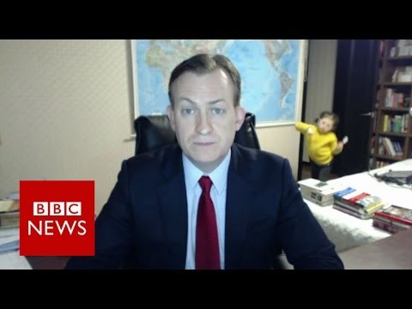
Top tips
It doesn’t have to be perfect!
Keep it short
Use a headset or webcam mic
Try to find somewhere quiet
Outline/script your video content
Rehearse
Position the camera above you
Have everything you need to hand
Interruptions can liven up a video…

Slide 6
Teams Recordings
Hold a meeting on your own or with others
Record the meeting
Share your screen, use MS Whiteboard etc.
The video is stored in Stream (shared only with those in the meeting)
Trim the video
Download or share the video

Slide 7
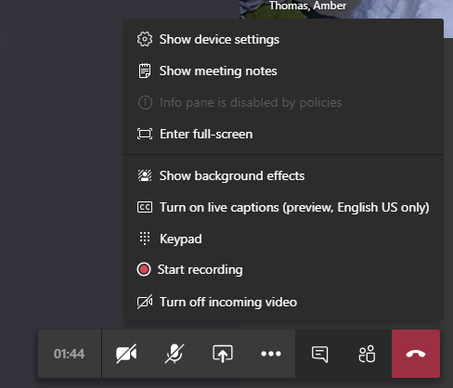

Slide 8
Example
Dr Robert O’Toole and Dr Bo Kelestyn shared this example with us
https://web.microsoftstream.com/video/2980d65d-5342-4551-94bd-2a80e6dd56d6

Slide 9
Stream
Microsoft video hosting platform
Record your screen (new feature)
Limited video editing options
Share by link, email, embed code and Teams groups/channels
Automated closed captions (will need checking!)
Be careful of this setting on upload - Allow everyone in your company to view this video
Get started with Microsoft Stream

Slide 10

PowerPoint
Use content you already have
Built-in to PowerPoint
Record audio narration
Record your screen
Export as video

Slide 11
Universal Capture
Echo360 product available on the software centre (update via VPN)
Need to make sure you have an account and sections set up
Record 2 video streams and audio
Publish to your sections to access via Moodle
Edit in Echo360
Universal Capture system requirements

Slide 12
Universal Capture
How to install Universal Capture
  https://warwick.ac.uk/services/its/servicessupport/academictechnology/support/guides/echo360-guides/ech-10
Using Universal Capture
  https://warwick.ac.uk/services/its/servicessupport/academictechnology/support/guides/echo360-guides/ech-09

Slide 13
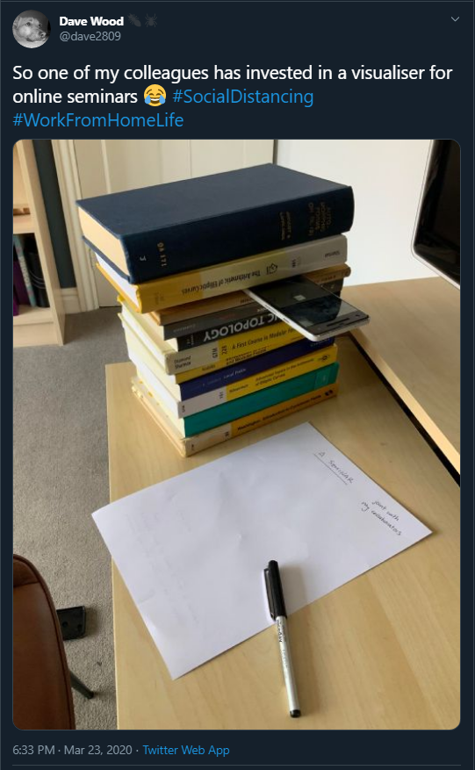
Mobile device
Record using your mobile device
Use the OneDrive mobile app to move the file between devices
Echo360 mobile app

Slide 14
Screencast-O-Matic
Launch it from their website
  https://screencast-o-matic.com/screen-recorder
Picture in picture
Resize the capture window to record specific parts of your screen
Up to 15 mins (free version)

Slide 15
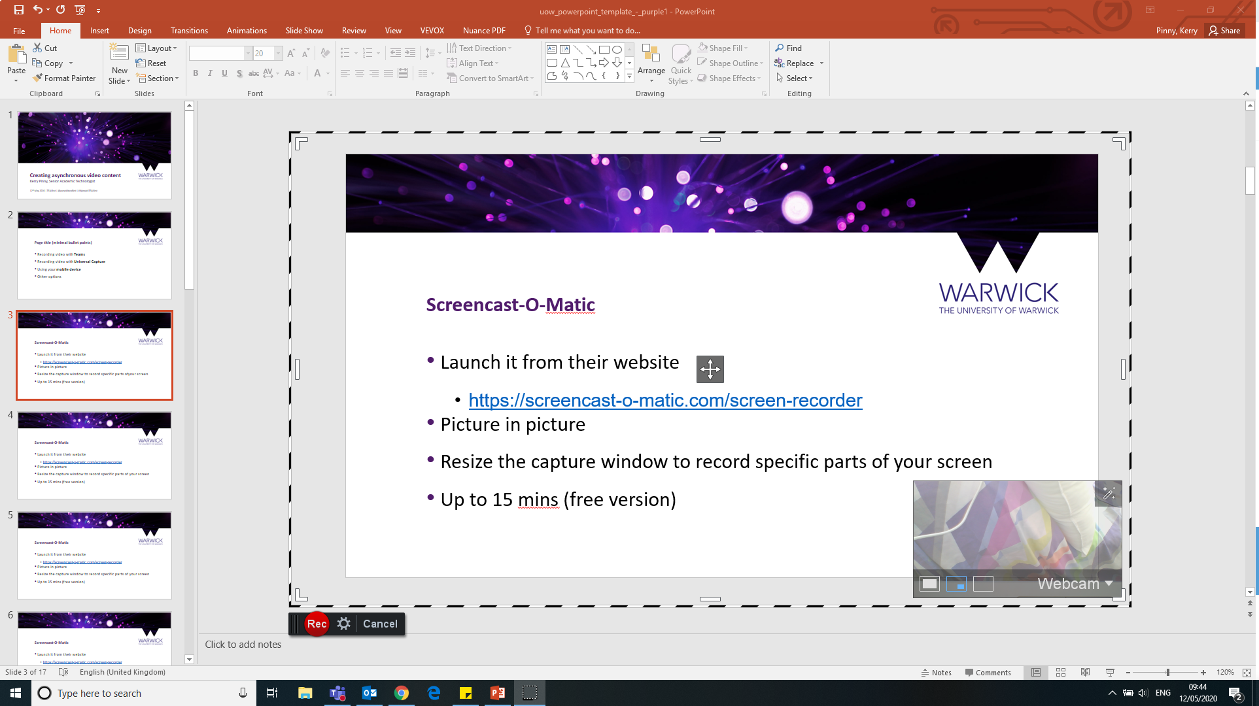

Slide 16
Camtasia Studio
£163.86 (2 machines)
https://www.techsmith.com/video-editor.html
Video editor
Zoom, pan and animate
Titles, annotations and callouts
Transitions

Slide 17
QuickTime Player
Mac
Screen recording function
https://support.apple.com/en-gb/HT208721

Slide 18
Editing Tools
Video Editor for Windows 10
iMovie for iOS
DaVinci Resolve

Slide 19
DaVinci Resolve
https://www.blackmagicdesign.com/uk/products/davinciresolve/
Fully featured video editing software
Mac OS X, Windows and Linux
Managed machines will need assistance to install

Slide 20
Help and further resources
warwick.ac.uk/covid19-teachonline
warwick.ac.uk/academictechnology
warwick.ac.uk/academictechnologyguides
academictech@warwick.ac.uk
warwick.ac.uk/av
warwick.ac.uk/itstraining
Academic Development Centre

