Slide 1


Building a longitudinal virtual patient to provide TEL for medical students
Dr Thomas Dale MacLaine – Medical Student
Dr David Harris – Senior Clinical Fellow
Dr Cornelia Juengst - Clinical Education Fellow
Catherine Fenn – Senior Academic Technologist
Dr Helen Gabathuler – Associate Clinical Professor
Dr Sue Davies - Associate Clinical Professor

Slide 2

Discussed in this presentation
Warwick MBChB Curriculum
Virtual patients
Meet our patient: Mr C. Jones
Results from current work
Future of virtual Patients

Slide 3
Warwick MBChB Curriculum

Slide 4
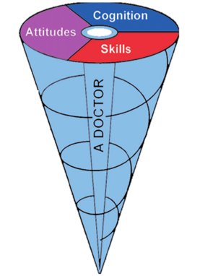
A Warwick Doctor: Spiral Curriculum
Years 3&4/ Phase III
Revision and mastery of clinical
Revision and mastery of theory
Continued clinical introduction
Year 2/ Phase II
Introduction of theory
Early clinical/ bedside teaching
Year 1/ Phase I

Slide 5
Warwick MBChB Curriculum: four dimensions
Spiral curriculum
Vertical integration
Beyond 3D: peer development
Case
Based
Learning
Horizontal integration
E.g. presentation based learning
E.g. Inter-year peer tutors, sharing clinical experiences and underlying acadmic principles
E.g. themes integrating scientific principles with clinical practice
E.g. phases revisit increasingly complex material
De Cates, Owen and Macdougall, 2018. Warwick Medical School: A four dimensional curriculum. Medical Teacher.

Slide 6
Learning within the ‘Community and General Practice’ theme
Phase in curriculum | Theoretical learning | Placement-based learning | Tech-Enchanced Learning
Phase 1 (Year 1) | Relationship between local environment and health - community Breaking bad news | Home visits with patients Brief health interventions | Currently, there is limited learning available on Moodle within the General Practice theme. Moodle is used as a resource bank, for organising lectures and providing assessments for mandatory training.
Phase 2 (Year 2) | Health needs assessment Palliative care | 21 days in GP Student-led consultations
Phase 3 (Years 3 & 4) | 6 week block with 9 days of teaching (predominantly simulations and video consultations), 18 days of GP-based consultations

Slide 7
Use of TEL for healthcare education
Highlights | Pitfalls
Bridges the gap between theoretical and clinical, allowing for a mix of revision and learning | Often no facilitator present to discuss the case with
Flexible and standardised delivery of course content | Requires IT experience and support to develop teaching platform
Enables easy engagement and submission evaluation | Limited by access students have to technology
Accessible for individuals in their self-directed learning time
Enables clinical decision-making without risk to patients
Allows cross-phase curriculum integration

Slide 8
Virtual patients

Slide 9

What is a virtual patient (VP)?
Standardised simulated patient
Emulates real clinical cases
Builds confidence with clinical decision making and clinical management of conditions
“The VP enables putting into practice and relating concepts learned”
“I feel it is a good practice, where we can put into practice our knowledge, without compromising anyone’s life or health.”
“It has encouraged me to research conditions that I do not understand and to improve my critical reasoning skills. I have learned that all of my actions must have a specific end”
Isaza-Restrepo et al., 2018. The virtual patient as a learning tool: a mixed quantitative qualitative study. BMC Medical Education (Extracts abbreviated)

Slide 10
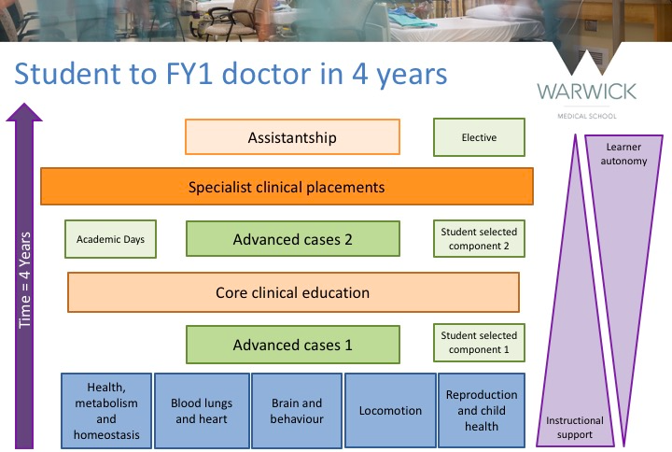
Longitudinal virtual patients
Little literature on longitudinal virtual patients; allows pioneering research in the field.
Mimics general practice, with continued encounters - no spot encounters.
VP can experience several health conditions, allowing for novel education on management of emerging comorbidities
Ideal for curriculum integration from different themes and phases
Iterative - can act on feedback before next academic year engages with the patient during that phase
Increases likelihood of engagement with the VP, with increased opportunity to cover difficult areas of learning

Slide 11
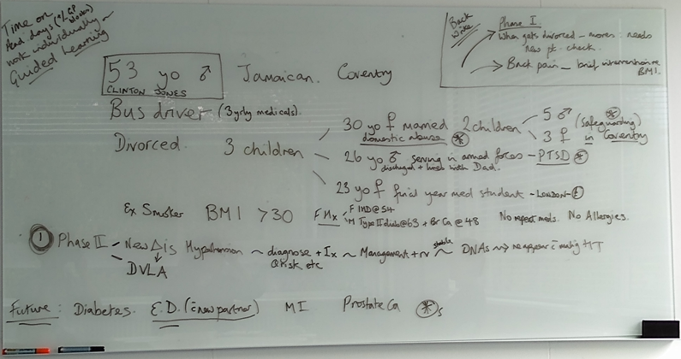
From an Idea to a Virtual Patient
Ideas session
Planning sessions
Using Moodle
H5P elements
Release to students

Slide 12
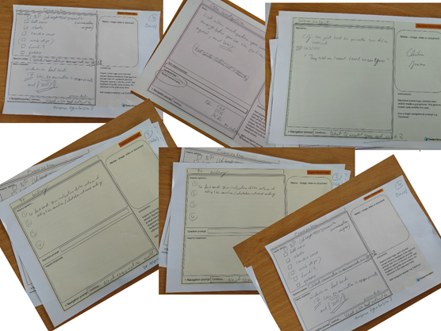
Used Decision Simulation sheets to aid planning
Colour coded for type of slide
Allowed a case to be built and start thought process of flow through the case
Brainstormed on paper, then converted to PowerPoint before moving to Moodle

Slide 13
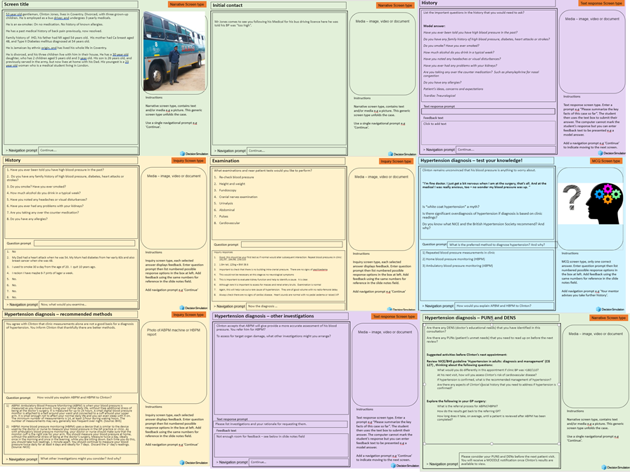
Episode 1 Plan

Slide 14

Moodle
Once in Moodle H5P elements were added for student interactivity
Quality assurance for content and flow before...
Episode 1 release to students on 27th March 2020

Slide 15
Meet our GP VP: Mr Clinton Jones
https://moodle.warwick.ac.uk/course/view.php?id=31003

Slide 16
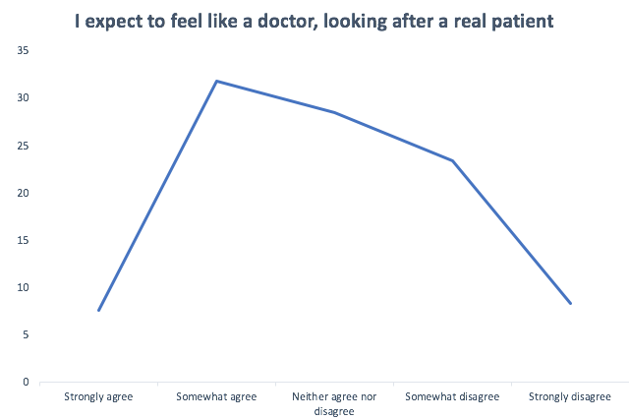
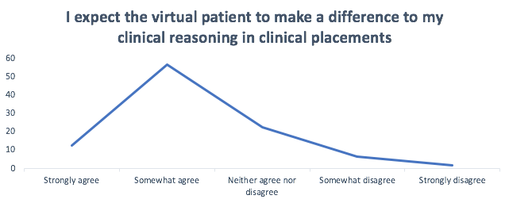
Pre-VP questionnaire
BSREC approved – questionnaire prior to launching GP VP
Previous use of VPs: 2/119 (1.7%) had, 114/119 (95.8%) had not.

Slide 17
Results from the first two episodes

Slide 18
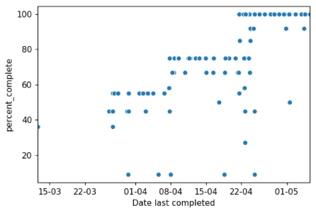
Progress to date
Anonymised, individual student data recorded
Session release dates:
24/03/2020 - Episode 1
08/04/2020 - Episode 1 test results
21/04/2020 - Episode 2
% of GP VP completed? | Number (/142) | Percentage (%)
0≤ X ≤25 | 5 | 4
25< X ≤50 | 14 | 10
50< X ≤ 75 | 48 | 34
75< X ≤100 | 75 | 53

Slide 19

General feedback
Accessibility:
Including back button to view
the previous pages.
Learning and development:
Thank you for the VP exercise. It has really tested my knowledge on hypertension!
Engagement:
Is the GP VP is part of our engagement criteria for the course, or is it optional? There is some confusion amongst students.
Am I too late to do the Clinton Jones case? I missed the two-week window to complete it.

Slide 20
Episode feedback
General:
It was a great episode!
Accessibility:
I like being able to type my answers before viewing the answers
Sometimes I give ‘a’ right answer, but don’t get ‘the’ right answer
It would be useful to have an electronic summary care record where we can refer to, to get relevant information for the work
Content:
I selected an answer based on NICE guidelines, though the checkbox told me I was wrong.
I am confused by the ECG. Please could you explain?

Slide 21

Our immediate developments
Produce further episodes
Currently piloted in Phase 2. Launching in other phases.
Allow for different decision -making options
Include videos of consultations to review for critiques
Explore options to allow students to ‘perform’ history taking/ exams
Strengthen the student voice involved in this work
Revise current episodes
Made content amendments following feedback
Exploring a healthcare summary record for Mr Jones
Encourage more students to engage with the content
Incorporating more text-entry boxes before answers

Slide 22

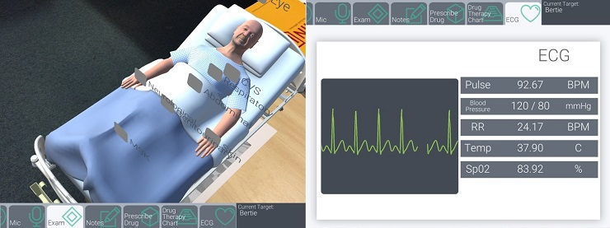

Where could GP VP go from here?
Gamebook-style branching - different outcomes and consequences for different clinical decisions
Virtual reality history taking and examinations

Slide 23

With thanks to all who have helped create our GP VP, those who have engaged with the work, and yourselves for listening.
Dr Thomas Dale MacLaine
Dr David Harris
Dr Cornelia Juengst
Catherine Fenn
Dr Helen Gabathuler
Dr Sue Davies
If you would prefer to email your questions about our presentation, please contact:
Thomas.Dale-MacLaine@warwick.ac.uk
David.J.Harris@warwick.ac.uk

