Slide 1

WOLC online tutors: the persistence army!

Slide 2
Rationale
Flexible approach to WOLC, whilst desirable, could lead to a drop in persistence of students across the units of study (as seen in lots of MOOC-like provision).
PGR teachers are experienced in Warwick pedagogy, and many in working in the online domain.
PGR teachers often liked by UGs as tutors they can confide in/closer in age and relative experience of study.
Such teachers on temporary contracts have lost teaching work in the summer term – an opportunity for them to continue to teach.

Slide 3
From proposal to 60 trained tutors…in a week!
Initial proposal to Ed Exec and WOLC team
Establishing of proposed hours (25 tutoring; 3 development)
Setting up contracts with HR STP team – 3 WOLC leads to manage timesheets.
3 hours of training/development – 1 hour web meeting; 2 hours preparation/reading inc. online tutor handbook.
Development of online tutors area on Moodle for contact/issues arising/ideas.
Weekly updates and instructions from Unit leads re. core tasks and activities. Ongoing tutor support.

Slide 4
Key tenets of online teaching
Supporting persistence – cognitive, affective and physical.
Establishing expectations – yours and theirs
Managing your time effectively and being realistic.
Visibility/availability – being a ‘real person’
Encouraging active peer interaction and support
Being inclusive in your practice.
Using the right tone
Seeing opportunities to make connections and/or improve the experience
Not expecting perfection!

Slide 5
Typical online tutoring activities
Summarising a range of blog posts or forum entries to try and capture the ‘spirit’ of the learning.
Positive reinforcement of core messages, Warwick technologies, tasks and connected services.
Supporting individuals who get in touch with you, as promptly as you can.
Monitoring student progress against tasks (Moodle gradebook).
Highlighting any particularly good pieces of work.
Signposting students to additional services/contacts as relevant.

Slide 6
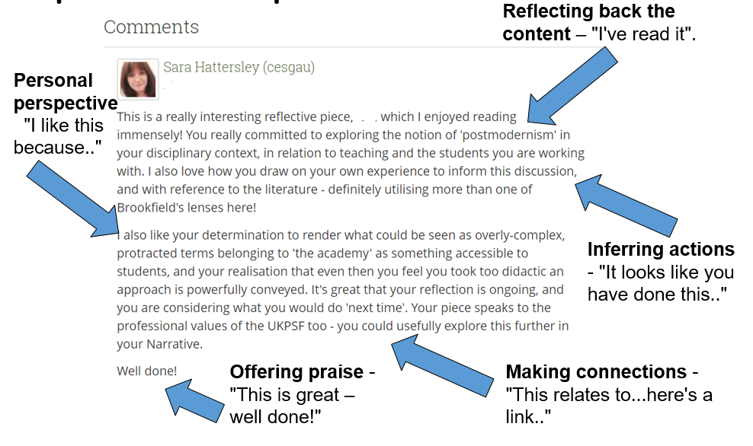
Blog response example

Slide 7
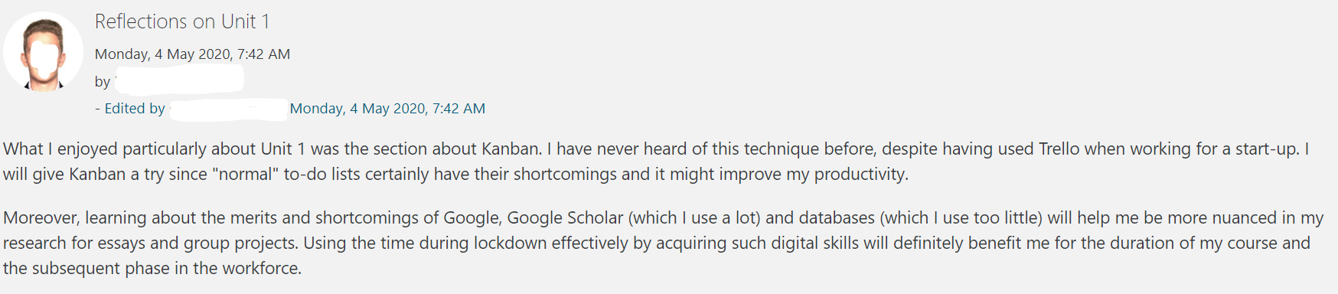
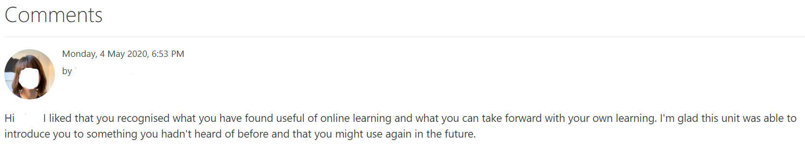
Individual blog response

Slide 8
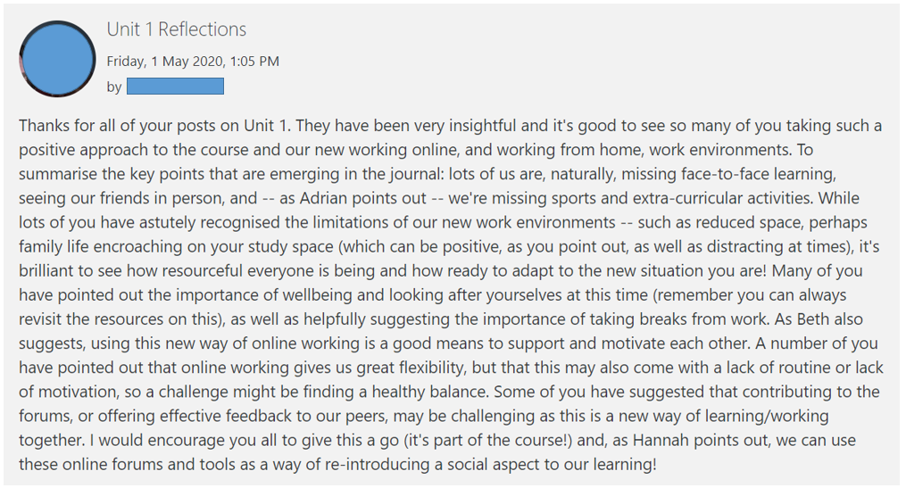
Summarising blog post

Slide 9
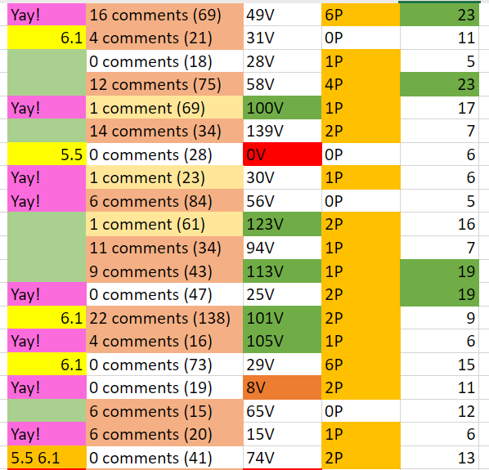
Supporting tutors – monitoring progress
Positive engagement – going above and beyond
Number of forum posts
Spotting potential issues (no/less engagement or too much?
Number of blog comments

Slide 10
Challenges
Short timescale – inevitable things you’d do differently..
Lack of a true overview from the start.
Huge number of applicants for 60 jobs.
Limited capacity (teaching hours) means careful direction of work.
Changing parameters – WOLC team decisions made ‘on the go’ impact upon work of tutors (inc. technology decisions, enrolment decisions etc).
Unit ‘look and feel’ – some consistency; some difference. Tutors are not designers –implications.
Different styles of tutoring, preferences of tutors etc.
Keeping up with ongoing issues raised.
Supporting at a distance – experienced teachers still need mentorship! Trusting? Supporting? Intervening?
Considering the value of the work…

