Slide 1

Transitioning to working online: sharing challenges and solutions
Dr Robert O’Toole NTF, Academic Technology Team
WOLC has had 6,110 participants!
Based on activities developed for the Warwick Online Learning Certificate for undergraduates:
https://moodle.warwick.ac.uk/course/view.php?id=38179

Slide 2
The plan
(Based on WOLC)
Think about your work-space.
Reflect on the positives and negatives of on-campus and online.
Learn about the digital visitors and residents model (VandR).
Learn about the 5 key types of collaboration.
Apply VandR to think about collaboration practices.

Slide 3
http://www.inspireslearning.com/journal/well-designed-desk-example-with-hotspots/

Slide 4
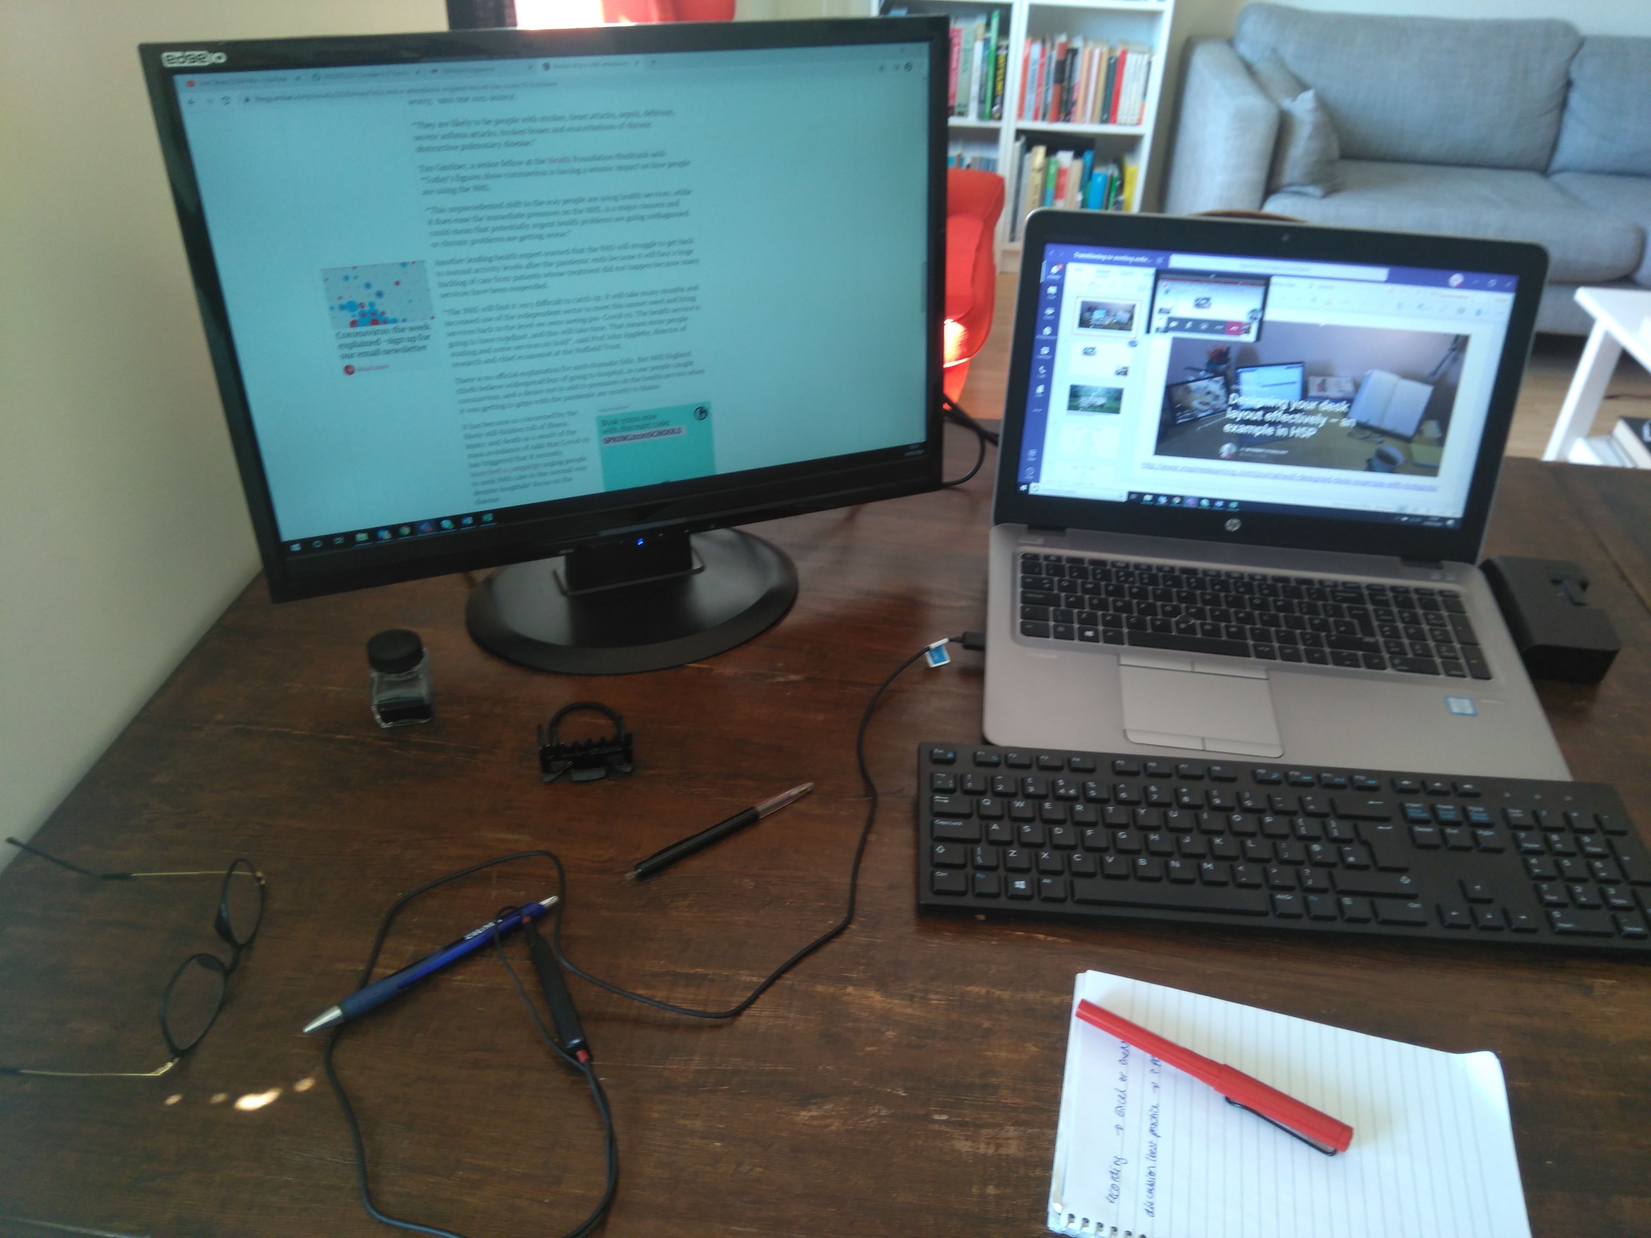
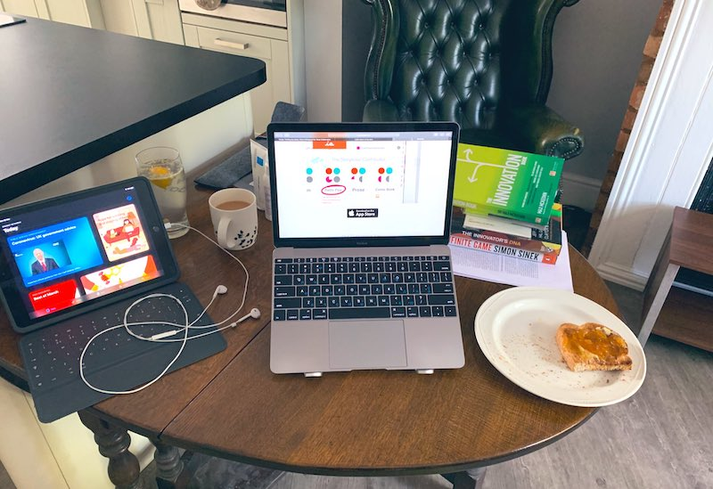
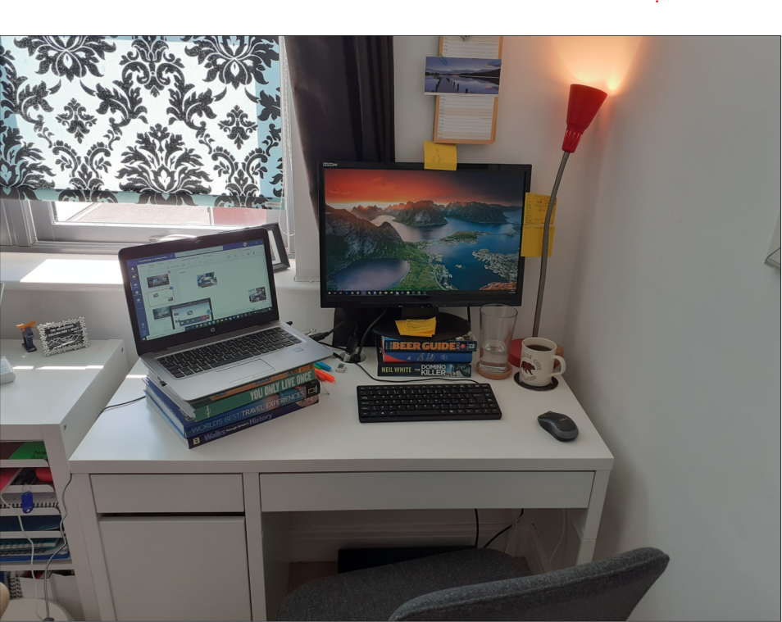
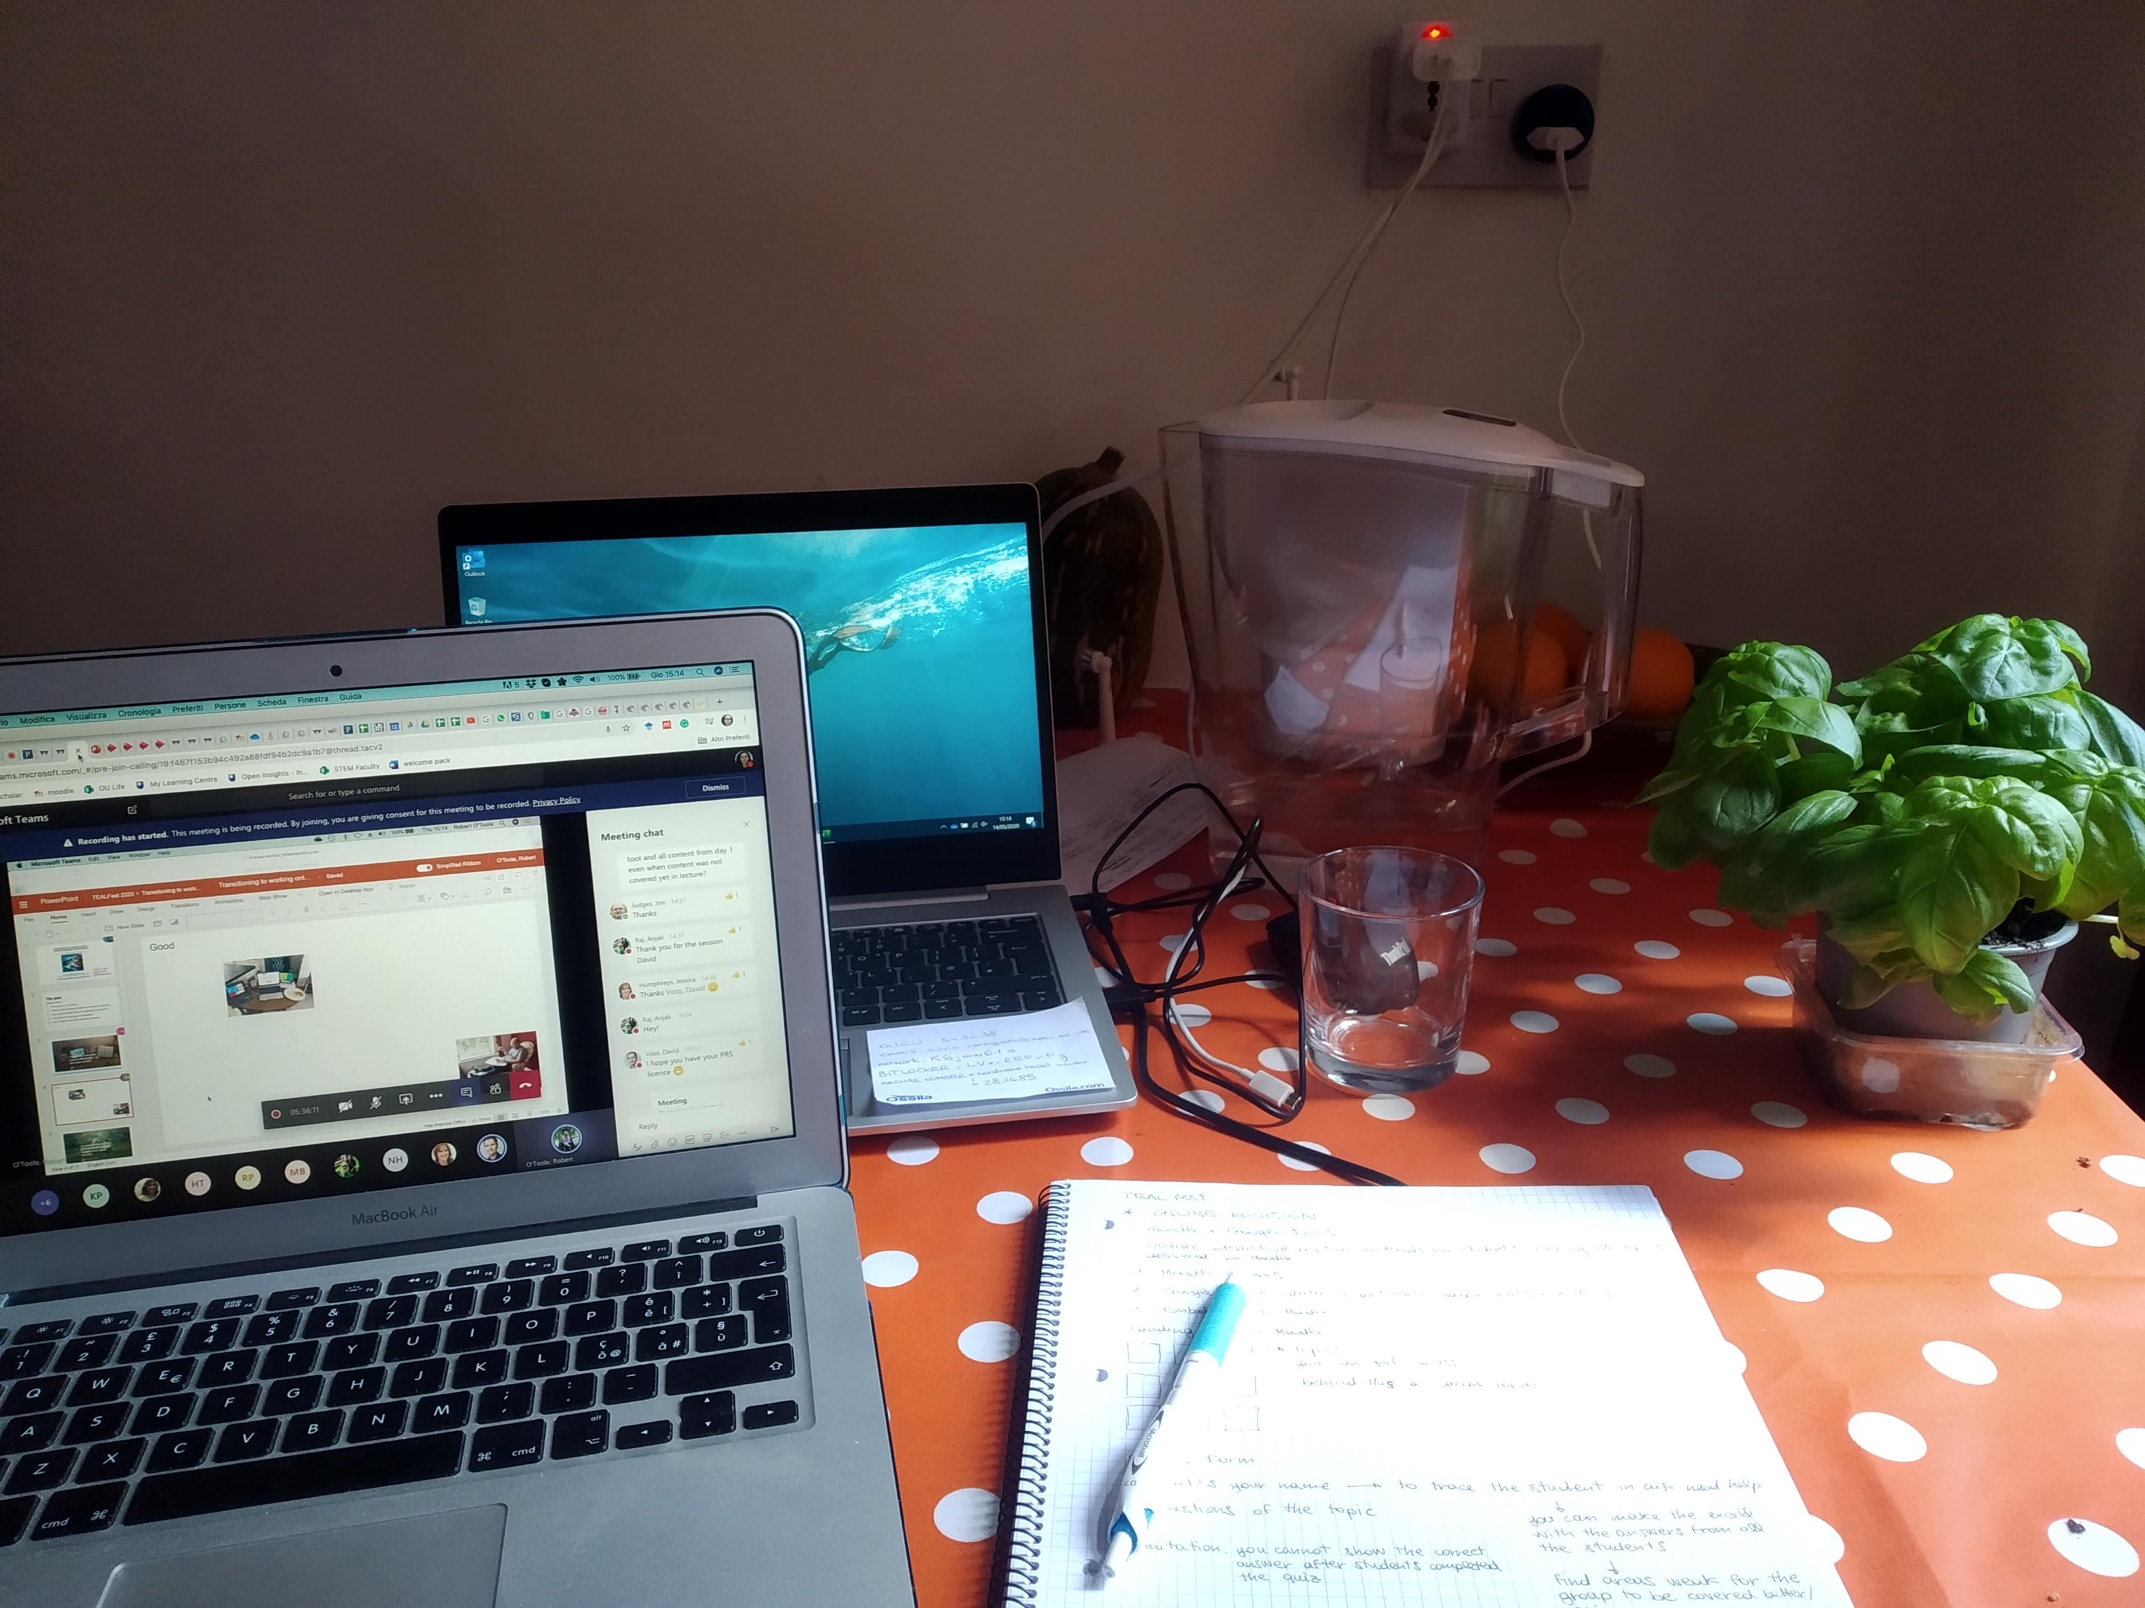
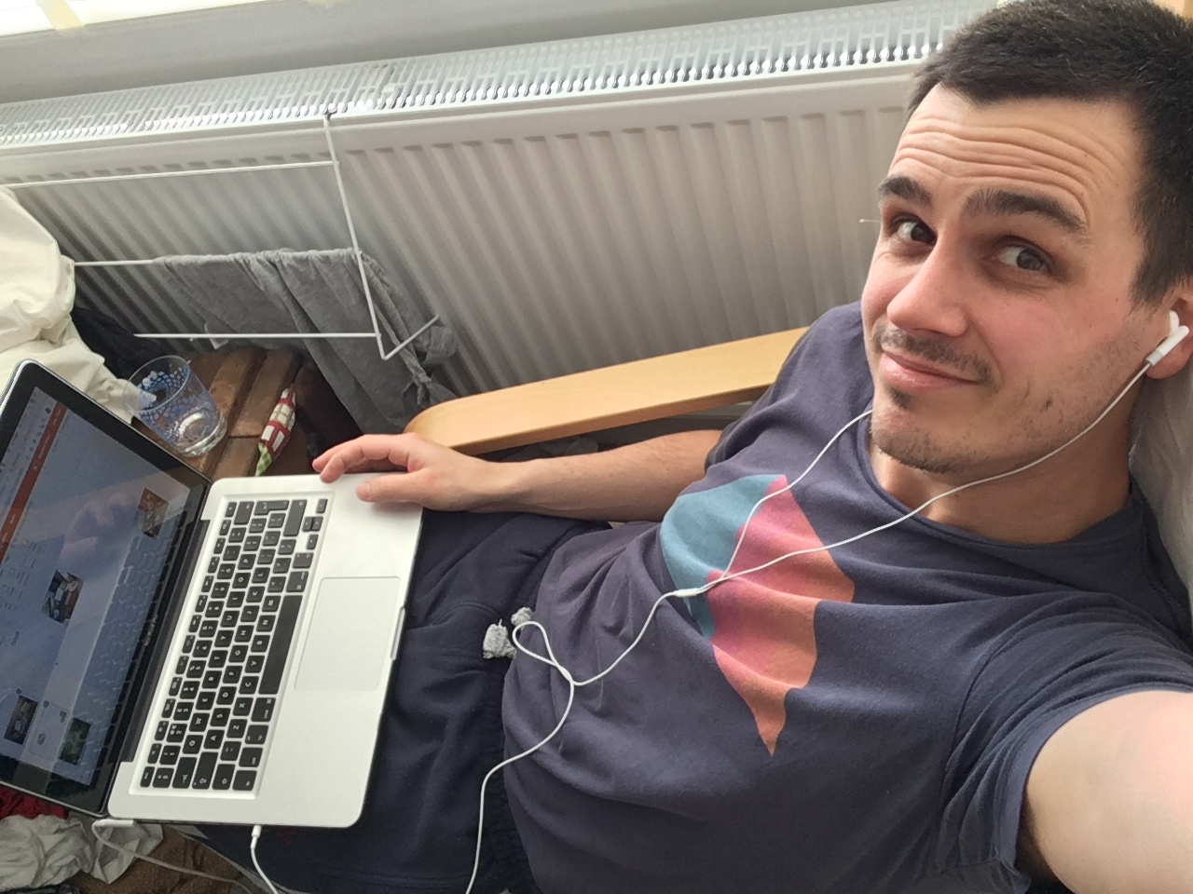
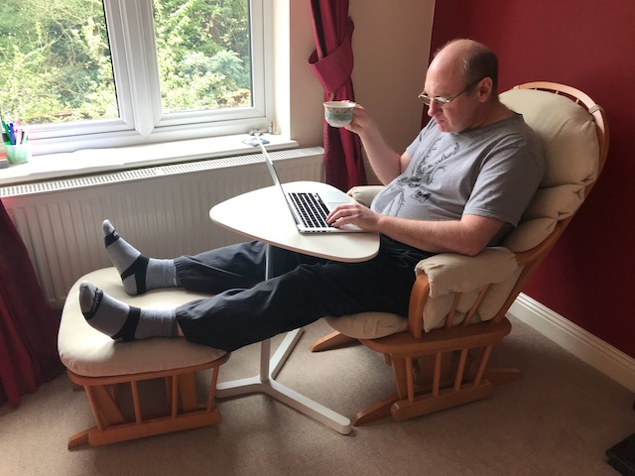
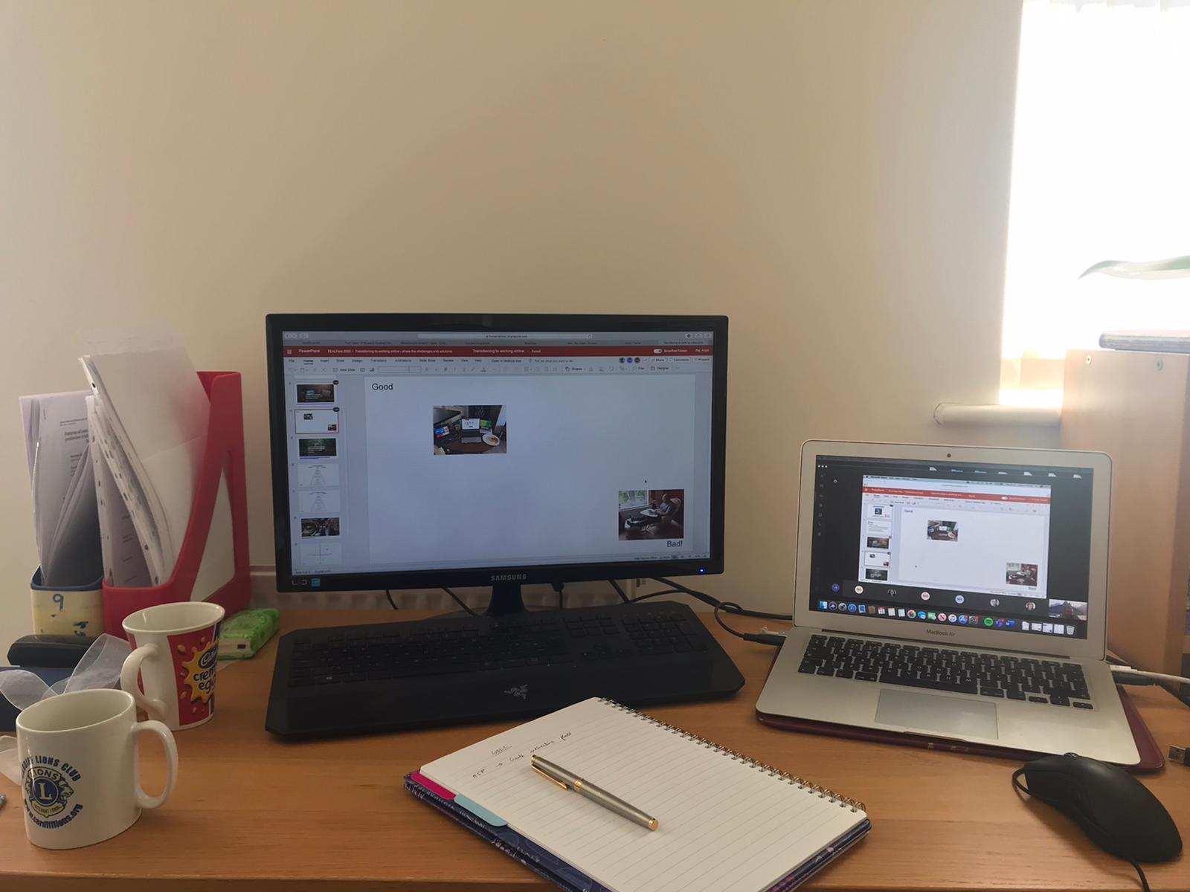
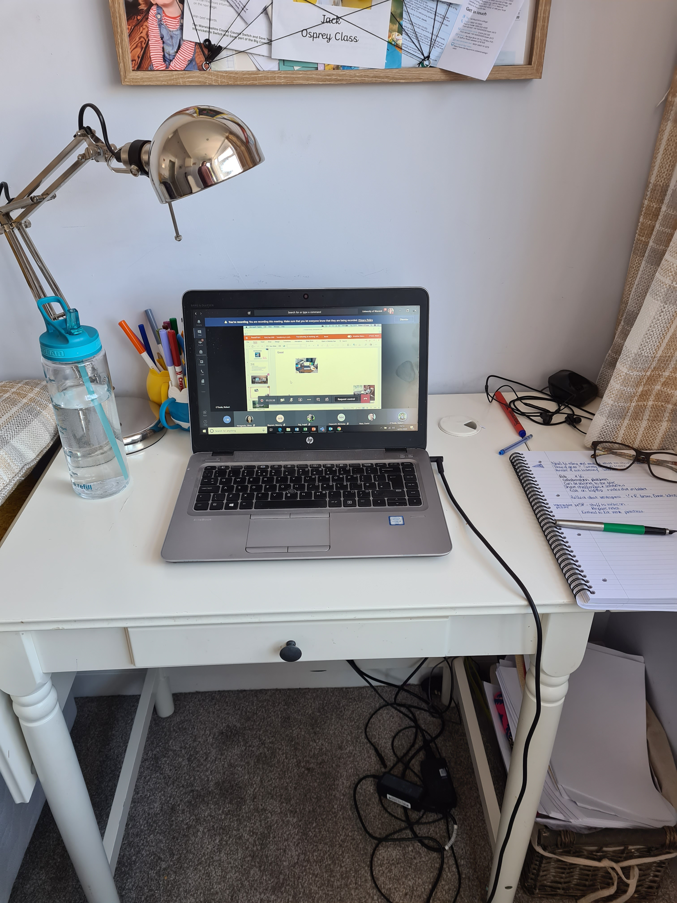
Good
Sorry Rob – Bad student here!
Bad!

Slide 5
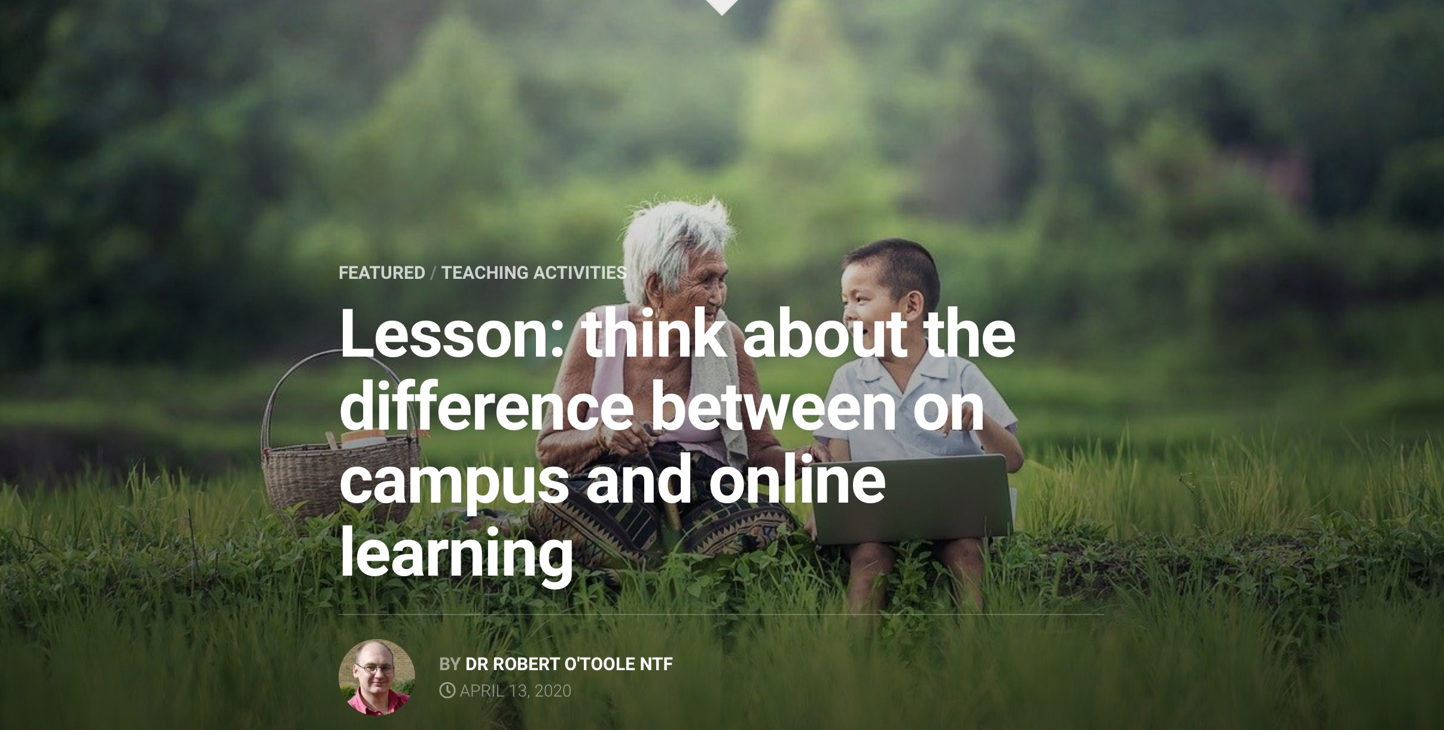
http://www.inspireslearning.com/journal/think-about-the-difference-between-on-campus-and-online-learning/

Slide 6
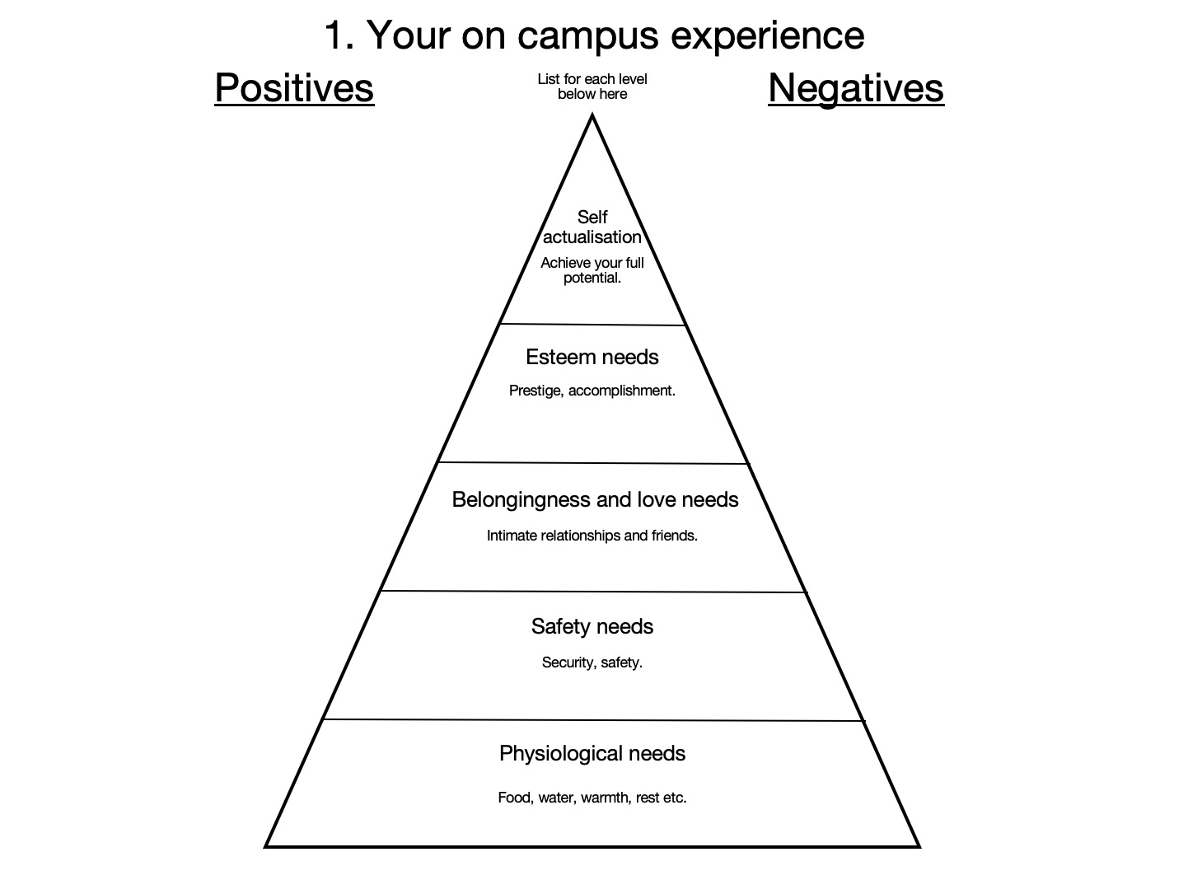
walks between meetings allow mini healthy breaks
Learning from colleagues
Easier to focus, complete tasks
Easier to meet colleagues on campus
Coffee break with my colleagues
Get infected with virus
With the commute, we have a proper break from work vs home
Get to cycle to work
Wick sport centre
Commuting time makes days longer

Slide 7
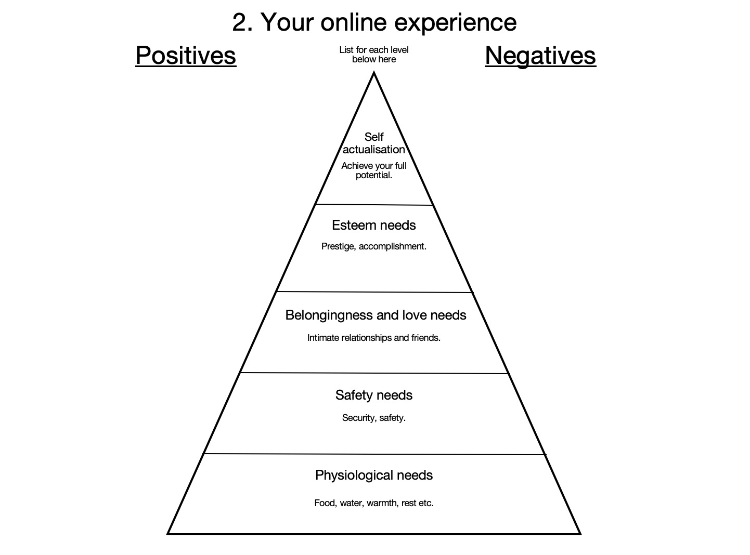
Less distractions can work continuously on tasks without interactions
I am living the quality of life now that enables me to thrive and grow
Juggle different roles – parent/work guilt
Family adaptation
​
​
Connect to colleagues online
Team social via Teams
Miss the social aspect of work
No screens in social life! No more video calls outside of work
No support staff
Constant supply of tea
Tempting to sit at the desk all day
Fresh Air!!
Have to think what to cook all the time
I can look after my wellbeing by using the garden and play during breaks
No commute!
Make my own food!
Exercising more at home
Very tiring to be in Teams all day
No need to commute

Slide 8
Becoming digitally resident for working online
(following a model by @daveowhite)
http://daveowhite.com/vandr/

Slide 9
Personal
Twitter
Apple Keynote
Visitor
Resident
Moodle
Teams
template note
Institutional

Slide 10
http://www.inspireslearning.com/journal/5-key-types-of-collaboration/

Slide 11
Personal
Radio 4
Youtube / spotify
Telegram/Whatsapp
reading/podcast
Telegram / whatsapp / skype
Family Zoom
Playing piano
Visitor
Resident
Canva
Trello
Skype
Zoom
OneNote
Kahoot
Construit (!)
MS Teams
ITunesU
Sitebuilder
Institutional
template note
Template note
template note
template note
template note

