Slide 1



Creating video content with PowerPoint
Kerry Pinny, Senior Academic Technologist, Academic Technology
Welcome, we will begin shortly after 10am. Relax and enjoy the music.
If you have a PowerPoint you’d like to work on during the session, open it now.
The session will be recorded. Use the chat or raise your hand for questions.
Did you know we now have a site-wide license for Padlet?
If you’re unfamiliar with Padlet, join us for a workshop 2nd September 11-12.
Sign up: https://warwick.ac.uk/ldcuevents

Slide 2
Today we’ll explore:
PowerPoint for Mac
The two methods
Recording your screen
Inserting ‘other’ video content
Transitions and animations
Exporting as a video
Accessibility
Hosting your video

Slide 3
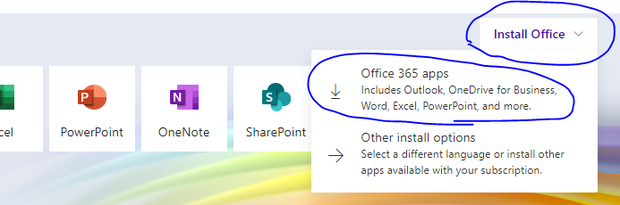
PowerPoint for Mac
PowerPoint 2016 does not export as video
  Use an alternative screen recorder software (e.g. Screenshot) to record the PowerPoint in presentation mode
Office365 PowerPoint 16.19 or higher does allow export as .mp4/.mov
Upgrade to Office365 apps via https://office.com
Webcam in the corner not supported currently

Slide 4

Synchronous vs. Asynchronous
Synchronous
Interaction
Perceived sense of presence
Instant feedback
Stressful
Technical difficulties likely
No interaction, what’s the advantage?
Exclusive
Asynchronous
Flexible
Self-paced
Inclusive
Perceived lack of presence
Risk of apathy/disengagement
"Synchronous or asynchronous?" video on Teaching for learning online.

Slide 5

Why PowerPoint?
Use content you already have
Functionality is built-in to PowerPoint
Record audio narration
Record your screen and embed it into your PowerPoint video
Insert your own videos
Export as a video
Use PowerPoint as a whiteboard

Slide 6

Top tips for recording in PowerPoint
It doesn’t have to be perfect!
Links in PowerPoints won’t be ‘clickable’ once it’s a video
Be descriptive, especially when referring to an image, graph etc.
Think about your content, does it make sense once it’s a video?
Keep it short (no more than 20 mins)
Use a headset or webcam mic
Pause between slides
Try to find somewhere quiet
Outline/script your video content
Rehearse
Save regularly!

Slide 7
Hierarchy of needs for video creation
Sound recording
(microphone placement, speed, etc)
Content
Video Location
(background, lighting, shot framing)
Video recording (camera quality)
Supporting Visuals
Advanced needs
When developing a video, put your effort relative to the size of the step.
Start at the bottom and work upwards in viability, planning and implementation.
If you get stuck half-way through, have a re-think and scale your output back to a podcast, narrated slideshow, or visually engaging document.
.
Basic need for time-based
(audio or video)
Basic needs
Inspired by Maslow’s hierarchy of needs: Maslow, A.H. (1943). "A theory of human motivation". Psychological Review. 50 (4): 370–96.

Slide 8
The two methods
Slide show > Record slideshow
Opens in slideshow mode
Record “Slide and narration timings”
Record “Narrations ink and laser pointer”
Pause and rerecord
Preview as you record
Audio icon is hidden in export video
Insert > Audio > Record audio
Record audio on a slide by slide basis
No ink or laser pointer
Audio icon is visible in export video

Slide 9

Hide the audio icon
Click on the icon on the slide
Click on Playback
Tick Hide During Show

Slide 10
Recording your screen
Insert > Screen recording
Records an area of your screen and audio
Include pointer
Will export as part of the video
Windows key + shift + Q to exit

Slide 11
Inserting ‘other’ video content
Online video e.g. YouTube, eStream, Microsoft Stream can’t be exported as part of the final video
  You can use the screen recording function to record a video playing on your machine. Check the audio is being picked up. I had to unplug my mic.
Video on my PC can be exported as part of the final video
  Insert > Video > Video on my PC
  Video can be trimmed

Slide 12
Transitions and animations
Transitions will be exported
  Amend the duration to suit
Animations will be exported
  Amend the order and duration of each animation to suit

Slide 13
Try it out!
Take 5 minutes to add narration to your PowerPoint
I’ll be here if you need help

Slide 14
Exporting as a video
.mp4 or .wmv
Ultra HD (4k), Full HD (1080p), HD (720p) and standard (480p)
File > Export > Create a Video
Preview slide timings (maybe?)
Turn your presentation into a video

Slide 15
Editing Tools
Video Editor for Windows 10 (free)
iMovie for iOS (free)
Adobe Premier Pro (monthly cost)
Microsoft Stream – trim video
Echo360 – editor
eStream - editor

Slide 16
Accessibility
The Public Sector Bodies (Websites and Mobile Applications) (No. 2) Accessibility Regulations 2018 require us to ensure that our platforms and content meet the international WCAG 2.1 AA accessibility standard.
The regulations do not require us to fix ‘Pre-recorded audio and video published before 23 September 2020’ because they’re exempt from the accessibility regulations. However, it’s worth getting into the habit.
At minimum, a transcript is required for all pre-recorded content (that is not in itself an alternative for text)
Subtitles/captions are also recommended.
Echo360 and Microsoft Stream have automated caption features.

Slide 17
Accessibility continued
PowerPoint does not have an automated transcription function
Take the video file you export and upload that to a ‘hosting’ platform that has automated transcriptions (Echo360 or MS Stream)

Slide 18

Where to host your video?
eStream
Integrated with Moodle
6GB size limit
Share externally
Echo360
Integrated with Moodle
Automated transcription
Share externally
Microsoft Stream
Integrated with Moodle
Automated transcription
Can’t be shared externally
You can use these now but it's worth waiting for transcription in Echo360.
Wait for this.
Sharing in Stream relies on sharing to people, channels or groups. Groups and channels are Office 365 groups.
We do not have any Office 365 groups for modules. When the Moodle – Teams integration is ready, you will be able to create a Team for a module which in turn will create an Office 365 group. So you will be able to share your Stream content with a module of students and embed it in Moodle.
You can start producing your video content now, save it somewhere safe and host it later.

Slide 19
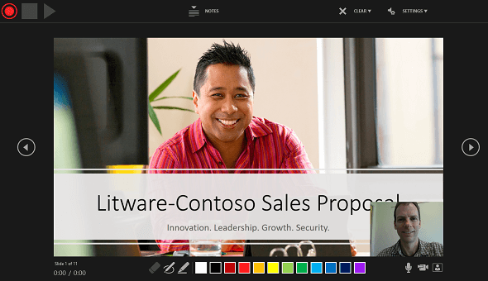
PowerPoint 365
New version coming this year (no ETA)
Webcam in the corner!
Publish directly to MS Stream

Slide 20

Help and further resources
warwick.ac.uk/academictechnology
warwick.ac.uk/academictechnologyguides
academictech@warwick.ac.uk
warwick.ac.uk/itstraining
Find out more about teaching online pedagogies and tools on:
Teaching for Learning Online

