Slide 1
Designing a liberated curriculum
Emma Coleman (Women’s Officer Warwick SU)
Emma Worrall (Arts UG Faculty Rep Warwick SU)

Slide 2
Embedding Liberation
Organisation of the module
Liberation Weeks
People Vs. Topics
Breadth
Ask yourselves: “How diverse/international/modern/liberated is my curriculum?”
Keep in mind: gender, race, sexuality, disability, colonialism class, Western hegemony…
Acknowledge your limits – and acknowledge the origins of your sources
Seminar questions

Slide 3
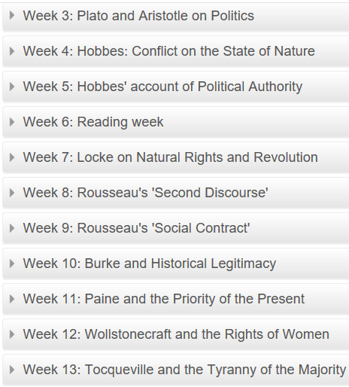
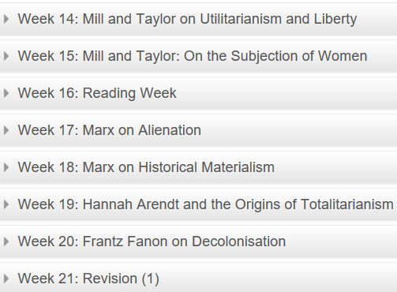

PO201 Political Theory From Hobbes – Politics 2nd Year Core Module

Slide 4

HI153 Making of the Modern World – History 1st year Core Module
Week 2 | Enlightenment, Revolution & Modernity | Week 13 | The Challenge to Positivism
Week 3 | Enlightenment, Revolution & Modernity | Week 14 | Faith and Modernity
Week 4 | The Wealth and Poverty of Nations | Week 15 | Gender and Sexuality
Week 5 | Nature and the Environment | Week 16 | -
Week 6 | - | Week 17 | Class and Urban Identity
Week 7 | Inequality and the Modern World | Week 18 | Race, Slavery and Citizenship
Week 8 | The Liberal Nation State | Week 19 | Formation of Modern Mass Culture
Week 9 | Extremism | Week 20 | Cold War
Week 10 | The Wider World | Week 21 | -
Week 11 | War, Violence and Modernity: Faces of War | Week 22 | The Sixties
Week 12 | War, Violence and Modernity: Holocaust and Genocides | Week 23 | Postmodernism – And After?
Notes:
Week 5 deadlines, critical approaches and perspectives not looked at until final week how supposed to adopt?

Slide 5
Student-focused curriculum
Encourage to design own questions and research initiatives where possible
Invite to bring own texts and knowledge
Invite feedback, listen to it and demonstrate it
Work with SU schemes
Notes:
PO353 Gender and Development students required to do 3 readings for each seminar but only 2 have to be from module reading list, which offers 8 or so options to choose from. Asks not to feel bound by the module reading list – declaring it is designed only to introduce to the topic, rather than act as an exhaustive list of the main scholarly works. I would therefore strongly encourage you to read beyond it in order to address issues you are particularly interested in and to develop as broad an understanding as possible.

Slide 6
Accessibility
Availability of texts – liberation without extra cost
Content warnings – language, traumatic images, videos, themes
Dyslexia-friendly fonts
Accessible language – jargon
Notes:
Serif fonts, with their ‘ticks’ and ‘tails’ at the end of most strokes (as found in traditional print fonts such as Georgia or Times New Roman), tend to obscure the shapes of letters, so sans-serif fonts are generally preferred. Many dyslexic people also find it easier to read a font that looks similar to hand writing as they are familiar with this style, and some teachers prefer them. However these types of fonts can lead to confusion with some letter combinations, such as “oa” and “oo”; “rn” and “m”.

Slide 7

Exercise
Map out the key thinkers in your area of study and link to liberation groups and concerns.

