Slide 1

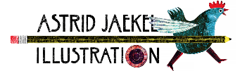


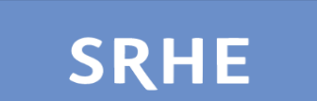
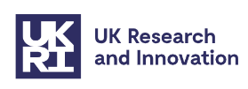
From flailing to flourishing? Connection and criticality for uncertain times
A/Prof Karen Gravett
Images from Pixabay

Slide 2

What does it mean to teach and learn in higher education today?
And what should, and could, it mean?

Slide 3
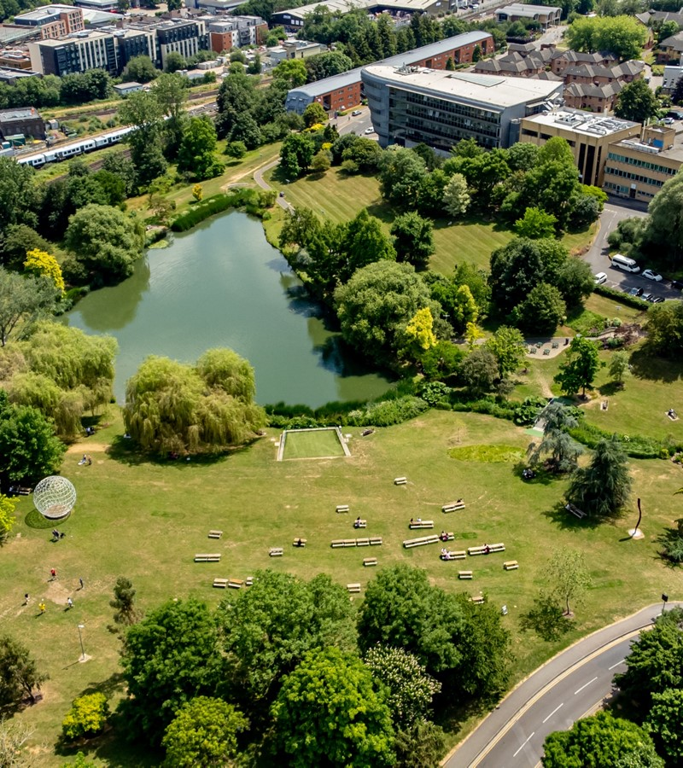
Higher Education
In (your) context

Slide 4


My context
Increasing pressures on educators and students
Era of global financial uncertainty
GenAI / postdigital times raising new questions for assessment, learning, connection and criticality
Gravett, K. (2025). Postdigital Relational Pedagogies. In: Jandrić, P. (eds) Encyclopedia of Postdigital Science and Education. https://doi.org/10.1007/978-3-031-35469-4_83-1

Slide 5
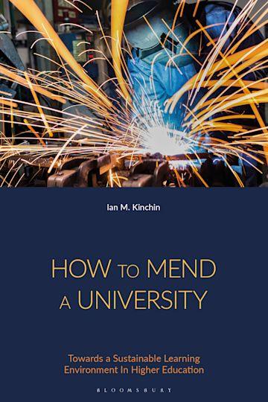
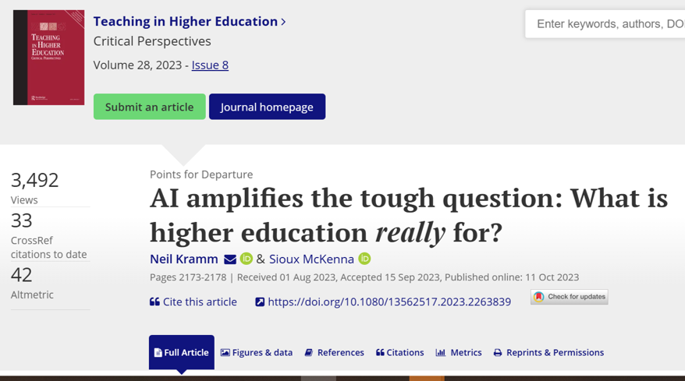
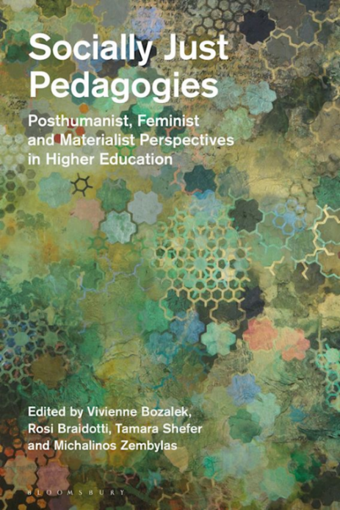
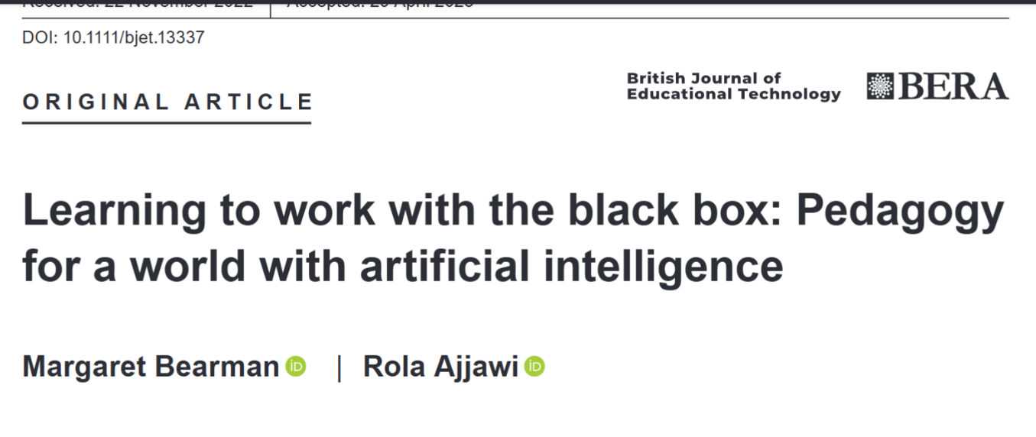
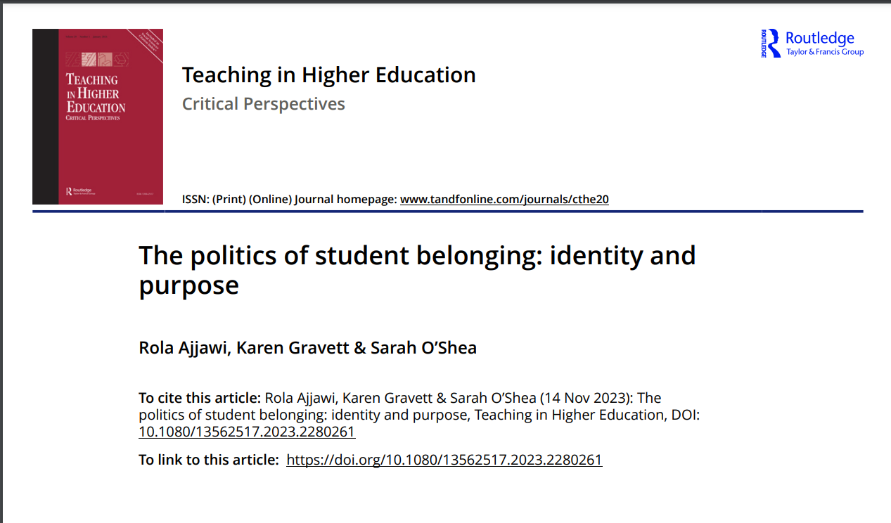
Discourses and discussions

Slide 6
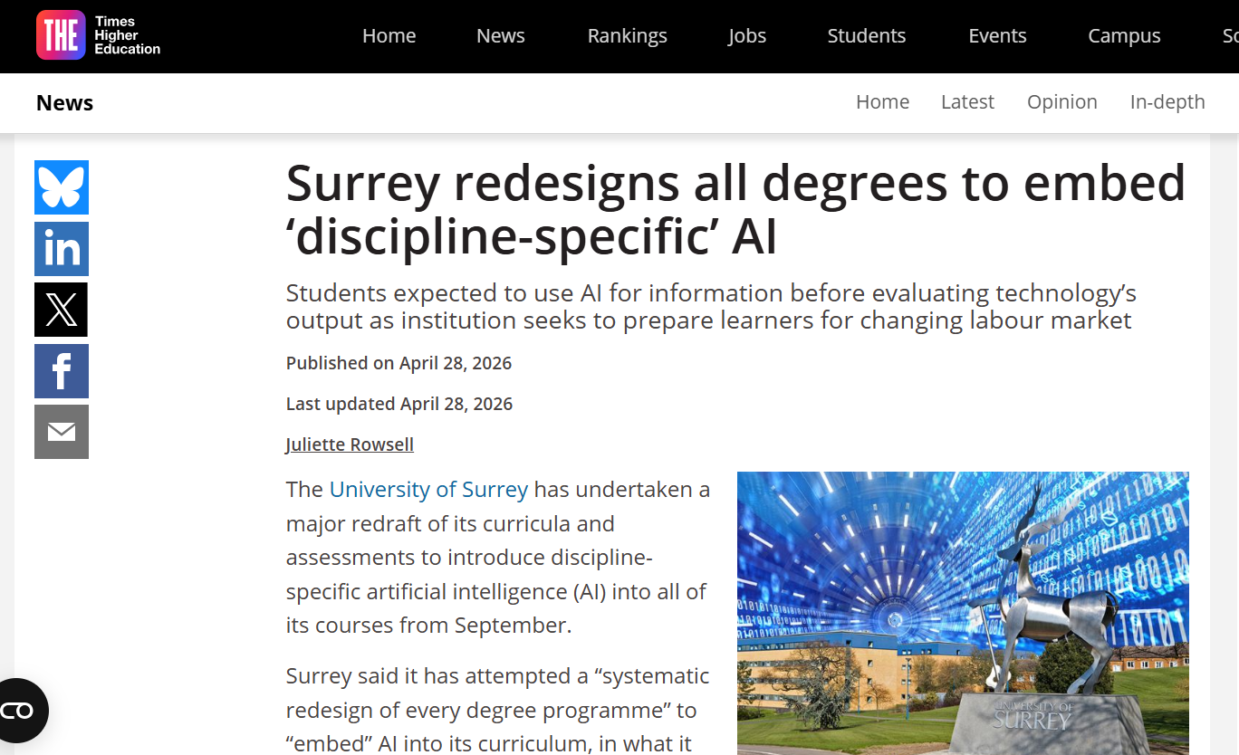

Slide 7

GenAI brings increasing opportunities?

Slide 8

GenAI brings increasing pressures, at a time of great pressure?

Slide 9

AI is a technology, but it is also part of society

Slide 10

AI is more than a tool

Slide 11
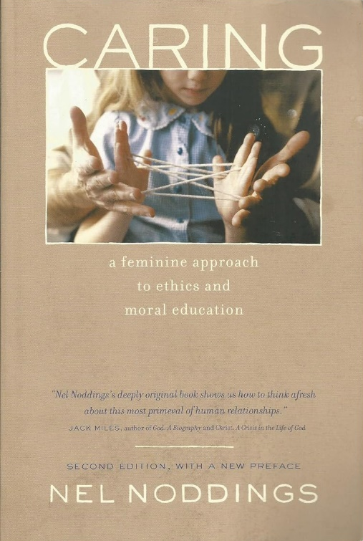
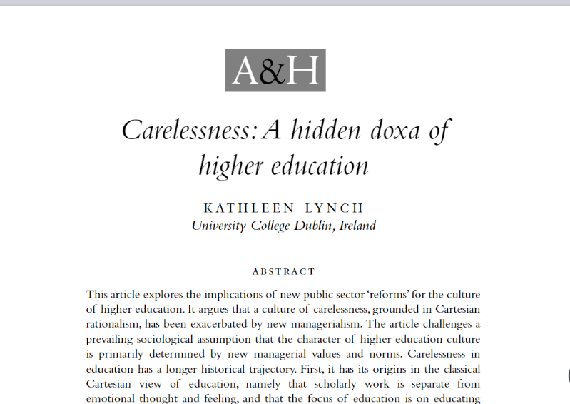
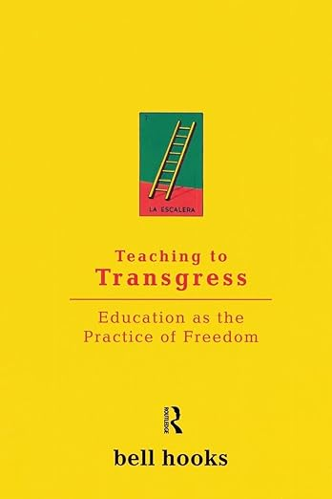
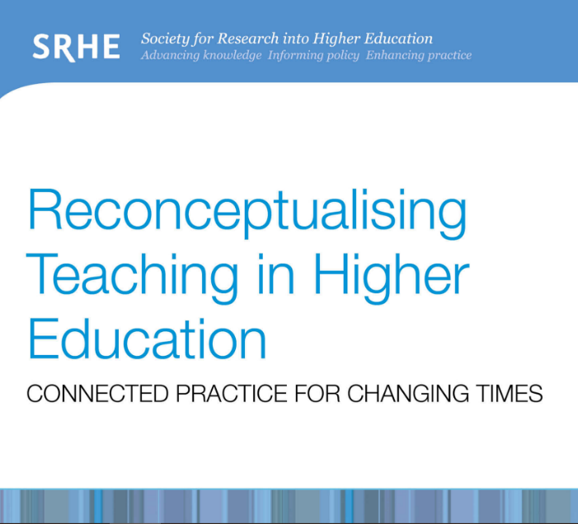
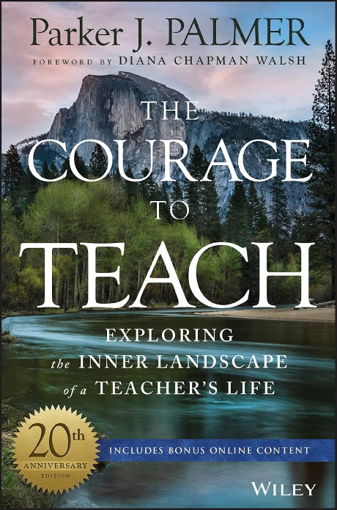
Critical pedagogies
Originated from an interest in thinking about connections, care, critical pedagogy and social justice
Interest has been revitalised in recent times, as a response to the pressures inhibiting the forging of connections. Universities have been described as environments that are uncaring and unhealthy

Slide 12

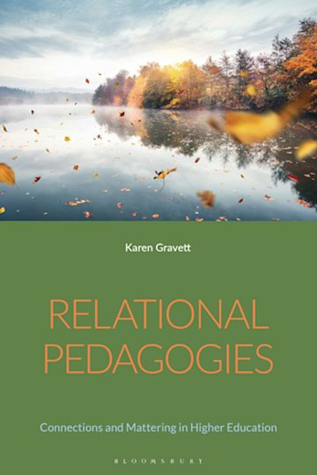
Relational pedagogies
Posthuman-inflected ideas to consider the relations we have with one another and to a broader, material, more-than-human, world.

Slide 13
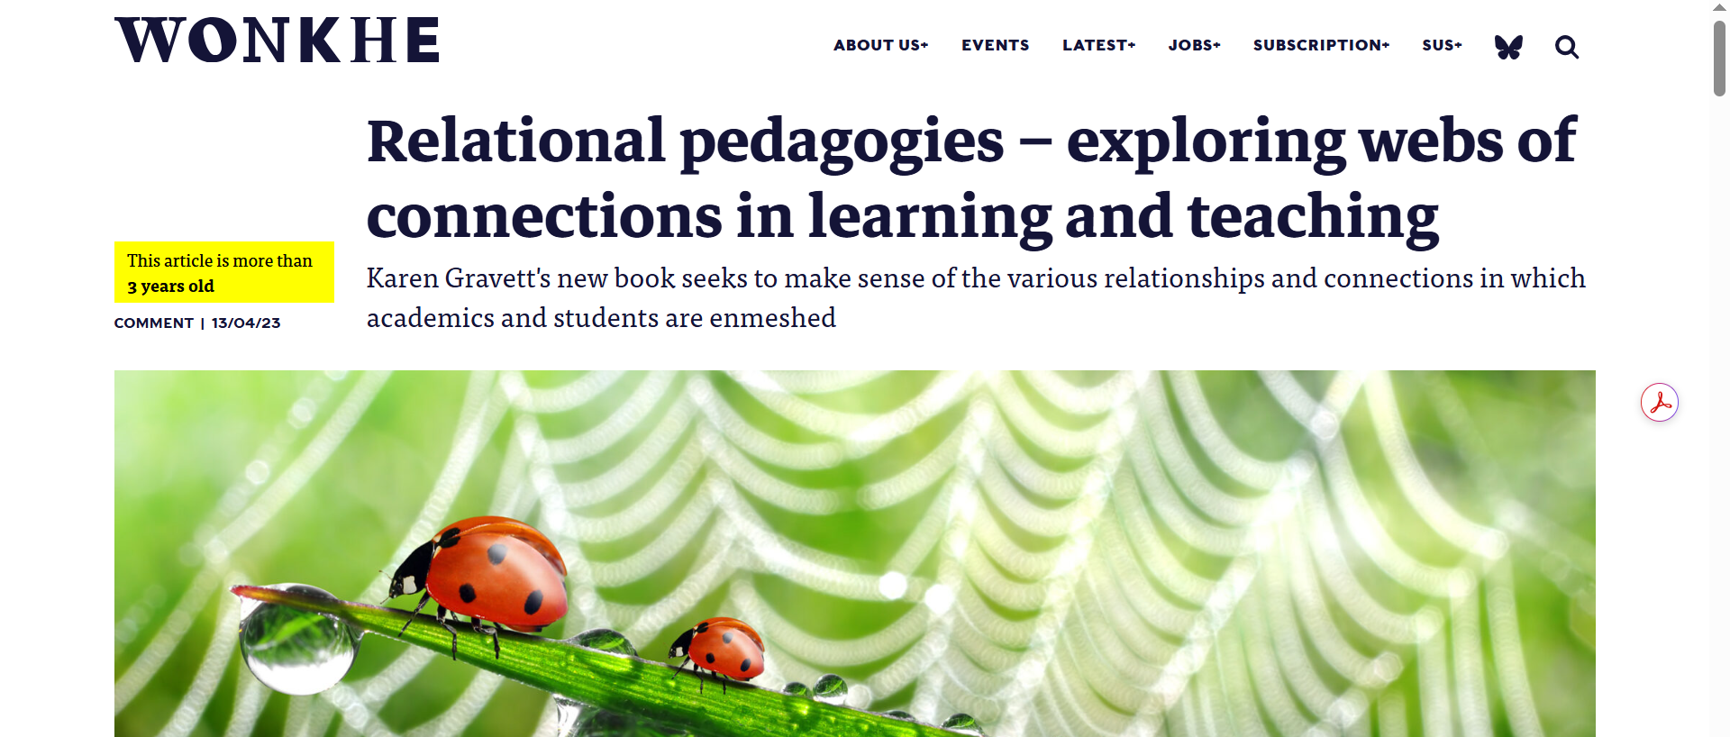

Slide 14
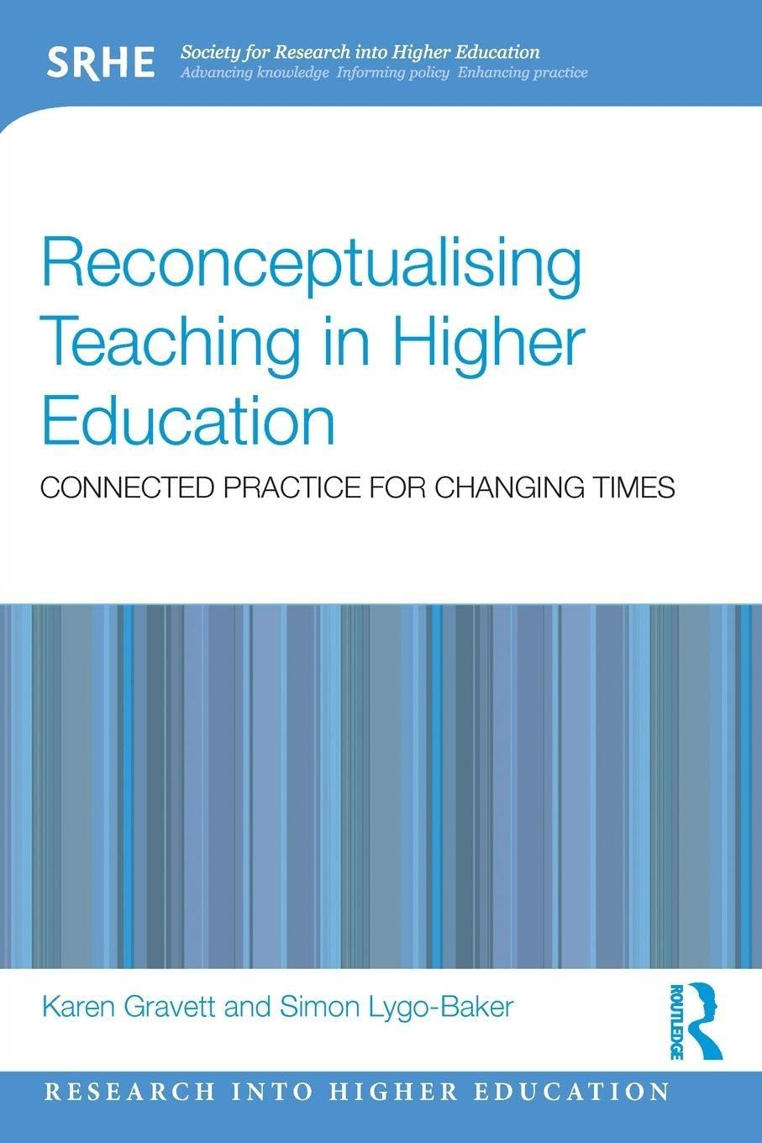
Teaching not a process of information transmission Affective, emergent, relational
Critical practice that values multiplicity and uncertainty
Situated practice: objects, bodies, affect and materiality

Slide 15

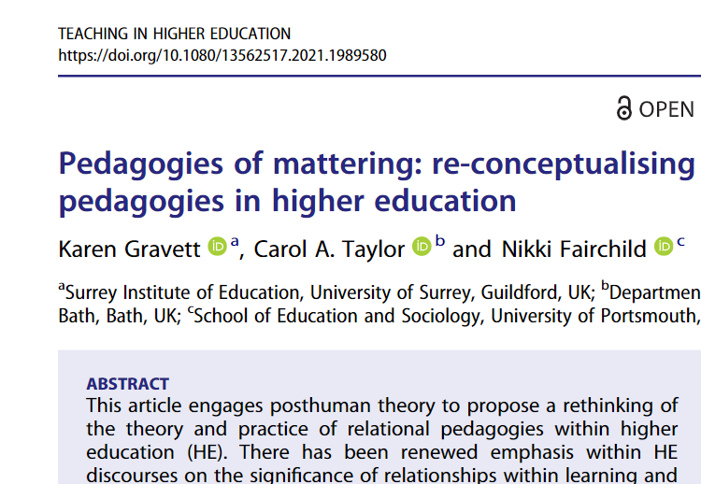
Mattering

Slide 16

Teaching and learning
Making connections through vulnerability, trust, and partnership
Openness and teacher vulnerability. ‘Presence’
Thinking about power
Valuing uncertainty

Slide 17
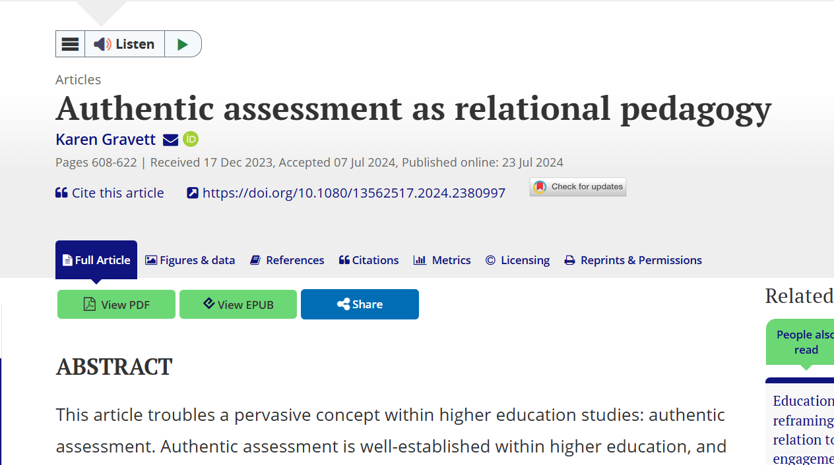
Assessment
How are assessment practices infused by emotions and power relations?
How can we redesign assessment with criticality and care in mind?
How can we redesign assessment
through thinking with inclusivity
and mattering?

Slide 18
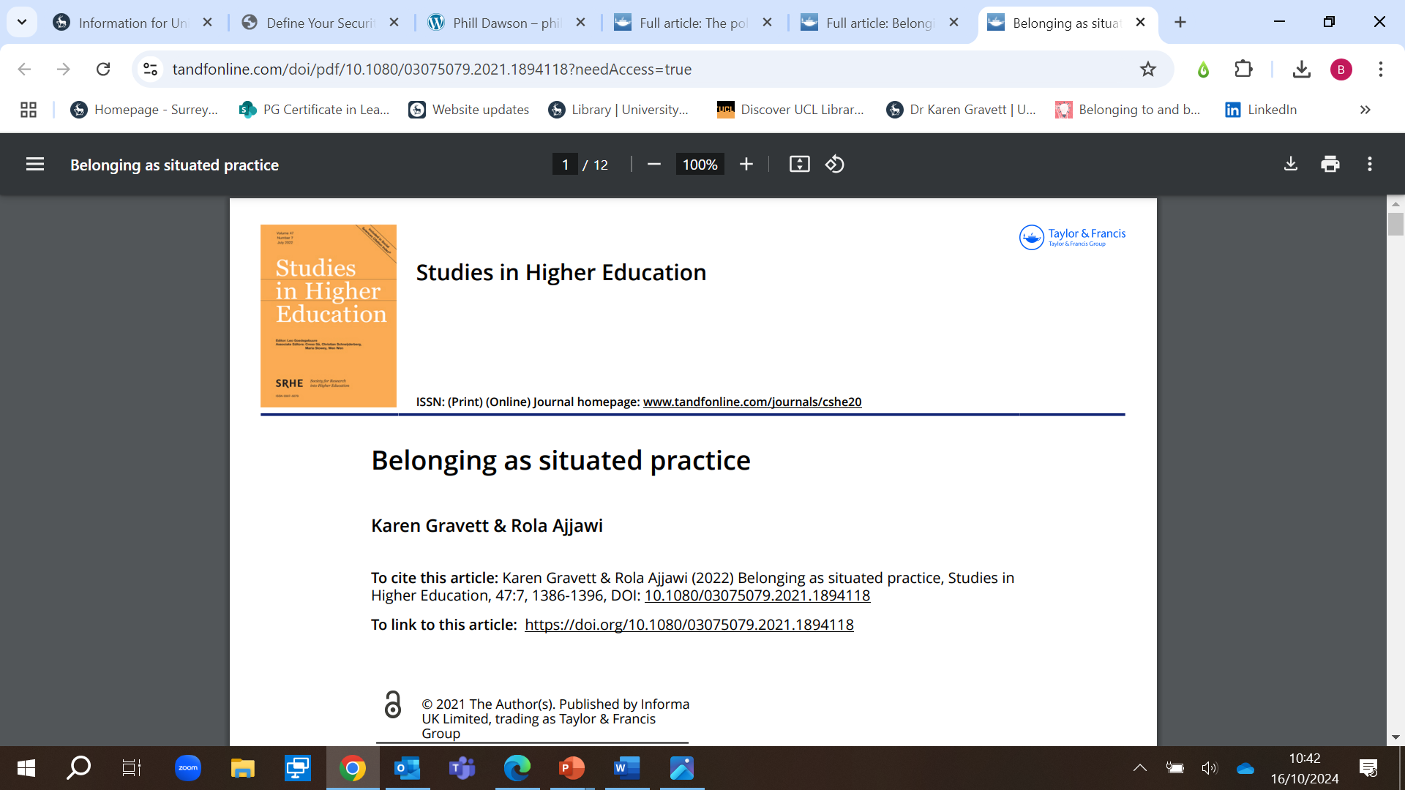
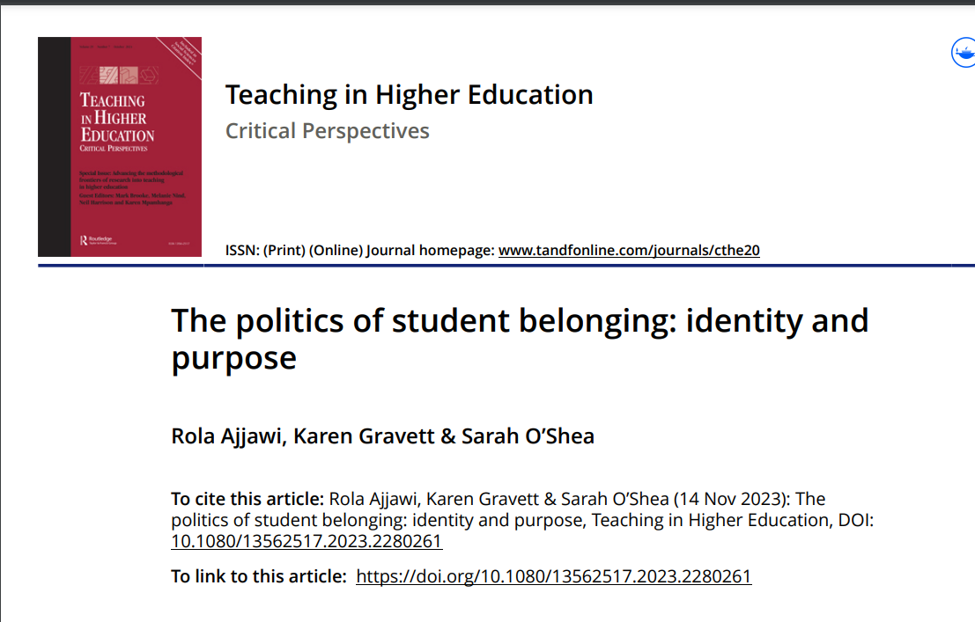
Belonging

Slide 19
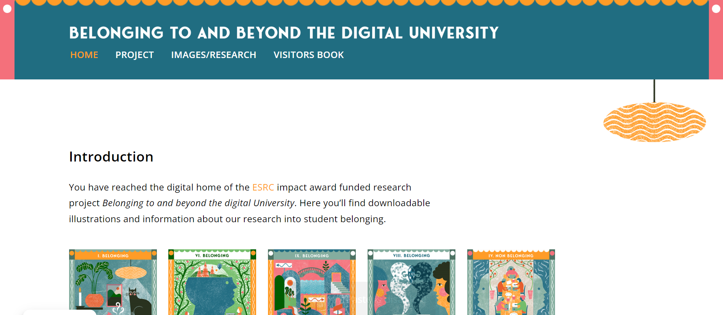
www.belongingtouniversity.co.uk

Slide 20

Noticing and dialogic approaches
Thinking about belonging and engagement
The power of micro-practices

Slide 21
Focus on connection and criticality in a complex world
Notes:
Chat

Slide 22
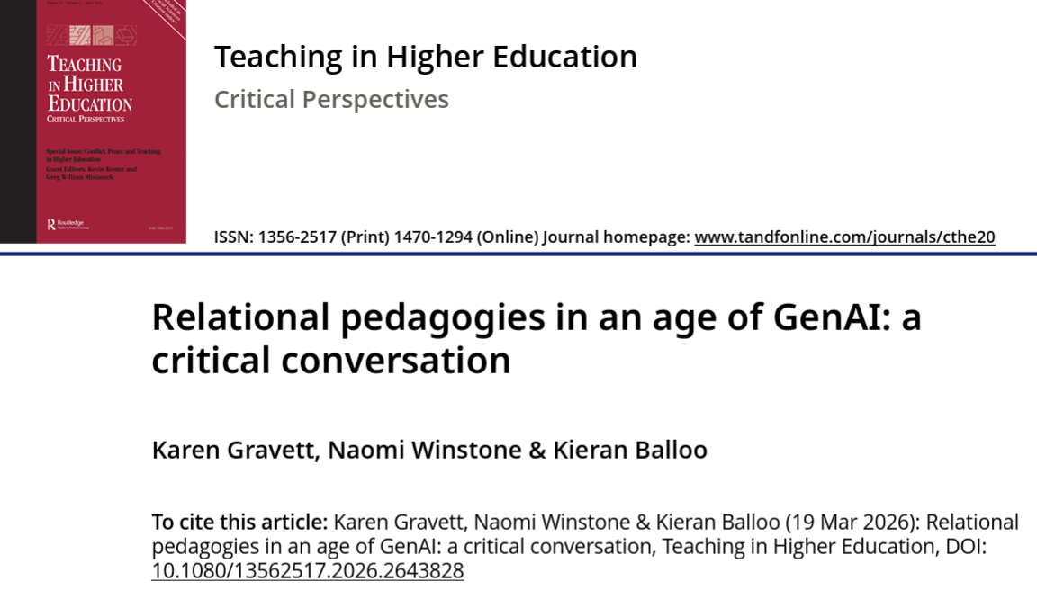
Relational pedagogies in an age of GenAI

Slide 23
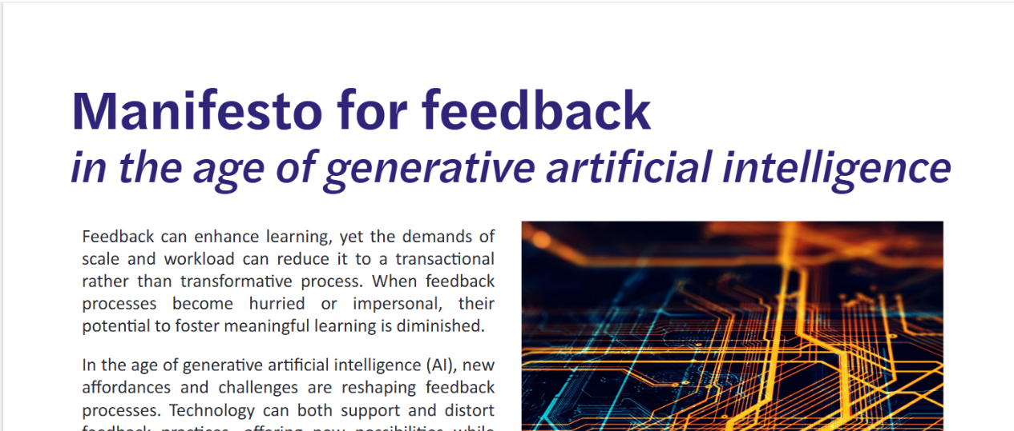
Questions for feedback
Winstone, N., Gravett, K., Noble, C. et al. (2025). https://doi.org/10.6084/m9.figshare.30195568.v2

Slide 24
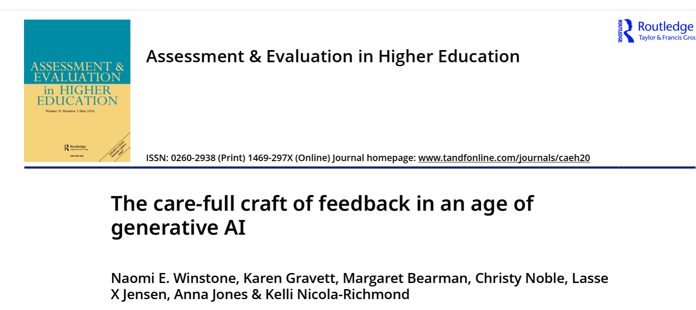

Slide 25
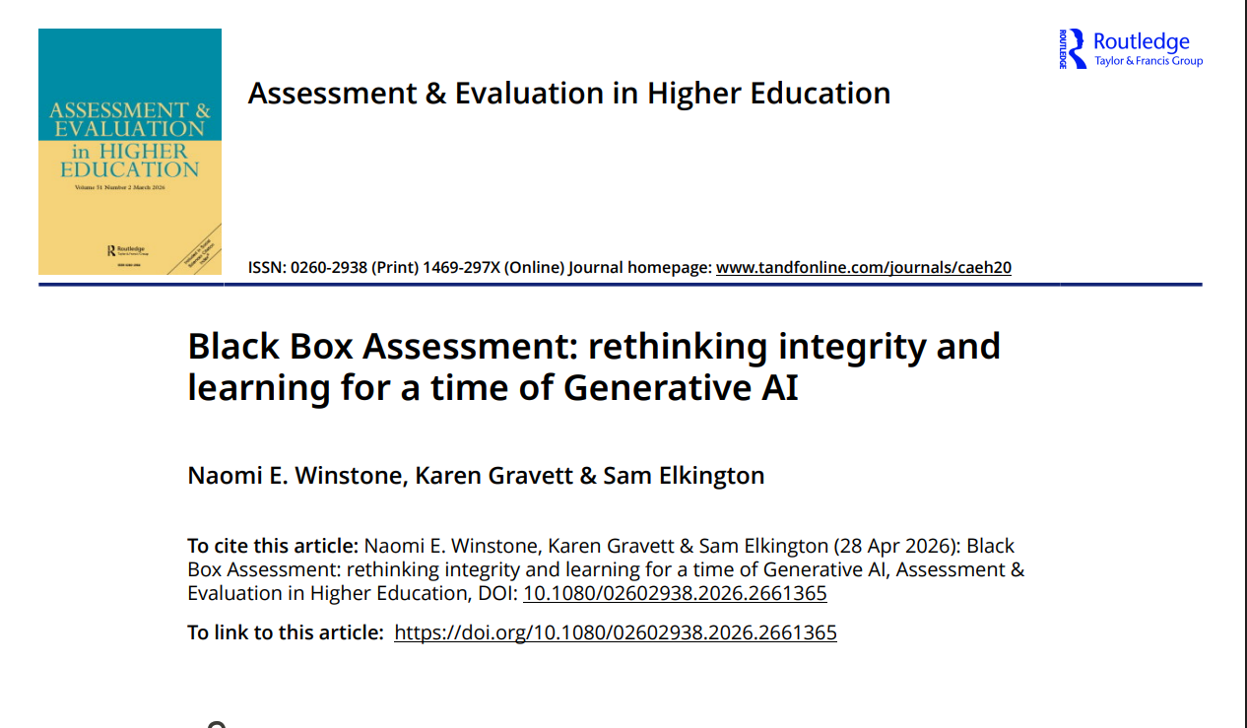
A more meaningful assessment?
Core principles:
assessing process to capture evidence of learning
valuing errors and revisions
fostering transparency and learner agency
rewarding the learning trajectory

Slide 26
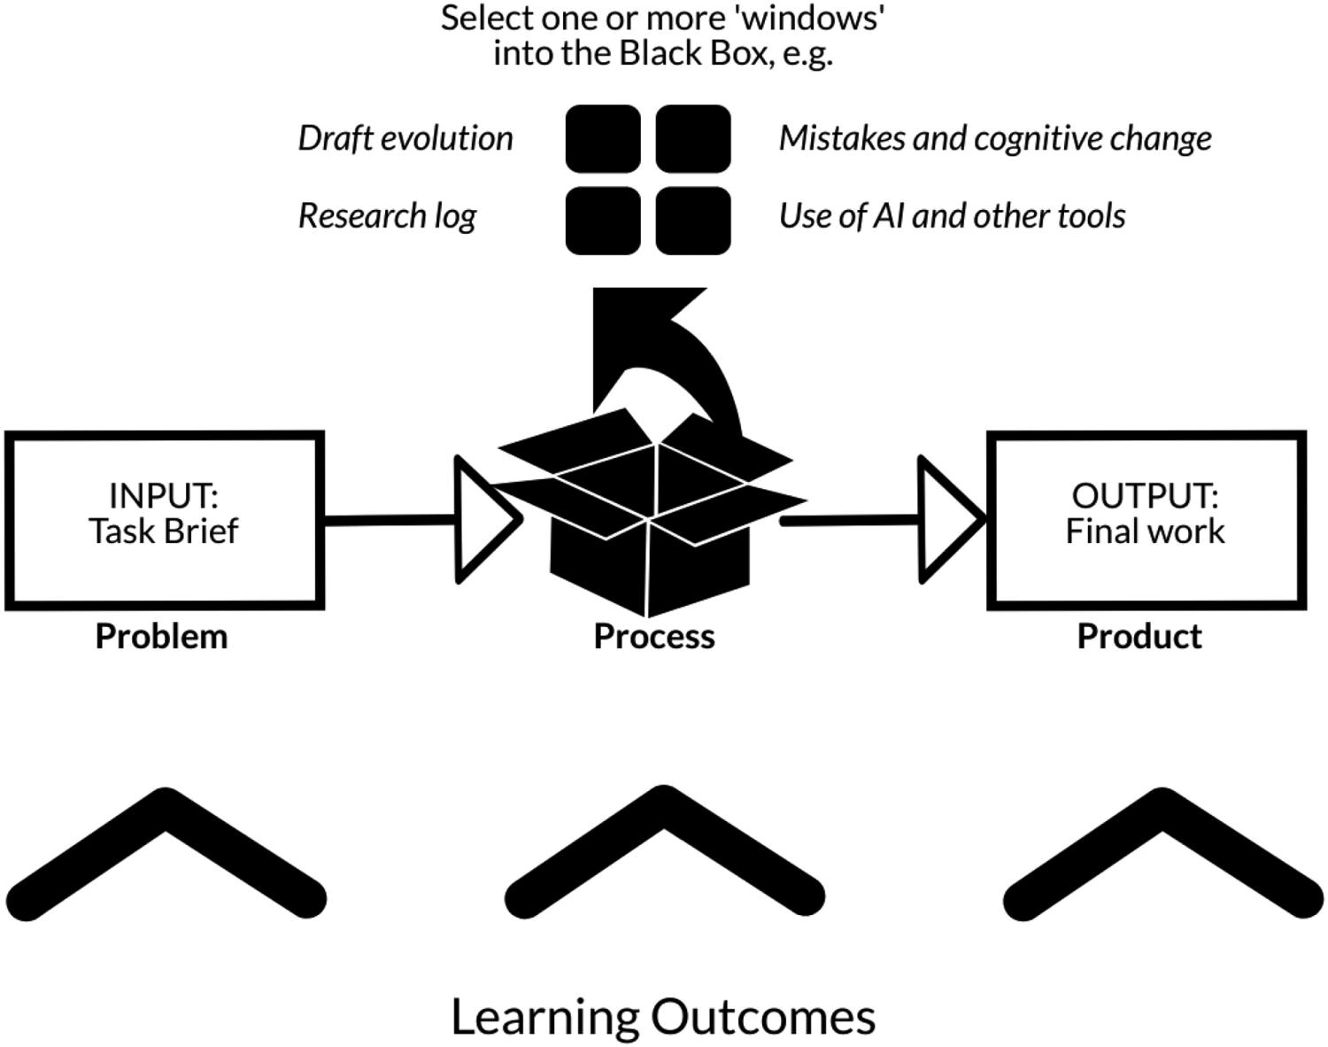
Figure 1. The Black Box Assessment design model. (Winstone, Gravett and Elkington, 2026)

Slide 27
How we connect with one another and with digital technologies is complex, and requires a critical practice
Notes:
Chat

Slide 28


What might it mean to teach and learn in higher education?

Slide 29
Ask questions and embrace complexity
Sit with uncertainty
Notice the micro-moments of teaching and learning
Consider how teaching and learning relations are entangled with matters of power
Think about relationships, connections and mattering
Understand the situated and messy nature of learning and teaching

Slide 30
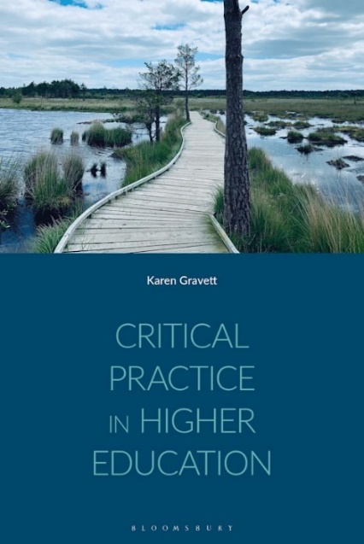
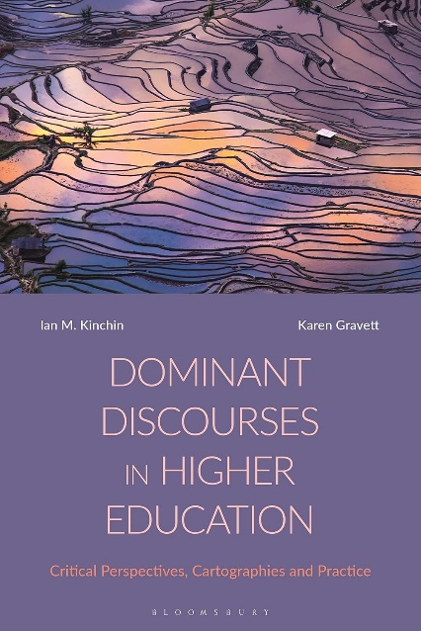

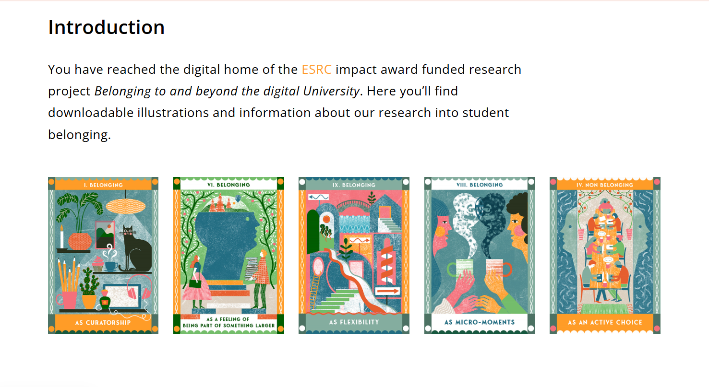
Find out more…

