Slide 1
Compassion at Warwick
Gemma Gray, Josh Davies, and Luke Hodson

Slide 2

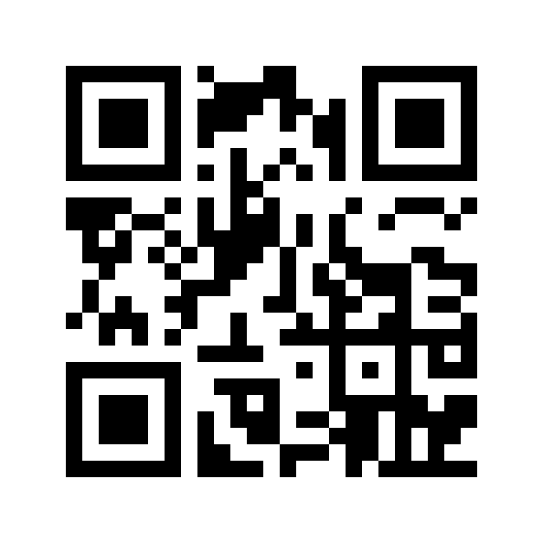
Joining Instructions
Join at vevox.app
Or search Vevox in the app store
ID: 109-595-303

Slide 3
Compassion in a word
Join: vevox.app ID: 109-595-303
Enter Text and Press Send
Vote Trigger

Slide 4
What does Compassionate Pedagogy mean?
“…notice, not normalise, ones own distress or disadvantaging, or that of others, and take action to reduce or prevent it.” Paul Gilbert, Compassionate Mind Foundation
“Pedagogical commitment that allows educators to criticize institutional and classroom practices that ideologically place underserved students at disadvantaged positions, while at the same time be self-reflexive of their actions through compassion as a daily commitment.” Hao et al (2011)

Slide 5
Compassionate pedagogy
Post pandemic awareness of importance of compassionate approach
Compassionate approaches align Universities as “caregiver”, with a role in reducing and mitigating against suffering
Debate around the application of compassion within HE (Waddington, 2024)
Concerns about reduction of agency and independence of students
Commodifying compassion
Consideration staff within processes

Slide 6
Compassionate at Warwick
Toolkits: Wellbeing Pedagogies, Neurodiversity Toolkit
Student co-production work
Designing inclusive Assessment WIHEA Learning Circle
Inclusive Education strategy: Inclusive education plans within each department
Compassion Communications

Slide 7
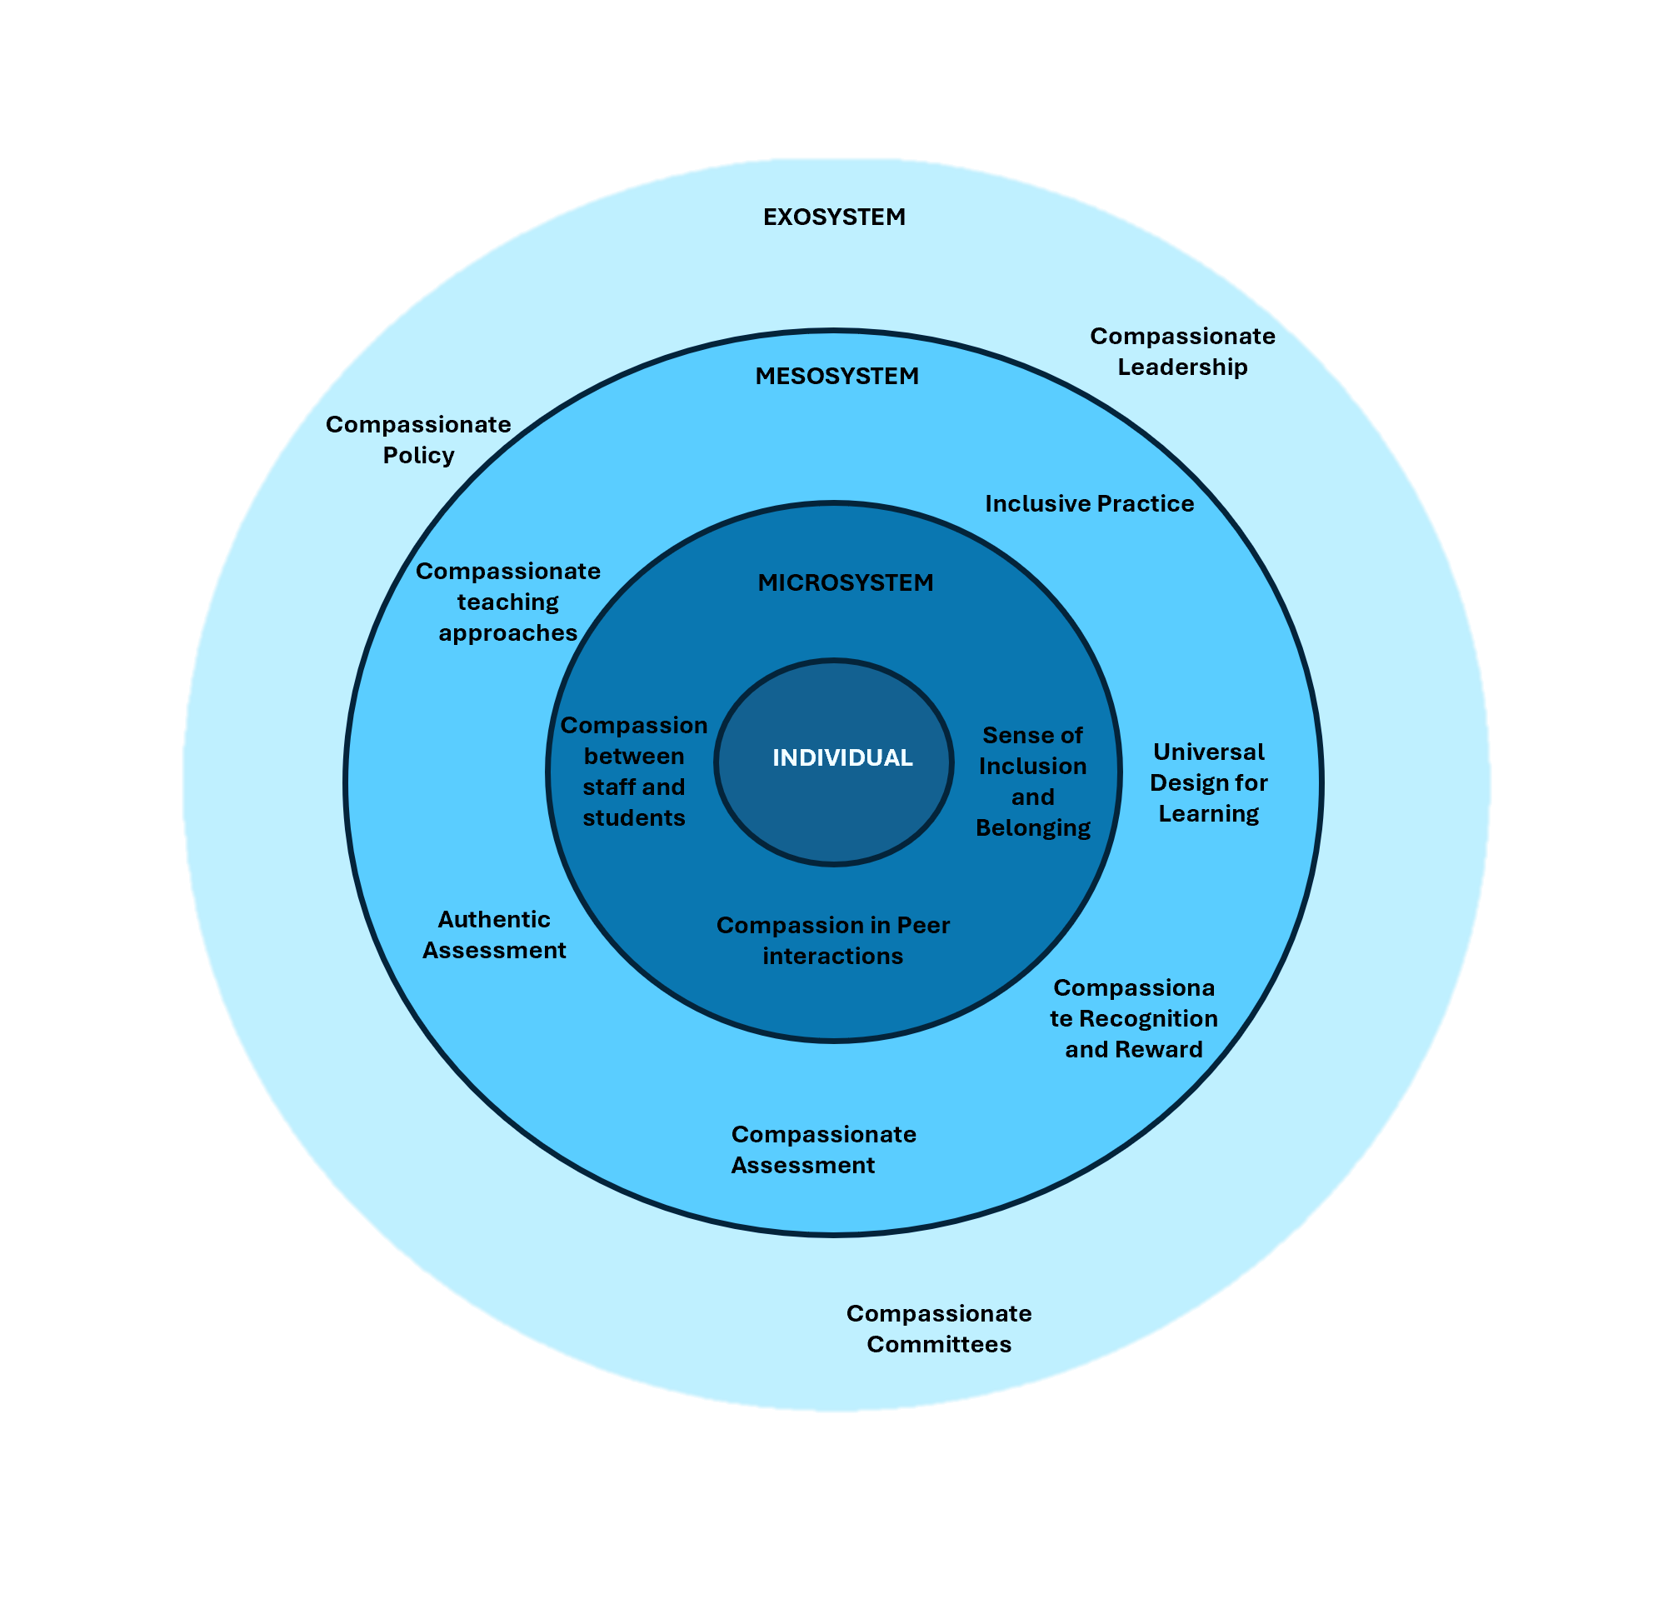
Compassion in Ecological Systems
Compassion within different spheres of the university system
Explore interaction between the systems
Sustainable approach
Working from the individual out

Slide 8
Compassion conversations
Rationale:
Extensive previous research on compassion towards students, but little explores how student and staff conceptualise and appreciate compassion within and across their environments
Methods:
Student-led online focus groups adopting autoethnographic approaches to explore the broad theme of what is compassion at Warwick.
Aim:
To support authentic discussion about compassion between different student groups and staff

Slide 9
Compassion Fatigue
Rationale:
Staff are people too
Methods:
Brief survey design
Intention to Leave, Empathy, Maslach Burnout Inventory, Professional Quality of Life Scale (compassion fatigue) + demographic details (e.g., caring responsibilities, gender etc)
Aim:
Association between compassion fatigue, burnout, compassion satisfaction and job satisfaction in UK academics

Slide 10
Moving forwards
Projects complete by summer 2025
Analyse and synthesise the results as we move forwards
Start working outwards within the ecosystems
What does compassionate leadership and policy look like?
Name change?
Critical Compassion

Slide 11
Compassion in a word
Join: vevox.app ID: 109-595-303
Enter Text and Press Send
Vote Trigger

