Slide 1
Evolution rather than revolution: How making small changes can enhance the authenticity of an assessment strategy

Slide 2
This session
Introduce to ‘authentic’ approaches as a vehicle to support effective student learning
Appraise the benefits of ‘authentic’ teaching and assessment approaches
Reflect upon what constitutes ‘authenticity’ in different subject areas
Explore the five dimensions of authenticity and how they might be manifest in an active learning classroom
Identify at least one action point that might be adopted to increase authenticity in the classroom

Slide 3

What do you know about the concept of ‘authenticity’ in pedagogy and assessment?

Slide 4
What is authentic pedagogy and assessment?
The focus is on the acquisition of higher order thinking processes and competencies rather than factual knowledge and basic skills. (Holliday, Dance et al 2015)
‘Authentic learning’ is framed around the process of developing judgement and the focus of ‘authentic assessment’ is upon how that judgement is informed. (Boud and Falchikov 2007)
Students are required to perform real world tasks that demonstrate meaningful knowledge and skills. (Mueller 2005)
Realism
Contextualisation
Problematisation
(Villarroel, Bloxham et al 2018)

Slide 5

What are the benefits of authentic approaches?
Deeper learning
Opportunity for greater inclusivity
Improved student evaluations of teaching
Improved teacher satisfaction
Development of employability skills
Addresses many of the current criticisms of HE (Villarroel, Bloxham et al 2018)
Supports proactive and constructive engagement with AI (AdvanceHE 2023)
Gulikers, Bastians and Kirschner (2004)

Slide 6
So, what does 'authenticity' look like? Three simple steps...
STEP 1....
STEP 2...
STEP 3...
For the students on your course, identify what roles they are likely to assume on graduation
Consider what attributes students are likely to need in order to perform well in those roles.
Reflect upon how existing assessments might be modified (or changed) to make them (more) authentic

Slide 7
Starting at the end…graduate destinations
Consumer Behaviour
Write the name of a module or course that you have some involvement with (Module Leader, Tutor, Programme Director etc) on a piece of red card and place these in the centre of the table.
MSc Business with Marketing

Slide 8
Starting at the end…graduate destinations
Trainee Accountant
In pairs or in groups, share your choice and discuss what roles or jobs students on these modules/courses are likely to apply for on graduation.
Identify at 1-3 roles/jobs that a graduate from your discipline might do.
Write these roles on the blue cards provided and put them in the centre of the table in relation to the courses
Consultancy
Brand Manager

Slide 9
Starting at the end…graduate destinations
Reflecting upon the roles identified:
What attributes are employers looking for when employing our graduates in these roles?
What kind of practical/transferrable skills will they need to successfully perform these roles (e.g. critical thinking, research, basic/advanced numeracy, teamwork, written communication, presentation etc)?
Write your thoughts on the green cards and arrange them on the desk in relation to the roles.
Write Reports
Manage budgets
Presentation skills
Information Search Skills
Time Management

Slide 10
So, with this knowledge, how can we modify our assessments to make them more authentic?
Dimension of Authenticity
The Assessment Task | The extent to which the assessment task students perform mirrors what they might be expected a professional context
The Physical Context | The extent to which the environment in which the teaching session and/or assessment mirrors a professional context
The Social Context | The extent to which the social relations/structures of the teaching context and/or assessment mirror a professional context
The Assessment Result or Form | The extent to which the artefact or outcome represents those produced in professional practice
The Assessment Criteria | The extent to which student performance is measured in relation to professional criteria/standards
A five-dimensional framework for authentic pedagogy and assessment (Gulikers et al 2004.)

Slide 11
What kind of assessments do we currently ask our students to produce?
Looking at the Gulikers et al (2004) framework, how could you modify your assessment?
Exam questions
PowerPoint presentations
Spreadsheet or modelled outputs
Essays
Business Report Writing
Lab work
Blog posts
Simulations
Notes:
After asking participants what kind of assessments our students currently produce we then need a a QR code so that they can upload those and we can get them to look at the Guliker framework to identify what tweeks they could make to make it more authentic

Slide 12
Evolution vs Revolution? Authentic assessment v. authenticity in assessment
Authenticity beyond features of the assessment task. How students experience and engage in the assessment as a function of:
Understanding its relevance: do learners see tasks as meaningful and related to their own emerging lives?
Adequate scaffolding: are learners supported in striving for authenticity in the assessment task?
Embedded within a broader pedagogical framework: just one aspect to judiciously consider in the design of educational processes, where there are inevitable tradeoffs.
Ajjawi et al. (2024, 2025), Fawns et al. (2024)

Slide 13
Evolution vs Revolution? Authentic assessment v. Authenticity in assessment
Some thought-provoking possibilities:
Assessment tasks may be intentionally inauthentic in relation to external contexts.
Educators have a responsibility to help learners find personal relevance in their assessments.
Authenticity may be promoted through genuine dialogue with learners about purposes and meanings associated with task.
Ajjawi et al. (2024, 2025), Fawns et al. (2024)

Slide 14
Moving forward, three key questions...
If you could make just one change to assessment on one of your modules/courses, what would it be?
What challenges, barriers, issues do you foresee?
How might you overcome these barriers?

Slide 15

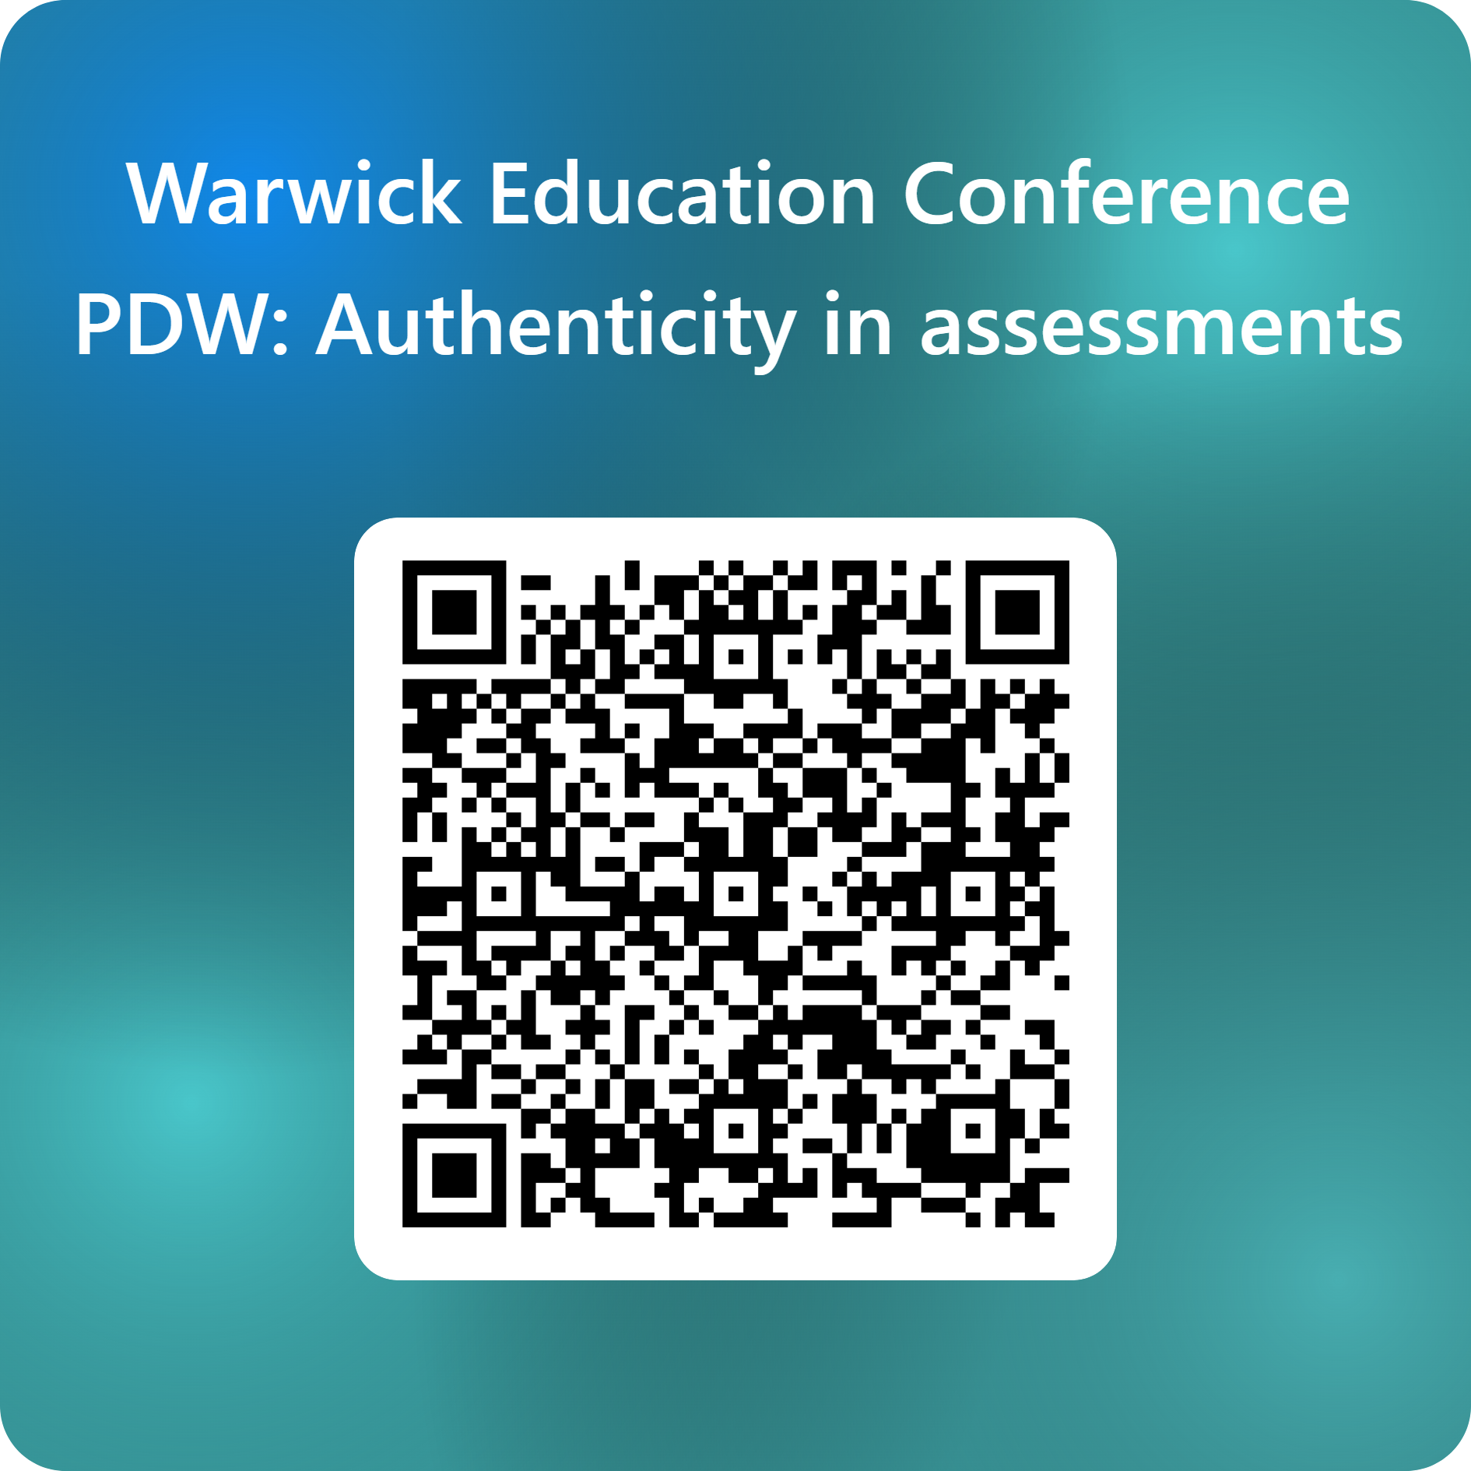
Mind the gap...
How has your understanding of authenticity changed?
Notes:
Highlight it's not all or nothing – it's a matter of degree.
Word cloud
Examples of current assessments
Using the framework wider discussion around how they could be modified
Minor tweaks and/or major changes?

Slide 16
References
AdvanceHE 2023, Authentic Assessment and AI [available online] https://www.advance-he.ac.uk/membership/all-member-benefit-projects/Authentic-Assessment-in-the-era-of-AI
Ajjawi, R., Tai, J., Dollinger, M., Dawson, P., Boud, D., & Bearman, M. (2024). From authentic assessment to authenticity in assessment: broadening perspectives. Assessment & Evaluation in Higher Education, 49(4), 499-510.
Ajjawi, R., Tai, J., Bearman, M., Boud, D., Dollinger, M., & Hayes, A. M. (2025). The multiplicity of authenticity in higher education assessment. In (Vol. 30, pp. 583-591): Taylor & Francis.
Boud, D. and Falchikov, N., 2007. Developing assessment for informing judgement. Rethinking assessment in higher education: Learning for the longer term, 14(4), pp.181-197.
Fawns, T., Bearman, M., Dawson, P., Nieminen, J. H., Ashford-Rowe, K., Willey, K., Jensen, L. X., Damşa, C., & Press, N. (2025). Authentic assessment: from panacea to criticality. Assessment & Evaluation in Higher Education, 50(3), 396-408.
Gulikers, J.T., Bastiaens, T.J. and Kirschner, P.A., 2004. A five-dimensional framework for authentic assessment. Educational technology research and development, 52(3), pp.67-86.
Holliday, W., Dance, B., Davis, E., Fagerheim, B., Hedrich, A., Lundstrom, K. and Martin, P., 2015. An information literacy snapshot: Authentic assessment across the curriculum. College & Research Libraries, 76(2), pp.170-187.
Mueller, J., 2005. The authentic assessment toolbox: enhancing student learning through online faculty development. Journal of Online Learning and Teaching, 1(1), pp.1-7.
Villarroel, V., Bloxham, S., Bruna, D., Bruna, C. and Herrera-Seda, C., 2018. Authentic assessment: Creating a blueprint for course design. Assessment & Evaluation in Higher Education, 43(5), pp.840-854.

