Slide 1

How do students and lecturers ‘do’ language in teaching and learning?
‘Languaging’ examples in our postgraduate teaching and learning
Mary van der Riet, Bronwyn Harris, Saran Shantikumar, Anwar Aljundi, Hongyu Ren, Yifei Chen, Jen Qi, Zilong Guan and Phillip Anyanwu
WARWICK MEDICAL SCHOOL *image from Freepik.com

Slide 2
About languaging
This presentation
Summarises exploratory discussions with students and lecturers about languaging in postgraduate teaching and learning
Aim for today
Recognise and value key workarounds
Think about systematising change
Consider how we can use languages as a “flexible resource that can be meaningfully deployed for learning and assessment purposes” (Costley & Leung, 2020)
Context
Multiple languages in the classroom
English as medium of admission, instruction & formal communication
Student learning extensively mediated through use of technology in teaching sessions
Realities of current sociopolitical context of HEI
Academic success should not just be related to language proficiency

Slide 3
Translanguaging is a pedagogical strategy that includes intentional use of different languages
(Cenoz & Gorter, 2011)
Are we working with translanguaging?
Not in the sense of intentionally combining more than one language in the same activity
YES in that translanguaging is about:
communication &
making concepts & knowledge accessible
Foster positive attitudes towards multilingualism
Value people’s context & be inclusive
Take advantage of preferred language literacy
Notes:
Are we working with 'translanguaging'?
-Not in the sense of intentionally combining more than one language in the same activity
-Yes in the sense that translanguaging is about communication & making concepts and knowledge accessible
Translanguaging means we -foster positive attitudes towards multilingualism
-values people's context and be inclusive
-take advantage of preferred language literacy

Slide 4

Challenges in live teaching sessions
Pace of delivery
Accents (students & lecturers)
Intense structure of timetable (e.g. five full days of teaching)
Lack of exposure to terms used within field e.g. health/research
Intensity, extra concentration, need for live/back translation
Being in the class for one hour, two hours listening, understanding in another language … taking notes wasn't easy, so I couldn't write notes on my notebook at all.
(Student)
Notes:
The first 4 could apply to the whole class
For other language speakers there is additional and invisible labour happening

Slide 5

Students’ real-time adaptations
I miss a lot of content by only looking at the PowerPoint slides afterwards
Use of translation software tools and large language models (AI) in the classroom
Students engage in extra work to process the live seminar/class
Putting content from the session into ChatGPT/DeepSeek to ‘explain’ it e.g.
  Particular ‘professional’ words or phrases from health or medical context)
  taking screenshots of the board/screen and asking AI to ‘help me to understand’ and ‘translate’
  (statements are from discussions with students)
I do as much as I can during the class so as not to forget details
I give ChatGPT some of the ideas or terms that I've heard during the presentation or the lecture and ask for a real example, to explain it again (in my own language), and I save that because when I go back to the presentation, I know that I have something here in the ChatGPT

Slide 6




Use of live translation and transcription tools
To track what is said in the lecture
DeepL ChatGPT Google Translate
Live transcription in another language
  In Microsoft Teams sessions: live transcription settings can be set in another language

Slide 7
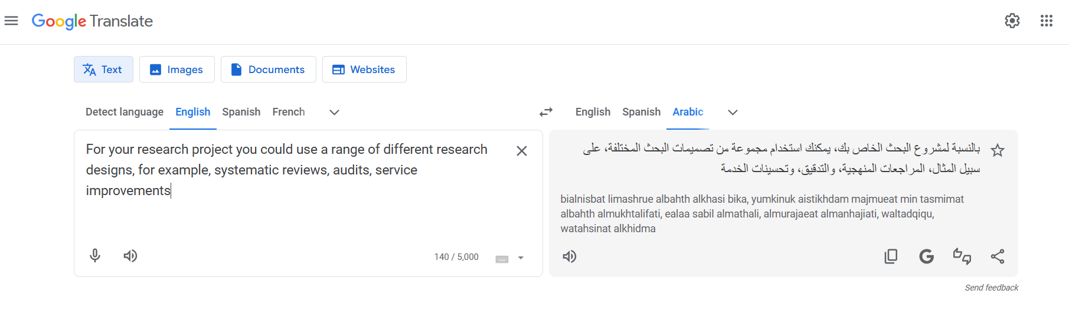
Screengrab of Live translation through Google Translate

Slide 8
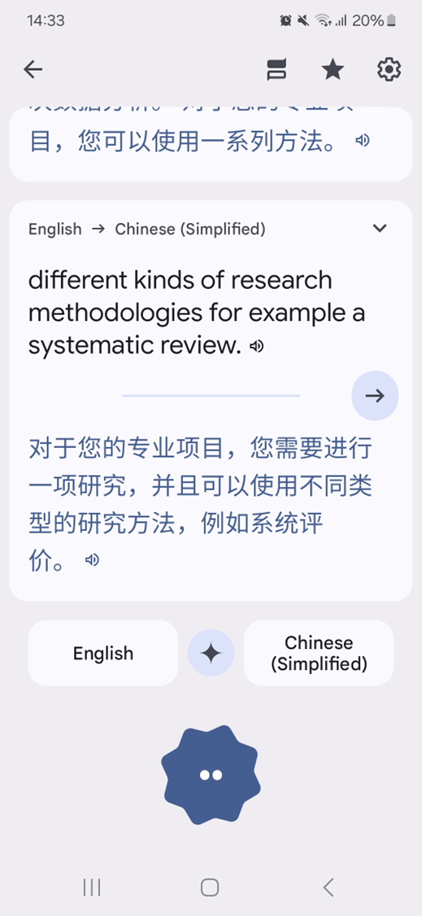
Live translation
Slow connectivity in lecture venues delays translation
Translation tools not always useful for translation of meaning
Language is also related to thinking processes: different languages have different ways of thinking
Context of words differs and translation by tools is not always contextualised e.g. medical or health content

Slide 9
Further languaging challenges in the classroom
Group work activities
Difficult to follow the discussion
Difficult to contribute and participate equally
Collaborative work which is assessed is very challenging
Use of chat software to type out and translate ideas
Assessed presentations
Handling Q and A
Notes:
Group work activities are
-difficult to follow the discussion
-difficult to contribute and participate equally
Collaborative work which is assessed is very challenging
-use of chat software to type out and translate ideas
Assessed presentations
-Handling of Q and A

Slide 10
Navigating academic reading and writing across languages
Written assessments: allow for time to check words and take time with writing
  Writing process: Work through translation tools (e.g. Google translate) to write and conceptualise in own language, and then translate
Reading in another language:
  Conducting evidence-based research and reviewing literature is challenging across languages
  Processing, and reviewing journal articles to assess relevance to topic is not easy in another language
Post graduate skills:
  Academic writing and reading skills, and critical appraisal, are even more difficult through another language
Notes:
The same here in this slide, I would say:
Navigating academic reading and writing across languages

Slide 11
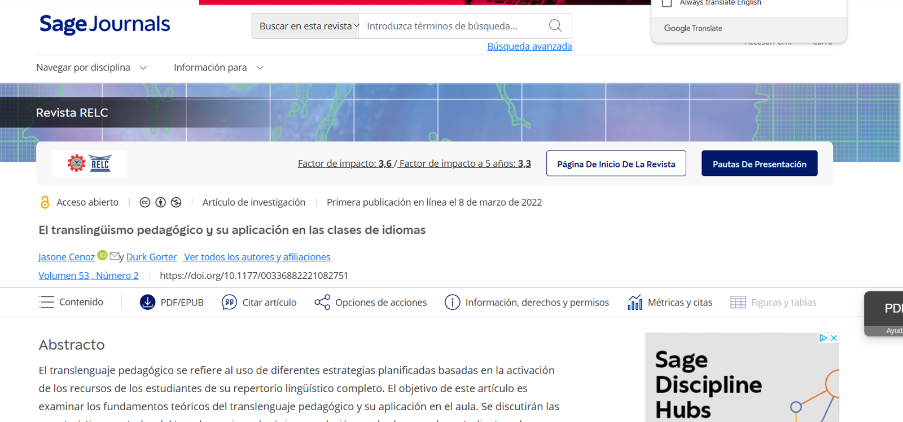
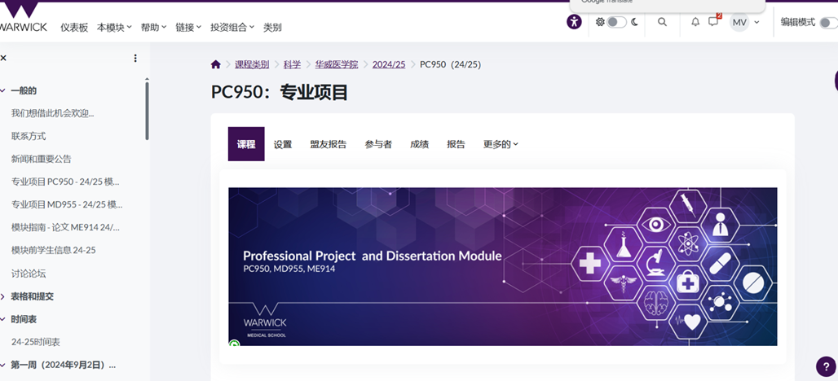
Translation tools used before and after teaching sessions
Use of AI (e.g. ChatGPT) to ‘brainstorm’ ideas or topics before a session
Automatic embedded text translation within devices Windows/Apple/ Huawei/Lenovo/Chrome
  To use online platforms
  To translate journal articles
  To read and write emails

Slide 12

What can educators do?

Slide 13
Strategies for educators
To be honest, I get lost, so then I look up and can see some of the words I didn't understand the meaning of …then I might write these in Google Translate, ChatGPT
Live captioning (subtitles) in all seminars/face to face teaching and Teams meetings
Powerpoint: switch subtitles on
Teams meetings: allow for live transcription, and translation
The written form of the live presentation helps with the auditory processing of the language and enables translation
Using the subtitles can help everyone understand what lecturers are saying
Subtitles help me to focus

Slide 14
Strategies for educators
Pace: Allow more time for processing within the class context
Communication and explanation: make key concepts very clear
Facilitate questions
Encourage students to speak and communicate in English (embracing mistakes)
Engage students e.g. search for terms online
Plan consolidation sessions where issues from the day are summarised, key questions are identified (posted to Moodle later)
Glossary of terms: if available before a module these can be translated and understood
Make material available in advance this facilitates translation
Normalisation of translating devices/technology

Slide 15
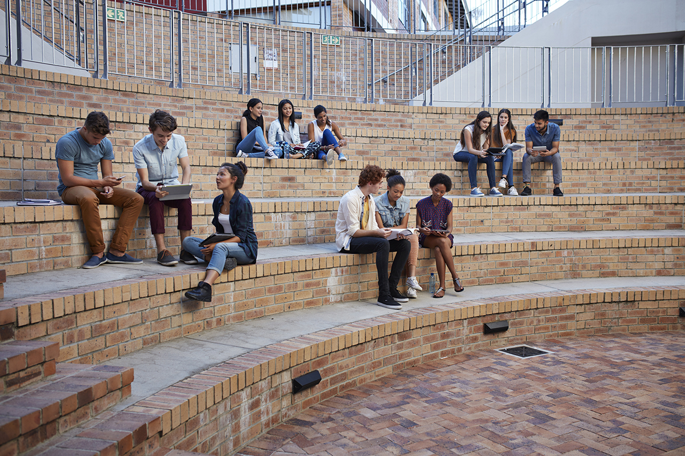

Concluding points:
How can we collectively (at WU) make ‘languaging’ in teaching and learning easier?
Ongoing exploring and innovating as we collectively think about how to create a linguistically inclusive learning environment
Purposeful utilisation and valuing of student linguistic (social & cognitive) resources
Please add your comments to the Mentimeter
(they will be anonymous)

Slide 16
Co-producing solutions
Co-producing solutions (shifting the burden of this invisible labour from students) e.g.
  providing translation apps
  facilitating lecture/seminar presentation platforms which allow for live subtitles and individual translation (Teams platforms)
  training for educators on how to draw on linguistic resources
  Please add your ideas to the
  Mentimeter
Thank you for listening
We welcome collaboration, please be in touch: Mary.van-der-Riet@Warwick.ac.uk
Notes:
We welcome collaboration, please be in touch: Mary.van-der-Riet@Warwick.ac.uk

Slide 17
Useful references
Cenoz, J., & Gorter, D. (Eds.) (2011). A Holistic Approach in Multilingual Education: Introduction. Special issue: Toward a Multilingual Approach in the Study of Multilingualism in School Contexts, The Modern Language Journal, 95, 3, 339-343, https://doi.org/10.1111/j.1540-4781.2011.01204.x
Cenoz, J., & Gorter, D. (2022). Pedagogical Translanguaging and Its Application to Language Classes. RELC Journal, 53(2), 342-354. https://doi.org/10.1177/00336882221082751
Cummins, J. (2019). The Emergence of Translanguaging Pedagogy: A Dialogue between Theory and Practice. Journal of Multilingual Education Research 9: 19- 36. https://research.library.fordham.edu/jmer/vol9/iss1/13
Rajendram, S., Shi, W., & Jun, J. (2023). Translanguaging in higher education: experiences and recommendations of international graduate students from the Global South. Critical Inquiry in Language Studies, 20(3), 258–278. https://doi.org/10.1080/15427587.2023.2242991

