Slide 1
the WARWICK SKILLS gap PROJECT: BRIDGING THE GAP BETWEEN UNIVERSITY & INDUSTRY
A WIHEA-funded project in collaboration with Student Opportunity, Department of Psychology, School of Engineering & Warwick Business School

Slide 2
Thomas Greenaway
Skills Developer – Student Opportunity
THE PROJECT TEAM
Dr Angela Lorenz
Associate Professor WBS
SPOs
Temi Adepoju
Jess Theo-Chinwo
Lewis Arnold
Malaika Khan
Ritvik Agarwal
Mehak Jain
David Molyneux
Head of Employer Engagement – Student Opportunity
Dr Jodie Lucas
Associate Professor WBS
Marion Patel
Warwick Award Manager Student Opportunity
Rachel Cuddihy
UG Prog Manager WBS
Dr Gitit Kadar-Satat
Assistant Professor Psychology
Amanda Bishop
Director of Student Experience, School of Engineering
Lead Research Assistant
Enobong David-Etesin

Slide 3
What is causing the self-reported gap between the skills graduates learn at university, and the skills they are now using in the workplace?
Project Context – Warwick Skills Gap Project (SGP)
Skills Gap Uncovered
Graduate Outcomes Survey, 2022
Key Findings
WIHEA-funded "Bridging the GAP" project involving SLS placement returners
Skills Gap Investigated
Contextualisation: Students struggle to apply university-gained skills at work
Digital Lag: Students found university-gained digital skills lagged behind industry standard
Need for Narrative: Students found a mismatch between skills prioritised at university and those prioritised at work
Further investigation through a follow-up project funded by WIHEA
Student-Led Research and Resource co-creation
6 student project officers (SPOs)
3 project streams
Collaboration across 4 departments
Scoping the problem: does the perceived skills gap exist beyond SLS? garnering student perspectives
Talking to employers: gaining industry perspectives on the skills gap
Providing solutions: harnessing student/employer insights in creating and curating skills building resources
Warwick SGP Initiated
Notes:
Whilst analysing the most recent Graduate Outcomes (GO) Data it was discovered that our students where more likely to report that they were not utilising the skills they had gain in their degree in their jobs

Slide 4
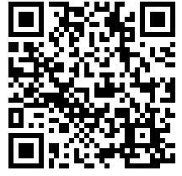
Project Overview – Warwick Skills Gap Project (SGP)
STREAM A
STREAM B
STREAM C
OVERVIEW
Expending research into Students' Perceived Skills Gaps in Psychology Engineering & WBS
Co-creating Resources based on data from SLS student’s Skills Gaps as generated from previous research
Collaborating with Employers to explore their perspectives on placements students’ skills gaps
HOW YOU CAN CONTRIBUTE
Promote our surveys and focus group adverts. Currently recruiting students in WBS, Psychology & Engineering.
Recommend skills building resources from your departments to be promoted through our Moodle site
Leverage your employer contacts for increased participation in our employer survey and interviews
Contact Stream C staff leads to share employer contacts
Angela Lorenz: Angela.Lorenz@wbs.ac.uk
Jodie Lucas: Jodie.Lucas@wbs.ac.uk
Survey QR code for students
Contact Stream B staff lead to provide recommendations
Amanda Bishop
Amanda.m.bishop@warwick.ac.uk
Notes:
DM

Slide 5
Focus Groups/Interviews
Students who have been on placements
Who: Final-year students who have returned from placement
Objective: To investigate whether the skills gap is present in Engineering, Psychology and WBS students. To understand if widening-participation background plays a role.
Sample Question: 'What were the most frequently used skills during your placement?' 'How did you expect to use the skills developed in your modules?'
Early themes emerging:
Soft skills and digital were developed at university and further strengthened on placement
Students felt like there was a big difference between the skills required at university and on placement
Students were challenged by the amount of responsibility given to them on placement
Notes:
Make the link to assessment
Skills
Amount of responsibility -
Is there space for assessed careers modules?
Assessment on skills development/placement readiness?
How much of the degree content/knowledge is relevant to the workplace?

Slide 6
Surveys
Students seeking placements
Who: Second year students who sought a placement for the 2025/26 academic year
Objective: To gain insight into current skills and expected skill levels post-placement
Identifying core skills that will be used
Self-assessment of readiness
Perceived workplace relevance
Digital skills readiness
Career impact

Slide 7
Stream C
Employers' advice
Who: Employers across a variety of industries such as Finance, FMCG and more
Objective: To gain insight into skills that employers expect from incoming students
Employer questions
Are there any skills you feel students need to improve upon?
What digital skills do you feel students can improve upon?
What are your expectations of students entering the workplace?

Slide 8
Content
Collating relevant information from various streams
Learnings
Previous research yielded from the first rendition of this project
Information yielded from stream A focus groups with students and information from Stream C and the employers
Digital Skills such as Linkedin learning, Jisc and WorkReady
Informing our solution...
Notes:
We wanted to inform our views, prior to conducting potential focus and surveys. We conducted literature views with the following types of search terms to ascertain current available data on the skills gap between employer expectations and what students currently possess when entering graduate entry-level jobs.
Some of the key learnings include:
There was some themes emerging from case-based studies at specific university sites, as well as interviews with employers.
Some of the general outcomes as a result of this literature view influenced themes we wanted to focus on when conducting our focus groups…

Slide 9
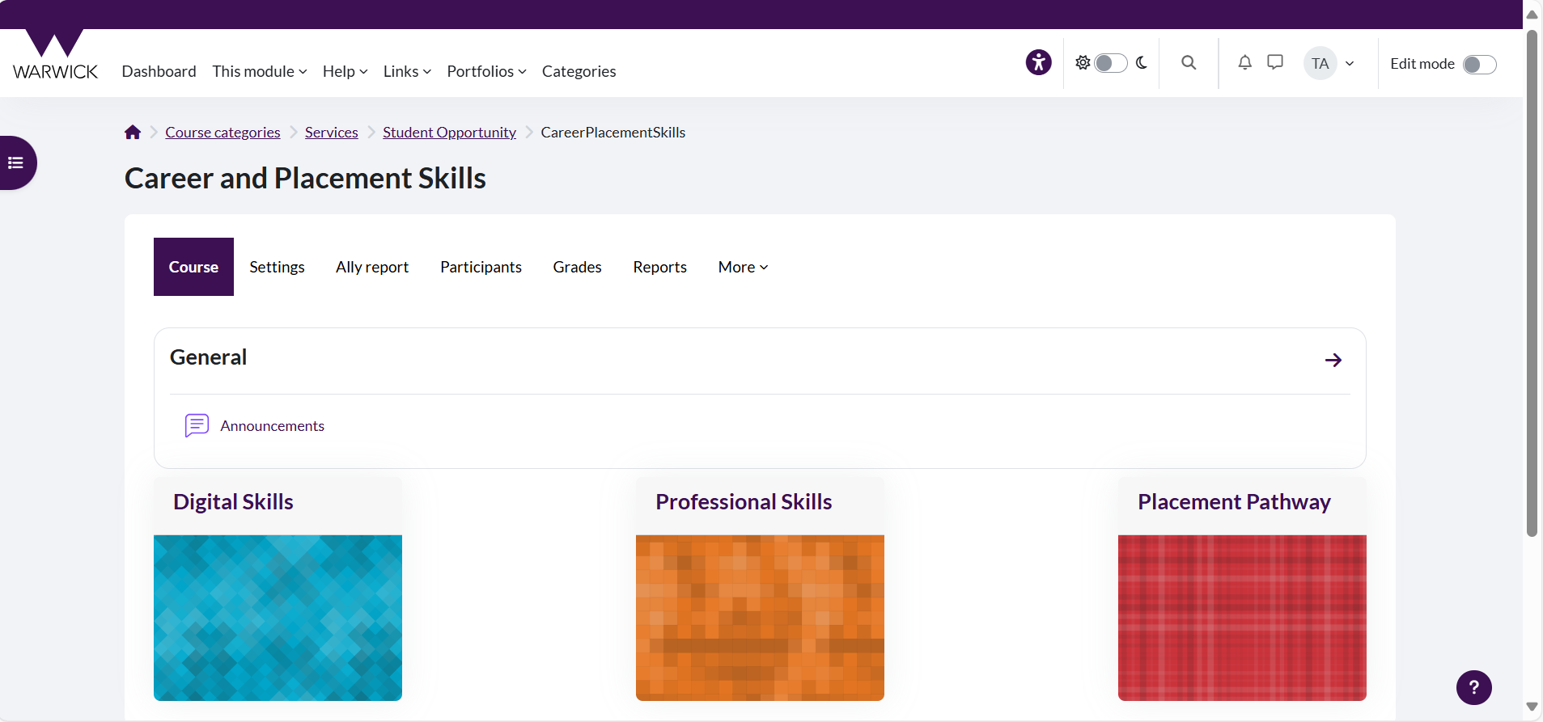
Outcomes
Connecting results from Stream A and C to create a relevant resource for students
A central Moodle page that gives advice to outgoing placement students from returning placement students.

Slide 10
Thank you for listening Any Questions?
For those interested, please keep up with the findings through email, or direct any further questioning to Marion Patel at marion.patel@warwick.ac.uk

