Slide 1

Transforming Student Approaches to Learning through Slow Pedagogies
Dr Elisabeth Blagrove (Psychology)
Dr Joanne Lee (SMLC)

Slide 2

What the Tortoise Taught Us

Slide 3


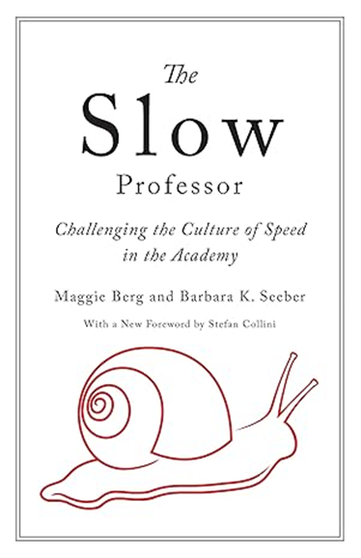




Slide 4



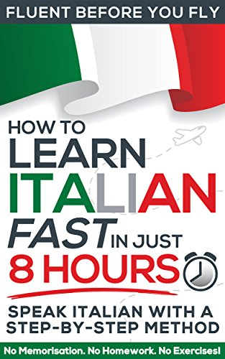

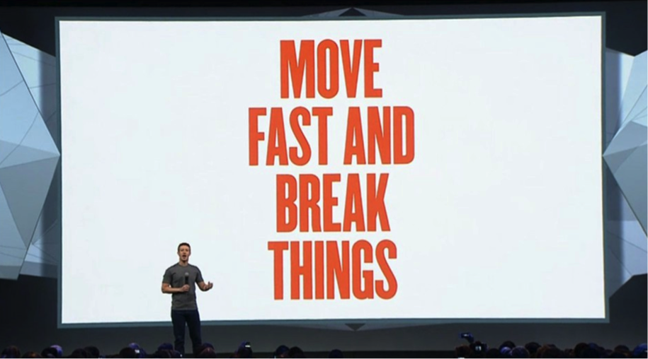
Notes:
Pressure to do things faster, do more in less time, eliminate rest and breaks, multitask

Slide 5
Values and Principles of Slow
Rejects 'cult of speed'
Quality over quantity
Mindful and ethical consumption
Community –meaningful connections
Sustainability
Preserves traditions and values cultural heritage
Promotes deep engagement
Balance 'il tempo giusto'
Pleasure

Slide 6
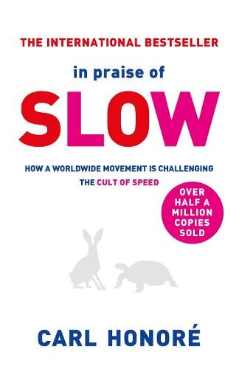
Slow is: calm, careful, receptive, still, intuitive, unhurried, patient, reflective, quality-over-quantity. It is about making real and meaningful connections - with people, culture, work, food, everything.
The Slow movement is not about doing everything at a snail’s pace […]. Slow philosophy can be summed up in a single word: balance. Be fast when it makes sense to be fast, and be slow when slowness is called for. Seek to live at what musicians call the tempo giusto – the right speed.

Slide 7

Slow Pedagogies... Not. So. Slow..?
Wellbeing Enhancement – Educational Experience – Humanistic & Contextual Alignment

Slide 8

1) Wellbeing Enhancement
Clear, empathy-based, engagement ‘ground rules’
Pacing/Spacing of Module Content
Emphasis on Choice & Agency
Community Responsibility
Focus on BALANCE...
Notes:
Wellbeing Enhancement
Develops students as moral agents
Importance of community
Community
Wellbeing
Focus, balance and wellbeing
Pleasure
Engagement

Slide 9

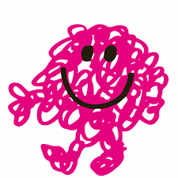
2) Educational Experience
‘Space’ for Fun (e.g., activities & assignment)
Specialist ‘extended’ topics- in standard & flipped format
Reflective Diaries
‘Confess the Mess’...
Notes:
Educational experience
Authentic joy of learning
Deep intellectual exploration, creative thinking and critical enquiry
Space for deep reflection
‘Messiness’ of deep learning
Ability to embrace and learn from failure

Slide 10

3) Humanistic & Contextual Alignment
Emphasis on experiential ‘richness’
Embrace risk & (possibility of) failure
Respect for tradition & cultural inheritance
Acknowledge contradictions/tensions
Notes:
Contextual Alignment
Quality over quantity,
Respects tradition and cultural inheritance,
Values complexity
The risk of debate and disagreement
Ability to embrace and learn from failure
Patience needed to solve problems
Time and space limitations

Slide 11



Bringing the Pedagogy Together... Our Assignment.
Notes:
Word count- 3500
2 pieces + Critical Reflection (why?
Overall reflection – what has the module meant to you? What has changed (if anything)?
Choose 2 out of the 7 tasks below to submit as a portfolio along with a critical reflection.
Creative piece e.g. poem, artwork or film (please consult with tutor)
A slow manifesto
A slow travel itinerary / experience
Scientific or social scientific research proposal
A slow marketing campaign plan
Syllabus or module design
A positive psychology intervention

Slide 12
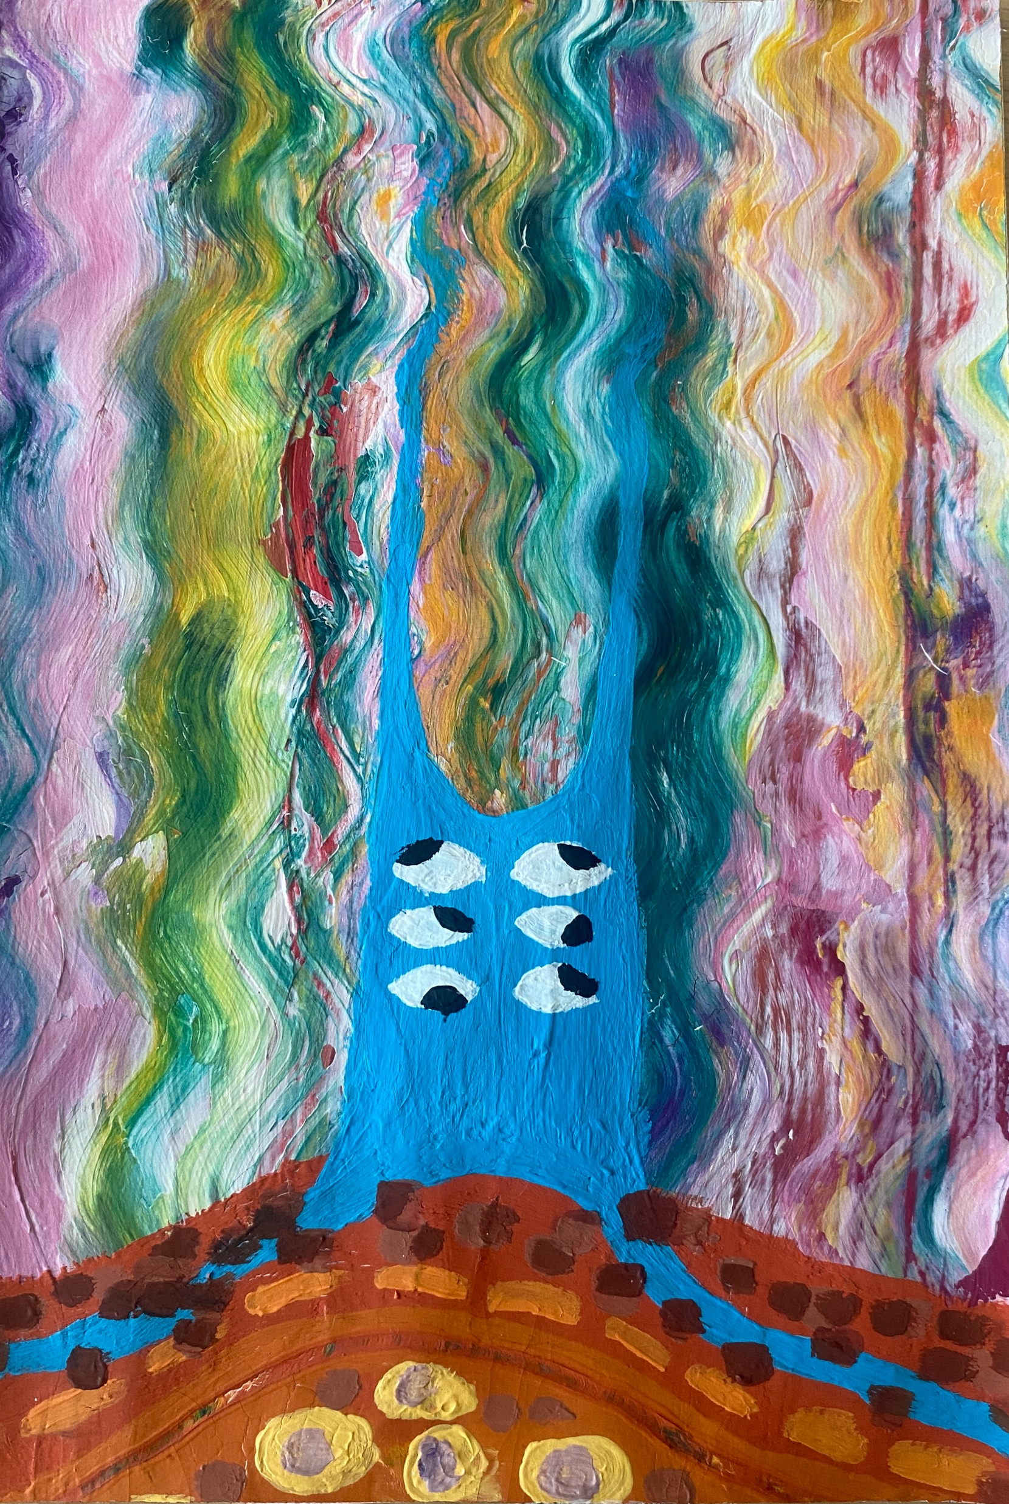
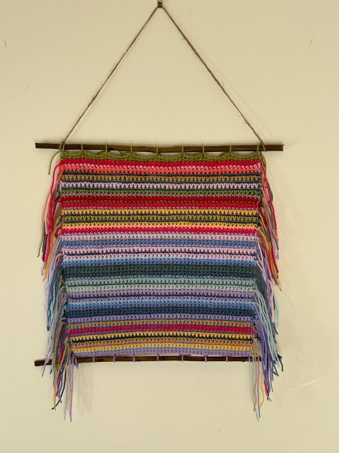
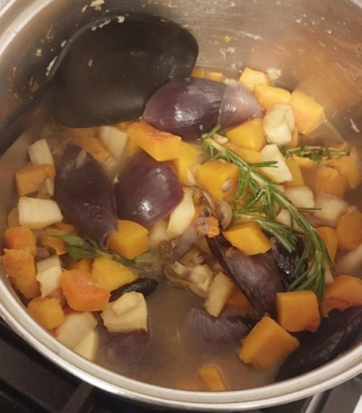

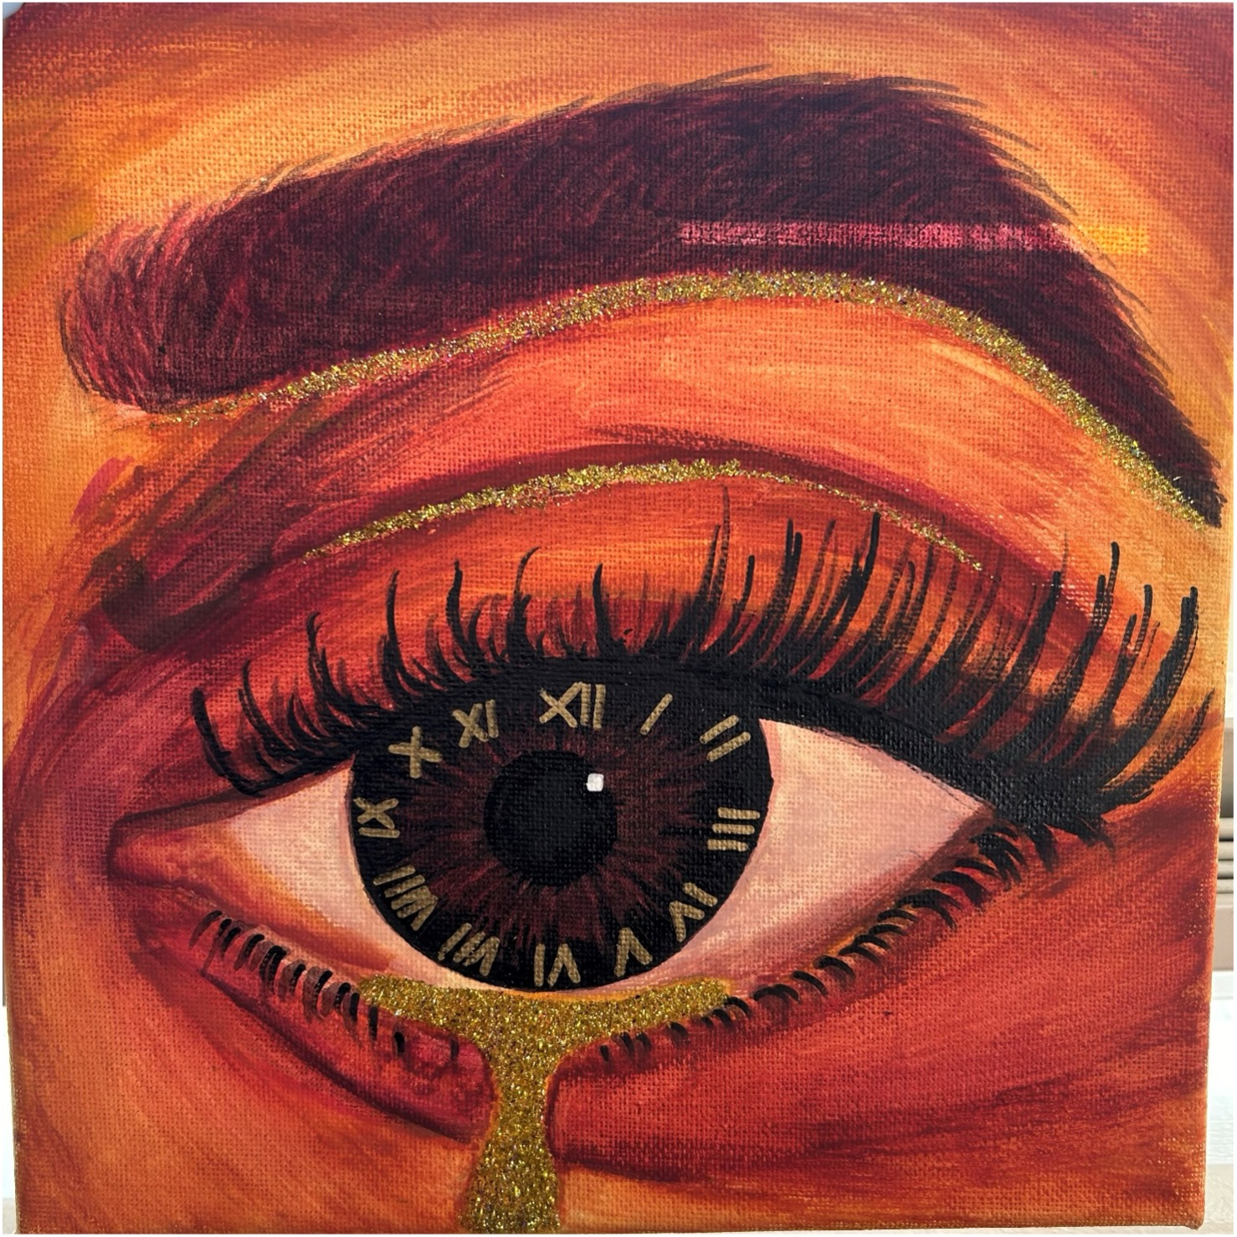
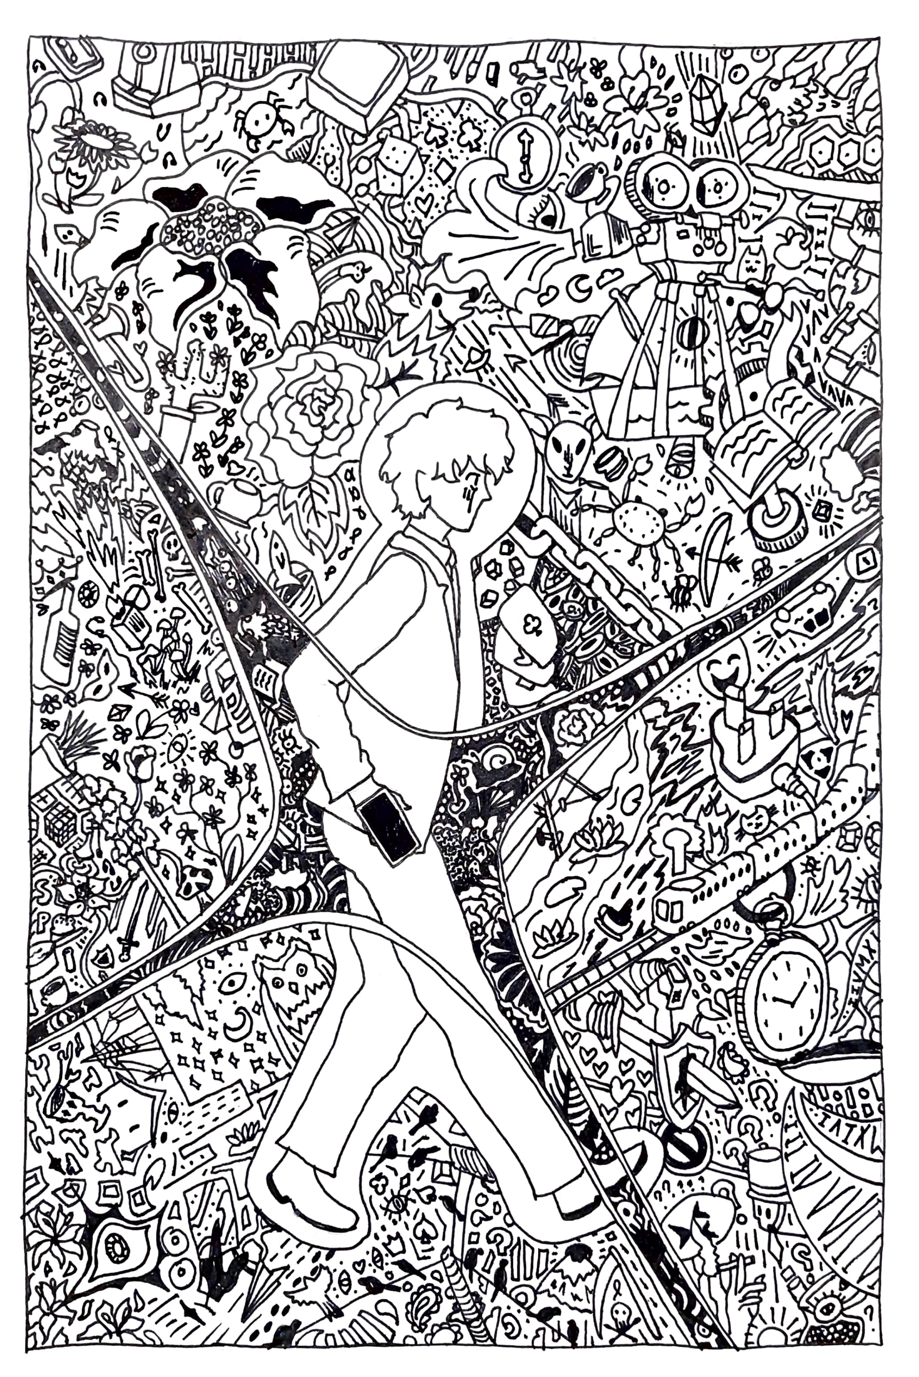
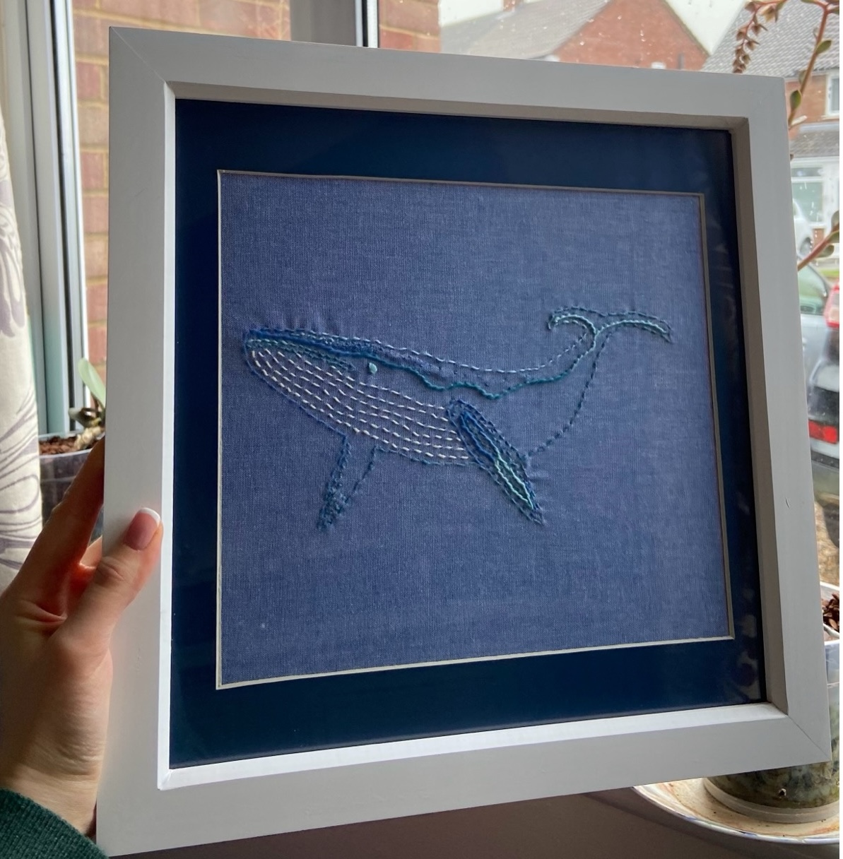
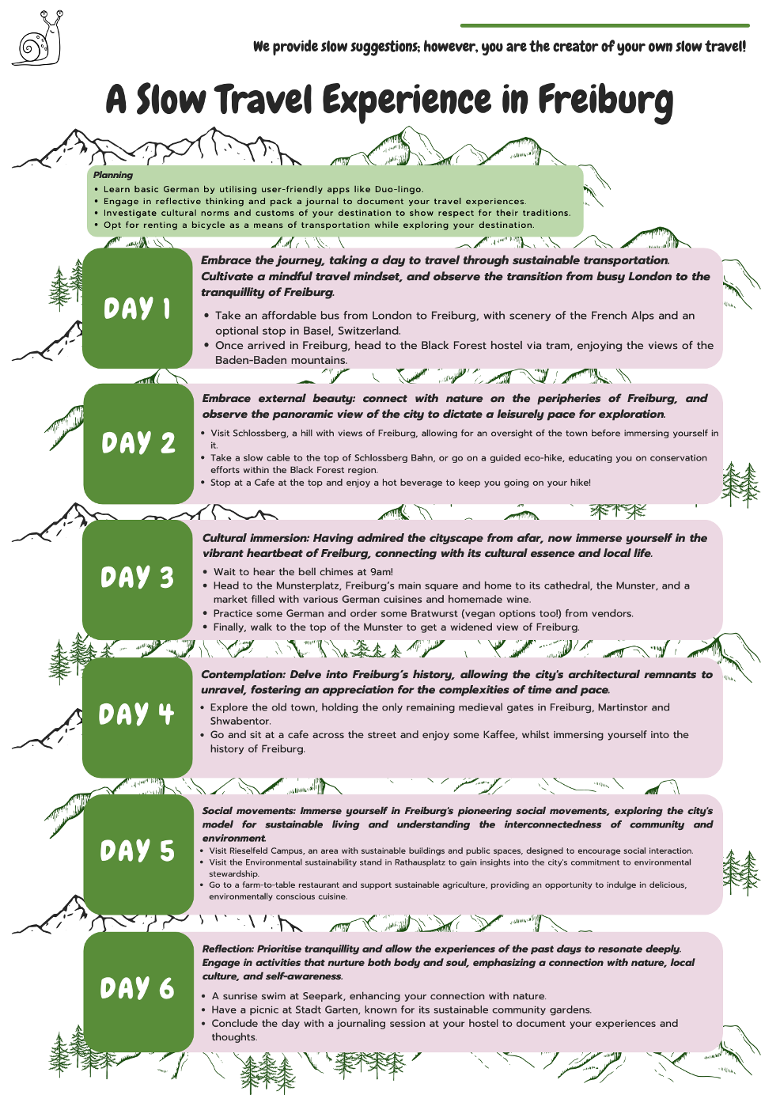


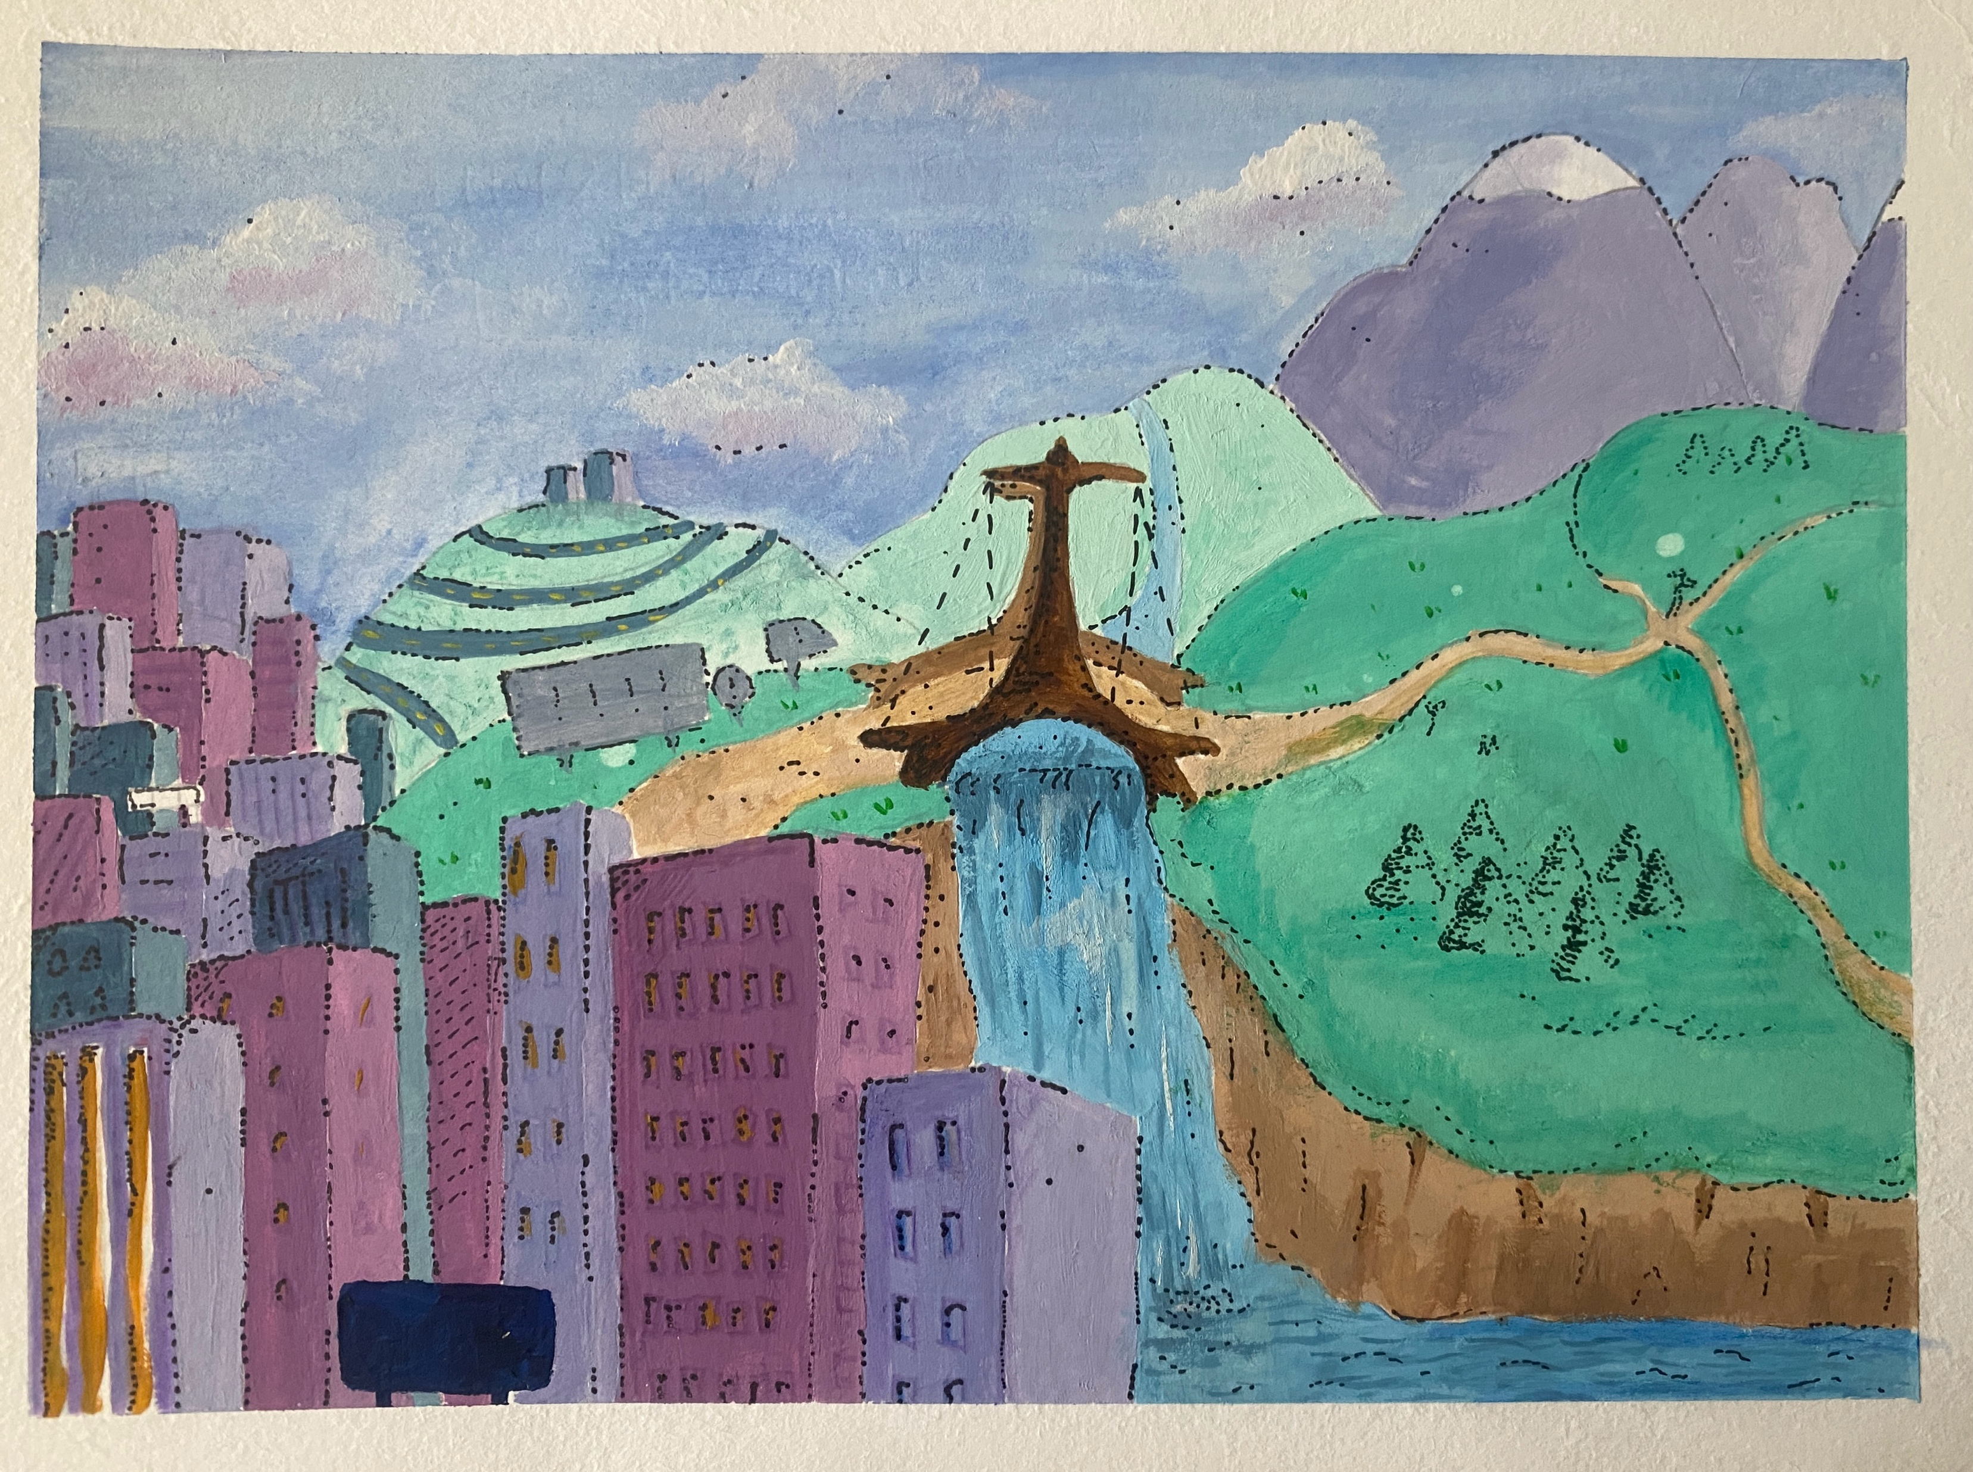


And Our Students did NOT disappoint...
EMBRACING A SLOWER START:
TIPS FOR NEW UNIVERSITY STUDENTS

Slide 13

“In comparison to before, I would now consider myself an active participant in my life, exploring new, inventive ways of living. I have learned that when you stop viewing time as an enemy, you start to view it as a gift, and you treat it like a treasure, you stop worrying about what is ahead and enjoy the process.”
“I used to eat my meals whilst working on my laptop, for example going through my emails and completing administrative tasks. I am now, however, trying to implement a ‘no work whilst eating’ approach. I find this to be a slower approach to mealtimes in terms of carving out a pause in my day and being more conscious and intentional rather than stressfully hurrying through my to-do list.”
“Overall, this module brought me more personal outcomes than any other: I know how to walk slowly now; I know that hockey is a slow moment for me that I need to take in as such, meditating is never ‘achieved’ I can always make it better; I enjoy art more than I have ever had before; I accept that during creative processes in playing music results are not always coming and that is ok; I notice details in the streets and in nature that I would not have seen otherwise; I take in information during conversations.”
“Taking the time to slow down and embroider helped to instill a sense of balance and calm into my life, which I found particularly beneficial when I was feeling stressed and overwhelmed with my course”
In their OWN WORDS ...

Slide 14
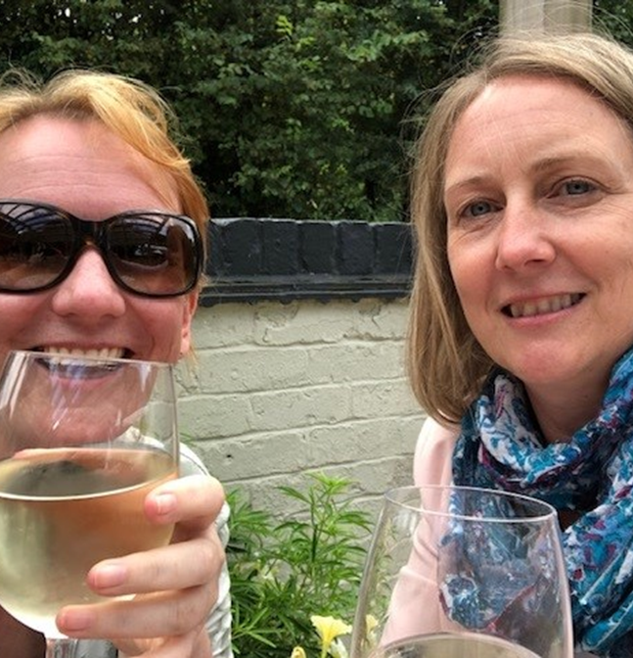
Our Slow Take-Aways :
Slow Pedagogies are not just for students- WE ALL COUNT...
Some LE constraints are inescapable. Accept them, Lean in, & Breathe.
Reinventing the wheel isn’t helpful. Recycle & Repurpose- with intention.
Share responsibility for LE Time & Space
Balance works. But it takes effort!

Slide 15
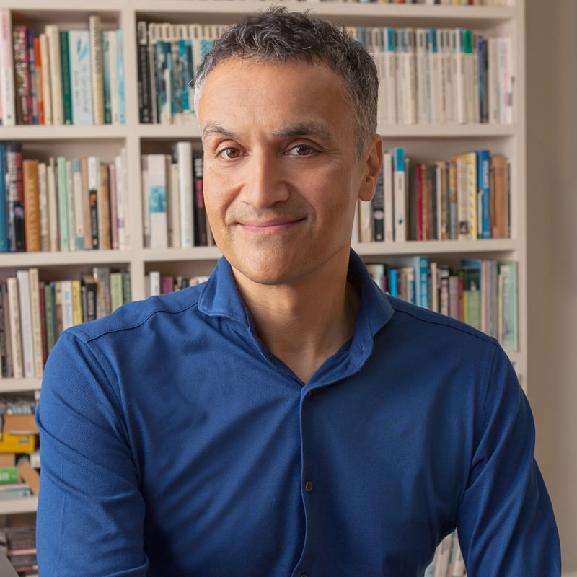
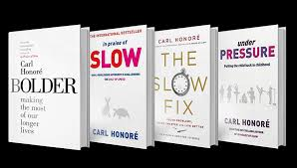
SAVE THE DATE! Thursday 23 October
Warwick Arts Centre
Carl Honoré
BOLDER: Warwick at 60

