Slide 1




Transforming Education? Examining the Impact of Generative AI on Assessments and Pedagogy within WMG
5/06/2025
Presenters:
Lee Griffin (WMG)
Susan Wakenshaw (WMG)
Jianhua Yang (WMG)
Shanshan Yang (WMG)
1
© WMG 2025
Notes:
00:00-00:05 Welcome and introductions Diana
Hello, and welcome to our panel:
“Transforming Education? Examining the Impact of Generative AI on Assessments and Pedagogy within WMG.”
I’m Diana Shore, and I’ll be guiding us through today’s session.
Transformation sits at the heart of learning—and as we all know, sometimes it nudges us gently, and sometimes it barrels in like a freight train. With generative AI, it's definitely the latter.
In this session, we explore how AI is not just reshaping what we teach, but how we teach—how students engage, how assessments are crafted, and how future graduates are prepared to work with AI rather than around it.
You’ll hear three innovative case studies from our colleagues at WMG:
– First, Dr. Jianhua Yang introduces “Gene,” a virtual AI team member that actually contributes to student group assignments—yes, it gets a mark too.
– Then Dr. Shanshan Yang will take us into the co-creation of AI-enhanced assessments in programming, where students are not just subjects, but partners in redesigning how they learn.
– And finally, Lee Griffin shows us what it means to train accountants who don’t just crunch numbers, but also critique the algorithms that try to do it for them.
Across all three cases, we’ll reflect on equity, critical engagement, and the broader implications for pedagogy.
We are joined today by Dr Tim Fawns an Associate Professor (Education Focused) at the Monash Education Academy. His role involves overseeing academic input to the development of initiatives and resources that help educators across Monash University to improve their knowledge and practice, and to be recognised for that improvement and effort. Tim is an Advance HE Principal Fellow. His research interests are at the intersection between digital, professional and higher education, with a particular focus on the relationship between technology and educational practice.

Slide 2
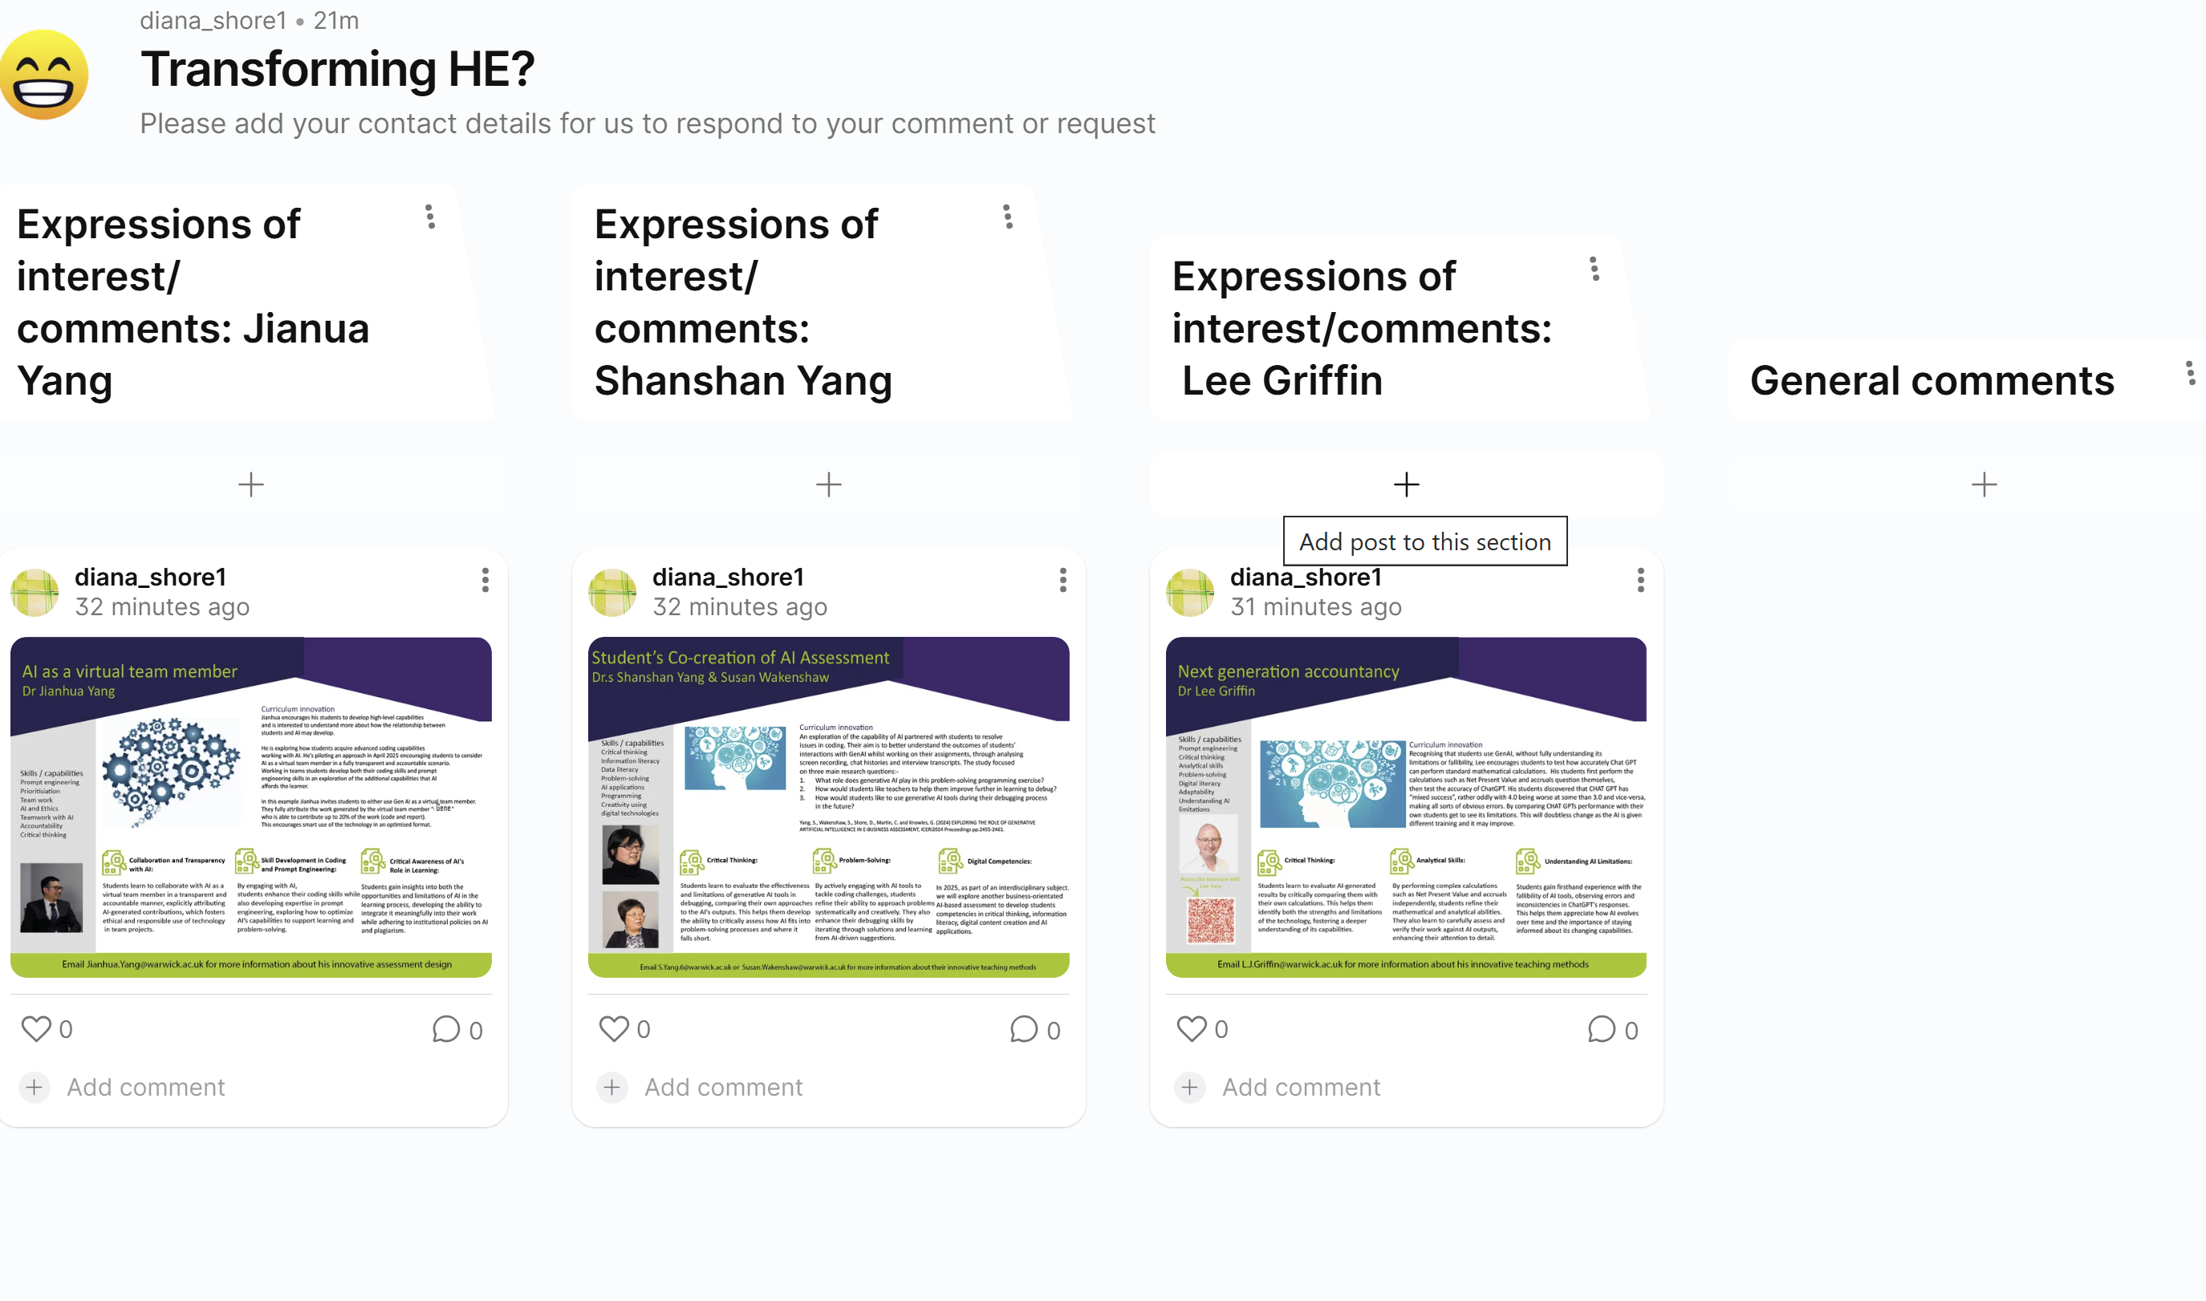
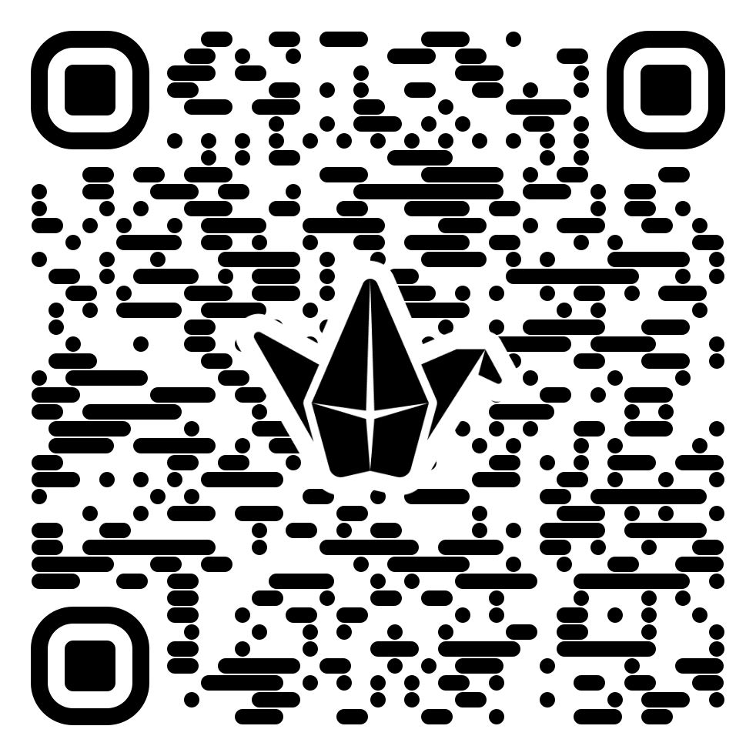
Notes:
Please use the QR code to open a padlett. We welcome expression of interest to collaborate, requests for further information about the interventions
We offer time at the end of each case time to discuss: -
inter-disciplinary opportunities for adoption or adaption;
the extent that these innovations can be considered transformational;
the ethical and equity issues that arose during the development and implementation of these innovations.
Let me pass the floor now to Jianua who examines his incorporation of Gene not student groups and reflects on how his experiences transformed his teaching and students learning

Slide 3
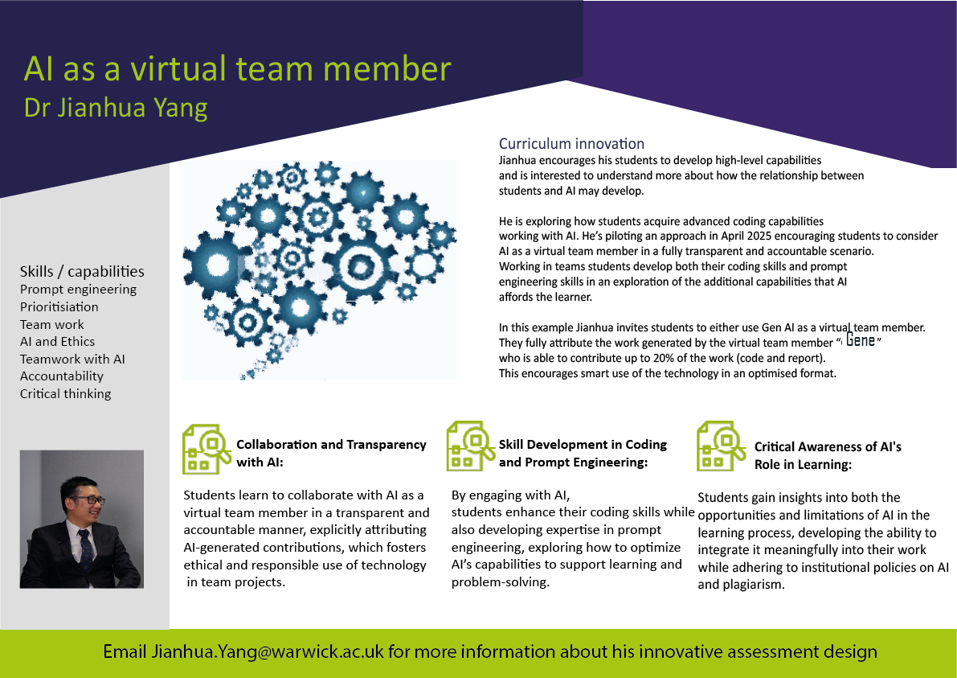
AI as a Virtual Team Member
Notes:
00:05-00:15
Case 1: AI as virtual team member
Jianhua Yang explores the evolving needs of industry and the employability of graduates who are not equipped with AI-related competencies. He examines the integration of a virtual AI entity, "Gene," as a contributing team member responsible for 20% of group assignments. The study assesses the impact of this approach on student collaboration, learning outcomes, and industry readiness. Issues of equity and fairness are addressed by ensuring that students with varying AI competencies are not disadvantaged. This discussion will be underpinned by literature on AI in collaborative learning and digital teamwork (e.g., xx , YY, zz ), providing transferable insights for other disciplines incorporating AI-assisted group work.

Slide 4
Research Hypothesis
GenAI in coding education (Cubillos et al., 2025):
  Does GenAI improve learning outcomes, learner autonomy, and creativity?
Digital divide (Gmyrek et al., 2024):
  Is the digital divide a barrier to the use of AI in education?
Collaborative Uses of GenAI Tools (Perifanou and Economides, 2025):
  How can GenAI tools be used collaboratively in group assessments?
Ethical and academic integrity (Viswanathan and Ng, 2025):
  What ethical considerations arise? How can these be addressed?

Slide 5
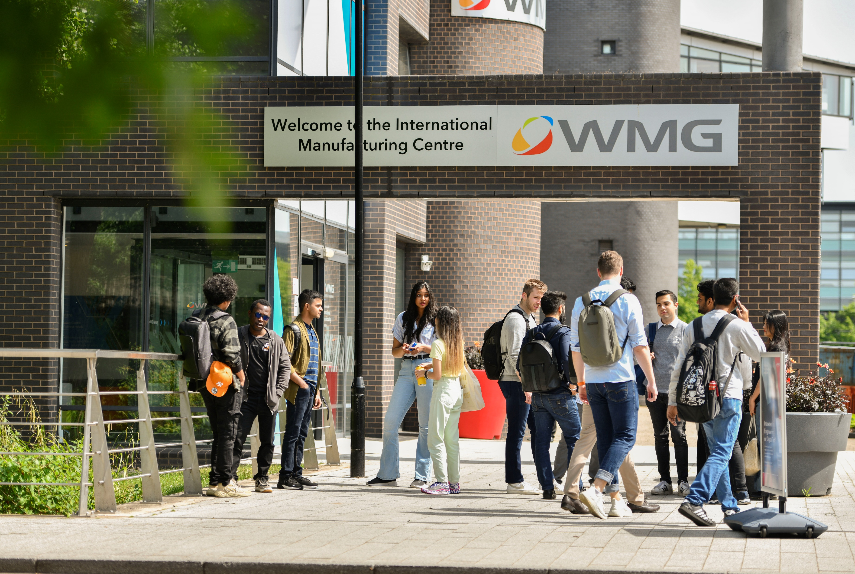
The Assessment
Option 1
  Include a virtual group member, Gene (ID 5671234).
  Communicate with Gene through a single dialogue window shared by the team, possibly via a designated point of contact.
  Save the entire conversation with Gene and include it in the report appendices.
Option 2
  Each member may use GenAI tools individually.
  Permitted uses:
    Text in, text out: Idea generation only.
    Code in, code out: Debugging.
    Code in, text out: Clarification of unclear code.
“You will work in groups of 4 students to develop a software programme
...
The software must meet the following functional and non-functional requirements
...
For GenAI, each group can choose one of the following two options: ”
5
© WMG 2025

Slide 6

Data Collection: Student Reports
Group interactions among students and with GenAI.
    Collective patterns? Test-driven development?
Reflections on the use of GenAI in the project.
    Positive/negative? Fabricate?
Ethical considerations and challenges faced.
  Privacy, data protection, and concerns.
6
© WMG 2025

Slide 7
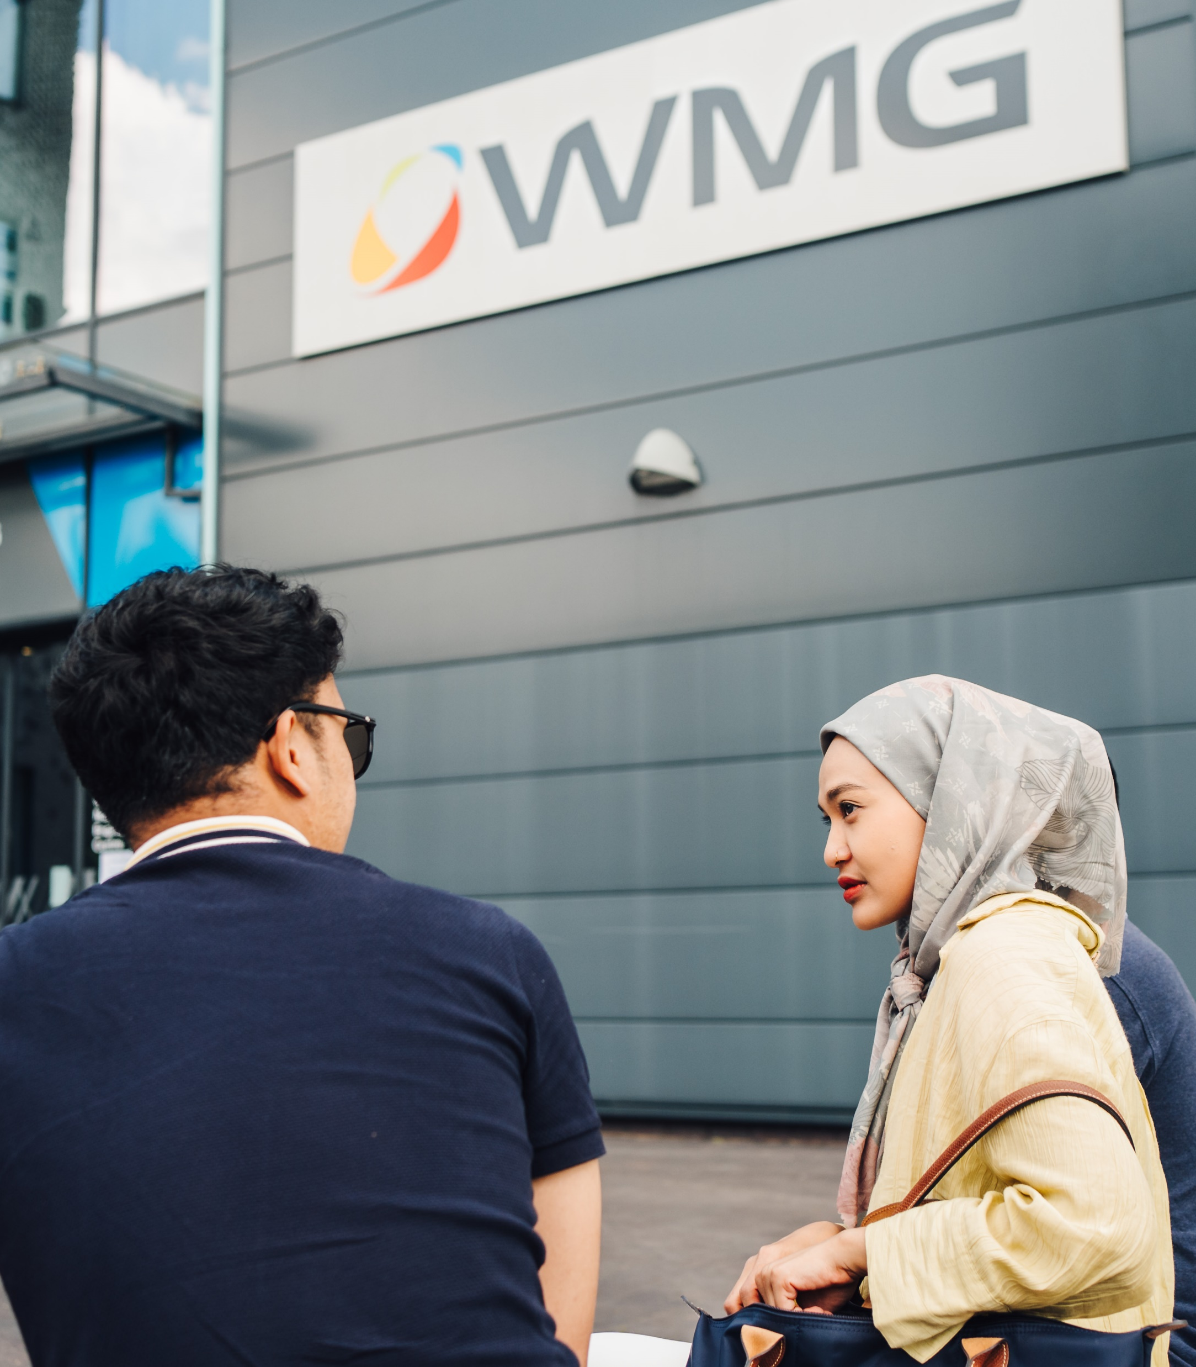
Data Collection: Student Surveys
Image to go here
Demographic Information
Usefulness of GenAI Tools
Specific Contributions and Limitations of GenAI
Using GenAI in a Team Environment
Ethical and Academic Integrity
General Reflection and Future Recommendations

Slide 8

Points to Consider
Collaboration vs. Automation
  How can we ensure that AI as a “team member” enhances rather than replaces human collaboration and learning?
Assessment Integrity
  Should AI contributions be assessed? If so, how do we maintain transparency and fairness for students with differing AI literacy levels?
Power Dynamics
  Does introducing AI into group work shift dynamics—e.g., who leads, who relies, who resents?
Gene Gets a Degree?
  If AI contributes to 20% of a project, does that merit co-authorship or just a “thank you in the acknowledgements”?
8
© WMG 2025

Slide 9

Discussion
Q&A
9
© WMG 2024
Notes:
00:15-00:20
Discussion

Slide 10
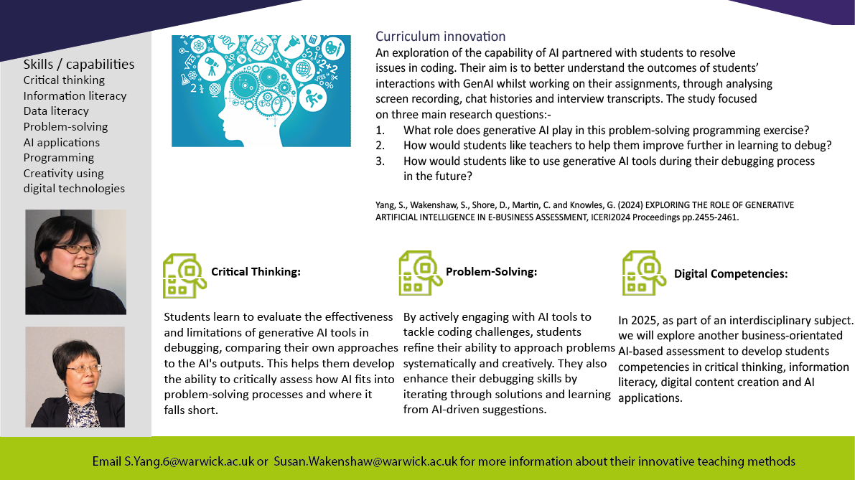
Notes:
00:20-00:30
Case 2: Co-creation of AI Assessment with Students
Susan Wakenshaw and Shanshan Yang examine the shifting role of programmers in an AI-driven landscape. Their case study investigates how generative AI tools enhance problem-solving, particularly in debugging code, and how student voices have been incorporated throughout the assessment development process to create an innovative, student-centered learning experience. The discussion will be framed using literature on student agency in assessment design and AI-assisted learning (e.g., xx , YY, zz), highlighting how co-creation principles can be applied across disciplines beyond programming.

Slide 11
Learning Objectives
Assessment Tasks
Marking
Assessment Design - Outline
What we do
Enhance and expand junior Python programmers’ debugging skills in the e-commerce industry through the use of generative AI tools for efficient problem-solving.
Use AI tools to discover and understand programming errors and their underlying causes.
Use AI tools to identify and describe potential solutions or workarounds for errors
Step 1: Set up the Python coding environment (install IDE, database, etc.)
Step 2: Access to Generative AI Tools
Step 3: Debug Python code where AI tools are allowed to use
Step 4: Record the debugging process
Criteria 1: Have they used any AI tools?
Criteria 2: Have they used AI tools to discover and understand syntax errors and their causes?
Criteria 3: Have they used AI tools to discover and understand logical errors and their causes?
Criteria 4: Have they used AI tools to identify potential solutions?
Criteria 5: Are they aware of the limitations of these AI tools?
Sources:
Yang, S., Wakenshaw, S., Shore, D., Martin, C., & Knowles, G. (2024) 'Exploring the role of generative artificial intelligence in e-business assessment', ICERI2024 Proceedings, pp. 2455-2461.
Monash University (2023) AI Design in Assessment Template - How do I design AI into my assessment.

Slide 12



Co-Creation with Students
How to work with us
1. Brainstorming
2. Co-create assessment outline
3. Content Development
4. Offer advices or tips on how to use AI
5. Pilot run

Slide 13
Findings: What role does generative AI play in this problem-solving programming exercise?
“Generative AI is useful for explaining error messages to me or explaining what elements of the code affect what part of the web app.”
Efficiency and speed
Learning experiences
Critical thinking
“Using AI greatly speeds up the process of debugging code by providing specific information about the problem immediately, which is faster than searching for solutions on Google and sifting through multiple forum posts.”
“AI gave incorrect solutions that didn’t fix the bugs and sometimes created new ones. So, I had to use my own knowledge to debug the code while using AI.”
13
© WMG 2025

Slide 14
Findings: How would students like teachers to help them improve further in learning to debug
Identifying missed bugs and understanding their causes
Choosing more appropriate solutions to fix bugs
Enhancing prompt engineering skills
“Teachers could go through it, see if I missed anything. I think making sure I understand why the bug was a bug and why the fix worked is helpful.”
“ Maybe we could learn more about how to use generative AI, like the type of prompts we should be using. Sometimes I get very broad responses, so maybe learning how to use prompts properly would help.“
“Which solution is better? Which method of debugging is more commonly used in the industry?”
14
© WMG 2025

Slide 15
Findings: How would students like to use AI tools during their debugging process in the future?
Opinion 1: No AI involvement
Opinion 2 : AI as a backup or reference tool
Opinion 3 : Combining AI with other existing methods or tools
Opinion 4 : Relying solely on AI
15
© WMG 2025

Slide 16
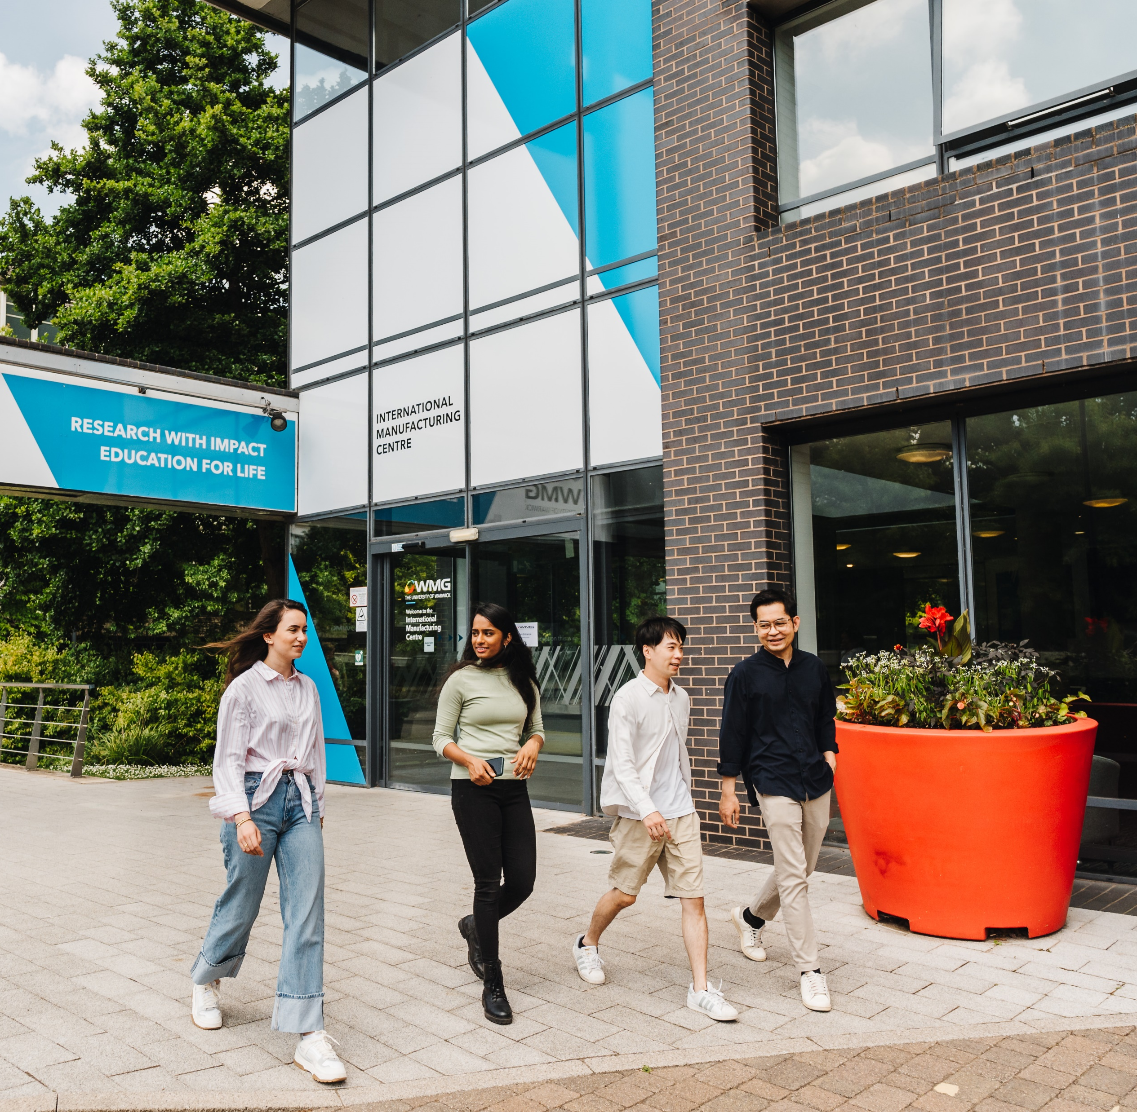
Points to Consider
The changing of submission formats
  Use alternative formats such as AI chat histories and video recordings.
The changing role of future programmers
  “AI tools will not replace programmers, but they will change the way programmers debug in the future.”
.”

Slide 17
Discussion
Q&A
17
© WMG 2024
Notes:
00:30-00:35
Discussion

Slide 18
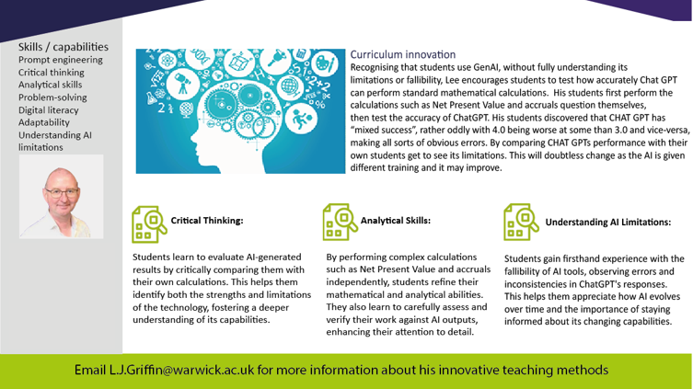
Notes:
00:35-00:45
Case 2: Next generation accountancy
Lee Griffin reflects on the evolving demands of industry and the importance of fostering critical AI literacy among future accountants. His approach challenges students to critically evaluate the capabilities and limitations of generative AI in performing fundamental accountancy tasks. By engaging with AI-generated outputs, students develop a nuanced understanding of AI’s role in professional judgment and decision-making. This session will draw on literature exploring AI in accounting education (e.g., xx , YY, zz) and will offer insights into how similar critical AI engagement can be cultivated in other disciplines requiring analytical and evaluative skills.

Slide 19
Why?
There is a danger that any institution makes an award to candidates who cannot ‘do’ the [thing] the award makes out they can
Our thinking usually heads to assessment
The question I am most asked is some variation of:
“How do I make my assessment AI proof?”
The unfortunate truth is “You probably can’t.”
19
© WMG 2025

Slide 20
Anthropic’s work
Even Collaborative conversations can have questionable learning outcomes. For example, “solve probability and statistics homework problems with explanations,” might involve multiple conversational turns between AI and student, but still offloads significant thinking to the AI.
We saw an inverted pattern of Bloom's Taxonomy domains exhibited by the AI:
Claude was primarily completing higher-order cognitive functions, with Creating (39.8%) and Analyzing (30.2%) being the most common operations from Bloom’s Taxonomy.
Lower-order cognitive tasks were less prevalent: Applying (10.9%), Understanding (10.0%), and Remembering (1.8%).
Anthropic looked at queries from .edu and .ac domains to see what the uses were…
https://www.anthropic.com/news/anthropic-education-report-how-university-students-use-claude
20
© WMG 2025

Slide 21
Yay! Accountancy
An approach to make students think, and at least make sure they can do the thing before they just use an AI.
This is likely to be how they will use AI should, giving cognition skills and technical skills
21
© WMG 2025

Slide 22
Yay! Accountancy
An approach to make students think, and at least make sure they can do the thing before they just use an AI.
This is likely to be how they will use AI should, giving cognition skills and technical skills
22
© WMG 2025

Slide 23
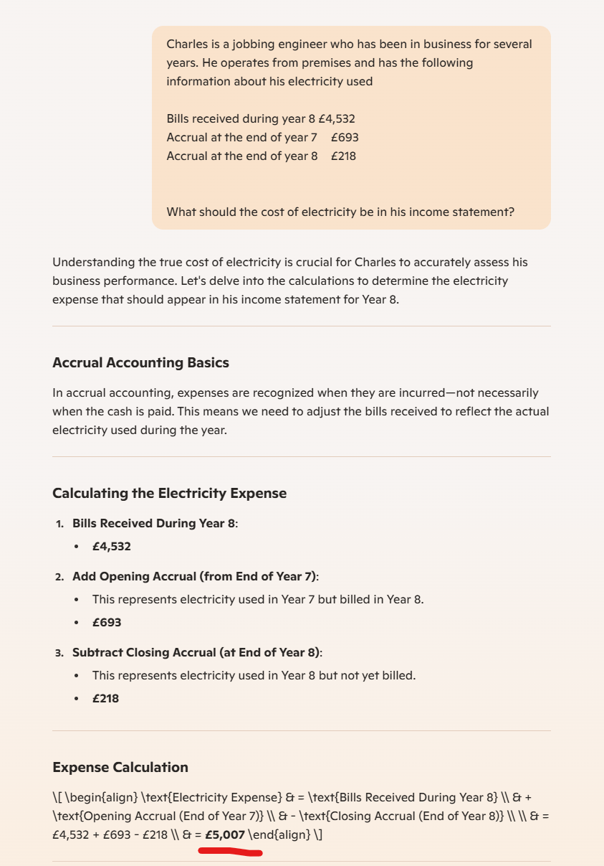
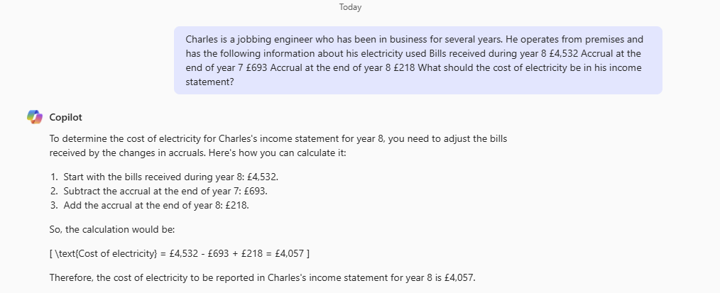
Two AIs give different answers…
Luckily you don’t need to know what any of this means.
Two answers?

Slide 24
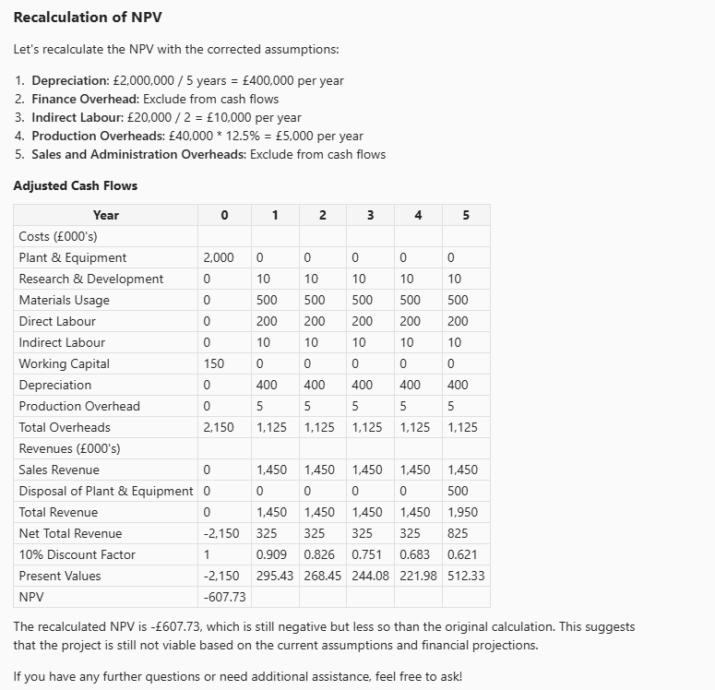
It’s the same with other items
Natural text Net Present Value questions currently cause all sorts of problems
The wrong answer. As at June 2025 I’ve not found an AI that can do it.
One would assume that will change.

Slide 25
So what?
“Bloomberg spent $500 million on ads. The U.S. population is 327 million. He could have given each American $1 million and still have money left over.”
Tweet posted 2020, repeated on MSNBC without question.
Tweet since deleted
Students can explore and discuss…
Tutor can encourage thinking about the answer the AI gives – does it make any sense at all?
How can you ask the question (prompt) in a better way.
25
© WMG 2025

Slide 26
Is AI transforming higher education? VOTE NOW
Go to vevox.app
Enter the session ID: 154-670-532
Or scan the QR code

Slide 27
Are these cases evidence that education is being transformed by GEN AI
0/0
Join at: vevox.app
ID: 154-670-532
Poll Open
Yes
0%
No
0%
Maybe
0%
Don't know
0%

Slide 28
Discussion
Q&A
28
© WMG 2025
Notes:
00:45-00:55
Discussion

Slide 29
References
Cubillos, C., Mellado, R., Cabrera-Paniagua, D. and Urra, E., 2025. Generative artificial intelligence in computer programming: Does it enhance learning, motivation, and the learning environment? IEEE Access, 13, pp.40438–40455. https://doi.org/10.1109/ACCESS.2025.3532883.
Gmyrek, P., Winkler, H. and Garganta, S., 2024. Buffer or bottleneck? Employment exposure to generative AI and the digital divide in Latin America. No. 121. ILO Working Paper.
Monash University, 2023. AI design in assessment template – How do I design AI into my assessment. Available at: https://docs.google.com/presentation/d/1Q8er9S3Tv6vV4PIs3mqXJorFkWMhLDXcgGrVPJORW4U/copy [Accessed 4 June 2025].
Perifanou, M. and Economides, A.A., 2025. Collaborative uses of GenAI tools in project-based learning. Education Sciences, 15(3), p.354.
Viswanathan, G. and Ng, B.Y., 2025. Rethinking online assessments for adult learners: Exploring synchronous group presentations. Journal of Applied Learning and Teaching, 8(Special Issue 2), pp.20–33.
Yang, S., Wakenshaw, S., Shore, D., Martin, C. and Knowles, G., 2024. Exploring the role of generative artificial intelligence in e-business assessment. ICERI2024 Proceedings, pp.2455–2461. Available at: https://doi.org/10.21125/iceri.2024.0662.
29
© WMG 2024

Slide 30




Thank you.
WMG
University of Warwick
Coventry
CV4 7AL
United Kingdom
L.J.Griffin@Warwick.ac.uk
Jianua.Yang@Warwick.ac.uk
S.Yang.6@Warwick.ac.uk
Susan.Wakenshaw@Warwick.ac.uk
@wmgwarwick
wmgwarwick
wmg-university-of-warwick
Notes:
Conclusion and Transferability
Thank you panel for your presentations and to our audience who has stimulated and helped to gain new insights. If you have more questions or would like to contact the case owners their email is on the slides.
00:55-1:00
Wrap up
Diana Shore

