Slide 1
Warwick and global citizenship
‘Adopt a class’ project

Slide 2
The Year Abroad: a year of discovery, but not just for students…
The story behind this project:
“in the light of the current decline in languages, could we transmit some of the cultural, linguistic and personal discoveries felt on the year abroad beyond the gates of the university?”
Notes:
INTRO CH / ADA – 1 MIN

Slide 3
The participants…
15 students:
Visited local Coventry schools languages depts (end of 2nd year)
Went on Year Abroad (France and Canada)
Shared online area: reflected on teaching and learning experiences; copied and collected resources
On return made resources into learning activities
Notes:
CH/ADA 2 – 3 MINS

Slide 4
Values of project-based learning (Helle et al, 2006)
‘problem or question serves to drive learning activities’
‘constructing a concrete artefact’
‘learner control of the learning process’
‘contextualization of learning’
‘multiple forms of representation’
‘motivation’
Interdisciplinary
Real world issues
Independence
Team work
‘rethink[ing] and redefin[ing] tasks’
Vertical (subject) and horizontal (‘generic skills’) learning
Intercultural negotiation
Notes:
4th point: emphasis on context for reasons of authenticity
Product important for students (and schools); process important to me as teacher
Intercultural dialogue and self reflection…

Slide 5
What kind of resources?
Food and food packaging
Receipts
Menus from school canteens
Museum plans and guides
Maps / town plans and other tourist documents
Transport tickets
Magazine adverts
Posters on billboards
Children’s books that deal with curriculum topics
Interviews with pupils
Photos
Notes:
CH 1 MIN

Slide 6
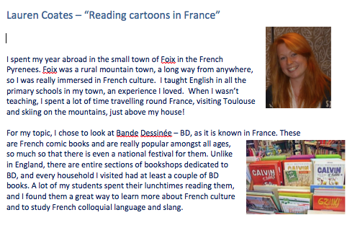
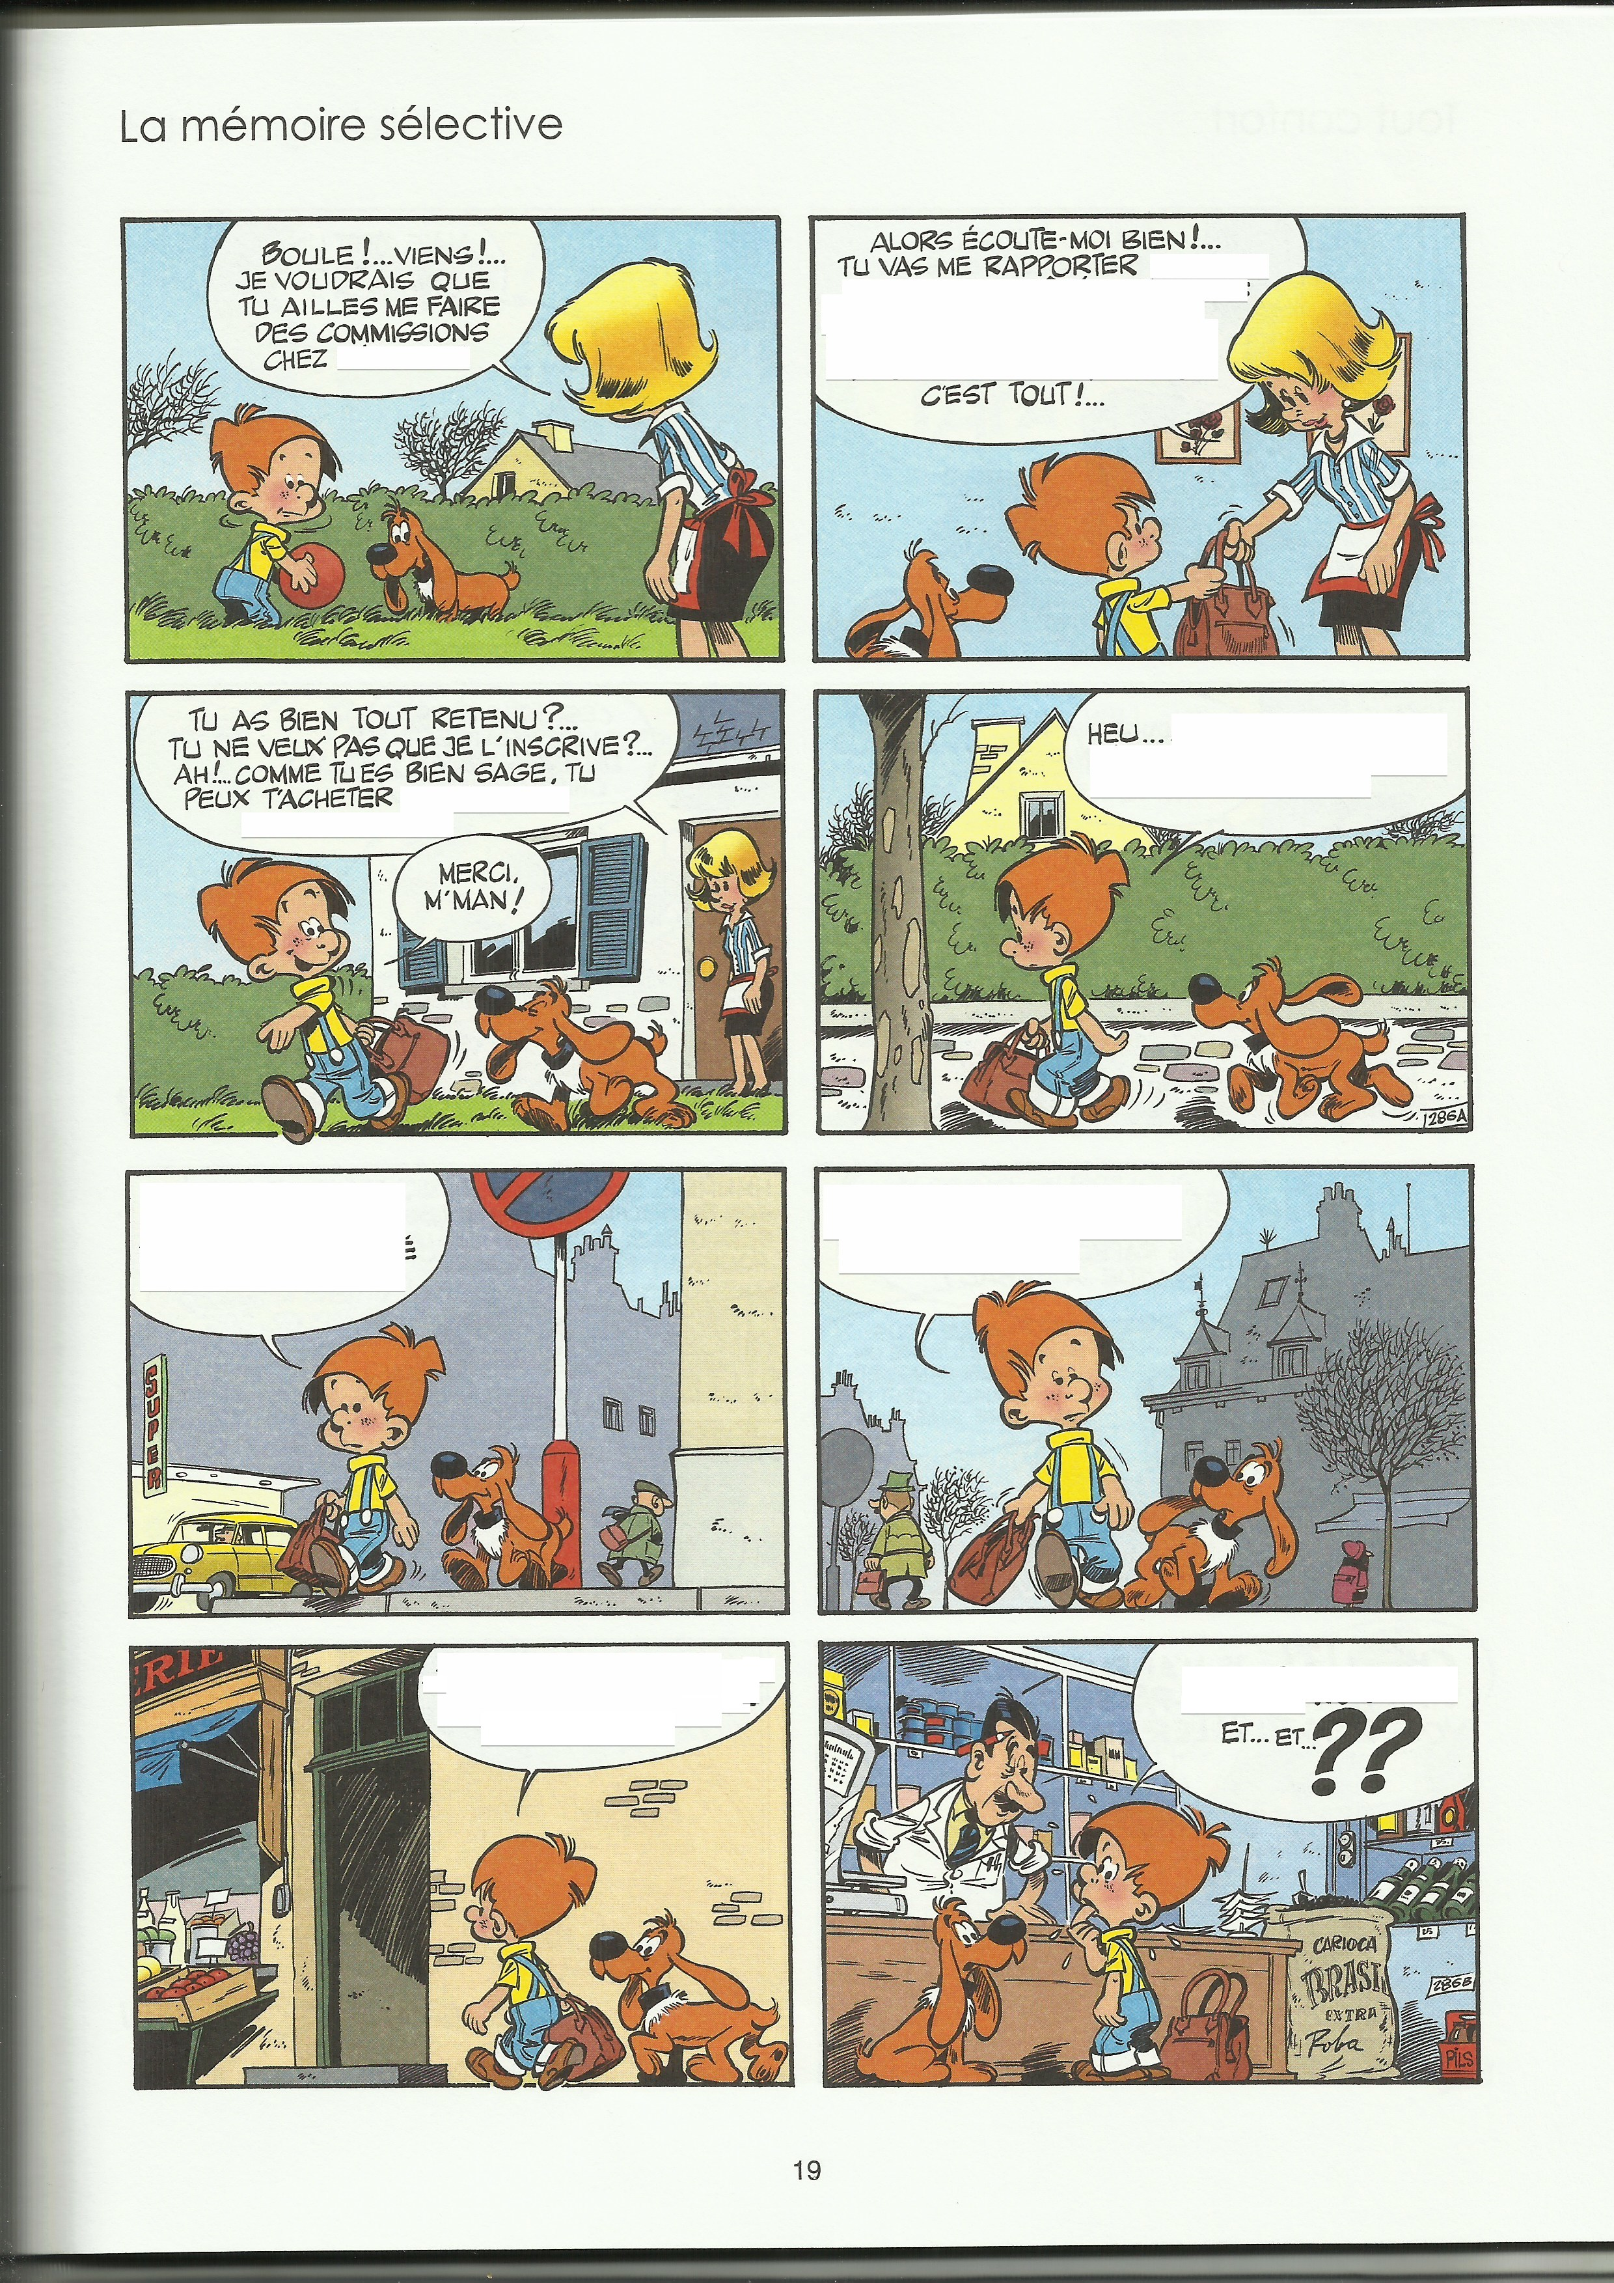
Culture and language: La Bande dessinée
Notes:
CH/ADA 1 MIN
MENTION ‘FACT FILE PROFILES’ : INFO IN EACH PACK ON STUDENT PARTICIPANT, SO THAT WE CAN MAKE CONNECTIONS WITH PUPILS WHO MAY KNOW NOTHING ABOUT THE YA

Slide 7
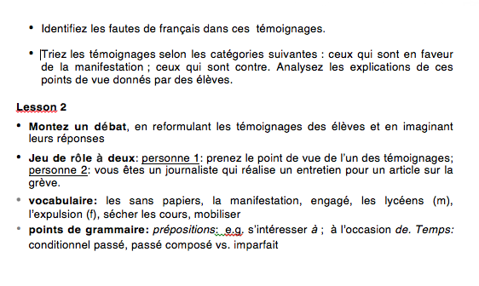
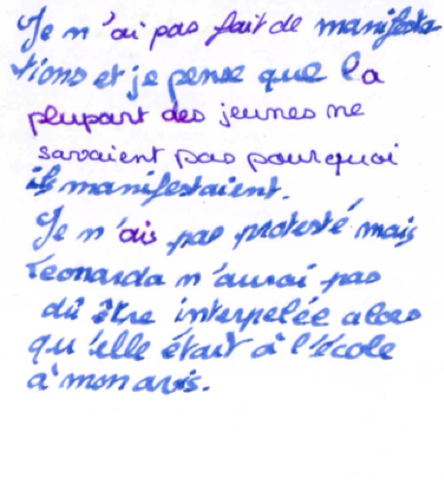
Molly-May: protest
Notes:
MOLLY MAY: 3 - 4 MINS:
WHERE YOU WERE ON YA
WHAT GAVE YOU THE IDEA
WHAT YOU DID WITH RESOURCE (FOR WHICH YEAR? WHY USEFUL AT THAT LEVEL?)
WHAT YOU GOT OUT OF DOING IT (SKILLS; COMMUNICATION WITH PUPILS; INTERCULTURAL UNDERSTANDING…)

Slide 8
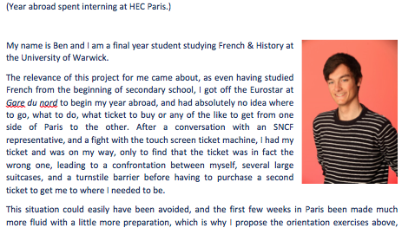
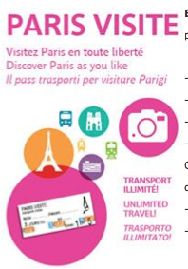

Ben: transport and travel
Notes:
BEN 3 - 4 MINS
WHAT YOU DID ON YA
WHAT GAVE YOU THE IDEA
WHAT YOU DID WITH RESOURCE (FOR WHICH YEAR? WHY USEFUL AT THAT LEVEL?)
WHAT YOU GOT OUT OF DOING IT (SKILLS; COMMUNICATION WITH PUPILS; INTERCULTURAL UNDERSTANDING…?)

Slide 9
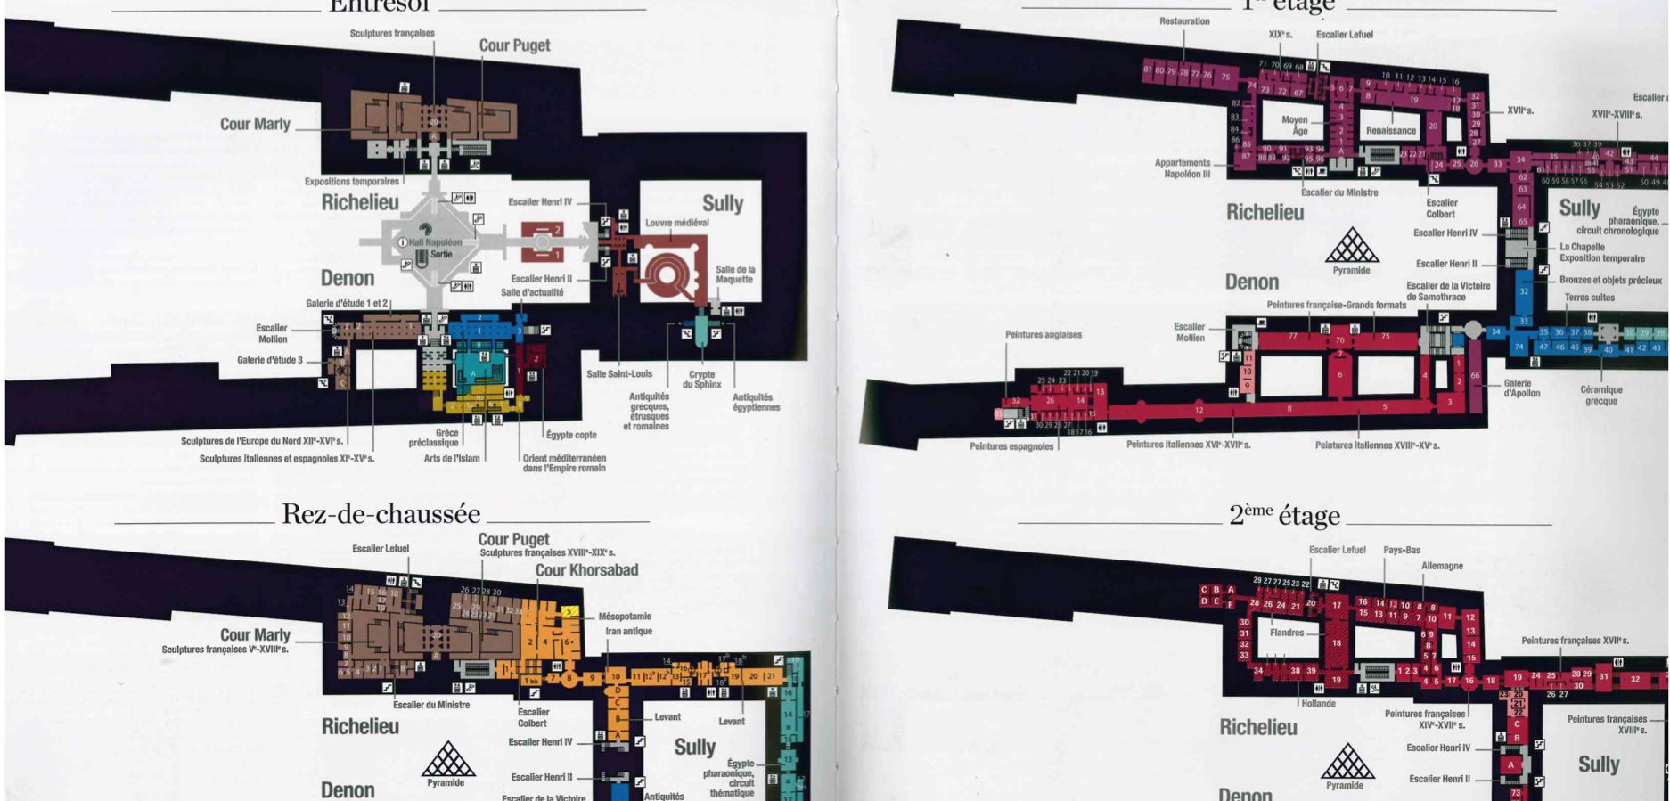
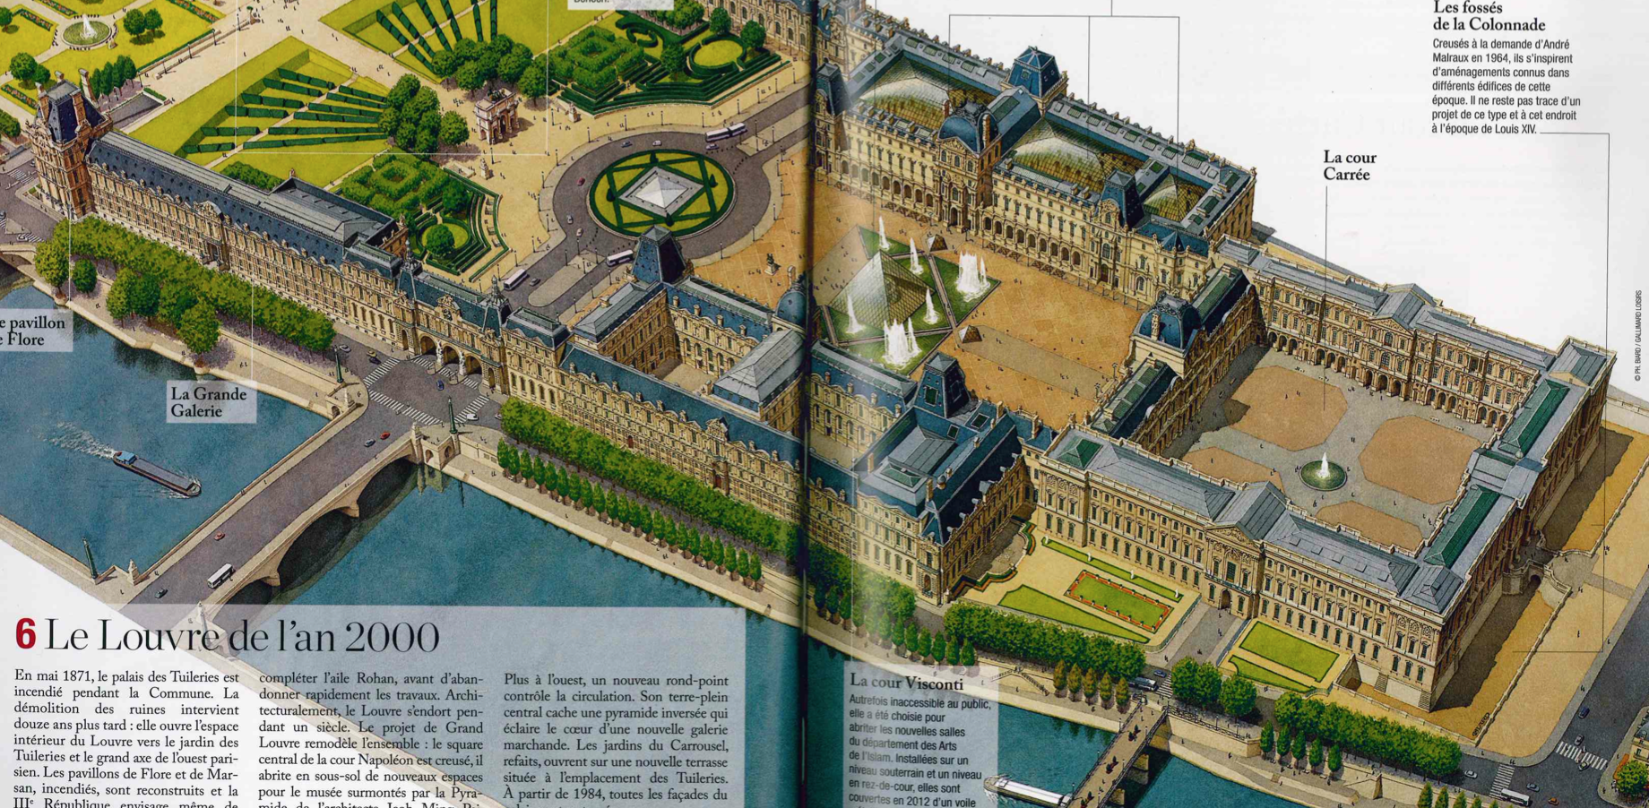
Jack: Paris’s history
Notes:
JACK
WHAT YOU DID ON YA
WHAT GAVE YOU THE IDEA
WHAT YOU DID WITH RESOURCE (FOR WHICH YEAR? WHY USEFUL AT THAT LEVEL?)
WHAT YOU GOT OUT OF DOING IT (SKILLS; COMMUNICATION WITH PUPILS; INTERCULTURAL UNDERSTANDING…?)

Slide 10
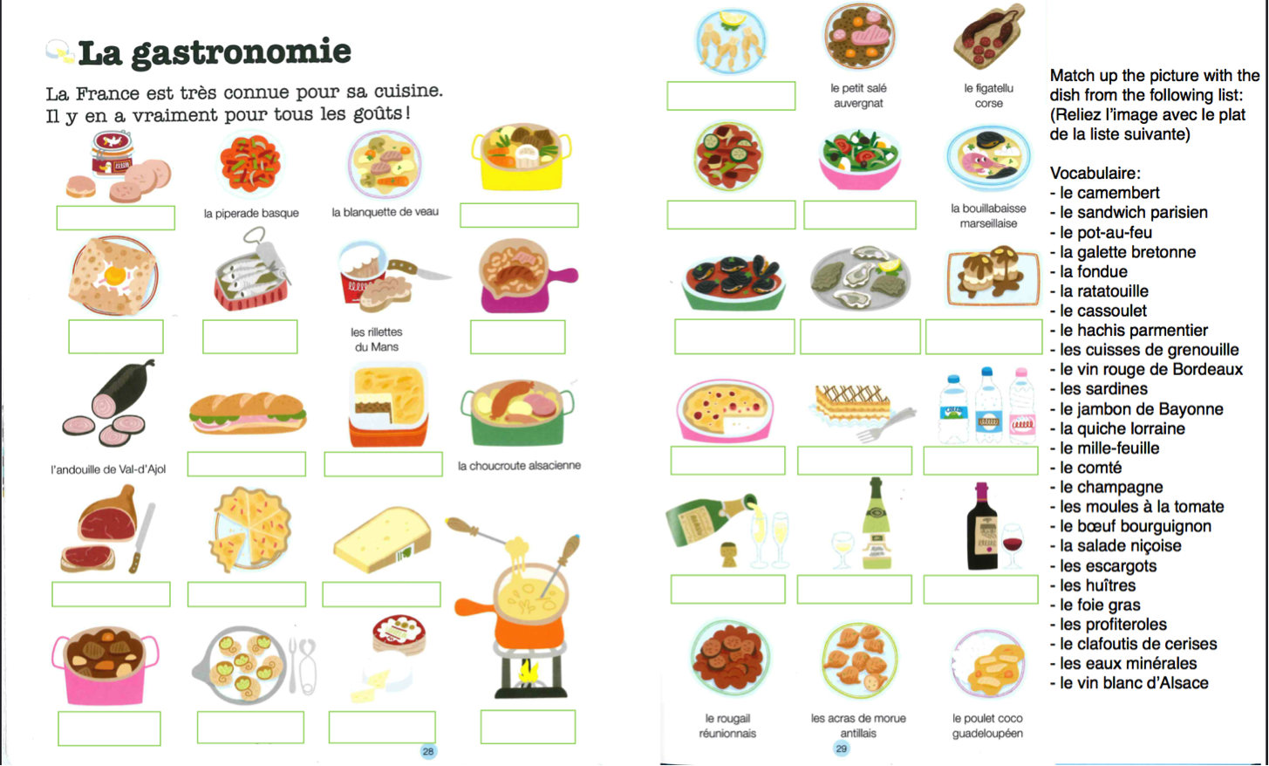
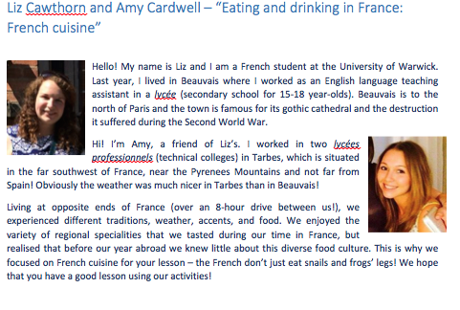
Liz and Amy: children’s literature and food
Notes:
CH 30/ADA SECS
NB: FUNDING AVAILABLE FOR BUYING MATERIALS: £30

Slide 11
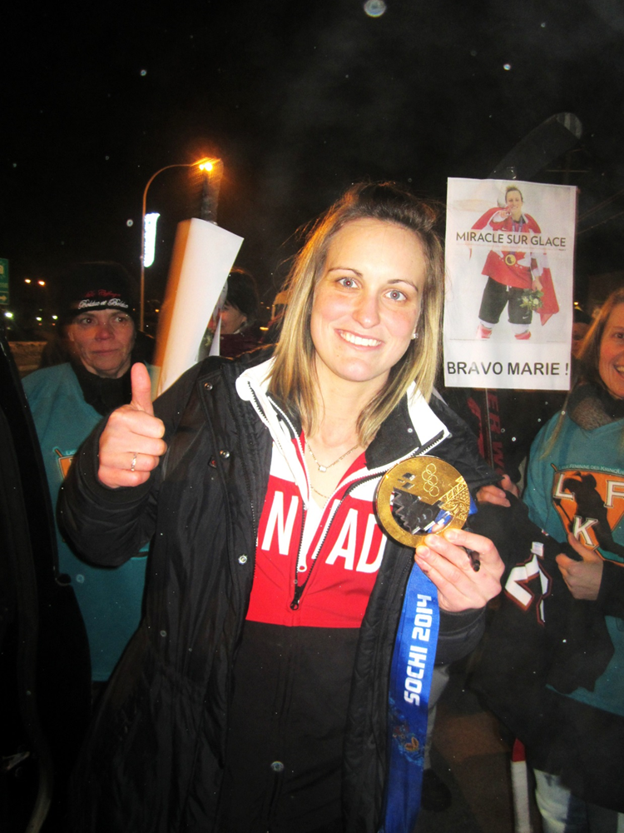
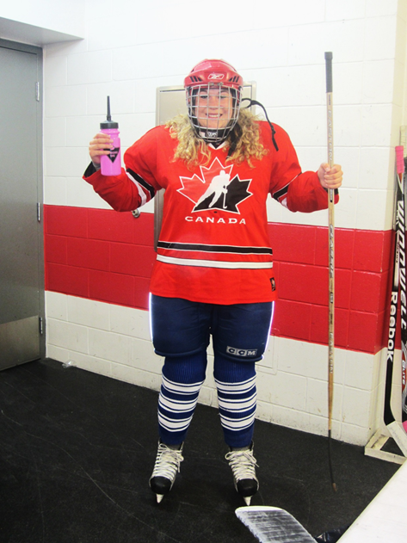
Le Hockey sur glace
J’ai appris à jouer au hockey sur glace (c’est très difficile!)
Marie-Philippe Poulin a gagné la médaille d’or aux Jeux Olympiques à Sotchi. Elle a marquée beaucoup de buts! Et je l’ai rencontrée quand elle est rentrée chez elle au Québec.

Slide 12
Over to you
Try out one or two of the activities designed by the students in your packs, or try the powerpoint available here:
http://www2.warwick.ac.uk/fac/arts/modernlanguages/currentstudents/undergraduate/french/yearabroad/schoolsprojectsamples .
What is their immediate impact?
Cognitive?
Intercultural?
Aesthetic?
Notes:
What are you covering: CLIL etc… cross fertilization of subjects…

Slide 13
Over to you…
Imagine you must choose a cultural artifact to communicate your culture:
How would you choose to present it to someone from another culture?
What strategies will you employ?
What cognitive processes are you going through?
What affective processes are you going through?
Notes:
Story telling … narrative…

Slide 14
‘Fragmented memory in a Global Age’
“What is culture […] for learners […] who must learn the implications of their own foreignness. […] Rethink[…] the relation of ‘language’ with ‘culture,’ and redefin[e] ‘culture’ as the stories we tell in order to establish, however provisionally, who we are.’” Freadman (2014)

Slide 15
What the students got out of it

Slide 16
the 41st International Festival of Bande Dessinée is taking place in Angoulême next weekend.
one idea I was thinking about for this project was the French hardback comic books which seem to be quite popular in France. BD or bande dessinée, are the latest craze in my town amongst younger teenagers.
I'll try and find some Quebecois equivalents too.
Turns out loads of people our age read them too, and I've even spotted a few on the metro
The children of the family I live with (year 7 and 8 equivalent) have lots of these books and when I asked them about this project and their ideas, BD was the resource that they thought would work best with people their age in England.
Notes:
Conversation around authenticity of BD, which spread amongst several members of the group. Interestingly, the discussion began to cross age groups – from children to adult readers; to cross regions and even to cross countries.
Emma: this pops up in textbooks but pupils have no idea why BD should be referred to…

Slide 17
“Understand that ins some regions there are different languages, different words, different cultural practices: things I hadn’t really thought about. You can have so many differences within one country and within one […] culture, it kind of made you aware of just how many cultural differences there could be within a continent. […] It makes you appreciate the sheer scale of it.” Jack, project leader

Slide 18
Thinking about interculture and education also led to:
Attendance at educational technologies conference in Paris
Participating in review team considering the international student experience within France for the ministry of education
History : French dissertation on the global student…

Slide 19
Deepening the YA skills set as part of MFL aims…
Metacognition
Interculture and values: self and other
Students as ‘cultural subjects who are both open to and resistant to experiences that challenge their current assumptions.’ (Freadman, 2014)
‘Translingual and transcultural competence’ (MLA, ‘Foreign Languages in Higher Education’, 2007)
Notes:
‘The idea of translingual and transcultural competence, in contrast, places value on the ability to operate between languages. Students are educated to function as informed and capable interlocutors with educated native speakers in the target language. They are also trained to reflect on the
world and themselves through the lens of another language and culture. They learn to comprehend speakers of the target language as members of foreign societies and to grasp themselves as Americans—that is, as members of a society that is foreign to others. They also learn to relate to fellow members of their own society who speak languages other than English.’ (MLA (2007), p. 237)

Slide 20
MLA, ‘Foreign Languages in Higher Education’, 2007
‘They are also trained to reflect on the world and themselves through the lens of another language and culture.’
‘They learn to comprehend speakers of the target language as members of foreign societies and to grasp themselves […] as members of a society that is foreign to others.’

Slide 21
Careers and skills benefits
organizational, communication, intercultural and linguistic skills
Creativity; autonomy
project management skills.
Notes:
CH/ADA 1 MIN

Slide 22
Culture in the Classroom
Hearing new voices
Not artificial
Not mainstream
‘Relevant’

Slide 23
Culture in the classroom…
FL not just linguistic: a Humanities subject!
Cultural study about the self as well as the other:
‘the goal of foreign language instruction is to get students to understand other worldviews, and to see themselves through the eyes of others.’ (Byram and Kramsch)
Limitations to teaching a culture you haven’t ‘lived’
Linguistic structures emerge from this kind of reflection on culture
Notes:
Desire to show that FL study is part of the humanities and produces critical thinking. Story and cultural memory highly important to the students’ developing sense of where they are when they are abroad..
Historical, geographical, and cultural understanding is at least as important to our students as obvious linguistic differences…

Slide 24
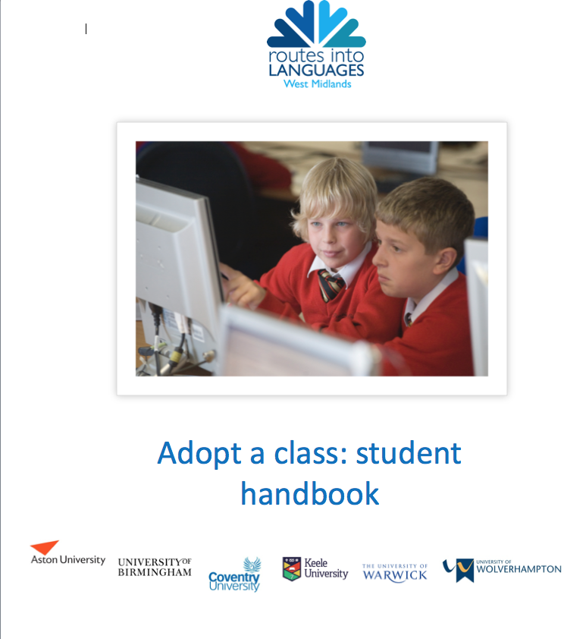

Slide 25
Project going forward…
What’s new this time around?
Closer links with schools:
You will be paired with a school before you go abroad and will liaise with teacher(s) throughout the year
You will be part of a larger regional universities project
The project will end with a student conference
Notes:
CH/ADA 1 MIN

Slide 26
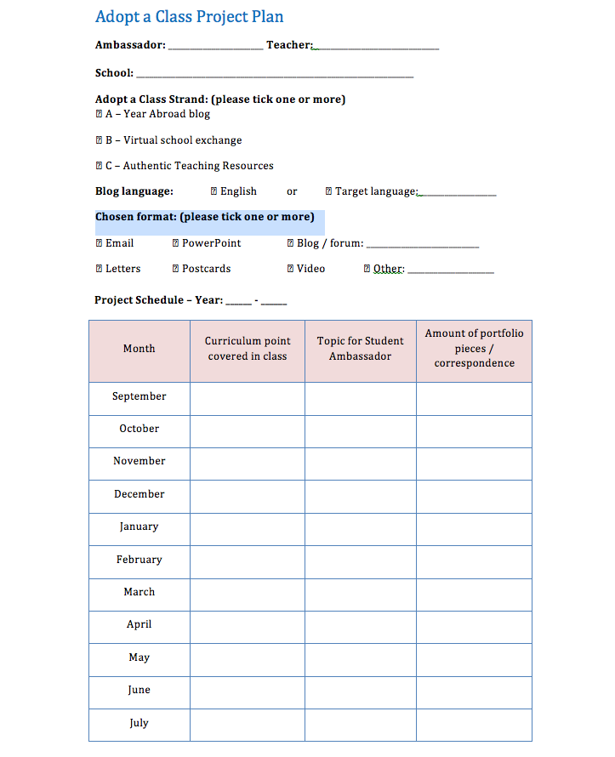
A firmer structure
OPTIONS
Strand 1: Year abroad blog
Strand 2: Virtual school exchange
Strand 3: Authentic Teaching Resources

Slide 27
Bibliography
Anne Freadman, ‘Fragmented Memory in a Global Age: The Place of Storytelling in Modern Language Curricula’, The Modern Language Journal 98 (2014), 373 - 385
Gilberte Furstenberg, ‘Making Culture the core of the Language Class: Can It Be Done?’, The Modern Language Journal, 94 (2010), 329 - 332
Heidi Byrnes, ‘Revisiting the Role of Culture in the Foreign Language Curriculum’, The Modern Language Journal, 94 (2010), 315 - 317
Katra Byram, Claire Kramsch, ‘Why Is It so Difficult to Teach Language as Culture’, The German Quarterly, 81-1 (2008), 20 - 34
Laura Helle, Päivi Tynjälä, Erkki Olkinuora, ‘Project-based learning in post-secondary education – theory, practice and rubber sling shots’, Higher Education (2006), 287 – 314
Michael Byram, ‘Linguistic and Cultural Education for Bildung and Citizenship’, The Modern Language Journal, 94 (2010), 317 - 321
Modern Language Association Ad Hoc Committee on Foreign Languages. (2007). Foreign languages and higher education: New structures for a changed world. Profession, 2007, 234– 245.

