Slide 1
A Progressive Employability Agenda: The Student Experience in PAIS
Justin Greaves
(with Caroline Omotayo, Nikita Shah and Michael Yip)

Slide 2
‘The outsiders want the students trained for their first job out of university, and the academics inside the system want the student educated for 50 years of self-fulfilment. The trouble is that the students want both’
(Harlan Cleveland, 1975)

Slide 3
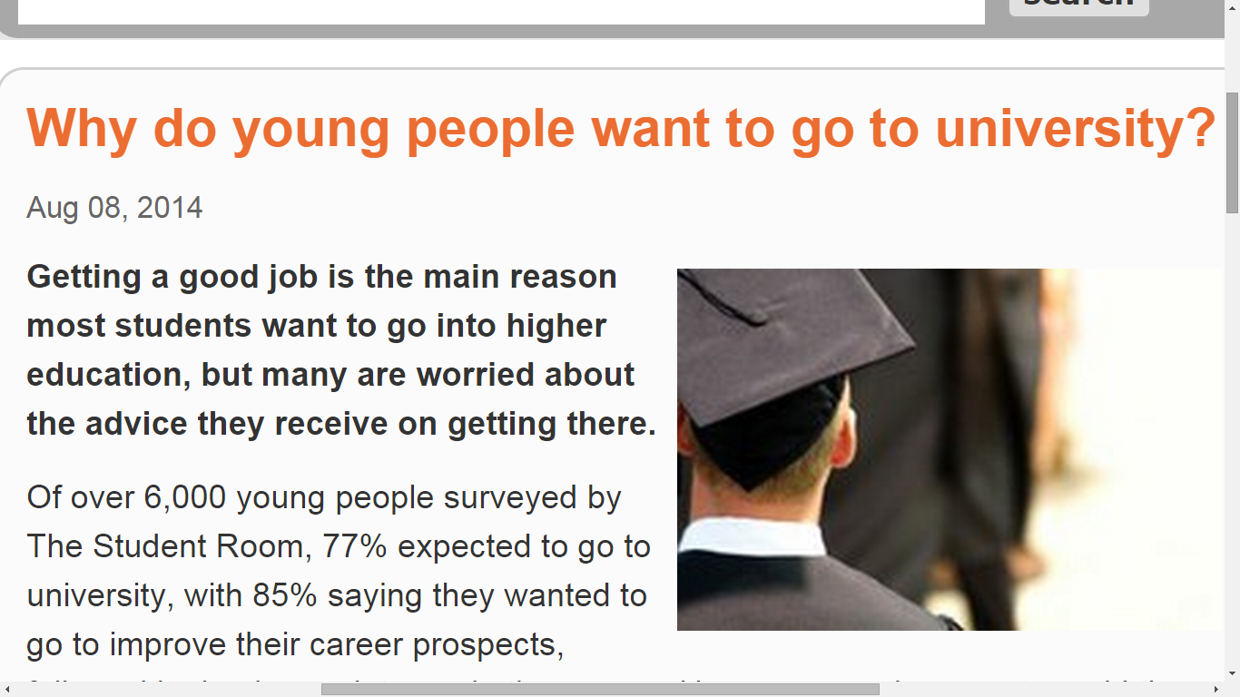

Slide 4
‘Employability’
‘A set of achievements – skills, understandings and personal attributes – that make graduates more likely to gain employment and be successful in their chosen occupations, which benefits themselves, the workforce, the community and the economy’
(Professor Mantz Yorke - 2004)

Slide 5
Why Being A Student Is a Powerful Thing?

Slide 6
‘Once you sign up to become a student here, you are part of the community of the University of Warwick. This is a wonderful thing and far, far better than being a ‘customer’. If the services are terrible we must fight for better ones, because we care about our community and we want it to be good’

Slide 7
Because we care about our community and we want it to be good

Slide 8
‘Students are not just consumers. They are producers, innovators, campaigners and producers. They are politicians and journalists, councillors and humanitarians’

Slide 9
Students as partners
Students as collaborators
Not them and us
Drivers for social progress

Slide 10
Choosing our language
We listen to feedback to make our community better
And to achieve excellence in what we do
We utilise the progressive identities of our students to help them be global, ‘ethical’ and ‘employable’ citizens

Slide 11

Personal Development
Biggest increase in University (NSS)
Up 16 points
Now 3rd in the Russell Group
1st in Russell Group for Communication Skills

Slide 12
Not consumerism
Can use NSS to increase standards
To drive through radical, progressive change
To ensure a challenging academic climate
Ensures a focus on all students
Ensures Universities listen to students

Slide 13
‘When else are students given an unambiguous opportunity to tell their University and the rest of the world what their experience has really been like’?

Slide 14
Student engagement is something you do, [student satisfaction is] something you measure’

Slide 15
‘Student engagement is first an foremost about getting into a mindset where you consider students to be peers who have something valuable to offer the academic community, whether in decision making structure, shaping the research environment or delivering and improving learning and teaching’

Slide 16
Developing skills
Awareness of skills
Reflecting on skills

Slide 17
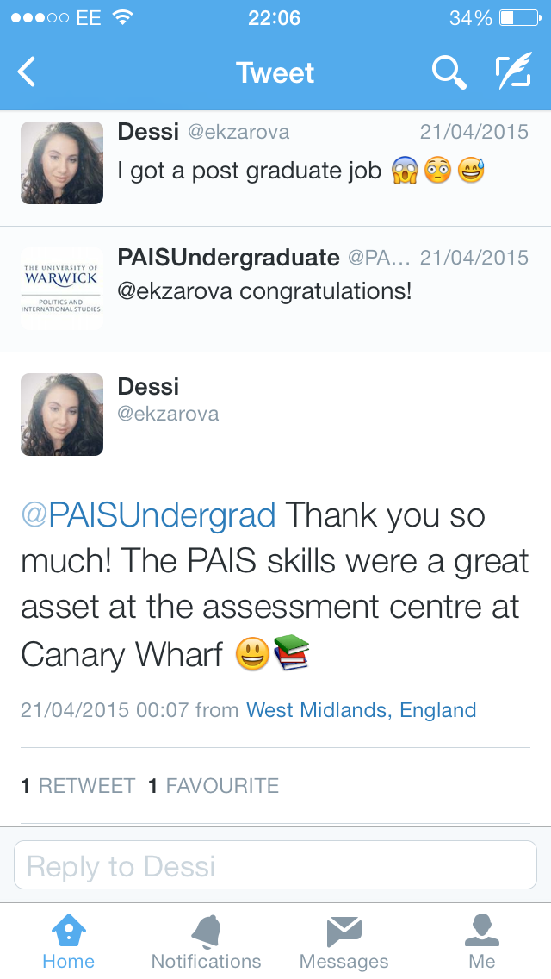

Slide 18
PAIS Initiatives
More study abroad opportunities
Undergraduate dissertation conference
Personal development pro-formas
One to one DSEP meetings
PAIS Marking criteria

Slide 19
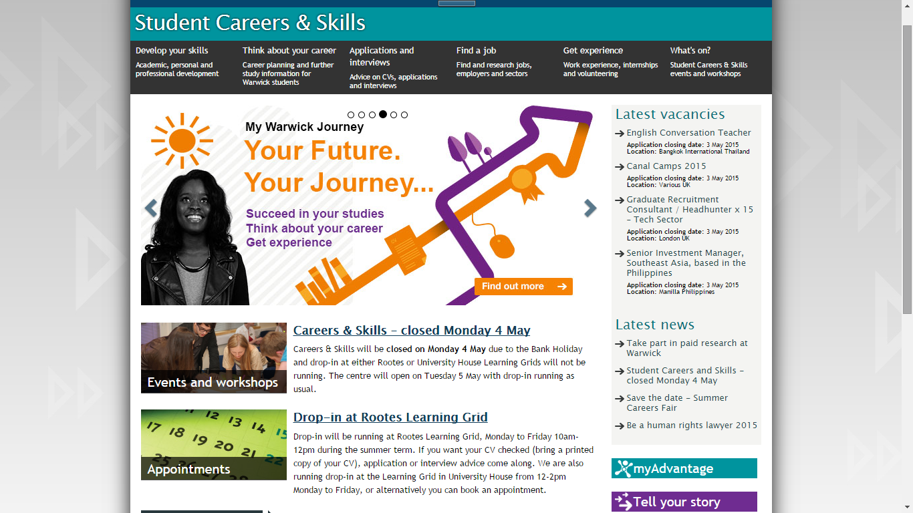

Slide 20
PR21
1st year methods and skills module
Employability with light touch
Embedded in discipline
New topics – conspiracy theories & counterfactuals
Assessment methods
Direct student input (Nikita)

Slide 21

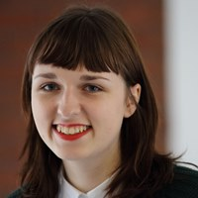
Ambassadors (1)
Two schemes
PAIS Student Ambassadors
NSS Ambassadors

Slide 22
Ambassadors (2)
Online Application form (outline of skills required and skills gained)
Interview, references, feedback to unsuccessful candidates
Training, £10 per hour
Mirrors recruitment process in the world of work

Slide 23
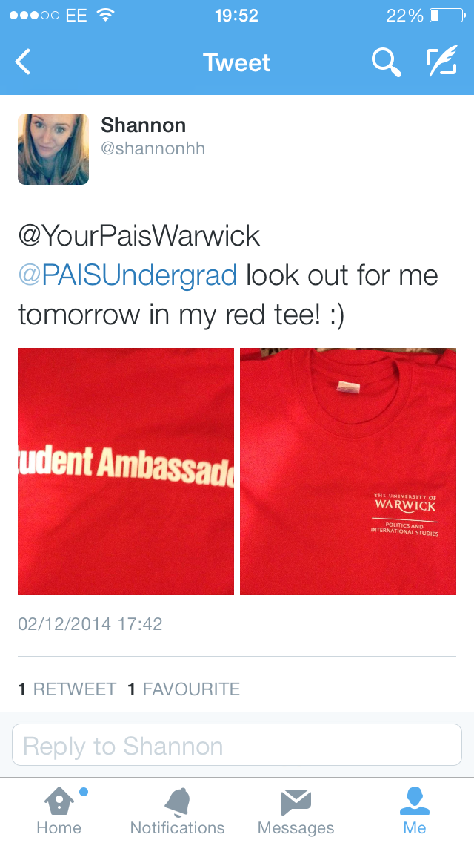

Slide 24
NSS ambassadors worked with me, designing and running the campaign
Students as co-producers
THEIR NSS, THEIR SURVEY

Slide 25


Slide 26
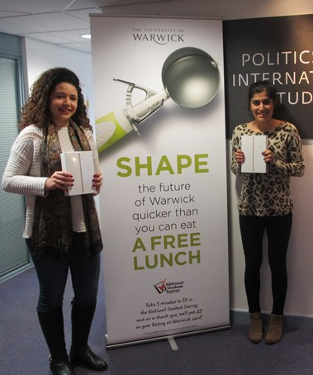
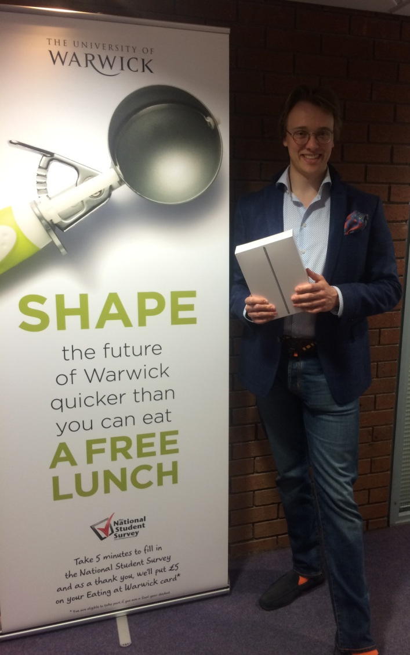

Slide 27
93 per cent response rate

Slide 28
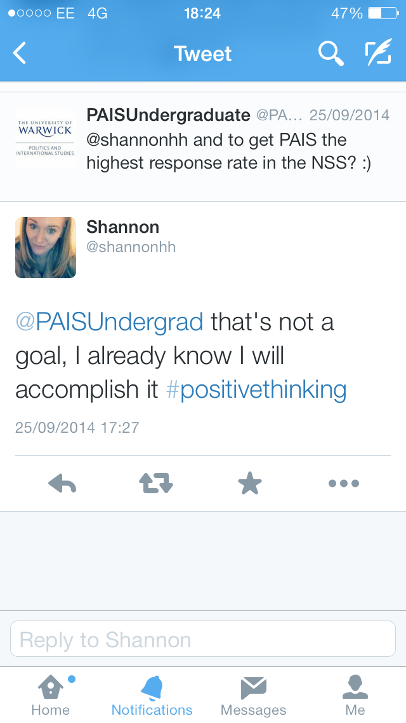

Slide 29


Slide 30
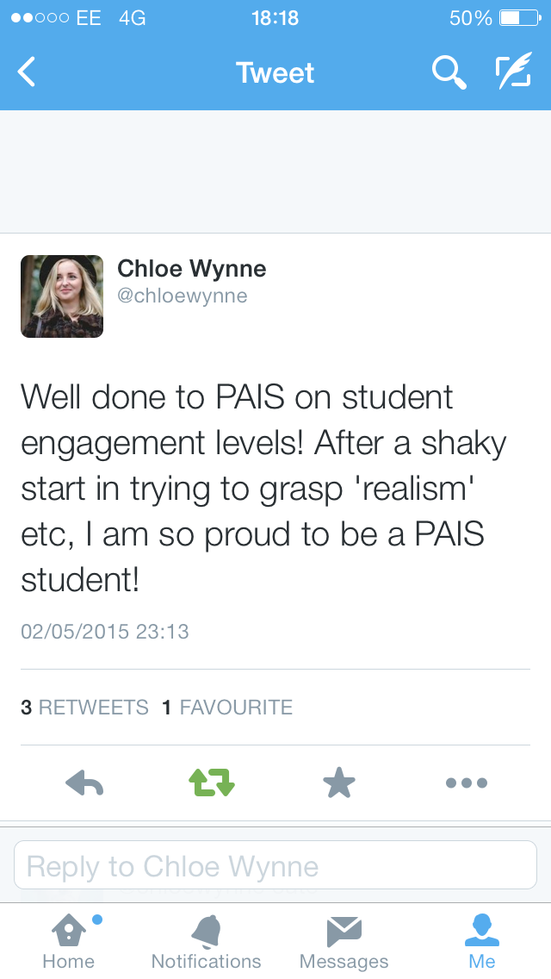

Slide 31
URA’s
Again – robust recruitment
£10 per hour
8 finalists appointed this year
Up to 20 weeks
Up to 8 hours per week
Working with academics on research, teaching and student experience

Slide 32
Thank You for Listening!

