Slide 1
Transforming Technologies: Reflections on Curriculum Design and Digital Identity
Sara Hattersley,
Centre for Lifelong Learning

Slide 2
About the course
Transforming Technologies: Teaching and Learning in the Digital Age
20 credit PG Award – 10 weeks, thematic approach (face-to-face + blended and ‘mini MOOC’ approach).
Part of new CLL flexible Masters route.
Supported by Moodle (students also using Mahara).

Slide 3
Course overview
Course Content
Critical analysis
Reflective practice
Technology Trends
The Digital Self
Assistive Technology
Curriculum Design
Social Media
Collaborative Approaches online
Classroom interventions that really work
E-Assessment
Mobile learning and BYOD
Technology futures

Slide 4
Explorations in Eytmology
Curriculum = (Latin) “a race” or “the course of a race”, deriving from the term currere, “to run/to proceed”.
Learning = (old English) leomian “learn” also (German) “lore”.
Pedagogy = (Greek) “to lead the child”
Technology = (Greek) techne “art, skills, cunning of hand” and logio/lego “I speak”
Source: Wikipedia (accessed 28/04/15) https://en.wikipedia.org/wiki/

Slide 5
Bringing it all together….
Leading students, using skill, art and cunning, which you articulate, to run and proceed in the learning race.

Slide 6

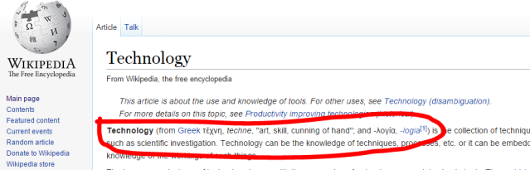
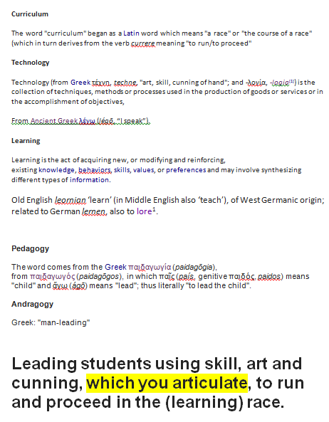
I know this is a quick way to find stuff – I just Google ‘Wikipedia’ – it’ll be the top link
I know the interface – I know how to search and move through the pages. I’m skimming for the ‘eytmology’ of the terms – it’ll be somewhere near the top.
1. Accessing Wikipedia
2. Navigating Wikipedia
Inherent knowledge
I know about the issues surrounding Wikipedia; I understand Darwikianism’ and this helps me make my digital choice.
3. Retrieving information
4. Re-presenting information
I’ll play about with the text and then re-present it in a slide in a better way (note to self- reference the source properly!)
I’ll cut and paste the bits I want into Word for now – a sort of notepad (it happens to be open).

Slide 7
Ways to make the curriculum ‘explicit’
Sharing and reflecting on key documentation (e.g. course proposal and approval records, lesson plans)
Explaining the relationship between learning and teaching activities, and assessment.
Sharing the rationale for choice of approach, in particular, technology employed.
Inviting students to be contributors to an evolving curriculum.

Slide 8
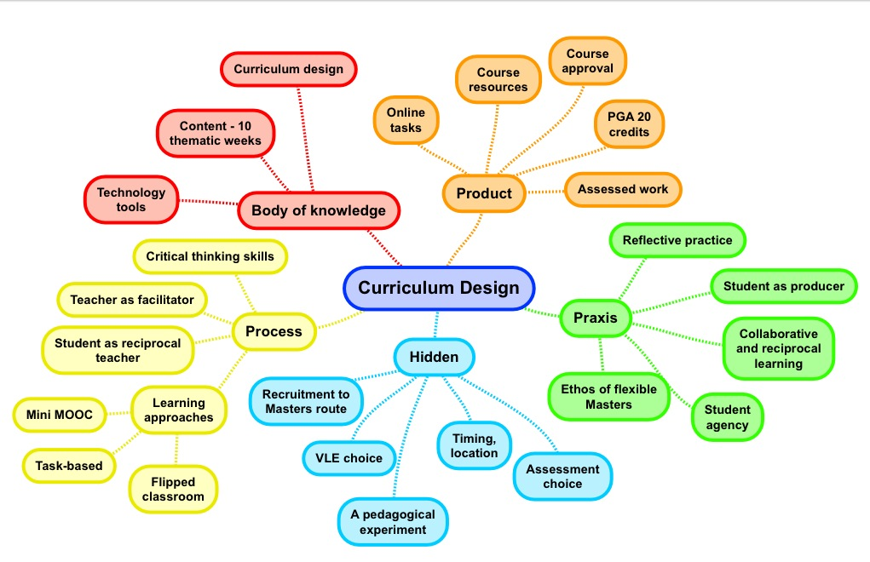
Source: Curriculum Theory and Practice http://infed.org/mobi/curriculum-theory-and-practice/

Slide 9
Modelling your thinking
‘Explanatory artefacts’ – videos, podcasts, infographics, mindmaps.
Sharing your ‘story’ – exposing your own digital literacies and practices (e.g. how I go about approaching a new tool; how I use a tool for a set purpose).
Unpicking and critically analysing tools, pedagogically, and evaluating choices.

Slide 10
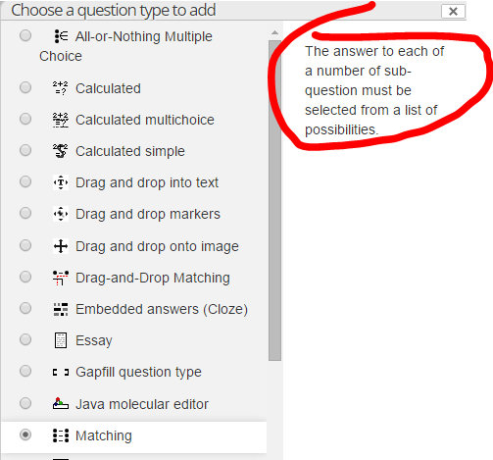
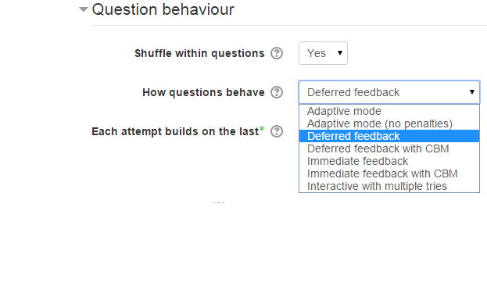
Moodle quiz: conscientious design
Pre-design thinking
What are you hoping to test?
Which question type might work? Why?
What are the pros, cons and likely outcomes, pedagogically, of the choice of quiz and the settings you have created?
What is the impact in terms of learner time and tutor (marking) time?
What skills are needed by the learner?
During and post-design
Build the quiz and reflect on the process. Does it do what you want it to do?
Test the quiz
How easy is it to see the results?
What do these results tell you/not tell you? What might you change?

Slide 11
Activities that promote student ‘agency’ in a VLE
Varied administrative and editing permissions
Shared glossary of terms, repository or other space for sharing artefacts and notes.
Resource or artefact creation for a key purpose.
Reflections/discussion in a group blog or forum
‘Ill-structured’ problems, using a wiki
Peer assessed work/paired collaborations
Profile information and settings
‘Stepping out’ into an alternative space

Slide 12
Activities that promote engagement and persistence
Notifications and alerts on forum entries, blogs and wikis.
Work timelines, checklists and management
Clear navigation and instructions
Task-based, inter-dependent, incremental activities.
Dialogue and feedback (tutor and/or peers).
Source: TAP http://mahara.warwick.ac.uk/view/view.php?id=14563

Slide 13
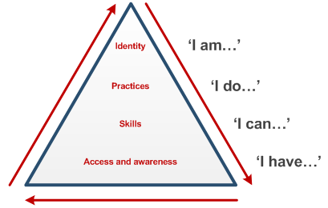
Digital identity and Digital Literacy
Literacies
Identities
Practices
Events
Domains
Beetham and Sharpe (2010)
Source: TAP (Amber Thomas) http://mahara.warwick.ac.uk/view/view.php?id=36138

Slide 14
Digital domains, tools and practices
Digital practices are often well-established and driven by use of preferred tools and domains.
Digital practices can also emerge from ‘chance encounters’ or ‘contrived routes’.
Digital domains and practices can overlap and change in their importance, over time.
Social media
e.g. Facebook=social; Twitter=professional
Devices
e.g. Phone=most things; iPad=classroom work, document annotation, sharing; laptop – last resort!
Tools
e.g. Tools I really like (Mahara) V tools I dislike (Prezi)

Slide 15


Slide 16
Using student digital practices and literacies
Working with them – using spaces and tools that are compatible to students and their own devices – supporting digital literacies
Working outside of them – using spaces and tools that are unknown to students (‘learning in disequilibrium’ – Piaget) – extending digital repertoire

Slide 17
Discussion
How far is a more ‘explicit’ curriculum a more desirable curriculum? Or is it better to be ‘artful and cunning’?
What are the best ways to give students agency in the curriculum design process? Do they want to do it?
What is the value of understanding our own and students’ digital literacies?

