Slide 1


Department of Chemistry
Dr Lynne Bayley
20/02/2013

Slide 2
Using Moodle
Extensively in 2 Modules (+ trials in other modules)
249 students @ 2 assignments per week
6,000 pieces of assessed work
70 postgraduate demonstrators
~50 academic staff

Slide 3
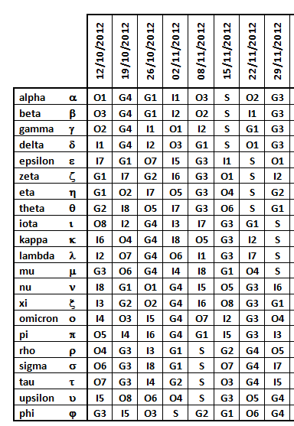
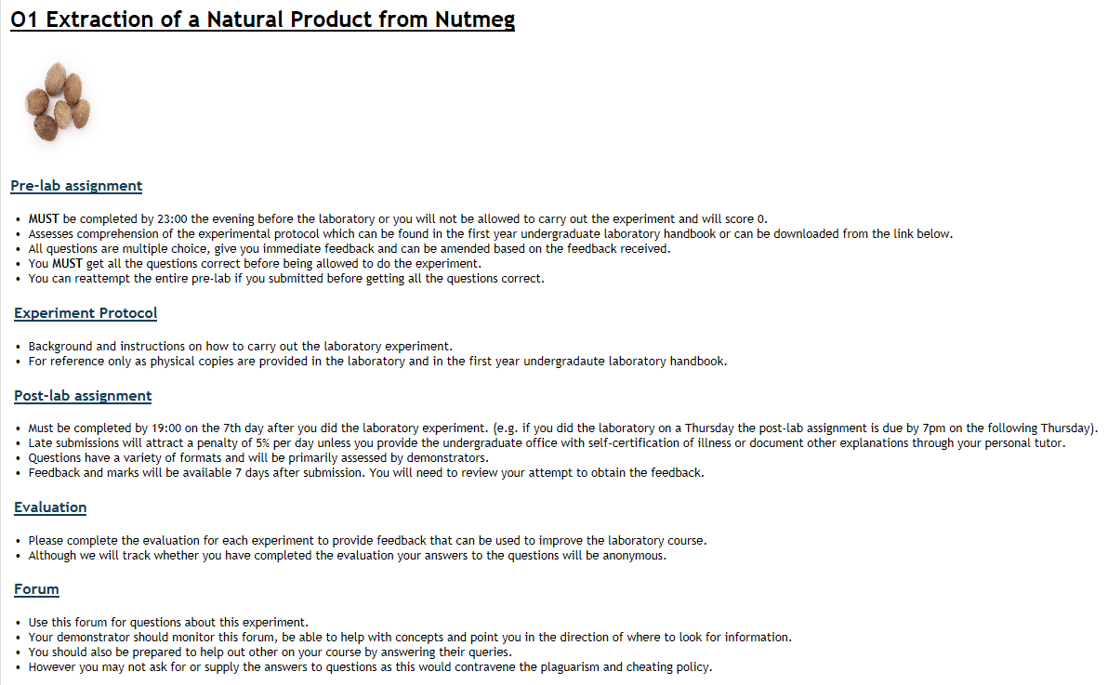
Laboratory Courses
51 different experiments
40 laboratory groups
Each group does a different experiment each week

Slide 4
Why Moodle?
FEEDBACK
Quality
Quantity
Deadlines
ADMINISTRATION
Marks
Tracking

Slide 5
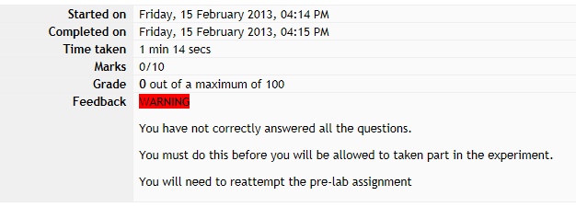
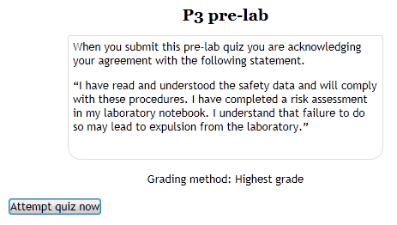
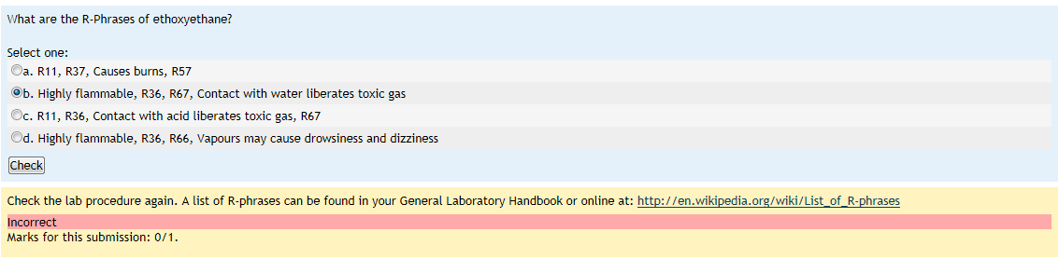
Moodle Quizzes
Personalised Feedback
Random Questions
Modes
Penalties

Slide 6
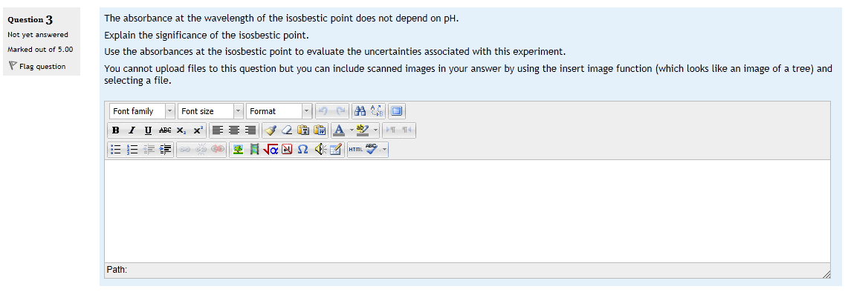
Quiz Question: free text answer
Student view:
Free text and . . .
Equations
Images
Multi-media

Slide 7
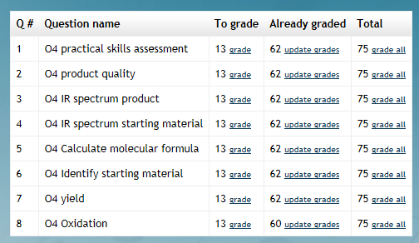
Quiz Question: free text answer
Marker view:
Easily see what needs to be marked
Mark all students answers to same question at same time
Smaller sections means relevant information can be presented at appropriate time

Slide 8
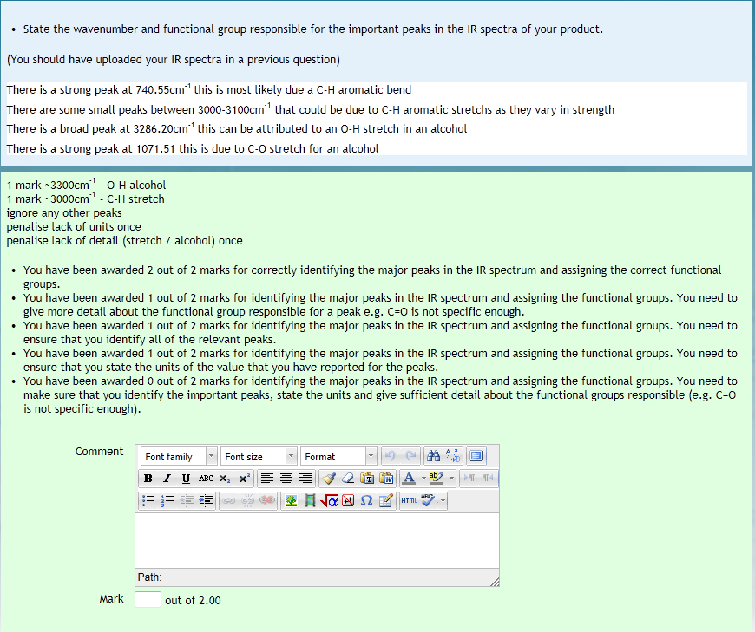
Quiz Question: free text answer
Marker view:
Question
Student’s answer
“Information for graders”
Feedback box
Mark

Slide 9
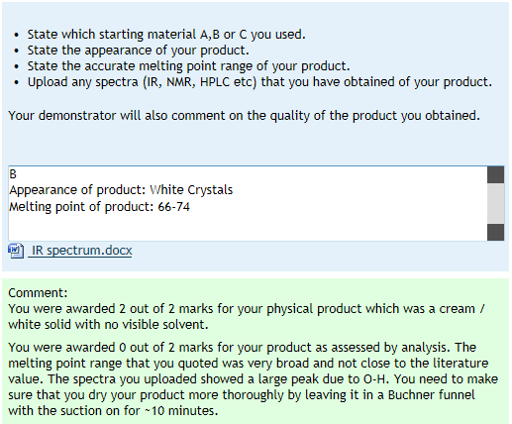
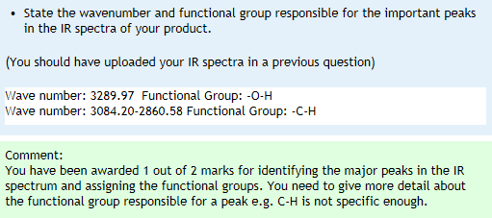
Quiz Question: free text answer Feedback view:
Immediate feedback
Can hide feedback for moderation

Slide 10
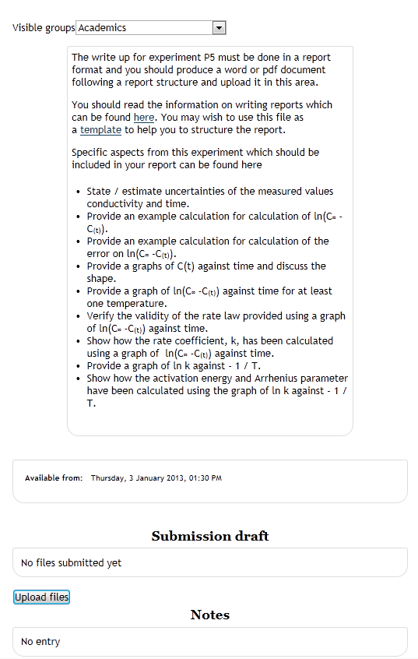
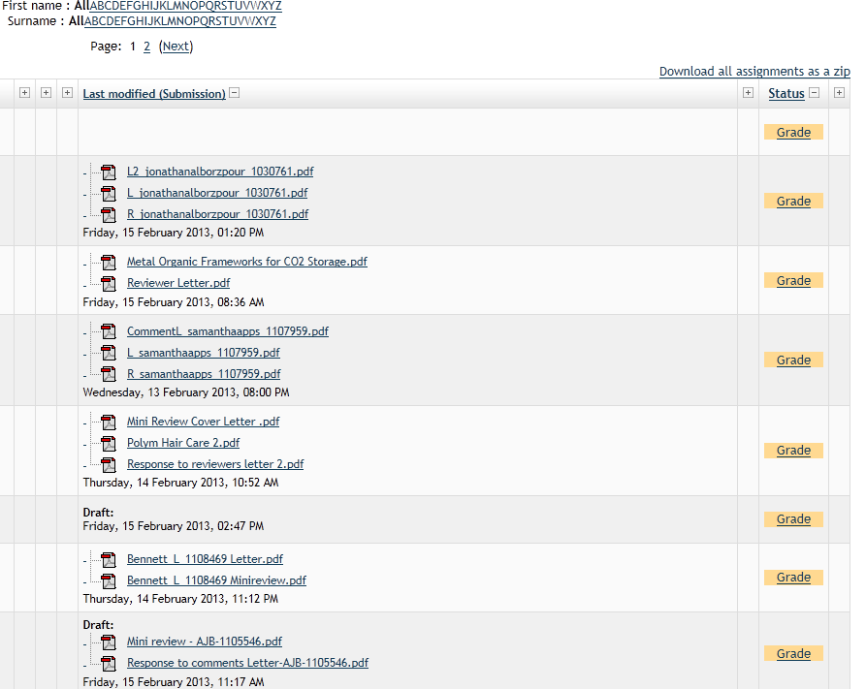
Assignment Submission
File Upload

Slide 11
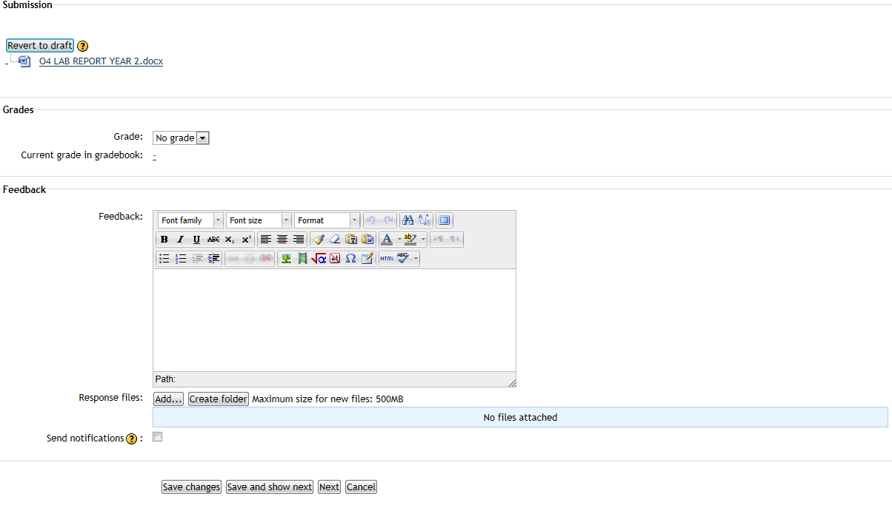
Simple Marking

Slide 12
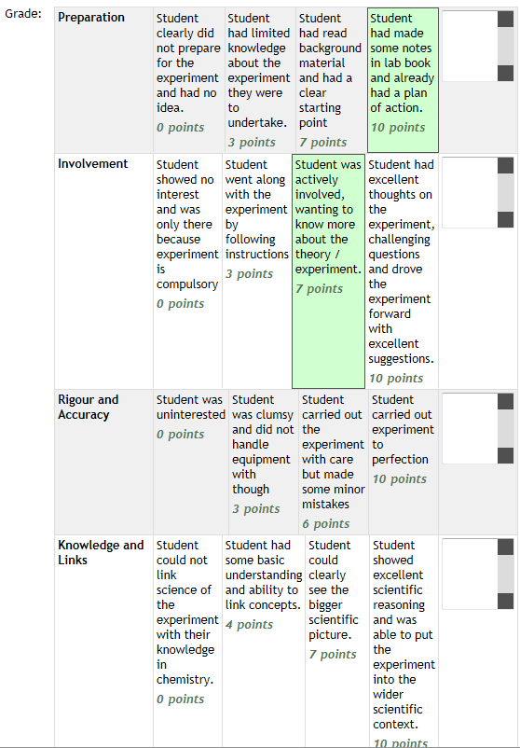
Rubric Marking

Slide 13
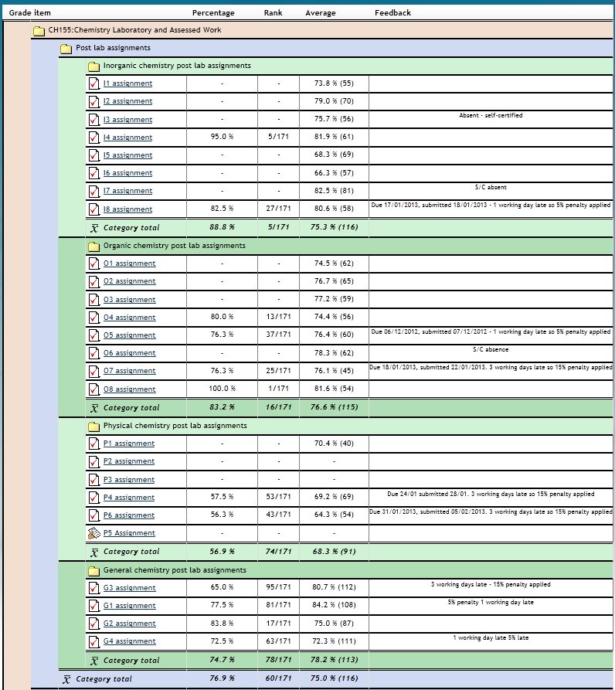
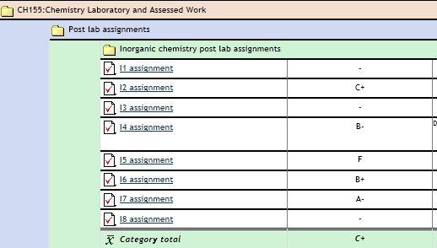
Grade views

Slide 14
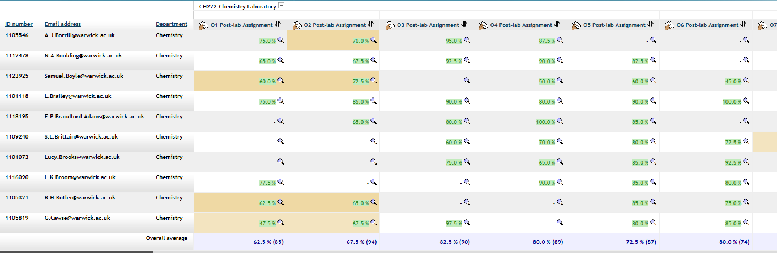

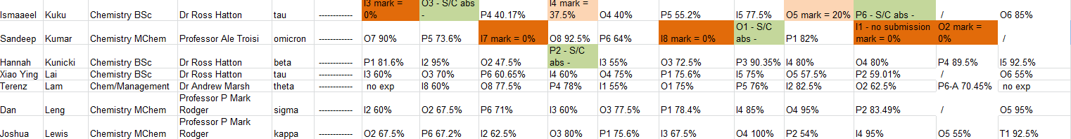
Administrator Grade Views

Slide 15
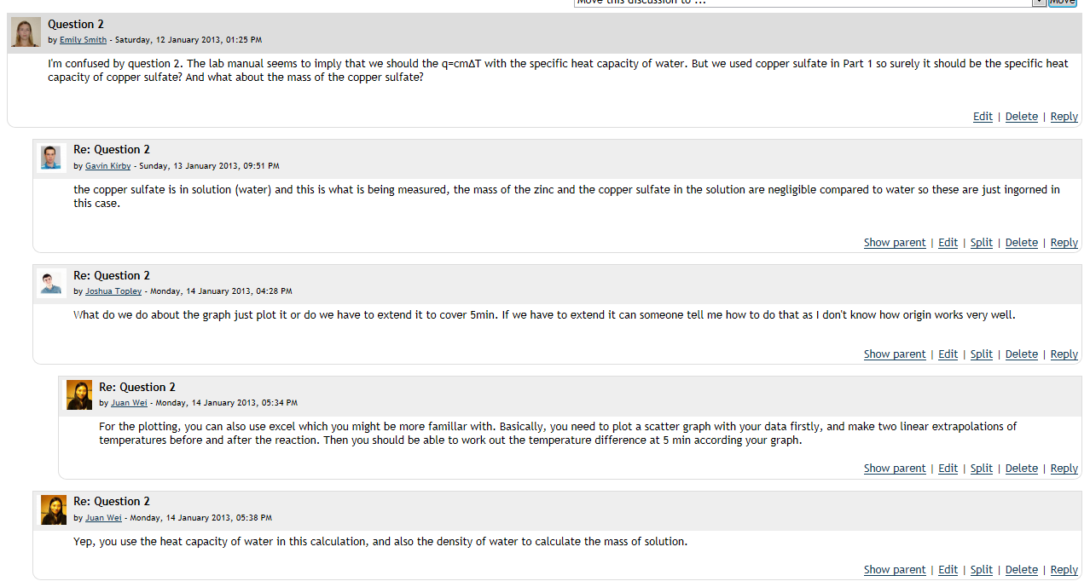
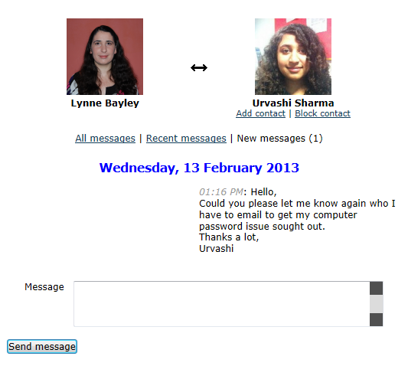
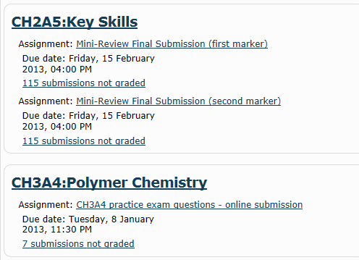
Communication
Forums
Messaging
Information

Slide 16
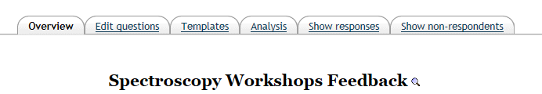
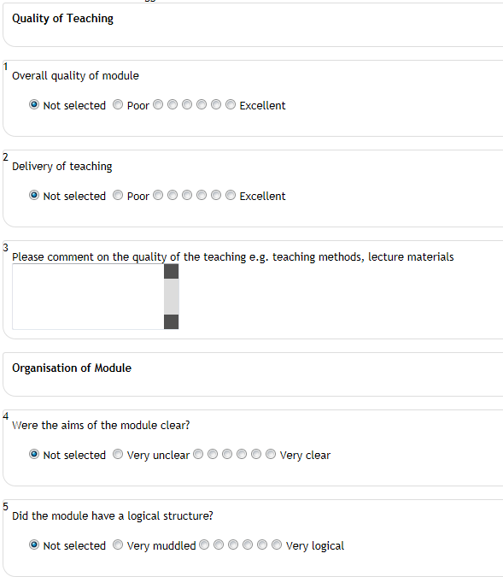
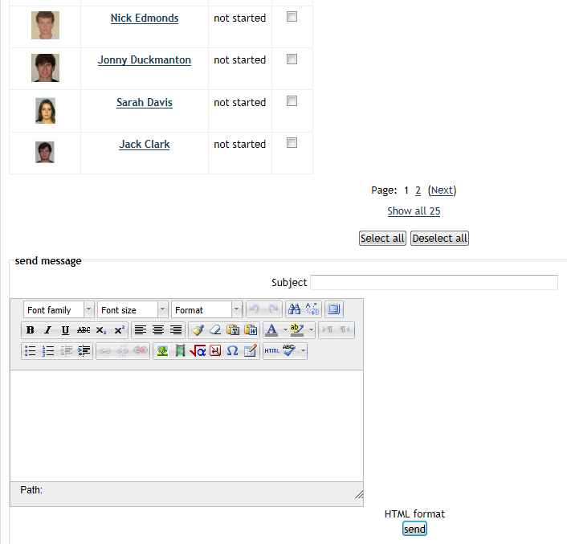
Surveys

Slide 17
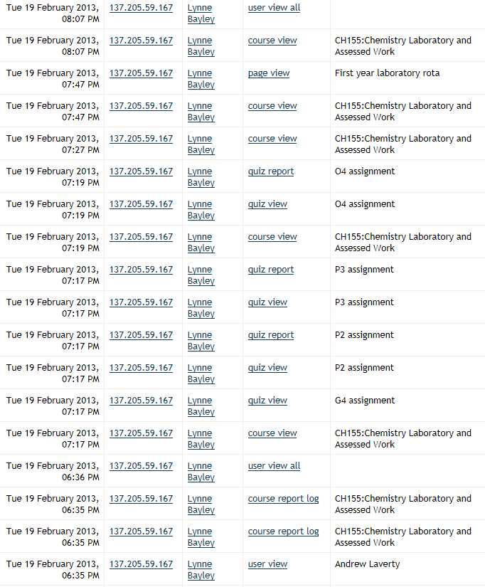
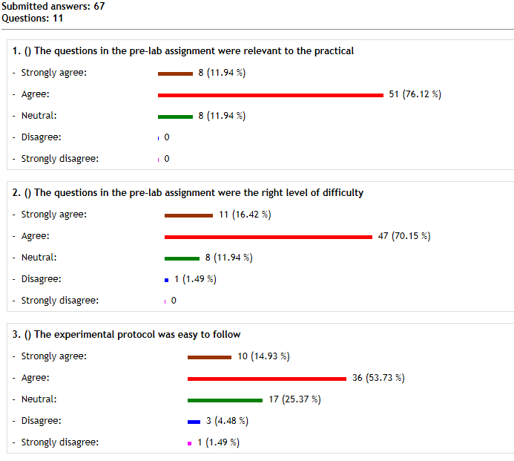
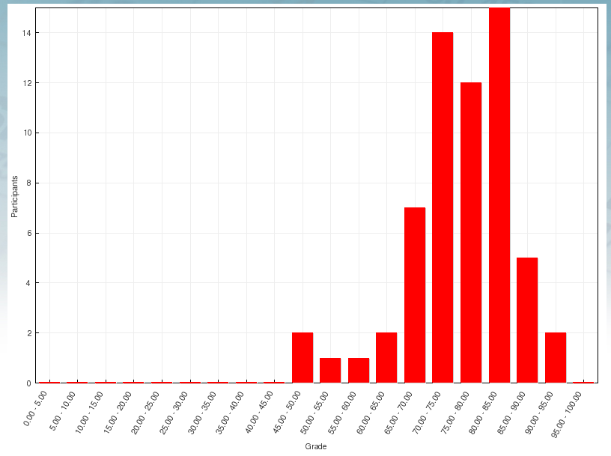
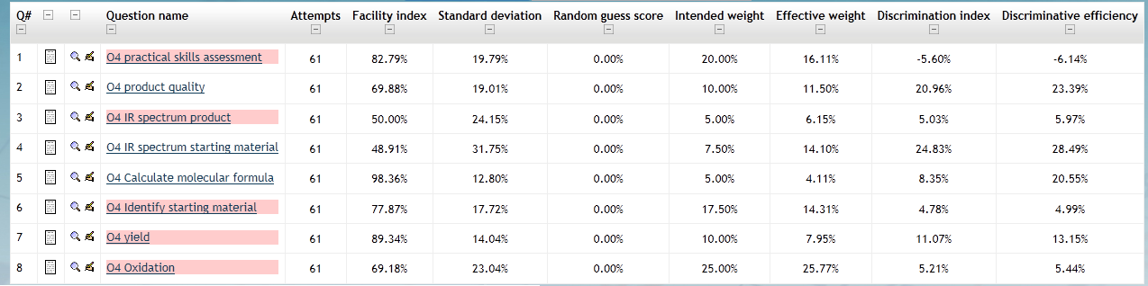
Reports

Slide 18
Overview of Moodle
Pedagogical design
Flexible and customisable
Informative and Effective
Complicated interface
Investment in set up

