Slide 1

Faculty of Social Sciences
Showcase Seminar
Sharing Feedback Practices
Jane Medwell

Slide 2

WIE Feedback…
Part of teaching for BA, MA, PGCE (M level), PhD, between supervision meetings
Given to standard undergraduates, widening participation students, full-time postgraduates, part-time professionals, home and overseas students.
Given by full and part-time teaching and research staff, school mentors and link tutors.

Slide 3
Assessment of…
Teacher Standards. Assessed through observations and placement profiles (reports, observations with verbal and written feedback)
Specific subject knowledge (electronic audits which also supply feedback- qualificatory assessment, forums, wikis )
General scholarship in social science. (essays, presentations, posters, performances- written only feedback).

Slide 4
Students and trainees want….
Feedback which is:
fast;
formative;
fair;
focused on them – no statement banks or tick boxes.
These are the key issues arising from a survey of BA and PGCE students four years ago.

Slide 5
All feedback in WIE
Criterion related but personalised
Transparent and shared by all participants in that assessment
Moderated (all) and second marked (written)
Completed and delivered within 20 (staff) working days
Written feedback is e-submitted e-marked and e-returned
Verbal feedback for groups and indivudials (not all) using word, Jing, Camtasia etc

Slide 6
Formative feedback
The assignment criteria and submission dates are published as part of the on-line module guide (including placement criteria)
http://www2.warwick.ac.uk/fac/soc/wie/teaching/pgce/primary/core_subjects/assignment/
http://www2.warwick.ac.uk/fac/soc/wie/teaching/undergraduate/singapore/module-outlines/ie372/assessment/writtenassignment

Slide 7
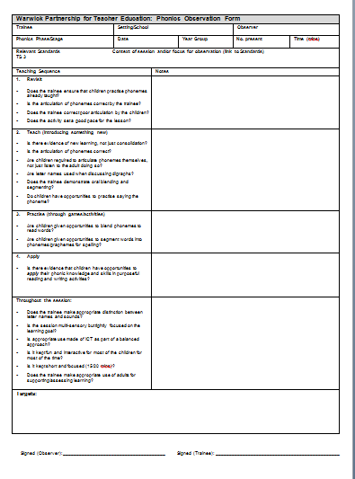
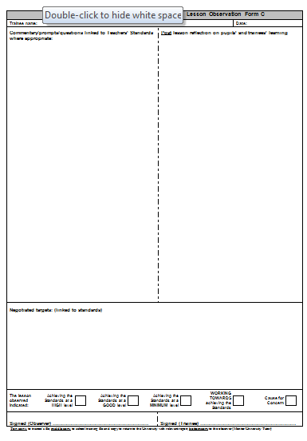
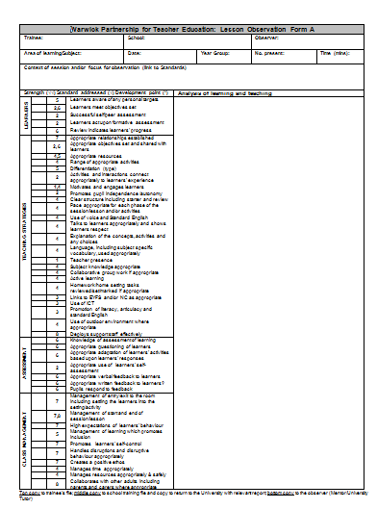
Lesson observations
Shared
Formative
Include
targets
On paper-
In triplicate!
The only
Paper we use

Slide 8
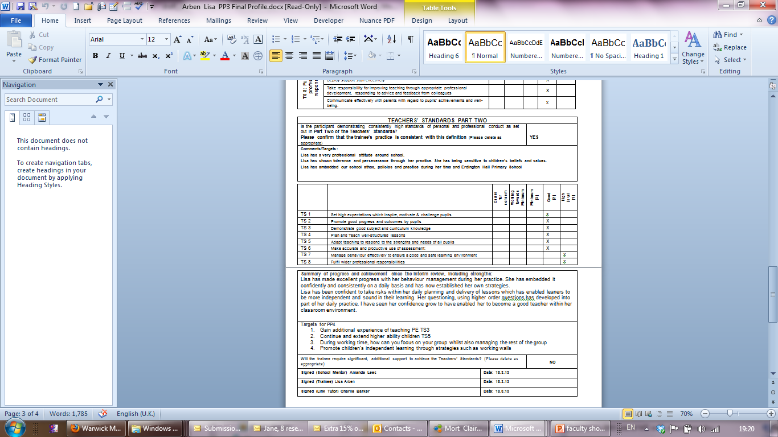
Placement
Profile reports
By mentors, link tutors
Emailed in
Summative - pass/fail
Formative - sets targets
Discussed with
personal tutor
Subject to moderation

Slide 9
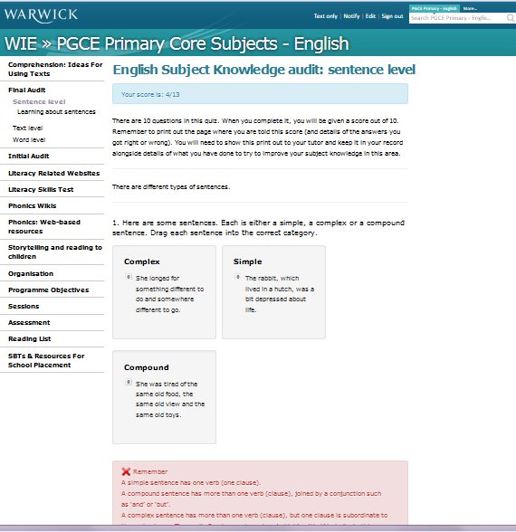
Electronic audits give feedback
fast and formative (but not part of module assessment)
a whole range of lower level knowledge in English, maths and scoence
Pre- and post-audits
In the module webpages

Slide 10
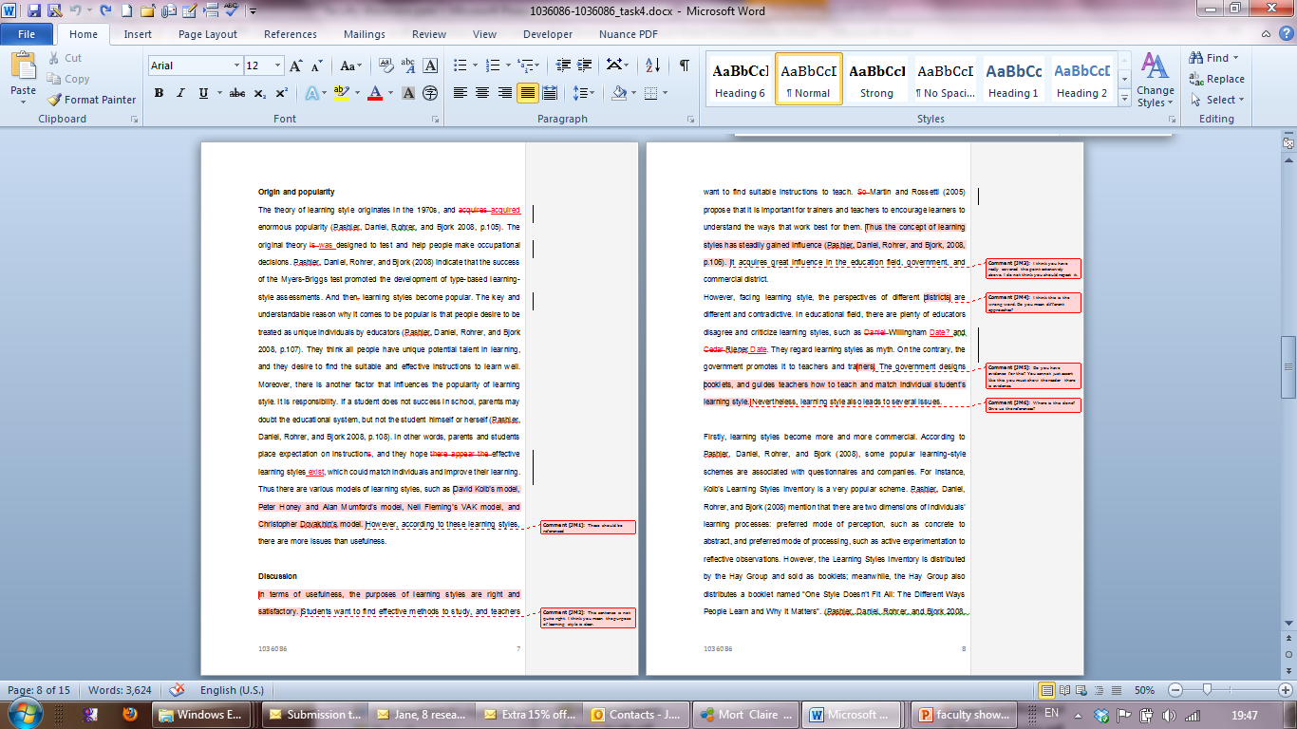
Essays
All e-marked
Read through
Put comments on
the text
Notes also used on
PhD and other
supervision writing
before discussion.

Slide 11
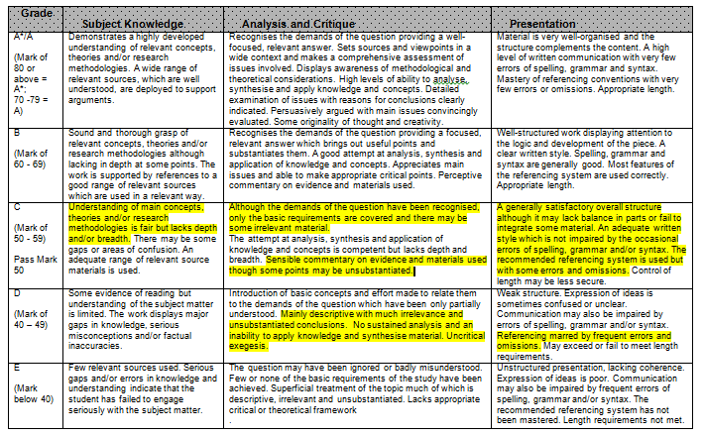
Essays- establishing best fit

Slide 12
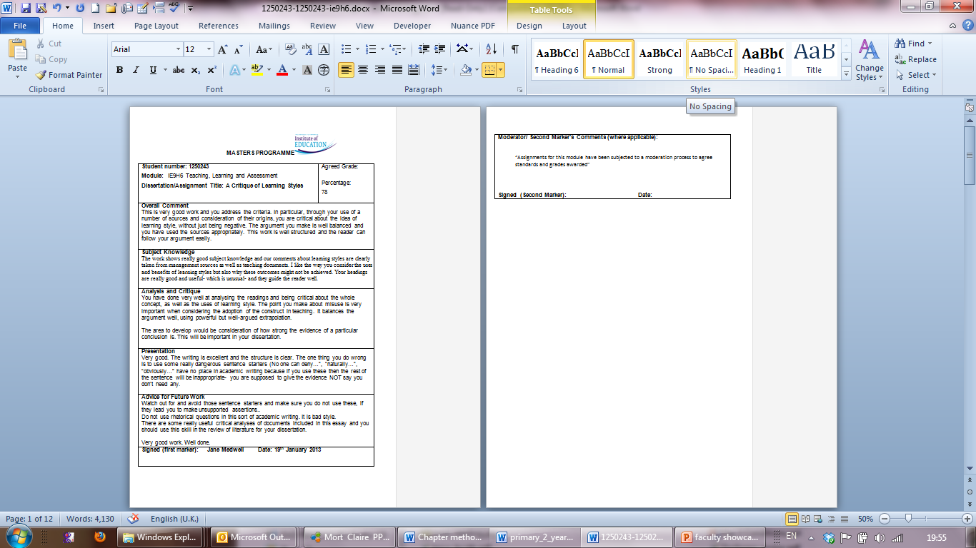
Essays
Feedback
summary
Personalised
Targets for
next time
How long
does it take?

Slide 13
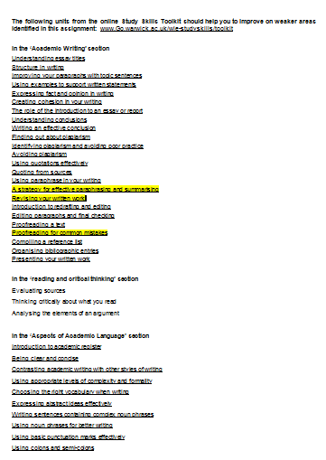
For those in need…
Study skills toolkit
Online help
This sheet also goes
back with the feedback
sheet and annotated script

Slide 14
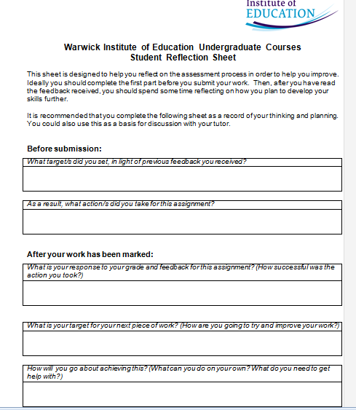
Get students to engage with feedback?
Feedback sheet
New- so results
are uncertain

Slide 15
In extremis…
We use Camtasia and Jing, Wallwisher, etc to communicate feedback to individuals and groups.
Example: http://screencast.com/t/avZkxjrEH
This is feedback for an overseas module. Jing offers five minutes to discuss it.

Slide 16
Conclusions about Feedback
fast; formative; fair; focused on them -we are all trying to do the best we can;
there is a tension between detail and accessibility in feedback (tick boxes are easy to make and hard to read);
Our students seem to like words, but only original words, and they like spoken words as well.

