Slide 1

MOVING ASSESSMENT ONLINE:
ACADEMIC INTEGRITY AND LEARNING DESIGN
Dr Peter Fossey
Academic Development Centre

Slide 2
Plan:
Examine the scale and nature of the threats to academic integrity
Consider reasons for breaches in academic integrity
Consider the role of learning design in minimising breaches of academic integrity

Slide 3
‘I want us to start from a place of trust. It is not the majority of students who cheat... We have to start from a position of trust’
([VC, Uni. of Calgary] Marshall, D., March 19, 2020, webinar address;
quoted in Eaton 2020, p.82).

Slide 4
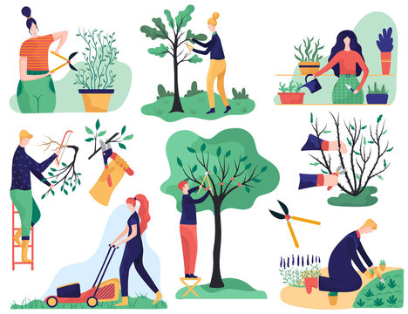
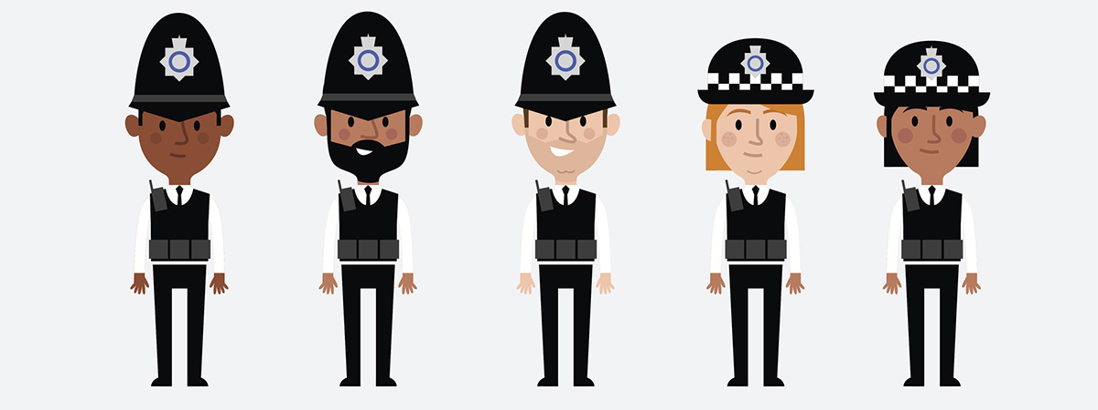
Policing or cultivating?
Notes:
We have a choice: we can try to police AI and stop it from happening, or we can try to cultivate an environment in which lapses of AI are not motivated and not desirable.
Policing is unlikely to be successful, and likely to have detrimental effects on students. It may even be counter-productive if the effect is to increase the perceived pressure on students – since the “preferred” method of cheating today is not copying or collusion, but contract cheating.
Alternative metaphor – arms race.

Slide 5
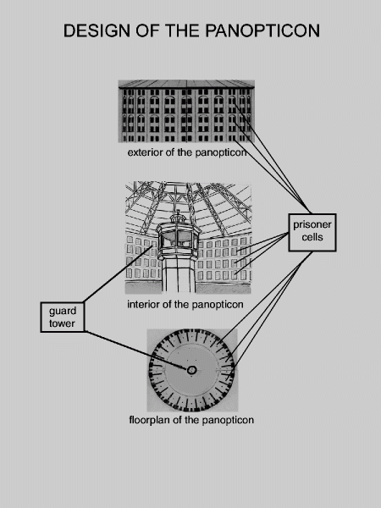

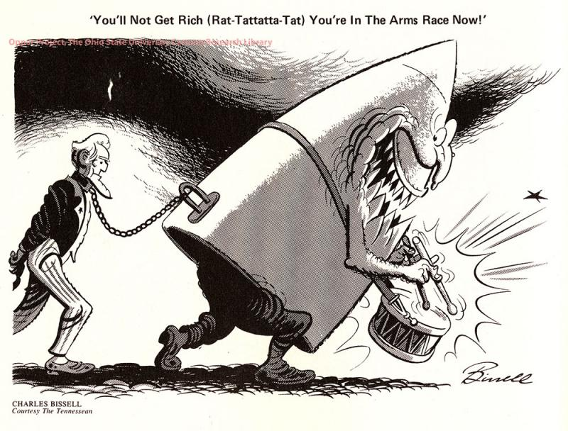
Policing or cultivating?
Notes:
Major problems with the policing strategy:
We get involved in an arms race which is costly and impractical
And we end up imposing unpleasant, stressful conditions on students who were well-intentioned to begin with

Slide 6
Policing or cultivating?
“The possibility of academic dishonesty can be better handled by proactively assisting our students [to] develop legitimate strategies and providing resources and support throughout their academic journey.”
(Teclehaimanot et al 2018)

Slide 7
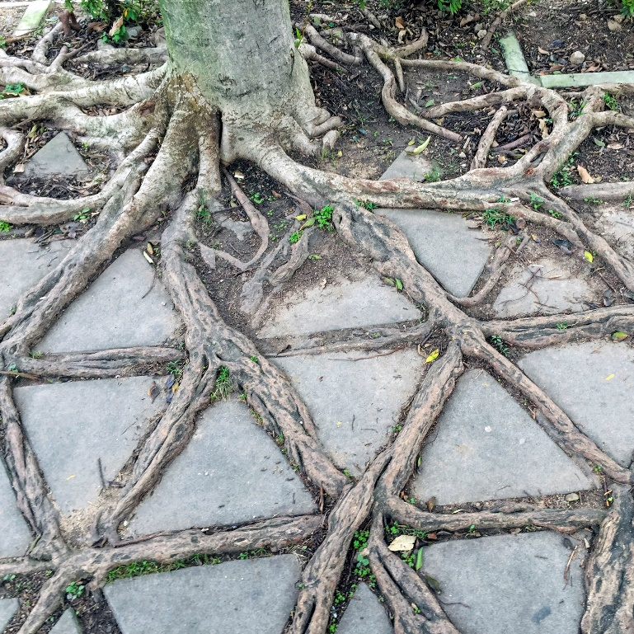
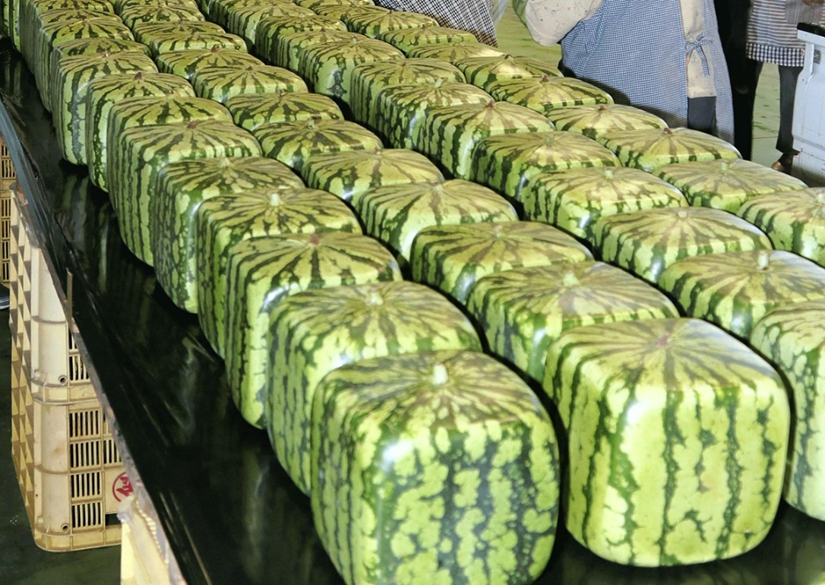
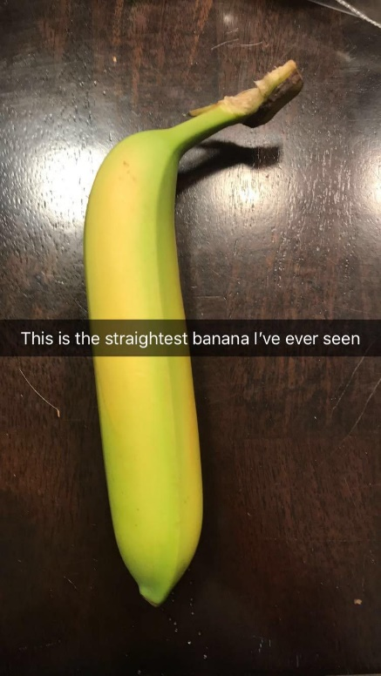
Policing or cultivating?
Notes:
“Gardening” does not mean giving students free rein, or being overly trusting. It’s a matter of shaping an environment in which the students’ attitudes to AI “grow” in the way that we need them to.
If we can develop students’ understanding of the value of AI and minimize the reasons for cheating, then we can also minimize the extent to which we need to engage in policing behaviours.

Slide 8
Nature and scale of the problem
Contract cheating – essay mills, online tutors, “outsourcing”
Copying
Collusion
Poor academic practice

Slide 9
Nature and scale of the problem
2013 and 2016: approx. 50,000 incidents (QAA 2018, p.5)
≈0.7% of students each year
…so a much smaller percentage of all assessments;
…but this is only the students who get caught

Slide 10
Nature and scale of the problem
So do we know how often lapses in AI go undetected?
Not really. Research is inconclusive.
Many more students have “thought about cheating”

Slide 11
Nature and scale of the problem
Research suggests that lapses in AI are no more prevalent in online courses than face-to-face ones
We might think that online assessment affords more opportunities to cheat, but that does not mean that students will take them

Slide 12
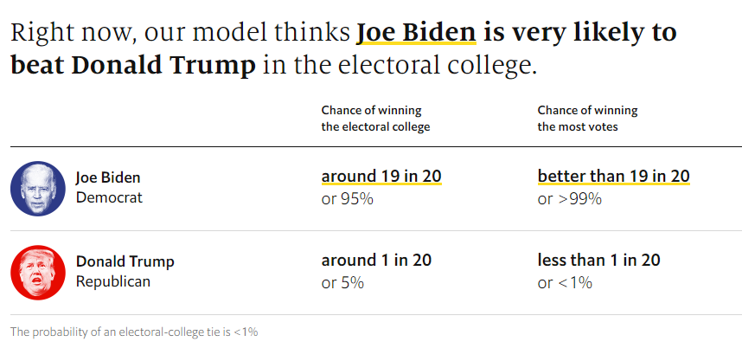
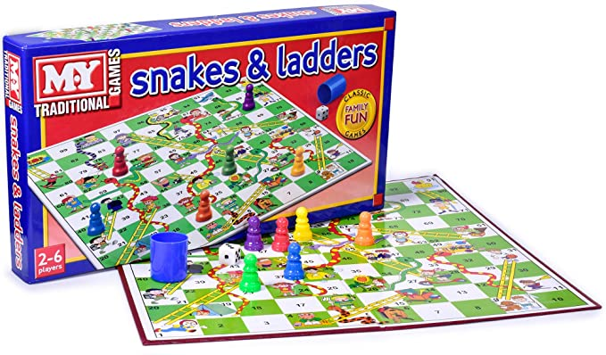
2. Reasons for lapses in AI
(The Economist, accessed 30/10/20)

Slide 13
Aside: Reasons for not cheating (Rundle et al 2019, p.5)
Top three responses:
It would be wrong or immoral
I want the sense of achievement from doing work myself
I feel I’d only be cheating myself because I am studying to learn
(Sample of 1808 students at a Western Australian university)
Notes:
When asked to offer a positive reason for not using a contract cheating service…

Slide 14
2. Reasons for lapses in AI
To support AI, students need to know:
What is expected of them wrt. AI and why
What constitutes academic success in this area
That sufficient support is available to them
…as early, regularly and definitively as possible

Slide 15
2. Reasons for lapses in AI
Pressure
- feeling unprepared, unsupported
- not understanding the task/criteria
- stakes are (too) high
Not understanding and valuing AI
- not knowing/understanding what AI is about
- not seeing the pedagogical point in the assessment
Notes:
When asked to offer a positive reason for not using a contract cheating service…

Slide 16
‘I want us to start from a place of trust. It is not the majority of students who cheat... We have to start from a position of trust’
([VC, Uni. of Calgary] Marshall, D., March 19, 2020, webinar address;
quoted in Eaton 2020, p.82).

Slide 17
3. Designing for Academic Integrity
General idea:
Lower the pressure
Make the assessment meaningful
Raise the need for more demanding skills and metacognition
Notes:
To the extent that an assessment relies on the presentation of factual knowledge, it will be easier and more tempting to cheat.

Slide 18
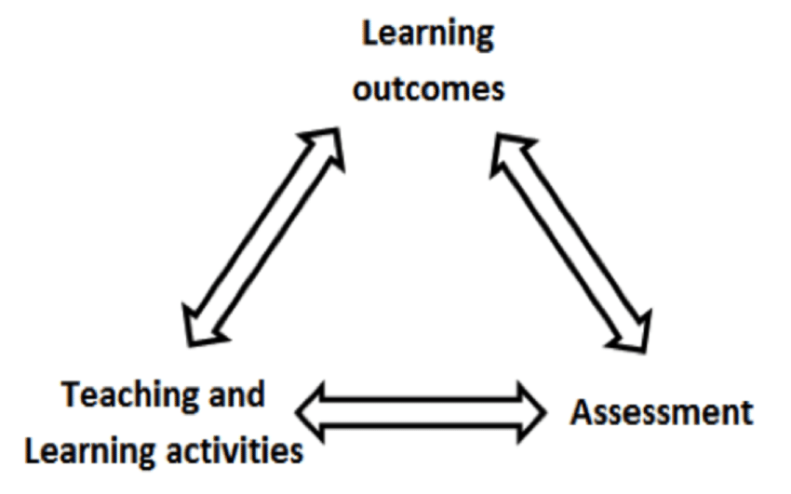
3. Design: Constructive Alignment
Promotes assessment literacy
Reduces the scope of the “hidden curriculum”
Tends to minimise uncertainty, lower pressure
(Biggs, 1999)

Slide 19
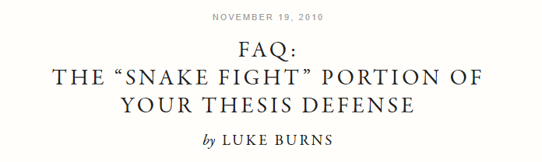
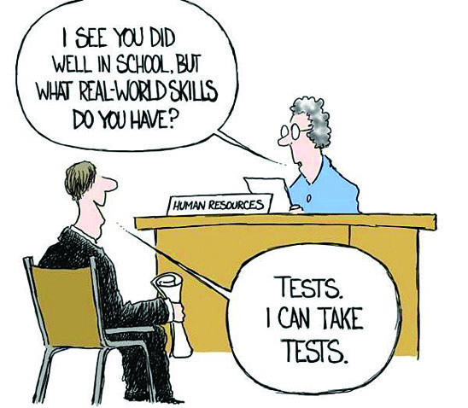
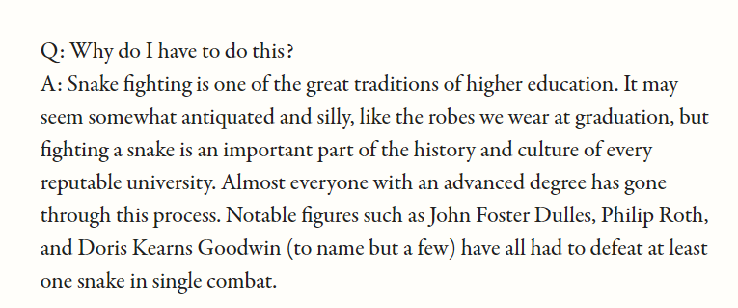
3. Design: Authenticity
(McSweeney’s, 2010)

Slide 20

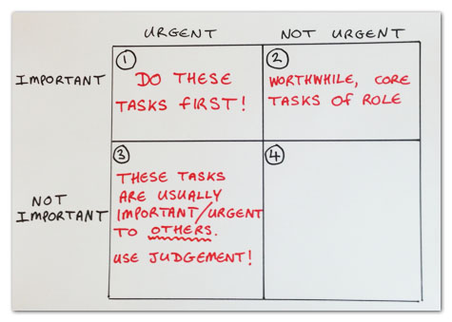
3. Design: Authenticity
Authentic assessments are “engaging and worthy problems or questions of importance, in which students must use knowledge to fashion performances effectively and creatively. The tasks are either replicas of or analogous to the kinds of problems faced by adult citizens and consumers or professionals in the field.”
(Wiggins 1993, p.229)

Slide 21
3. Design: higher-order skills
Metacognition – awareness/understanding of one’s own reasoning, decision-making, views and actions.
How easy would it be to blindly guess?
How easy would it be to look up the answer?
How easy would it be to answer from memory without understanding?

Slide 22

Self-assessment tool:
Yes – I have engaged with them on these issues.
Q
Maybe – the information is available to them.
I don’t know, so I need to find out or make sure
Maybe not – this information is not made explicit anywhere.
I need to provide them with information and chance for engagement

Slide 23
Conclusion
Start from a place of trust
Work with motivations and values more than opportunities
Preparation and support is better than policing
Design for authenticity and higher-order cognitive skills

Slide 24
Self-assessment tool:
Assessment Literacy
Do the students fully understand the assessment? Specifically:
What they need to do
What is being assessed (incl. which LOs)
How the assessment relates to the rest of the course
Why this assessment method has been chosen
The relevance of this method to their future learning/career
YES
MAYBE
MAYBE NOT

Slide 25
Self-assessment tool:
2. Preparation
Do the students know how to prepare/practice for the assessment?
Are they able to use timely formative feedback?
Is nearly all of the credit for the module concentrated in one place?
Do the students already know all the details of the assessment?
YES
MAYBE
MAYBE NOT

Slide 26
Self-assessment tool:
3. Support
Are there clearly defined times and methods for students to contact you?
Do they have a peer network/community in the cohort?
Are they aware of the support available elsewhere?
(Warwick Academic Writing, Wellbeing Support Service, Hardship Fund)
YES
MAYBE
MAYBE NOT

Slide 27
Self-assessment tool:
4. Design
Does the assessment test abilities and understanding that have wider significance beyond the assessment?
Are the abilities required by the test method useful in themselves?
Does the assessment mainly test higher-order cognitive and metacognitive abilities?
YES
MAYBE
MAYBE NOT

Slide 28
PS: online proctoring/invigilation is not the answer
Students find it stressful and invasive (esp. if it involves a webcam)
It introduces another potential cybersecurity concern
The students are responsible for setting up the hardware, which puts them under extra pressure, and opens up loopholes anyway
It can still be foiled by using multiple devices, hiding notes, having someone else in the room but off-camera, etc.
More sophisticated systems throw up false positives (flagging, for e.g., students who read the questions out loud, or close their eyes to think)
It is not clear how this new tech fits with established processes for appeals

