Slide 1

ACADEMIC DEVELOPMENT CENTRE
Dr. Peter Fossey
Senior Teaching Fellow
Academic Development Centre
p.j.fossey@warwick.ac.uk

Slide 2
ACADEMIC DEVELOPMENT CENTRE
What can you do with the ADC?
Take a course which leads to a teaching qualification
Find resources and guidance to help you develop your teaching
Connect with peers and more experienced staff across the university
Nominate someone for an award, or be nominated yourself!

Slide 3
Academic Development
Why bother?
Good for you
Good for your students
Good for the university
Good in the wider context

Slide 4
Reflective and Scholarly Practice:
Be actively curious about your teaching practice
Make decisions based on evidence and research
See your practice as an ongoing process of improvement
Be sensitive to the wider context in which you teach

Slide 5
Activity:
Why don’t students make full use of feedback?
Reasons include:
They do not understand it (Chanock 2000)
There is too much of it for them to use effectively (Tian and Lowe 2013)
They struggle to apply it to later assessments (Ackermann et al 2017)
It is damaging to their self-image (Nussbaum and Dweck 2008)

Slide 6
Activity:
What is positive feedback for?
To offset the negative emotional response caused by critical feedback
Research suggests that positive feedback is often not very effective in this respect.
To show the student where their tentative judgements are correct
Students are often working at the limits of their abilities, so need confirmation.
Winstone, N. E. (2016) “‘It’d be useful, but I wouldn’t use it’: barriers to university students’ feedback seeking and recipience” in Studies in Higher Education, vol.42, p.2026-2041.

Slide 7
Activity:
How can we make positive feedback effective?
Make it specific.

Slide 8
ACADEMIC DEVELOPMENT CENTRE
Preparing to Teach in Higher Education
APP Postgraduate Researchers
PGA Technology Enhanced Learning
APP Teaching Excellence
APP EXP
3-4 Hours
Self-directed, online
Mandatory for GTAs
Certificate & pay
6 Months Taught
For PGRs who teach
AFHEA
6 Months Project-based
Few restrictions
AFHEA, 20 CATs, PGA
12 Months Blended
For TFs and APs
FHEA
You decide Experiential
For everyone
AFHEA - PFHEA
Academic Development Programme
PGA Teaching and Learning in HE
PGA TEL: Theory and Application
KEY
Usually 1-2 hours
Workshops
For everyone
Standalone
+6 Months Blended
For PGRs who teach
AFHEA, 30 CAT PGA
8 Months Project-based
Few restrictions
FHEA, 30 CAT PGA
Length Structure
Eligibility
Award(s)
Notes:
Need to add PGCHE?

Slide 9






Advance HE and HEA Fellowship

Slide 10
Advance HE and HEA Fellowship
Working to professionalise lecturing
Fellowship scheme
Well-supported by the sector and policy makers
Fellowship is recognised internationally
We run courses accredited by Advance HE

Slide 11
Advance HE and HEA Fellowship
Teach/support learning with a smaller range of responsibilities (GTAs, post-docs, non-teaching roles)
Associate Fellow of the HEA
Fellow of the HEA
Senior Fellow of the HEA
Principle Fellow of the HEA
Teach/support learning incl. designing, teaching, and assessing
(academics with teaching responsibilities)
Lead/support others who teach (academics with leadership or support roles related to teaching)
Leadership and influence beyond the institution, in context of teaching and learning

Slide 12
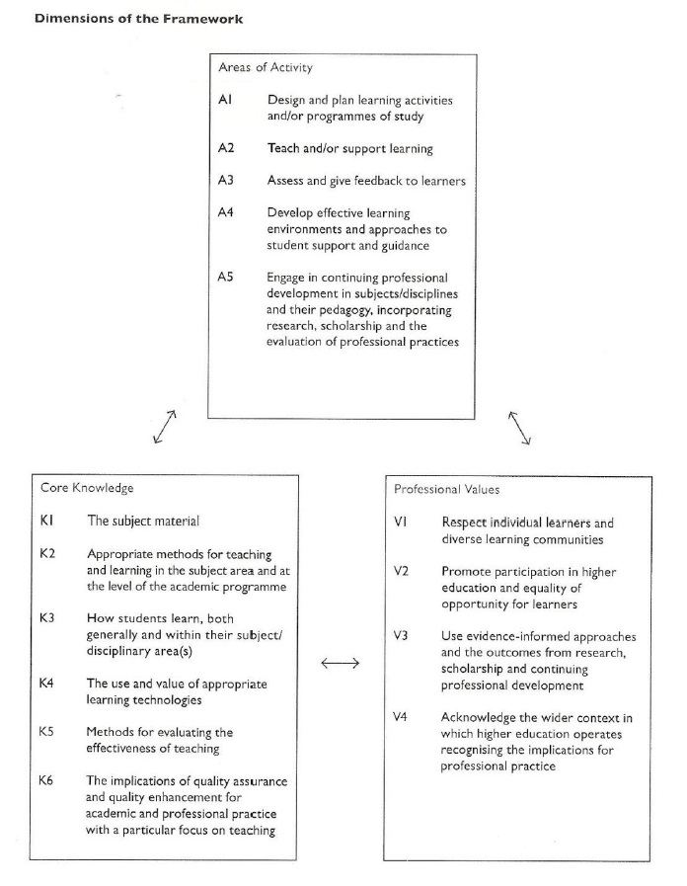
The UK Professional Standards Framework
AFHEA:
Any two
2+, relevant to your Areas of Activity
2+, relevant to your Areas of Activity

Slide 13
ACADEMIC DEVELOPMENT CENTRE
Preparing to Teach in Higher Education
APP Postgraduate Researchers
PGA Technology Enhanced Learning
APP Teaching Excellence
APP EXP
3-4 Hours
Self-directed, online
Mandatory for GTAs
Certificate & pay
6 Months Taught
For PGRs who teach
AFHEA
6 Months Project-based
Few restrictions
AFHEA, 20 CATs, PGA
12 Months Blended
For TFs and APs
FHEA
You decide Experiential
For everyone
Different awards
OR…
Academic Development Programme
PGA Teaching and Learning in HE
PGA TEL: Theory and Application
KEY
Usually 1-2 hours
Workshops
For everyone
Standalone
+6 Months Blended
For PGRs who teach
AFHEA, 30 CAT PGA
8 Months Project-based
Few restrictions
FHEA, 30 CAT PGA
Length Structure
Eligibility
Award(s)
Notes:
Need to add PGCHE?

Slide 14
Preparing to Teach in Higher Education
3-4 Hours
Self-directed, online
Mandatory for GTAs
Certificate & pay
Short, introductory course
Readings, videos, activities, reflective writing
Some key ideas for teaching in HE
Practical thinking for different teaching contexts
Assessment: create a session plan and self-evaluation

Slide 15
Academic Development Programme
Usually 1-2 hours
Workshops
For everyone
Standalone
Outreach: life beyond the classroom ✅ Nick Barker, School Outreach Fellow in Residence
Large Group Participation ✅ Dr. Peter Fossey, Senior Academic Developer, ADC
Avoiding Death by PowerPoint ✅ Dot Powell, Director of Teaching and Learning Enhancement, WBS
The Academic Literacy of New Arrivals Amy Stickels, Senior Teaching Fellow, Warwick Foundation Studies
App happy? Synchronous spaces and interactive tools: an exploration Sara Hattersley, Senior Teaching Fellow, ADC
Making Engaging Asynchronous Videos Oliver Turner, Teaching Fellow, ADC
Assessment for Learning in Moodle Jim Judges, Senior Academic Technologist

Slide 16
APP Postgraduate Researchers
6 Months Taught
For PGRs who teach
AFHEA
Taught course – series of workshops, individual and group activities
Core elements of teaching practice, including design, delivery, inclusivity, professional values
Designed specifically for PGRs who teach
Summative assessment: teaching philosophy statement, narrative of professional practice (teaching observations)
PGA Teaching and Learning in HE
+6 Months Blended
For PGRs who teach
AFHEA, 30 CAT PGA

Slide 17
PGA Technology Enhanced Learning
6 Months Project-based
Few restrictions
AFHEA, 20 CATs, PGA
Project-based: learning and assessment centres on a “technology intervention” of your own devising
Support through online workshops and resources
For anyone who is employed by the university to teach or support learning, broadly construed
Summative assessment: presentation and evaluative/reflective writing on your project
OR…
PGA TEL: Theory and Application
8 Months Project-based
Few restrictions
FHEA, 30 CAT PGA

Slide 18

Warwick Awards for Teaching Excellence (WATE)
Postgraduate category
Nominations by staff and students
3 awards per year
Funding for teaching intervention, and support to develop your online presence
Trophy by Maxim Kulikov from the Noun Project

Slide 19
Other resources:
Teaching for Learning Online
Academic Integrity
ADP Asynchronous Content
Learning Design Consultancy Unit
Come and join us!
https://warwick.ac.uk/fac/cross_fac/academic-development

