Slide 1
Writing with AI
Dr. Isabel Fischer
Associate Professor (Reader) Information Systems Management

Slide 2
How to write a non-descriptive assignment (for assessments where AI use is permitted or encouraged)
Step by Step instruction

Slide 3

Step 0: Prerequisite when writing assessments augmented with AI
Trial various GenAI / AI tools – Copilot being the university’s recommended tool – please only use non-subscription versions – e.g., by enhancing your previous assignments using the feedback you received as prompts for improvement
There are more AI tools than just GenAI chatbots
Ensure you do not upload any sensitive data
Consider aspects of AI Ethics, e.g. read the publications to the left, including links / references made in the articles
Read up on what is specifically recommended for students, e.g.: https://warwick.ac.uk/fac/cross_fac/academy/activities/learningcircles/future-of-learning/
Take note and reflect on your learning and also on how your attitudes changed (if they did).
Fischer, I. (2024), Covelent: The balancing act of GenAI adoption in consulting, Journal of Information Technology Teaching Cases, 0(0), (a Sage Journal). https://doi.org/10.1177/20438869241280977
Fischer, I. (2024), Evaluating the ethics of machines assessing humans, Journal of Information Technology Teaching Cases, 14(2), pp 273-281, (a Sage Journal). https://doi.org/10.1177/20438869231178844
Fischer, I., Beswick, C. & Newell, S. (2021), Rho AI – Leveraging artificial intelligence to address climate change: financing, implementation and ethics, Journal of Information Technology Teaching Cases, 11(2), pp 110-116, (a Sage Journal). https://journals.sagepub.com/doi/full/10.1177/2043886920961782

Slide 4
Prerequisites continued: Attach your past assignments to GenAI tools (e.g. Copilot) and add the following prompt:
Example Prompt: I have recently submitted the attached assignment and received the feedback that it was too descriptive without really engaging with literature Overall I want to learn to improve the writing with fewer sub-sections or even no sub-sections and putting the theory first with a clear argument and then using literature and my example to support the argument I am making. What do you think could be a strong academic argument to centre my work and how would you then have written the assignment. Possibly taking ideas of how to engage with theory from this article: Is it Worth it? How Paradoxical Tensions of Identity Shape the Readiness of Management Educators to Embrace Transformative Technologies in their Teaching. Journal of Management Education, 48(4), pp 829-848, https://doi.org/10.1177/10525629231201843

Slide 5
Step 1: Curiosity - What is the topic, and what am I interested in?
Think about your area of interest and how this fits within the assignment brief
Then write your first prompt for broad GenAI suggestions, prompt AI to suggest different angles, controversies, or questions related to the topic.
Reflect on what personally resonates and why - Keep track of what you thought about the GenAI responses for your written reflection part.
Example: I am interested in: Tech Adoption Challenges, Trust, AI Ethics for Tech Implementation, Analysing resulting phenomena using Paradoxical Tensions, Sensemaking, Framing, or Attribution Theory as a lens.
You might be interested in: Working in the future in Digital Marketing, a theory / framework you like / liked from past assignments.
A prompt could be – I am interested in… to understand X phenomenon. How do you think I can approach my academic assignment in this area:… Please use academic referencing so that I can start reading relevant articles.
Then read and form your own opinion, using perhaps further prompts and literature / google scholar searches to refine your area of focus.
Write an outline yourself (possibly copy pasting some earlier GenAI output)
Write in English or in your native language (or in any language that helps you to develop your thoughts)

Slide 6
Step 2: Framing and Positioning: Refine your idea – focusing on the main part of your assignment
Having written an outline yourself (possibly copy pasting some GenAI output from Step 1)
Then ask GenAI to review amend and improve, e.g., prompt: What is my central idea / argument and could you bring in literature in support and against my argument?
Read GenAI suggestions to understand if you want to integrate the GenAI suggestions
Get GenAI (possibly a different tool) to double check literature by summarising the literature initially listed – does what GenAI write make sense in the context?
Now write / collate a 2nd outline which includes literature and theoretical underpinnings

Slide 7
Step 3: Review and Refine Evidence, Analysis and Critical Evaluation - How do I support my argument and contrast it with counterarguments?
Review the 2nd outline – is it logical / does it make sense? What is missing? Are the sources credible (read at least abstracts, check number of citations / recency, journal quality), check biases – use a different GenAI tool and ask specifically what is missing – make sure various sources are synthesised for your argument and the counterargument.
Once you are happy with the outline, provide the GenAI tool with information on how the assignment should be written and the marking criteria (copy paste the assessment information into the prompt) – ask for GenAI to write the 3rd draft.
Emphasise the image parts of your assignments – Prompt: Note the tailored image requirements of the assignment, what tailored images can I include (you can also prompt for multimodal input)
This should be the last generic draft, from here onwards change paragraphs, sentences, words only as you don’t want to lose your own storyline.

Slide 8
Step 4: Structure & Clarity: Does my essay flow logically and complies with academic writing requirements
Review the 3rd draft – for flow and clarity. Start enhancing paragraphs at a time: Keep the main file at this point rather than GenAI re-writing entire drafts, allow yourself time to reflect
Write your reflective part (following steps 1– 4).
The comprehensive document becomes your 4th draft – from now on get GenAI & AI to review and refine, but by making suggestions rather than re-writing
Re-read yourself several times (also on subsequent days) – does it make sense to you – would you give yourself 70+ across all marking criteria?
Did you pay attention to the overall presentation of your word document, e.g. include page numbers, correctly referenced literature in text, and list of references in alphabetical order, with the right parts of references in the right format (e.g. journal in italics) – consider using Zotero or a different citation software

Slide 9
Step 5: Fact checking Citations and References
Check DOI / Links – over half tend to be wrong, titles/authors often wrong, formatting not APA/Harvard
Arenas, D., Lozano, J. M., & Albareda, L. (2009). The role of NGOs in CSR: Mutual perceptions among stakeholders. Journal of Business Ethics, 88(1), 175-197. https://link.springer.com/article/10.1007/s10551-009-0109-x
Banerjee, S. B. (2018). Transnational power and translocal governance: The politics of corporate responsibility. Human Relations, 71(6), 796-821. https://journals.sagepub.com/doi/10.1177/0018726717726586
Fransen, L. (2012). Multi-stakeholder governance and voluntary programme interactions: Legitimation politics in the institutional design of corporate social responsibility. Socio-Economic Review, 10(1), 163-192. https://academic.oup.com/ser/article-abstract/10/1/163/1625171?redirectedFrom=fulltext
Halme, M., Rintamäki, J., Knudsen, J. S., Lankoski, L., & Kuisma, M. (2020). When is there a sustainability case for CSR? Pathways to environmental and social performance improvements. Business & Society, 59(6), 1181-1227. https://journals.sagepub.com/doi/10.1177/0007650318755648
Hockerts, K. (2015). A cognitive perspective on the business case for corporate sustainability. Business Strategy and the Environment, 24(2), 102-122. https://onlinelibrary.wiley.com/doi/10.1002/bse.1813
Preuss, L., Fischer, I. & Arora, B. (2024), How do Stakeholder Groups Make Sense of Sustainability: Analysing Differences in the Complexity of their Cognitive Frames, Business Strategy and the Environment, 33(3), pp 2367-2383, https://onlinelibrary.wiley.com/doi/10.1002/bse.3611
Sharma, G., & Jaiswal, A. K. (2018). Unsustainability of sustainability: Cognitive frames and tensions in bottom of the pyramid projects. Journal of Business Ethics, 148(2), 291-307. https://www.jstor.org/stable/45022441

Slide 10
Step 6: Fact checking what citations actually claim in the original text
Double check, does the article say what GenAI claims it says? Read (!) and re-prompt several times, e.g., In a new context window and/or different GenAI tool
  Assess if the following articles’ foci align with the arguments/ statements in the following text… (then add text and full list of references)
  Summarise what each of the articles in the list of references says on the topic of XXX (e.g. conceptualisation of CSR and Sustainability by stakeholder groups) and assess how well each claim aligns with the cited sources
  Are there any gaps and could you suggest quality academic literature to fill the gaps? List the full references
  Any further recommendations or refinements? Please list them first before revising the text.
For subscription-free versions it’s better to copy-paste text than attaching documents as otherwise you will not be able to sufficiently prompt, check, amend.

Slide 11
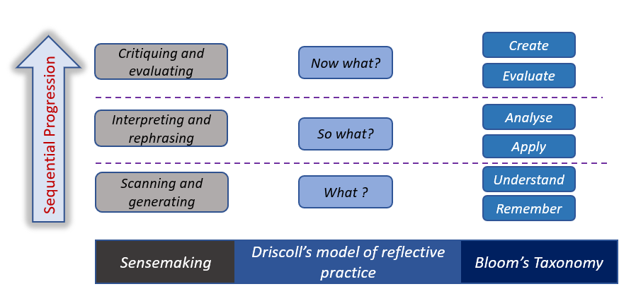
Step 7: Did I demonstrate critical engagement and reflection? Re-read and consider how you can enhance your writing further.
Preuss, L., Fischer, I., & Luiz, J.M. (2023). Using sensemaking as a lens to assess student learning on corporate social responsibility and sustainability. Higher Education Quarterly. https://doi.org/10.1111/hequ.12429
Fischer, I., Sweeney, S., Lucas, M. & Gupta, N. (2024), Making Sense of Generative AI for Assessments: Contrasting Student Claims and Assessor Evaluations, International Journal of Management Education 22(3), https://authors.elsevier.com/sd/article/S1472-8117(24)00152-6

Slide 12
Step 7: Ensuring critically analysis and reflection - Is the suggestion interesting and easy to read?
Make sure that your critical analysis and evaluation remains easy to follow. This is especially important in a business context where decision-makers are time-poor and unwilling to invest excessive cognitive effort in deciphering complex writing.

Slide 13
Step 8: Now focus on the other parts of your assignment
What would be the best title
Write the abstract (essay) or executive summary (report).
For these steps I strongly recommend that you first write your own text and then use several (repeat!) prompts across different tools to see how to enhance
Read aloud to yourself / get word to read to you and/or get friends to proof-read (especially the short sections such as title and executive summary), asking them or AI to paraphrase to give you assurance that your audience understands what you want to say and that all is logically presented.

Slide 14
Step 9: Images & Tables
At the time of writing this presentation, this is an area that GenAI tools are particularly struggling with producing appropriate material
Remember:
  Table: Label / caption on top of / before / above table
  Figures and Graphs: Label below figures and graphs
  For Table / Figure / Graphs give a title (and then reference, if it needs to be referenced in brackets or write ‘self-made’ if entirely produced by you)
You can use AI to create images but make sure they are tailored and don’t have any spelling mistakes
If possible, use British English throughout (except for references if the original writing uses American English)

Slide 15
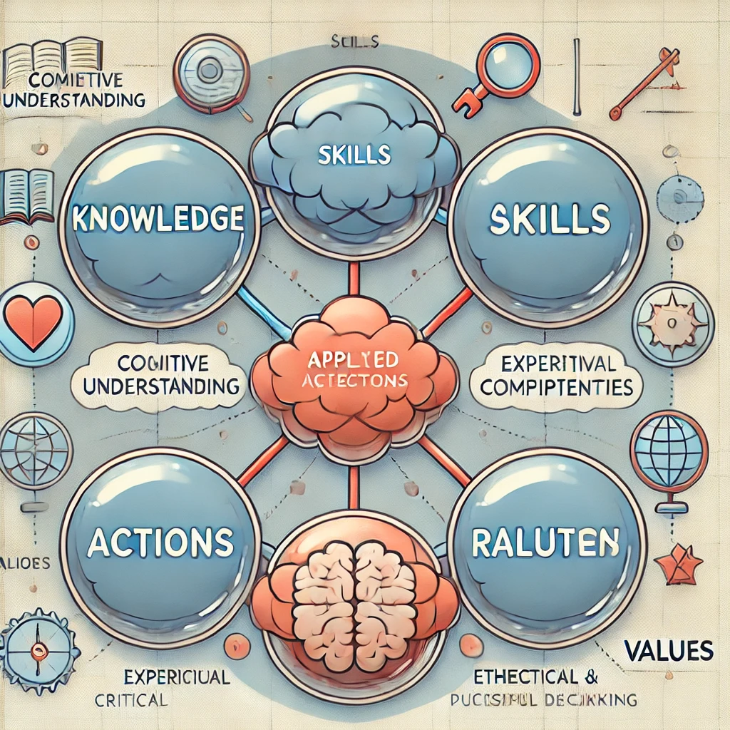
Example: Spelling mistakes in images

Slide 16
Step 10: Reflection on your use of AI
Take time to reflect on your learning throughout the process
Avoid generic statements, e.g., AI was excellent.
Avoid descriptive statements, e.g., I followed the following steps.
In the world document and below some sentences – don’t just copy, getting a high mark is linked to be novel & innovative
Change is a theme that currently resonates with me especially as a postgraduate preparing to take the next step in my career. I considered ways I could stay ahead of the curve and embrace change (Mui, 2012). I took this assignment as an opportunity to explore generating images using AI for the first time. The process took a lot longer than expected because I was unfamiliar with the level of detail needed in prompts to achieve desirable results. I had to repeatedly restructure my prompts to generate the desired images, which decreased efficiency. I also clearly observed DALL-E's hallucinations and limitations with spelling (see Appendix C). Moving forward, I believe that effectively leveraging AI requires a good understanding of the "jagged frontier" of its capabilities and limitations (Dell'Acqua et al., 2023). I also sought GenAI’s feedback on the assignment (see Appendix D)…

Slide 17

Appendix: Anticipating the future

Slide 18

Why do I need to consider what the future might bring
‘Founded’ logical predictions / recommendations make your suggestions worthwhile to consider for the reader.

Slide 19
Theorising ‘the future’
Practitioner report & toolkit: https://www.gov.uk/government/publications/futures-toolkit-for-policy-makers-and-analysts
Beane, M. I., & Leonardi, P. M. (2022). Pace Layering as a Metaphor for Organizing in the Age of Intelligent Technologies: Considering the Future of Work by Theorizing the Future of Organizing. Journal of Management Studies, https://doi.org/10.1111/joms.12867
Beck, S., Bergenholtz, C., Bogers, M., Brasseur, T. M., Conradsen, M. L., Di Marco, D., ... & Xu, S. M. (2022). The Open Innovation in Science research field: a collaborative conceptualisation approach. Industry and Innovation, 29(2), 136-185.
Beck, S., LaFlamme, M., Bergenholtz, C., Bogers, M., Brasseur, T. M., Conradsen, M. L., ... & Xu, S. M. (2023). Examining Open Innovation in Science (OIS): what Open Innovation can and cannot offer the science of science. Innovation, 25(3), 221-235.
Bugeau, A. and Ligozat, A.L., 2023. How digital will the future be? Analysis of prospective scenarios. Preprint Kitsing, M., 2021. The political economy of digital ecosystems: Scenario planning for alternative futures. Routledge.
Ködding, P., Koldewey, C. and Dumitrescu, R., 2023. Scenario-based foresight in the age of digital technologies and AI. New Digital Work: Digital Sovereignty at the Workplace (pp. 51-67). Cham: Springer International Publishing.
Leonardi, P. M. (2009). Crossing the Implementation Line: The Mutual Constitution of Technology and Organizing Across Development and Use Activities. Communication Theory, 19(3), 278-310.
Leonardi, P. M. (2009). Why Do People Reject New Technologies and Stymie Organizational Changes of which They Are in Favor? Exploring Misalignments Between Social Interactions and Materiality. Human Communication Research, 35(3), 407-441.
Sætra, H. S. (2023). Technology and Sustainable Development: The Promise and Pitfalls of Techno-Solutionism (p. 287). Taylor & Francis.
Schumacher, E. F. (2011). Small is beautiful: A study of economics as if people mattered. Random House.
Salo, A. and Cuhls, K., 2003. Technology foresight—past and future. Journal of forecasting, 22(2‐3), pp.79-82.
Spaniol, M.J. and Rowland, N.J., 2023. AI‐assisted scenario generation for strategic planning. Futures & Foresight Science, 5(2), p.e148.
Spaniol, M.J., 2023. Using scenarios to assess innovations. Technology foresight for public funding of innovation: Methods and best practices (pp. 59-65). European Commission. Joint Research Centre.

Slide 20
Why and How to Think About the Future?
How do individuals, organisations, and societies plan for uncertainty?
Why do some innovations succeed while others fail?
Can we predict the future, or should we create it?
Ways to predict / create the future:
Forecasting (data-driven predictions)
Foresight (exploring multiple plausible futures)
Scenario Planning (structured narratives for strategic decision-making)
Backcasting (working backwards from a desired future)

Slide 21
Scenario Planning and Backcasting
Best-case scenario (e.g., AI enables personalised learning, reduces inequality)
Worst-case scenario (e.g., AI deepens digital divides, replaces human teachers)
Surprise scenario (unexpected technological breakthrough or crisis)
Best-case scenario backcasting
If this scenario happens, what steps led us here?
What policies, decisions, and innovations shaped this outcome?
What needs to be done today to reach a desirable future?

Slide 22
Some further considerations
Pull of the Future: What visions or trends are driving change?
Push of the Present: What forces (tech, policies, economy) are influencing decisions now?
Weight of the Past: What traditions, regulations, or barriers are slowing change?
Potential questions to go deeper into critical evaluation:
Should we passively forecast the future or actively shape it?
How can we prepare for multiple futures?
What should policymakers, educators, and innovators do today?

Slide 23
Example – School in 2030
What might the school of 2030 be like? An exercise in social science fiction
https://discovery.ucl.ac.uk/id/eprint/10087160/1/Social%20Science%20Fiction%20PAPER_07_11_19.pdf
In exploring this question, we are adopting a number of explicit assumptions… we are primarily grounding these stories in terms of the technological conditions… as the main lens through which to view difference and change over the next ten years. While touching on issues of population expansion, shifting global economics and increased commercialisation of education, we are not envisaging more radical demographic, environmental and/or economic futures.
Lackey’s (1994) guidelines for writing social science fiction provided a useful frame to these activities. From a symbolic interactionist perspective, Lackey encourages writing that explores how definitions and emotions emerge from (and are modified during) interactions with others.
Lackey, C. (1994) Social science fiction. Teaching Sociology, 22(2): 166-173

Slide 24
Thank you

