Slide 1




Neurodiversity and Wellbeing
Dr. Jag Jutley-Neilson
Director of Student Experience
Warwick Institute of Higher Education Academy Learning Circle lead for Neurodiversity and Higher Education

Slide 2
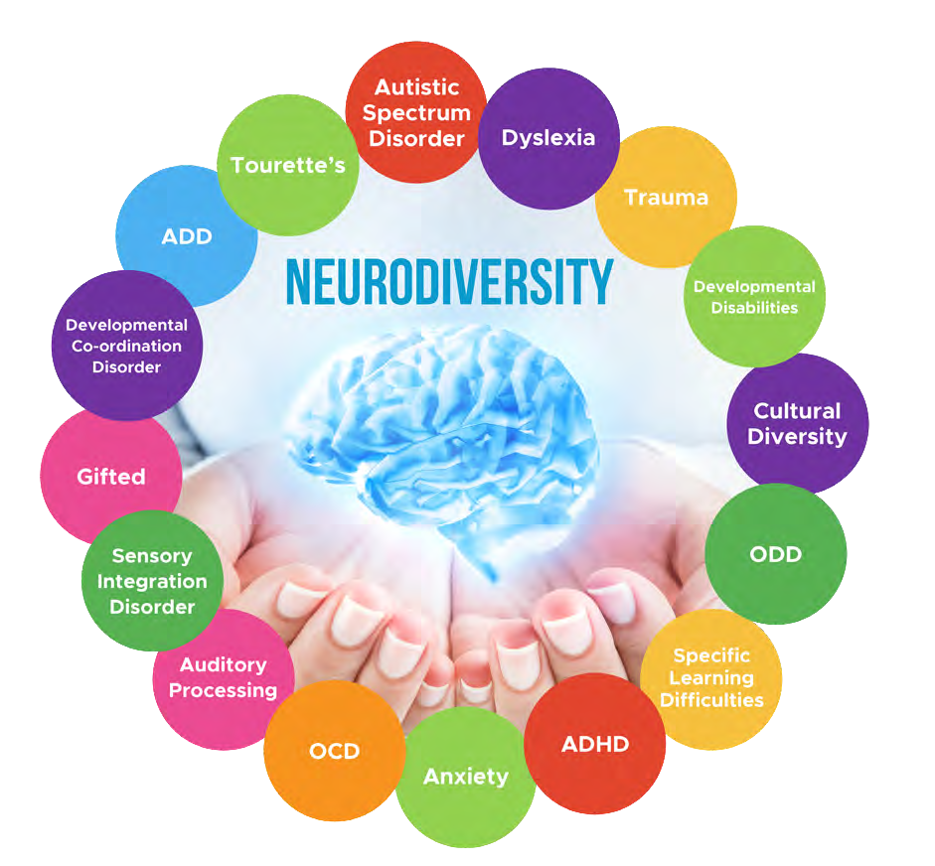
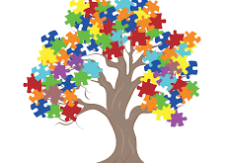
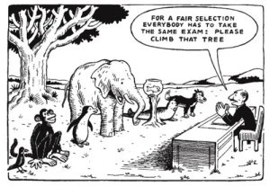
What is Neurodiversity
Judy Singer coined the term in the 1990s
Moving away from deficit model.
Image from: https://www.nordangliaeducation.com/en/our-schools/bratislava/article/2019/7/15/celebrating-neurodiversity
Notes:
“Neurodiversity may be every bit as crucial for the human race as biodiversity is for life in general. Who can say what form of wiring will prove best at any given moment?”.
The 1 in 67 of us on the autistic spectrum excel in science, engineering, mathematics, and across industry; they are your academics, chemists, physicists, accountants, mathematicians, computer programmers and surgeons
The 1 in 20 of us who have ADHD are prevalent in the ‘workaholic’ entrepreneurs, creative industry designers, marketers, artists, musicians, MP’s, inventors, actors, journalists, professional sports men and women.
Neurodiversity is often considered as a social justice movement that focuses on celebrating neurodiversity along with biodiversity and cultural diversity.

Slide 3


Neurodiversity
Autism Spectrum Disorder
ADD/ADHD
Dyspraxia
Dyslexia
Dyscalculia
Specific Language Impairment
Tourette's Syndrome
Often co-occurrence of these learning differences
Not categorical, but more dimensional
Notes:
Dyspraxia
common disorder affecting fine and/or gross motor coordination
DCD is thought to be around 3 or 4 times more common in boys than girls, and the condition sometimes runs in families.
intellectual ability is in line with the general population.
6%, being severe in 2%; a further 10% have the condition at a milder level, which implies that most school classes will have at least one affected child
At least one child per class
ASD
Communication
Social
Sensory
Restrictive rigid routines
Above intelligence, some learning disability
Mainstream – routine, unstructured time, communication, social skills, planning sensorty
71 of children with ASD attend mainstream - https://www.ambitiousaboutautism.org.uk/stats-and-facts - 4] DfE Special educational needs in England: January 2014
1 in 100
4:1 Girls Boys
ADD/ADHD
types of behavioural problems: inattentiveness, and hyperactivity and impulsiveness.
Inattentiveness
The main signs of inattentiveness are:
having a short attention span and being easily distracted
making careless mistakes – for example, in schoolwork
appearing forgetful or losing things
being unable to stick to tasks that are tedious or time-consuming
appearing to be unable to listen to or carry out instructions
constantly changing activity or task
having difficulty organising tasks
Hyperactivity and impulsiveness
The main signs of hyperactivity and impulsiveness are:
being unable to sit still, especially in calm or quiet surroundings
constantly fidgeting
being unable to concentrate on tasks
excessive physical movement
excessive talking
being unable to wait their turn
acting without thinking
interrupting conversations
little or no sense of danger
Dyslexia
Dyslexia is a common learning difficulty that can cause problems with reading, writing and spelling.
It's a specific learning difficulty, which means it causes problems with certain abilities used for learning, such as reading and writing.
Unlike a learning disability, intelligence isn't affected.
It's estimated up to 1 in every 10 people in the UK has some degree of dyslexia.
Symptoms of Tourette's
Tics - physical.vocal

Slide 4
5 minute Think-Pair Share:
How Neurodiverse is your class?
What strategies do you use/(know) to help foster an inclusive learning environment ?

Slide 5
Neurodiversity and Wellbeing
Mental health difficulties more common for individuals with ASD (Russell et al., 2015) and ADHD (Halmoy et al 2009) than neurotypical populations
Dyspraxia and Depression (Kirby et al., 2013) are a common co- occurrence
Specific Language Impairment and Emotional Regulation co-occur (Assous et al., 2018)

Slide 6
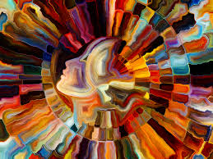
Neurodiversity and Wellbeing
Mindfulness positive effect on wellbeing
Helps to focus on learning – stop and think
Helps to reduce stress - talk and share
Uncertainty of the new - self- acceptance
Notes:
Think write pair shre

Slide 7

Summing it all up:
Neurodiversity, Mindfulness and Our Teaching
Universal Design for Learning (UDL) is an approach to designing curriculum and instruction that prioritizes accessibility and inclusivity. The why, what and how of learning
What is mindfulness?
“Awareness that arises through paying attention, on purpose, in the present moment, non-judgementally” (Kabat-Zinn, 2005
Mindfulness and UDL
Focus
Calm
Self-Acceptance
Notes:
Mindfulness focuses on the present as a way to de-clutter our minds from worrying about the past or future

Slide 8
Table Discussion
Why are neurodivergent students more vulnerable to wellbeing difficulties?

Slide 9
Neurodiversity, well-being and mindfulness
well-being
mindfulness
Neurodiversity

Slide 10
Any Questions?
Dr Jagjeet.Jutley-Neilson@warwick.ac.uk

