Slide 1



Engaging Assessment
Special Interest Group
2nd September 2020
@RAISEnetwork

Slide 2

RAISE Engaging Assessment SIG:
Neurodiversity in higher education & impacts on assessment
Convenors:
Dr Jagjeet Jutley-Neilson, University of Warwick
Dr Paul O’Brien, University of Lincoln
Kiu Sum, University of Westminster
#RAISE20 #RAISEEngAssess
Wednesday 2nd September 2020

Slide 3

Welcome to RAISE
Aims of RAISE
To meet regularly to discuss specific and more general aspects of student engagement (SE).
To develop a conceptual map of student engagement and set of principles that underpin its promotion - and then to promote that widely.
To establish an annual conference drawing together leading edge work on SE - and to feed into publication through journals and books.
To gain funding to support these events and activities, and to ensure that students can also participate in them.
To create a bank of useful resources for us to share.

Slide 4

Lincoln 2021: RAISE Annual Conference
Save the date: September 2021

Slide 5
RAISE events this week
Wednesday 2nd September 2020
10:00-12:00 Engaging Assessment SIG on Neurodiversity in HE and impacts on assessment
13:00-16:30 Partnership SIG on Pandemic Partnerships and Power
Thursday 3rd September 2020
09:00 -10:00 Annual General Meeting – All Welcome!
10:00 -12:00 Real-world ‘messy evaluation’ and attempts to make the curriculum more engaging (Evaluation SIG)
14.00-16.00 Degree-awarding gaps (Inclusive practice SIG)
Friday 4th September 2020
10.00-12.00 Postgraduate pedagogy and themes for the future (PG practice SIG)
14:00-15:00 New SIG! Early Career Researchers (ECR) group launch

Slide 6

Journal
Student Engagement in Higher Education Journal
Peer reviewed journal seeking Research Articles, Opinion Pieces, Case Studies and Book Reviews relating to Student Engagement.
ISSN: 2399-1836

Slide 7
RAISE Network Activities
Register for a free RAISE account (www.raise-network.com) and automatically be added to our mailing list.
Join our Special Interest Groups for specialist discussions & events.
Contribute to the RAISE Journal—Student Engagement in HE Journal (Submissions Open).
Attend the RAISE Annual Conference in September for the largest International Student Engagement Conference.

Slide 8





Housekeeping
    Session will be recorded
    Feel free to use the chatbox anytime – please avoid sharing any personal information (send to all or to moderators only)
    Please mute your microphones if not speaking (but feel free to use them in group discussions!)
    Technical problems
    And most importantly – enjoy the session!
#RAISE20 #RAISEEngAssess

Slide 9
Safeguarding
To protect staff and students who are joining today’s session on a topic that may perceived sensitive to them – such as the terminologies used
To provide all attendees a safe space to share their experiences and personal experiences will remain confidential in the session
Views and opinions from today’s meeting remains our own and not our work and or study place.
#RAISE20 #RAISEEngAssess

Slide 10

Grab your mobile device!
#RAISE20 #RAISEEngAssess

Slide 11
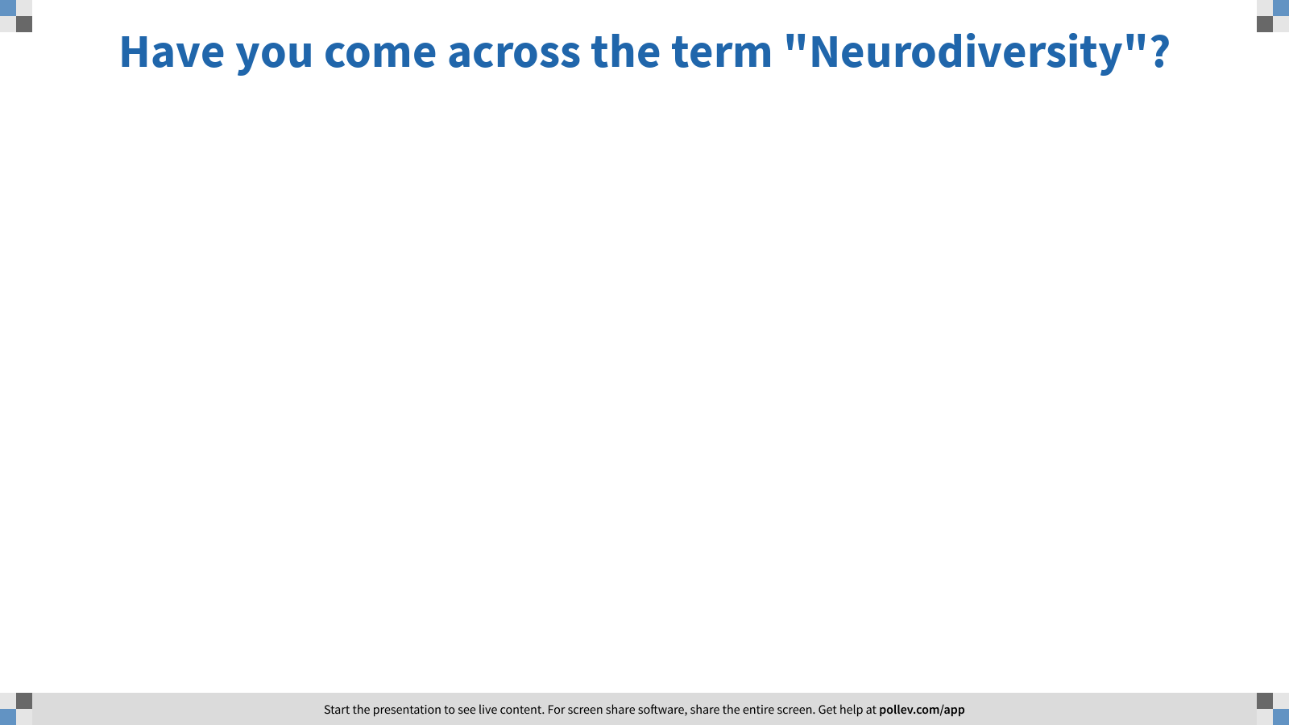
Notes:
Poll Title: Have you come across the term "Neurodiversity"?
https://www.polleverywhere.com/free_text_polls/V60sviW4uN6xEIvh4FQK5
Respond: pollev.com/kiusum7

Slide 12

Neurodiversity and Higher Education
Dr. Jag Jutley-Neilson
Director of Student Experience
Warwick Institute of Higher Education Academy Learning Circle lead for Neurodiversity and Higher Education

Slide 13

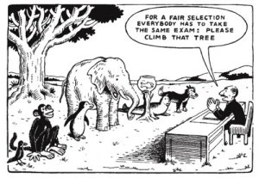

What is Neurodiversity ?
Judy Singer coined the term in the 1990s
Moving away from deficit model.
Image from: https://www.nordangliaeducation.com/en/our-schools/bratislava/article/2019/7/15/celebrating-neurodiversity

Slide 14
Neurodiversity
Autism Spectrum Disorder
ADD/ADHD
Dyspraxia
Dyslexia
Dyscalculia
Specific Language Impairment
Tourette's Syndrome
Often co-occurrence of these learning differences
Not categorical, but more dimensional

Slide 15
Disability and HE stats
In 2018-19, 14.3% (~ 1/8) students studying in England declared at least one disability (Office for Students,2020, Coronavirus Briefing note)

Slide 16
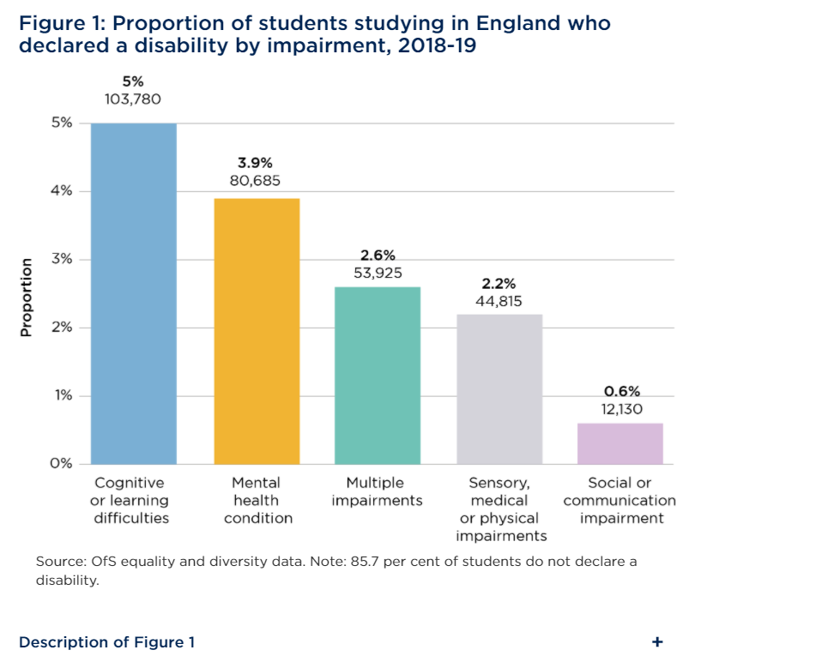
Source taken from: https://www.officeforstudents.org.uk/publications/coronavirus-briefing-note-disabled-students/

Slide 17
Disability and UK HE stats
“2.8% difference between the proportions of disabled and non-disabled students graduating with first and upper second-class degrees”
“a gap of 0.9 percentage points between the proportion of disabled students continuing their courses past the first year, compared to non-disabled students”
“a gap of 1.8 percentage points between the proportion of disabled students progressing into highly skilled employment or postgraduate study”.
“In 2019, 81.4 per cent of disabled students said they were satisfied with their course, compared to 84.3 per cent of non-disabled students”
Stats taken from New independent commission aims to boost support for disabled students announcement )OFS, May 2020) (https://www.officeforstudents.org.uk/news-blog-and-events/press-and-media/new-independent-commission-aims-to-boost-support-for-disabled-students/)
Not taken into consideration intersectionality or students who have not declared their disability.

Slide 18
ASD and Continuation in Higher Education
11,015 autistic students in 2017/18 in HE institutes across the UK (Higher Education Statistics Agency, 2019).
autistic students more likely to drop.
Cage and Howes (2020) 14 qualitative interviews of autistic students who dropped out of university. Themes identified;
  accessing diagnosis
  autism understanding
  mental health
  outsider status.

Slide 19
ASD and Assessment
Difficulties Information processing speed, time management, group work, presentations, motivation to study, following lectures, and asking questions (Jansen et al. 2018).
Strengths such as proficient memory skills, a focus in detail, original and creative thoughts, passionate interests, the desire to acquire accurate knowledge, and adherence to rules when clear structure is provided (Anderson et al. 2017a)

Slide 20
When thinking Neurodiversity, also consider wellbeing
Mental health difficulties more common for individuals with ASD (Russell et al., 2015) and ADHD (Halmoy et al 2009) than neurotypical populations
Dyspraxia and Depression (Kirby et al., 2013) are a common co- occurrence
Specific Language Impairment and Emotional Regulation co-occur (Assous et al., 2018)

Slide 21
Moving forward
Gathering existing good practice (case studies, projects, surveys, workshops)
Look at any available metrics
Strong student voice (SU, representation and partnership work)
Where can your communities of practice make impact (task groups/working groups)
Staff training – personal tutor and professional services
Think about the whole learning and student experience (induction to graduation)
Course and module level inclusivity

Slide 22
Thank You for listening!
Over to Dr Paula O’Brien

Slide 23

Panel Discussion
#RAISE20 #RAISEEngAssess

Slide 24
Panel Discussion
Q1: What is the Learning Experience of students who identify as being Neurodivergent (Specific Learning Differences) at the University of Lincoln (e.g. transition, curriculum, student opportunity, wellbeing, SU and wider student experience)?
#RAISE20 #RAISEEngAssess

Slide 25
Panel Discussion
Q2: How do we support Neurodivergent (Specific Learning Differences) students once they are here and post two years after graduation (student cycle)?
#RAISE20 #RAISEEngAssess

Slide 26

Group Discussion
#RAISE20 #RAISEEngAssess

Slide 27
Breakout Room Instructions
We will now randomly allocate you to your breakout rooms
You will need to discuss a specific question
Please reflect on your own experiences, pedagogical knowledge, any perceived challenges and/or offer suggestions
One person from your breakout room will then feedback to the group
Each group will have 2 minutes to feedback
#RAISE20 #RAISEEngAssess

Slide 28
Jane was diagnosed with Autism Spectrum Condition and ADHD when she was 10 years old. She has just accepted her place at University X and has chosen not to declare her disability on her UCAS application form. Do you foresee any challenges for Jane and/or staff?
    Support
    Transition
    Assessment
    Anything else?
Are there any potential issues that may arise when considering neurodiversity and assessment together?
    Policy
    Timing
    Student experinece
    Group work
    Support
    Anything else
What specific challenges are likely to occur due moving teaching and learning online for 2020/2021 (COVID-19)?
    Support
    Transition
    Assessment
    Anything else
#RAISE20 #RAISEEngAssess

Slide 29

Conclusion
#RAISE20 #RAISEEngAssess

Slide 30
Next Steps
Future collaboration: Pollev.com/kiusum7
Contact us:
Dr Jagjeet Jutley-Neilson: Jagjeet.Jutley-Neilson@warwick.ac.uk
Dr Paula O’Brien: POBrien@lincoln.ac.uk
Kiu Sum: k.sum@my.westminster.ac.uk
#RAISE20 #RAISEEngAssess

