Slide 1

Gender-Diverse & Trans-Inclusive Teaching Workshop
Sam Parr
With thanks to
Warwick International Higher Education Academy
Notes:
Introduce the facilitators
[Optional round of introductions with name, area of work, and pronouns]

Slide 2
What can we do to establish the culture of a teaching space?

Slide 3
What does it mean to be
cis or trans?

Slide 4


Gender 101
You are assigned a binary gender at birth (Male or Female)
-> written on your birth certificate
Cisgender or Cis
Transgender or Trans
Cis female
Binary Gender
Non-Binary Gender
Cis male
Trans woman
Trans man
Notes:
Assigned a binary gender (male or female) at birth based on genitalia predominantly, occasionally additional testing such as chromosomes and internal anatomy.
Socialised in this gender role as you grow up.
Come to an understanding of whether you agree with the gender identity you were assigned at birth.
If yes, you are a cis person.
If no, you are a trans person.
You may have a binary gender identity (male or female), or a non-binary gender identity (outside of the male and female binary).
Some people, particularly those from other countries and/or cultures, may not use these specific terms or may understand them in different ways.

Slide 5
Cis & Trans
A trans person is…
…someone who self-defines as a gender different to that which they were assigned at birth.
A cis person is…
…someone who self-defines as the same gender as that which they were assigned at birth.
Notes:
Note that there is no one universally accepted definition of ‘trans’.
Not everyone who fits the definition of trans will identify as trans, and thus the importance of respecting self-definition of identity labels.
Avoid language which suggests a ‘change’ of gender e.g. ‘changed gender’, ‘used to be X’, ‘when they were Y’.
Language/terminology of note:
‘a trans person’, not ‘a trans’ (trans is not a noun)
‘self-defines’ just means what you identify your gender as, not different somehow to ‘your gender’ (no ‘real’ gender ‘true’ gender etc.)
‘gender assigned at birth’ = the gender written on someone’s first birth certificate

Slide 6
In Numbers
0.3-1% of the population identify as trans
More people identify as trans as awareness and understanding grows
It was previously thought that there were many more trans women than trans men and non-binary people.
University is known as a relatively safe place to come out/transition, which increases the number of trans people in HE
Warwick has an active trans community, which makes it a destination for trans students
250-500 trans people at Warwick
Notes:
Addresses the stereotypes that:
There are very few trans people
Trans people are mostly trans women
Being trans is becoming more ‘popular’
University, and particularly a university with an active trans community, is seen as a safer place to be during coming out/transition.
-> Amplification effect in terms of prevalence.

Slide 7
Why are we developing trans-inclusive teaching?

Slide 8
Our Trans Students
71% of Warwick trans students have experienced LGBTUAphobia at Warwick.
Only 45% of Warwick trans students felt supported by the University.
53% of trans people aged 18 to 24 have experienced a hate crime/incident in the past 12 months.
14% of trans students have considered dropping out or have dropped out because of experiencing harassment or discrimination in the last year.
cf 63% of LGBTUA+ students
cf 38% of LGBTUA+ students
Stonewall, 2018
Stonewall, 2018
Being LGBTUA+ at Warwick research
Notes:
Being LGBTUA+ at Warwick research: https://www.warwicksu.com/campaigns-communities/communities/lgbtua/being-lgbtua/

Slide 9
Core Assumption #1
One student told us "This model requires every member of the population to be in exactly one of two 'types'. Teachers used the genders of male and female as the most 'obvious example' of two such mutually exclusive types in the real world. This year I was glad the lecturer used an example of a pond with two different species of fish in.“
Another student told us “Repeated uses of phrases like ‘the other gender’ or ‘ladies & gentlemen’ made me feel like my identity and experiences weren’t valid or recognised by my course.”
Core assumption #1: There are only two genders,
‘male’ and ‘female’.

Slide 10
Core Assumption #1
"On Family Law we directly engage with and challenge the assumptions in English family law that centre the heteronormative experiences of family life. We interrogate legal reinforcement of gender roles in marriage and the importance of sexual identity. We evaluate issues of equality both in the way that the law treats different types of couples and the roles that the law expects within marriage. We look at the role that queer activists have played in shaping English family law and students are exposed to video footage of campaigners such as Celia Kitzinger from various campaign groups about the need for children to have a mother and a father and the need for marriage to be for hetereosexuals only.”
Dr Maebh Harding from the School of Law
Core assumption #1: There are only two genders,
‘male’ and ‘female’.

Slide 11
Scenario
You want to collect gender identity data for a group.
How might you do this in a gender-diverse and trans-inclusive way?

Slide 12
Core Assumption #2
A student told us "Someone in one of my courses asked people their height to create two sample binomial distributions based on gender. He just went along assuming what gender people fit under which hurts even more."
Another student told us "Another is people gendering others when it's unnecessary. I'd answered a question and he called me the 'lady in the front'. It's so cringeworthy."
Core assumption #2: You can determine someone’s gender from their name, appearance, voice, expression...

Slide 13
Core Assumption #2
"I deliberately wore heels to highlight the point that items are gendered by the observer, rather than being innately gendered. The heels were 5.5" stilettos, red PV - with a rubber sole and a small metal buckle. None of these items are gendered reading onto the materials. In wearing male-passing clothes and presenting as masculines but then disrupting this with items that refocused the attention elsewhere, it subverted - queered perhaps? - the expectations of the viewer.”
Nick Cherryman, MA/PhD in Sociology
"I've adopted a policy I encountered at a convention a few years ago, and make sure that when I identify a student in a lecture (if multiple students have questions, are volunteering, etc.) I do so by clothing/location/hair colour/accessories, etc. No more 'gentleman at the back’.”
Dr Ric Crossman from Statistics
Core assumption #2: You can determine someone’s gender
from their name, appearance, voice, expression...

Slide 14
Scenario
You want to challenge the assumption of gender in your teaching space.
How might you do this in a gender-diverse and trans-inclusive way?

Slide 15
Core Assumption #3
A student told us “I can’t remember ever hearing about a trans contributor in my field, although there are many!”
Another student told us “Sometimes trans issues are covered, but it’s clear no one has ever talked to a trans person when developing the content. It’s often using outdated terminology, problematic comparisons, and done in an abstract way that’s dehumanising.”
Another student told us “There’s a conflation between anatomy and gender, so that when people are discussing pregnant people, they default to ‘women’.”
Core assumption #3: Everyone identifies as the gender they were assigned at birth, and their gender identity is fixed.

Slide 16
Core Assumption #3
"The online resources and session on transgender health issues came out of a meeting I invited final year students to (a LGBTQA+ person from the Student Union also came along). I wanted to develop some teaching in these areas but wanted to offer teaching and learning that students found helpful. At the meeting we decided to develop online learning resources and have a face to face session on trans people and health. Some students have reviewed the resources before we made them available to all students.”
Dr Clare Blackburn from Warwick Medical School
"In the final year of the course, we have a session on trans people and health. This is delivered by a trans woman lecturer and included a plenary involving trans students from the Student Union who are willing to share their experience of health care.”
Dr Clare Blackburn from Warwick Medical School
Core assumption #3: Everyone identifies as the gender they were assigned at birth, and their gender identity is fixed.

Slide 17
Scenario
You want to introduce some trans-specific content to your teaching.
How might you do this in a gender-diverse and trans-inclusive way?

Slide 18
Tackling the Core Assumptions
Core assumption #1: There are only two genders,
‘male’ and ‘female’.
Core assumption #2: You can determine someone’s gender from their name, appearance, voice, expression...
Core assumption #3: Everyone identifies as the gender they were assigned at birth, and their gender identity is fixed.
Notes:
[Displayed whilst group scenarios are explored.]

Slide 19
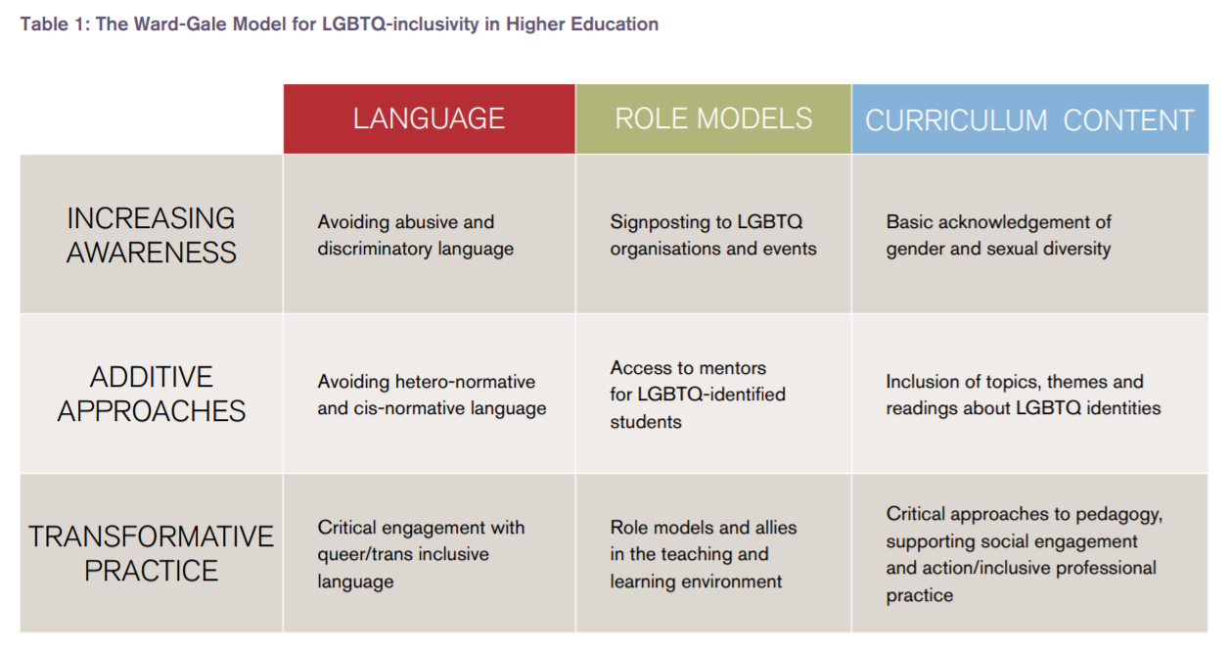

Slide 20
What barriers are there to developing trans-inclusive teaching practices?

Slide 21
What will you do to develop trans-inclusive teaching practices?

Slide 22
Further Resources
University/SU Trans Web Portal
Get Pronouns Right campaign
Gender-inclusive teaching guidance
Notes:
Add
Trans community support group
Trans Students’ Officer

Slide 23
Questions?
Anonymous question-answering:
reddit.com/r/AskWarwickTrans/
Confidential question-answering:
sam.parr@warwicksu.com
trans@warwicksu.com

