Slide 1
Developing a critical digital perspective on AI tools in Higher Education
Chris Rowell | Digital learning Producer UAL | June 2023
Notes:
Hello, my name is Chris Rowell and I currently work as a Digital Learning Producer at the University of the Arts London.
In a previous life I have worked as a FE and HE lecturer, a Learning Technology Manager and as an Academic Developer in three London universities.

Slide 2
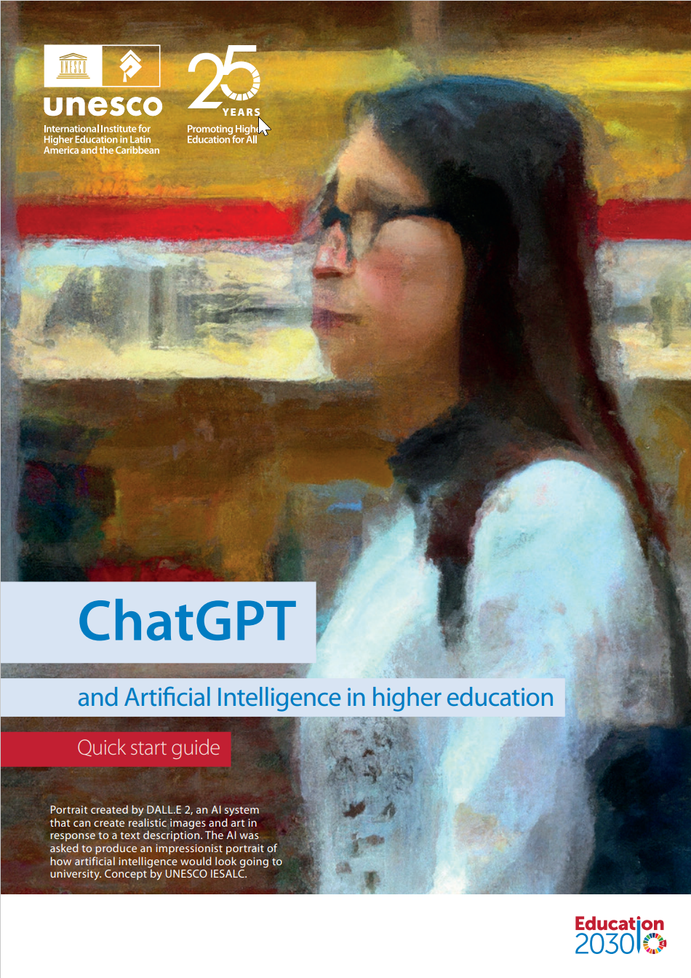
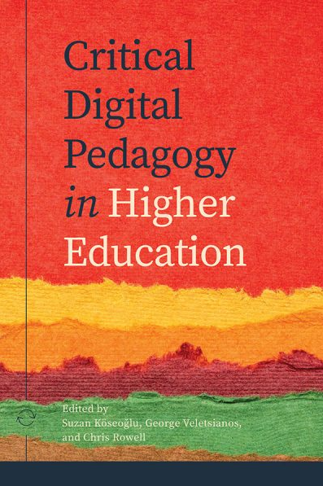
Introduction:
CDP – the book
ChatGPT – the guide
  UNESCO report – Mike Sharples
  Critical Digital Pedagogy in HE – Suzan Koseglu, George Veletsianos and Chris Rowell (eds.)
Notes:
Since the release of ChatGPT there have been numerous discussions about its use (and AI) in higher education. So far, these discussions have focused on issues to do with academic integrity, ethical concerns and its implications on assessment strategies.
In this short talk, I will look at ChatGPT and AI through the lens of ‘critical digital pedagogy’. This perspective will invite us to ask different questions about how AI tools are being used, or could be used, in a HE context.
2. However, like all educational technology, AI should be viewed in its context – and we need to ask some important questions about how it is being used.

Slide 3
Some principles of critical digital pedagogy and how they relate to AI
Notes:
The ideas of Critical Pedagogy were first articulated in the work of Paulo Freire in the 1960’s, way before AI became a thing in education.
Obviously, he was talking about a very different time but I think his ideas are still important and the principles that underlie his world view about how students learn are still very relevant to how digital education takes place in a modern university.
So this talk is briefly trying to develop his principles into a modern context……

Slide 4
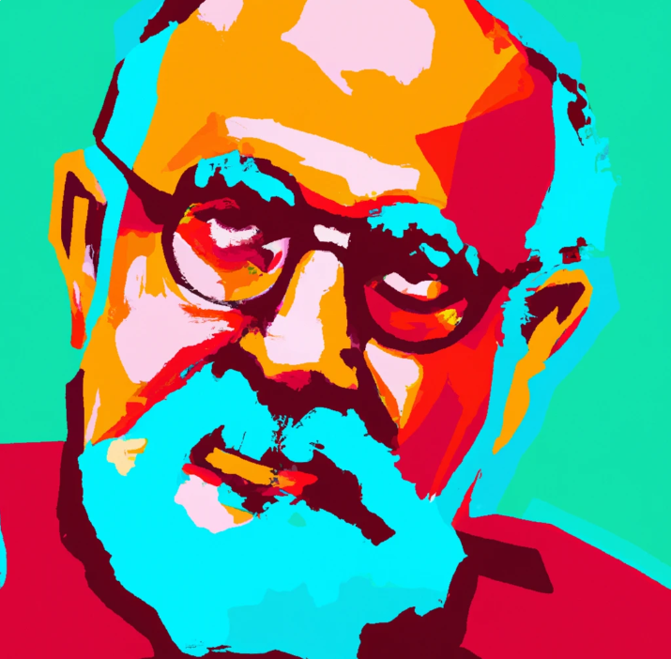
1. ‘Knowledge should be co-created between tutors and students’
Paulo Freire’s rejection of ‘banking education’ where students are seen as receptacles to be filled up with knowledge by the expert teacher
Freire contrasted this with a dialogical system of education
Image created with DALL-E using the prompt “a painting of Paulo Freire in the style of Andy Warhol”
Notes:
‘Knowledge should be co-created between tutors and students’.
This principle is based around Paulo Freire’s rejection of ‘banking education’ where students are seen as receptacles to be filled up with knowledge by the expert teacher.
2. Freire contrasted this with a dialogical system of education where knowledge is co-constructed between students and the teachers based on discussion, dialogue and interaction.
Well is this something that AI can do? In one sense, yes it can. A good example of this is to use AI as a sparring partner for an argument. A fundamental part of making an argument in an essay or a presentation is to understand a counterpoint. ChatGPT is especially good at generating these counterarguments.
3. Also using these types of tools, they are starting to be used to enhance the formative feedback process.
Both staff and students can already use ChatGPT to make and give feedback on students assignments. The tools can be used to write marking criteria and rubrics which in turn can be used to mark and give feedback on students assignments. There has been quite a lot of research showing that formative feedback is one of the most effective ways of reducing the attainment gap – which is the difference between the percentage of white students and black (and other ethnic minority) students achieving top grades on their course.
With careful use of this type formative feedback it could be possible that it would have a positive impact on the attainment gap in higher education.

Slide 5
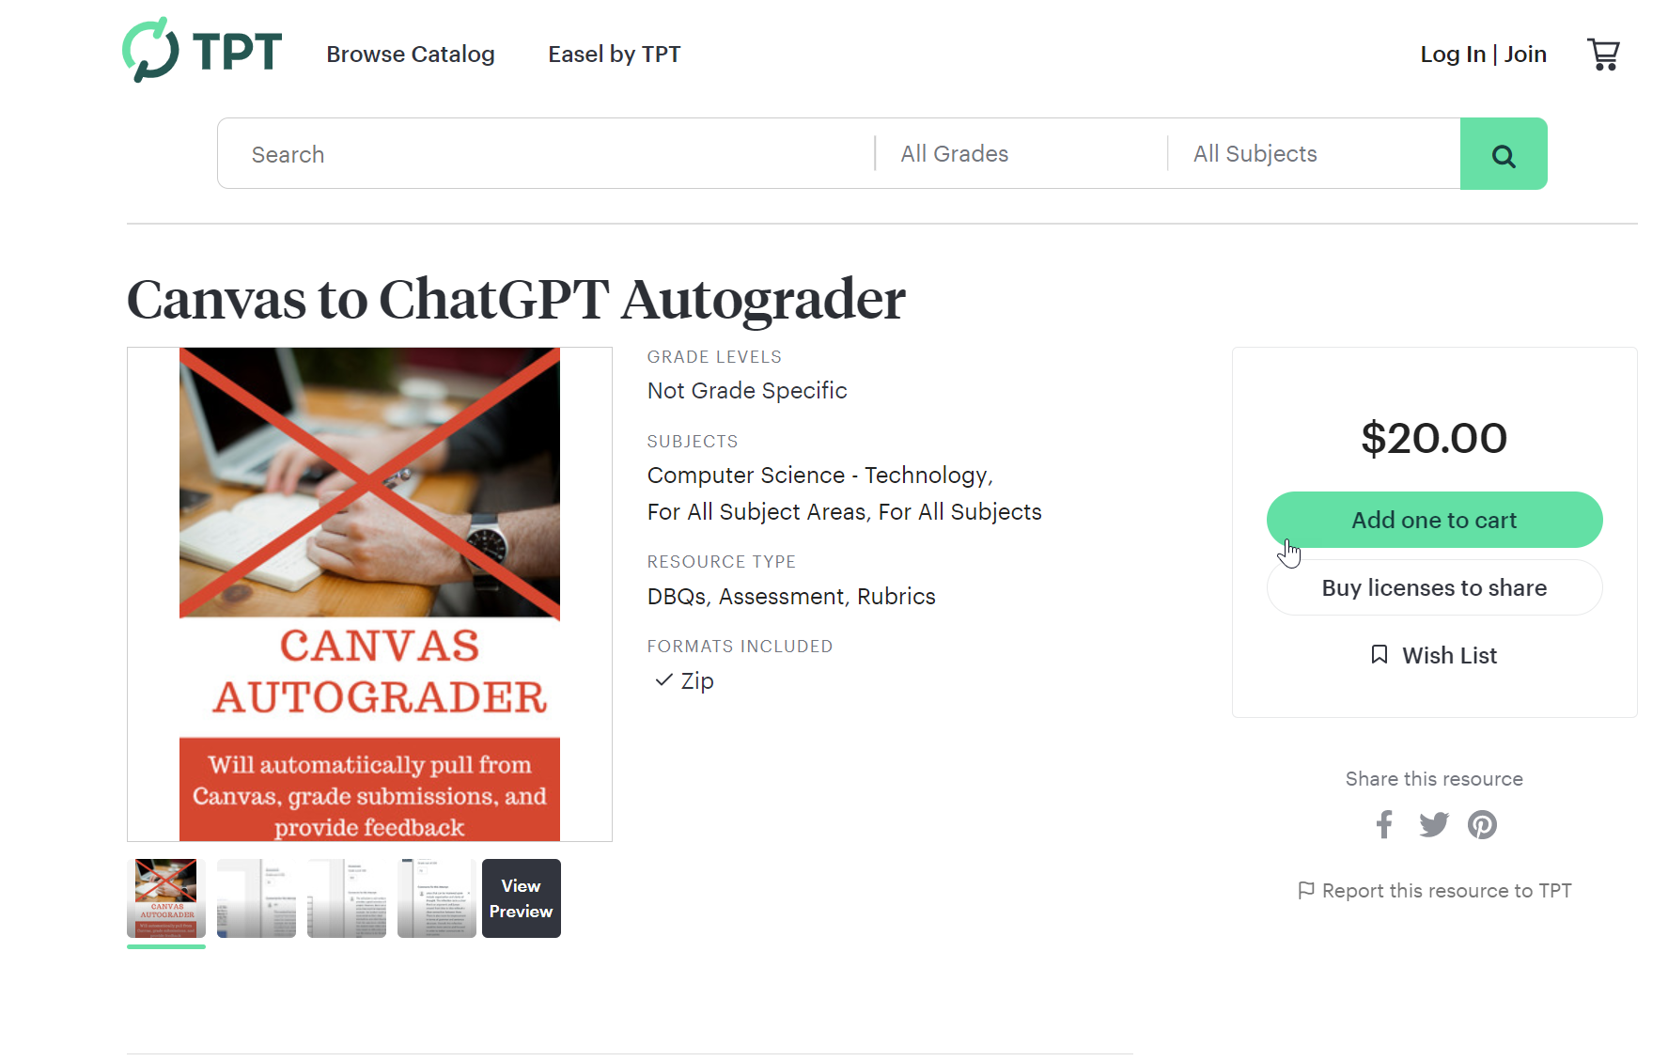
Careful use of formative feedback?
Advert Description:
This is an auto-grader for teachers using Canvas and ChatGPT's API that will pull student's submissions, automatically grade and give feedback for each student. It is a python script that requires minimal set-up, but NO CODING KNOWLEDGE needed! I have provided step-by-step instructions for set-up and execution. This can be used to grade attached submissions as well as text-entry. It works best with a rubric given in the assignment description. Perfect for giving students feedback on IB/AP practice assessments using their rubrics. The script pulls the assignment description when feeding the student's submissions to ChatGPT's AI.
Notes:
However, we need a serious word of caution here too – already we have examples of AI providers stepping into this perceived market – this recent advert that popped up on my Twitter time line.
This adverts claims that it can:
*Use rubrics to grade the students submissions
*Give feedback on the students assignments
*Then upload the grades and feedback into the Canvas VLE (similar to Moodle or Blackboard)
It does so by uploading the students work into ChatGPT – which in my opinion is highly questionable and unethical !!

Slide 6
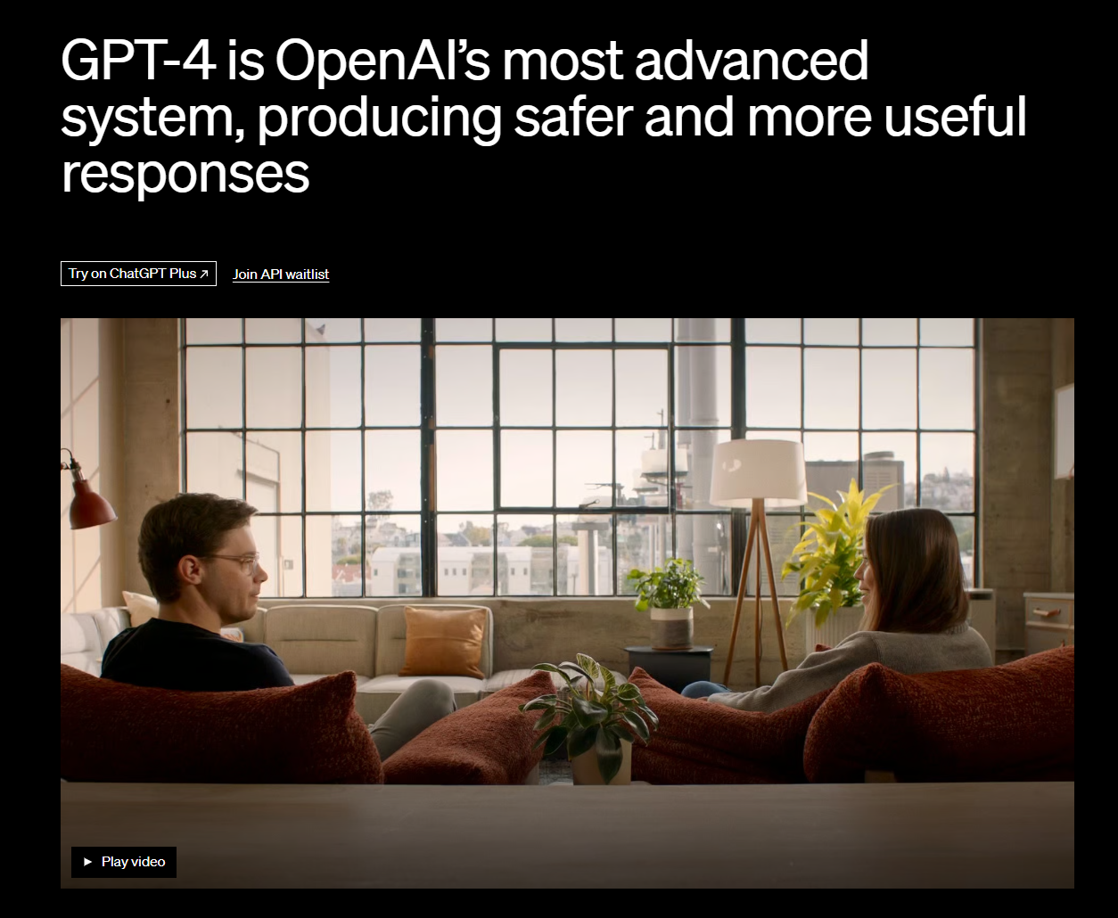
2. Digital learning environments develop the importance of democracy
Is AI education more democratic?
How long will this last?
Notes:
Digital learning environments develop the importance of democracy
On the face of it the opportunities for a AI infused education appear to be more democratic. …
The chat based tools like ChatGPT and the image generating tools like DALL-E or Midjourney are (mostly) free to use for all. It could be argued that we do not need expensive textbooks that disadvantage from low income families – and that often includes students from black and ethnic minority back grounds.
Also, this gives students the ability to manage their own learning, through project based learning, study groups or self assessment.
At the moment it’s a fairly even playing field for all to use.
However, the big question here is for how long this will remain like this? Most of these AI companies have not been developed with a primary education focus – they are often commercial entities with share holders who will demand more than a market share – and will aim to ‘monitarise’ their products.
ChatGPT 4 is a good example of this – $20 per month – for a better product…its no longer that even playing field!!!!

Slide 7

3. ‘Education (and technology) is inherently political’.
Control over our data
Market dominance
Intellectual property and patents
Midjourney: Use rights
Notes:
Education (and technology) is inherently political
By ‘political’ I don’t mean ‘party political’ but political in terms of ‘power and influence’. Ed tech companies exert their power in different ways:
1. Control over our data –
2. Market dominance and the illusion of choice
3. Intellectual property and patents….it is this last issue that I have had quite a few discussions about – this is probably because I’m based in a an art college institution which largely focuses on visual images.
Midjourney (which generates images from language descriptions) is a good example of this. So that that its free service has a creative commons licence but if you want to own the copyright of the images you generate you have to pay for their service.

Slide 8

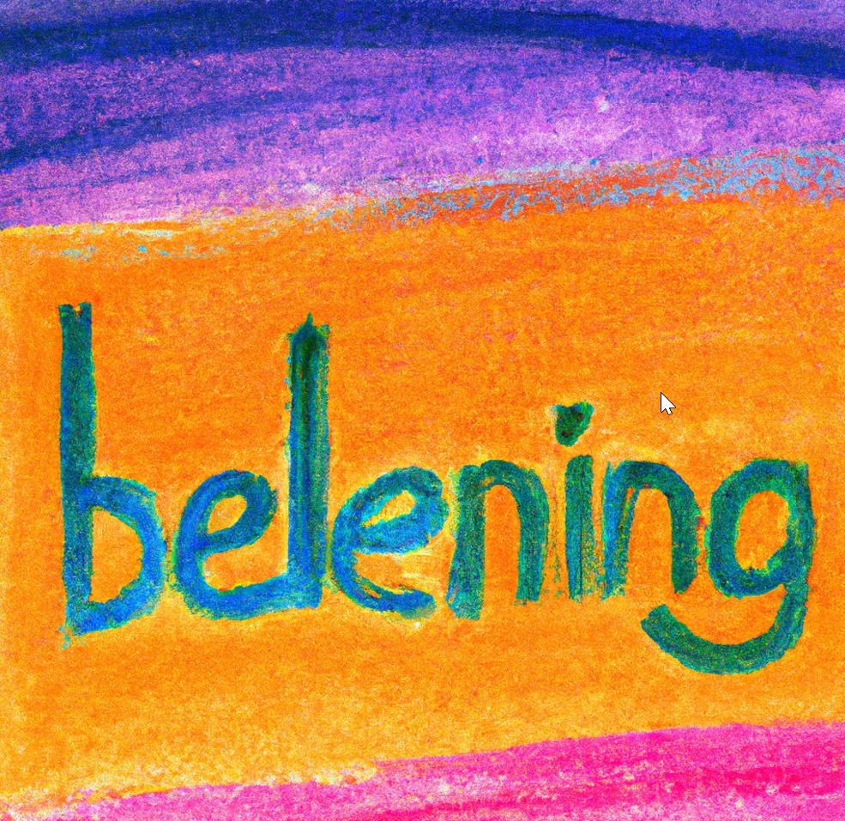
4. ‘Education is built on trust and belonging and should cultivate hope and optimism’.
Image created by DALL-E using the prompt ‘TRUST in the style of a Andy Warhol Painting’
Image created by DALL-E using the prompt ‘An oil Pastel painting of the word BELONGING’
Notes:
Education is built on trust and belonging and should cultivate hope and optimism
An essential requirement of critical pedagogy is that there should be a mutual trust between staff and students, this will enable students to have a stronger sense of belonging on their courses.
Trust and belonging are often neglected in the digital space, sometimes as a result of neglect but often because mistrust is actually built into the educational technology provided….I think Turnitin is a good example of this.
Also I think this sense of trust is essential for a genuinely anti-racist – anti biased education to exist.
Do these forms of AI engender trust and a sense of belonging? – well in my opinion, for some of the reasons I’ve already outlined no they don’t…from the start they haven’t been designed with these things in mind…

Slide 9
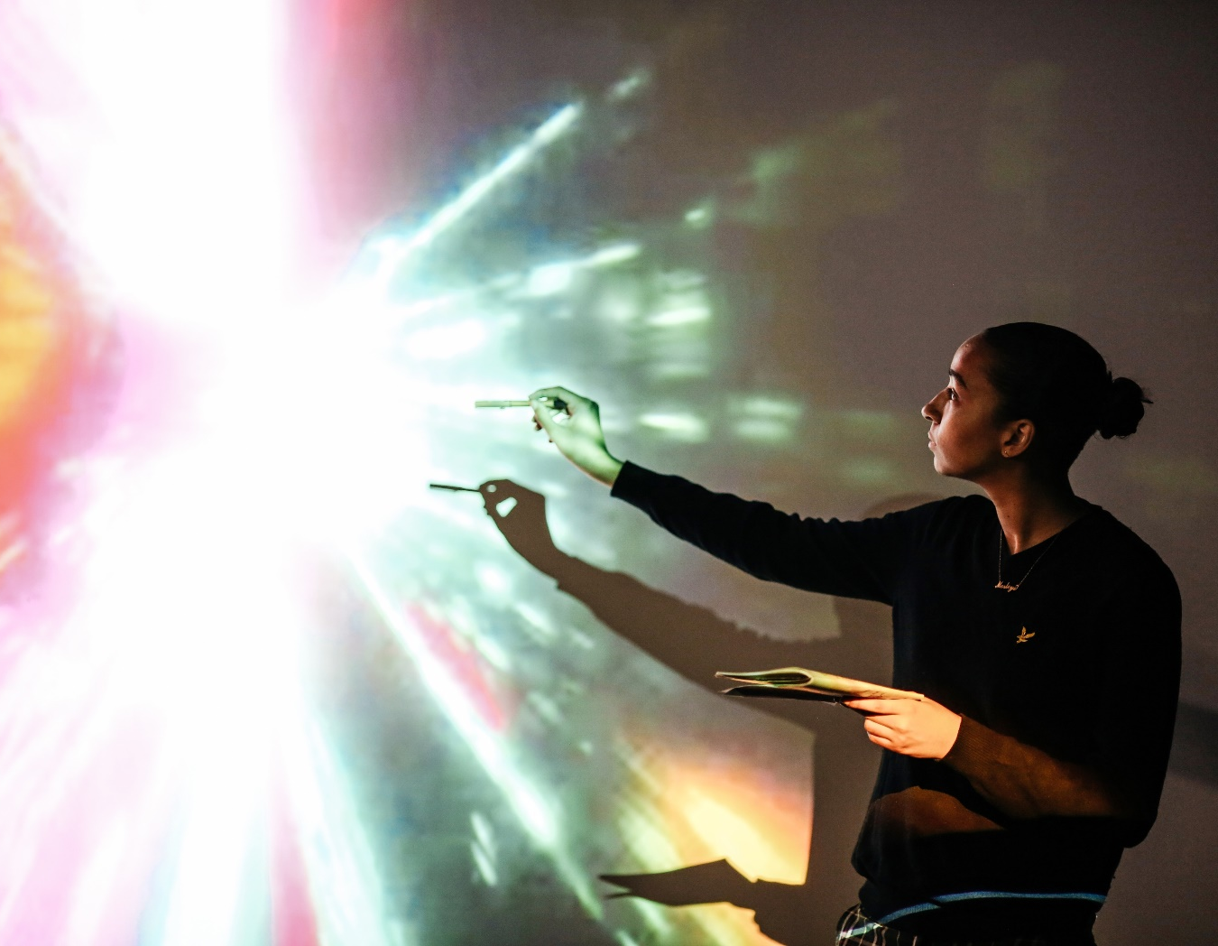
5. ‘Students become critical thinkers who create new knowledge’
*Developing information literacy
*Questioning and challenging assumptions
*Evaluating arguments and evidence.
*Multidisciplinary learning
  Ella Williams presenting
  2020 BA Film and Screen Studies, London College of Communication, UAL | Photograph: Alys Tomlinson
Notes:
Students become critical thinkers who create new knowledge
Given that we have very little control about how these AI tools is developed I think its our duty to help students understand and navigate these tools – and these are skills that need to developed not just with black or minority students but with all students – this means developing their:
*Developing information literacy
*Questioning and challenging assumptions
*Evaluating arguments and evidence.
*Multidisciplinary learning
I think the best example of how this can be integrated into the curriculum was a on a Public History course, where the tutor asked the students to ask ChatGPT for a definition of public history and then their tak was to the critique this definition.

Slide 10
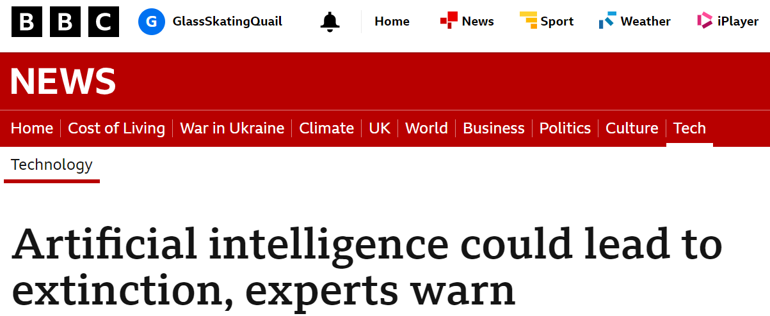
Conclusion
The ‘genie is out of the bottle’!
AI wont save us, neither is it the end of the world!
Let’s take a critical approach…who are the winners and losers?
Thank you!
https://www.bbc.co.uk/news/uk-65746524
Notes:
A critical approach to AI in HE doesn’t mean trying to ban it or stop its use in education – the genie is already out of the bottle! Its too late to do that even if we thought it was a good idea!
I think we need to take a look at what it can do well and what it cant..
We also need to think about the context – these are challenging times for HE – The expansion of HE means that students numbers have increased dramatically in recent years – and too often we look for technology, like AI to save us – it wont! We can and should use it but it needs to be freely accessible to all our students….

Slide 11
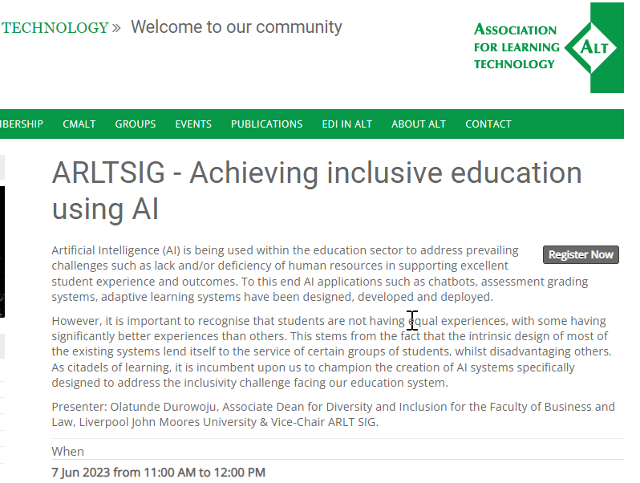
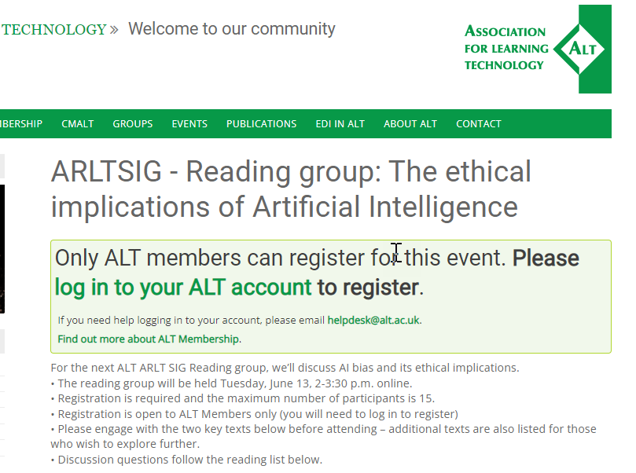
Future events: https://www.alt.ac.uk/
https://www.alt.ac.uk/civicrm/event/info?reset=1&id=816 https://www.alt.ac.uk/civicrm/event/info?reset=1&id=815

Slide 12
Thank you!
Email: c.rowell@arts.ac.uk
Twitter: @chri5rowell

Slide 13
References
Koseoglu S, Veletsianos, G. and Rowell, C. (2023) Critical Digital Pedagogy in HE. Athabasca University Press. Read Online Download
Freire, P (1970) Pedagogy of the Oppressed, London, Penguin
hooks, b. (2013). Teaching Community: A Pedagogy of Hope, Abingdon, Routledge.

