Slide 1
Neurodiversity (SpLDs) and the Student Experience masterclass
Eleanor Hassall, Bethan Hewitt, Robyn Ellison, Jagjeet Jutley-Neilson & Gemma Gray.

Slide 2
Participation
Pop microphones off
Pop cameras on, or feel free to turn them off if you do not want to be recorded
Slides and recordings will be shared after the masterclass
Do not give personal identities away
Please be respectful of others

Slide 3
Format of today’s session
Welcome (5 mins)
Student Panel with Q&A Neurodivergent student’s academic experience at Warwick (25 mins)
Breakout room activity: sharing good practice and challenging experience (10 mins and 5 min group feedback)
Neurodiversity and Student Experience Interim Project report (20 mins)
Breakout activity – Discussion of student case studies (10 mins and 5 min group feedback)
Next steps (5 mins)

Slide 4

1. What disabled students want you to know - Student Panel talk
Student Speakers
Eleanor Hassall
Bethan Hewitt
Robyn Ellison
Link to padlet…
This Photo by Unknown Author is licensed under CC BY-SA-NC

Slide 5
2. Breakout room activity
“In what ways do you make your pedagogy/work inclusive for neurodivergent/disabled students?”
What successes and challenges have you faced with your approach??
Given what the panel has discussed today, do you think there are areas of your practice that could be addressed?
Please add your group’s thoughts to Padlet (link here), this will be useful for the inclusive practice toolkit

Slide 6

3. Neurodiversity and Student Experience project report

Slide 7
Rationale for WIHEA project
The continuation rate for students with disabilities in 2016/17 was 89.6%, compared with the 96% continuation rate for students with no disabilities (Access and Participation plan 2020-21).
The University’s 2018 TEF submission reported lower NSS scores for disabled students than non-disabled for
Teaching on their course (Disabled Students - 85.2% vs Not Disabled students - 87, 1%),
assessment and feedback (Disabled Students -67.0% vs Not Disabled students - 70.0%),
and academic support (Disabled Students -77.0 vs Not Disabled students - 81.0%) lower than non-disabled students.

Slide 8
Project Aims
The project was exploratory in nature and aimed to look at:
Neurodivergent students’ academic learning experiences (survey and interviews)
Creation of an “inclusive good practice pedagogical toolkit”
This toolkit would include pedagogical exemplars for staff to use
These exemplars are supported by capturing neurodivergent students learning and student experience voices in pen portraits and infographics

Slide 9
Language use
We focused on students with Specific Learning Differences (SpLD) and Social and Communication Differences due to greater numbers of students who are declaring SpLDs and Social and Communication Differences across Higher Education.
We used a social model framework for this project and the term Neurodiversity was adopted after student and staff consultation.
Neurodiversity is an umbrella term for Dyspraxia, Dyslexia, Attention Deficit Hyperactivity Disorder, Dyscalculia, Autistic Spectrum, and Tourette Syndrome.

Slide 10
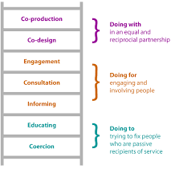
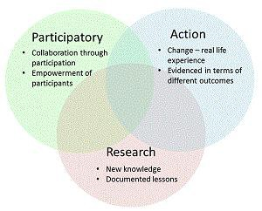
Project Design
Co-production of survey and focus group interviews
students researchers designed
academics and PSS worked together to review, etc.
Participatory Action Research
Recruitment
Survey design

Slide 11
Participants
85 participants completed the full survey and 17 student were interviewed
Years aged between 18-20, 43% (n = 37), 21-24 years, 12% (10) 25-29, 8% (n =7), 1 participant was 40+ years of age
53 participants were female, 13 students were male, 2 students were genderfluid, 12 students were non-binary, 4 students were transmasculine, and 2 students preferred not to say
59 students described their ethnicity as White, 7 students as African, 7 students as another White background, 4 South Asian, 2 students as East Asian, 5 students as other mixed/multiple backgrounds, and 1 student as preferred not to say
Eleven students from degree apprenticeships, postgraduate research, or postgraduate taught, 72 students on undergraduate programmes, and one student preferred not to say

Slide 12
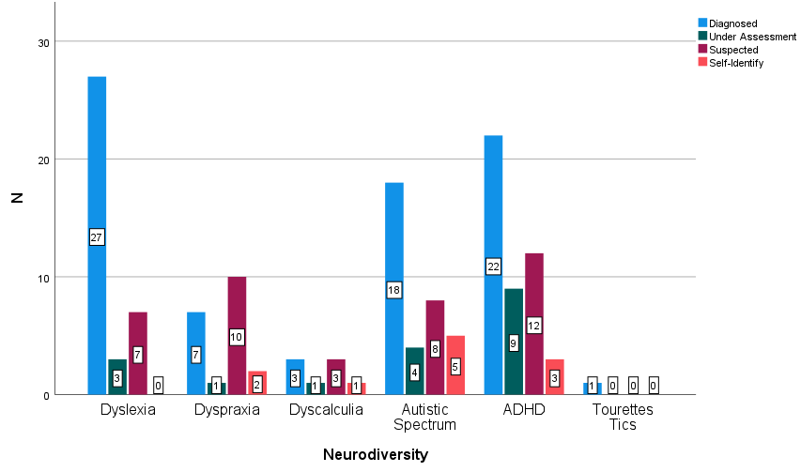
Participants
13 students had more than one diagnosis
53 (62%) students received Reasonable Adjustments (RAs)
23 (30%) did not receive RAs
7 (8%) students were unsure if they received RAs

Slide 13
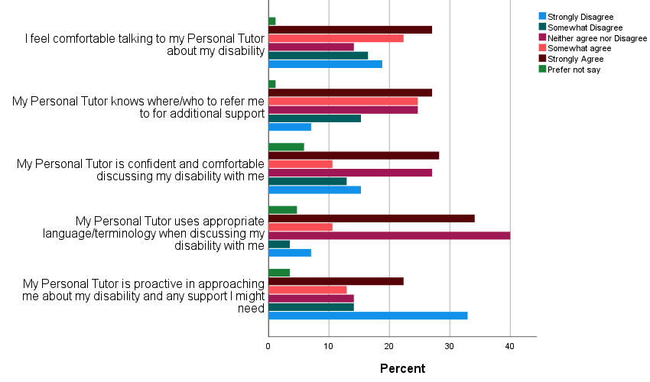
Personal Tutor
"I told my tutor and umm I really like my tutor, but she said to me "Are you sure? Well, have you always been dyspraxic or is this a new thing?" (Jas)
"One of my tutors said to me "oh well you don't seem dyslexic" and I thought oh okay great then that's no worry… [sarcastic] […] it's not like you can't look at someone and tell they're dyslexic" (Hannah)
"My personal tutor was the person who supported me through getting my diagnosis in my 2nd year!” (Darius)
"My personal tutor in first year (xxx) was FANTASTIC at letting me know what reasonable adjustments were available. The PT went above and beyond but I know that I had a really unique experience as most of the other people who I know with 'issues' are unable to get support from their PT.” (Peter)

Slide 14
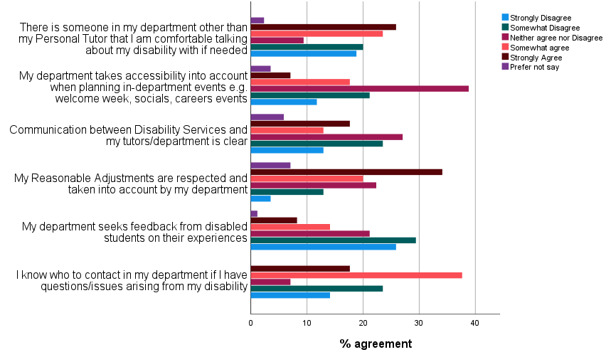
The Department
"It would be great if they had another contact person that I knew that if I needed any Reasonable Adjustments especially if Personal Tutors are failing […] to go to that person and know that they will be good at their job” (Jane)
“I do a joint degree, little to no reference to my disability is made by the department that isn't my home department. Not entirely sure if they know I'm dyslexic or dyspraxic” (Zoe)
“I also got told conflicting pieces of advice by literally 5 senior academics in the department, including the [XXX]…. umm so consistency – that would be really helpful.“ (Peter)

Slide 15
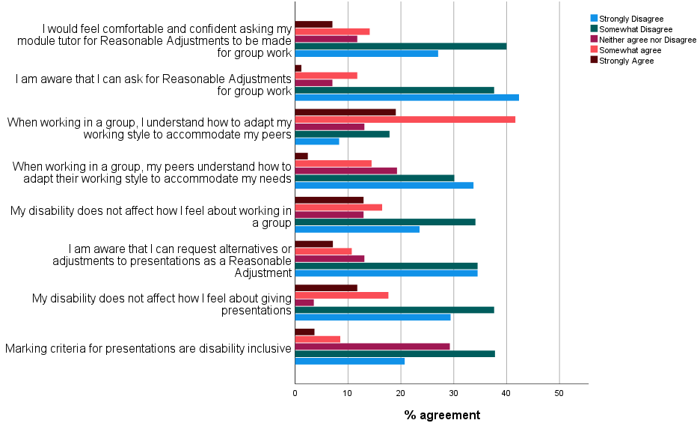
Presentations and Group Work

Slide 16
“I feel I've been marked for things like not making eye contact, and not like using much intonation in my speech and things like that because it's not something I can really control. So, I feel that markers weren't really aware when I was doing them that that was my disability”
“I'm gonna have to like either mask really well, and just make eye contact with everyone and be really stressed, and really kind of like I dunno”
“I guess some things about eye contact to be honest, like when it comes to presentations, umm because, I don’t know how to make eye contact”

Slide 17
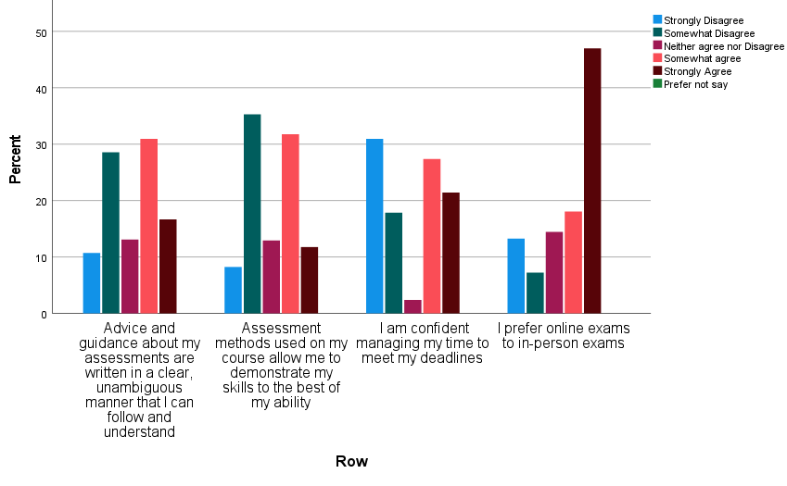
Assessment and Feedback

Slide 18
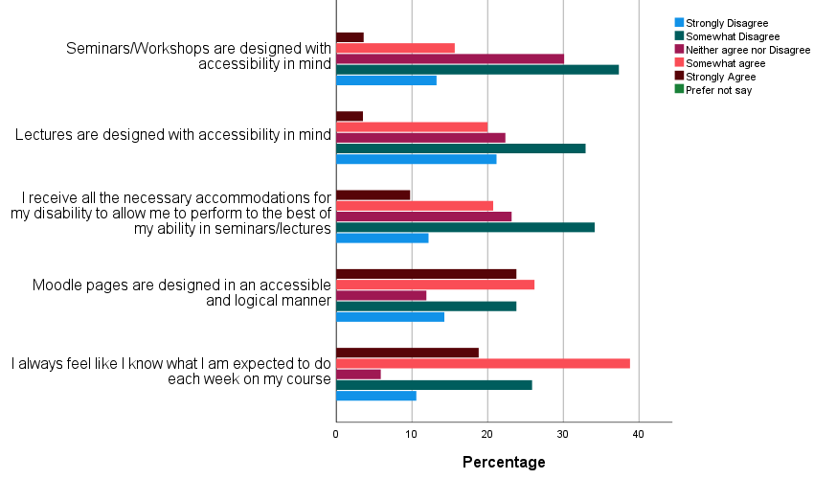
Teaching and Learning
“The one thing that is a real bugbear for me is that I cannot always concentrate for that period of time, and there’s slide, slides have so much information” (Mikeal)

Slide 19
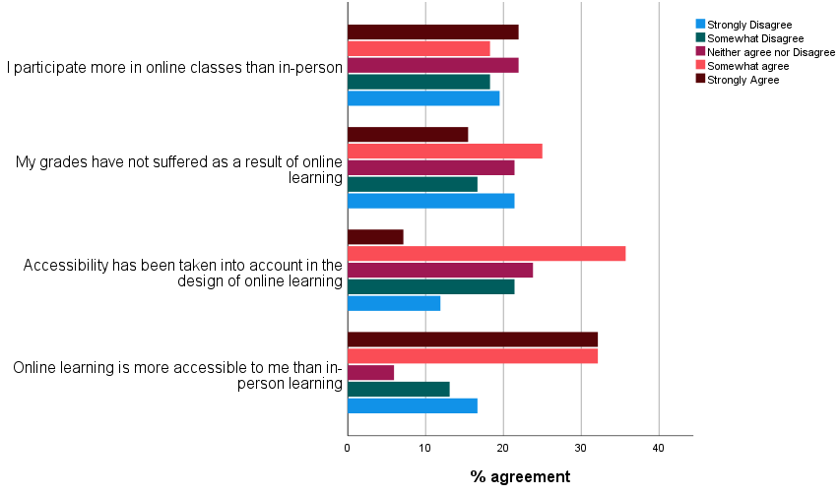
Online Learning during COVID-19 lockdown
“on the whole, it’s [online learning] been, in terms of lectures, it’s been more accessible for me” (Zoe)
Some people present their content in a really great way, it’s very simple, it slowly builds on things, it ticks all the boxes for inclusive teaching, and some of them are just like “I’m gonna copy the whole textbook and put it on one PowerPoint slide, have fun”. (Shaan)
“I think keeping that element of having it all digitised is really helpful and like I know some neurodiverse students prefer having things printed out but maybe having- still keeping things available online as well is really helpful” (Loretta)

Slide 20
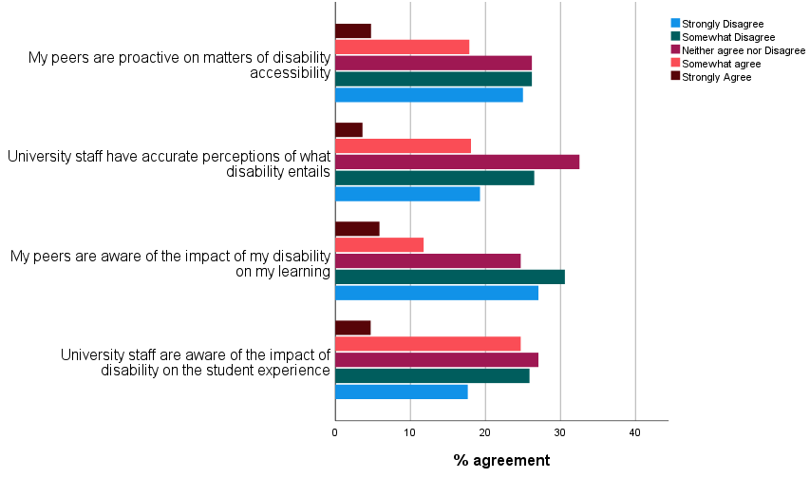
Perceptions and Awareness
“I'd like an understanding of, especially with females and neurodiversity, we present differently. We're not Sheldon Coopers. I like to refer myself to Amy Farrah-Fowler” (James)
“understanding that autism isn't this three-year-old boy sitting on the floor, playing with trains and liking timetables, and kicking off when things change. It's a fully capable young student who has made it this far to get to university, and just needs a little bit of extra help, a little bit more guidance.” (Zane)
“There need to be much better discussion and teaching around the history and current attitude to disability in XXXXX eugenics and public health in particular” (Jas)

Slide 21
Qualitative interviews themes (n=17)
Support and Wellbeing
Accessible resources
A sense of Belonging
Attitudes
Poor knowledge
Conflicting information
Navigating the system
Misperceptions
Lack of clarity
Compassion and interest

Slide 22

Neurodiversity Toolkit link
https://www.powtoon.com/c/crVLpZEJVpK/2/m

Slide 23
Breakout activity
Discussion of student case studies (10 mins and group feedback)
4 case studies, you will look at one as a group
We will send a case study to each group
Think about how would you in your role
support the student
and what recommendations could you make to your department about this situation
You can add thoughts to the padlet – link here

Slide 24
Case Study 1
You are an undergraduate programmes manager and a student has come to see you and is upset and does not know what to do. They have told you that they disclosed their new ADHD diagnosis to their tutor (they only knew about another diagnosis prior to this meeting) and that the tutor seemed to show very little interest in the conversation. Their tutor also discouraged them from using university resources specific to their disability.

Slide 25
Case Study 2
A student had reported to the SSLC that when they got written feedback from their research project, it upset them
“the secret marker, I don't know who it is, didn't know my situation obviously because they I didn't know who I was, they just knew I handed it in four days late, went on like a mini-rant under their feedback, being like, ‘they should be properly accounted for, how late the student handed it in, they've clearly capitalized off of being able to hand in four days later than their peers.’

Slide 26
Case Study 3
A student has disclosed to their personal tutor that feedback on their assessed presentation included comments on lack of eye contact with eye contact and fiddling. The student has said she is autistic and struggles with eye contact and when she is nervous she will stim. The student is upset and concerned that she has been marked down.

Slide 27
Case Study 4
A first-year student has raised issues with communication of reasonable adjustments in the department. The student did not realise that also had flexible deadlines (they just knew they had extra time for exams). The student only found out after they had put in for mitigating circumstances which were linked to their ADHD and Anxiety diagnosis.

Slide 28
Next Steps…
Addition of Warwick Inclusive Practice exemplars – please send us examples
Working to socialise and present findings.
New learning circle
Other work on disability and student experience

Slide 29
Thank you for listening ☺
Please email with any questions
jagjeet.jutley-neilson@warwick.ac.uk

