Slide 1
Preparing Pre-Arrival Students for the Warwick Student Experience
Pre-Arrival Module
Dr Damien Homer
Notes:
Damien General Intro – welcome to the presentation
Damien – introduction
Kathryn – introduction
Kathryn - explanation of how we ended up working together on this project
Damien – outline of what we are going to discuss: background/context; aims; methods – co-production & technology; results (the resource); evaluation; next steps

Slide 2

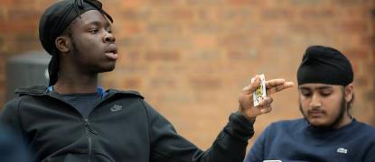
Context of the project
Pre-Arrival Module
The project has sought seek to improve student engagement and experience before arrival at University and support student’s academic induction.
The e-learning intervention provided pre-arrival students with reassurance about coming to University and helped them prepare for Welcome Week and start to their academic studies.
By completing the e-learning module it is intended that pre-arrival students will feel ready and prepared for student life and learning at Warwick, and that this will help offset some of the anxieties around the ‘un-known’ when starting their studies.
Notes:
Kathryn

Slide 3
Pre-Arrival Module
Why was the project needed?
Students particularly from Widening Participation backgrounds can be at a disadvantage to some of their more confident peers who have more established support networks that help them effectively navigate their first term.
This can include those that are the first in their family to attend university, care leavers or those different socio-economic backgrounds. Some of these students may not have had people they can talk to about coming to university.
Notes:
Damien

Slide 4
Pre-Arrival Module
WP Student Network
Discussion with Director’s of Student Experience
Focus groups
Welcome Week feedback
What was the evidence that the project was needed?
Notes:
Kathryn

Slide 5
This project drew upon the work of:
‘widening participation extends beyond simply gaining access to HE’ (Moore et al, 2013, iv),
And…..
Induction and transition processes to support ‘non-traditional’ groups of students are needed as these groups are more likely to have higher non-continuation rates (Social Market Foundation, 2017).
Pre-Arrival Module
How the literature informed the project
Notes:
Damien

Slide 6
This project drew upon the work of:
Bovill, Cook‐Sather & Felten (2011)
‘Academic staff should not
only consult students but also explore ways for students to become full participants in the design of teaching approaches, courses and curricula.’
And…..
Roll & Brown (2017)
‘Students should be equal partners in research processes’
Pre-Arrival Module
How the literature informed the project
Notes:
Damien

Slide 7
Pre-Arrival Module
This project drew upon the work of:
Mihans, Long, Felten (2008)
‘Co-creating……helped us to see that our goal should be to listen to the students and to learn what was important to them’
How the literature informed the project
Notes:
Damien

Slide 8
Project Aims: To provide students with what they need to have a good start at university
Pre-Arrival Module
Sense of belonging
Preparation
Reassurance
Resources + links
‘Unknown’
Orientation
Notes:
Damien – Project aims?

Slide 9

Pre-Arrival Module
WIHEA Funding
We received WIHEA funding to enable us to move the project forwards, this enabled us to have resources to pay any participations who took part in the project.
Notes:
Kathryn – enabled us to recruit students. Students were recruited based on their team working skills; awareness of the challenges that might face widening participation students on coming to university; prior experience of student facing work/ambassadors; technological knowledge. Aimed to get a balance of students from different backgrounds, subjects, stages of study. International student representation.
The project was a great opportunity for students to learn new skills – problem solving, technology, learning design, creativity, team work and so on. Also a learning community opportunity/

Slide 10
Pre-Arrival Module
Students
Co-created project
Academic Staff
Professional Services staff
Notes:
Kathryn – stakeholder engagement: academic staff in Arts Faculty departments; professional services staff – esp. colleagues in academic technology and academic development (gave vital introduction to students about the principles of online learning design and how to work with Moodle)
Two people on the graph who are missing are Damien and I, and our role on the project was in some ways the most complicated. We had lots of ideas but didn’t want to take over. The solution was to role play with us as clients….

Slide 11
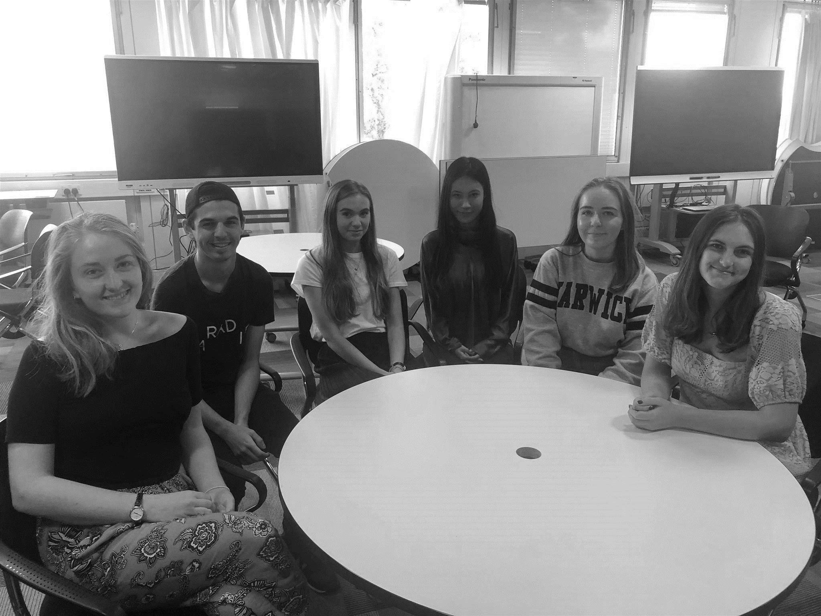
Pre-Arrival Module
Students at the centre of the process
Students were involved from the start of the process.
They co-designed the:
Content
Structure
Design of the resources
Notes:
Kathryn

Slide 12
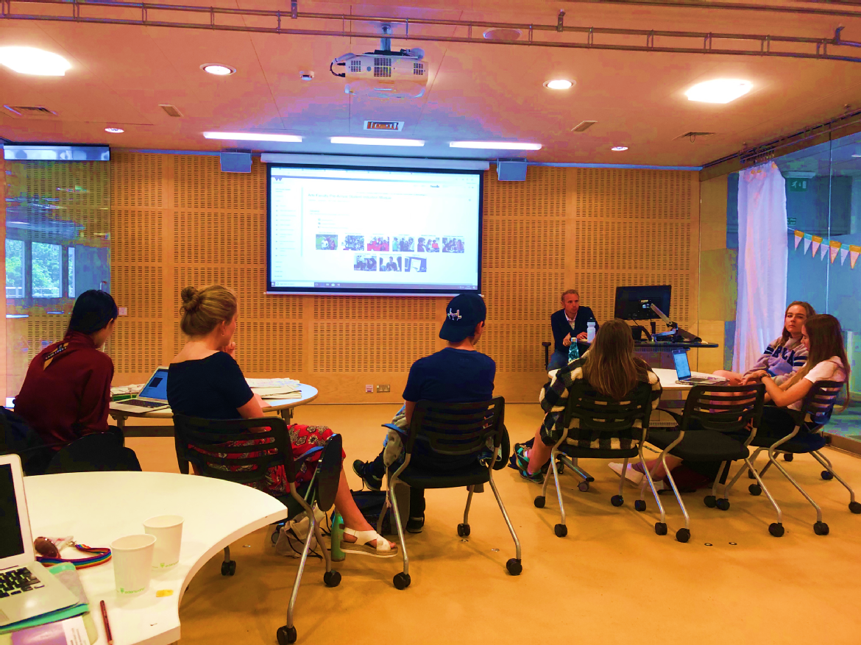
How the project worked
Pre-Arrival Module
Phase 1 (April 2019)
Advertised job roles and held focus groups with students to discuss their pre-arrival experiences and induction. Wrote job descriptions and interviewed for the student collaborator roles.
Phase 2 (May – July 2019)
The project leads and the student group focused on developing e-learning resources for pre-arrival students in Moodle.
Phase 3 (August 2019)
Editing and beta testing of the resource(s) and getting feedback from stakeholders.
Phase 4 (September – October 2019)
Launch of the resource and monitoring from the project leads.
Phase 5 (November – December)
Evaluation of the project
Notes:
Kathryn – what we did

Slide 13
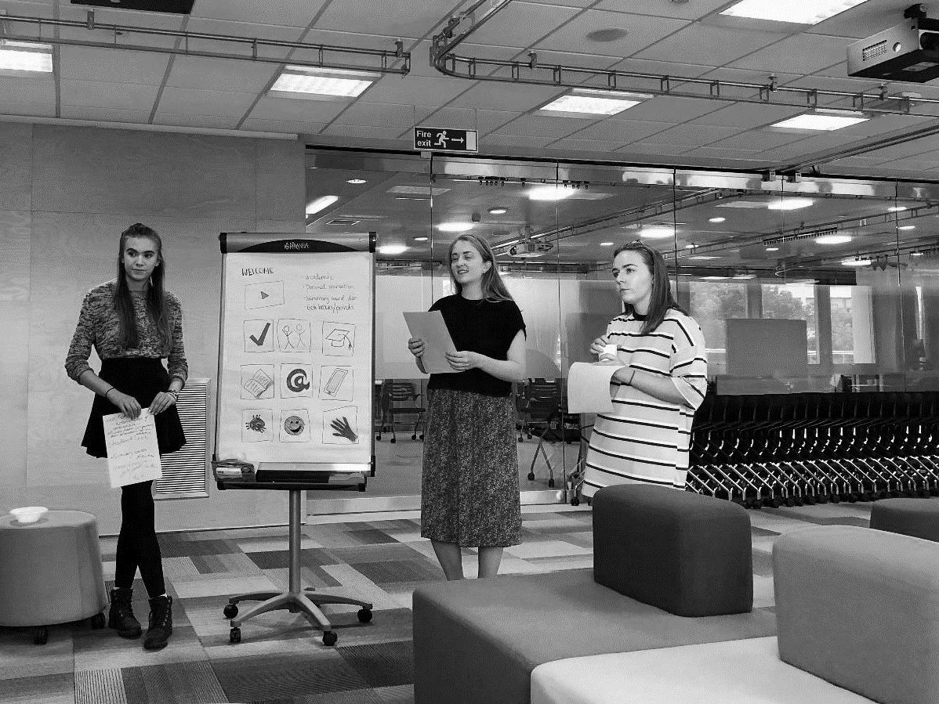
How is the Moodle site structured?
Welcome
Day in the Life
Warwick
Community
University
Support
Services
Departmental
Information
Teaching and
Learning
Checklists
Questions to ask
Library Support
International
Students
Notes:
Damien – how we identified these as the focus areas

Slide 14
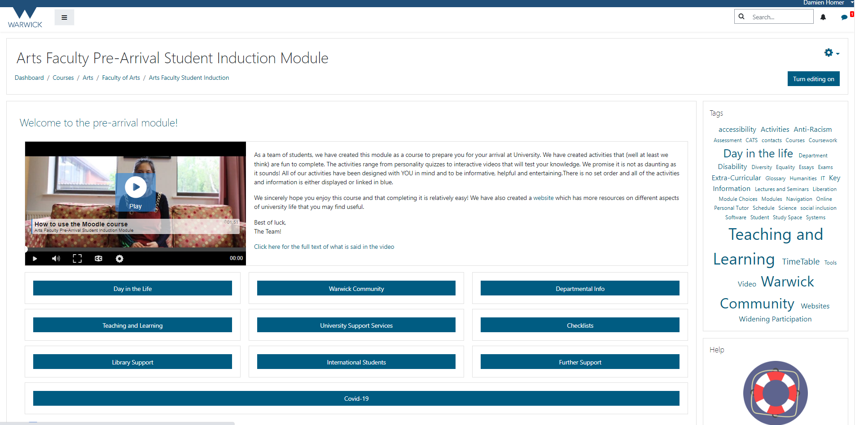
Pre-Arrival Module
What does the Moodle site look like?
Link: https://moodle.warwick.ac.uk/course/view.php?id=31314
Notes:
49sec

Slide 15
Pre-Arrival Module
Videos:
https://www.youtube.com/watch?v=jY2rNkDyeZc&feature=youtu.be
https://www.youtube.com/watch?v=33DJ_9QOwOA&feature=youtu.be
Interactive presentations:
https://moodle.warwick.ac.uk/mod/hvp/view.php?id=683237
Quizzes:
https://moodle.warwick.ac.uk/mod/hvp/view.php?id=683248
Checklists:
https://moodle.warwick.ac.uk/course/view.php?id=31314#section-8
Content examples
Notes:
7sec

Slide 16
Outcomes/legacy
Other faculties are using it in 2021/22
Working with Welcome Week team
Over half of all new Faculty of Arts students used the module
Journal article and conference
Notes:
Damien

Slide 17
Pre-Arrival Module
Findings
What is good for WP students is often good for all students, do not assume knowledge.
Students are most interested in ‘what University life and learning is like’. And assessment…
Co-created projects with students mean moving from a hierarchal relationship to one of shared responsibility.
All technology based projects take long than you think
Utilising the expertise of existing staff – don’t reinvent the wheel.
Being able to apply for, and receive, funding has really helped us to appropriately reward the students who co-created the project.
Notes:
Damien

Slide 18
Pre-Arrival Module
Findings
Technology can complement and add value to existing formal induction structures
Can enable extension of induction period (pre induction and post welcome/week 1)
Useful to have a resource students can go ‘back to’
Good for getting students used to university technologies
Handy if you have a Covid-19 crisis…
Notes:
Kathryn

Slide 19
Pre-Arrival Module
Any questions?

