Slide 1


Dr Jennie Mills
Associate Professor, Academic Development Centre

Slide 2
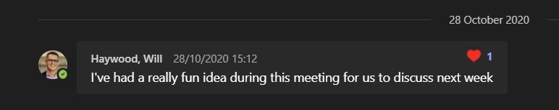

A really fun idea . . . .
Inspired by BBC Radio 4 - ‘The Listening Project’
Authentic student and staff voices heard in conversation
Lived experience – pandemic pedagogy in context
Learning from listening
Holding the space
Notes:
To reflect and learn from the experiences of blended learning, this project generates a virtual “listening room” in which a series of recorded and edited conversations between pairs of students form the basis for conversations between pairs of teaching staff which are in turn feed back to the students for their reaction.
The aim of the project is to gain a wider and deeper perspective on experiences of blended learning than is possible from surveys and especially to understand how these ideas take shape in the context of peer conversations. Moving away from the traditional student voice model of ‘you said - we did’, this project will capture more authentic representations of student perceptions, experiences and opinions on their learning in 20/21 and authentic staff perceptions, experiences and opinions placing them in dialogue in order to move to a better place of understanding and of partnership.
Will Haywood CTE
Naomi Waltham-Smith, Centre for Interdisciplinary Methodologies
Jim Judges, Academic Technology.

Slide 3
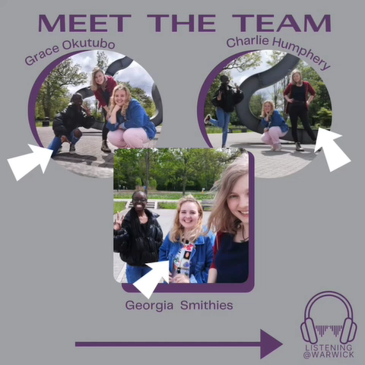
Notes:
Highly experienced: radio, performance, podcasts.
Charlie final year Biological Sciences student. Head of Arts at Warwick Student Radio.
Grace second year Politics, Philosophy and Law student. Own podcast ‘Living life Gracefully’.
Georgia masters Film Studies – filmmaker, radio presenter
Student editors
social media
recruited guests
set up recordings
identified themes
hosted podcasts
produced
edited
We did the same for the staff. Will Haywood, Naomi Waltham-Smith, Jim Judges.
Students worked with students staff worked with staff.
Sign-up MS Forms: broad area of interest (themes identified by students). Opt to sign-up with someone knew or with a stranger.
Compensated for their time with £30 voucher. (students). Entry into prize draw (staff).
Ethical approval.

Slide 4

Here comes the science bit . . . .
Recorded in Teams
Edited using Audacity
Copyright free music to give it extra pizzazz
Hosted via . . . . tbc
. . . that was it

Slide 5
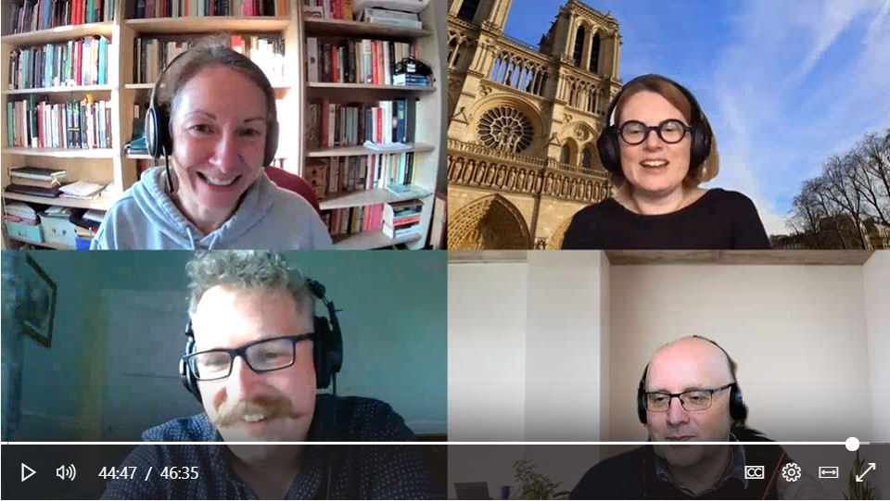
Holding the space
Notes:
Produced 5 staff conversations > 9 episodes.
Produced 6 student conversations > 12 episodes.
Experience teaching and learning inescapable context – happening in people’s actual lives – buses, families, work, LIFE (staff and student) – sort of stuff you don’t get from a survey.

Slide 6
***SPOILERS***
What am I part of?
What am I doing?
Why am I doing this?
Who is part of it with me?
How do we feel?
Notes:
Remarkably sophisticated concept learning students have.
Empathy all round.
Led to re-consideration their role as learners – self-directed, autonomy, and as educators: what is university for?
Realism – ‘hard not to hop to Wetherspoons rather than sit through a Law lecture’.
In some cases the difference in perception students and staff quite striking, particularly around assessment – better quality work (staff) – harder (students).
Some things work better online: mainly flexibility but also issues social inclusion. Also occasioned rethinking other ‘normal’ practices – lectures/assessment – driver for change not necc online solutions.
Relational – significance of the social elements of learning thrown into sharp relief ‘What am I part of? – learning is collaborative process. More than communication (although that’s part of it). More profound sense of disconnection.
Sense of being adrift: ‘What am I doing?’ Clarity purpose – nature of ‘being at university’ – not only task structures – wider identity work. Part of connections.
Human activity: checking in (forgotten after first efforts – needs to be sustained)
Spaces have a mindset and a physicality – both bring barriers and benefits in the online ‘learning environment’ – accessibility/inclusion – international students living circumstances, blurring work and leisure spaces and impact on mental health.

Slide 7
What questions do you have?

