Slide 1
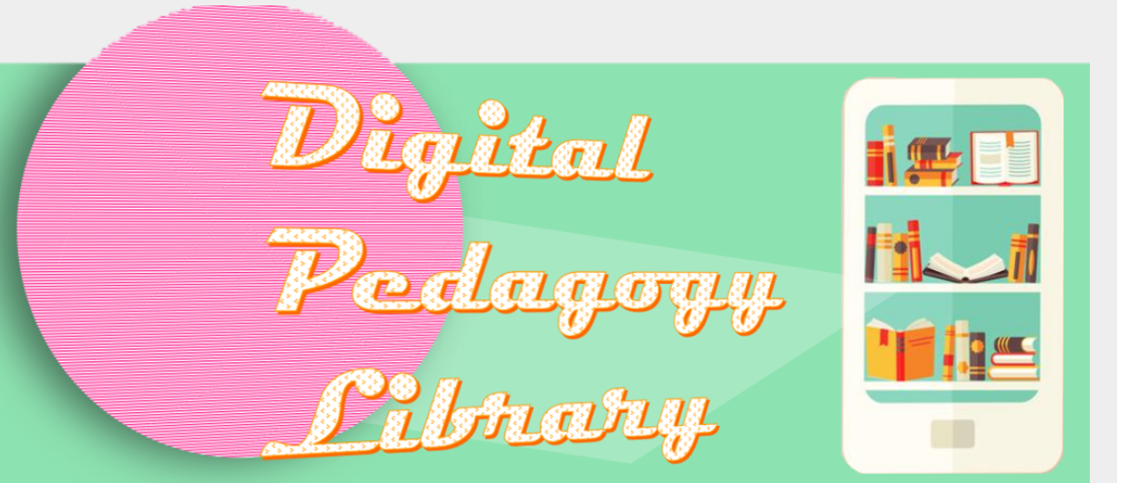
Digital Pedagogy Library
WIHEA funded Project 2021

Slide 2

Project team
Dr Rebecca Stone (Director of Student Experience, Faculty of Arts)
Jess Humphreys (Senior Teaching Fellow, ADC)
Nathalie Cooper (Student project intern)
Ilia Ryzhenko (Student project intern)
With support from Dr Robert O’Toole (Faculty of Arts), Dr Elena Riva (IATL), Dr Bryan Brazeau (Liberal Arts)

Slide 3

What is the Digital Pedagogy Library?
A showcase of digital pedagogic approaches in the form of easy-to-follow recipes.
The DPL aims to inspire innovation in digital pedagogy and experience, providing an insight into exciting opportunities in the field of digital pedagogy.

Slide 4
Friendship Interviews
“The method provides us with a meaningful window into the lives of students, as defined and explained by students.” (Heron 2019)
Heron, Emma (2019) ‘Friendship as method: reflections on a new approach to understanding student experience in higher education’ Journal of Further and Higher Education pp.393-407 https://doi.org/10.1080/0309877X.2018.1541977

Slide 5
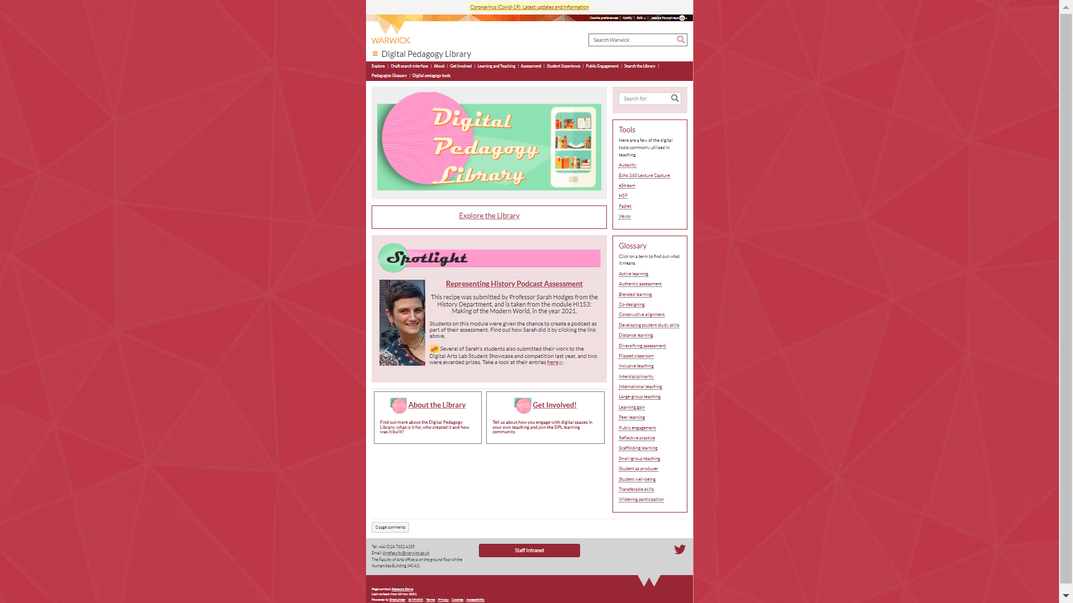
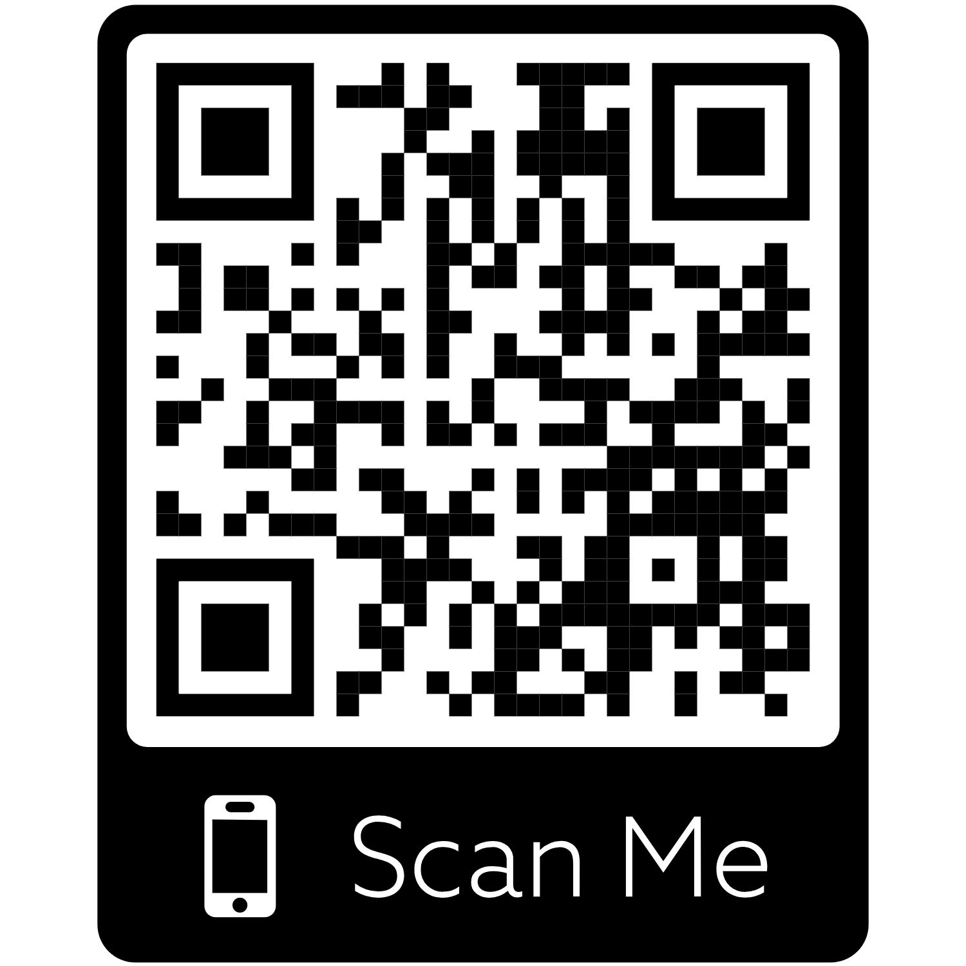
Introducing the Digital Pedagogy Library (DPL)
https://warwick.ac.uk/dpl

Slide 6

Where next…
DPL phase 2 starts in January 2022
Working with colleagues across the institution
Any questions or if you would like to get involved then let us know:
Jessica.humphreys@warwick.ac.uk/ Rebecca.stone@warwick.ac.uk
Submit here:
https://warwick.ac.uk/fac/arts/dal/digitalpedagogylibrary/getinvolved/

