Slide 1
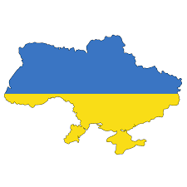
Leadership for Educational Transformation (Ukraine)
Dr Bo Kelestyn
Professor Gwen van der Velden

Slide 2
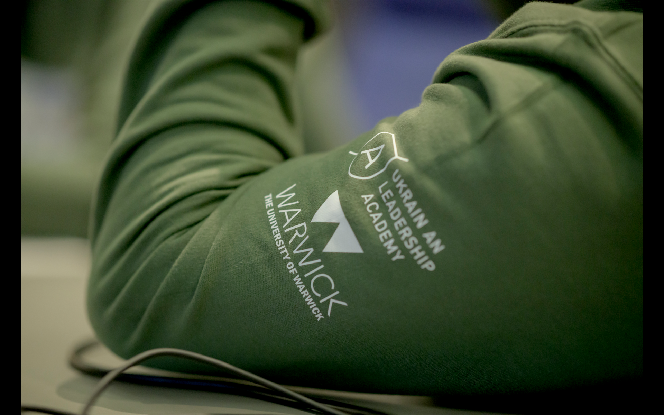
Warwick’s Leadership for Educational Transformation programme for Ukraine
Educational leadership development at Masters level
40 participants – school leaders, educational agency leaders, Ministry of Education and Science members, Deputy Minister (Primary Ed), Digital education leaders and policy advisors
Macro module: the impact of war on the education system
Meso: leading during crisis: organisations and pedagogy
Micro: pedagogy and design of teaching and learning during conflict

Slide 3
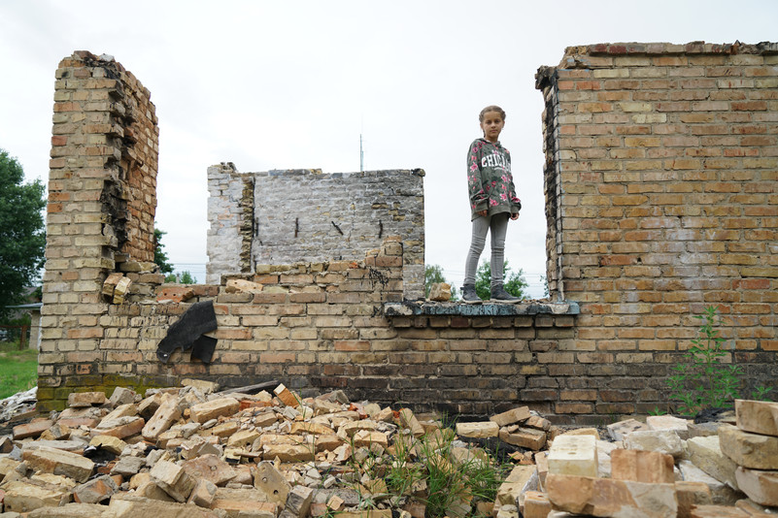
The impact of war on Ukrainian Education
Damage and destruction to schools
Destroyed: Early childhood education – 104 Secondary education – 187
Damaged: Early childhood education – 1,098 Secondary education – 1,586
Need for shelters
Schools: 3454 of which 1198 immediately needed
Vocational Colleges and Universities: 4298 of which 298 immediately needed
Children and young people
1.2 Million Hybrid learning
1.5 Million Distance Learning only, of which 0.5 Million Abroad
1.3 Million in School

Slide 5
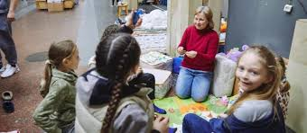
The impact of war on Ukrainian Education
Learning losses:
Displaced learners
Interrupted learning (Covid & war)
Online and hybrid learning
Teacher displacement, and teacher losses
New teaching challenges:
Trauma Informed Teaching
Language learning (Ukrainian) abroad
Returners from military duties
Evacuated (in country) children in (residential) care
Teaching in shelter

Slide 6
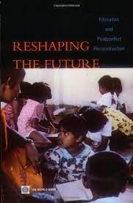
Why does Education reconstruction matter?
A traumatised society needs hope.
Key to reconstruction of the workforce and therefore the nation
Lost cohorts can lead to future social disquiet.
Research of education reconstruction shows that in funding terms, primary (43%) and tertiary (12%) education are often prioritised, whilst secondary education lags behind (8%).
With each year, individuals’ educational recovery time is lengthened and the differential between directly and indirectly afflicted areas increases.
This then becomes a longer term political issue, when substantially more funding and resource is put towards those areas that have suffered more in educational provision terms.

Slide 7
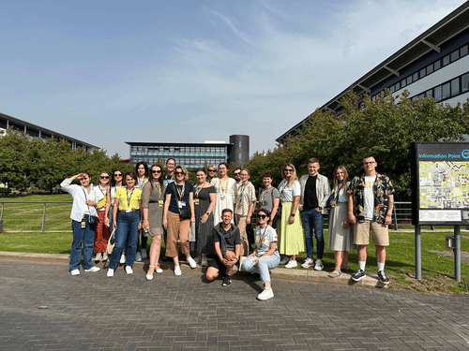
Challenges to Educational Leadership in Ukraine
Teaching workforce decreases fast
Leaders are able to move to better paid roles
Senior leaders in all parts of bureaucracy have been replaced
Educational leadership training and development are rare
Removal of all ‘Russian Imperial Policy’ (Zelinsky 2023) (de-russification and decommunization processes) – major change to all layers of policy, law, strategy and in education, pedagogy

Slide 8
Pedagogical design of the residential
Immersive learning – a week of being in the role of one of your key stakeholders
Experiential learning – Reflection is a key skill for leaders
Metacognitive learning - Metacognition is having an awareness of your thought processes and an understanding of the patterns behind them.
Case based learning – working through scenarios and challenges to experience leadership aspects
Collaborative learning – Learning from expertise and skills of others together

Slide 9
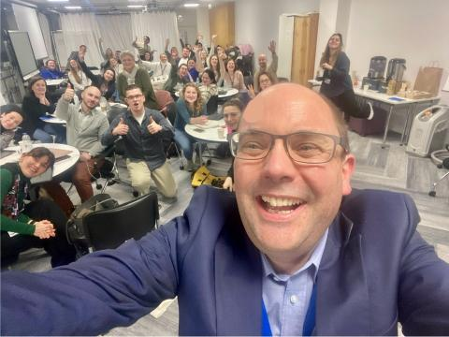
Warwick colleagues and externals – Thank you!
Warwick: Matt Street, Luke Hodson, Liz Blagrove,
Beccy Freeman, Stuart Croft, Will Curtis, Chris Twine, Elena Riva, Dave Bishton, Andy Hind, Ahmad Akkad, Kate Ireland, Adele Brown, Jonty Leese, Georgina Newton, Jen Rowan-Lancaster, David Plumb, Chris Ennew, Pontso Moroosi, Sarah Dahl
IDG, IT helpdesk, EPQ, committees, student opportunity, accommodation, conferences
External: Terese Mpofu, Peter Kent, Claire Gordon, Jon Scott
Oksen Lisovyi - Minister of Education and Sciences Ukraine
Mykhailo Fedorov - Deputy Prime Minister of Ukraine for Innovation, Education, Science and Technology Development
Mychailo Wynnyckyj - Deputy Minister Higher Education

Slide 10
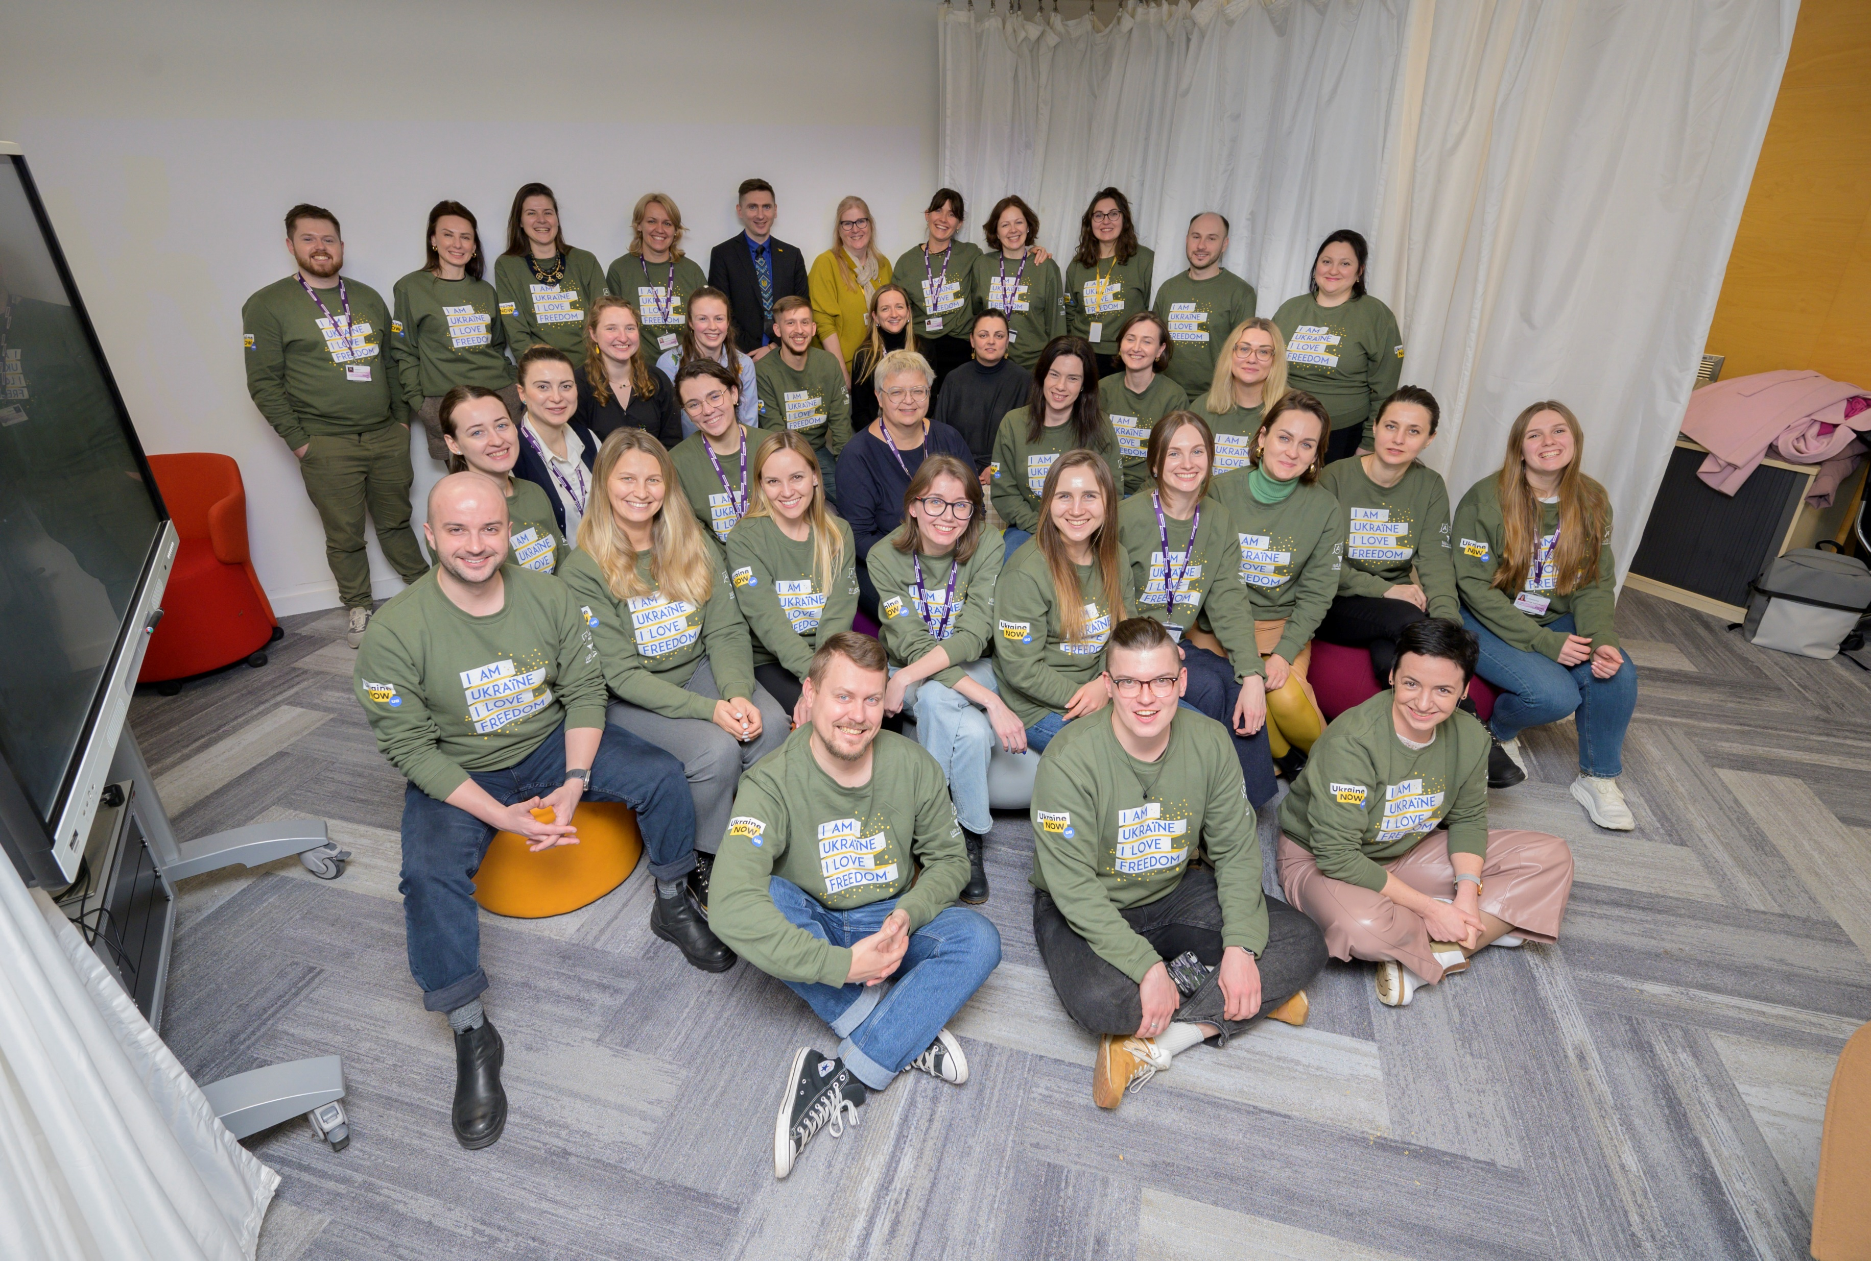

Slide 11
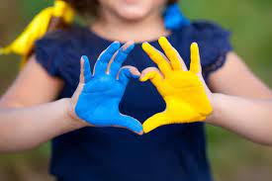
Education project: Educating parents who foster
Increased numbers of displaced children – evacuated and fostered away from war zones
(Russian) background of institutionalising children in care
Social responsibility has grown during war
Programme of education for foster parents and youth/ social workers, based on child centred principles, alongside development of support structures.
Maryna Tereshchuk – Educational Projects Manager,
East Europe Foundation

Slide 12

Education project: Student engagement through project work
Students increasingly disengaged with study, due to distance learning, lack of social engagement and school destruction
The Russian approach to teaching is didactic and focus on knowledge. Ukraine is moving the European way: skills, self sufficiency, collaboration, creativity.
Introduction of project work as a means of creating responsibility, ownership and collaboration – teaching staff to teach differently, and students to take charge of their learning.

Slide 13
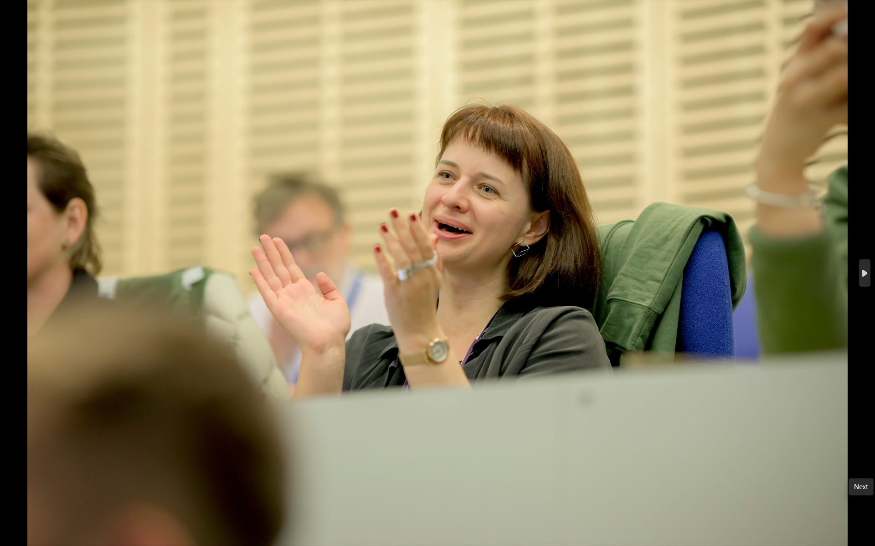
Education project: Recasting assessment methods
CEO of Ukraine’s national Quality Assurance Agency
Multi-year project of standardising assessment across all secondary schools according to a single national system – and align to PISA and EU
Dealing with substantial resistance to change, as well as war context and staff resilience challenges
Outstanding approaches to change
Tetiana Vakulenko – CEO Ukrainian Centre for Educational Quality Assessment

Slide 14
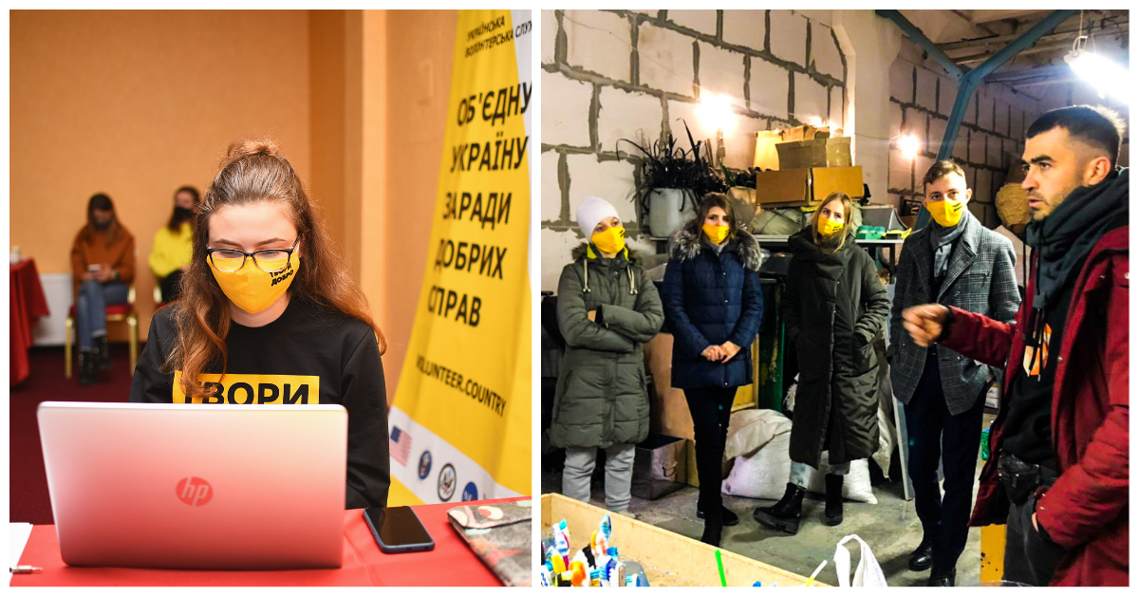
Education project: Volunteering for Social Cohesion scheme
Civilian Support Service “One Heart: Power of Youth”
597 young people from 16 regions of Ukraine, aged 18-29, including 190 IDPs. 853 young people joined the project.
Community events and training on: “Principles of Humanity: Approaches to Volunteering”, “Basic Psychological Assistance”, “Working with Teams”, “The Art of Communication and Conflict Mediation”
- Next step: online marathon of the good deeds called ‘Dobrodvizh’. The goal of the project is to encourage young people to volunteer.
Olena Dzhevaga – Head of Coordination Centre, Ukrainian Leadership Academy

Slide 15
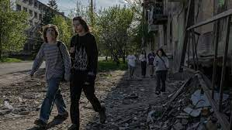
Education project: Mentoring at the frontline
‘Mentoring in border and frontline communities’
Training the trainers programme for NGOs working at the frontline and Eastern borders
Focused on teenagers
Launching THIS week – three pilots
Tetiana Kovryga – Executive Director, Go Global

Slide 16
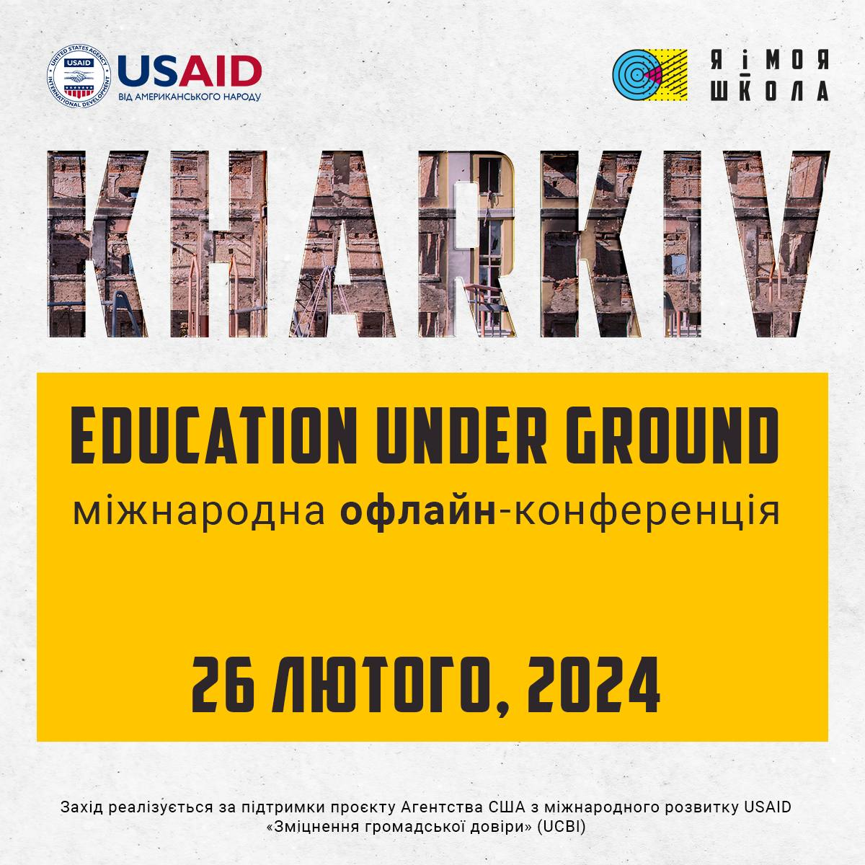

Slide 17
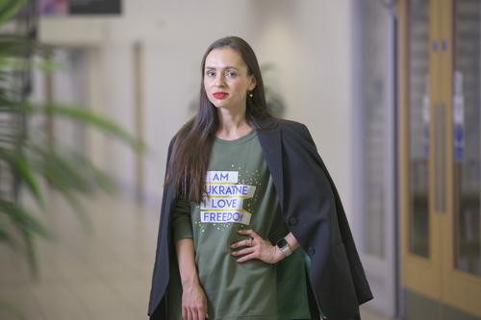
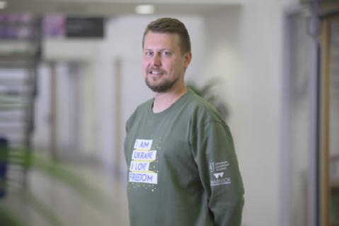
Research undertaken by participants:
Lifelong Learning – Diana Rakus
Educational leadership development in Ukraine – Ivanna Kurtyk
AI in universities – introduction of national standards – Dmytro Chumachenko
Educational Change Models – Olha Dovganich
Gamification in assessment for schools – Petro Lapchack

Slide 18
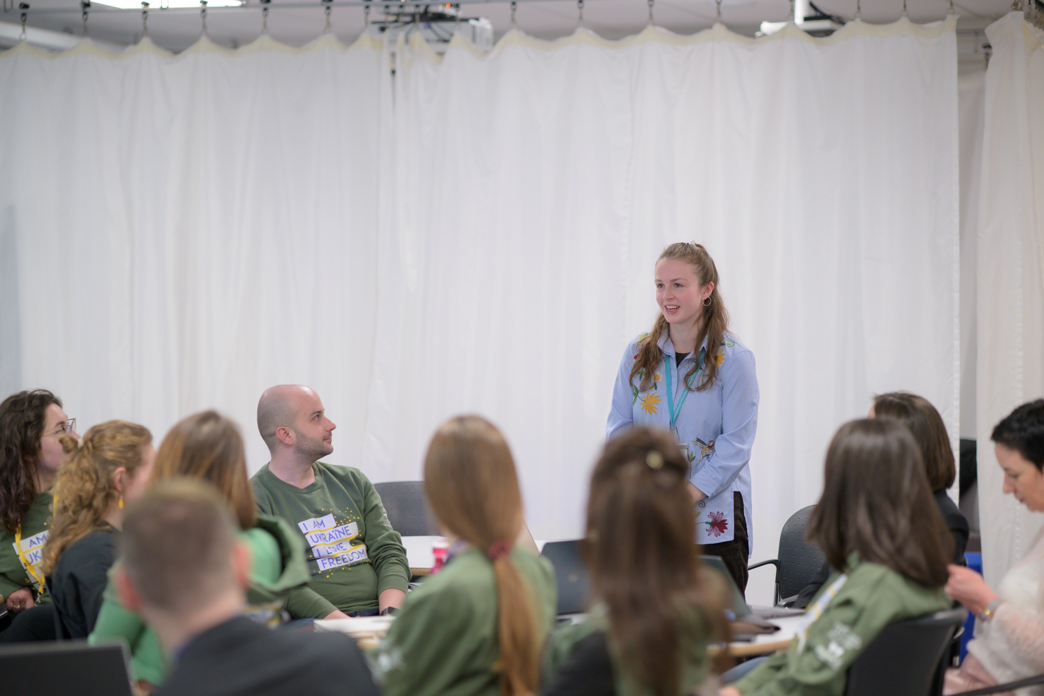
WIHEA funded project
Continuous Co-Creation Curriculum Renewal Framework Development - Post Conflict Education Reconstruction Curriculum
Constant need for change of the programme
Co-creation at a distance and during extreme conditions
Participants are all education leaders
A framework that works with our QA mechanisms, is effective and sustainable
Inca Hide-Wright (WIHEA Student Fellow, Psychology alumna and MASc at Liberal Arts) – appointed project student and evaluator

Slide 19
Next steps
WonkHE.com series of publications by participants
Publications (SEDA: Educational Developments, RAISE: WIHEA project)
Elective Module on Education Reconstruction (SELCS)
Continue the programme in 2024/25
Collaborations – British Council, Kyiv School of Economics/KMBS/UCU, Ukraine President’s Fund
Masters in Education Reconstruction and Transformative Leadership (by distance learning with delivery partners)

Slide 20
Questions, remarks, observations are very welcome
Bo.Kelestyn@wbs.ac.uk
G.van-der-Velden@warwick.ac.uk

