Slide 1
Universities and post pandemic digital praxis: critically reframing education and the curriculum
Bill Johnston, Sheila MacNeill, Keith Smyth
WIHEA Seminar, 7/4/22

Slide 2

Introductions
Thank you for taking the time to join us today.
Please say hello in the chat, where you are from and what your role is
https://bit.ly/3IMEoAH

Slide 3
“We need to be able to articulate an understanding of what universities are for that is adequate to our time if we are to be able to decide what to do.”
(Collini, S, 2017, Speaking of Universities )

Slide 4
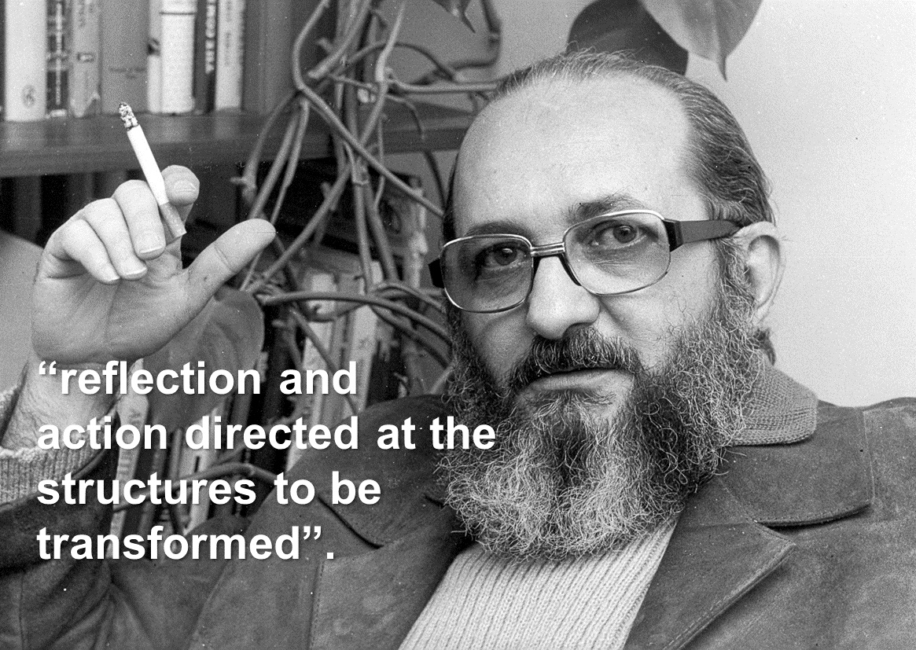
A critical time for criticality?

Slide 5
Examples of structures to change
Populist politics and reactionary policies e.g. legislation attacking freedom of speech, restrictive border controls . . .
Deteriorating standards of living, attacks on workers pay/ pensions/ job security and further weakening of trade unions.
Growing inequalities in health, education, housing, employment and communities.
Inadequate responses to the Pandemic and weak recovery measures, including educational recovery and innovation.

Slide 6
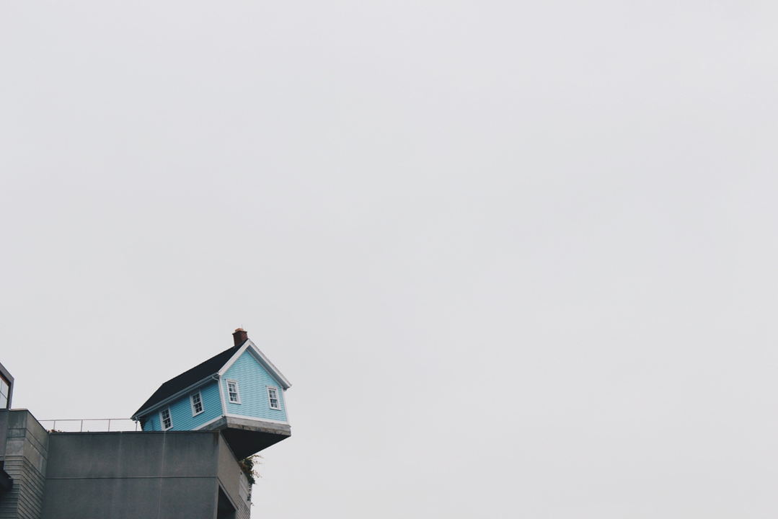
Precarity
Photo by Cindy Tang on Unsplash
https://unsplash.com/photos/ob-hsLNxYPc

Slide 7
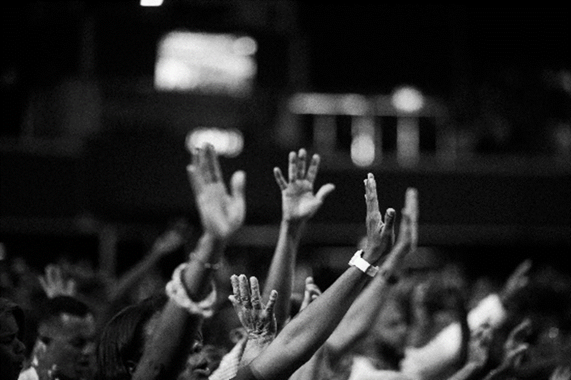
Readiness?
Photo by Luis Quintero from Pexels
https://www.pexels.com/photo/grayscale-photography-of-people-raising-hands-2014775/

Slide 8

Have/not
Photo by Annie Spratt on Unsplash
https://unsplash.com/photos/4-4WPFLVhAY

Slide 9
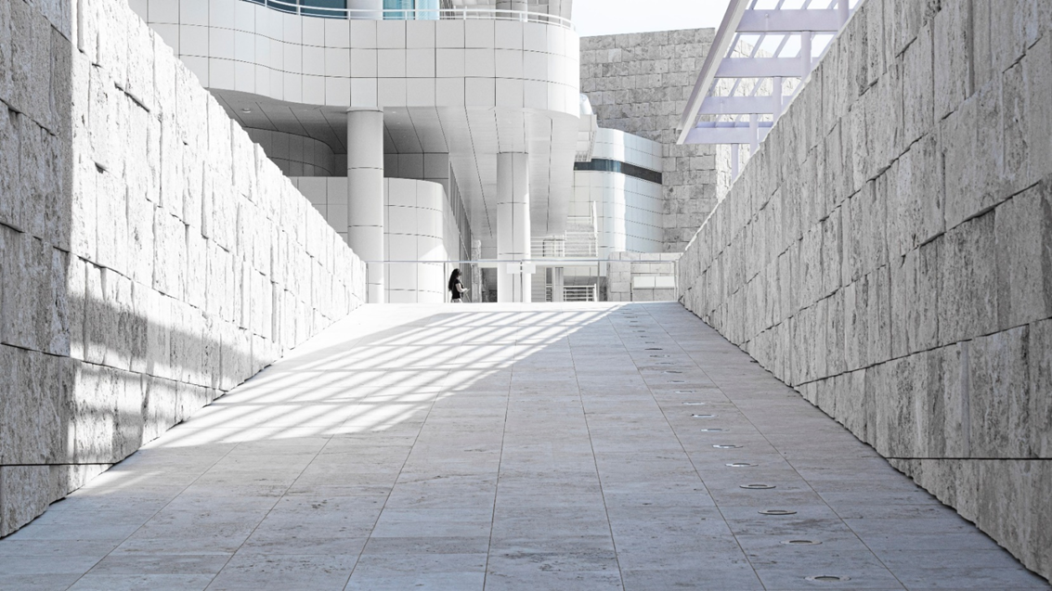
Beyond barriers
Photo by Vincentas Liskauskas on Unsplash
https://unsplash.com/photos/5pIp6y3w9Kc

Slide 10
Break out:
In your break out rooms share your experiences of changes to learning and teaching over the past 2 years? Share your examples in the padlet wall
The shredder: what did you try that really didn’t work?
The shopwindow: what did you try that you would recommend?
The greenhouse: what did you try that you are nurturing/developing?
The pantry: what did you try that is now an essential ingredient?
The museum: what did you try that was fine for the time, but you’ve now stopped archived?

Slide 11
Feedback - short plenary
Notes:
2.30ish

Slide 12
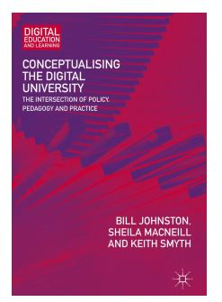
The Digital University: a 10 year journey
Discursive, reflective, dialogic process, grounded in critical pedagogy
Challenging neo-liberalism
Using Freire, information literacy and open education as critical lenses

Slide 13
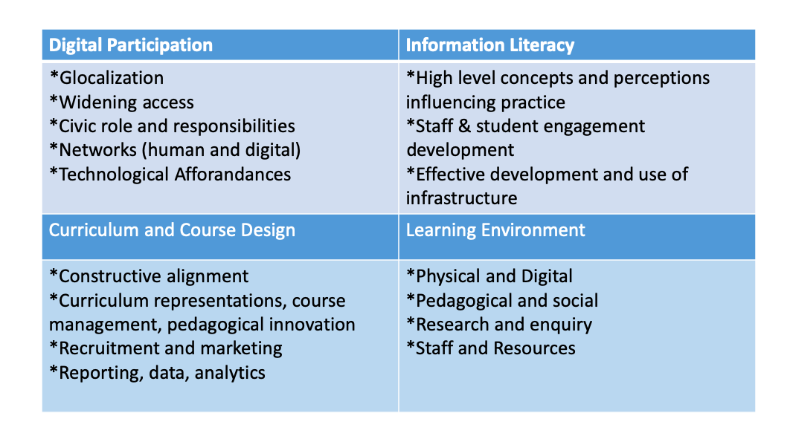
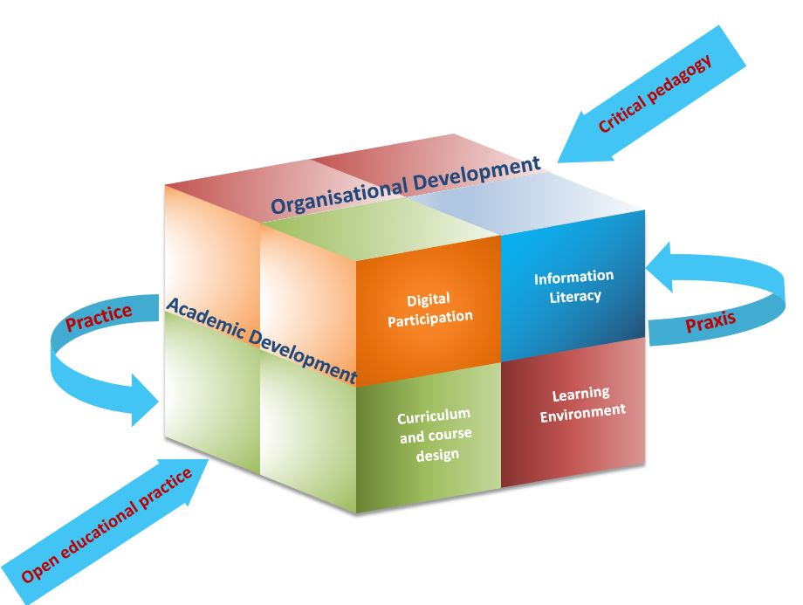
Digital Universty Conceptual matrix,, MacNeill, Johntson,(2012 )
Revised conceptual matrix,, MacNeill, Johntson, Smyth, (2019 )

Slide 14
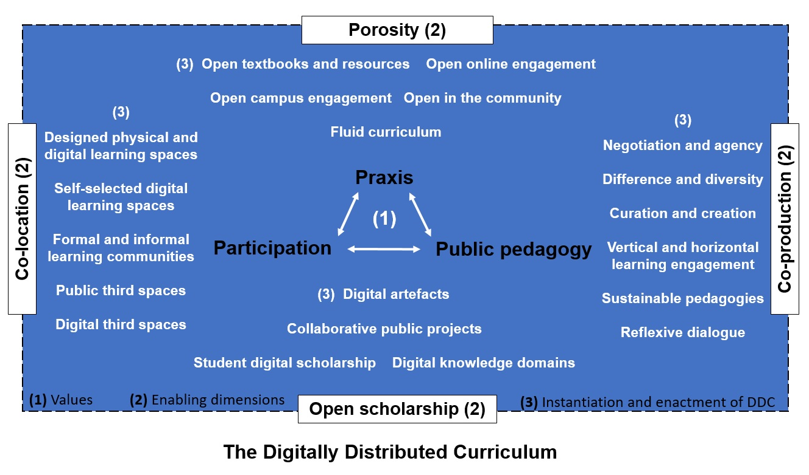
The curriculum as an open, negotiated space

Slide 15
An institutional experience
Dis/co-location
From and of the campus and curriculum
Co-production
Of the initial and ongoing response
Of resources
Porosity
Increased awareness of ‘open education’ in online digital context
Move towards specific open practices
Emergency enrichment of the digital landscape
Of pedagogy
Of the narrative
Student digital scholarship

Slide 16
Break out: share you examples
In your break out groups discuss the ways your work has or could map to the levels of the digitally distributed curriculum model.
Share your examples/thoughts in the google doc.
https://bit.ly/3uVDMne
Notes:
2.50ish

Slide 17
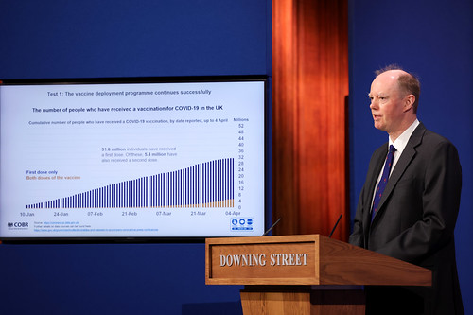
“Next slide please”: public pedagogy and the pandemic
Pandemic public information delivered via broadcast and other media - a form of unintentional public pedagogy?
Scientific data openly shared with public on scale and regularity never seen before – akin to an open public lecture everyday?
Challenges around data literacy – did you really understand those graphics?
Who got to ask questions?
This Photo by Unknown Author is licensed under CC BY-NC-ND

Slide 18
Pandemic Public pedagogy, public education: a new open curriculum?
news
information
learning
civic reasoning

Slide 19
What does this mean going forward?
What is meaningful for our times?
Has the purpose of education now changed?
How can we reflect and learn from the experience of the past 2 years as part of our recovery? pedagogies of care (bel hooks), “the lost art of convalescence” (Gavin Francis)
What needs to be challenged and changed?
Where and how does the sector create inclusive spaces to ask/answer these questions in meaningful ways?
What role does educational research have in answering these questions?

Slide 20
References
Freire, P. (1970). Pedagogy of the Oppressed. New York: Contunuum.
Freire, P. (1974). Education for Critical Consciousness. London: Continuum.
hooks, bell. (1994). Teaching to Transgress: Education as the Practice of Freedom. London: Routledge.
Francis, G. (2022). Recovery: The lost art of convalescence. Profile Books.
Johnston, B., MacNeill, S. and Smyth, K. (2019). Conceptualising the Digital University: The Intersection of Policy, Pedagogy and Practice. Switzerland: Palgrave MacMillan.
Johnston, B., MacNeill, S. and Smyth, K. (2021). Paulo Freire, University Education and Post Pandemic Digital Praxis. Online: https://postpandemicuniversity.net/2021/11/09/paulo-freire-university-education-and-post-pandemic-digital-praxis/
MacNeill, S., Johnston, B. and Smyth, K. (2020), Critical Engagement for Active Participation: The Digital University in an Age of Populism. New Directions for Adult and Continuing Education, 2020: 115-127. https://doi.org/10.1002/ace.20372

