Slide 1
WIHEA Project 2017-18 Exploring the potential of Chinese digital media platforms to support social learning and enhance student experience
Esther de Perlaky, Student Careers & Skills
Christine Fenton, Student Careers & Skills
Notes:
WIHEA funding provided opportunity to explore a range of aspects of social media
Generated a lot of interest from across Warwick, and resulted in a range of contributions:
CAL – Helen Spencer-Oatey and Tilly Harrison
LDC - Jess Humphries
WMG – Jay Bal
WBS Fiona (Xu Nou)
Academic Technology Team – Amber
Warwick Beijing Office - Reedy
Student researcher students
Xuemeng Cao – Centre for Educational Studies
Yihan Guo – WMG
Ming Yang, GSD

Slide 2
Project Overview
Student led research project – Warwick Chinese students & UK HE
Taylor Wessing China - Employer perspective
Careers and Skills – Promoting employability WeChat summer campaign
Online learning - Preparing for a Careers Fair using WeChat groups
Student Focus groups
Notes:
Conducted over summer period by UG student
Lots of interest from Chinese employers, Taylor Wessing international law firm employing 1200 lawyers in 33 offices internationally
SCS – focussed content to support Chinese students in careers and employability – worked with Beijing office
Using WeChat Groups function to deliver an online training course
Undertake student focus groups to explore use of social media in greater depth

Slide 3
1. Student led research: UK HE use of Chinese social media
University of Exeter
University of Birmingham
Wuhan College, China

Slide 4
University of Exeter
Notes:
WeChat – approaching 1 billion users
Functionality greater than other social media platform.
Includes messaging, photos, AND payment and gifting functionality
Weibo – microblogging, preferred by TV and newspapers, limited social interaction
Youku – video streaming (like YouTube)

Slide 5
1. Student led research: Interviews with Chinese students
Use of WeChat - for personal communication and professional purposes, less for academic purposes
Weibo valued as an academic App but doesn’t have the interactive functions
Don't use Instagram & Twitter, Facebook and WhatsApp - problematic in China
Notes:
Student research
Interviewed UG, PG and Warwick Alumni about use of various forms of social media for personal, academic and professional purposes
WeChat is the go to application for communication

Slide 6

2. Case Study: Using WeChat to support internship programmes with TW, China
TW posting news articles as ‘Moments’
Preparing students for their placement
Establish & maintain ongoing connections internally and externally
Recommend other work opportunities
Taylor Wessing LLP is an international law firm with 33 offices internationally. The Firm has around 400 partners and 1200 lawyers worldwide.
Notes:
Taylor Wessing
International law firm – 1200 lawyers in 33 offices globally
Taylor Wessing Beijing office uses WeChat to communicate with interns and support their professional development
Similar picture with all Chinese employers – this is Global Recruiters club
Our work with employers indicates that the use of WeChat in this way is fairly standard practice

Slide 7
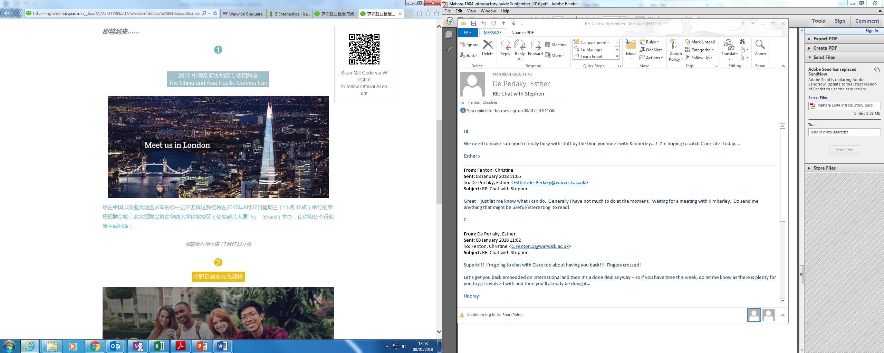
3. Case Study: Using WeChat to support Warwick students’ employability
Careers and Skills summer WeChat campaign:
Self access online resources
Employer case studies
Careers Fairs
Alumni stories
Notes:
Careers and Skills
Working with Warwick Beijing office who posted the relevant content on the Warwick WeChat official account
Signposted students to relevant content on Warwick websites
Challenged students to use summer period for employability related activities
Contextualised for Chinese students – UG and PG, recent graduates

Slide 8

4. Case Study: WeChat online training course: ‘Preparing for a Careers Fair’
Notes:
Context:
Careers Fair at the Shard 27the September
30 employers, several flying in specifically for event
Students still in China, in transit or in the UK
Feedback from previous event – employers indicating that students could have been better prepared
Worked with Fiona in WBS to devise content, recruit students, deliver content.
Students recruited from those signing up for the Shard Careers Fair
75 % WBS, 25% elsewhere
87% PG students
90% Chinese students, 10% non Chinese students

Slide 9
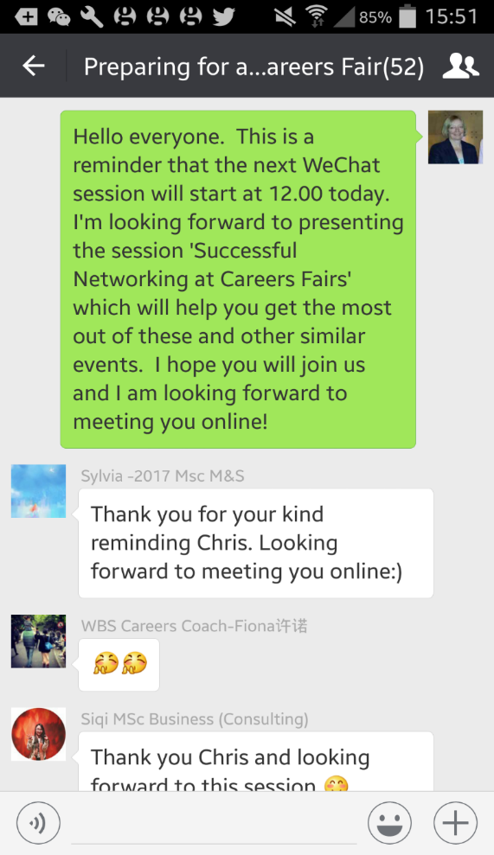
WeChat course: 50 students in 5 groups
Weekly online presentations:
Effective communication
Researching employers
Successful networking
PowerPoint slides and voice recordings
Homework submitted via WeChat
Online feedback
Notes:
Each session had a tutor who delivered the content, set the homework, provided feedback
Introductory task – getting to know each other
Weekly online presentation
Homework – variety of tasks: research, reflect, observe
Example:
Communication:
Observe someone who is a great communicator – what do you notice?
Have a conversation with a stranger – what works well, what didn’t work well, what would you do differently next time?
Research an employer – undertake company investigation
Networking:
Share a piece of information/resource within your group
Construct some questions to ask an employer
Share with members of your group

Slide 10
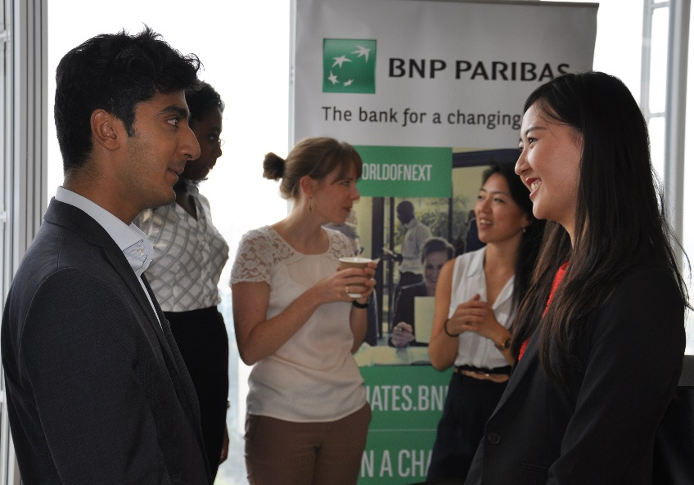
Warwick Asia Pacific Careers Fair, Sept 2017, Shard
Applying the learning:
Employers said:
Students were better prepared
Students said:
100% of students felt well prepared and more able to construct good questions
Liked being able to revisit presentations
Wanted more of this!
Notes:
Employers commented very favourably about the students preparation: research undertaken questions asked
Students wanted more: variety, differentiation, sector specific content and employer content, WeChat

Slide 11
5. Student focus groups
WeChat provides continuity of contact with fellow Chinese students and future employers
Lack of familiarity with Western social media presents barriers to integration with non-Chinese students
Rapidly increasing use of social media to support learning and employability
Notes:
Focus groups for further exploration
CAL students for a different perspective
Student quotes:
At Warwick most of my classmates are Chinese so I use WeChat. For my non-Chinese classmates we will have a face to face discussion at the time and after the class but we don’t carry on that conversation in the same way that I do with my Chinese classmates (PGT student)
All the information I have about Warwick comes from Weibo, it’s where I found out about this course that I am on (UG student Year 1)
We’ve set up some Messenger groups and Facebook groups but that’s not as convenient and we’re not that used to it. So it’s a dilemma, but we want to be closer. So it’s a nice gesture for the university to do this and look at using WeChat.
Protocols for using social media in China are different from those in UK – the expectation is that a WeChat message will be read 24/7
In some cases use of WeChat is superceding use of email for professional purposes

Slide 12
Key learning points
WeChat is an integral part of Chinese culture and its wide range of functionality makes it the ‘go to’ social media application
WeChat offers potential for Warwick to engage with Chinese (and non-Chinese) students in new, and added value, ways

Slide 13
Next steps
Ongoing use of the WeChat platform to connect students with global employability opportunities and career preparation
Close liaison with China and HK Warwick offices to maximise WeChat platform for prospective, current students and alumni
Use of WeChat to extend Warwick’s reach and leadership positioning in global careers and employability in UK HE sector through our new Global Recruiters Club

