Slide 1
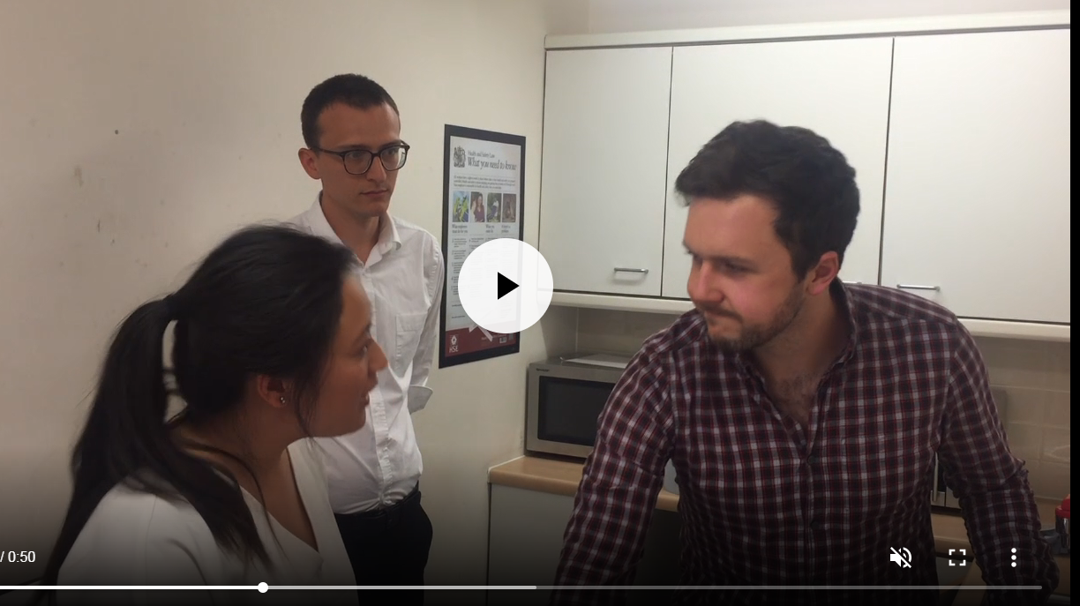
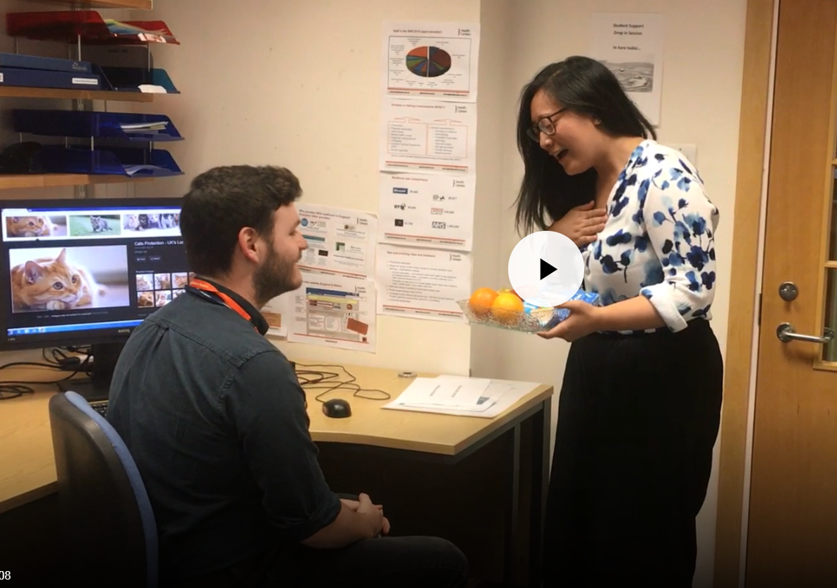
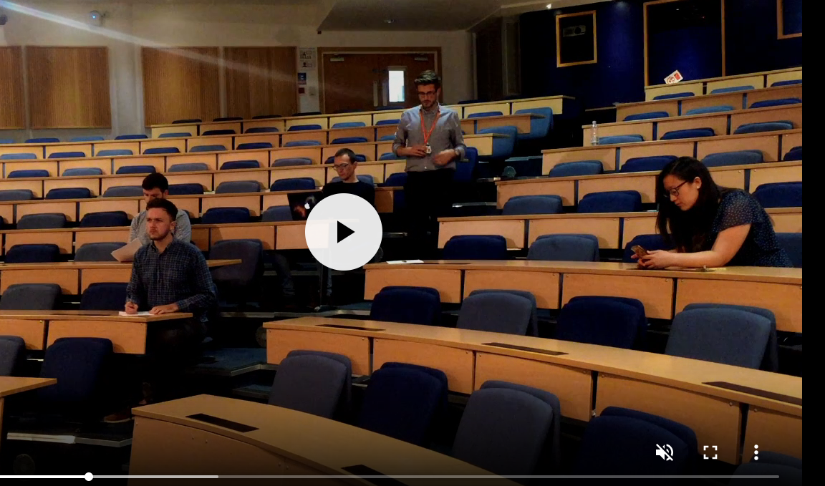
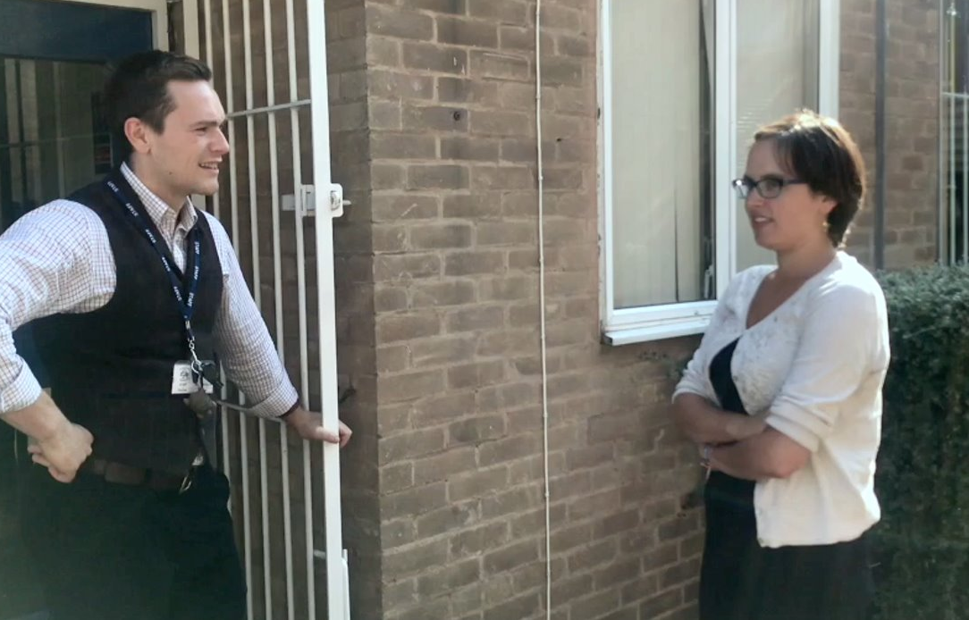
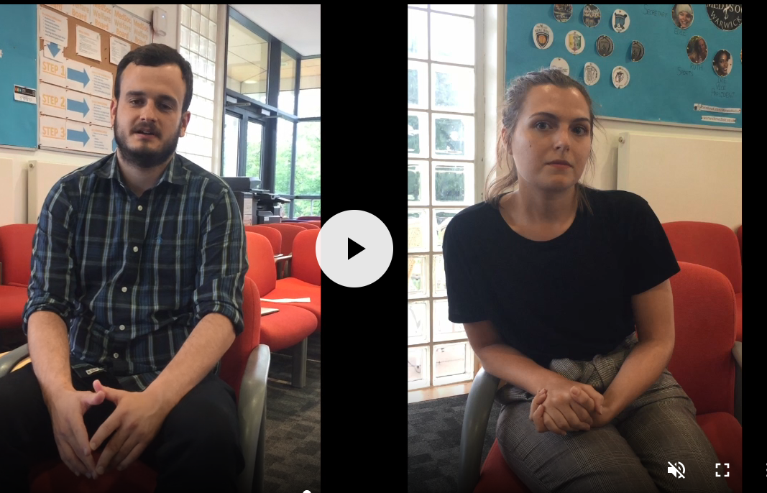
Learning about professionalism –
by students for students
Medical students and student teachers developing professionalism teaching materials together
With thanks to WIHEA, The Warwick International Higher Education Academy
Dr. AM Chilton, J Taylor, and the whole student team, listed below
Background
In this project, two departments with a strong commitment to professionalism (Warwick Medical School and the Centre for Teacher Education) collaborated to produce interactive and thought-provoking educational materials relating to professional behaviours.
The aim was to create resources that could be used across both the teaching and medical professions, demonstrating to students the common factors that apply to both professions, and helping them to develop their own knowledge, skills and attitudes in this important area.
Methods
The research literature suggests that students learn best how to act in a professional manner by…
Results
A total of 35 cases were generated, of which most are completed or in final development.
Issues included a wide range of topics, a sample of which can be seen to the right. Because they were based on real scenarios, some actually needed further action in the real world (e.g. where a student had experienced discrimination but had not reported it before our project).
Students were very motivated to help develop our professionalism curriculum, and believed that their authentic experiences could become useful learning opportunities for others. They enjoyed working on the project, and many felt their own professionalism skills had developed as a result.
A medical student encounters a racist patient...
Discussing real issues and cases
Our students generated real cases, based on their own experiences
Cases were developed to produce thought-provoking educational scenarios for use in small group sessions.
The cases were designed to encourage group discussion and debate. A mix of formats was used (interactive slides, audio and video presentations).
A professional gets offered a lovely gift…
Discussing professionalism dilemmas in a safe group setting
Guidance and advice was provided at the end of each case presentation so that students could learn the most professional way to act in each scenario
A student signs in to a mandatory lecture, then leaves…...
Learning from role models
A parent complains about a student teacher taking her daughter’s class…
‘The students came up with so many great ideas – having students produce the cases from their own real life experience was very important’
‘Generating scenarios was easy…it was much harder to pin down the right way to behave for each case’
‘Doing this project gave me a framework for dealing with professionalism issues in the workplace’
A student lies about his teaching experience in a job interview…
With thanks to the fantastic student team who developed the case material:
Samantha Chan, Richard Ford, Madhu Rangaraju, Felicity Davies, James Bloomfield, Dean Skutela, Alex Menzies, Jordan Moss, Lin Chang, Stuart Hamner, Romy Garbutt, Christopher Evans, Becky Riddle, Laura Richards, Jenardan Sellathurai

