Slide 1

Can digital resources enhance student’s mastery of threshold concepts?
A Concept Paper Presentation
2 June 2023 / EERN conference

Slide 2
Presentation summary
Features of threshold concepts
Literature gap
Why digital?
Research questions
Project scope

Slide 3

Threshold concepts
Transformative
Irreversible
Integrative
Bounded
Troublesome
(Meyer and Land, 2006)
Notes:
A shift in perception. A transformation of personal identity
Cannot be unlearned without significant effort. Adam and Eve
Exposes hidden interrelatedness
Counter-intuitive or alien

Slide 4
Literature Review

Slide 5
Literature Gap
Establish reasons for gap
Is there a link between TCs and active, student- centred learning?

Slide 6
Constructivism and troublesome knowledge
Active learning
“Knowledge and learning as actively acquired”
Creative learning
“Learners need to create or recreate knowledge for themselves”
Social Learning
“We co-construct [understanding] in dialogue with others”
(D.C Philips in Perkins, 2006)
Notes:
Learner roles
Emphasis on learning not teaching

Slide 7
Types of troublesome knowledge
Ritual knowledge
Routine knowledge that is meaningless unless contextualised
Inert knowledge
Active problem solving connected to their world
Conceptually difficult knowledge
Outside of their lived experience
Foreign or alien knowledge
  Introducing new perspectives
“The shift in perspective may lead to a transformation of personal identity, a reconstruction of subjectivity.”

Slide 8
Threshold concepts
Transformative
Irreversible
Integrative
Bounded
Troublesome

Slide 9
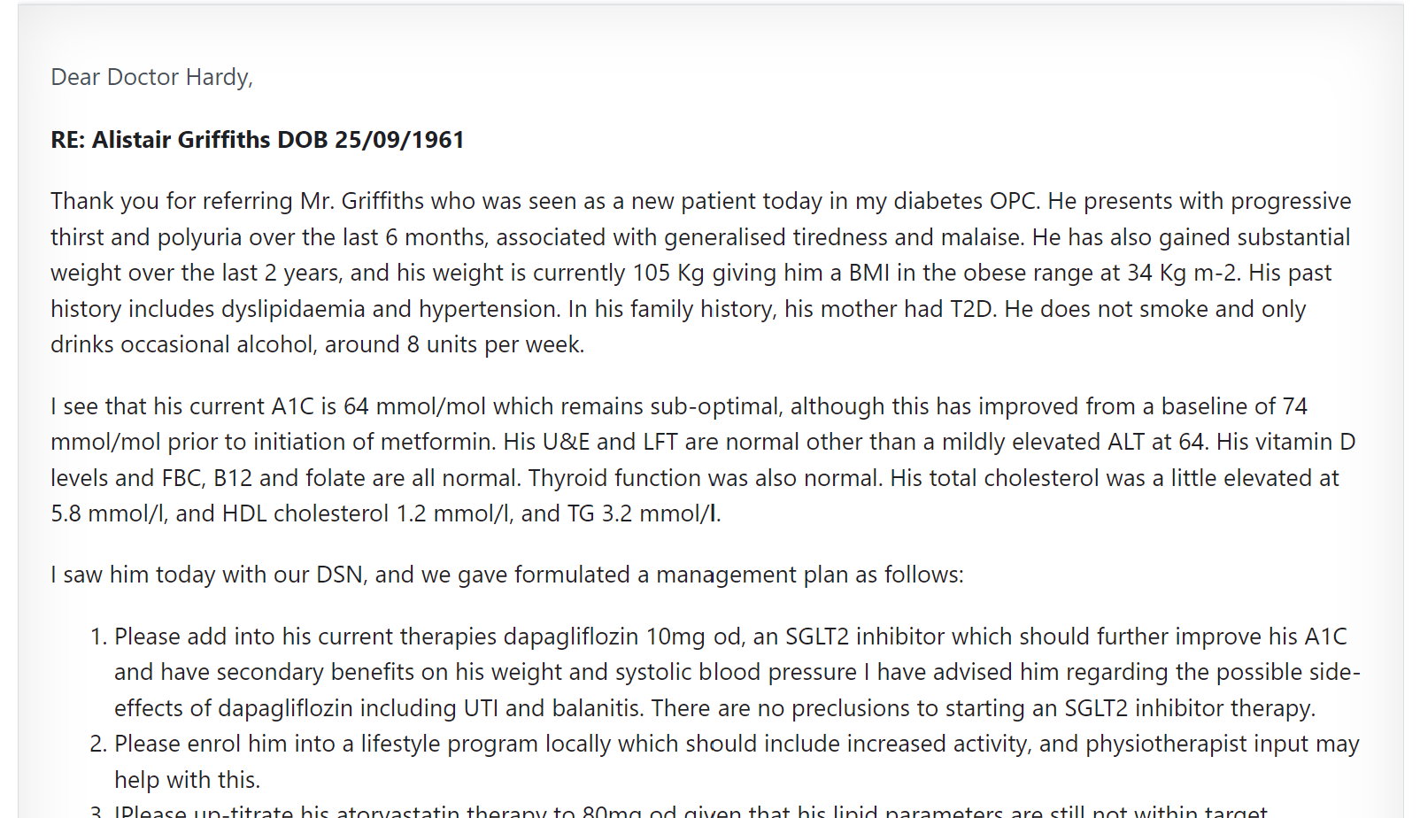
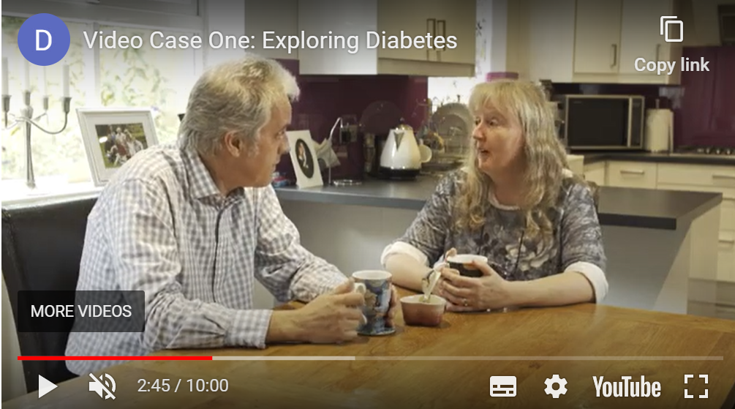
Why digital?
Ritual knowledge. Contextualising knowledge brings it to life. Example: Digital Healthcare Science: Doctor’s notes vs. Case study video
Conceptually difficult knowledge: Knowledge which may contradict lived experience.
Example: a virtual world where friction and gravity do not exist.
Foreign or alien knowledge. Perspectives that conflict with the learner’s.
Example: Test a product from a different perspective in a virtual world

Slide 10


Further considerations for digital
Safety
Scale
Sustainability
Accessibility (inaccessible places and alternative formats)
Equality, Diversity and Inclusion
Permanence
Connectedness: Communities of practice and crowd sourcing

Slide 11
Overview of Research Questions
Can immersive and interactive digital resources help students cross the threshold in engineering?
What concepts have proved troublesome or transformative for students?
What teaching methods support threshold concept mastery?
What learning strategies support threshold concept mastery?
What is the added benefit of digital?
Notes:
Roles of engineers and value of learning (Male and Bennet, 2015)
Complex numbers (Baillie et. al., 2006)
Classification of process variables (Makhathini, 2020)

Slide 12
Project scope
Research
Application
Literature review
Identified a gap
Run focus groups (Engineering and Management students)
Interviews with tutors
Qualitative analysis of findings
  What are the thresholds?
  How are they tackled?
Ideation workshops (students and tutors)
Digital resources build
Digital resources dissemination

Slide 13
References
Baillie, Caroline & Goodhew, P. & Skryabina, Elena. (2006). Threshold Concepts in Engineering Education—Exploring Potential Blocks in Student Understanding. International Journal of Engineering Education. 22.
Gamez‐Montero, Pedro J., et al. “Flipped Learning and Threshold Concepts in the Turbomachinery Section of Fluid Engineering Course.” Computer Applications in Engineering Education, vol. 29, no. 4, 2021, pp. 795–809, https://doi.org/10.1002/cae.22280.
Khoo, Elaine, et al. “Evaluating Flipped Classrooms with Respect to Threshold Concepts Learning in Undergraduate Engineering.” Ieee, 2015 IEEE Frontiers in Education Conference (FIE), 2015, pp. 1–4, https://go.exlibris.link/wpyKQtsv. Accessed 1 June 2023.
Olaniyi, Nkaepe E. “Threshold Concepts: Designing a Format for the Flipped Classroom as an Active Learning Technique for Crossing the Threshold.” Research and Practice in Technology Enhanced Learning, vol. 15, no. 1, 2020, pp. 1–15, https://doi.org/10.1186/s41039-020-0122-3.
Meyer, J., & Land, R. (2006). Overcoming Barriers to Student Understanding: Threshold Concepts and Troublesome Knowledge (1st ed.). Routledge.
Perkins, D. in Meyer, J., & Land, R. (2006). Overcoming Barriers to Student Understanding: Threshold Concepts and Troublesome Knowledge (1st ed.). Routledge.
Quinlan, Kathleen M., and U.a. “Methodological Challenges in Researching Threshold Concepts: A Comparative Analysis of Three Projects.” Higher Education, vol. 66, no. 5, 2013, pp. 585–601, https://doi.org/10.1007/s10734-013-9623-y.

