Slide 1
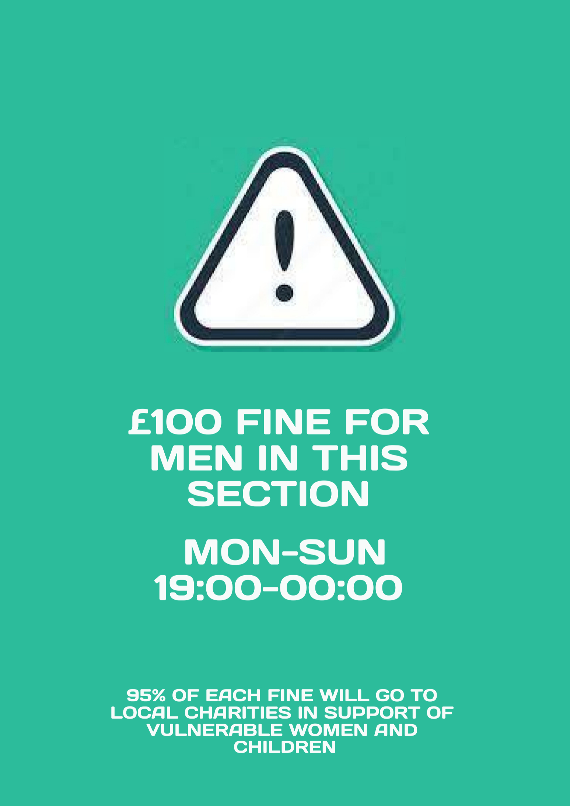
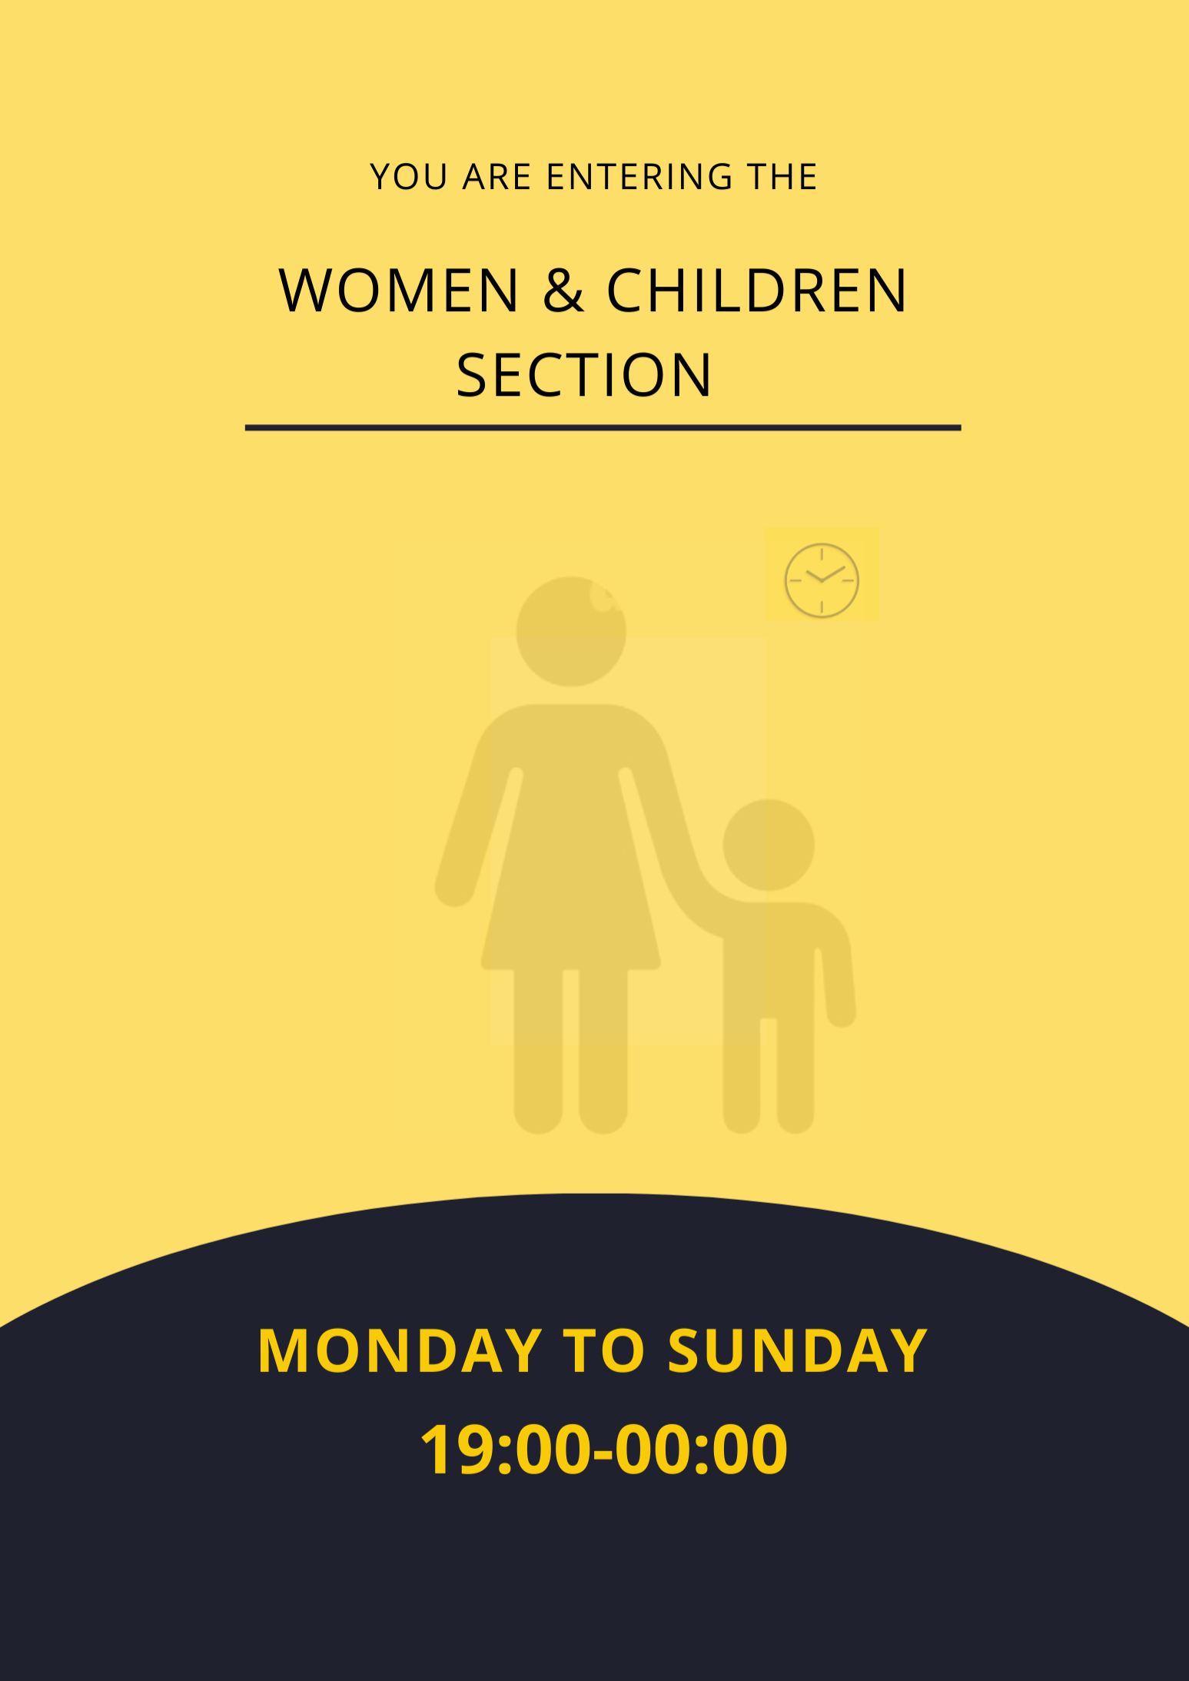


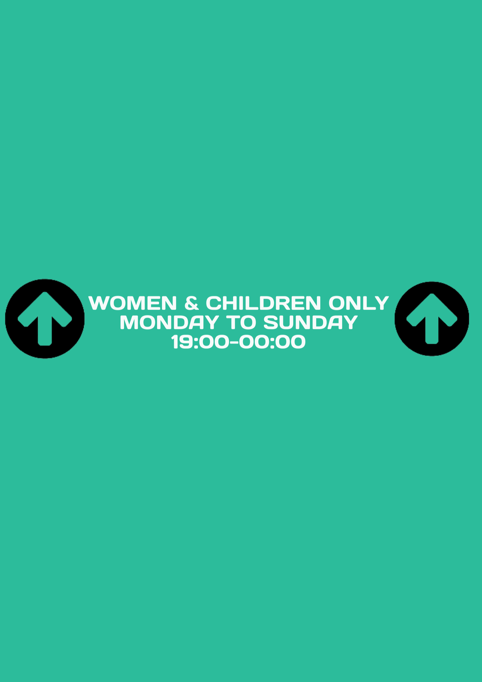

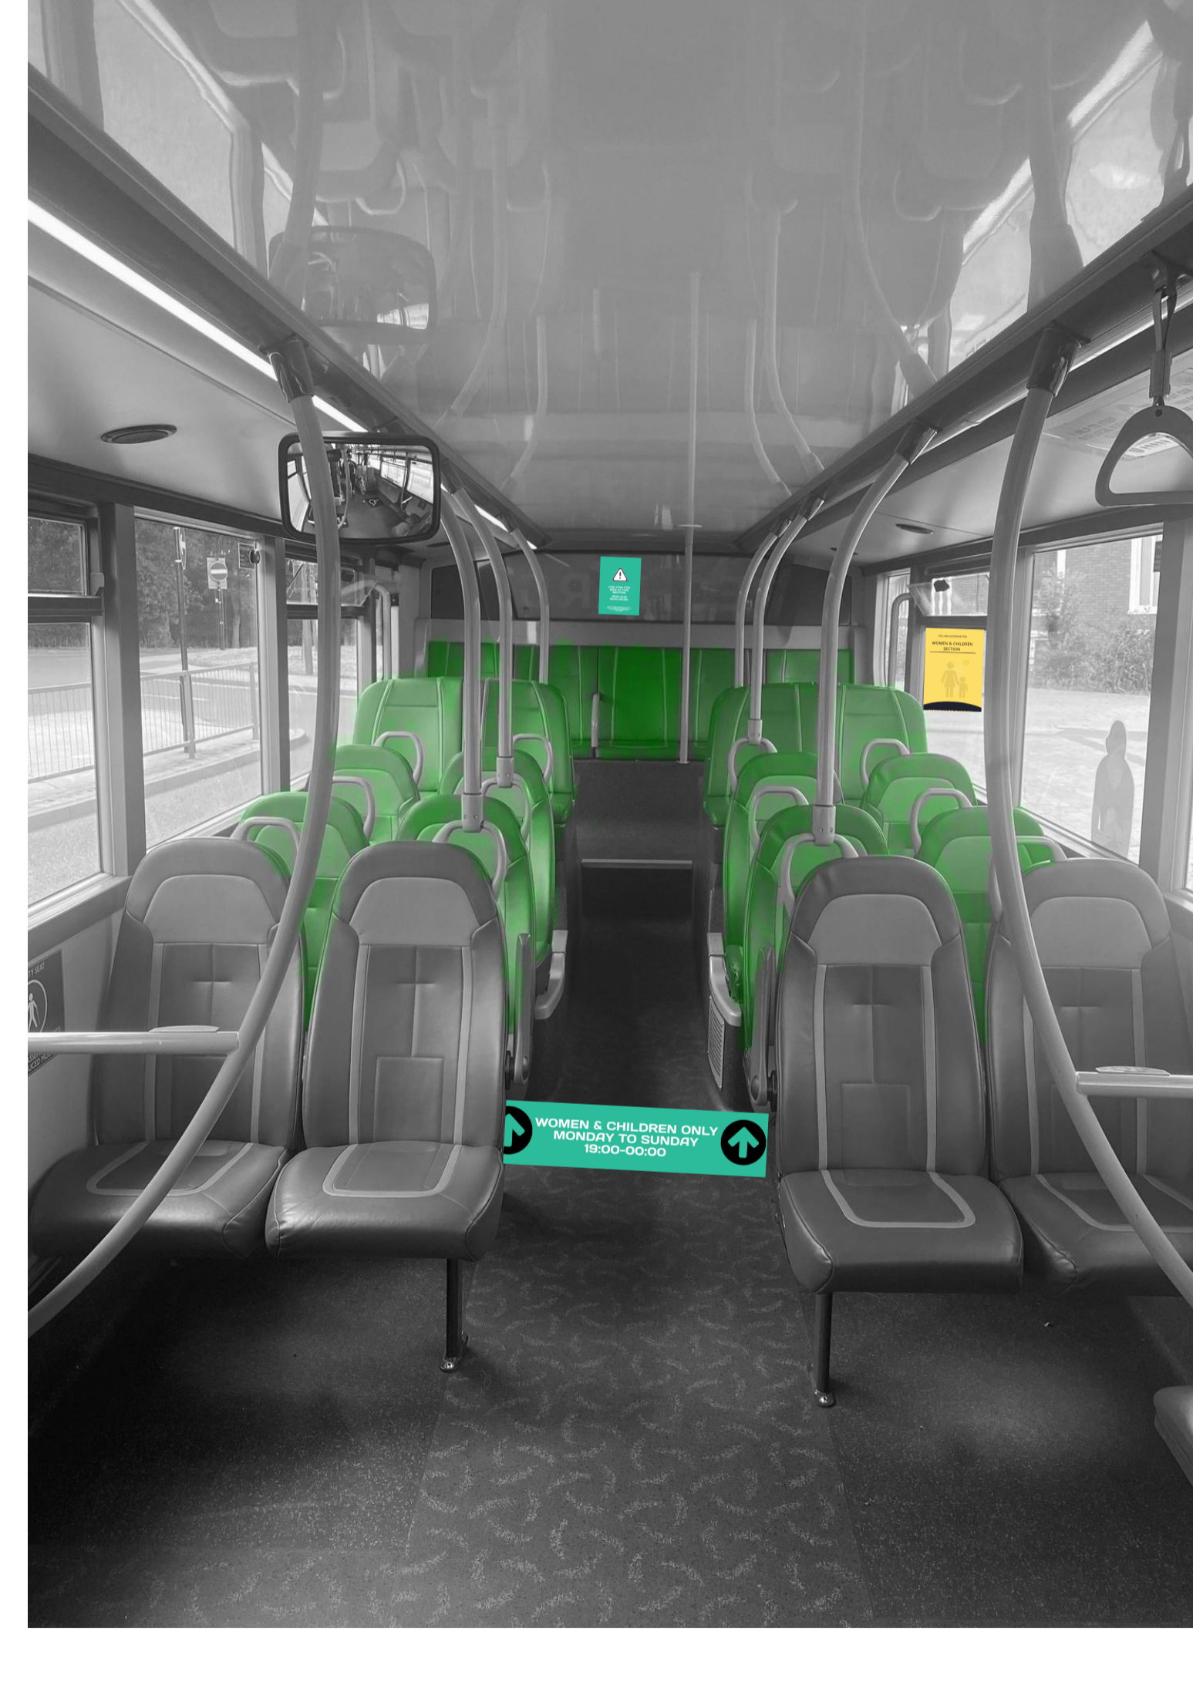


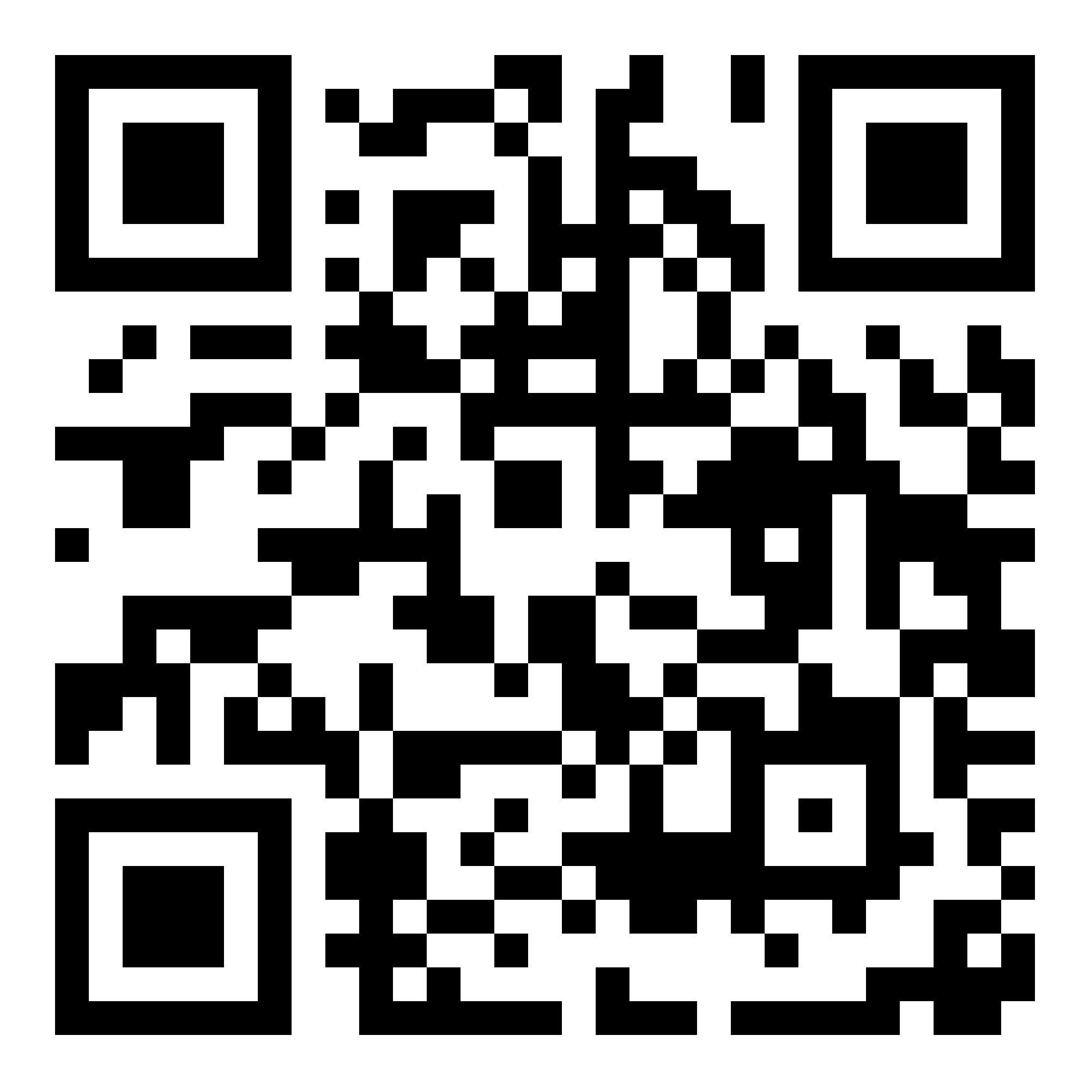

Team 8: Dylan Davis, Yiwen Gao, Ian Sze
The University of Warwick | Sustainability Challenge
FEMALE DESIGNATED SEATING AREA
CHALLENGES TO COVENTRY BUSES
SOLUTION OVERVIEW / SPECIFICATION
BENEFITS OF IMPLEMENTATION
89%
Accessibility:
Easy to reach the seating area
Easy to supervise, reduces time and cost for bus drivers to intervene
Inclusiveness:
Single women or with children, and people with any disability that requires additional needs and priority seating.
Acceptance:
Anti-stereotype: Usage of gender-neutral seats colour; solution must adapt
to exiting Coventry culture.
Emphasise and promote the benefits of switching to public transport and its increased safety for women and children in the evenings.
SOCIAL
ENVIRONMENT
OUR IDEA AIMS TO SOLVE SUSTAINABLE DEVELOPMENT GOALS SUCH AS:
Improves access to women and children ^{[3]}
Encourages active bystander behaviour.
Reduces inequalities in the long run, removing anti-social behaviour that decreases bus usage by women and children.
Upcycles materials such as plastic waste
Increase of public bus usage over private vehicles improves local atmosphere and community wellbeing,
Creating less traffic on the road, causing travel durations to become quicker; much more efficient.
Of women would be encouraged to take public buses more if there were changes to develop a safer environment ^{[1]}
To Do List
Figure 1: Penalty Information Poster | Figure 2: Warning Information Poster | Figure 3: Coloured Floor Directions
3. Good Health and Well-being
10. Reduced Inequalities
11. Sustainable Cities and Communities
Penalty Information Poster (1)
Distinctive
Coloured Seats
Economic
Social
Environment
Only38%
Economic
Warning Information Poster (2)
Uses a circular economic approach
Confidence gained within women and children will save them money by substituting cars/taxis for buses.
Solution will payback reasonably fast, increase profitability for bus companies and revenues for local charities.
of women would choose to take a bus instead of a taxi/car at night, whether alone or with friends ^{[2]}
#WORLDSTODOLIST
Coloured Floor Directions (3)
Figure 4: Diagram of implemented solution with labelled components
Table 1: Summarised specification for the designated women (and children) seating area
Specifications
1.0 Function | The solution must be a non-compulsory seating area designated for women (and children) at night to maintain freedom of deciding where to sit and aid their confidence to increase travelling via public bus instead of private vehicles.
2.0 Materials | Materials must be of sourced from recycled paper for the posters/stickers as well as recycled paint and/or cloth for producing distinct coloured seats.
3.0 Cost | The solution is reasonably affordable, and its expenses are primarily derived from the start-up cost, which will be paid back overtime given the increase in bus uses and revenue from fines.
4.0 Environment | The solution should be eco-friendly, providing a safer environment and increasing self-confidence for women and children. The environment on the bus must socially and economically deter anti-social behaviour to arise.
5.0 Maintenance /Enforcement | The solution should be easily maintained, replacing or repairing damaged posters and seats. The solution must be heavily enforced with CCTV recordings. With designated seating areas being strategically close to the driver, bus drivers must quickly and effectively intervene threatening situations with fines and other actions that ensures passengers remain safe. Enforcement should also be sourced from active bystander behaviours.
PROMOTING SOLUTION UPTAKE
‘These teenage boys that were clearly drunk were being nasty to me one evening after I said they pushed in line, next thing they kicked a football at my suitcase on the bus’ ~ Anonymous, age 61
‘At night, drunken guys smoke on bus, a girl went to tell the driver, the driver came up to the upper deck and scolded them’
~ Anonymous, age 32
SCAN TO VIEW OUR
PROJECT VIDEO
PLEASE CONSIDER VOTING FOR OUR PROJECT!
[1] Primary Data, Appendix A. [2] Primary Data, Appendix B. [3] Office for National Statistics (2021). Perceptions of personal safety and experiences of harassment, Great Britain - Office for National Statistics. [online] www.ons.gov.uk

