Slide 1

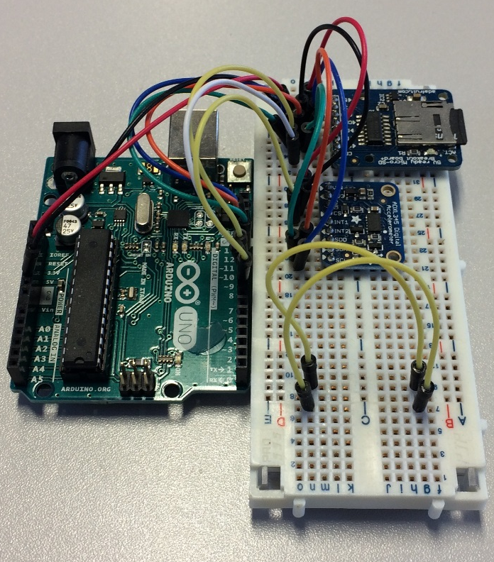
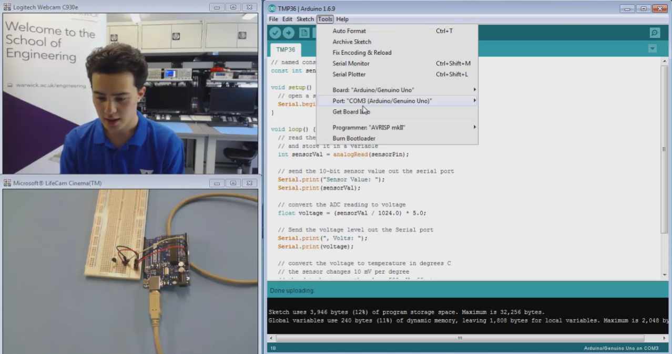
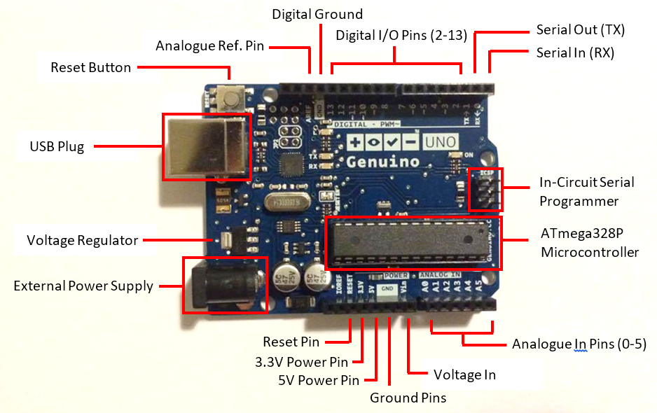
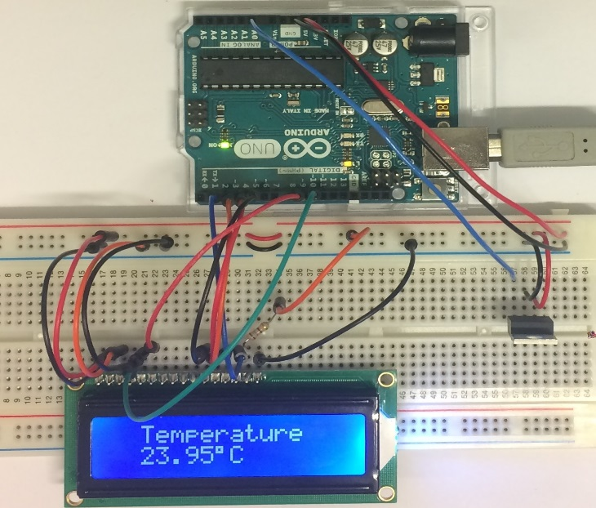
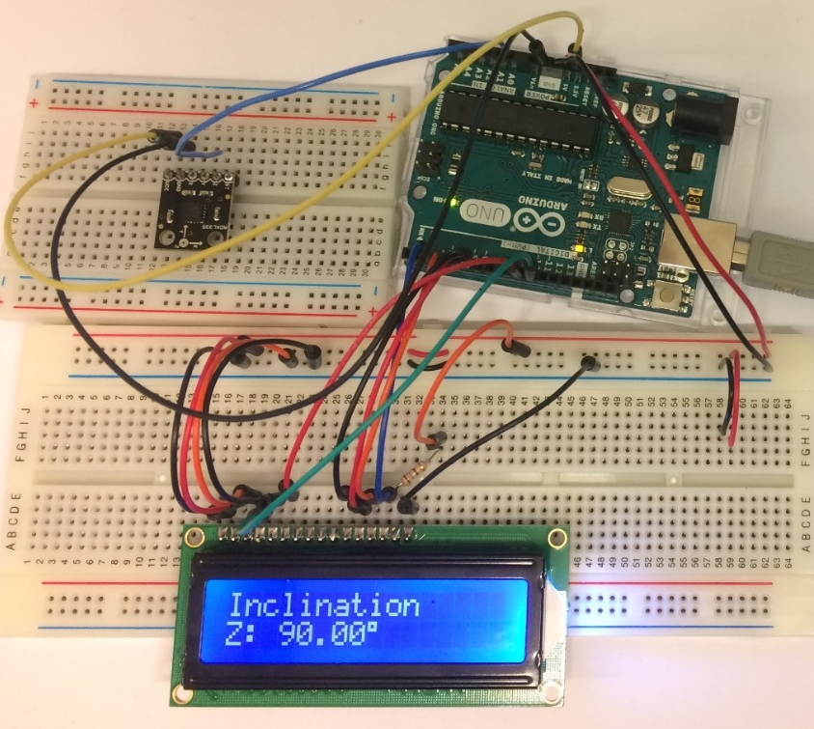

Student Engagement in Electronics through Microcontroller Experiential Learning (SEEMEL)
Akira Tiele, Siavash Esfahani, Alex Bucknall, Stephen Pithouse
School of Engineering
Project Lead: Dr Christos Mias
Collaborative Staff Partners: Dr Chris Purssell, Mr Ian Griffith, Dr Claire Lucas, Dr Richard Lillington, Dr Georgia Kremmyda.
1
3
The student feedback was positive (Table 1) and hence this year the three workshops are running as part of the second year ES2A8 Engineering Design module [3] and are attended by all 2nd year engineering students (more than 300). Furthermore, workshop 1 was used in the School’s Headstart course in July 2016.
The aim of this project was to Improve further the student engagement (and in particular the engagement of civil/mechanical engineering oriented students) with electronics in the School of Engineering; where the engineering degrees have currently the first two years common. This improvement leads to more career/innovation opportunities in interdisciplinary fields such as civionics (i.e. the use of electronics in civil engineering) for structural health monitoring.
It was proposed that the aim could be achieved in a student led teaching environment, via an experiential learning approach, in which students synthesise functional complex devices based on easily programmable microcontrollers and peripheral devices, such as sensors.
To validate this proposition, the project team ran three microcontroller hands-on workshops which employed multiple forms of support to the student “learners”: face-to-face interaction between student “learners” and student “mentors”, videos and handouts. The Arduino Uno (Figure 1) [1] was chosen as the microcontroller because of its ease of programming using its Integrated Design Environment (IDE) software. Camtasia software and two cameras were used for the videos. The format of the videos (Figure 2) is similar to that of reference [2].
Introduction
Questions | Definitely agree | Mostly agree | Neither agree nor disagree | Mostly disagree | Definitely disagree
Workshop 1 was easy to follow and informative | 6
Workshop 2 was easy to follow and informative | 6
Workshop 3 was easy to follow and informative | 4 | 2
The videos were helpful | 3 | 3
The handouts were helpful | 6
I would like to attend additional Arduino workshops | 5
Following the workshops, I am interested in applying microcontrollers in my preferred area of Engineering (civil, mechanical, electronic/electrical, systems) | 3 | 2
Following the workshops I am interested to learn more about electronics | 4 | 1
I believe these workshops can support the learning of electronic modules | 5
Feedback & Table 1
2
The first workshop was an introduction to Arduino, with hands-on activity on how to write and run a simple code to make a light emitting diode blink and to observe on the computer screen the ambient temperature using a temperature sensor. In the second workshop, the temperature recorded by the temperature sensor was displayed on a liquid crystal display (LCD), Figure 3, as it is normally done in commercial products. In addition, an analogue acceleration sensor was used to create an inclinometer which displayed on the LCD the inclination angle (Figure 4). The third workshop recorded digital acceleration sensor data to a micro-SD card (Figure 5).
The workshops ran on three consecutive days after the student summer exams and 1st/2nd year students were invited. Eleven students registered but only six completed all workshops (among them two civil and two mechanical students).
Figure 5
Figure 2
Workshop Details
Figure 1
Figure 3
Figure 4
[1] The Arduino website www.arduino.cc . Date last accessed: 5/1/2016.
[2] Arduino Lessons www.toptechboy.com/arduino-lessons/. Date last accessed: 5/1/2016.
[3] Year 2 ES2A8 Engineering Design module, Microcontroller Laboratories, www2.warwick.ac.uk/fac/sci/eng/eso/modules/year2/es2a8/resources/es2a8_microcontroller_workshops/. Date last accessed: 5/1/2016.
References
Acknowledgements: Dr Robert O’Toole for providing advice on IT equipment, providing the Camtasia license and for recording the workshop activity. Warwick IT Services providing the IT equipment and installing the IDE software for Arduino. Mr Ashley Richley assisting with the IDE installation process including testing the software. The Project was funded by WIHEA through the Student Engagement Programme.
Nov. 2016

