Slide 1
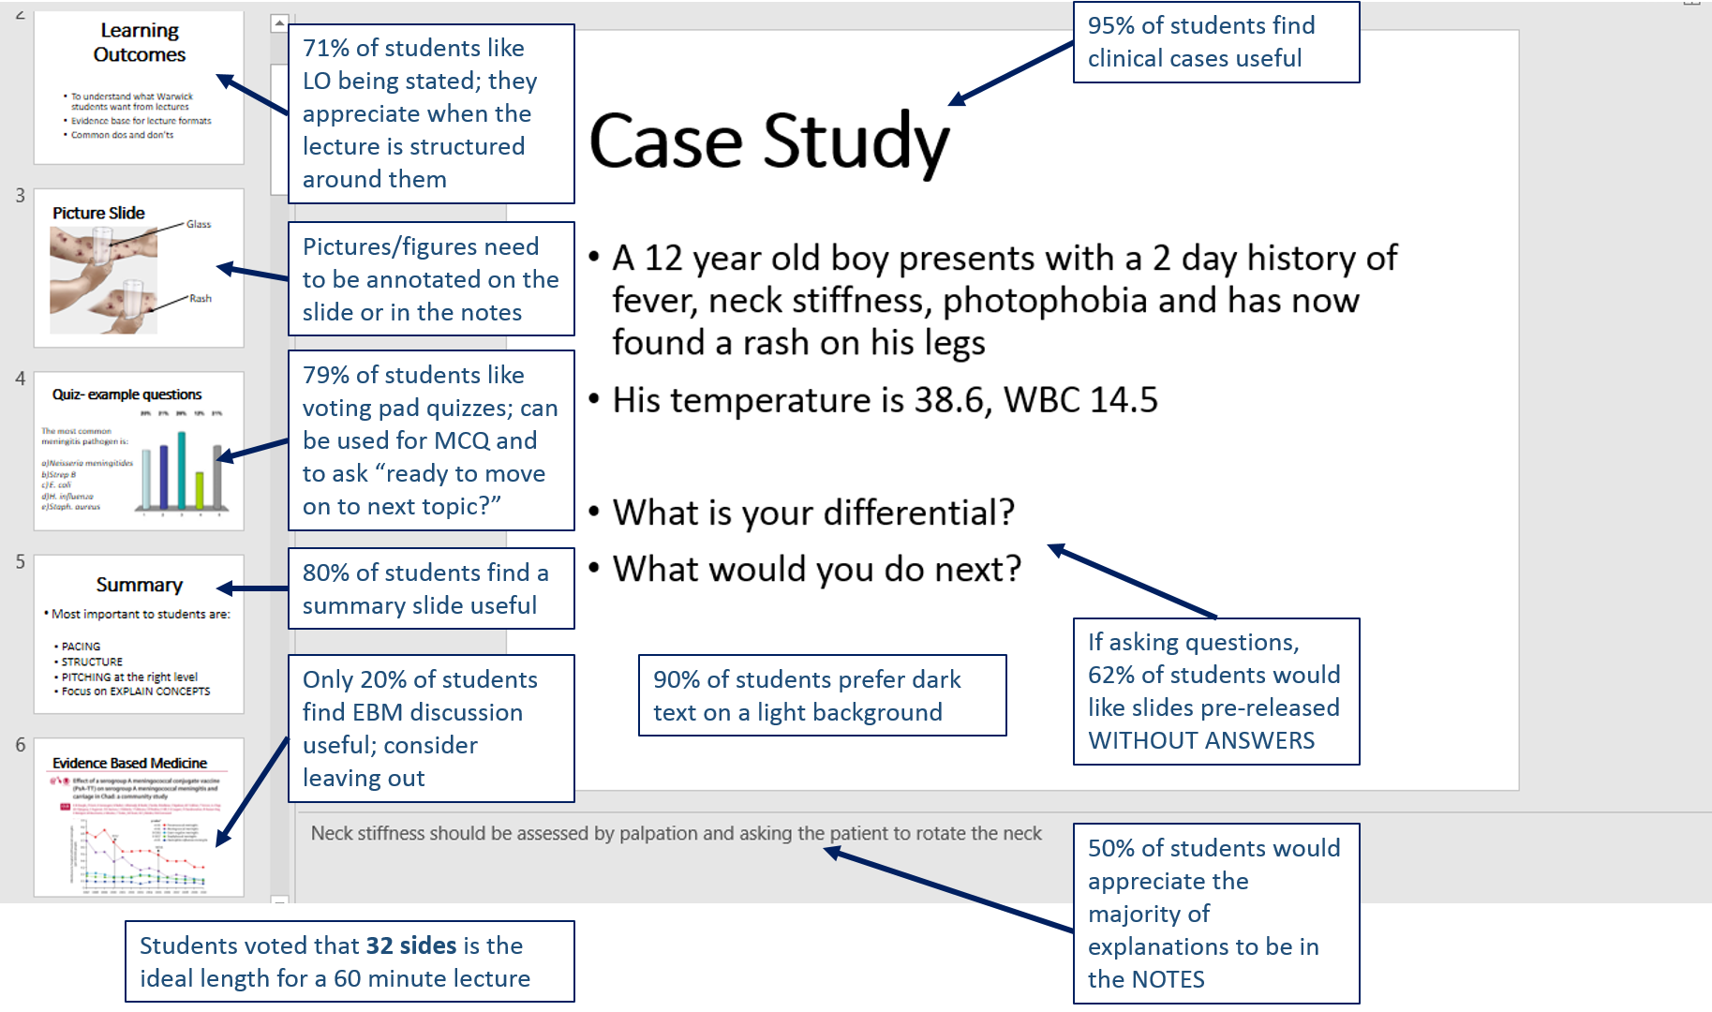
Warwick Medical School – Mystery Shopper Programme
John Flemming, Hannah Maxfield, Logan Mills, Kate Myler and Dr Kate Owen
What is our programme about?
We have started and are currently running a ‘Mystery Shopper’ programme, where MB ChB students participate in training and then provide anonymous feedback to lecturers shortly after lectures are delivered.
Why was this needed?
Who is involved?
What did we do?
Most lecturers welcome constructive criticism and want to improve delivery to benefit students.
The current method is not very specific. Several weeks can elapse between a lecture and a student being asked for feedback.
A small committee of students across all MB ChB cohorts with the assistance of the Deputy Head of the MB ChB programme have lead the project.
Participants in the overall scheme include approximately 50 trained volunteers across every cohort.
Plan: We surveyed all MB ChB students to find out how they wanted to be instructed?
Do: We trained students to be expert feedback providers in a 90 minute session. They now provide feedback using an online form that is based on survey results.
Study: We will resurvey all students to assess the impact of the intervention. We use feedback from lecturers to adapt the feedback form iteratively.
Act: We have just finished training new 1st year students in order to make the intervention sustainable.
What impact has it had?
What have we learned?
Feedback from lecturers has been universally positive. This programme of timely feedback has helped instructors tailor their message to each audience, to determine what is most important and make the time best spent for everyone.
This programme has also given students a voice and helped us feel much more engaged in the feedback and instruction process.
We students have learned the best and most useful instruction techniques by surveying our cohort and applying the responses in our feedback forms.
We have learned to be structured in our appraisal methods when assessing lectures.
We have learned how to deliver constructive, useful feedback to lecturers who will see us and other cohorts.
Why should YOU do this?
Students take ownership of their learning.
Students are more engaged in lectures.
Lecture quality improves.
Student input reduces the burden on faculty, ensuring sustainability.
Infographical Results of our Survey of 44 Years 1, 2 & 3 Students

