Slide 1

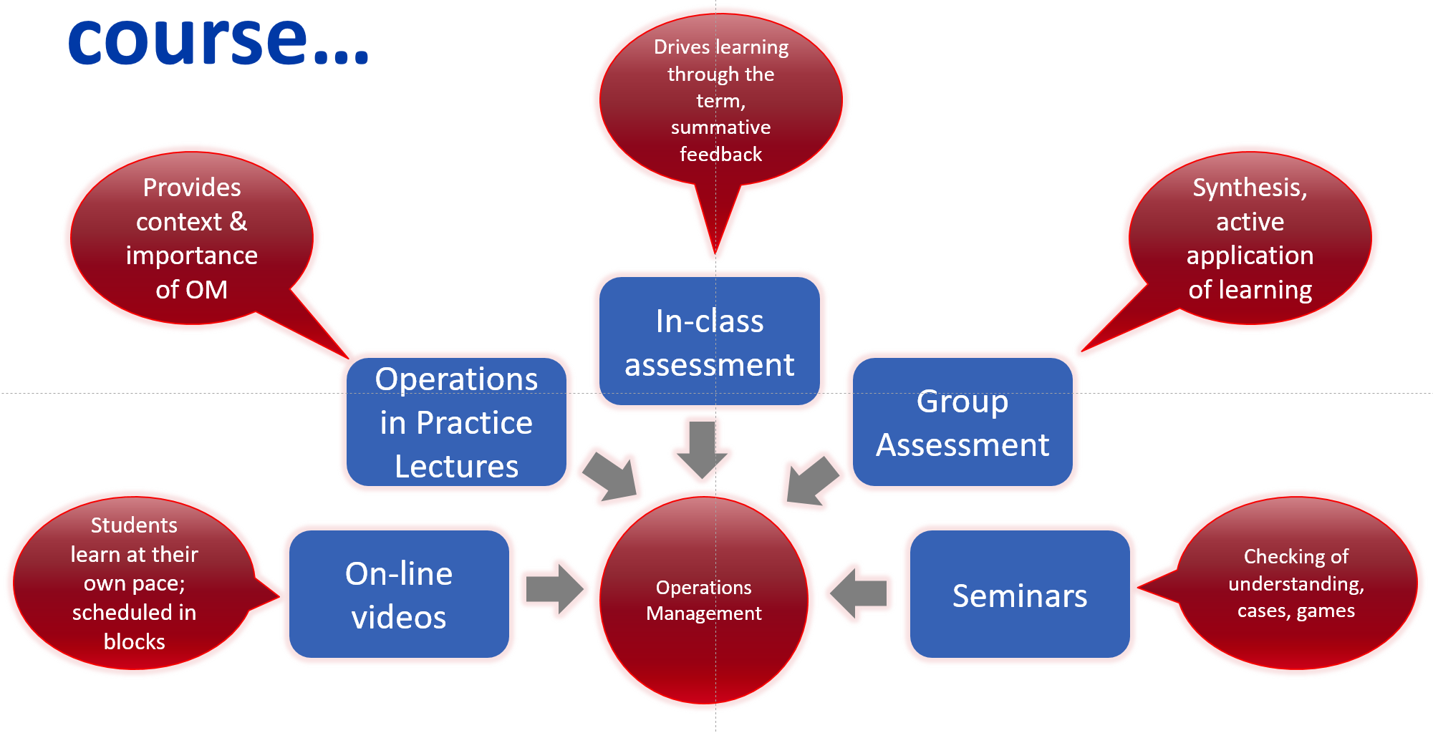
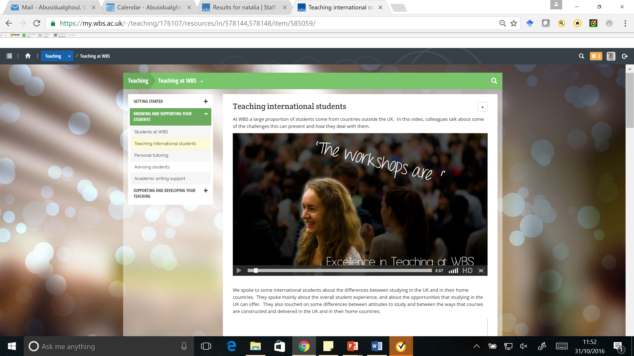
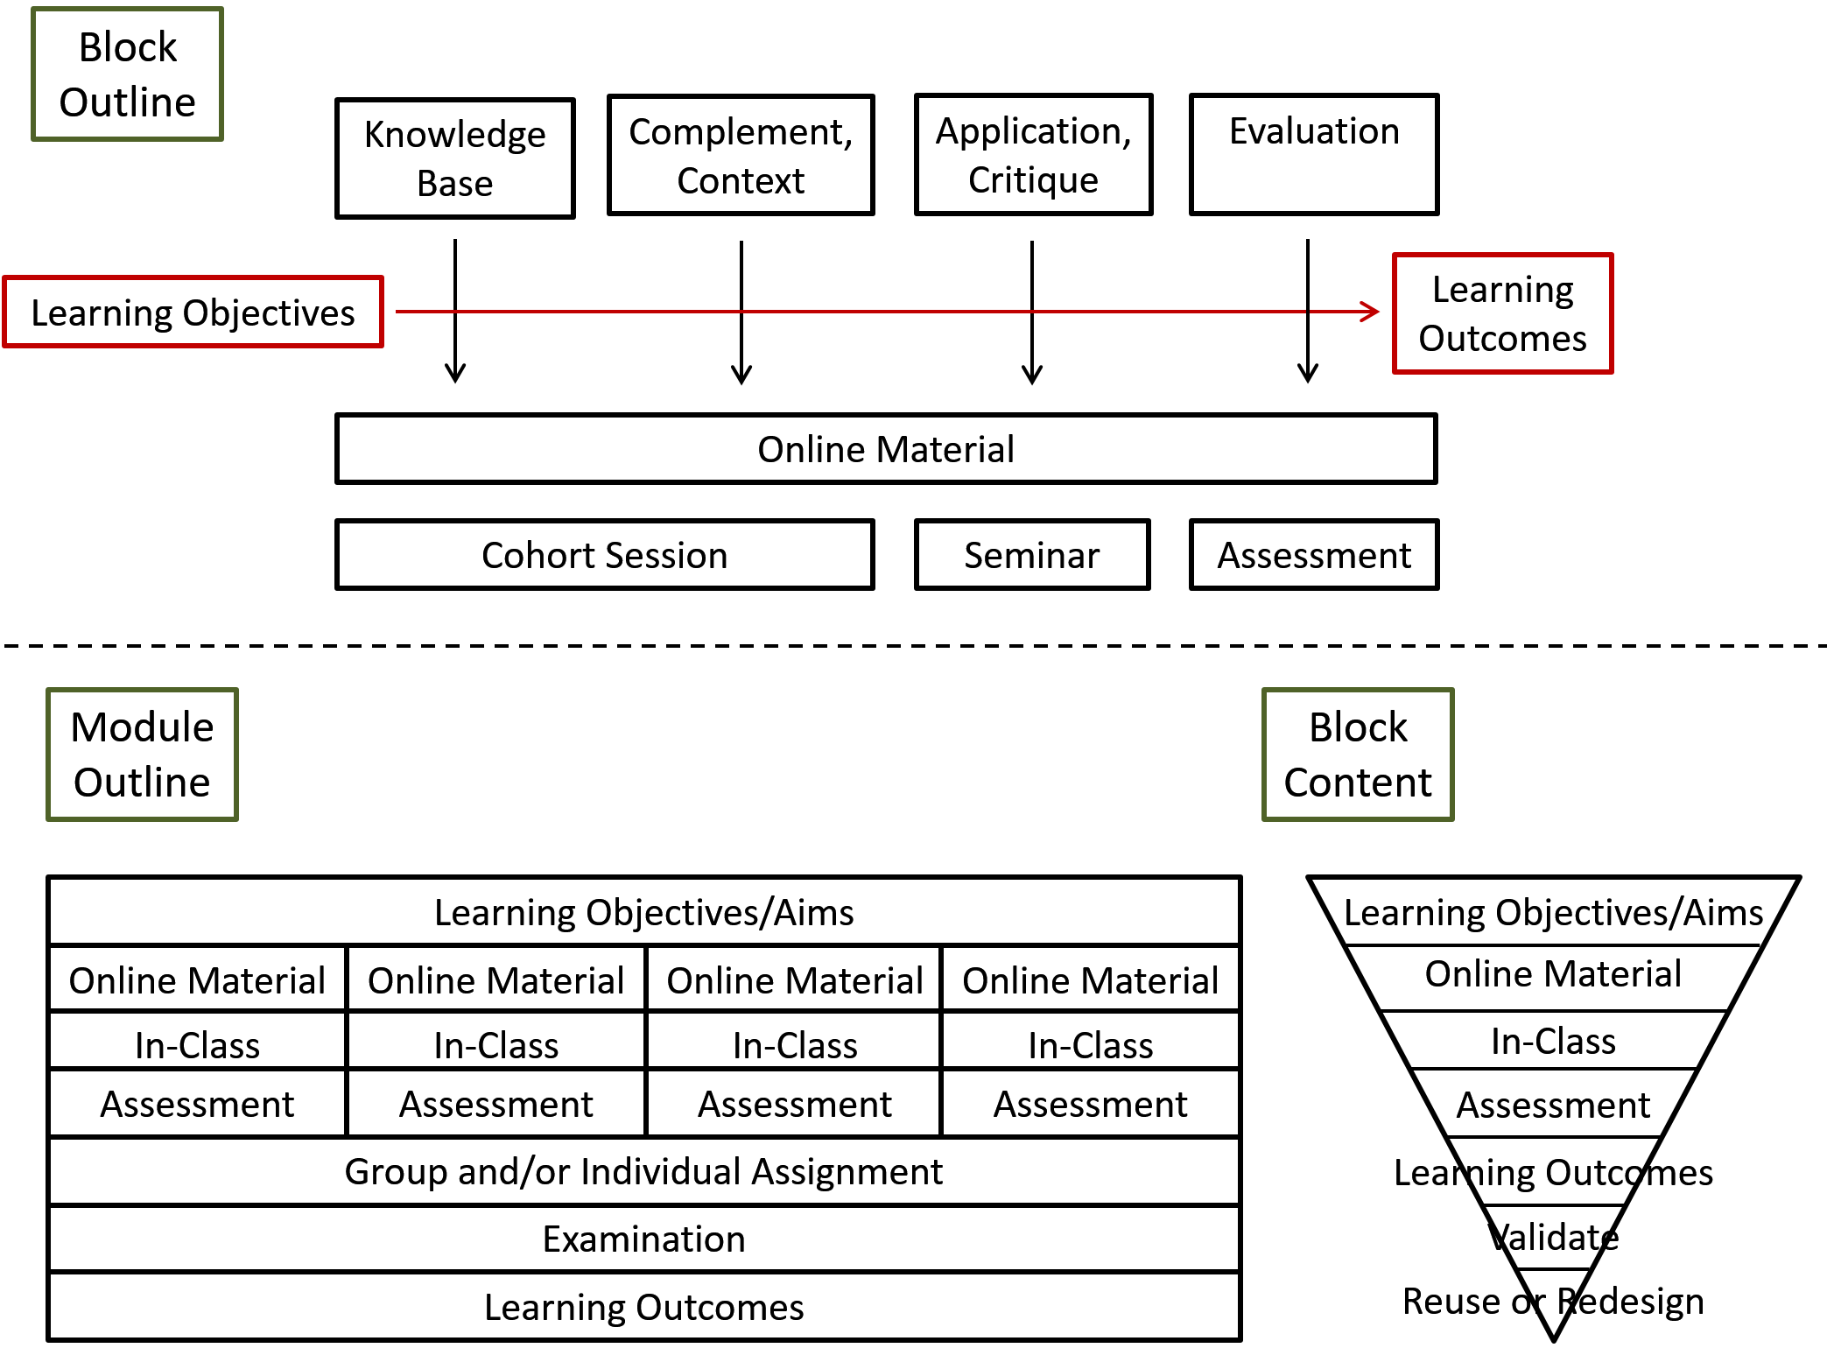
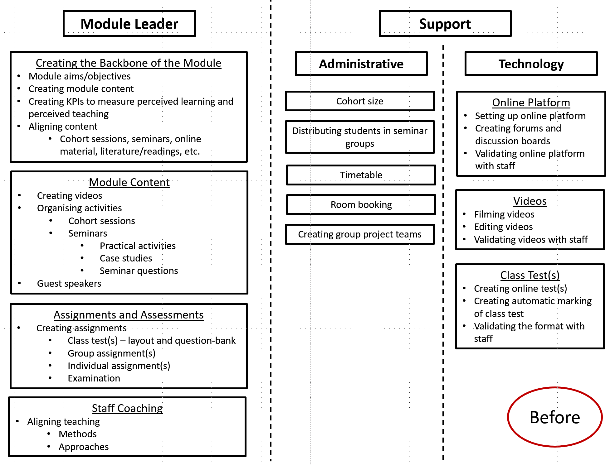
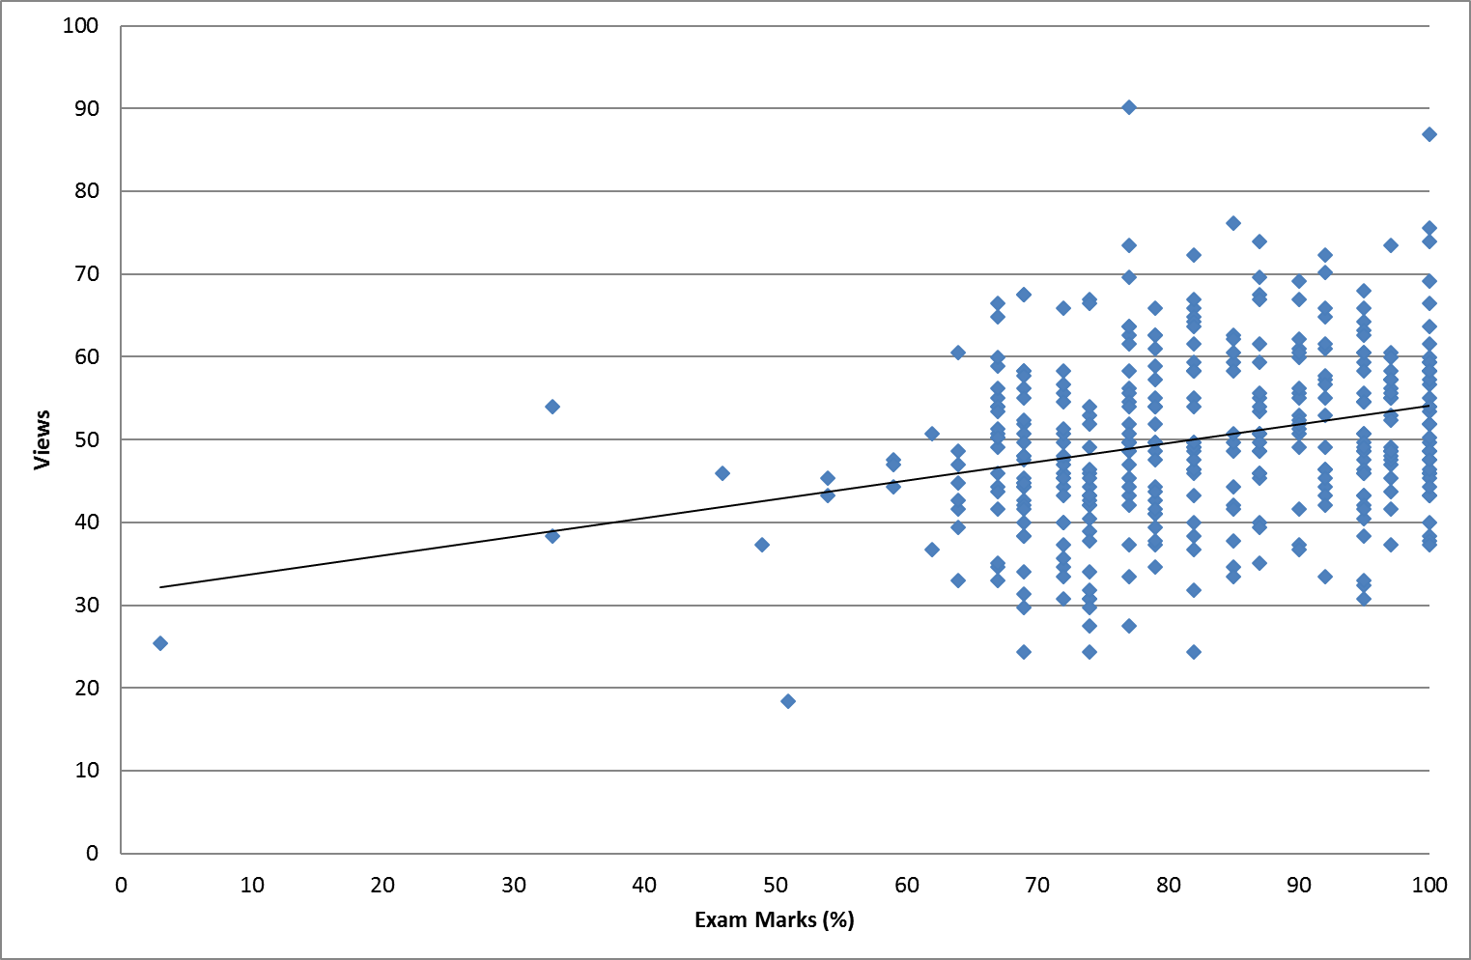
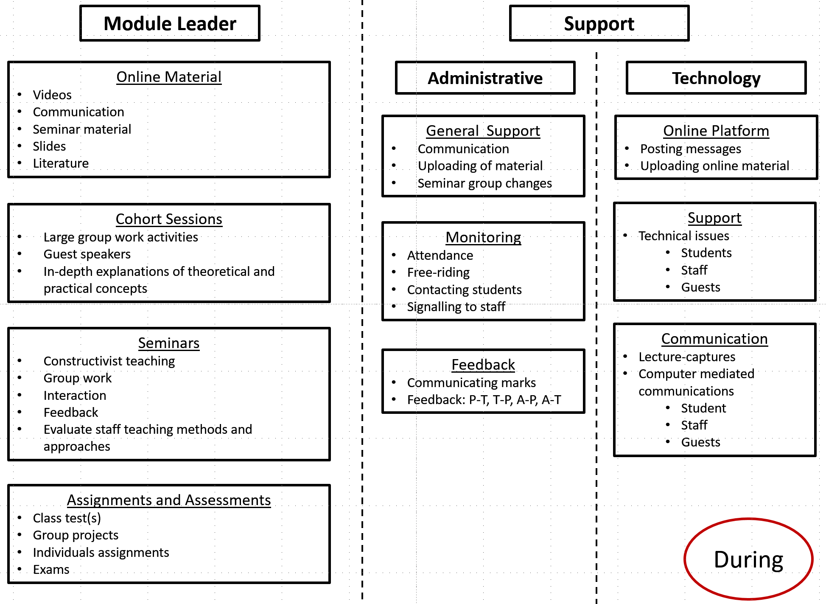
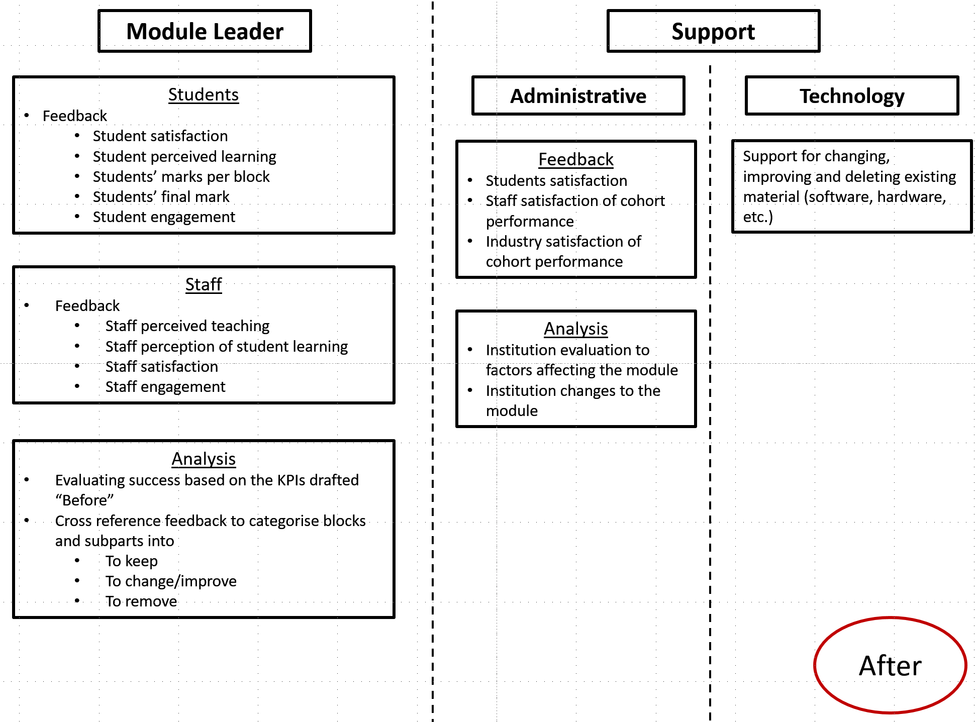
WIHEA Student Engagement Project
“Best [course] this term […] great delivery - combination of online videos, very interactive seminars and guest lectures, this approach saved time and put emphasis on engagement with the material […] good mixture of summer exam, online tests and group work.”
“The videos were a really nice way of learning, you can go over bits which you didn't find clear very easily.”
The Flipped Classroom: Design & Impact
First Year UG Operations Management Module Design
Module Methods Map
TEAM
Anna Röhss
Jonathan Canioni
Alex Rae
Vikki Abusidualghoul
Mark Johnson
Mehmet Chakkol
Max Finne
“The online videos allowed me to learn at my pace.”
Student Researcher-led Interviews & Focus Groups
Student Researcher-generated Model
Student Researcher-generated Design
Before
Why flip?
During
Student Researcher-led Literature Review
Constructivist environments are stimulating (Jonassen et al. 2005)
After

