Slide 1


Global academic practices: change and impact
Bridget Middlemas, PICASA Project
21st Standing Conference on Academic Practice, University of Warwick, July 2018

Slide 2
What might we learn from, and how are we contributing to, practices beyond the UK?
What is the current state of academic practice/educational development/pedagogic research in the countries you have worked with?
How do you see academic practice changing? Now or in the future?
What opportunities do you see arising? What challenges?

Slide 3
4 of our EU funded projects
E-Taleb – Developing a new Lebanese professional standards framework (Lebanon, 2016-date)
HEART – Higher education at the heart of human rights education (Western Balkans, 2011-2014)
INCLUSION – Developing institutional and national guidelines for inclusion in higher education (Bosnia & Herzegovina and Armenia, 2016-2019)
PICASA – Promotion of internationalisation through cultural & structural adaptations (Armenia, Belarus, Georgia & Ukraine, 2013-2016)

Slide 4

PICASA Project
(Promoting Internationalisation through Cultural & Structural Adaptations)
We researched the internationalised curriculum through our work on the EU funded PICASA Project
Roehampton was responsible for making recommendations about curriculum revisions to existing programmes
We worked with 20 universities in Armenia, Austria, Belarus, Belgium, Georgia, Italy and Ukraine.
We have also had an advisory role with 20 higher education institutions in Kerala, India

Slide 5
Context?
Post-Soviet countries (only formed around 20 years ago)
Starting to admit more international students to their programmes
Some international faculty, but not many (1-3%)
Not used to working in a democratic, collaborative way – much more used to a very top-down model
Really wanting to be “more international”

Slide 6
What was our focus?
We wrote policy and strategy documents on internationalisation, and trialling innovative methods
Looked at the financial and social implications of sending students and faculty overseas for extended stays
Reflected on cost effective and sustainable alternatives
Reflected on our own taught programmes and internationalisation policies to see if we could make some changes to the way that we think about “internationalisation” at Roehampton

Slide 7









The importance of good communication
Hello, բարի լույս, hola, guten tag, привет, bonjour, γεια σας….

Slide 8
Listening to your students …
You know, I was really terrified. My English is improving now, but still last year I barely could not understand what people were saying. I think that everyone got the impression that I was so stupid, because I would say “oh, yeah” and just be laughing and saying nothing else.
I felt ridiculous virtually all the time, and I was so terrified but still … I , some of my tutors helped me out. In class it really didn’t feel safe… in my own language, I am such a confident person
Maria, 2nd year life sciences undergraduate, 2013

Slide 9
What were Maria’s issues?
Trying hard to be accepted
Nervous
Confused
Embarrassed
Not confident
Feeling stupid
Not feeling safe
So, what can we do differently?

Slide 10
Where is “internationalisation”?
Formal policy & strategy | Informal
Admissions | Welcome arrangements
Marketing / publicity | Word of mouth
Research initiatives | Twitter & Facebook
Visiting scholars | Personal contacts
Curriculum | International student interns
Accommodation | Clubs and societies
Research | International networking

Slide 11

Internationalisation of what, exactly?
The whole institution?
Policy and strategy documents?
Admissions office?
The students?
The staff?
The curriculum?
The menu in the student union?
Work placements?

Slide 12
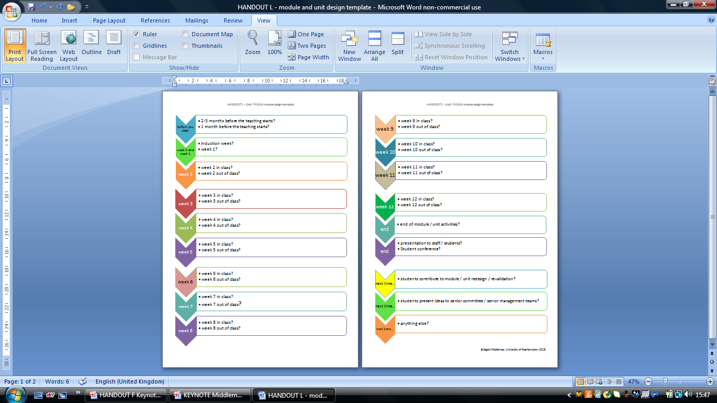
Planning for Internationalisation?
ACTIVITY

Slide 13
Where could internationalisation happen on one of your taught programmes?
Revised readings / resources?
Guest lectures?
Student to student discussions on a set topic?
Joint projects ( jointly assessed?)
Research tasks ( e.g. for a literature review) with an international partner?
Field trip or research visit?
“Languages for all” modules?

Slide 14
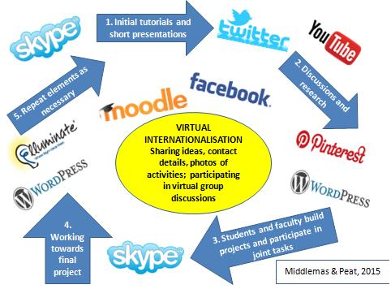
Can internationalisation be virtual?
Middlemas & Peat, 2015

Slide 15
Another way of working?
Virtual internationalisation
  Making the most of technology to support collaborative ways of working
  Makes use of everyday, familiar technologies
  Informal arrangements or credit bearing courses
  Opportunities for asynchronous engagement, not restricted to a certain time slot
  Enables students and staff to develop international skills of employability, languages, social communication, diplomacy and collaboration

Slide 16
How does internationalisation relate to discussions around “inclusion”?
“Inclusive learning and teaching in higher education refers to the ways in which (we) engage students in learning that is meaningful, relevant and accessible to all.
It embraces a view of the individual and individual difference as the source of diversity that can enrich the lives and learning of others”
                Hockings, C. (2010:1)

Slide 17
How does it relate to staff training programmes /
UKPSF applications?
V1 Respect individual learners and diverse learning communities
  A4 Develop effective learning environments and approaches to student support and guidance
  K3 How students learn, both generally and within their subject/ disciplinary area(s)
  K4 The use and value of appropriate learning technologies

Slide 18
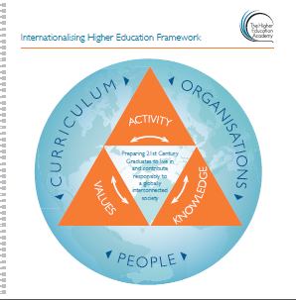
HEA’s Internationalising the curriculum framework
(HEA, 2014)

Slide 19
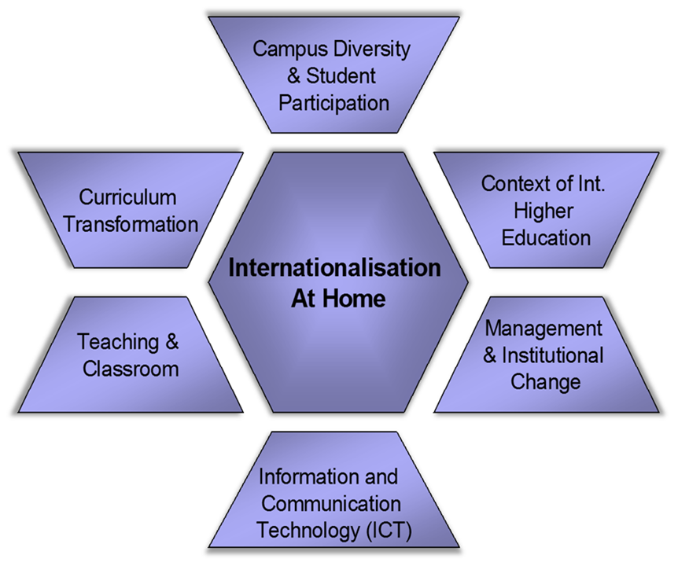

Internationalisation “at home”

Slide 20
Resources
HEA Internationalising the curriculum framework at: https://www.heacademy.ac.uk/system/files/resources/internationalising_the_curriculum.pdf
KH Leuven University (2013) International Competencies and Learning Outcomes at: http://www.internationalecompetenties.be/en/
Middlemas, B. & Peat, J. (2015) ‘Virtual Internationalisation’ and the Undergraduate Curriculum in UK and Overseas Universities. Journal of Applied Perspectives in Academic Practice at: http://jpaap.napier.ac.uk/index.php/JPAAP/article/view/195
Oxford Brookes University (2017) Internationalising the Curriculum resource Kit at: https://www.brookes.ac.uk/services/cci/resourcekit.html
PICASA – Overview of the project at: http://ysu.am/uploaded/Brochure.pdf

Slide 21
Global academic practices: change and impact
Bridget Middlemas
b.middlemas@roehampton.ac.uk

