Slide 1

Teaching Excellence & the Career Map
Jon Scott

Slide 2

Teaching Excellence & the Career Map

Slide 3
Teaching Excellence & the Career Map
‘In the past, rewards in higher education – particularly promotion – have been linked much more closely to research than to teaching. Indeed, teaching has been seen by some as an extra source of income to support the main business of research, rather than recognised as a valuable and high-status career in its own right. This is a situation that cannot continue. Institutions must properly reward their best teaching staff; and all those who teach must take their task seriously.’
The Future of Higher Education (DfES White Paper, 2003)

Slide 4
Teaching Excellence & the Career Map
‘For too long, teaching has been the poor cousin of research. Skewed incentives have led to a progressive decline in the relative status of teaching as an activity.’
‘Teaching excellence matters, not only for students and taxpayers, but also for those who care about social mobility, since we will not truly begin to reduce inequality unless more students fulfil their aspirations and progress on into their chosen careers. Excellent teaching needs to flourish across the sector; lacklustre teaching and unacceptable variability in quality need to be addressed.’
Success as a Knowledge Economy: Teaching Excellence, Social Mobility and Student Choice. BIS-16-265; May 2016, paras 23 & 26

Slide 5
Teaching Excellence & the Career Map
‘For too long, institutional incentives have led universities to prioritise research performance over teaching and learning outcomes.
The TEF puts in place new reputational and financial incentives to correct this imbalance by assessing universities on the quality of the student experience, teaching standards and the role of providers in securing good outcomes for graduates.’
Jo Johnson July 2017

Slide 6
Teaching Excellence & the Career Map
The mission of higher education includes the
promotion of excellence in research and teaching.
However, it is widely recognised that the systems
by which academic staff are evaluated and rewarded
focus primarily on their research performance.
Royal Academy of Engineering 2018

Slide 7
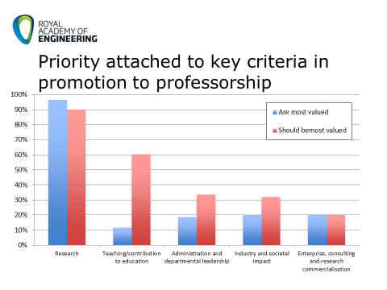
Teaching Excellence & the Career Map
Royal Academy of Engineering 2015

Slide 8
Teaching Excellence & the Career Map
Royal Academy of Engineering (2015)

Slide 9
Teaching Excellence & the Career Map
Perceptions of academic staff in the life sciences
Improving the status and valuation of teaching in the careers of UK academics (2014).

Slide 10
Teaching Excellence & the Career Map
Status of teaching-focused/teaching only staff in STEM
Gretton & Raine (2015)

Slide 11

Teaching Excellence & the Career Map
Long haul cartoon

Slide 12

Teaching Excellence & the Career Map

Slide 13
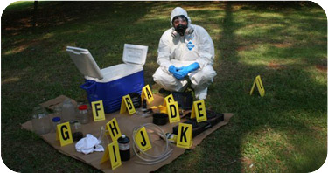
Teaching Excellence & the Career Map

Slide 14

Teaching Excellence & the Career Map

Slide 15
Teaching Excellence & the Career Map
Promoting Teaching: Making evidence count. Higher Education Academy (2013)
Higher Education Teacher Career Progression Framework. Royal Society of Biology (2015)
Rewarding Educators and Education Leaders in Research-Intensive Universities. Higher Education Academy; Fung, D & Gordon, C (2016)
The Career Framework for University Teaching Royal Academy of Engineering (2018)

Slide 16
Teaching Excellence & the Career Map - Spheres of Impact
Royal Academy of Engineering 2018

Slide 17
Teaching Excellence & the Career Map - Levels of Evidence
Sphere of Influence
Students
Departmental/Faculty
University
National
International
Recognition
Professional Recognition – e.g. UKPSF
Teaching Awards
External Examining
Programme Review Panel Membership
Invited Presentations

Slide 18
Teaching Excellence & the Career Map
Impact
Innovative practice and its dissemination
Publication
New materials and their dissemination
Development of policy: departmental, faculty, institutional, national
Leadership

Slide 19
Teaching Excellence & the Career Map
Scope of activity
Professional Learning
- Personal and professional development
- Gaining teaching qualifications
2. Student Engagement
- Delivering excellent teaching, assessment and feedback through face-to face, blended or distance teaching or research supervision
- Need to collect the evidence, e.g. student feedback, peer reviews, external examiner comments etc.

Slide 20
Teaching Excellence & the Career Map
Scope of Activity
3. Curriculum Development
- Designing new modules/programmes
- Embedding core skills into programmes
- Developing new approaches to assessment and
feedback
- Collect and evaluate evidence
4. Research & Scholarship
- Projects on enhancing teaching, learning & assessment
- Pedagogical research
- Contributions to textbooks
5. Leadership & Collaboration

Slide 21
University of Leicester Contribution Map for Promotion
Single set of titles: Lecturer, Associate Professor, Professor
3 Career Routes: Teaching Focused, Teaching & Research, Research Focused
Transfer from T & R to TF route has to be approved by PVC (SE)
All T & R and TF staff have to attain UKPSF recognition, or equivalent to be considered
All T & R and TF staff have to include review of teaching contribution as part of the case

Slide 22
University of Leicester Contribution Map: Teaching & Research Route
Grade | Title | Contribution & Achievement Domains
 | Applying for… | Research | Teaching | Enterprise | Engagement | Leadership
8 | Lecturer | 70% or 80% in combination with a minimum of 30% in each |  | 20% or 30%, normally no more than 20% in any one domain
9 | Associate Professor | 60% or 70% in combination with a minimum of 20% in each |  | 30% or 40%, normally no more than 20% in any one domain
10 | Professor | 60% in combination with a minimum of 20% in each |  | 40% with at least 10% in leadership

Slide 23
University of Leicester Contribution Map: Teaching Route
Grade | Title | Contribution & Achievement Domains
 | Applying for… | Scholarship | Teaching | Enterprise | Engagement | Leadership
8 | Lecturer | 80% in combination with 10% or 20% in scholarship |  | 20% with no more than 20% in any one domain
9 | Associate Professor | 70% in combination with 10% or 20% in scholarship |  | 30% with no more than 20% in any one domain
10 | Professor | 60% in combination with 10% or 20% in scholarship |  | 40% with no more than 20% in any one domain and at least 10% in leadership

Slide 24
University of Leicester Contribution Map: Teaching Route
Associate Professor (Grade 9) – Exemplar Teaching Contributions
Delivering excellent teaching and student support
Leadership at programme level
Contribution to quality assurance and enhancement at college and/or university level and engagement in external assessment and review
Contribution to scholarship, may include pedagogical research, to underpin innovation at programme level in teaching and assessment practice and/or enhancements of student learning or experience at university level
Contributions to national debates and innovation in learning and teaching practice and/or policy
External recognition of teaching practice at a senior level

Slide 25
University of Leicester Contribution Map: Teaching Route
Associate Professor (Grade 9) – Exemplar Scholarship Contributions
Engagement in scholarship, publication and grant activity that enhances teaching and learning in the discipline and the pedagogical resources of the discipline, including the development of new approaches, texts and learning materials
Contribution to the development of scholarship in the discipline (for example through presentations to national and international conferences and contributions to professional practice such as editing, refereeing and reviewing).
A record of continued successful supervision of research students

Slide 26
(Some of the) Challenges
Establishing a viable, credible promotion framework
Research, REF, scholarship?
Reputational reach – national/international?
Institutional cultures
Equity of esteem
Belief in the system
Importance of role models
The gatekeepers
Role of Heads of Department, Deans etc
Promotion panel composition
L & T Specialists
Panel training

Slide 27
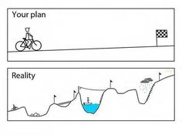
Teaching Excellence & the Career Map

