Slide 1

E-Learning in context: a longitudinal perspective
Prof Sara de Freitas (UoC)
Standing Conference on Academic Practice
Changing Academic Practices
21st Annual Conference, 5 - 6 July 2018

Slide 2
Summary
Looking back
A bit about me
Context for e-learning / online and blended learning
Case studies of practice:
Dynamic learning analytics
Introducing game-based approaches
Impact upon student engagement and retention
Pedagogy
Future learning
Changing learning behaviours
The future?

Slide 3
A bit about me
First role was at Birkbeck College, London setting up the London Knowledge Lab
Work with the Learning and Skills Research Centre (LSRC) included developing understanding of e-learning pedagogy and theory
Work with Terry Mayes on e-learning models and theories
Published books and articles on e-learning and game-based learning focusing upon student retention and attrition, student engagement and feedback
Founded the Serious Games Institute at Coventry University
Moved into enior management in Australia
Developed game platform at Curtin University: Challenge App
Introduced blended learning across Murdoch University (STEP and TNE projects)
Introducing blended and online learning at Cumbria
Prepared report for Office for Students on online and blended learning

Slide 4
Traditional paradigm of learning | New learning paradigm | Future learning
Curriculum-based pedagogy | Challenge and activity-led learning | Student developed pedagogy
Tutor-led learning delivery | Peer-focused interactions | Artificial Intelligence (AI) scaffolded learning
Classroom and lecture hall focus | Any-time, anywhere learning | Seamless lifelong learning
Summative assessments | Formative assessment / Peer assessment | No assessments / levelling, points and awards
Age and stage | Competency and personalised learning | Unique learning patterns
Text-focused | Multimedia usage | Adaptive learning
Traditional curriculum e.g. literacy and numeracy | New curriculum e.g. 21st century skills | Hidden curriculum e.g. personalised skills and cognition training
Core curriculum | Work readiness | Blended work and learning

Slide 5
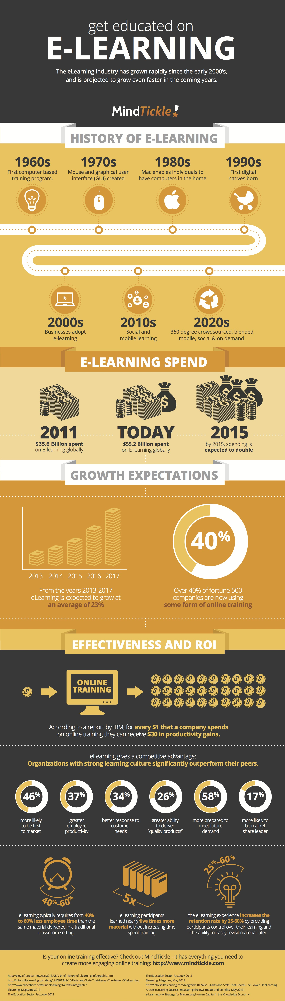

Slide 6
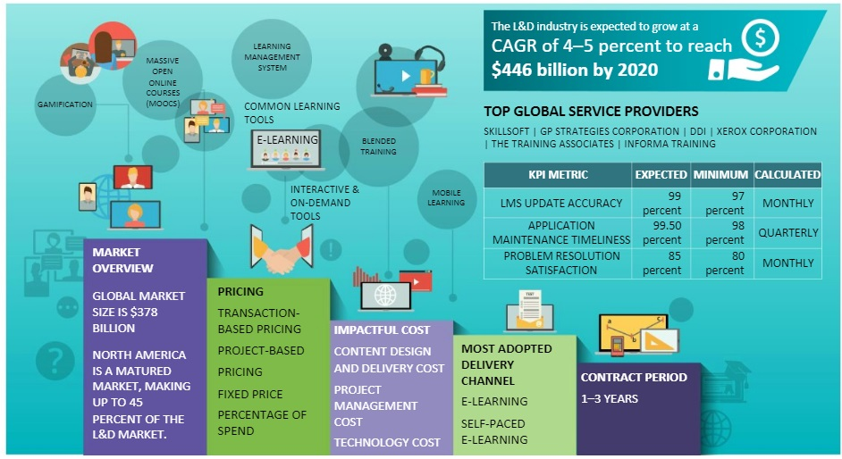

Slide 7
What impact has e-learning and digitization had upon current practices?

Slide 8
Case study 1: Understanding our students: Dynamic Learning Analytics

Slide 9
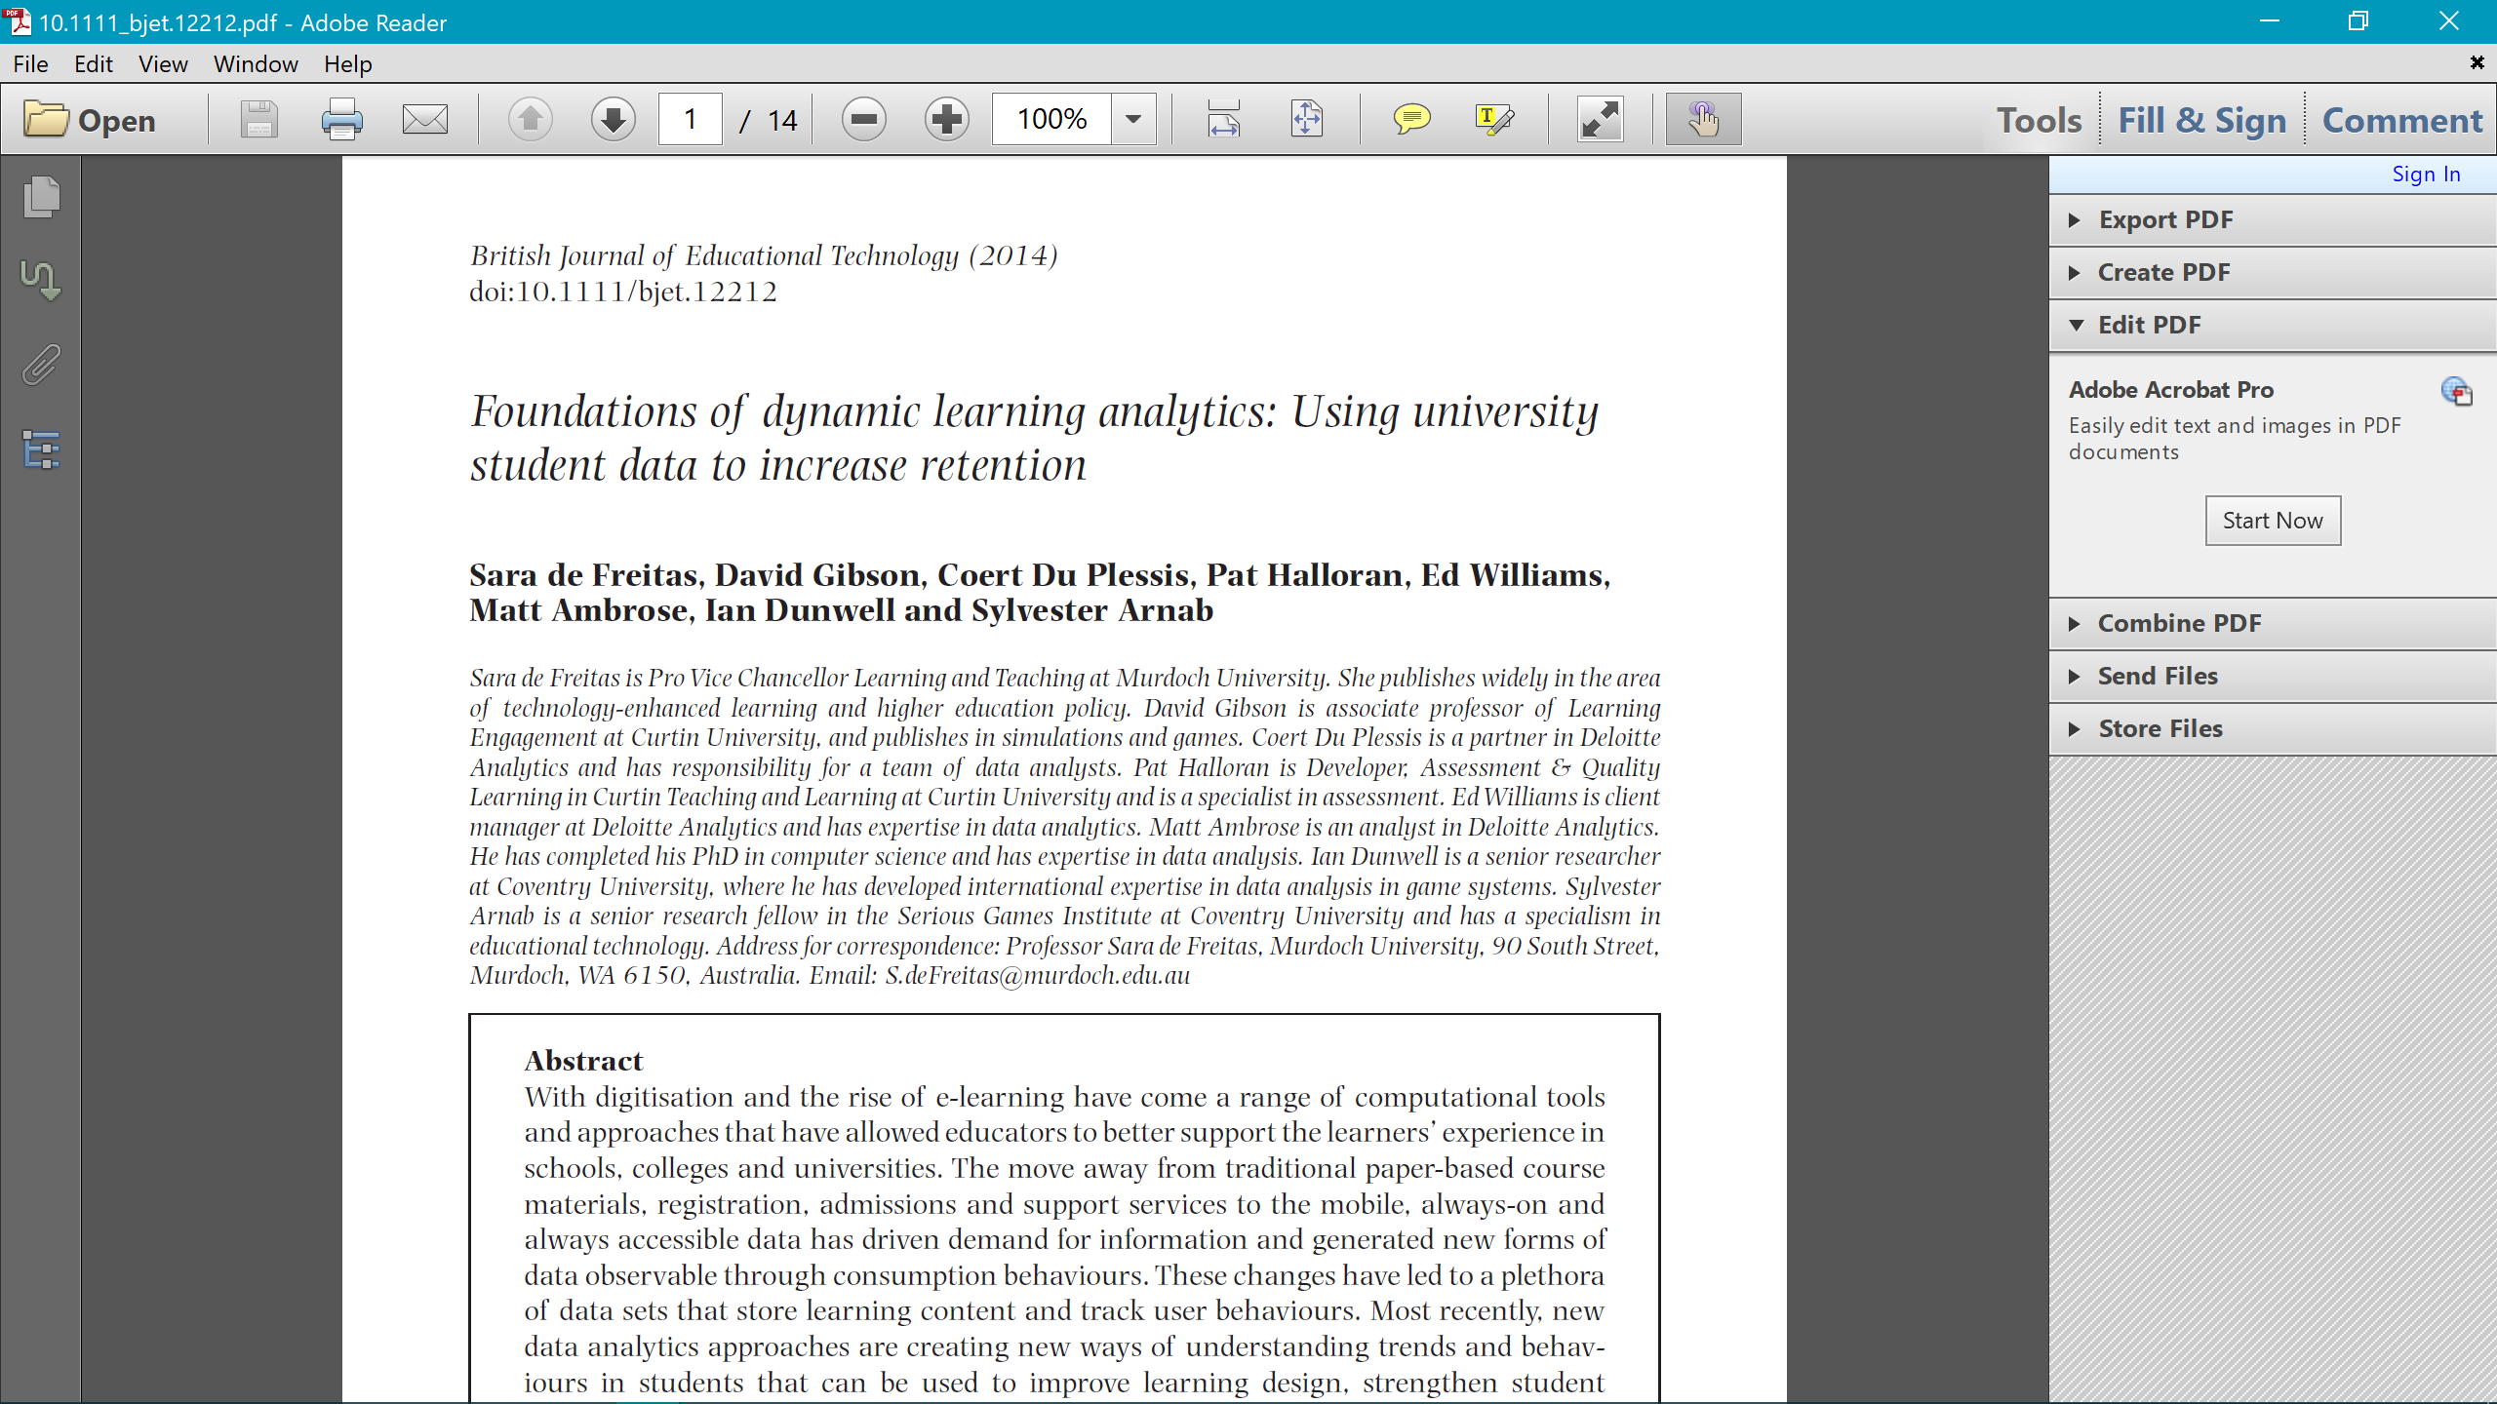

Slide 10
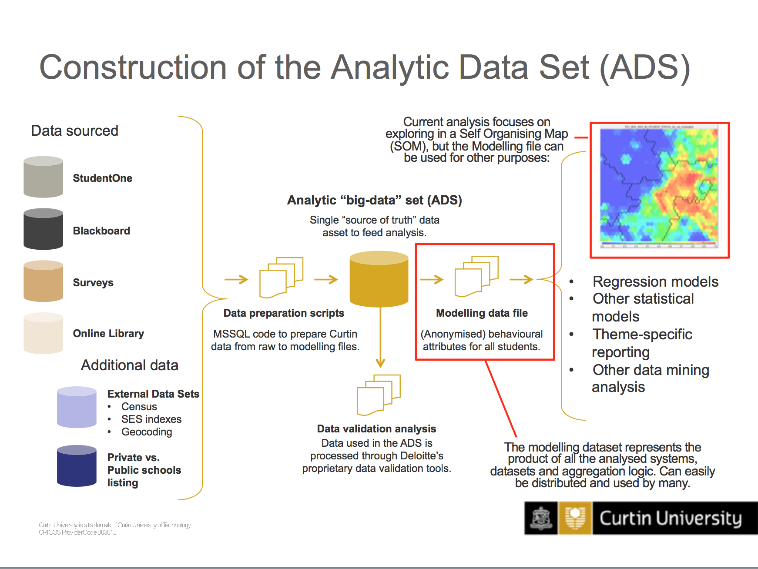
Dynamic Learning Analytics: Curtin Analytics

Slide 11
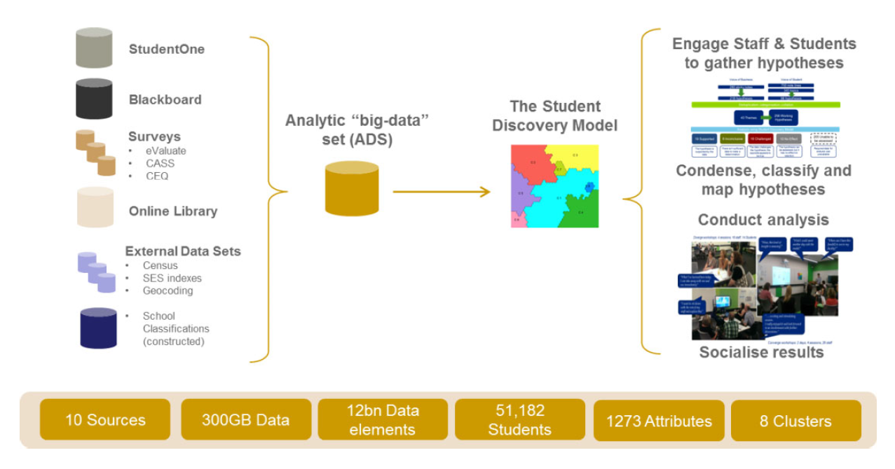
Dynamic Learning Analytics: Curtin Analytics

Slide 12
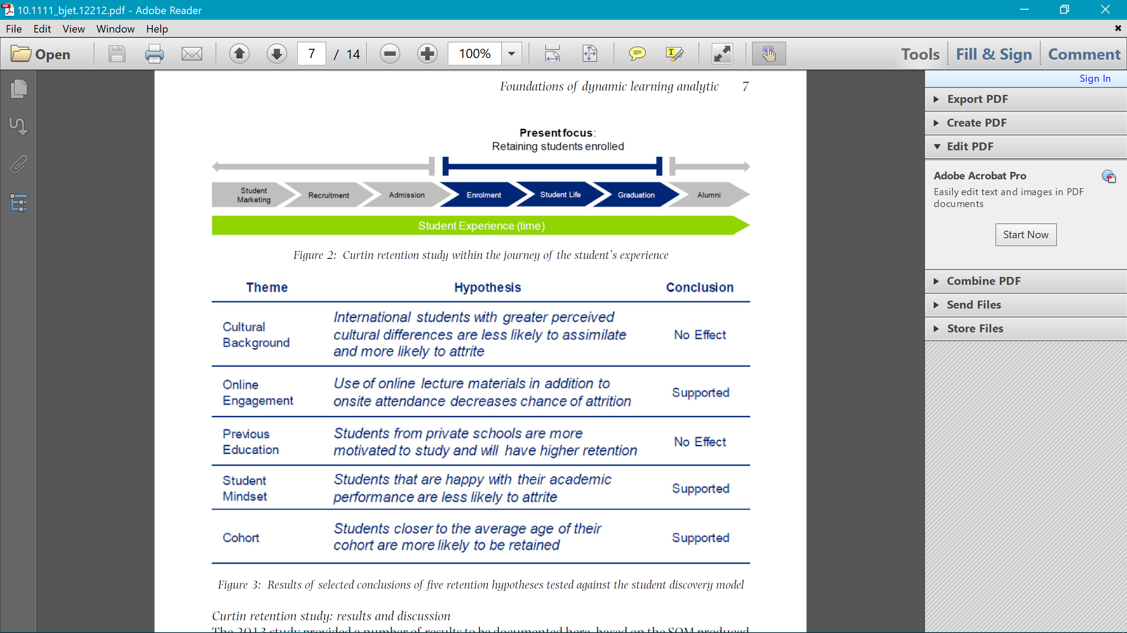
Dynamic Learning Analytics: Curtin Analytics

Slide 13
Curtin study

Slide 14
Case study 2: Engaging our students: Challenge App

Slide 15
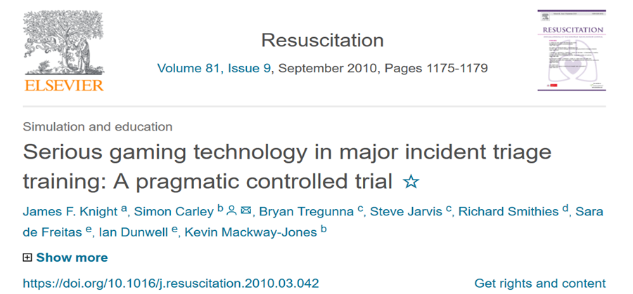
Case study: measuring immersion in games
Triage Trainer study findings

Slide 16
Triage Trainer: The results
Trial results of tt game trainees versus non-game trainees:
Tagging accuracy of tt game trainees:
Significantly higher accuracy [χ2 = 13.126, p<0.05]
Step accuracy of tt game trainees. comparing the ratios of participants who achieved an 8/8
Accuracy rating (i.e. followed the correct protocol for all 8 casualties):
Significantly more accurate (28%) than the non-game group (7%) [χ2 = 7.29, p<0.05]
Time taken by tt game trainees to complete triage of all 8 casualties:
No significant difference on time taken (p>0.05)
Notes:
TRUSIM

Slide 17
Key learnings:
Games more effective than traditional
Blended most effective
Importance of getting game design right
Multi-skilled teams required
Cost associated can be high
Feedback needs to be designed into the game and scaffolds development
Learner engagement and motivation increased
Greater brain activity during gameplay
Gaps in literature:
More research needed on analytics, feedback, motivation, engagement
Why are games effective for learning
Feedback research not based on logical assumptions, positive bias
Not as many studies showing negative findings
Future research:
Analytics driven studies
Longitudinal studies
Rigorous evaluations
More combined RCT and qualitative studies
Develop more effective practitioner tools and frameworks

Slide 18

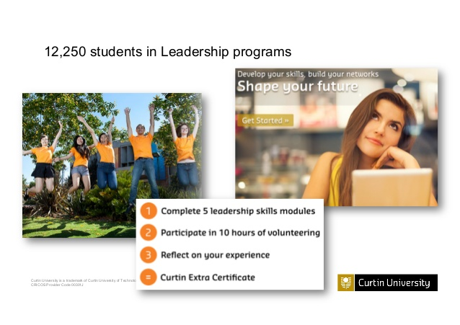
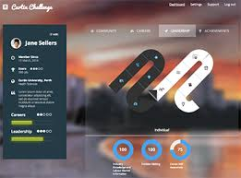
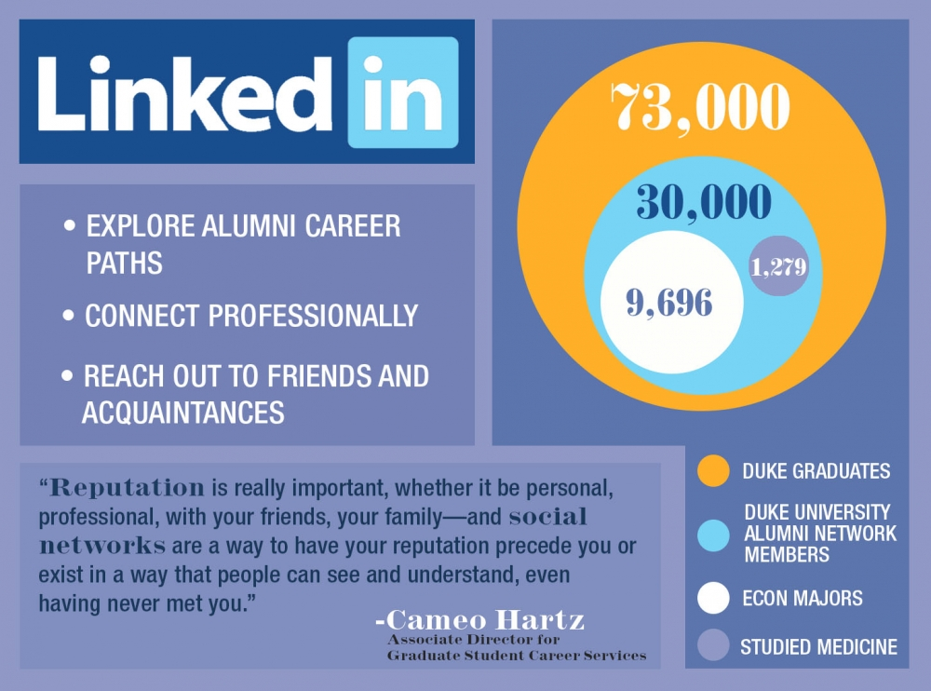

How can we ensure that our students are fully engaged with the development of their own employability?
Transition from school
1st year experience
2nd-3rd year experience
Alumni & Industry
Visibility of employability in student journey
Prepare students: Different students need different support, needs to be personalized but consistent. Student expectation setting: start early (use personal development plans / assessment tools). Prepare staff: training sessions / resources
Excite and engage students through student design challenges, hackathons, business panels and lectures, careers events & fairs, summer schools, showcases, case studies, student awards and access to incubator, e.g. Industry sponsorships / placements / exchanges / projects / student employment.
Services match student needs: Student mapping journey exercise to evaluate and assess best places to add in extra modules and support. Services need to be well branded, legible and communicated to students and staff. Integrated student services with careers focused activities e.g. Student Union events, Graduate Fairs, job shadowing, mentoring, Graduate programmes, Alumni mentoring programmes
Employability is a whole of university activity and needs coordination from centre (e.g. research, faculties, services)
Approach 1: Integrating employability measures through the curriculum
Graduate attributes
Developing skills
Employers as partners co-designing courses
Industry boards for all courses
Examples from my own practice:
Curriculum-based approach in practice
Different tactics: embed into all courses different content or centrally invest in developing a suite of modules that can be embedded or standalone: creativity and enterprise skills, careers skills, digital literacy skills, financial skills
Stanford New Technology Ventures. 25 year programme involving content & course content from Stanford & access to Silicon Valley mentors
Working with subject leaders, associate deans and lecturers to redesign courses, and bringing in externals to support content design, development and staff training
UniTemps model
Coordinating temp student work/placements
Approach 2: Integrating employability measures through the co/extra curriculum activities of students
Students are employed by the university
Possible set up of temping agency as part of the university (e.g. UniTemps/ Futureworks)
Extra-curriculum points and rewards:
Curtin Extra
Points collected for community projects/programmes. 10 hours of volunteering plus 5 leadership modules leads to Curtin Extra Certificate. Linked to the Challenge App is a gamified platform for careers and leadership online modules and tools
Approach 3: Employer and alumni outreach, postgraduate sponsorships and placement scheme
Alumni as employers
Clear paths of progression to postgraduate study
Collaborations with industry/alumni/students: Innovation Hub
Developing an innovation hub as part of our student hub development
Reimagined careers service
Work spaces for industry projects
Student Innovation fund
Access to employers

Slide 19
Case study 3: The impact of online and blended learning upon our students and upon their engagement and retention

Slide 20
Four interlinked studies undertaken at Murdoch University
Longitudinal study that mirrored the Curtin Study undertaken by the Business intelligence unit
We replicated the BI study as an academic attrition study to cross validate it (paper to come)
We undertook a thorough analysis of peer assisted learning at Curtin (UniPASS programme) (paper almost completed)
We analysed efficacy of a range of interventions using time series approach and dynamic analytics (STEP paper to come)
We undertook a blended learning study of transnational students using 171 modules across our provision

Slide 21
Objectives of the interlinked studies
Map and model the individual student experience and journey towards developing personalised support plans and approaches
To improve the understanding of how interventions impact experience
To understand more about how learning gain operates
To improve performance, retention, completion and progression in students

Slide 22
Objectives of the interlinked studies
Map and model the individual student experience and journey towards developing personalised support plans and approaches
To improve the understanding of how interventions impact experience
To understand more about how learning gain operates
To improve performance, retention, completion and progression in students

Slide 23
Objectives of the interlinked studies
Map and model the individual student experience and journey towards developing personalised support plans and approaches
To improve the understanding of how interventions impact experience
To understand more about how learning gain operates
To improve performance, retention, completion and progression in students

Slide 24
Traditional paradigm of learning | New learning paradigm | Future learning
Curriculum-based pedagogy | Challenge and activity-led learning | Student developed pedagogy
Tutor-led learning delivery | Peer-focused interactions | Artificial Intelligence (AI) scaffolded learning
Classroom and lecture hall focus | Any-time, anywhere learning | Seamless lifelong learning
Summative assessments | Formative assessment / Peer assessment | No assessments / levelling, points and awards
Age and stage | Competency and personalised learning | Unique learning patterns
Text-focused | Multimedia usage | Adaptive learning
Traditional curriculum e.g. literacy and numeracy | New curriculum e.g. 21st century skills | Hidden curriculum e.g. personalised skills and cognition training
Core curriculum | Work readiness | Blended work and learning

Slide 25
Conclusions and future work
Ensure we are operating at policy and strategic level esp. OfS and Panel on Post-18 HE Review
Paper sent to OfS about blended and online need to influence the sector positively
Need to ensure we are competing with US and Australia
Link between engagement and retention needs to be established
Need to understand the difference in online and blended and face to face provision

Slide 26
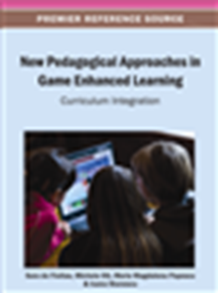
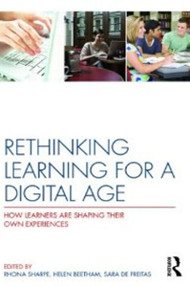

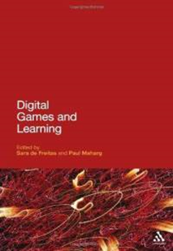
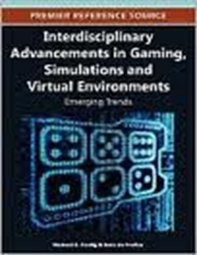
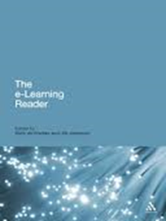
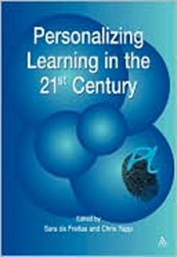
Education in Computer Generated Environments. Published by Routledge in 2014

