Slide 1
Equality, Diversity and Inclusion at Research-Intensive Universities
Standing Conference on Academic Practice
5-6 July 2018
Professor Simone E Buitendijk
Vice-Provost (Education)

Slide 2
Why do universities need to act?
waste of talent
less satisfaction and success in staff and student body
diminished societal and global impact

Slide 3
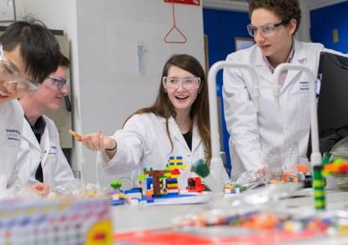
Some statistics
20-25% female profs (fewer in STEM)
BME students – less access and worse results
LGBT students – more mental health issues
female engineering students – less successful in projects
enterprise/start-ups – fewer women

Slide 4
Key issues
highly competitive, ‘up or out’ culture
culture based on recognition of excellence
pervasive bias -- at odds with meritocracy

Slide 5
What university leaders tell their young researchers is important:
team work and collaboration
multidisciplinary work
societal impact
teaching

Slide 6
What the system actually teaches them:
be highly competitive
focus on your own cv in terms of grants, publications and authorship
avoid multidisciplinary work
societal impact is not that important
teaching does not really count

Slide 7
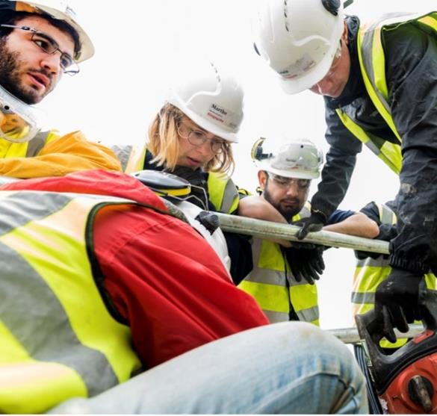
What approach do we need?
system
strategic
evidence-based
comprehensive
collaborative

Slide 8
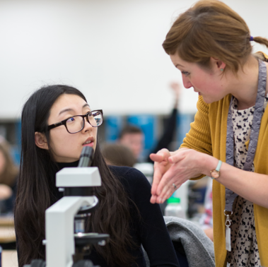
Why system approach?
move away from the rhetoric of blame on individuals
if system is flawed – good people may be doing the wrong thing
bias in the system is the main problem: ‘myth of meritocracy’
cycle can only be broken by fixing the system first

Slide 9
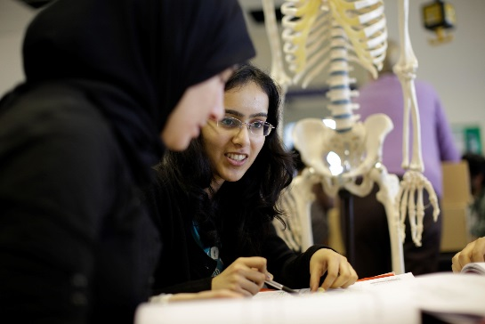
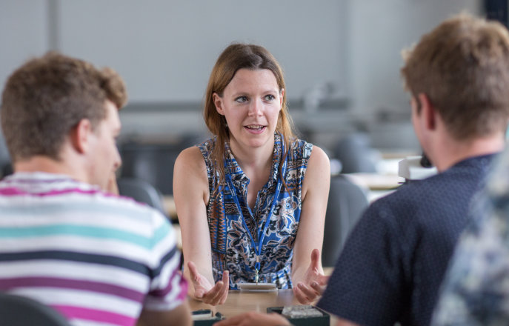
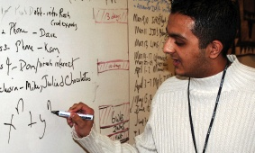
Why strategic approach?
problems are very engrained, cultural and complex
combating wide-spread bias needs a strategic approach
change management and targeted interventions are needed
strategic analysis of system
statistics
goals
detailed, comprehensive plans

Slide 10
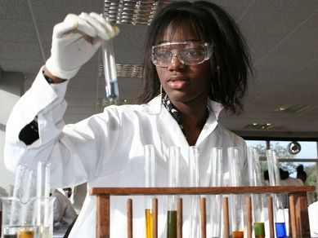

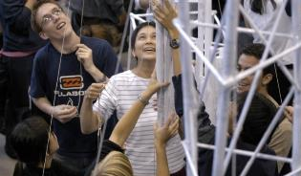
Why evidence-based?
enormous amount of rigorous data on (gender) inequality available
not waste effort and energy
if not done well, interventions can back-fire
carry out post-implementation analysis, to add to existing body of knowledge and to do it right within own institutions

Slide 11
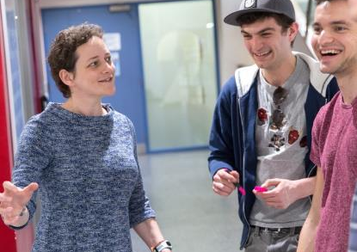
Why comprehensive?
gender
ethnicity
culture/background
sexual orientation
disability
intersectionality

Slide 12
Why comprehensive?
culture
research content
staff
students

Slide 13

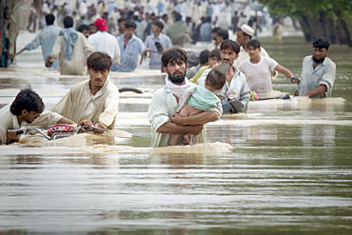
Climate change
women disproportionately affected
women and girls more often responsible for water gathering
women and girls suffer more in times of food shortage
majority of poor farmers are women
women are more likely to die in floods
women are important agents of change

Slide 14
Nationality bias in publications and citations: rich countries are viewed as producing better research
(Harris et al, 2017)

Slide 15
Why comprehensive?
admissions
retention
curriculum content
role models
mental health
grades
graduate success
selection
promotions
awards
grants
visible roles
leadership positions
publications
research content
curriculum content
institutional privilege

Slide 16
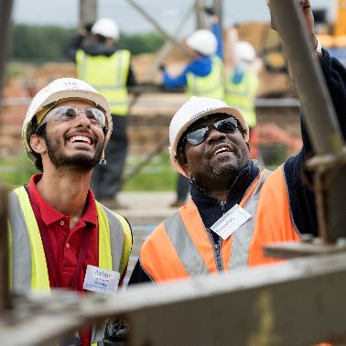
Why collaborative?
We can’t do it alone
University networks
Joint strategies/toolkits
comparisons/evaluation/research/support
Funders
Publishers
Policy makers (Athena Swan/DFG/EU)
Head-hunters
Business
Other stakeholders (local communities/charitable foundations)

Slide 17
dsfds
Annual Review of Psychology,Gender Stereotypes, Naomi Ellemers, Faculty of Social Sciences, Utrecht University, 3508 TC Utrecht, Netherlands;email: N.ellemers@uu.nl, 2018. 69:275–98
Job Attitudes and Performance during Three Career Stages. JOHN W. SLOCUM, JR., AND WILLIAM L. CRON. Journal of Vocational Behavior 26, 126-145 (198.5)
Role models in career development: New directions for theory and research Donald E. Gibson. Journal of Vocational Behavior 65 (2004) 134–156
Gender in the Global Research Landscape, Analysis of research performance through a gender lens
across 20 years, 12 geographies, and 27 subject areas. Elsevier, 2017 https://www.elsevier.com/research-intelligence/resource-library/gender-report
From Malawi to Middlesex: the case of the Arbutus Drill Cover System as an example of the cost-saving potential of frugal innovations for the UK NHS Matthew Prime, Ibtehal Attaelmanan, Arjuna Imbuldeniya,Matthew Harris, Ara Darzi, Yasser Bhatti. BMJ Innovations Publish Ahead of Print, published on March 30, 2018 as doi:10.1136/bmjinnov-2017-000233
Does a research article’s country of origin affect perception of its quality and relevance? A national trial of US public health researchers M Harris, J Macinko, G Jimenez, M Mahfoud, C Anderson. BMJ Open 2015;5:e008993. doi:10.1136/bmjopen-2015-008993
‘They hear “Africa” and they think that there can’t be any good services’ – perceived context in cross-national learning: a
qualitative study of the barriers to Reverse Innovation Matthew Harris, Emily Weisberger, Diana Silver and James Macinko. Globalization and Health (2015) 11:45 DOI 10.1186/s12992-015-0130-z
Explicit Bias Toward High-Income- Country Research: A Randomized, Blinded, Crossover Experiment Of English Clinicians, Matthew Harris, Joachim Marti, Hillary Watt, Yasser Bhatti, James Macinko, and Ara W. Darzi. Health Affairs November 2017 36:1 1
Low-cost innovation in healthcare: what you find depends on where you look. Matthew Harris, Yasser Bhatti, Matt Prime Jacqueline del Castillo and Greg Parston. https://doi.org/10.1177/0141076817738501
Do International Health Partnerships contribute to reverse innovation? a mixed methods study of THET-supported partnerships in the UK. Kavian Kulasabanathan, Hamdi Issa, Yasser Bhatti, Matthew Prime, Jacqueline del Castillo, Ara Darzi and Matthew Harris. Kulasabanathan et al. Globalization and Health (2017) 13:25. DOI 10.1186/s12992-017-0248-2

Slide 18
dsfds
That’s not how the learning works – the paradox of Reverse Innovation: a qualitative study. Matthew Harris, Emily Weisberger, Diana Silver, Viva Dadwal and James Macinko. Harris et al. Globalization and Health (2016) 12:36. DOI 10.1186/s12992-016-0175-7
Gender, Work Time, and Care Responsibilities Among Faculty. Joya Misra, Jennifer Hickes Lundquist and Abby Templer Source: Sociological Forum, Vol. 27, No. 2 (JUNE 2012), pp. 300-323. Wiley. http://www.jstor.org/stable/23262110
Resisting resistance: Counter-resistance, consent and compliance in a consultancy firm. Dan Kärreman and Mats Alvesson. The Tavistock Institute, DOI: 10.1177/0018726709334880 Volume 62(8): 1115–1144
Implicit bias in academia: A challenge to the meritocratic principle and to women’s careers –And what to do about it. LERU Advice Paper no.23 - January 2018. ´Prof. Jadranka Gvozdanovic, University of Heidelberg; Dr Katrien Maes, LERU.
Limits to meritocracy? Gender in academic recruitment and promotion processes Mathias W. Nielsen. OUP Science and Public Policy, 43(3), 2016, 386–399 doi: 10.1093/scipol/scv052 Advance Access Publication Date: 28 August 2015
Engaging Gatekeepers, Optimizing Decision Making, and Mitigating Bias: Design Specifications for Systemic Diversity Interventions. Claartje J. Vinkenburg. The Journal of Applied Behavioral Science 2017, Vol. 53(2) 212–234
Science of science. S. Fortunato et al., Science 359, eaao0185 (2018). DOI: 10.1126/science.aao0185
Excellent education in research-rich universities. January 2018. Prof. Dilly Fung, Prof. Juliane Besters-Dilger, Prof. Rob van der Vaart, February 2017

Slide 19
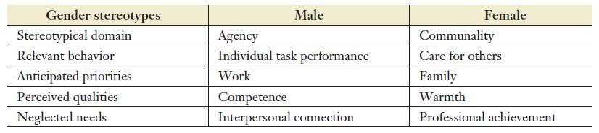
Gender stereotypes and gendered expectations
Naomi Ellemers, Utrecht University, Gender Stereotypes, Annual Review of Psychology 2018 69.275-98

Slide 20
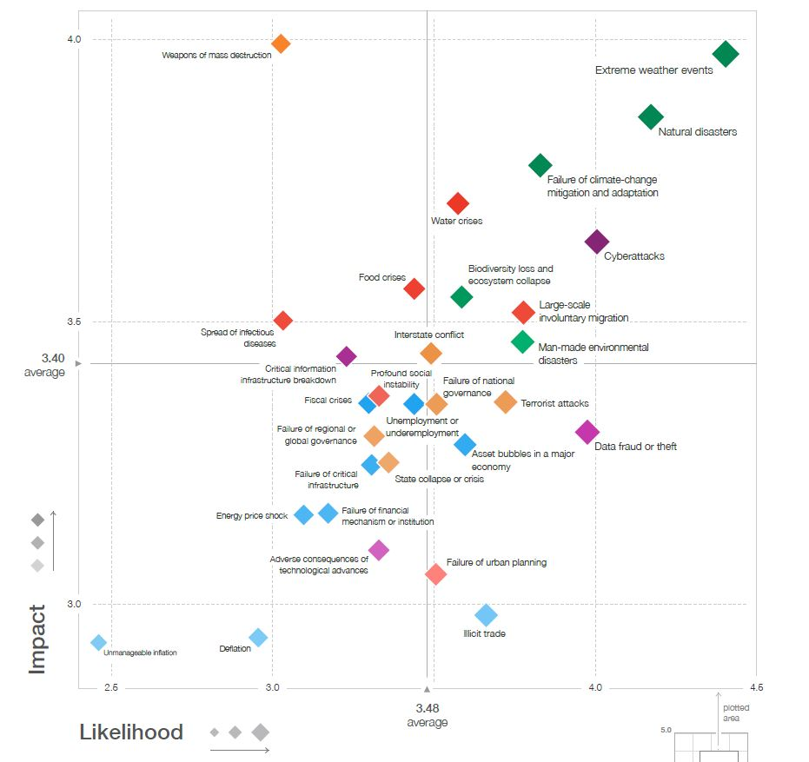
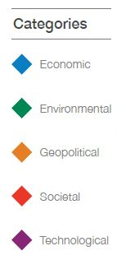
The Global
Risks
Landscape
World Economic Forum Global Risks Perception Survey 2017-2018

Slide 21

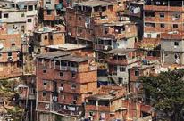

We can make the world a better place

