Slide 1
Epidemics on networks
Lorenzo Pellis
University of Warwick, UK
Warwick, 22nd September 2016

Slide 2
Introduction
Basic SIR and SIS
Key epidemiological quantities
Relaxing basic assumptions
Notes:
15 minutes

Slide 3
Introduction
Basic SIR and SIS
Key epidemiological quantities
Relaxing basic assumptions
Notes:
First, I apologise with those that have already thought a lot about it

Slide 4
Framework
SIR epidemic model
Large population
Single initial case
Rest of the population is fully susceptible
Examples:
Influenza pandemics
SARS
Ebola
S
I
R

Slide 5
The equations
Equations:
Assumptions:
Homogeneous mixing
Constant recovering rate
Many possible variations on the same theme…
Initial conditions:
Parameters:

Slide 6
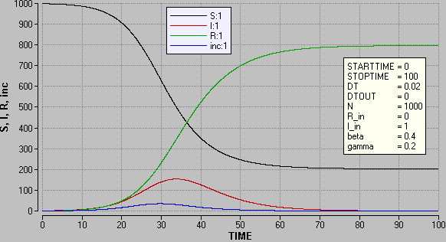
Full dynamics

Slide 7
Alternative framework
SIS epidemic model
Large population
Single initial case
Rest of the population is fully susceptible
Examples:
Chlamydia
Human papilloma virus
(Respiratory syncytial virus / influenza)
S
I

Slide 8
The equations
Equations:
Assumptions:
Homogeneous mixing
Constant recovering rate
Many possible variations on the same theme…
Initial conditions:
Parameters:

Slide 9
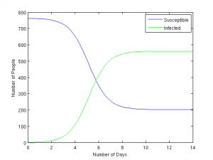
Full SIS dynamics

Slide 10
Other possible frameworks
Single epidemic wave:
SIR
SEIR
SITR
MSEIR
…
Endemic equilibrium:
SIS
SEIS
SIRS
SIR with demography
…

Slide 11
Introduction
Basic SIR and SIS
Key epidemiological quantities
Relaxing basic assumptions
Notes:
First, I apologise with those that have already thought a lot about it

Slide 12
Key epidemiological quantities
Can we provide summary information of the full dynamics?
Real-time growth rate
Threshold condition
Epidemic final size
...

Slide 13
Key epidemiological quantities
Can we provide summary information of the full dynamics?
Real-time growth rate
Threshold condition
Epidemic final size
...

Slide 14
Full dynamics

Slide 15
The equations
Equations:
Assumptions:
Homogeneous mixing
Constant recovering rate
Many possible variations on the same theme…
Initial conditions:
Parameters:

Slide 16
Linear SIR: Malthusian growth
If , at the beginning the number of cases increases exponentially, with exponent
If , the number of cases decreases and the epidemic “dies out”
is called Malthusian parameter, or real-time growth rate

Slide 17
Key epidemiological quantities
Can we provide summary information of the full dynamics?
Real-time growth rate
Threshold condition
Epidemic final size
...

Slide 18
Threshold condition
A large epidemic occurs if and only if
For roughly 50 years, the same condition was expressed by mathematicians as
where was called relative removal rate
During the ’80s (HIV epidemic), biologists and epidemiologists stepped in, interpreting it as:
Clearly it is the same thing, but...

Slide 19
Basic reproduction number R₀
=
Average number of new cases generate by a single case, per unit of time, in a totally susceptible population
=
Average duration of the infectious period
Called basic reproduction number
Defined as the average number of new cases, generated by a single case, throughout the infectious period, in a totally susceptible population
An epidemic occurs if and only if

Slide 20
Key epidemiological quantities
Can we provide summary information of the full dynamics?
Real-time growth rate
Threshold condition
Epidemic final size
...

Slide 21
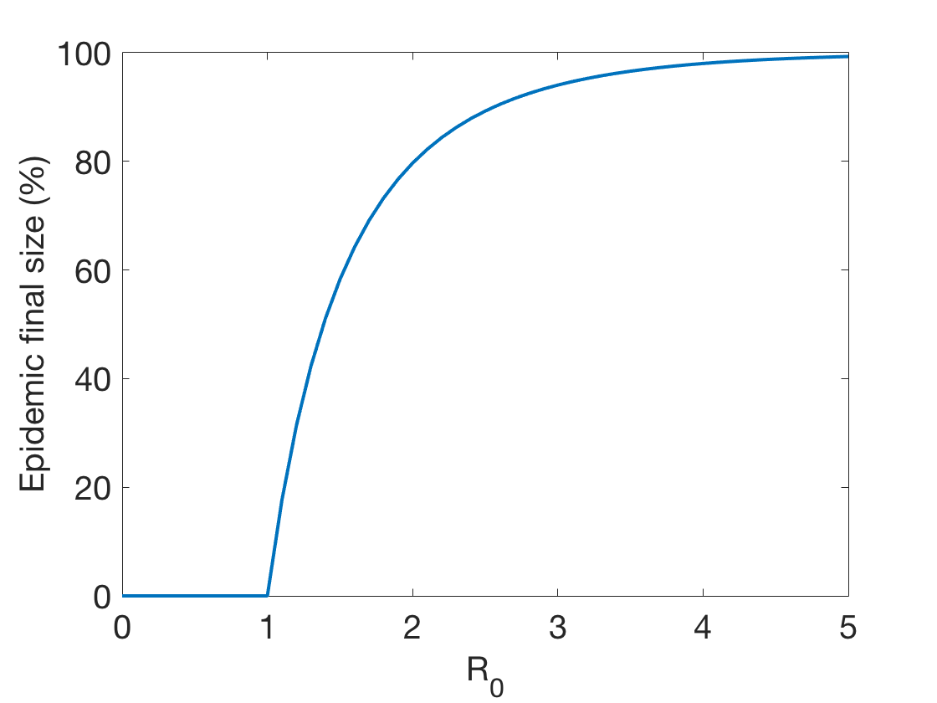
Epidemic final size
Largest solution of

Slide 22
Properties of R₀
Threshold parameter:
If , only small epidemics
If , only large epidemics

Slide 23
Properties of R₀
Threshold parameter:
If , only small epidemics
If , only large epidemics
Average final size:

Slide 24

Properties of R₀
Threshold parameter:
If , only small epidemics
If , only large epidemics
Average final size:
Critical vaccination coverage:

Slide 25
Properties of R₀
Threshold parameter:
If , only small epidemics
If , only large epidemics
Average final size:
Critical vaccination coverage:

Slide 26
Introduction
Basic SIR and SIS
Key epidemiological quantities
Relaxing basic assumptions
Notes:
First, I apologise with those that have already thought a lot about it

Slide 27
Relaxing assumptions
Deterministic model:
Make it stochastic
Constant infectivity and recovery rate:
Constant infectivity, any duration of infectious period
Time-varying infectivity
Homogeneous mixing:
Heterogeneous mixing
Households models
Network models

Slide 28
Relaxing assumptions
Deterministic model:
Make it stochastic
Constant infectivity and recovery rate:
Constant infectivity, any duration of infectious period
Time-varying infectivity
Homogeneous mixing:
Heterogeneous mixing
Households models
Network models

Slide 29
Markovian stochastic SIR model
Population of individuals
Upon infection, each case :
remains infectious for a duration , ,
makes infectious contacts with each person in the population at the points of a homogeneous Poisson process with rate
Contacted individuals, if susceptible, become infected
Recovered individuals are immune to further infection

Slide 30
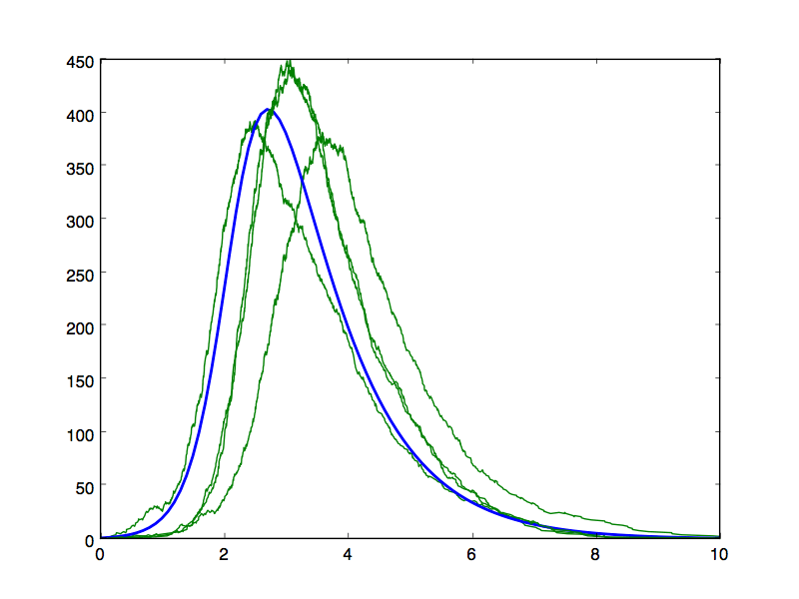
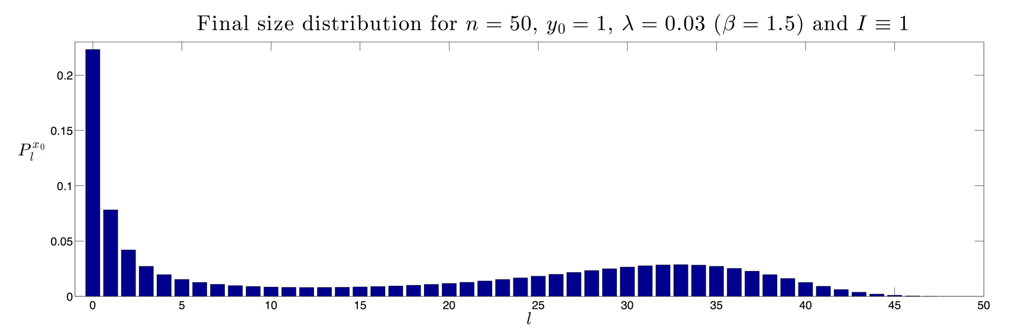
Effects of stochasticity
Random delays
But when the epidemic takes off, a deterministic approximation is very reasonable (CLT)
Early extinction

Slide 31
Branching process approximation
Follow the epidemic in generations:
number of infected cases in generation (pop. size )
For every fixed ,
where is the -th generation of a simple Galton-Watson branching process (BP)
Let be the random number of children of an individual in the BP, and let be the offspring distribution.
Define
We have “linearised” the early phase of the epidemic
Pellis, Ball & Trapman (2012)

Slide 32
Properties of R₀ - deterministic
Threshold parameter:
If , only small epidemics
If , only large epidemics
Average final size:
Critical vaccination coverage:

Slide 33
Properties of R₀ - stochastic
Threshold parameter:
If , only small epidemics
If , possible large epidemics
Average final size (cond on non-extinct):
Critical vaccination coverage:

Slide 34
Relaxing assumptions
Deterministic model:
Make it stochastic
Constant infectivity and recovery rate:
Constant infectivity, any duration of infectious period
Time-varying infectivity
Homogeneous mixing:
Heterogeneous mixing
Households models
Network models

Slide 35
Standard stochastic SIR model (sSIR)
Population of individuals
Upon infection, each case :
remains infectious for a duration , iid
makes infectious contacts with each person in the population at the points of a homogeneous Poisson process with rate
Contacted individuals, if susceptible, become infected
Recovered individuals are immune to further infection
Even more realistic:

Slide 36
Relaxing assumptions
Deterministic model:
Make it stochastic
Constant infectivity and recovery rate:
Constant infectivity, any duration of infectious period
Time-varying infectivity
Homogeneous mixing:
Heterogeneous mixing
Households models
Network models

Slide 37
Multitype epidemic model
Different types of individuals
Define the next generation matrix (NGM):
where is the average number of type- cases generated by a type- case, throughout the entire infectious period, in a fully susceptible population
Properties of the NGM:
Non-negative elements
We assume positive regularity

Slide 38
Basic reproduction number R₀
Naïve definition:
“ Average number of new cases generated by a typical case, throughout the entire infectious period, in a large and otherwise fully susceptible population ”
What is a typical case?
What do we mean by fully susceptible population?

Slide 39
Multitype epidemic model
Different types of individuals
Define the next generation matrix (NGM):
where is the average number of type- cases generated by a type- case, throughout the entire infectious period, in a fully susceptible population
Properties of the NGM:
Non-negative elements
We assume positive regularity

Slide 40
Perron-Frobenius theory
Single dominant eigenvalue , which is positive and real
“Dominant” eigenvector has non-negative components
For every starting condition, after a few generations, the proportions of cases of each type in a generation converge to the components of the dominant eigenvector , with per-generation multiplicative factor

Slide 41
First few generations
where

Slide 42
Perron-Frobenius theory
Single dominant eigenvalue , which is positive and real
“Dominant” eigenvector has non-negative components
For every starting condition, after a few generations, the proportions of cases of each type in a generation converge to the components of the dominant eigenvector , with per-generation multiplicative factor
Define
Interpret “typical” case as a linear combination of cases of each type given by

Slide 43
Relaxing assumptions
Deterministic model:
Make it stochastic
Constant infectivity and recovery rate:
Constant infectivity, any duration of infectious period
Time-varying infectivity
Homogeneous mixing:
Heterogeneous mixing
Households models
Network models

Slide 44
Model illustration
Pellis, Ferguson & Fraser (2009)

Slide 45
Household reproduction number R*
Consider a within-household epidemic started by one initial case
Define:
average household final size, excluding the initial case
average number of global infections an individual makes
“Linearise” the epidemic process at the level of households:
Pellis, Ball & Trapman (2012)

Slide 46
Household reproduction number R*
Consider a within-household epidemic started by one initial case
Define:
average household final size, excluding the initial case
average number of global infections an individual makes
“Linearise” the epidemic process at the level of households:
Pellis, Ball & Trapman (2012)

Slide 47
Relaxing assumptions
Deterministic model:
Make it stochastic
Constant infectivity and recovery rate:
Constant infectivity, any duration of infectious period
Time-varying infectivity
Homogeneous mixing:
Heterogeneous mixing
Households models
Network models

Slide 48
Basic concepts
What is a network?
A pair (set of nodes, set of edges)
Can be represented with an adjacency matrix
What does it represent?
Anything that involves actors and actor-actor interactions
Nodes can be individuals, groups, households, cities, locations…
Edges can be transmissions, friendships, flights routes…
Some properties:
Degree distribution
Assortativity (degree correlation)
Clustering
Modularity
Betweenness centrality
Notes:
Assortativity = propensity of epidemiologically similar nodes to be neighbours of each other. A simple example is degree correlation
Betweenness centrality = sum over all pairs of nodes of the fraction of all shortest paths for that pair that passes through the node. If you want, divide by number of pairs (not including the vertex)

Slide 49
Constructing a network
Just draw one
Direct measurement
Deterministic algorithm
Stochastic algorithm
Erdös-Rényi random graph
Configuration model
Preferential attachment model (e.g. BA model scale-free)
Small world network
A random graph:
is a family of graphs, specified by a random algorithm
each specific graph occurs with a certain probability
its properties are random variables (e.g. size of the largest connected component) or mean/variance of such variables
Notes:
Draw an extreme (almost empty) graph and a more common one

Slide 50
Epidemics on a network
Some networks are labelled (e.g. age of nodes)
In an epidemic, labels vary over time (e.g. S, I, R)
If you run a stochastic epidemic on a random graph, results are random because of the epidemic process AND of the graph
Usually one thinks:
but there might be better approaches:
making the graph as the epidemic is running
if possible, average over the graph family and only then over the epidemic process
…

Slide 51
Simple VS complex networks
Many different types:
Static VS dynamic
Small VS large
Clustered VS unclustered
Correlated VS uncorrelated
Weighted VS unweighted
Markovian VS non-Markovian
SIS VS SIR
I focus on large simple networks, i.e. static and unweighted:
tree-like (i.e. unclustered) VS with short loops
no correlation other than that due to clustering

Slide 52
NETWORKS IN EPIDEMIOLOGY: Applications
Sexually transmitted infections
Foot-and-mouth disease
Social networks
Notes:
First, I apologise with those that have already thought a lot about it

Slide 53
NETWORKS IN EPIDEMIOLOGY: Applications
Sexually transmitted infections
Foot-and-mouth disease
Social networks
Notes:
First, I apologise with those that have already thought a lot about it

Slide 54
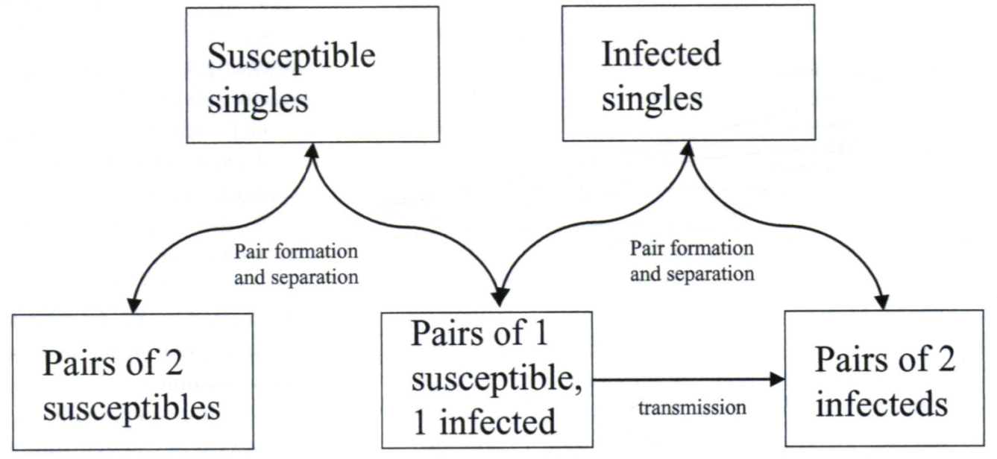
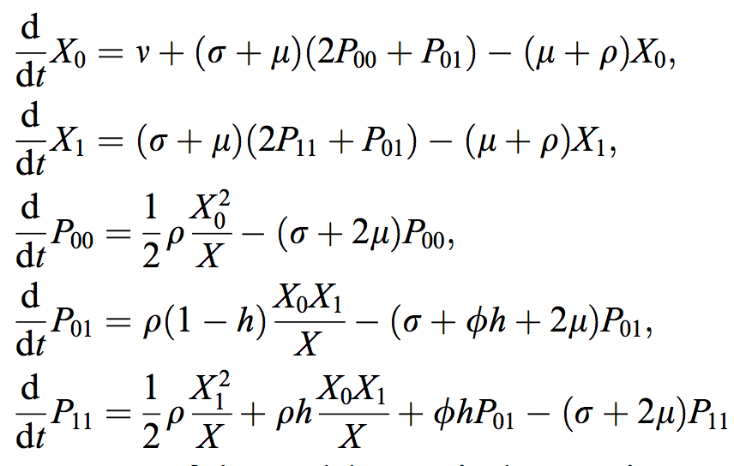
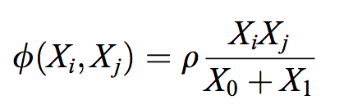
Pair-formation models
Kretzschmar (2000)
Kretzschmar & Dietz (1998)
Notes:
Pairs form and dissolve

Slide 55
Comparison with homogeneous mixing
Very fast pair dynamics lead back to homogeneous mixing
Pairs reduce the spread (and ) thanks to sequential infection:
pairs of susceptibles are protected
pairs of infectives “waste” infectivity
Comparison at constant
Kretzschmar & Dietz (1998), “The effect of pair formation and variable infectivity on the spread of an infection without recovery”
Endemic equilibrium is always higher
The same can have 2 growth rates and 2 endemic equilibria, so one needs information about partnership dynamics (for both prediction and inference)
Notes:
❶ Take last comment further

Slide 56
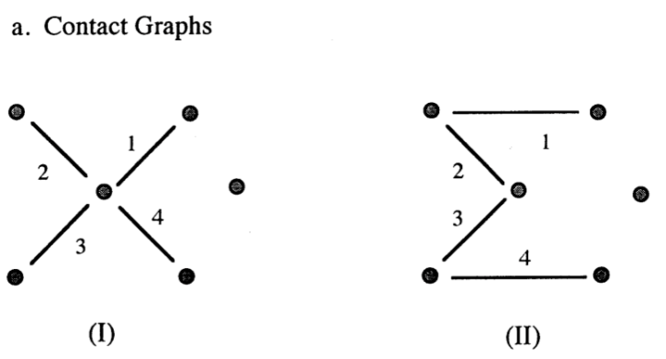
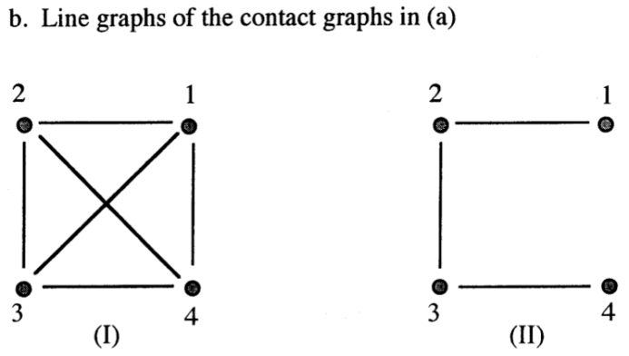
Concurrency
Working definition: the mean degree of the line graph
Morris & Kretzschmar (1997), “Concurrent partnerships and the spread of HIV”
Impact: always bad as it amplifies the impact of many partners
Faster forward spread (no protective sequencing)
Backwards spread
Dramatic effect on connectivity and resilience of the sexual network
Quantitative impact:

Slide 57
NETWORKS IN EPIDEMIOLOGY: Applications
Sexually transmitted infections
Foot-and-mouth disease
Social networks
Notes:
First, I apologise with those that have already thought a lot about it

Slide 58
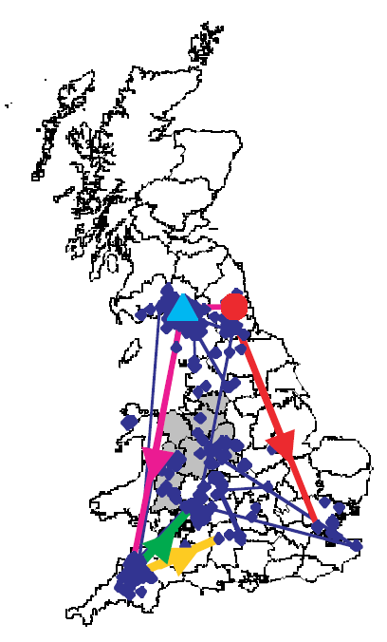
Foot-and-mouth disease
Models involved a dispersal kernel
Keeling et al (2001, 2003)
Ferguson, Donnelly & Anderson (2001)
Keeling (2005)
Some models added a network of market connections
Ferguson, Donnelly & Anderson (2001)

Slide 59
NETWORKS IN EPIDEMIOLOGY: Applications
Sexually transmitted infections
Foot-and-mouth disease
Social networks
Notes:
First, I apologise with those that have already thought a lot about it

Slide 60
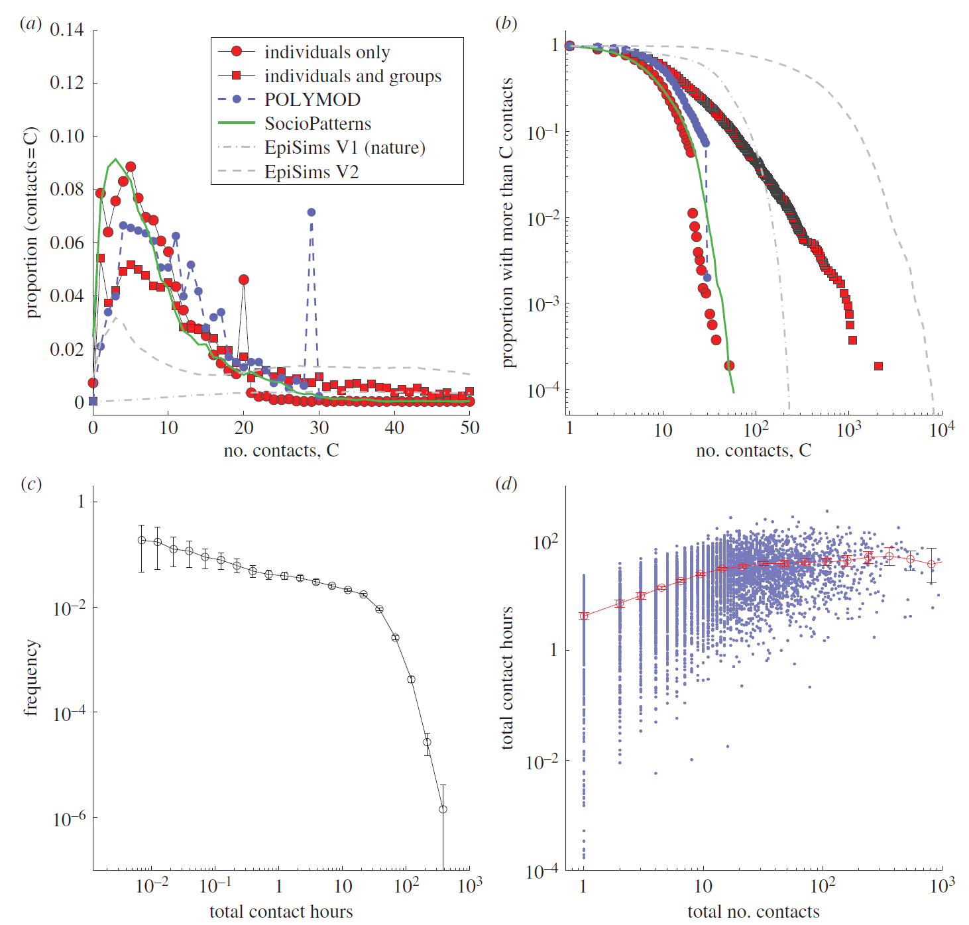
Danon, Read, House, Vernon & Keeling (2013)

Slide 61
Social network
Basic network:
Just use the data about degree distribution
Advanced information:
Use age of nodes --> degree correlation
Use clustering

Slide 62
Other applications?
Interventions:
Remove high-degree nodes (more infectious and more susceptibles)
Remove highly central nodes (break the network in disconnected subgroups)
Contact tracing
Degree-based sampling for treatment
… (your input here) …

Slide 63
SIR epidemics on large Tree-like Networks
Key epidemiological quantities
Full dynamics
Moment closure
Notes:
First, I apologise with those that have already thought a lot about it

Slide 64
SIR epidemics on large Tree-like Networks
Key epidemiological quantities
Full dynamics
Moment closure
Notes:
First, I apologise with those that have already thought a lot about it

Slide 65
R₀ – basics
Simplest case: - regular
is bounded by
First infective is special:
All others have 1 link less to use
Formally:
If is the probability of transmitting across a link,

Slide 66
R₀ – basics
Simplest case: - regular
is bounded by
First infective is special:
All others have 1 link less to use
Formally:
If is the probability of transmitting across a link,

Slide 67
R₀ – details
Time varying infectivity (TVI) model:
Standard stochastic SIR (sSIR) model:

Slide 68
R₀ – details
Time varying infectivity (TVI) model:
Standard stochastic SIR (sSIR) model:

Slide 69
R₀ – details
Time varying infectivity (TVI) model:
Standard stochastic SIR (sSIR) model:

Slide 70
R₀ – details
Time varying infectivity (TVI) model:
Standard stochastic SIR (sSIR) model:
Markovian:

Slide 71
R₀ – details
Time varying infectivity (TVI) model:
Standard stochastic SIR (sSIR) model:
Markovian:

Slide 72
R₀ – details
Time varying infectivity (TVI) model:
independent
Standard stochastic SIR (sSIR) model:
Markovian:
NOT independent

Slide 73
R₀ – details
Time varying infectivity (TVI) model:
independent
Standard stochastic SIR (sSIR) model:
Markovian:
NOT independent

Slide 74
Degree-biased degree distribution
Consider a degree distribution
Let be the degree of a randomly selected node:
A node of degree is times more likely to be reached by an edge than a node of degree 1
The degree of a randomly selected infective is not but
Let . Then:
A node of degree is times more susceptible and times more infectious
Mean degree of a typical infective:
So ( mean and variance):

Slide 75
Final size

Slide 76
R₀ VS final size
Degree of a typical case infected early on comes from the size-biased distribution:
and are strongly affected by high degree nodes
On the contrary, the final size is mostly driven by the large number of low degree nodes

Slide 77
SIR epidemics on large Tree-like Networks
Key epidemiological quantities
Full dynamics
Moment closure
Notes:
First, I apologise with those that have already thought a lot about it

Slide 78
Deterministic approaches for SIR
Deterministic models for full dynamics (expected, asymptotic):
Specific to SIR:
Effective degree model: Ball & Neal (2008, MathBiosci)
Prob generating function model: Volz (2008, JmathBiol), Miller (2011, JMathBiol)
Can be extended to SIS (approximate):
(Effective degree) Neighbourhood model: Lindquist et al (2011, JMathBiol)
Pair approximation (moment closure): Keeling (1999, ProcRoySocB), Eames & Keeling (2005, PNAS), House & Keeling (2011, Interface)
All four methods proved to be exact for SIR on unclustered networks
They can capture degree heterogeneity
Notes:
So there are quite a lot of results for SIR epidemics. However, for SIS models almost no exact results are available even in the simplest network

Slide 79
SIR network models
Many results for SIR, even on networks that are:
Dynamic: Volz & Meyers (2007; ProcRSocB), Kamp (2010, PlosCompBio)
Weighted: Kamp et al (2013, PlosCompBio)
Clustered (typically approx): Miller (2009, Interface) Volz et al (2011, PlosCompBio)
Non-Markovian (‘message passing’): Karrer & Newman (2010, PhysRevE)
However, here we consider only simple networks, i.e.:
Static
Unweighted
Unclustered
Undirected
Markovian

Slide 80
Deterministic approaches for SIR
Deterministic models for full dynamics (expected, asymptotic):
Specific to SIR:
Effective degree model: Ball & Neal (2008, MathBiosci)
Prob generating function model: Volz (2008, JmathBiol), Miller (2011, JMathBiol)
Can be extended to SIS (approximate):
(Effective degree) Neighbourhood model: Lindquist et al (2011, JMathBiol)
Pair approximation (moment closure): Keeling (1999, ProcRoySocB), Eames & Keeling (2005, PNAS), House & Keeling (2011, Interface)
All four methods proved to be exact for SIR on unclustered networks
They can capture degree heterogeneity
Notes:
So there are quite a lot of results for SIR epidemics. However, for SIS models almost no exact results are available even in the simplest network

Slide 81
Effective degree (ED) model
Proved to be exact (mean behaviour, conditional on non-extinction)
Assumptions:
number of S and I nodes of effective degree
ED at : number of links still available for transmission
A node decreases its ED by one when infected by or transmitting to a neighbour, or when a neighbour recovers
Notes:
Consider a node with effective degree k+1. It will become an infected node with effective degree k if…

Slide 82
Effective degree (ED) model
Proved to be exact (mean behaviour, conditional on non-extinction)
Assumptions:
number of S and I nodes of effective degree
ED at : number of links still available for transmission
A node decreases its ED by one when infected by or transmitting to a neighbour, or when a neighbour recovers
Infecting Being infected Being contacted Neighbour recovering
Notes:
… it was an infective with effective degree k+1 and tries to infect (successfully or not) any of the neighbours

Slide 83
Effective degree (ED) model
Proved to be exact (mean behaviour, conditional on non-extinction)
Assumptions:
number of S and I nodes of effective degree
ED at : number of links still available for transmission
A node decreases its ED by one when infected by or transmitting to a neighbour, or when a neighbour recovers
Infecting Being infected Being contacted Neighbour recovering
Notes:
… if it was susceptible and gets infected by one of the neighbours
(\rho is the probability a neighbour is infective – or the probability of pairing with an infective from the network)

Slide 84
Effective degree (ED) model
Proved to be exact (mean behaviour, conditional on non-extinction)
Assumptions:
number of S and I nodes of effective degree
ED at : number of links still available for transmission
A node decreases its ED by one when infected by or transmitting to a neighbour, or when a neighbour recovers
Infecting Being infected Being contacted Neighbour recovering
Notes:
… if it was infectious and receives an infectious contact from any of the infectious neighbours

Slide 85
Effective degree (ED) model
Proved to be exact (mean behaviour, conditional on non-extinction)
Assumptions:
number of S and I nodes of effective degree
ED at : number of links still available for transmission
A node decreases its ED by one when infected by or transmitting to a neighbour, or when a neighbour recovers
Infecting Being infected Being contacted Neighbour recovering
Notes:
… and if any of the infectious neighbours recovers – thus burning the bridge

Slide 86
Deterministic approaches for SIR
Deterministic models for full dynamics (expected, asymptotic):
Specific to SIR:
Effective degree model: Ball & Neal (2008, MathBiosci)
Prob generating function model: Volz (2008, JmathBiol), Miller (2011, JMathBiol)
Can be extended to SIS (approximate):
(Effective degree) Neighbourhood model: Lindquist et al (2011, JMathBiol)
Pair approximation (moment closure): Keeling (1999, ProcRoySocB), Eames & Keeling (2005, PNAS), House & Keeling (2011, Interface)
All four methods proved to be exact for SIR on unclustered networks
They can capture degree heterogeneity
Notes:
So there are quite a lot of results for SIR epidemics. However, for SIS models almost no exact results are available even in the simplest network

Slide 87
Probability generating function (PGF) model
Volz:
probability that a random edge has not transmitted yet
fraction of degree-1 nodes still susceptible at time
probability that a node of degree is still susceptible
probability that a susceptible node is connected to a susceptible/infected node
PGF of the degree distribution
Then:
Miller:

Slide 88
Deterministic approaches for SIR
Deterministic models for full dynamics (expected, asymptotic):
Specific to SIR:
Effective degree model: Ball & Neal (2008, MathBiosci)
Prob generating function model: Volz (2008, JmathBiol), Miller (2011, JMathBiol)
Can be extended to SIS (approximate):
(Effective degree) Neighbourhood model: Lindquist et al (2011, JMathBiol)
Pair approximation (moment closure): Keeling (1999, ProcRoySocB), Eames & Keeling (2005, PNAS), House & Keeling (2011, Interface)
All four methods proved to be exact for SIR on unclustered networks
They can capture degree heterogeneity
Notes:
So there are quite a lot of results for SIR epidemics. However, for SIS models almost no exact results are available even in the simplest network

Slide 89
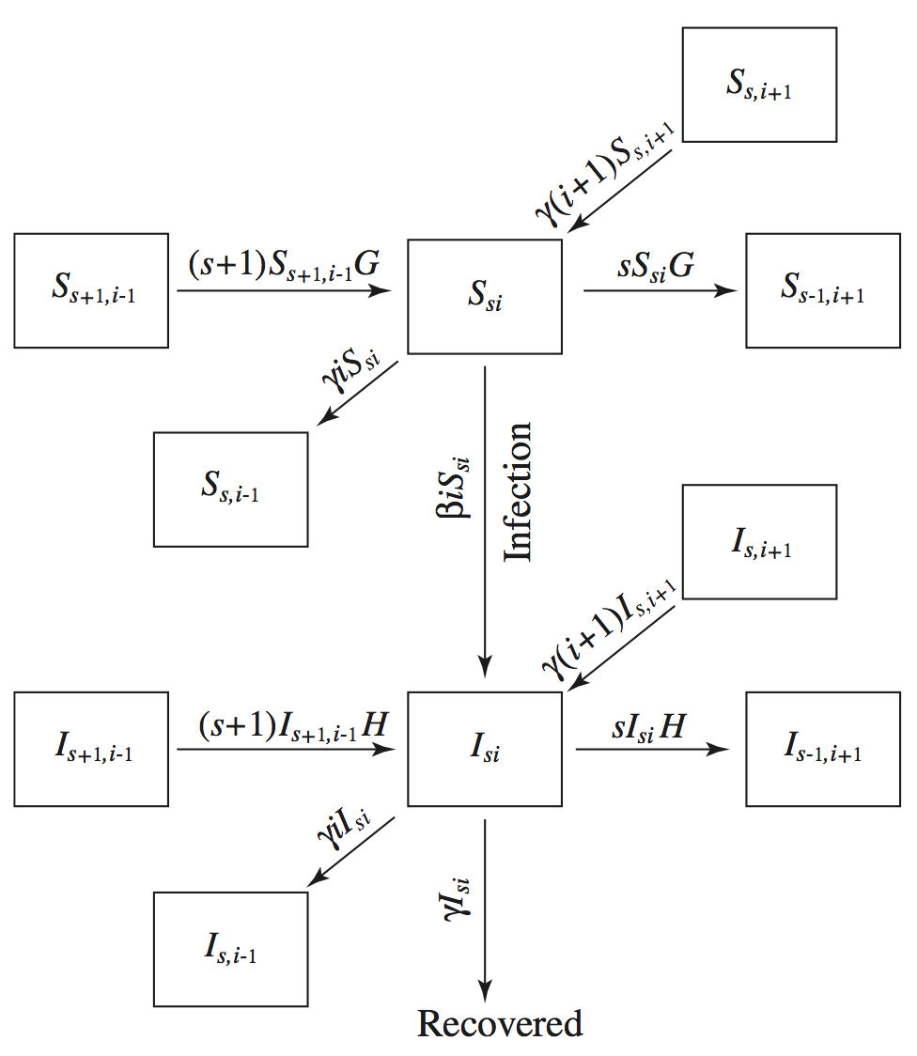
SIR neighbourhood model
Lindquist et al (2011)
Notes:
The numerator of G is the total rate at which a susceptible neighbour of an S_{si} node gets infected from other neighbours. (s+1)S_{s+1,i-1} / den(G) is the probability that the neighbours is susceptible

Slide 90
SIR epidemics on large Tree-like Networks
Key epidemiological quantities
Full dynamics
Moment closure
Notes:
First, I apologise with those that have already thought a lot about it

Slide 91
Deterministic approaches for SIR
Deterministic models for full dynamics (expected, asymptotic):
Specific to SIR:
Effective degree model: Ball & Neal (2008, MathBiosci)
Prob generating function model: Volz (2008, JmathBiol), Miller (2011, JMathBiol)
Can be extended to SIS (approximate):
(Effective degree) Neighbourhood model: Lindquist et al (2011, JMathBiol)
Pair approximation (moment closure): Keeling (1999, ProcRoySocB), Eames & Keeling (2005, PNAS), House & Keeling (2011, Interface)
All four methods proved to be exact for SIR on unclustered networks
They can capture degree heterogeneity
Notes:
So there are quite a lot of results for SIR epidemics. However, for SIS models almost no exact results are available even in the simplest network

Slide 92
History
Moment closure:
Originated in probability theory to estimate moments of stochastic processes
Goodman (1953); Whittle (1957)
Extended to physics, in particular statistical mechanics
Pair approximations:
pioneered by the Japanese school
Matsuda et al (1992), Sato (1994), Harada & Isawa (1994)
Extensively studied by Keeling and Morris PhD thesis in Warwick
Keeling (1995); Morris (1997)

Slide 93
Moment closure - basics
Mean-field approximation:
Original system:
Closure:
Closed system:
Implicit assumptions:
Large network ( )
The state of a neighbour is picked up randomly from anywhere in the network
Notes:
Dimensional considerations: to move to frequencies, [AB] needs to be divided by dN and [A] by N. Then both N and d disappeared and we talk about fractions…

Slide 94
From probabilities to population
probability that node is
probability that node is and is
mean number of susceptible nodes in the network
mean number of SI pairs in the network
Notes:
We may avoid writing
SS pairs are counted twice

Slide 95
Full dynamics (4)
Sharkey (2014?)
Pairwise approximation – “local”:
Pairwise approximation – “global”:
Taylor & Kiss (2012)

Slide 96
Pairwise approximation (SIR)
Original system:
Closure:
If the state of depends only on the state of and not of
So we close as

Slide 97
Pairwise closure on a tree
It is exact because (with deterministic initial conditions):
Only and appear in the equations
In , the third individual recovers independently of anything else
In , the third individual cannot get infected unless we proceed to , but this does not appear in the equations
When can it fail?
Stochastic initial conditions (don’t explain)
When there are loops, because the third individual may be linked to the first individual by another path.

Slide 98
SIR epidemics on large clustered Networks
Clustering
The Martini-Glass network
Moment closure
Notes:
First, I apologise with those that have already thought a lot about it

Slide 99
SIR epidemics on large clustered Networks
Clustering
The Martini-Glass network
Moment closure
Notes:
First, I apologise with those that have already thought a lot about it

Slide 100
Clustering
Defined as the fraction of triplets that form a closed triangle
The real problem are loops, not necessarily triangles
But triangles are the smallest and those that impact the dynamics the most

Slide 101
Clustering via households
Fully connected cliques, linked in a tree-like fashion
For any clustering and any required degree correlation, it is possible to construct a suitable household model
But the resulting network is very specific…
Therefore, the question: “what is the impact of clustering/assortativity on …” is badly posed

Slide 102
SIR epidemics on large clustered Networks
Clustering
The Martini-Glass network
Moment closure
Notes:
First, I apologise with those that have already thought a lot about it

Slide 103
The Martini-Glass (MG) network
Choose the simplest network with triangles:
Regular
With degree 3
Triangles never touch
Compare tree-like (3R) with clustered (MG):
Compare Constant (C) with Markovian (M)

Slide 104
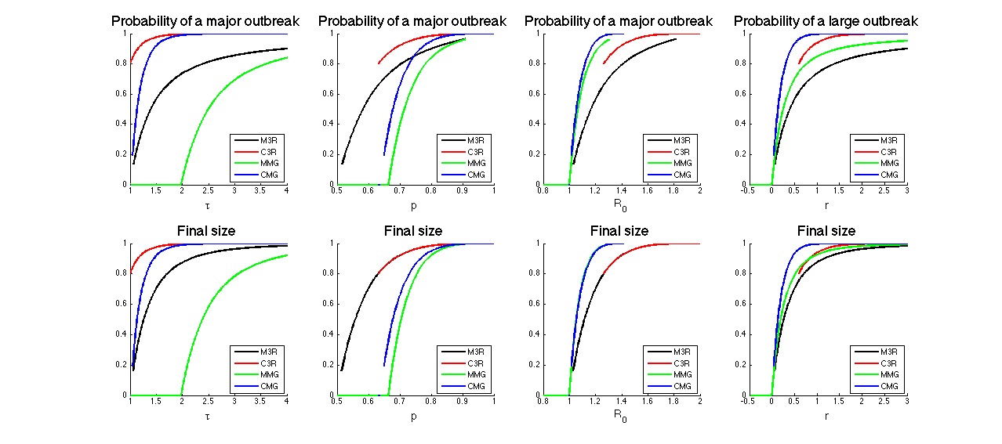
Impact of clustering?
Even with such specific clustering, the result is not obvious
It depends on how the comparison is done!

Slide 105
SIR epidemics on large clustered Networks
Clustering
The Martini-Glass network
Moment closure
Notes:
First, I apologise with those that have already thought a lot about it

Slide 106
Pairwise approximation (SIR)
Original system:
Basic closures:
Open triplet: Closed triangle: Kirkwood & Boggs (1942)
Overall (clustering coeffficient ): Keeling (1999)

Slide 107
SIS on large unclustered networks
Motivation
Systematic approximations
Results
Notes:
First, I apologise with those that have already thought a lot about it

Slide 108
SIS on large unclustered networks
Motivation
Systematic approximations
Results
Notes:
First, I apologise with those that have already thought a lot about it

Slide 109
Motivation
Network epidemic models originally motivated by STIs:
Easier to define / measure “contacts”
Sexual contacts very different from “random”
Many theoretical results for SIR epidemics:
, final size, …
Many approaches for the full dynamics (expected, asymptotic)
Recently proved to be exact on unclustered networks
However, most STIs have SIS-type dynamics (exception: HIV)
In contrast to SIR, almost no results for SIS on networks
Here:
simplest possible network (static, unweighted, unclustered)
Markovian dynamics

Slide 110
SIS: local correlations
Degree heterogeneity is “conceptually” easy to capture
If prepared to increase the system’s dimensions
Maybe not in extreme cases (power law degree)
Instead we focus on:
build-up of local correlations between states of neighbours
Important for SIS
Conceptually hard
Strongest for:
low degree
low heterogeneity
Focus on -regular network

Slide 111
SIR is “simple”
Either node is S, but it’s in a “pool” of Ss

Slide 112
SIR is “simple”
Either node is S, but it’s in a “pool” of Ss
no contribution to the dynamics

Slide 113
SIR is “simple”
Either node is S, but it’s in a “pool” of Ss
no contribution to the dynamics
Or is S and near an I neighbour:

Slide 114
SIR is “simple”
Either node is S, but it’s in a “pool” of Ss
no contribution to the dynamics
Or is S and near an I neighbour:
the other 2 are susceptible

Slide 115
SIR is “simple”
Either node is S, but it’s in a “pool” of Ss
no contribution to the dynamics
Or is S and near an I neighbour:
the other 2 are susceptible
If the epidemic started in at least 2 places:

Slide 116
SIR is “simple”
Either node is S, but it’s in a “pool” of Ss
no contribution to the dynamics
Or is S and near an I neighbour:
the other 2 are susceptible
If the epidemic started in at least 2 places:
escapes infection independently

Slide 117
SIR is “simple”
Either node is S, but it’s in a “pool” of Ss
no contribution to the dynamics
Or is S and near an I neighbour:
the other 2 are susceptible
If the epidemic started in at least 2 places:
escapes infection independently
S neighbour is unaffected

Slide 118
SIS: surrounding of S
Knowing that is S is not enough to tell something about its surrounding

Slide 119
SIS: surrounding of S
Knowing that is S is not enough to tell something about its surrounding
As for SIR, if has never been infected, it’s:

Slide 120
SIS: surrounding of S
Knowing that is S is not enough to tell something about its surrounding
As for SIR, if has never been infected, it’s:
either surrounded by S

Slide 121
SIS: surrounding of S
Knowing that is S is not enough to tell something about its surrounding
As for SIR, if has never been infected, it’s:
either surrounded by S
or has 1 I and 2 S neighbours

Slide 122
SIS: surrounding of S
Knowing that is S is not enough to tell something about its surrounding
As for SIR, if has never been infected, it’s:
either surrounded by S
or has 1 I and 2 S neighbours
Unlike SIR:

Slide 123
SIS: surrounding of S
Knowing that is S is not enough to tell something about its surrounding
As for SIR, if has never been infected, it’s:
either surrounded by S
or has 1 I and 2 S neighbours
Unlike SIR:

Slide 124
SIS: surrounding of S
Knowing that is S is not enough to tell something about its surrounding
As for SIR, if has never been infected, it’s:
either surrounded by S
or has 1 I and 2 S neighbours
Unlike SIR:

Slide 125
SIS: surrounding of S
Knowing that is S is not enough to tell something about its surrounding
As for SIR, if has never been infected, it’s:
either surrounded by S
or has 1 I and 2 S neighbours
Unlike SIR:

Slide 126
SIS: surrounding of S
Knowing that is S is not enough to tell something about its surrounding
As for SIR, if has never been infected, it’s:
either surrounded by S
or has 1 I and 2 S neighbours
Unlike SIR:

Slide 127
SIS: surrounding of S
Knowing that is S is not enough to tell something about its surrounding
As for SIR, if has never been infected, it’s:
either surrounded by S
or has 1 I and 2 S neighbours
Unlike SIR:

Slide 128
SIS: surrounding of S
Knowing that is S is not enough to tell something about its surrounding
As for SIR, if has never been infected, it’s:
either surrounded by S
or has 1 I and 2 S neighbours
Unlike SIR:

Slide 129
SIS: surrounding of S
Knowing that is S is not enough to tell something about its surrounding
As for SIR, if has never been infected, it’s:
either surrounded by S
or has 1 I and 2 S neighbours
Unlike SIR:

Slide 130
SIS: surrounding of S
Knowing that is S is not enough to tell something about its surrounding
As for SIR, if has never been infected, it’s:
either surrounded by S
or has 1 I and 2 S neighbours
Unlike SIR:

Slide 131
SIS: surrounding of S
Knowing that is S is not enough to tell something about its surrounding
As for SIR, if has never been infected, it’s:
either surrounded by S
or has 1 I and 2 S neighbours
Unlike SIR:

Slide 132
SIS: surrounding of S
Knowing that is S is not enough to tell something about its surrounding
As for SIR, if has never been infected, it’s:
either surrounded by S
or has 1 I and 2 S neighbours
Unlike SIR:

Slide 133
SIS: surrounding of S
Knowing that is S is not enough to tell something about its surrounding
As for SIR, if has never been infected, it’s:
either surrounded by S
or has 1 I and 2 S neighbours
Unlike SIR:

Slide 134
SIS: surrounding of S
Knowing that is S is not enough to tell something about its surrounding
As for SIR, if has never been infected, it’s:
either surrounded by S
or has 1 I and 2 S neighbours
Unlike SIR:
it’s surrounding depends on how many times it has recovered

Slide 135
SIS: surrounding of S
Knowing that is S is not enough to tell something about its surrounding
As for SIR, if has never been infected, it’s:
either surrounded by S
or has 1 I and 2 S neighbours
Unlike SIR:
it’s surrounding depends on how many times it has recovered
We need to count reinfections!

Slide 136
Need for reinfection counting
A triple in state ISI is:
is rare for SIR:
from 2 initially infected cases
when infection goes around a (long) loop
is common for SIS:
when the central node of a III triple recovers
however, early on in the epidemic, the standard approximation predict it to be rare:

Slide 137
SIS on large unclustered networks
Motivation
Systematic approximations
Results
Notes:
First, I apologise with those that have already thought a lot about it

Slide 138
Systematic approximations
2 main approaches:
Motif (generic group of connected nodes)
Neighbourhood (a central node and all its nearest neighbours)
Then either of them can be expanded in:
Size ( for motif, for neighbourhood)
“Reinfection-counting” (up to times)
Simplifying assumptions:
Simple network (static, undirected, unclustered)
All nodes are identical (except they can be S or I)
Regular network (each node has exactly neighbours)

Slide 139
3-regular tree
dim = 2
dim = 7
dim = 5
dim = 111
dim = 9+7 = 16

Slide 140
2-regular “line”
dim = 2
dim = 5
dim = 9
dim = 19

Slide 141
Mean-field approximation (m = n = 1)
This basically completely ignores the network structure:
Equations:
With closure:

Slide 142
Motif approximation, m = 2
This is the standard pairwise approximation
Equations for the pairs:
With closure:

Slide 143
Motif approximation, m = 2
An alternative formulation, easier to extend
Equations for the pairs:
With external force of infection:

Slide 144
Motif approximation, m = 3
Close at the level of quads:
Equations for the triplets:
With closures:

Slide 145
Motif with reinfection counting, m = 2
Add an index telling how many times a node has been infected till now:

Slide 146
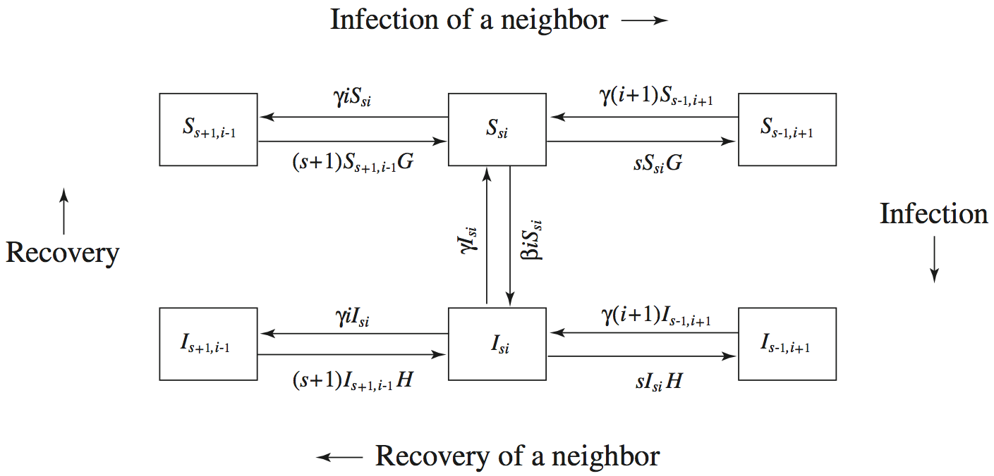
Neighbourhood approximation, n = 2
This is the “effective degree” model of Lindquist et al (2011)
number of susceptible/infected nodes with susceptible and infectious neighbours
Notes:
Cancel the caption at the bottom and rewrite G and H

Slide 147
Neighbourhood approximation, n = 2
Equations for nodes with state of neighbours
With FOI from outside the neighbourhood:

Slide 148
SIS on large unclustered networks
Motivation
Systematic approximations
Results
Notes:
First, I apologise with those that have already thought a lot about it

Slide 149
Notes:
We tested HOW WELL each model approximate the real-time growth rate and the endemic prevalence

Slide 151
Notes:
All approximations perform consistently better
As you can see, all approximations become less accurate as we approach the critical transmission rate
In particular, all approximation overestimate the prevalence, which should be 0 at the critical threshold

Slide 152



Slide 154
SIS: Conclusions
For SIS infections on networks:
exact results are really hard to obtain, even in simplest cases
local correlations are strongest for low, homogeneous degree
Systematic approximations:
Motif or neighbourhood
Reinfection counting
Results:
Reinfection counting is key for good approximation of
Endemic prevalence quite accurate with all methods, but in particular with the neighbourhood approximation
Neighbourhood + reinfection counting very accurate for both outputs, but high dimensional
Maybe easier to use different models for different outputs

Slide 155
Conclusions
Notes:
First, I apologise with those that have already thought a lot about it

Slide 156
Overall conclusions
Simplest epidemic models assume homogeneous mixing:
Ways of relaxing this assumption:
Heterogeneous mixing
Households models
Network models
Many analytical results for SIR on networks:
Exact on unclustered networks
Approximate on clustered networks, but typically proved bounds
Almost no analytical results for SIS on networks
Approximations are needed
Moment-closure techniques very flexible
Difficult to control the quality of the approximation

Slide 157


Acknowledgements
Matt Keeling
Thomas House
Alison Cooper
Thank you all!

Slide 159
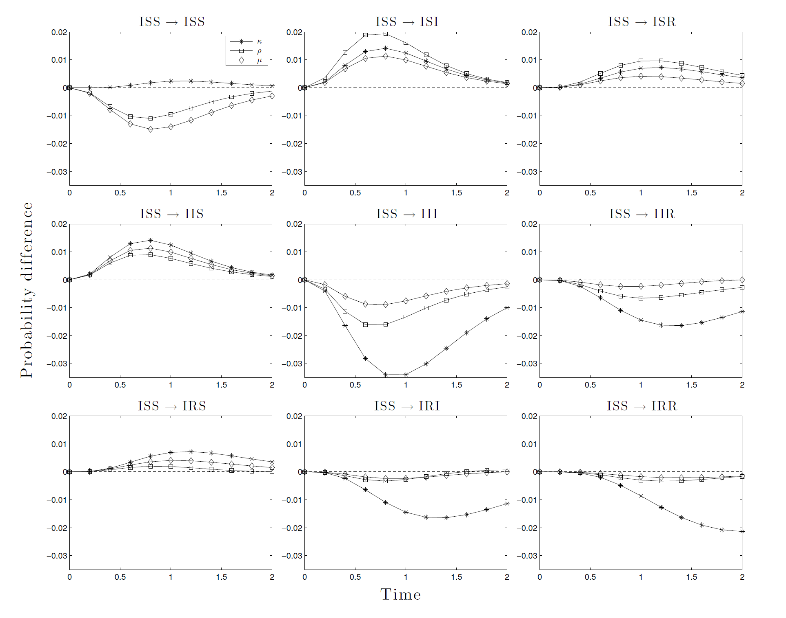
Other closures
Kirkwood
1-step maximum entropy
Maximum entropy
Conclusions:
None is uniformly better
ME seem generally better

