Slide 1
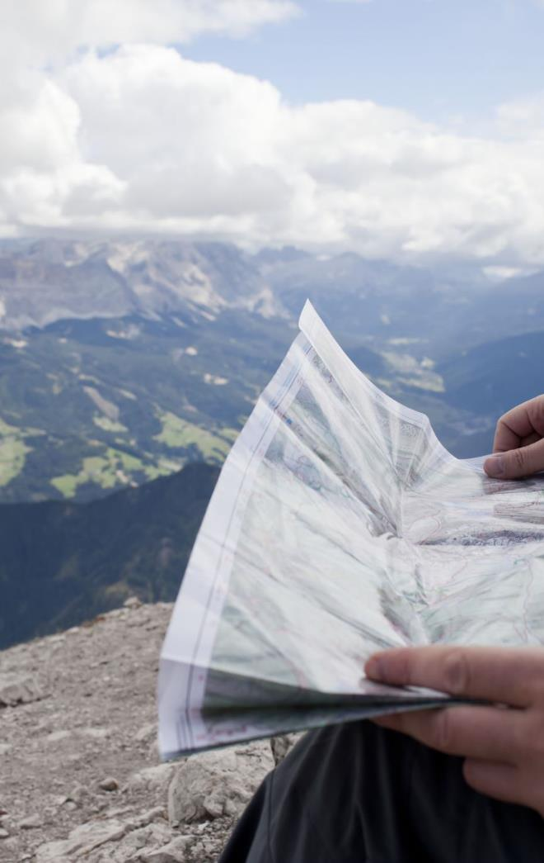
Thinking with AI
A workshop: mapping AI, making policy
Notes:
Session A, 3 hours including a break. Guidance extracts, paper and post-its on each table; collage materials ready but kept aside.

Slide 2
Not whether AI is good or bad. What is happening with AI, and what we would want to protect?
Nobody has to describe their own use of AI today.
Notes:
10:00, 10 minutes. 'Today we are going to look at how AI shows up in this university and make our own response to it.' Say that nobody has to describe their own use; maps can record what happens in a role or a department, not what any one person does.

Slide 3
Today
01
Over the fences
02
Mapping interactions
03
The collective map
04
Break
05
Collage a policy
06
Gallery walk and close
Notes:
10 + 25 + 25 + 15 + 15 + 50 + 25 + 15 minutes = 3 hours.

Slide 4
Over the fences
Read the guidance from different departments side by side.
What does it assume AI is?
What does it assume students about students?
What is it trying to protect?
What's missing?
Notes:
10:10, 25 minutes. Post-its on each extract. Leave five minutes to share the most surprising difference between departments.

Slide 5
Mapping interactions
Map where AI shows up in everyday university work.
Where
For each
Teaching and studying
Assessment
Admin and support
Research
Who uses it?
What for?
What does it replace, or support?
Notes:
10:35, 25 minutes. Groups of 3 to 4, mixed by role where possible. The purpose of mapping is to identify, describe and review the purpose and function of AI use.

Slide 6
Mapping template
Preparation
Lecture
Seminar
Assessment
Admin
Student
Activity
AI Use
Teacher
Activity
AI Use
Administration
Activity
AI Use

Slide 7
The collective map
Put the maps on the wall, side by side.
What are the key insights?
How does AI use differ for academics, professional staff and students?
Where do the maps converge and diverge?
Notes:
11:00, 15 minutes. Room discussion.

Slide 8
Break
15 minutes
Notes:
11:15. Put the collage materials out on the tables during the break.

Slide 9
Collage a policy
Choose one audience. Then don’t plan: make
Choose one audience:
Work with
Students
Academic and professional staff
Senior leadership
Parents
Employers
On your own, in silence, images only.
Then together: build one poster from your pieces (you can add more).
No written words yet.
Think metaphorically: if your policy were a place, weather, object etc
Notes:
11:30, 50 minutes. Provide magazines, scissors, glue, paper and pens.
Part 1: 30 minutes
5 min: “For this part, don’t plan. Making is thinking. Start tearing and cutting before you know what the policy is; the policy will show up in what you choose. Look for images that feel right rather than ones that illustrate a point. Think in metaphor: if your policy were a place, a piece of weather, a building, an animal, what would it be?” Groups choose their audience.
12 min: Working alone, in silence. Each person makes a small piece (A4 size is plenty big enough): images only, no words – thinking metaphorically, e.g. if this policy were a place, a weather, etc.
13 min: Together. The group builds one poster from its individual pieces, cutting, combining, rearranging and adding. Talking is fine now, but not written words.
Making collage work:
Discourage discussion about what to make; encourage people to pick things up, put them down, move them around.
Tearing is often better than cutting: it’s harder to be precise, which is the point.
If a group stalls planning, ask them to each put three images on
Most people aren’t used to thinking with their hands, and some will find it uncomfortable. Treat the discomfort as part of the work, not a sign it isn’t working.
If you find the silence awkward you might want to play some background music, but during the quiet making remind people of the rules to protect independent thinking.

Slide 10
Read it back
What does it say? Who is it speaking to?
On post-its beside the collage:
What does your policy protect?
How does it relate to the map?
Add a few words, if it needs them.
What practical steps would it take?
Are existing structures enough?
What needs to change?
Notes:
11:55
Part 2: 35 minutes
12 min, reading it back: What does it say? Who is it speaking to? What does it protect? How does it relate to the map? Add a few words if it needs them.
8 min, practical steps: On post-its beside the collage: what practical steps would it take for this policy to happen? Are existing structures enough? What needs to change?

Slide 11
What does this make difficult?
Gallery walk
Notes:
12:20, 25 minutes. Posters on the wall. Groups move round with post-its, one per poster, then read what was left on their own.

Slide 12
Optional close
Use only if the session is introducing the campaign.
Notes:
If you are introducing the campaign unhide slides 10-12.

Slide 13
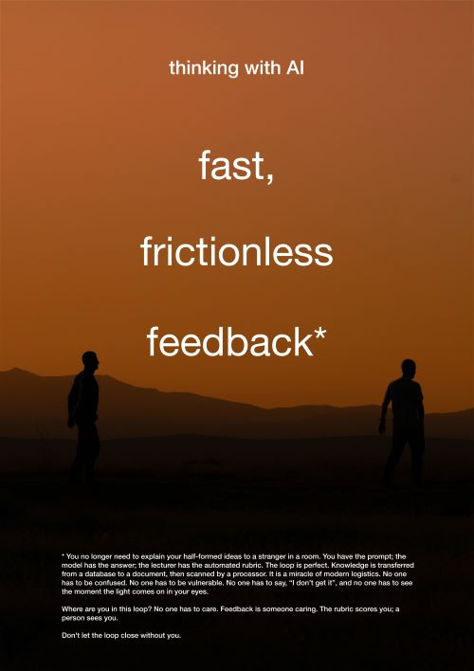
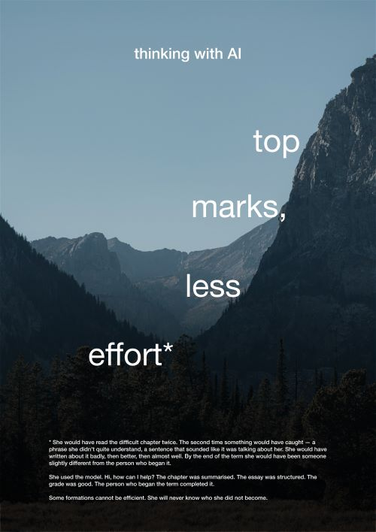
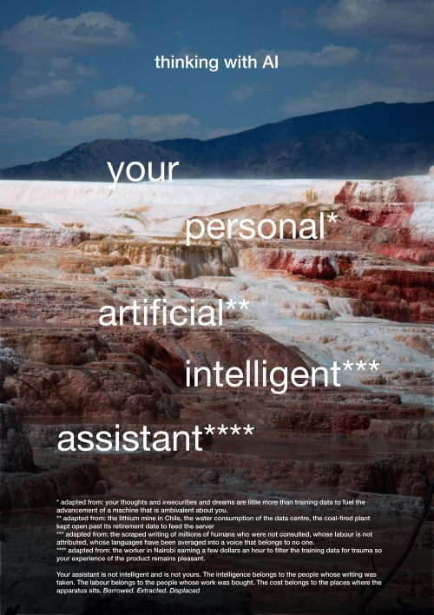
One response to the same material
What did they see that we did not?
Notes:
Show these after the gallery walk, never before the making.
These posters came out of two workshops like this one at Warwick. A small team took what people said and made a set of satirical posters. Each one borrows the voice of AI marketing, then turns in the small print. They’re one response to the same kind of material you’ve been working with today, not the right answer. What did they see that we didn’t? What did we see that they didn’t?

Slide 14
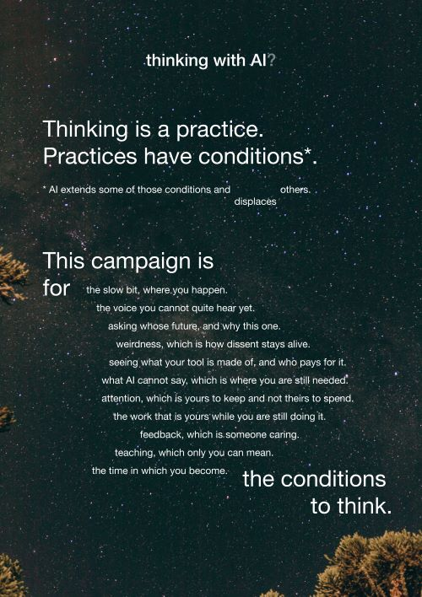
Thinking with AI - manifesto
Notes:
The manifesto. Read it in silence.

Slide 15
What can we see now that none of us could see when we walked in?
Where should this work go next?
Close
Notes:
12:45, 15 minutes. Collect or photograph posters only if participants have agreed. If using the optional close, take 10 minutes of this block.

Slide 16
Thank you
Thinking with AI. For the conditions under which thinking happens.
Thinking with AI, University of Warwick. Posters and materials licensed CC BY-NC-SA 4.0.

