Slide 1
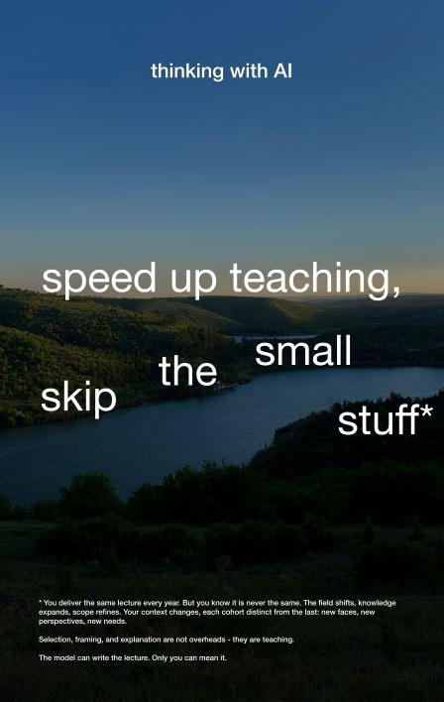
Thinking with AI
A department session: deciding with conditions
Notes:
Session B, 2 hours. Before you start: the live question is on slide 2, the department's guidance and a cluster of posters are on every table, and poster 13 is held back for the close.

Slide 2
[Write the live question in the department here.]
Today’s question
Notes:
10:00, 10 minutes. 'Today we are going to work on a real decision. We are not going to start with whether AI is good or bad. We are going to start with what our teaching depends on, and test the decision against that.’
Replace the bracketed text with the question agreed beforehand, e.g. 'Do we allow AI-assisted drafting in second-year essays?'

Slide 3
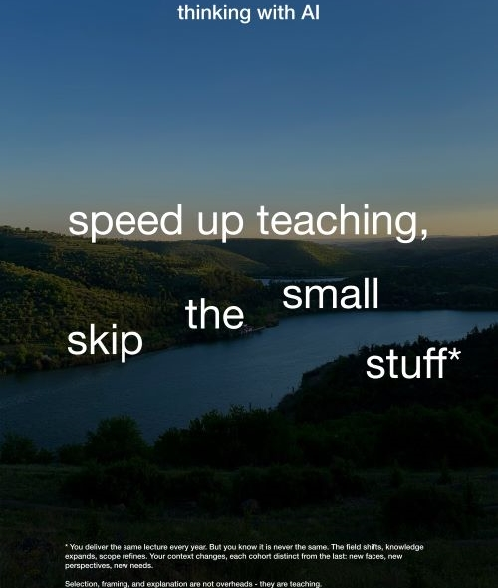
For the conditions under which thinking happens.
Nobody has to describe their own use of AI today.
Notes:
These posters come from a Warwick project. Students and staff mapped where AI shows up in university life, and a small team turned those conversations into a set of satirical posters. Each one borrows the voice of AI marketing, then turns in the small print. They aren’t against AI, and they aren’t selling it. They’re about the conditions good thinking needs, and what happens to those conditions when AI arrives.
For you: The room might hear this as a sensible middle, a bit of both, used responsibly. It isn't: Andreotti and colleagues call it the contaminated middle, where innocence is no longer available. Say clearly that nobody has to describe their own AI use; people can talk about the poster's 'you' instead and use anonymous post-its.

Slide 4
Today
01
Name the question
02
First pass: your work
03
The turn
04
Second pass: as a department
05
Test the decision
06
What must change
Notes:
Two hours: 10 + 25 + 10 + 30 + 30 + 15 minutes.

Slide 5
First pass: your work
Read the poster in silence for 5 minutes. Read the small print: that is where it turns.
What are you thinking?
What emerged here that nobody brought in?
What does that make difficult?
Read it as being about your own work: writing, feedback, teaching, admin, research.
Notes:
10:10, 25 minutes. One poster per table to start; swap with the next table after about 12 minutes. If a table stalls, use the 'your work' prompts in the guide, but only after the three questions have run dry.

Slide 6

In what cases can you tell where you stop and the tool starts?
What are we about to ask of students that we do not ask of ourselves?
Notes:
10:35, 10 minutes. The turn. Whole room. Take three or four responses and do not resolve them.
This is the entanglement the department is already in, before it decides anything on the students’ behalf.

Slide 7
Second pass: as a department
Read the same posters again, beside our own AI guidance.
What conditions does our education depend on?
Write three to five, in plain words.
For example: “Students draft badly before they draft well.”
Notes:
10:45, 30 minutes. Each table writes its conditions on flipchart paper. If a table stalls, use the 'your curriculum' prompts in the guide.

Slide 8
Test the decision
Take each option in turn.
The options
For each option
[Option A]
[Option B]
[Option C]
What condition does this have to answer to?
What does it protect?
What does it displace?
Notes:
11:15, 30 minutes. Replace the bracketed options with the two or three on the table. Bring tables together for the last 10 minutes to see where they agree.

Slide 9
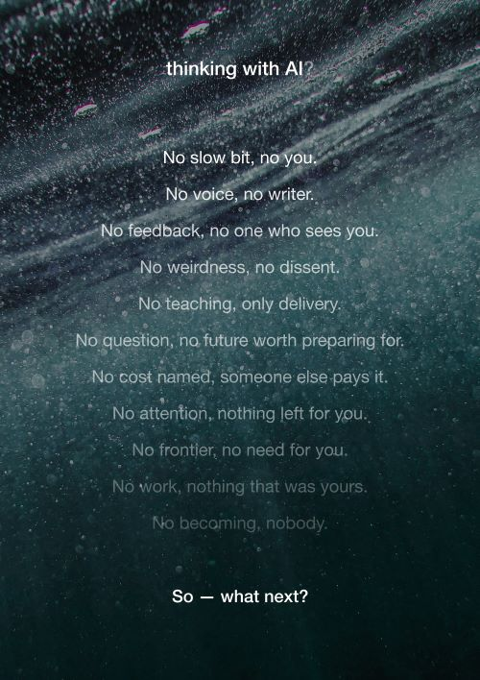
Manifesto
Notes:
11:45. Show poster 13 and let the room read it in silence before moving on.

Slide 10
Our statement
Draft it at your table.
We have decided …
It has to answer to …
So we will also …
Notes:
Tables draft the statement. The third line is what stops the condition being decoration: it names what changes to honour it.

Slide 11
Are our existing structures enough? Who does this go to next?
What has to change
Notes:
Finish here. Collect the statements; they belong to the department. Say where they will go and when.

Slide 12
Thank you
Thinking with AI. For the conditions under which thinking happens.
Thinking with AI, University of Warwick. Posters and materials licensed CC BY-NC-SA 4.0.

Slide 13
Poster clusters
Pick the cluster closest to the live question.

Slide 14
Poster clusters: questions
Cluster | Departments arrive asking | Posters | The question it opens
Assessment | How do we permit, limit or detect AI use? | 11, 3, 10, 4 | What is this assessment for?
Writing and voice | Can students use AI for drafting and editing? | 2, 7, 4, 11 | Where does a students’ voice get made?
Feedback and workload | Can AI help us mark and prepare teaching? | 3, 5, 9 | Which parts are overhead, and which are the teaching?
Employability | Are we producing AI-ready graduates? | 1, 6, 10 | Ready for whose future?
When a tool arrives | It is here. What now? | 8, 6, 9 | What is it made of, and who pays?
Attention and presence | Students aren’t engaging or reading. | 9, 3, 2 | What conditions does attention need?
Notes:
Clusters are a starting point. Mix them if you know the room.

Slide 15
Poster pack
Show the poster a table is working with. Print at A3 for the tables.

Slide 16

Poster 1
AI-ready workforce

Slide 17
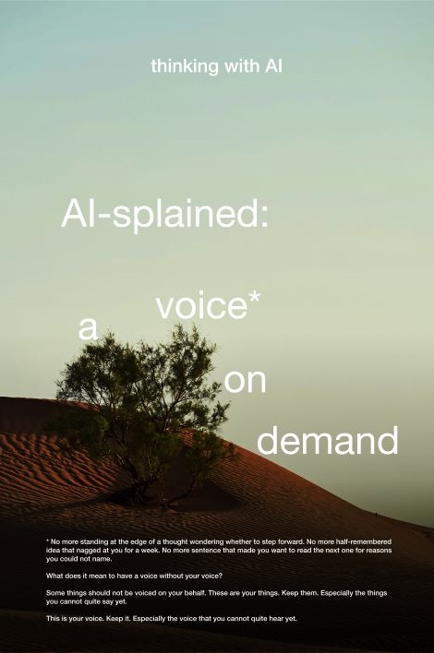
Poster 2
AI-splained: a voice on demand

Slide 18
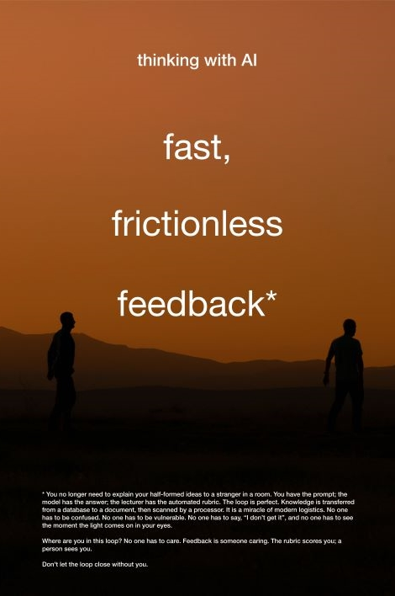
Poster 3
Fast, frictionless feedback

Slide 19
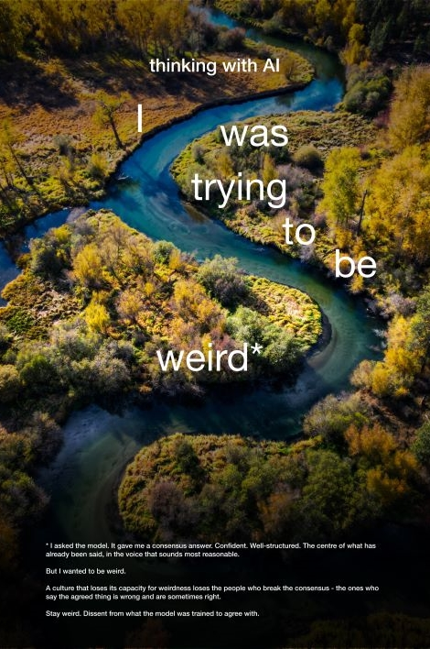
Poster 4
I was trying to be weird

Slide 20
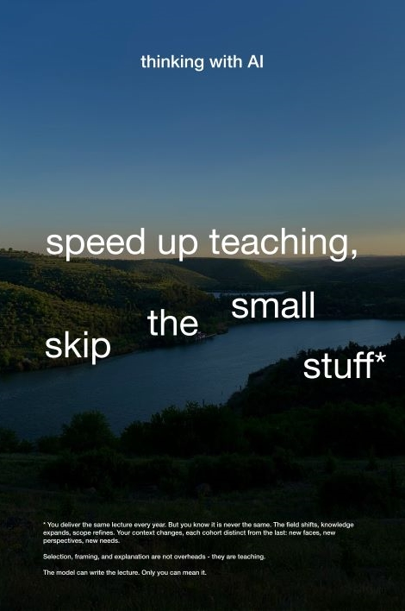
Poster 5
Speed up teaching, skip the small stuff

Slide 21

Poster 6
The future is already here

Slide 22
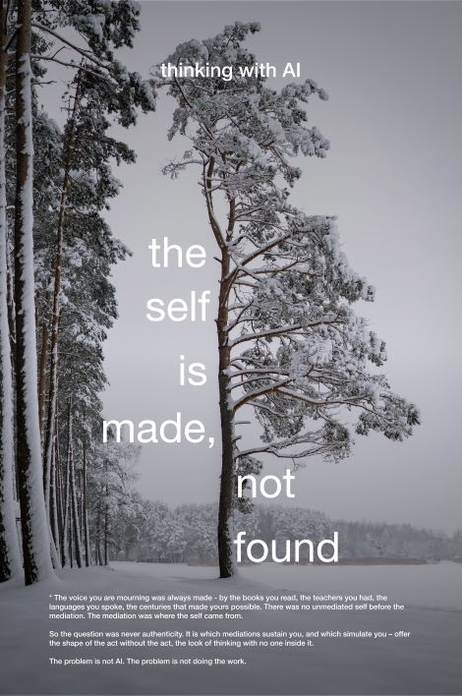
Poster 7
The self is made, not found

Slide 23
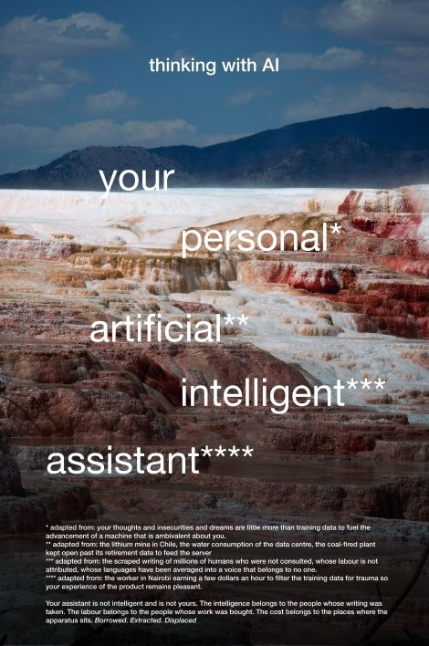
Poster 8
Your personal artificial intelligent assistant

Slide 24

Poster 9
Attention is all you need

Slide 25
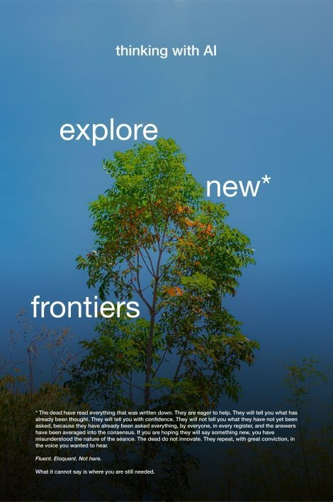
Poster 10
Explore new frontiers

Slide 26
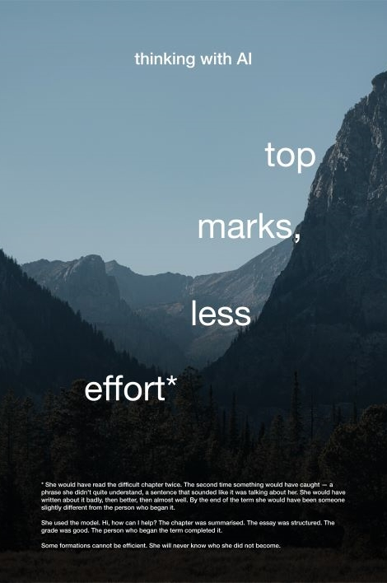
Poster 11
Top marks, less effort

