Slide 1
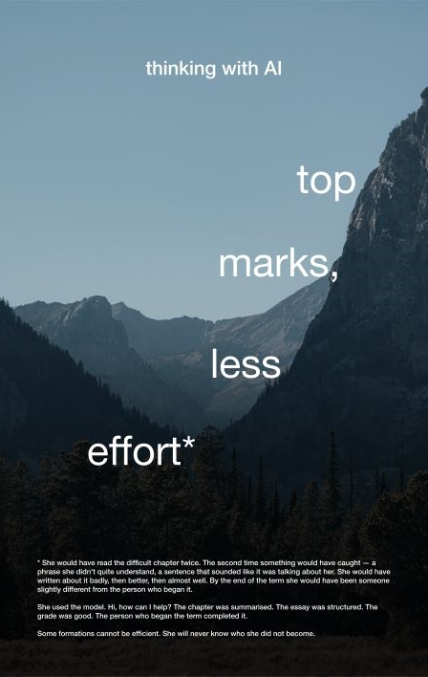
Thinking with AI
A seminar for critical AI literacy
Notes:
Session C, 50 minutes. One poster per table, post-its and pens, and a rule card per student. Poster 12 is held back for the close.

Slide 2
Not how to use AI. Which parts of studying are the learning?
Nobody has to say how they have used AI.
Notes:
10:00, 5 minutes. 'Today isn't about how to use AI, or whether you should. It's about which parts of studying are the learning, and what happens to them when something else does them.' Be explicit that nobody has to describe their own AI use.

Slide 3
Today
01
The poster
02
My rules
03
Close
04
Across the room
Notes:
50 minutes: 5 + 20 + 10 + 10 + 5.

Slide 4
The poster
Five minutes in silence. Read the small print: that is where the poster turns.
What are you thinking?
What came up in your conversation that none of you had thought of before?
What does that make difficult?
Notes:
10:05, 20 minutes. Five minutes silent reading with post-its around the poster, then fifteen on the three questions. Start with the poster's figure, then students' own experience. Prompts for stalled tables are in the guide; don't open with them.

Slide 5
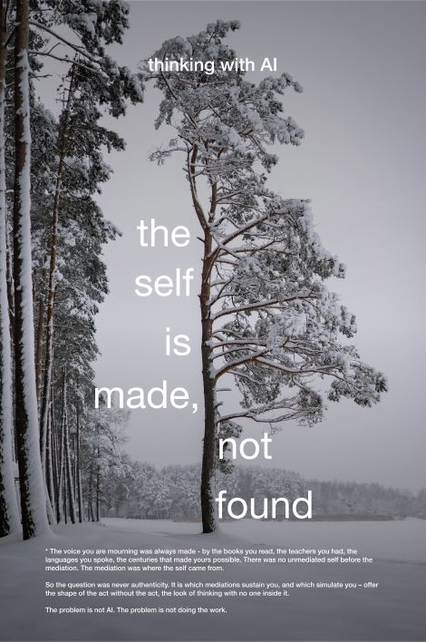
Where can’t you tell where you stop and the tool starts?
Then ask
Notes:
Bring this in during the last part of the 20 minutes, once tables have talked about the poster and their own experience. Let it get there; don't start there.

Slide 6
One think your table only noticed by talking it through.
Across the room
Notes:
10:25, 10 minutes. Each table shares one thing. Note them where everyone can see. Don't sum up.

Slide 7
My rules
On your own. The card stays with you.
I will use it for …
It has to answer to …
I will keep for myself …
Notes:
10:35, 10 minutes. Two or three rules each. Pairs can share if they want to. Don't collect the cards.

Slide 8
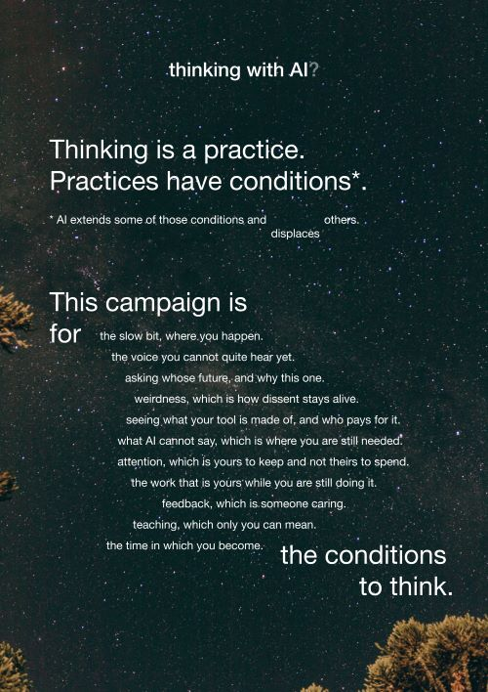
Notes:
10:45, 5 minutes. Show the manifesto. Read the list aloud, or let the room read it in silence. End on its last line.

Slide 9
Thank you
Thinking with AI. For the conditions under which thinking happens.
Thinking with AI, University of Warwick. Posters and materials licensed CC BY-NC-SA 4.0.

Slide 10
Poster pack
Show the poster a table is working with. Print at A3 for the tables.

Slide 11
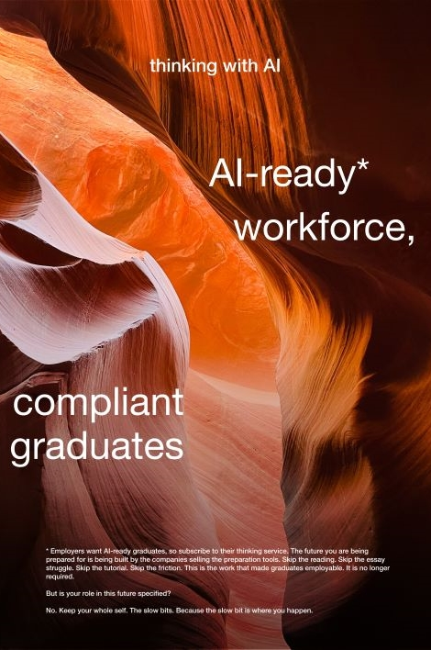
Poster 1
AI-ready* workforce

Slide 12
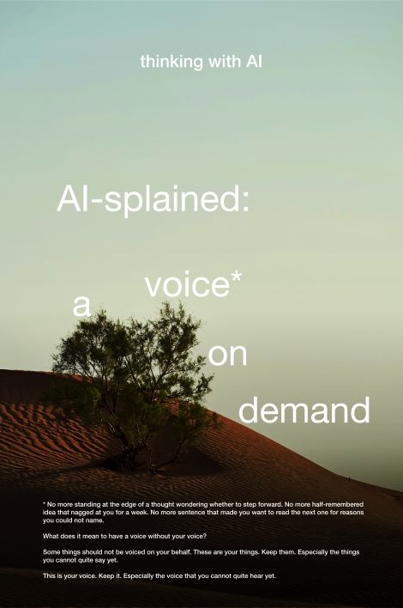
Poster 2
AI-splained: a voice* on demand

Slide 13
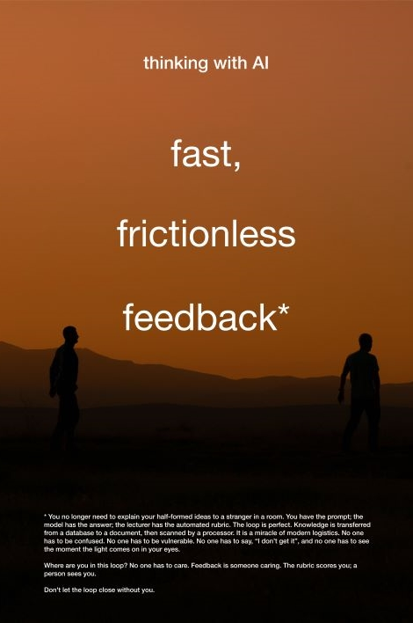
Poster 3
Fast, frictionless feedback

Slide 14
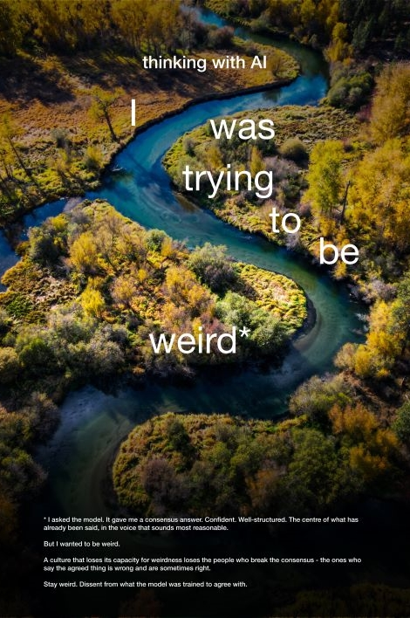
Poster 4
I was trying to be weird

Slide 15
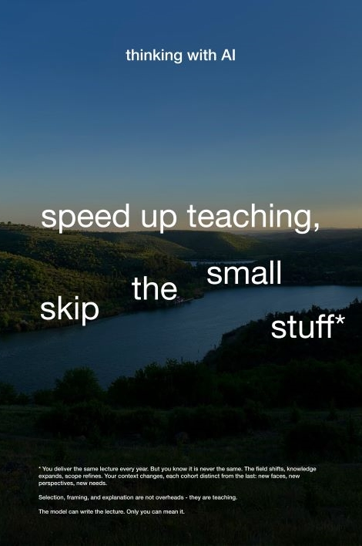
Poster 5
Speed up teaching, skip the small stuff

Slide 16
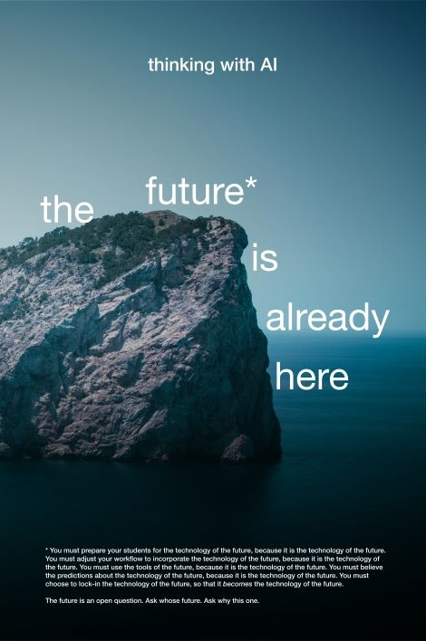
Poster 6
The future is already here

Slide 17
Poster 7
The self is made, not found

Slide 18
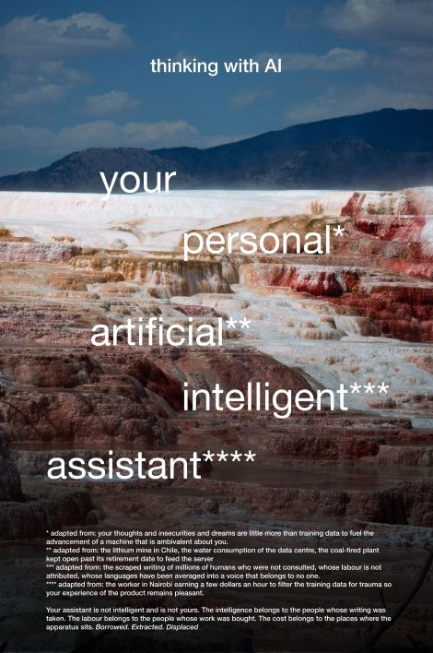
Poster 8
Your personal artificial intelligent assistant

Slide 19
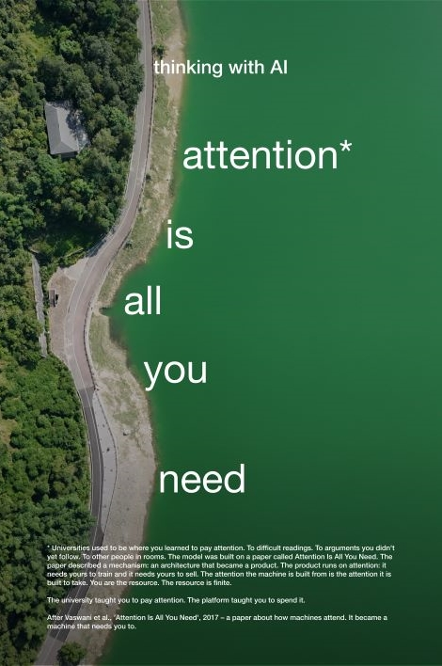
Poster 9
Attention is all you need

Slide 20
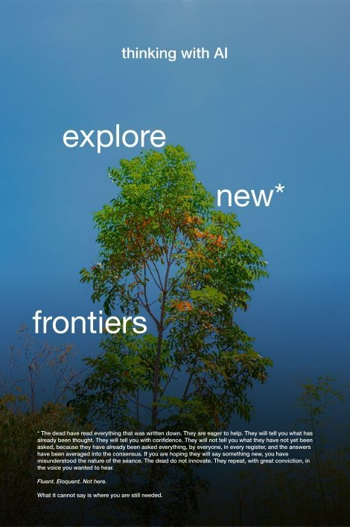
Poster 10
Explore new frontiers

Slide 21
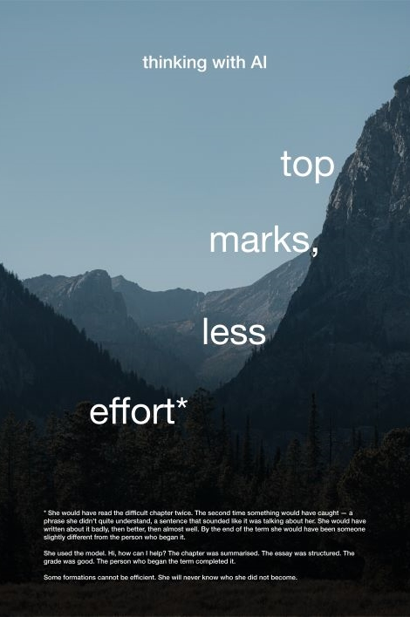
Poster 11
Top marks, less effort

