Slide 1
Condensation and metastability in the zero-range process
Paul Chleboun
Stefan Grosskinsky
Complexity Forum
27/10/2010

Slide 2
The big idea
We use general techniques such as;
Large deviations and entropy methods.
To help our understanding of;
condensation in non equilibrium statistical mechanics.
Demonstrate methods
by application to a simple toy model.

Slide 3
Motivation
What is condensation & why do we care?

Slide 4
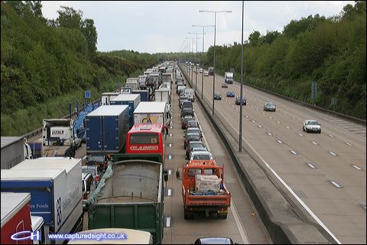
Motivation
What is condensation & why do we care?
1) Traffic jams.

Slide 5
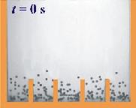
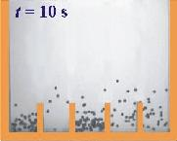
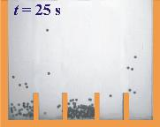
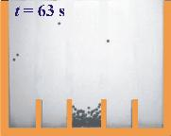
Motivation
2) In granular media.

Slide 6
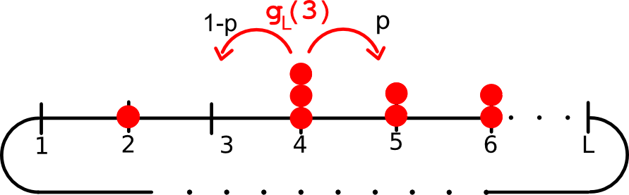
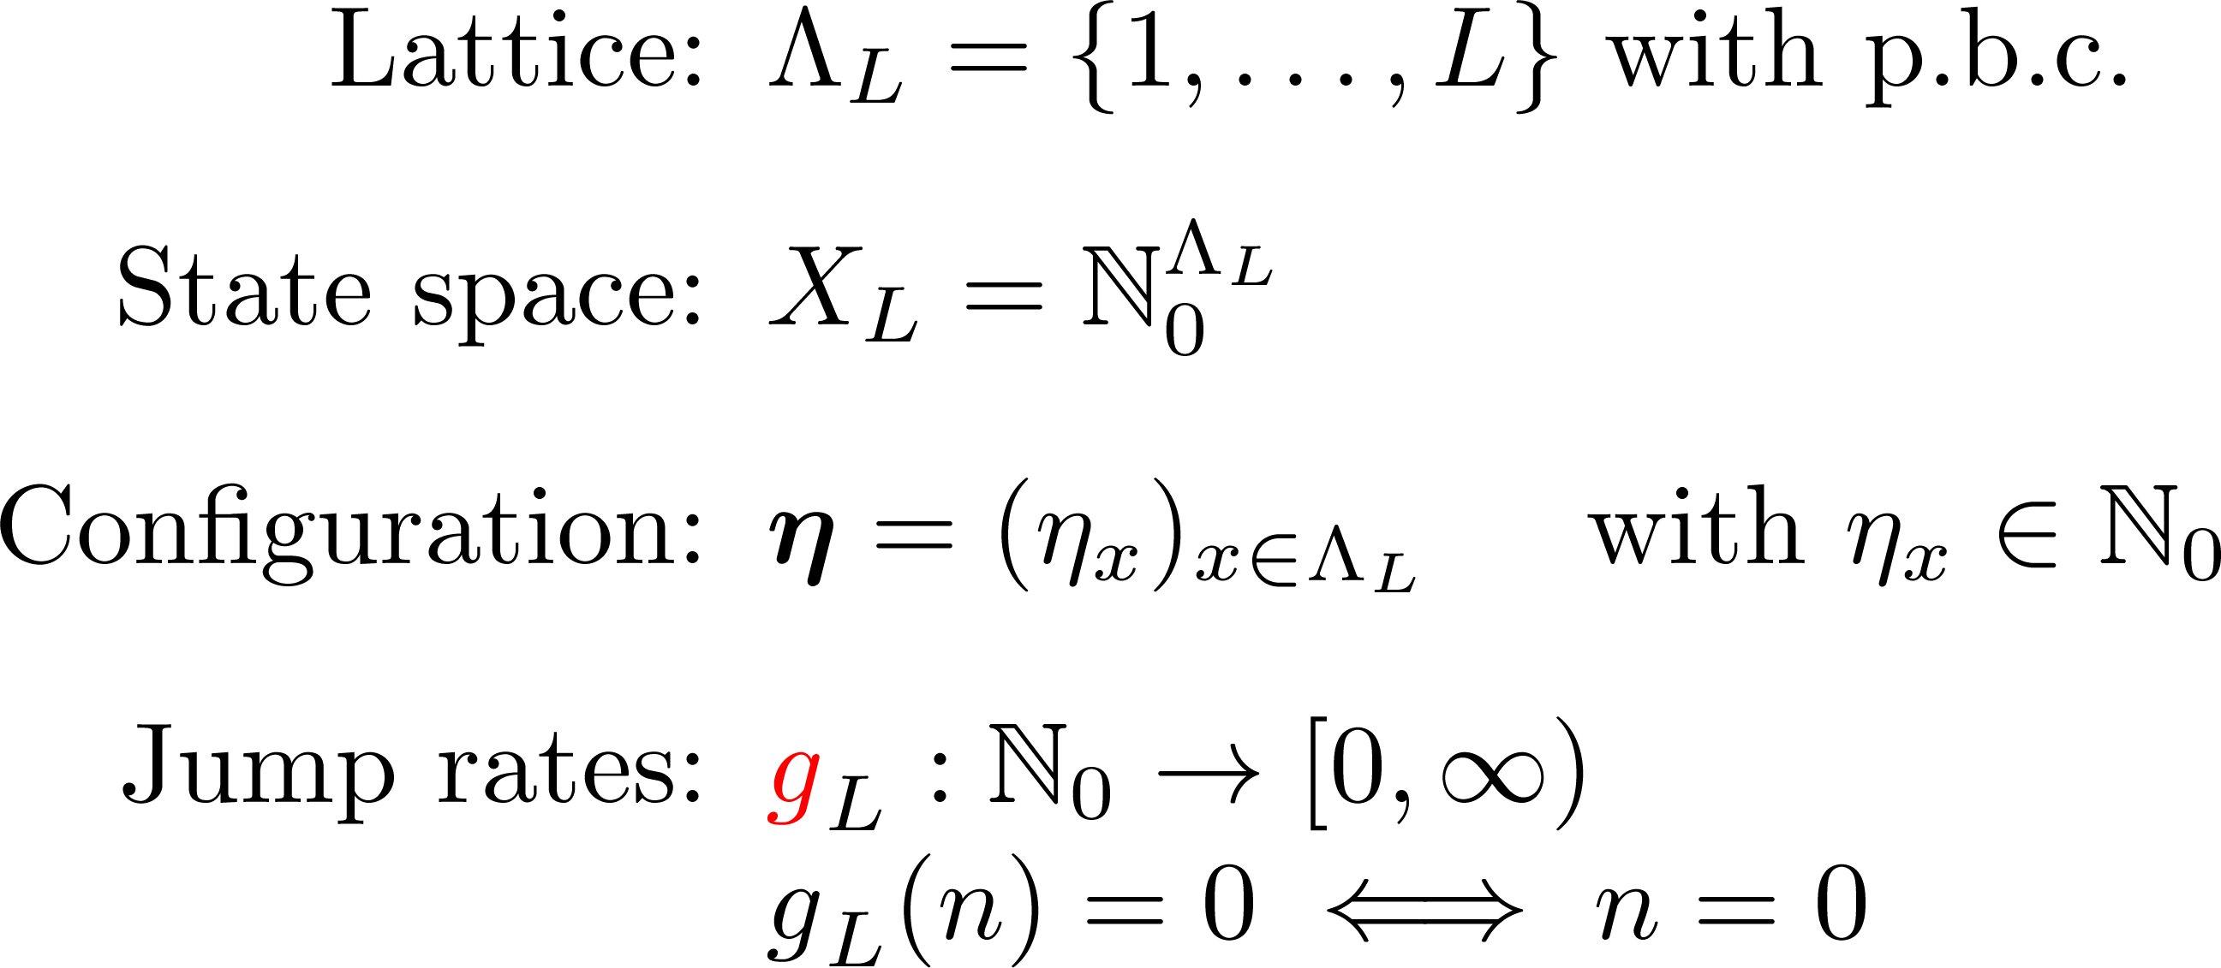
The zero range process
[Spitzer (1970), Evans (2000)]

Slide 7
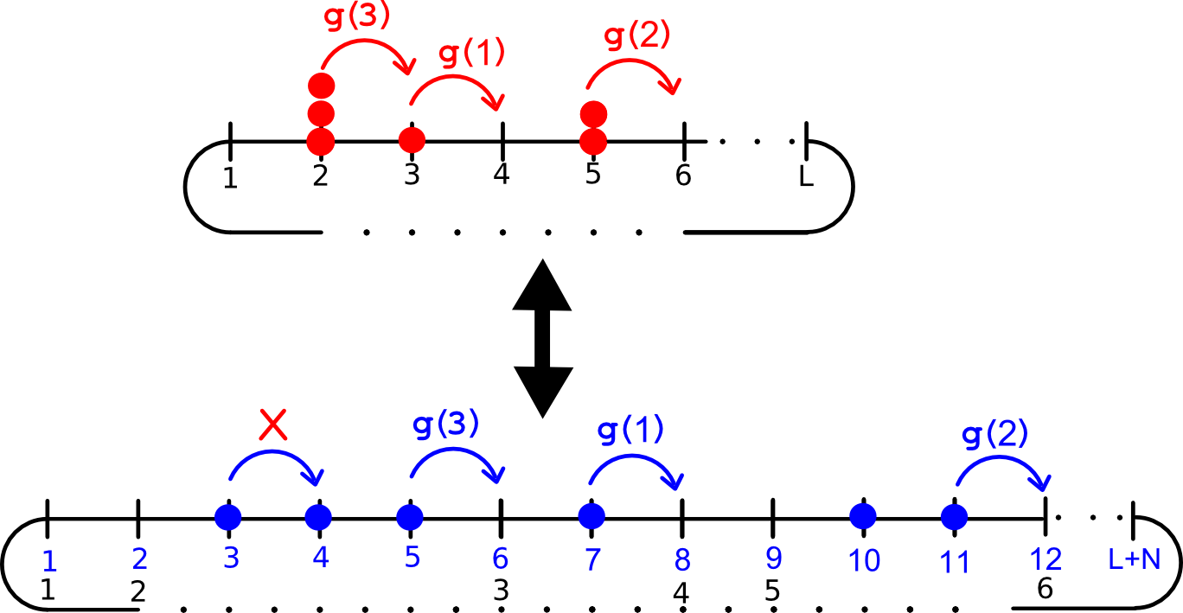
Relation to exclusion process Traffic Modelling
Notes:
Traffic modelling, Fast fast fast

Slide 8
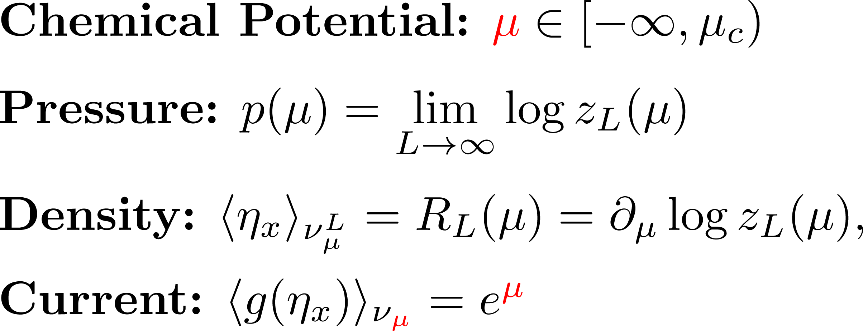
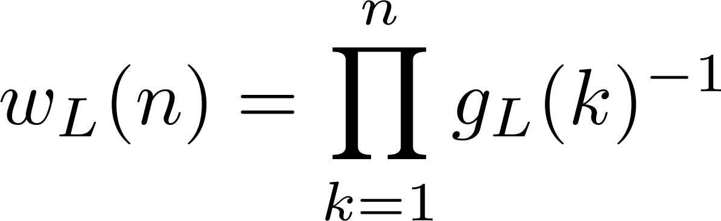
Stationary measures Grand canonical
A family of stationary product measures
Single site weights:
Notes:
Spend time
Strictly increasing so invertible define the inverse phi

Slide 9
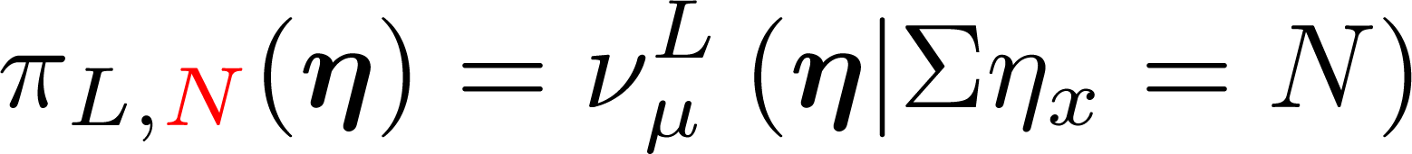
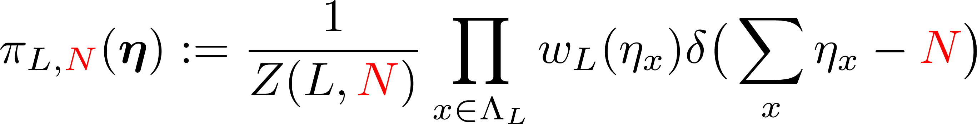
Stationary measures Canonical
Dynamics conserve total number of particles
Fixed L and N the system is irreducible and finite state so ergodic.

Slide 10
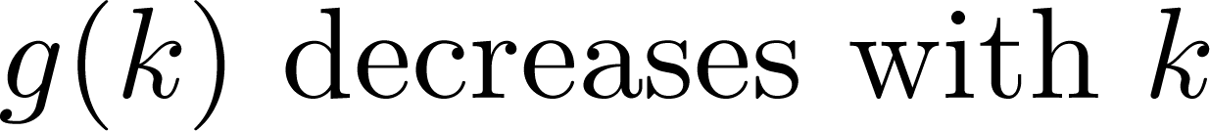
Condensation transition
[van der Meer, van der Weele, Lohse, Mikkelsen, Versluis (2001-02)]

Slide 11
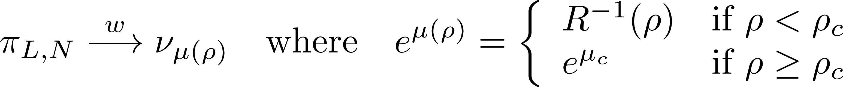
Condensation transition
Example:
[Grosskinsky, Schuetz, Spohn (2003)]

Slide 12
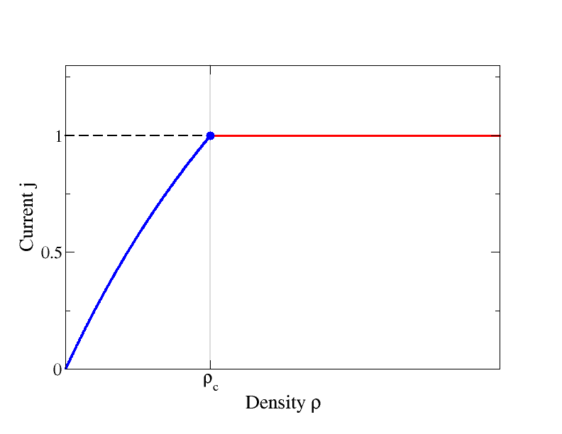
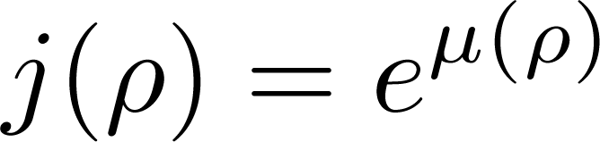
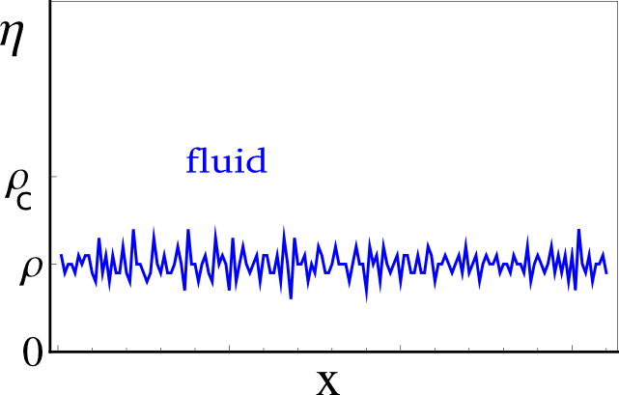
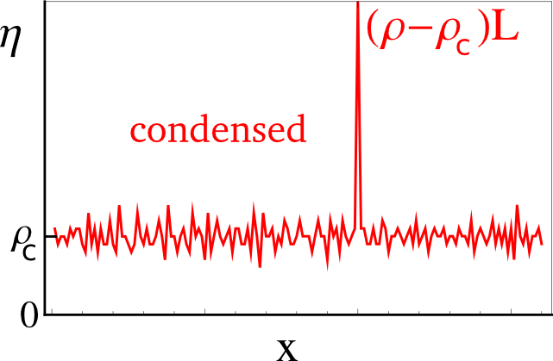
Condensation transition In pictures
Notes:
It is worth explaining average current increases even though jump rate is decreasing. On average fewer lattice sites contain 0 particles

Slide 13
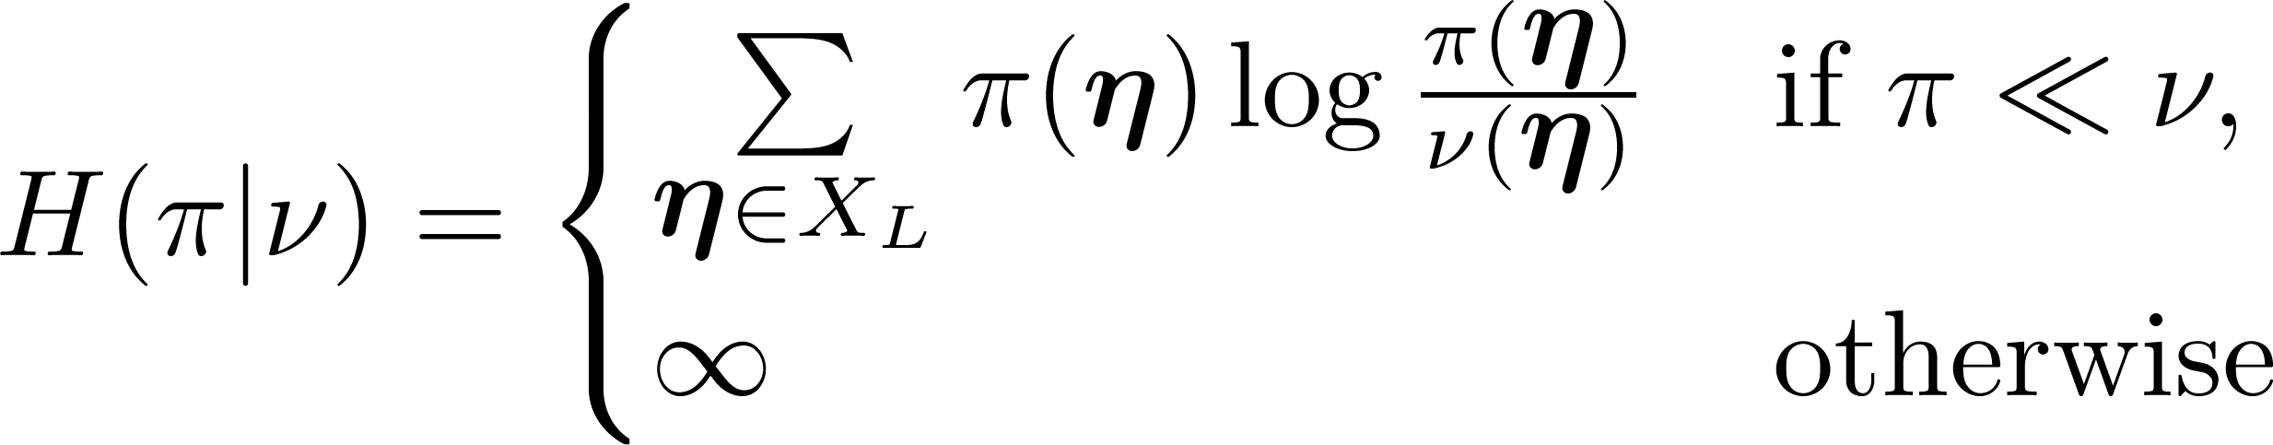
Entropies
Relative entropy (Kullback-Leibler divergence) :
Canonical entropy:
Grand canonical entropy:
Notes:
Canonical entropy, basically the shanon entropy modulo the stationary weights

Slide 14
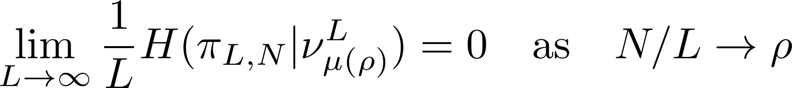
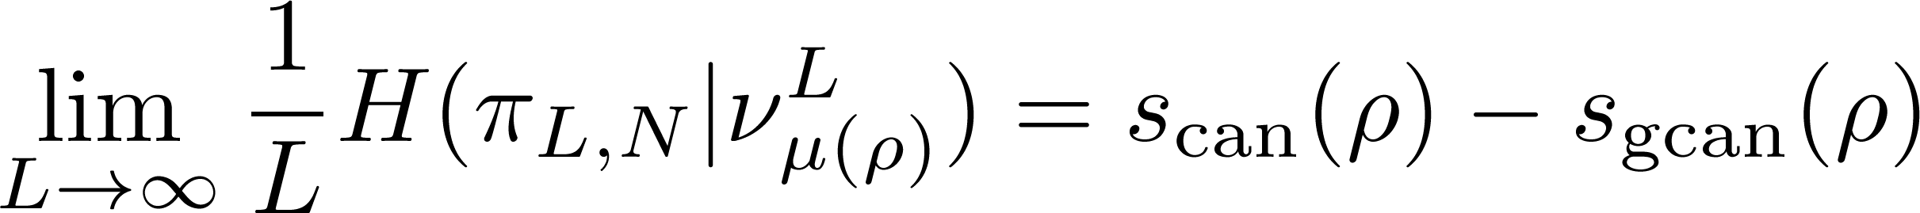
Equivalence of ensembles
Implies a form of weak convergence
Equivalence in terms of thermodynamic functions is the same as equiv. in terms of week convergence
Notes:
Equivalence in terms of week convergence is the same as equivalence in terms of the thermodynamic functions being the same

Slide 15
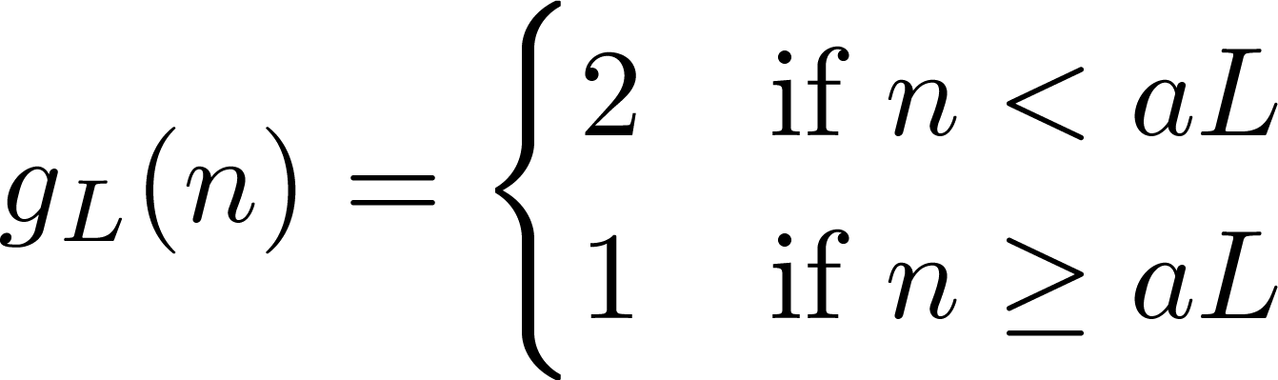
Metastability Toy example

Slide 16
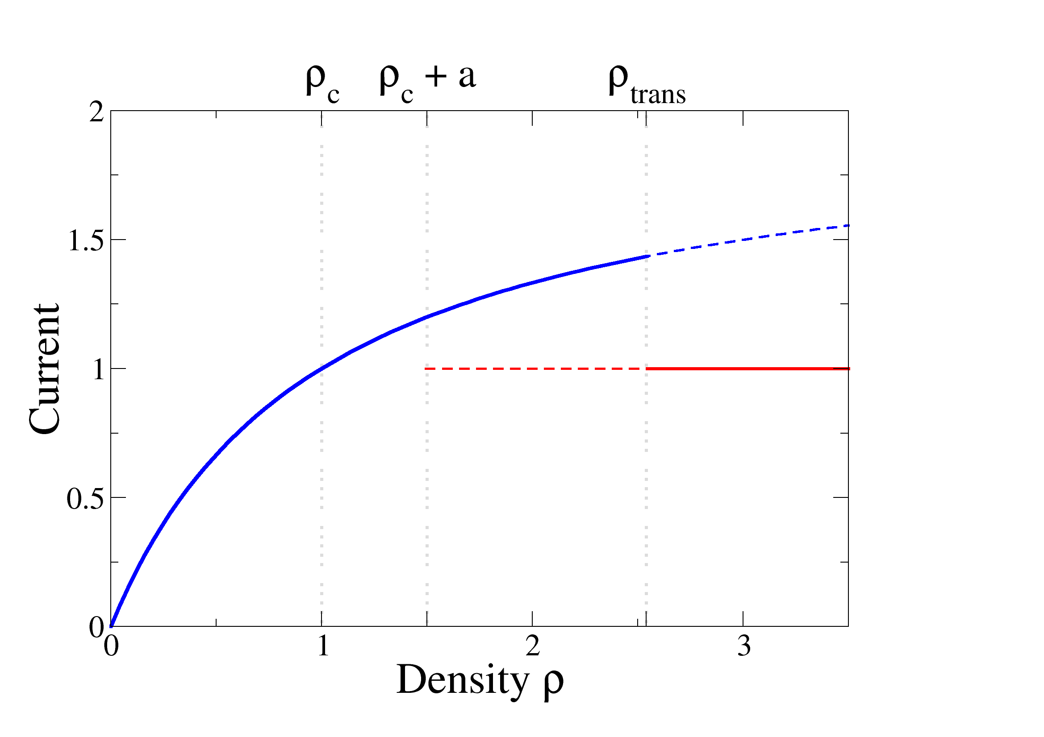
Metastability Toy example

Slide 17
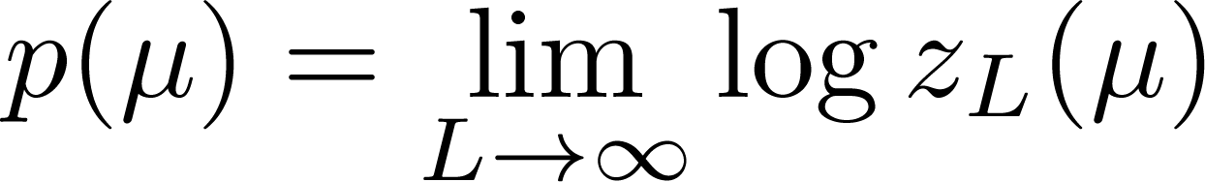
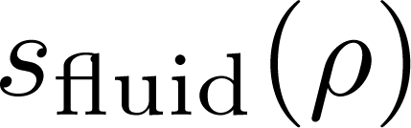
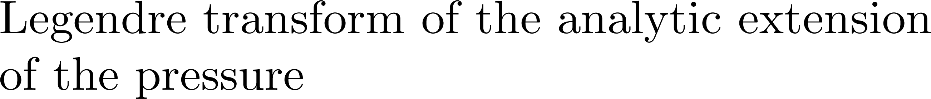
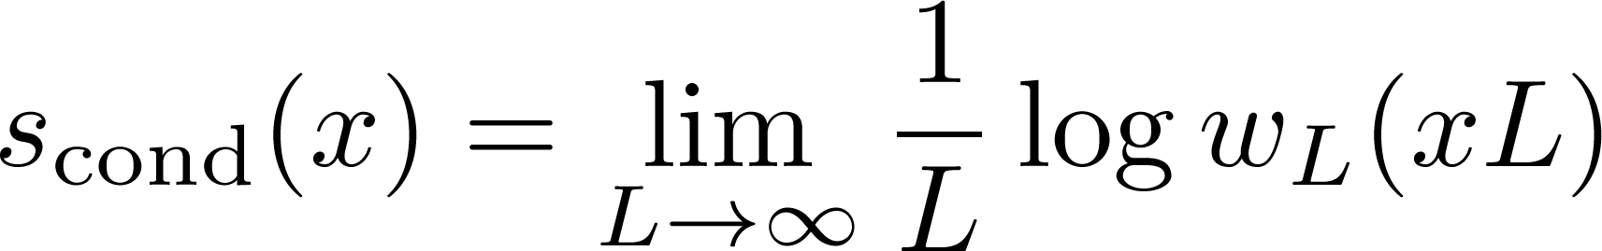
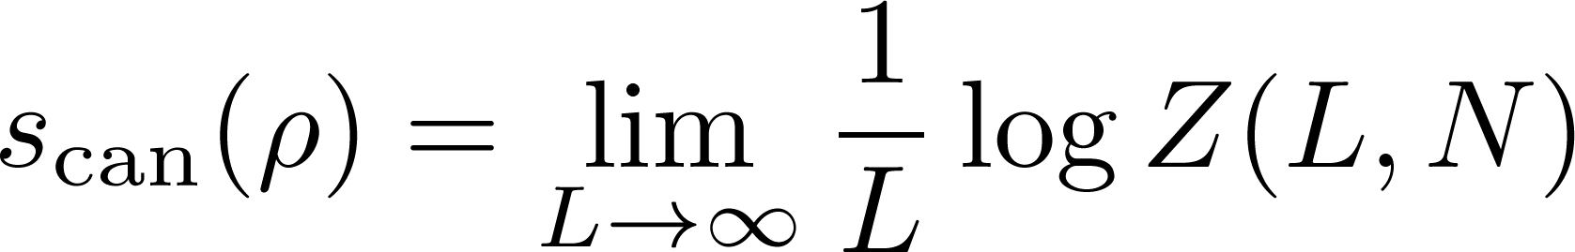
Entropies
On the blackboard
Notes:
Explain in words, in PARTICULAR Scond! Contribution to the entropy dues to a single site containing macroscopic quantity

Slide 18
Canonical distribution of the maximum
How does the condensate move?

Slide 19
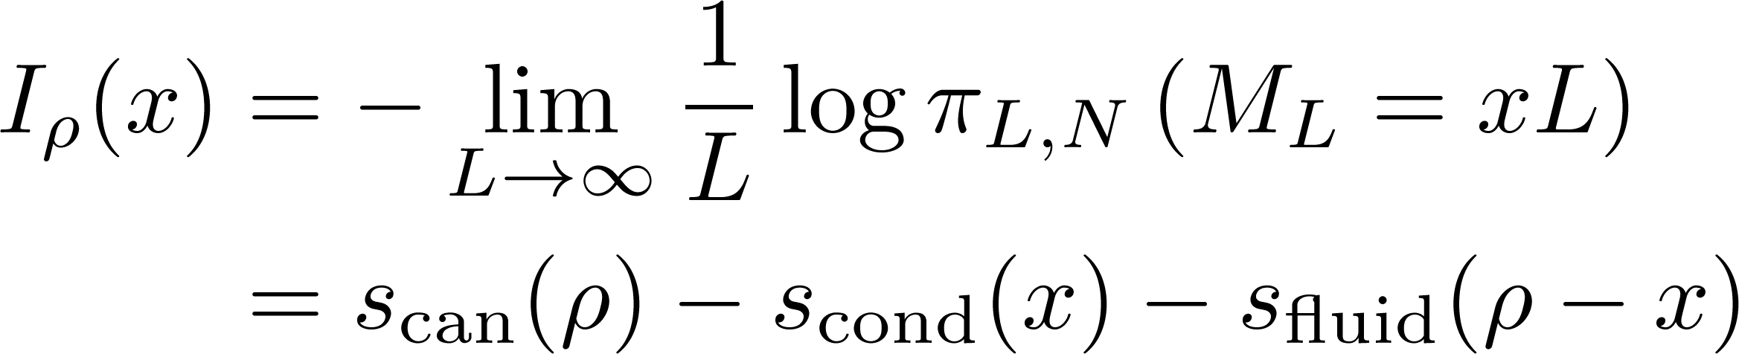
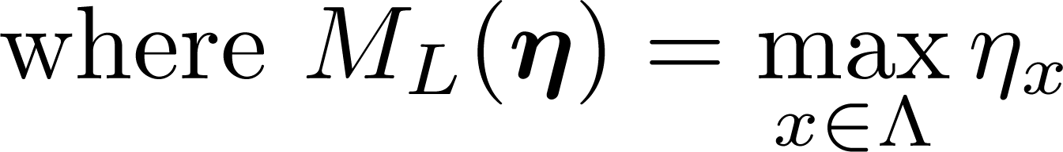
Canonical distribution of the maximum
Rate function for maximum

Slide 20
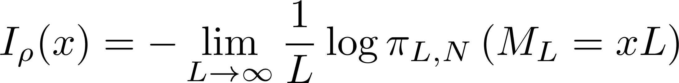
Canonical distribution of the maximum
Rate function for maximum

Slide 21
System density: ρ = 1.75
Notes:
If there is time discuss the life time and link to a continuous time random walk

Slide 22
Mechanism A

Slide 23
Mechanism A

Slide 24
System density: ρ = 2.4

Slide 25


Mechanism B

Slide 26
Mechanism B

Slide 27
Applications
The metastable switching processes can be described by an effective random walk argument.
This correctly predicts the life times of the states.
The same methods have been used to study:
Finite size effects in the ZRP
Mass transport models
Notes:
Rate function as integral of currents gives effective description of the dynamics

Slide 28
Remarks
We have developed a general approach to studying the condensation transition.
Very useful methods for calculating lifetimes of states using simple current and entropy calculations.
The large deviation results are helpful in understanding the dynamics.
Size Dependent systems help us to understand finite size effects in non-size dependent systems.

Slide 29
Acknowledgements
Thank you for listening!
Thanks to:
EPSRC for funding.
Many people in the Complexity DTC, staff and students, for helpful discussion.

Slide 30
Advert
Sorry for the rush.
If you are interested and want to here more details (and the things I didn’t have time for) then...
Probability forum:
Wed, Nov 10 (2 weeks) at 12pm in A1.01 Zeeman building

